Slide 1
BLACKJACK
Carlos Mercado, Edgar Renteria, Jordan Nicholls, Maria Guimaraes-Diniz-Tomaz

Slide 2
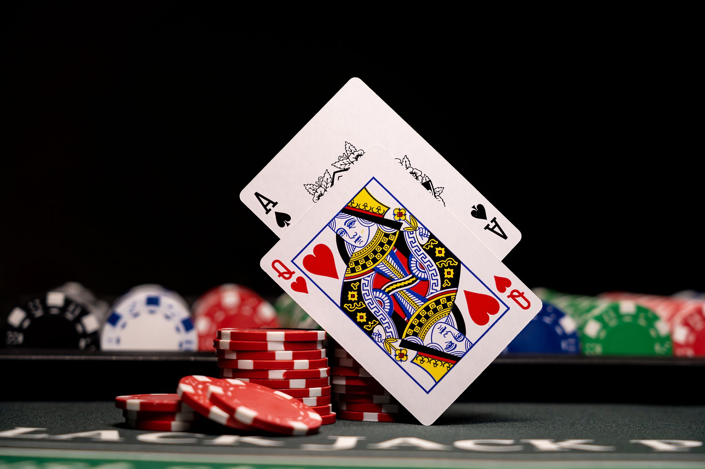

MOTIVATION
Blackjack is a very popular game
Monte Carlo Concept simulation provides a powerful tool to optimize strategies
Powerful for understanding of the concept of probability
The movie “21”.

Slide 3
Monte Carlo Methods
Monte Carlo (MC) methods do not require complete information about the environment.
Use of experience —sequences of states, actions and gains from interacting with the environment or from simulations
Large amount of Random samples

Slide 4
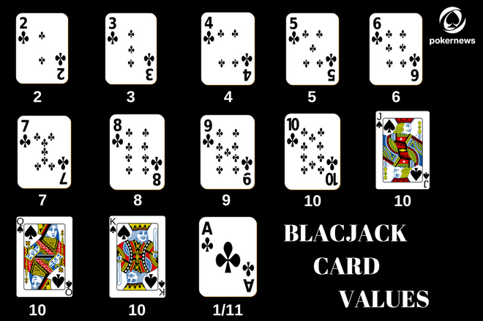
Background and Rules
OBJECTIVE: A player try to obtain cards whose sum of their numbers is as close to 21 as possible, but without exceeding this value.
DECK TYPES:
Finite deck of 52 playing cards (if card drawn cards total decreases)
Infinite deck (Deck never decreases)
CARD VALUES:

Slide 5

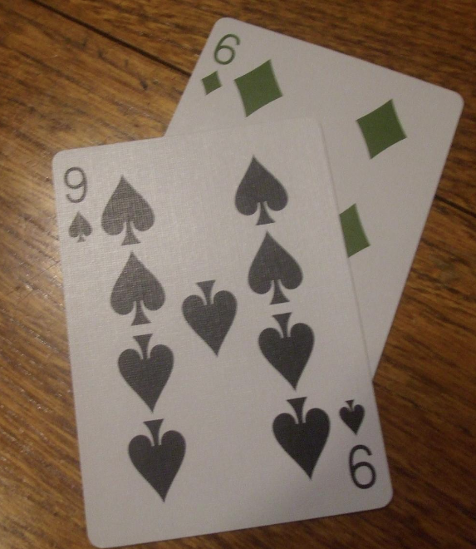
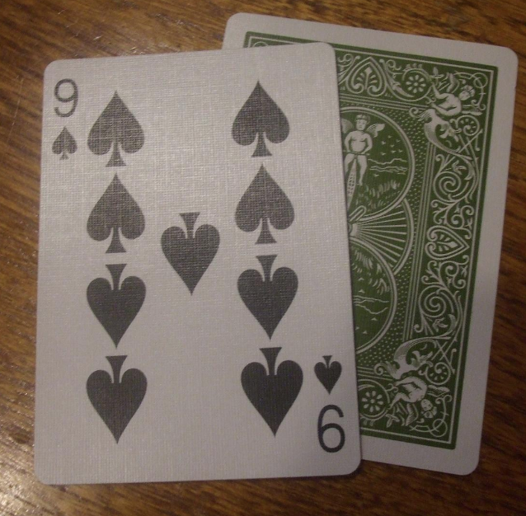
Banking game players: PLAYER and DEALER
PLAYER: start with a hand with two up cards.
DEALER: start with a hand with two cards (up/down).
KEYS:
HIT (draw a card from the deck)
STICK (stop drawing)
BUST (If the sum of the values exceeds 21, you loose)
SOFT (any hand with an ACE except Blackjack)
BLACKJACK (If the first drawn two cards give a
hand value of 21: win)

Slide 6
Policies
Policy 1: if your hand ≥ 17, stick. Else hit.
Policy 2: if your hand ≥ 17 and is hard, stick. Else hit unless your hand = 21.
Policy 3: Always stick
Policy 4: Hand < 21, Hit
Policy 5: Hit until face card.

Slide 7
Blackjack Monte Carlo Implementation
Give the dealer two cards, and give the player two cards.
Add up both the dealer and the player cards.
Check for blackjacks for player and dealer
For given policy, add cards, or stay.
After staying, append cards to dealer hand until their hand sums to 17 or greater.
If dealer is over 21. Bust, dealer loses.
Winner is the person who has the greatest sum of cards at this point.
Repeat for multiple iterations.
TALKING ABOUT THE FUNCTIONS:
generate_card: generate cards from a deck of 52 cards as described earlier
simulate_game: simulate the game using the specified policy (1>5)
estimate_policy: will simulate multiple games and will return the total of wins out of 10000.
simulate_single_deck: will simulate a single game using a single deck of cards.

Slide 8
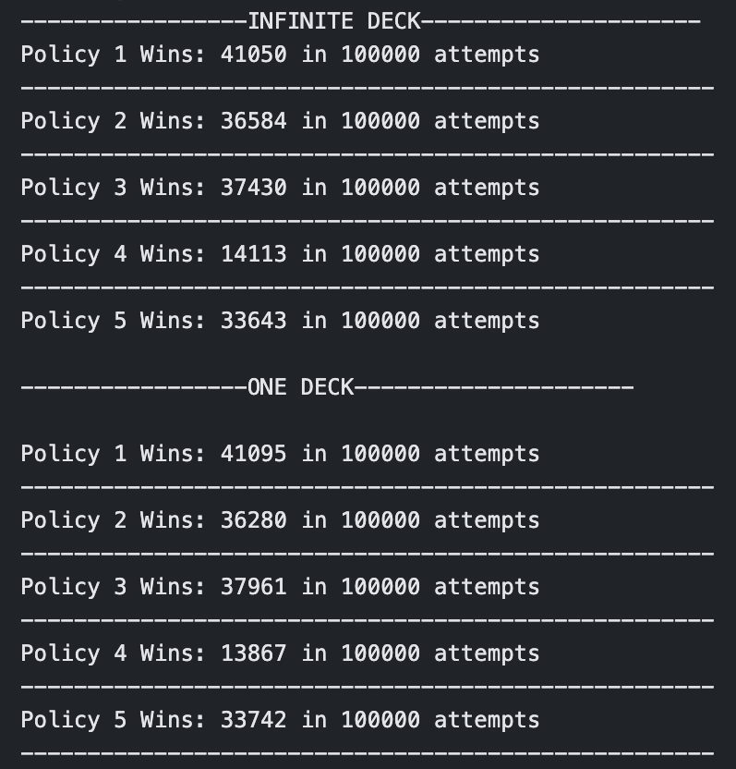
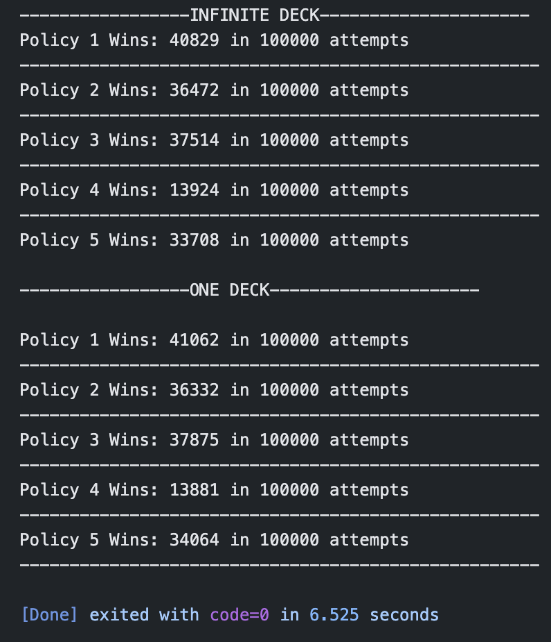
Blackjack Monte Carlo Implementation

Slide 9
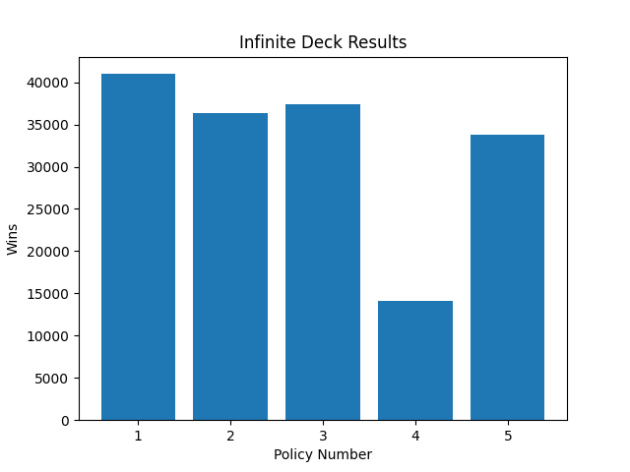
Results/Discussion
From the results we can see that policy 1 (stay if hand >= 17 else hit), is the best approach of the 5 for infinite decks.
The worst approach is not surprisingly approach 4 (hit until 21).

Slide 10
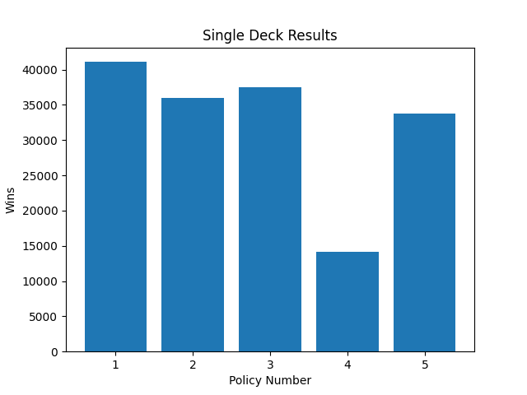
Results/Discussion
Just like the infinite deck approach, policy number one is the best of the five.
Worst approach is still policy 4.

Slide 11
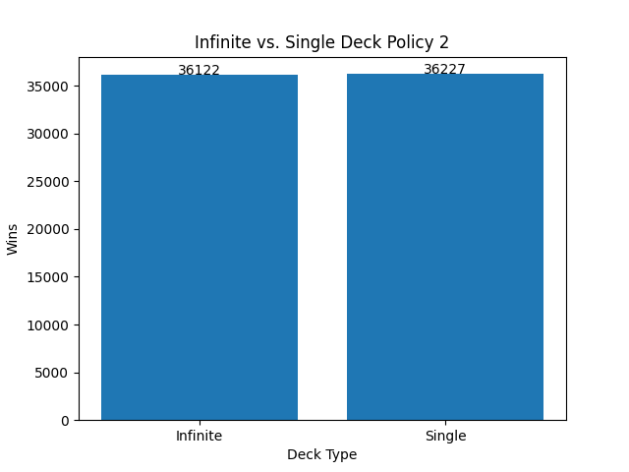
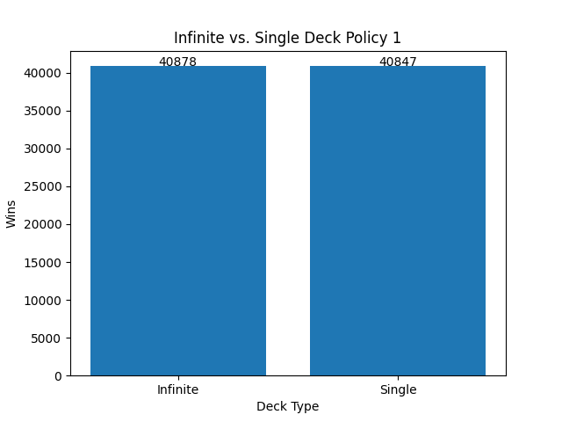
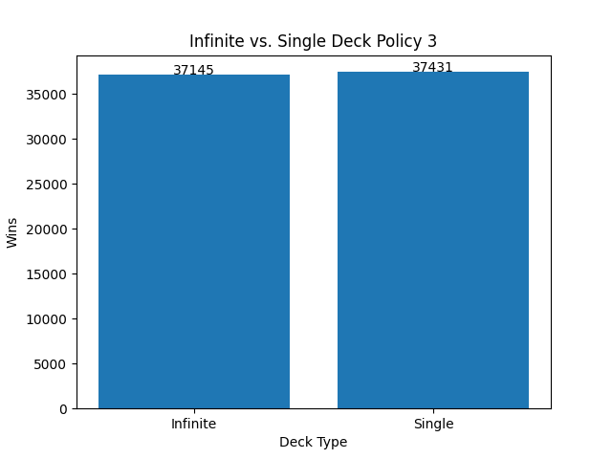
Results/Discussion (Inf vs. Single Deck)
Very small differences in wins in the different deck approaches.

Slide 12
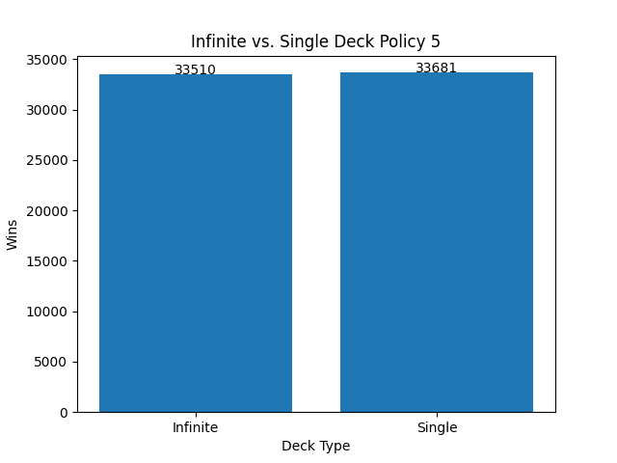

Results/Discussion (Inf vs. Single Deck)

