Slide 1
Conway’s Game of Life
Carlos Mercado, Maria Guimaraes, Edgar Renteria, Jordan Nicholls

Slide 2
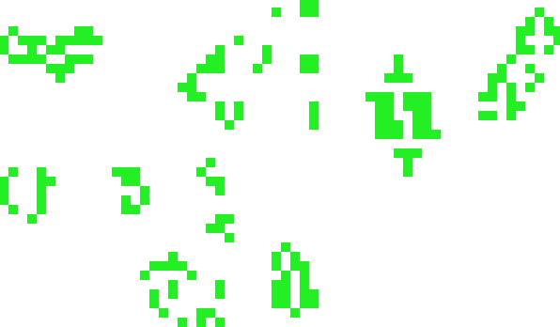
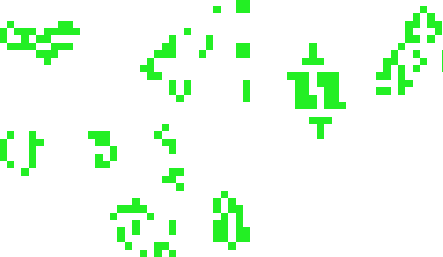
Motivations
Analyze the rules of the game.
Understand the behavior of certain “shapes” of cells, and how they interact with each other.

Slide 3
The Rules
If a cell is ALIVE and it has fewer than two live neighbors it dies. (Underpopulation)
If a cell is ALIVE and it has two or three live neighbors it lives on to the next generation.
If a cell is ALIVE and it has more than three live neighbors it dies. (Overpopulation)
If a cell is DEAD cell has exactly three live neighbors, it becomes an ALIVE cell. (Reproduction)

Slide 4
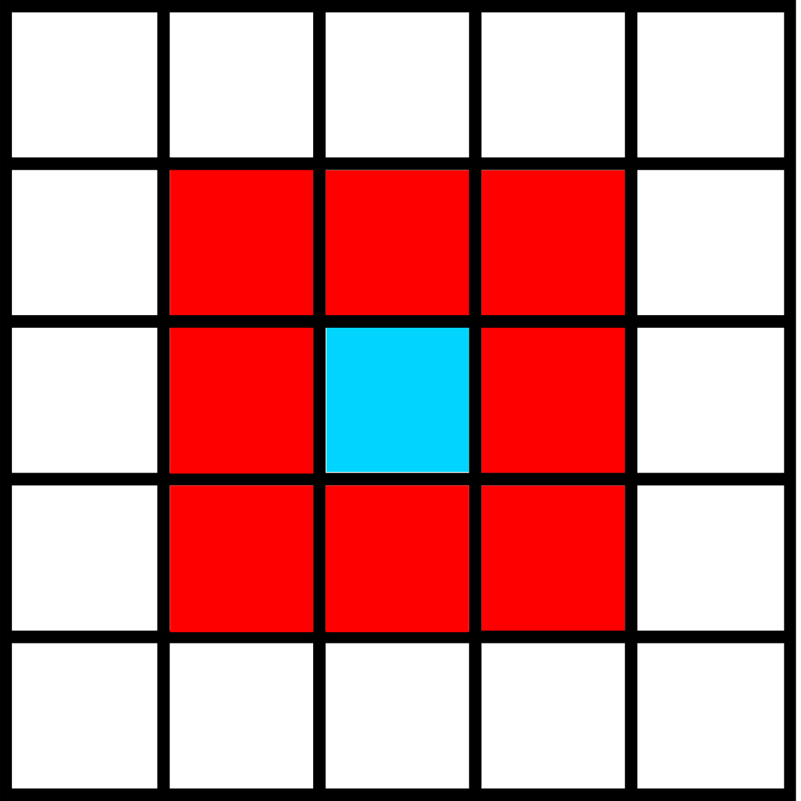
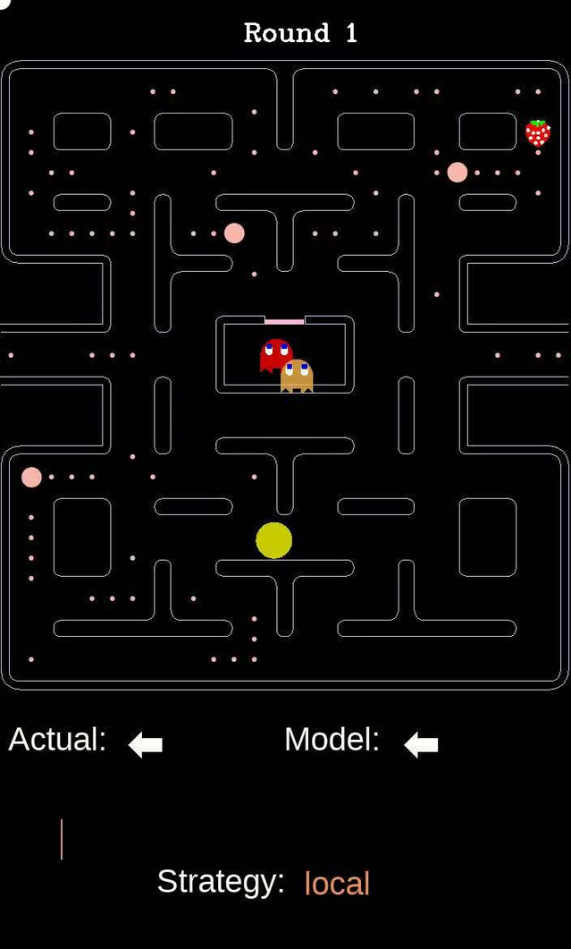
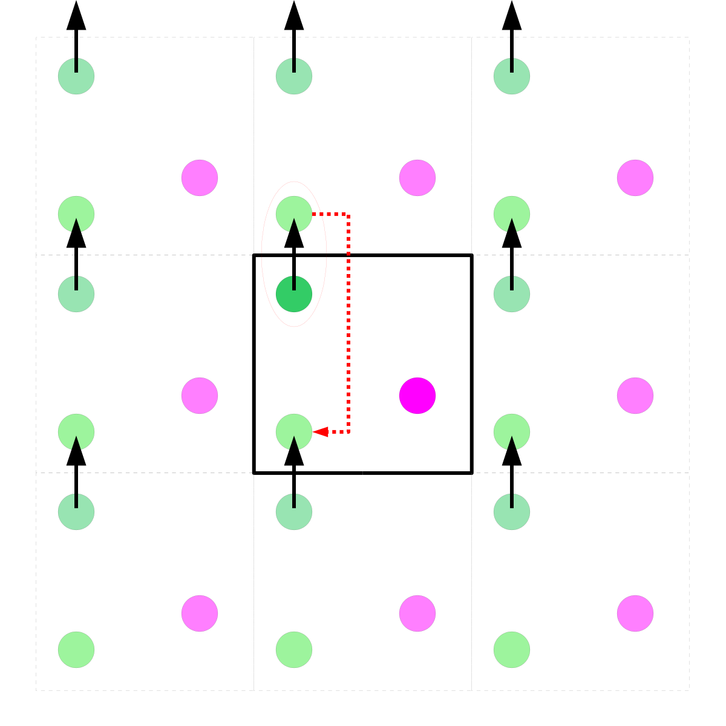
Approach
Moore Neighborhood
Periodic Boundary Condition

Slide 5
Approach
Initial state:
NxN matrix with some cells set to alive, represented as a 1, and the rest set to dead (0).
Determining the new state of the map (transition function):
For each cell, find the total amount of live neighbors and use that information alongside the rules to find the next state of the cell.
Do this step until we have an entire new map.

Slide 6
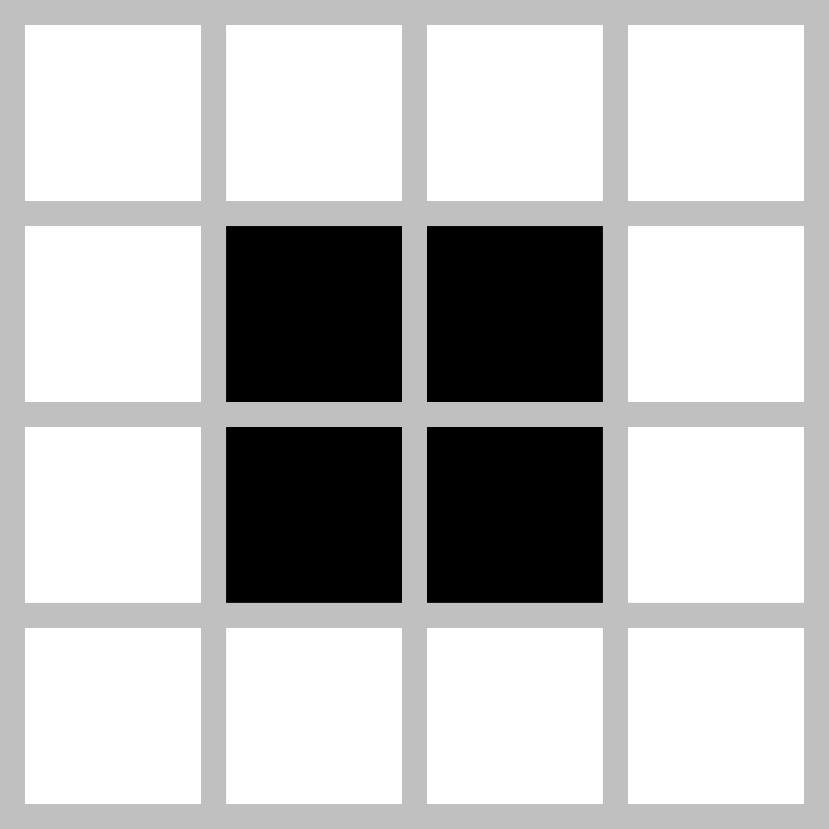

Results and Discussion
There are a few shapes that are common in the simulations
Block
2x2 live cell shape.
It will stay this shape perpetually.
Blinker
Three live cells in a row.
It will perpetually “rotate” 90 degrees.
Glider
5 cells in a specific order.
Shape will perpetually fly across the board

Slide 7

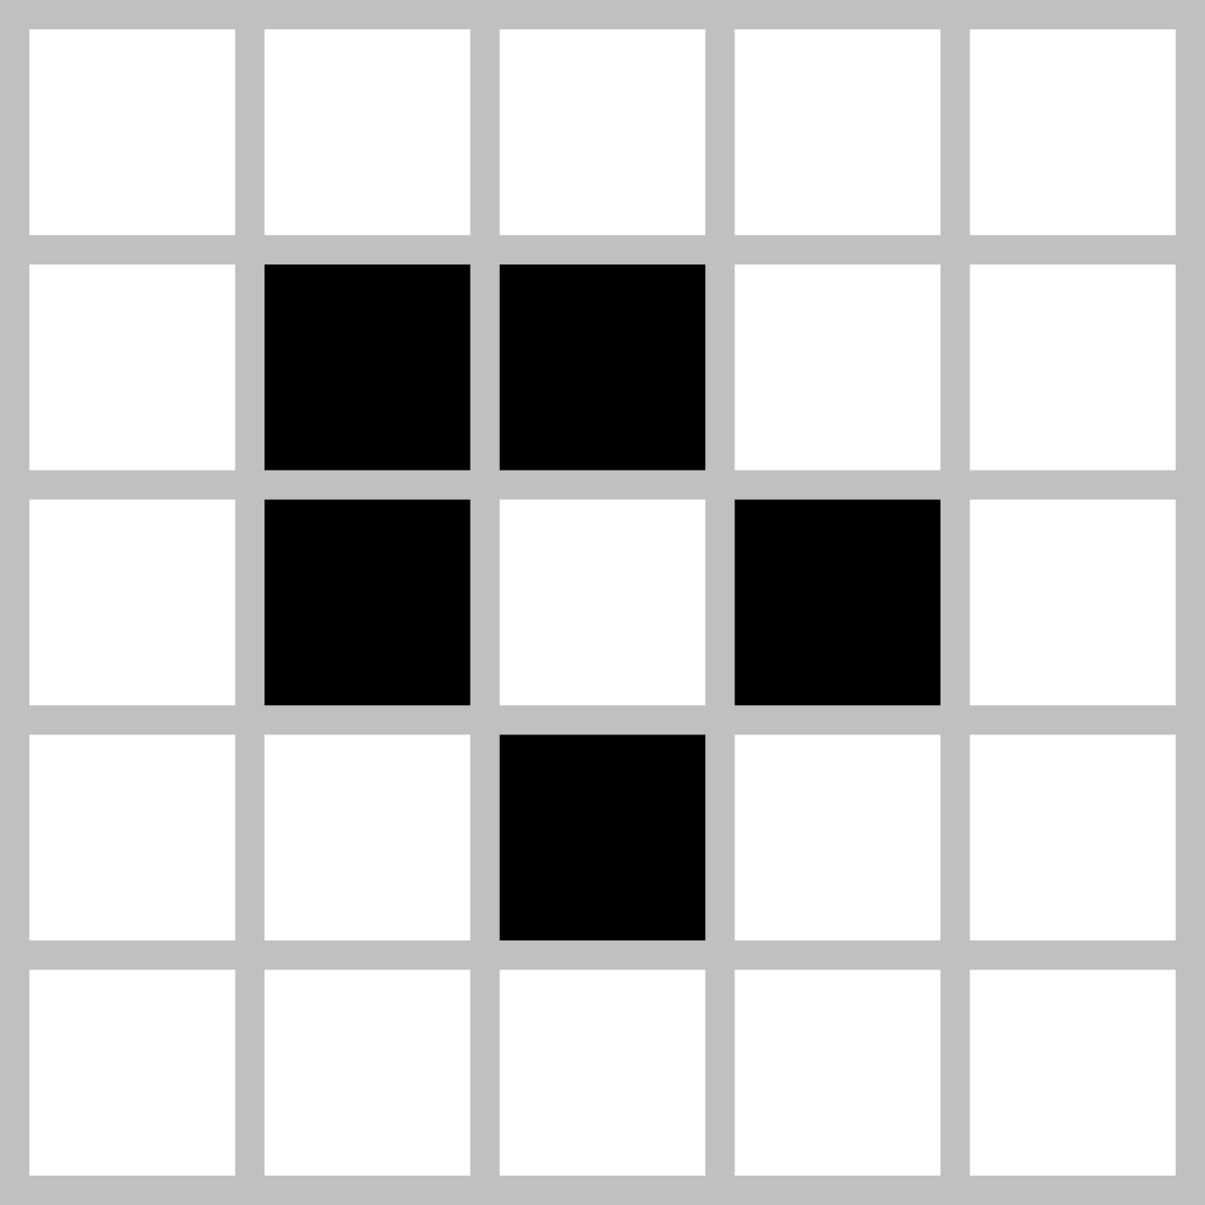
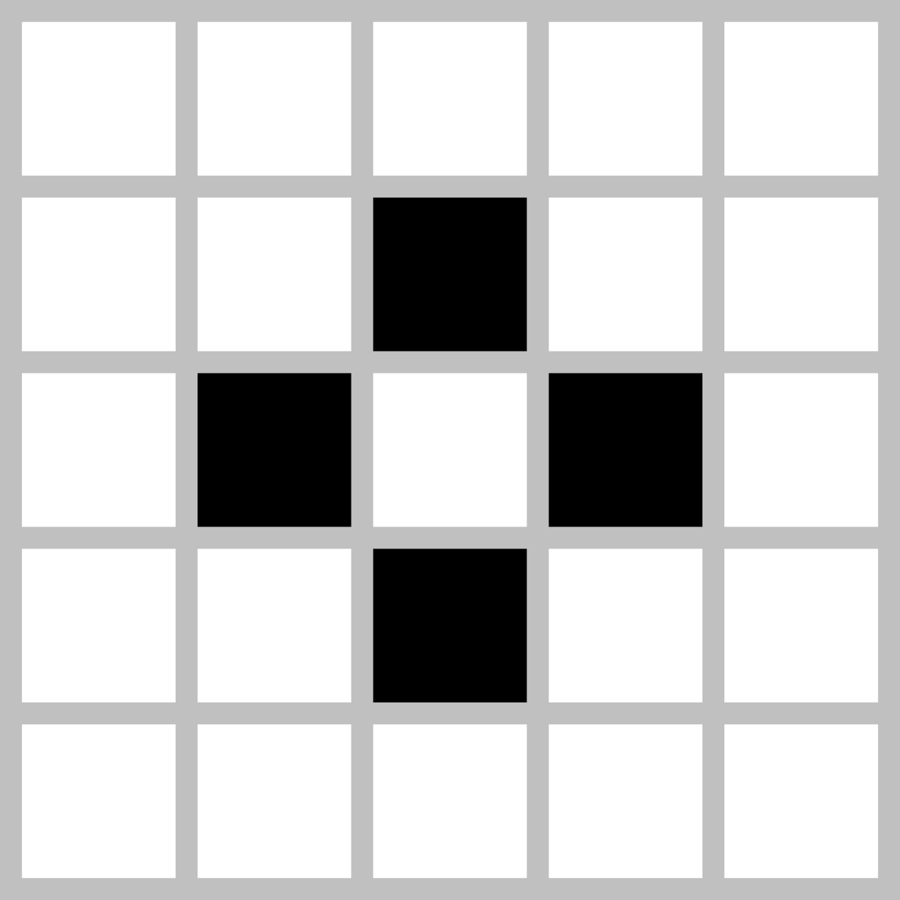
Results and Discussion
Something interesting about the shapes formed by the simulation is that they can be put into three groups.
Still lives
Shapes that do not change shape unless they are interrupted by other live cells
Block Boat Tub

Slide 8
Results and Discussion
Oscillators
Shapes that always return to their original shape after a finite amount of generations
Blinker
Toad
Pulsar

Slide 9
Results and Discussion
Spaceships
Shapes that move themselves across the map.
Middle-
weight
spaceship
Glider
Heavy-
weight
spaceship

Slide 10
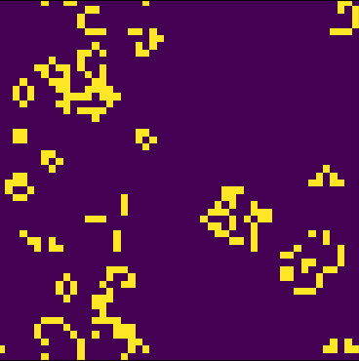
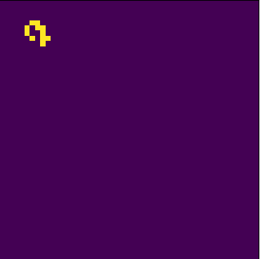
Interesting Properties
It is very easy for a simulation to become suddenly complicated. Just two relatively simple shapes like a glider and a blinker can create an unpredictable end state.
Chaotic

Slide 11
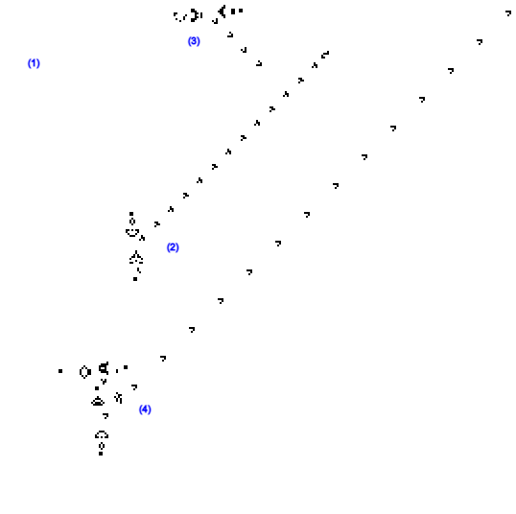
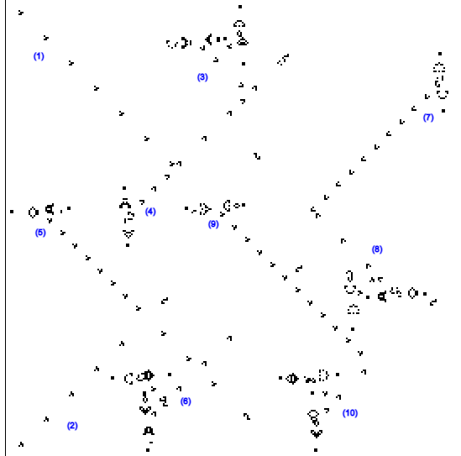
Results and Discussion
The game is turing complete, meaning that it is as powerful as any computer with unlimited memory and no time constraints, but more interestingly we can implement logic gates with the game.
NOT gate
AND gate

Slide 12
Conclusions
Although the game is made of of only a few simple rules, from those rules emerge very complex behavior.

