Slide 1
Evaluating the significance of outdoor Advertising using computer vision and deep learning
Carlos Andres Pizarroso Troncoso
Supervisor: RNDr. Zuzana Berger Haladová, PhD

Slide 2
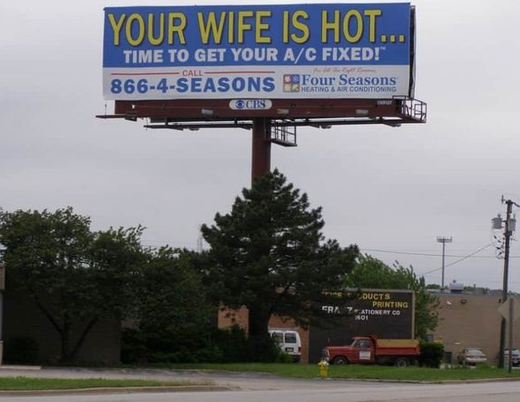
motivation
How long have you stared at the advertisement?
Impact of advertisement on drivers.
Contribution to road safety.
An application of Deep Learning in Computer Vision.

Slide 3
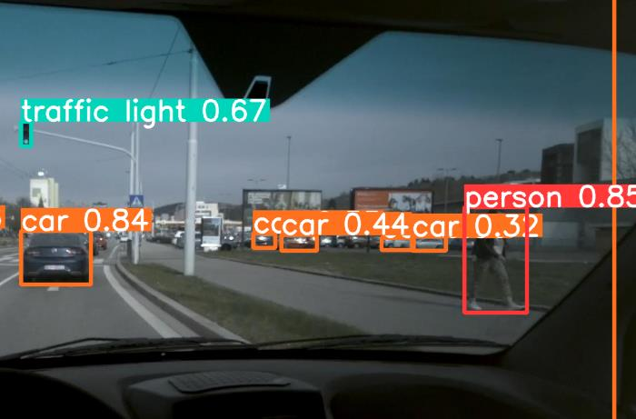
goals
Long-term goals:
Develop an automated system which evaluates road advertisement significance.
Object detection, tracking, deep learning.
Short-term goals:
Acquire fundamental knowledge on object detection and deep learning.
Train successfully an object detector that will be part of the final pipeline.

Slide 4
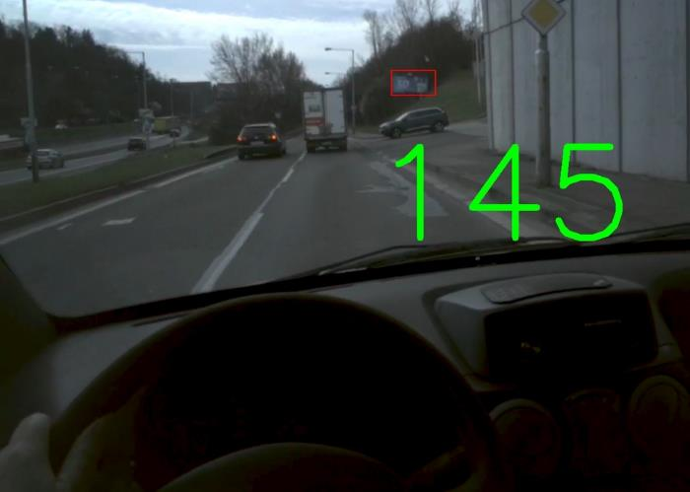
Dataset
BillboardLamac Dataset
Existing dataset of 8 videos captured by eye tracker worn by 8 different drivers.
145 unique billboards with 155912 bounding boxes.
Annotated billboards with unique ID consistent in all videos.
Object detector
Train/validation/testing: 794/199/219 images.

Slide 5
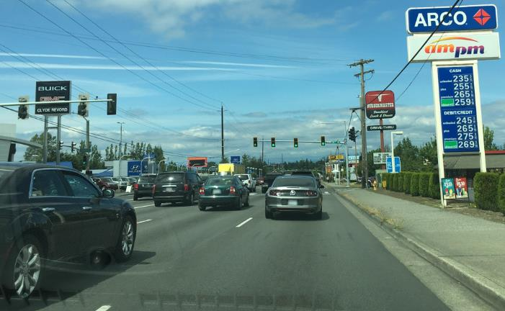
Supplementary dataset
Mapillary Vistas Dataset
Large scale street level image dataset.
25000 high-resolution images.
66 classes (billboards included).
Object detector
Images without billboards filtered.
Train/validation/testing: 2000/500/500 images.

Slide 6

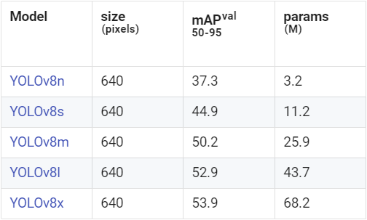
Object detection: yolo
You Only Look Once (YOLO):
Series of Convolutional Neural Network models designed for real-time object detection.
Developed on PyTorch framework.
Detection models pre-trained on COCO dataset.
Classification models pre-trained on ImageNet dataset.

Slide 7
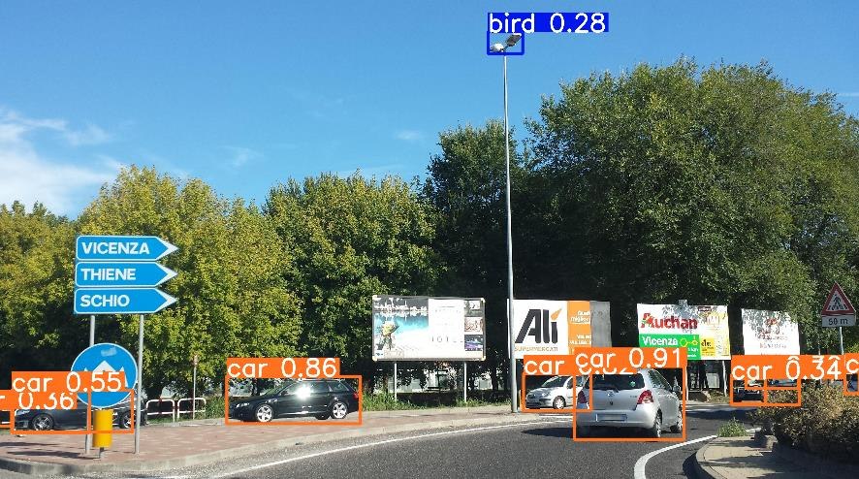
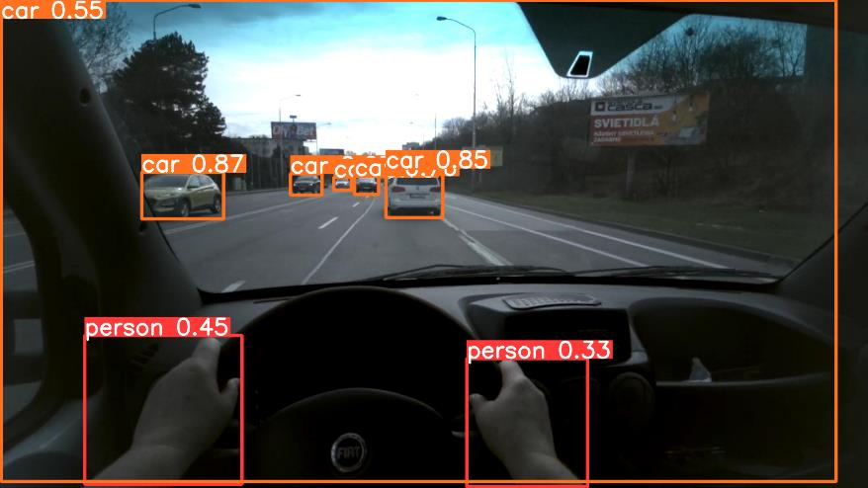
Object detection results: 0
Mapillary vistas test set
Billboardlamac test set

Slide 8
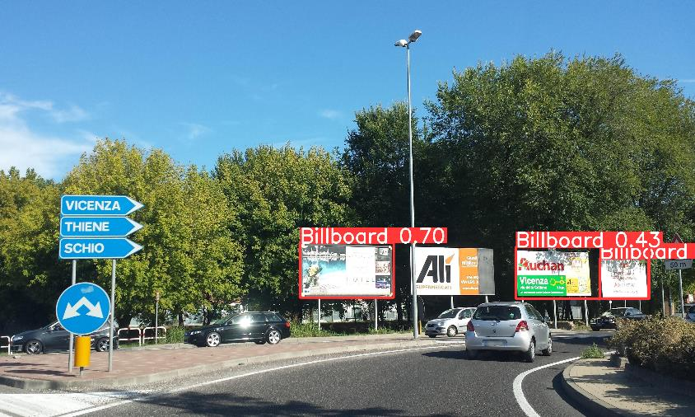
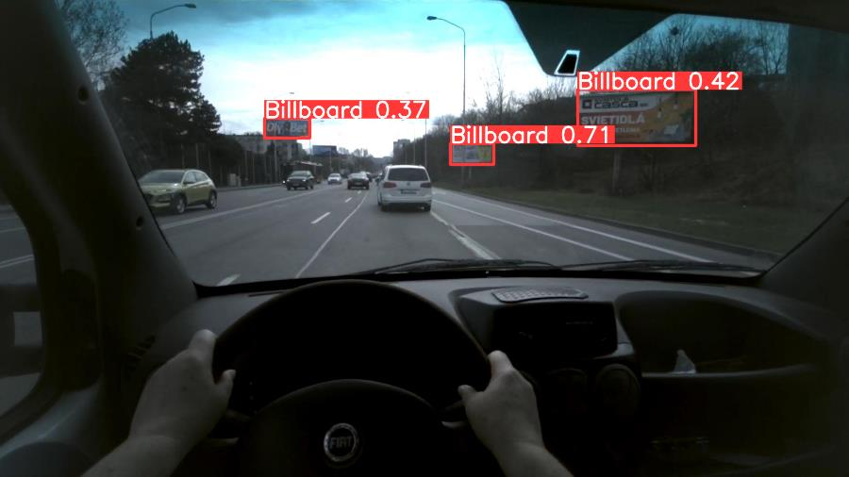
Object detection results: 1
Mapillary vistas test set
Billboardlamac test set

Slide 9
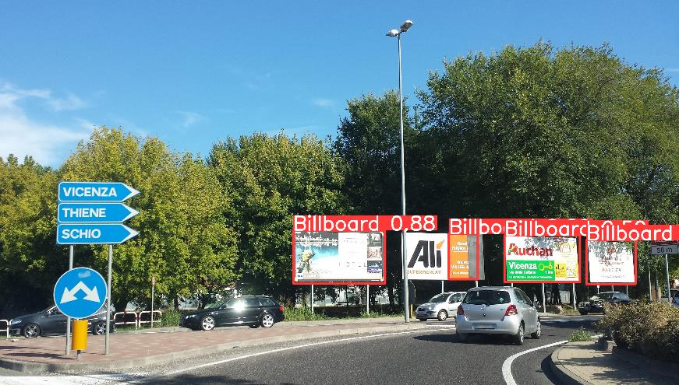
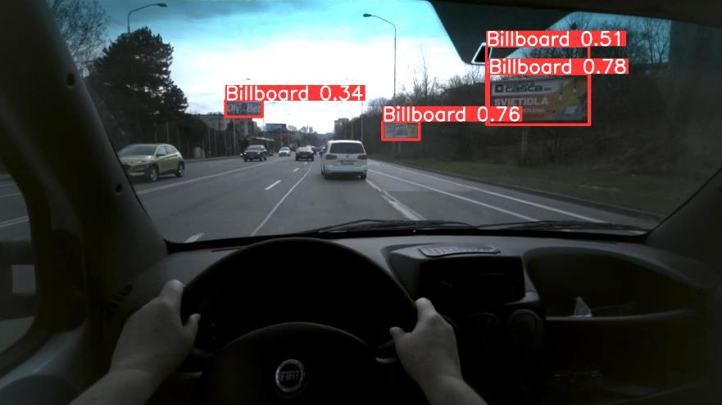
Object detection results: 2
Mapillary vistas test set
Billboardlamac test set

Slide 10
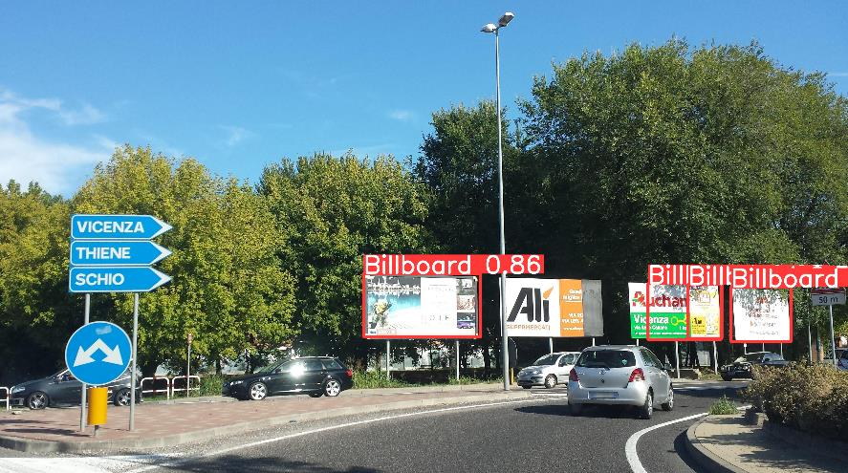
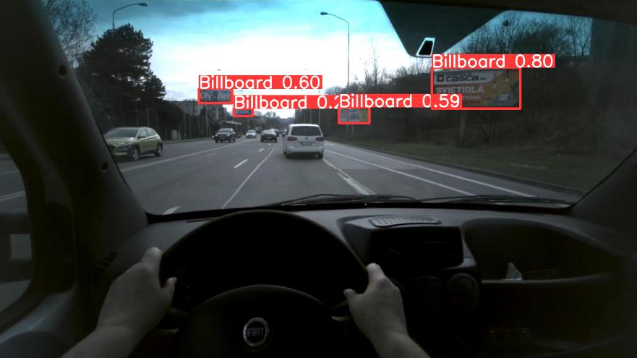
Object detection results: 3
Mapillary vistas test set
Billboardlamac test set

Slide 11
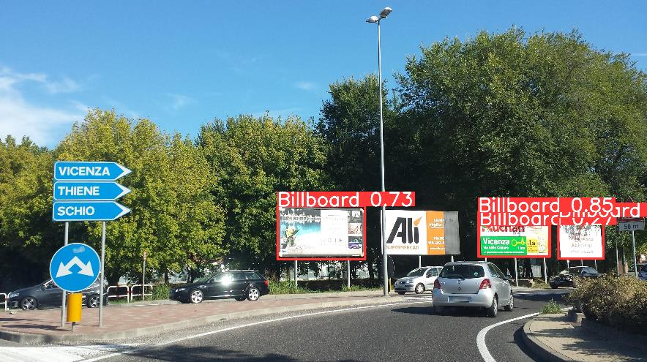
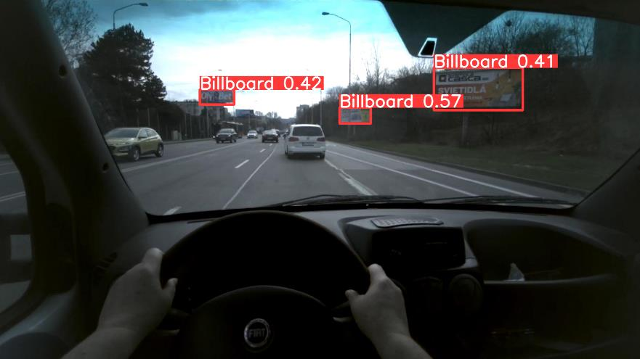
Object detection results: 4
Mapillary vistas test set
Billboardlamac test set

Slide 12
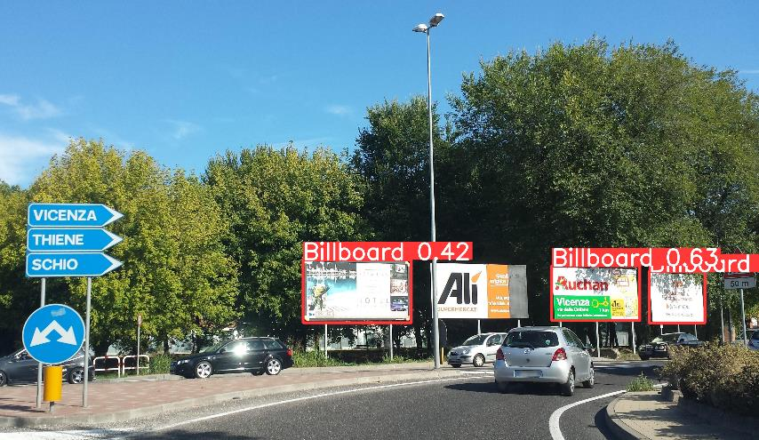

Object detection results: 5
Mapillary vistas test set
Billboardlamac test set

Slide 13

Object detection results: 6
Previous models used a batch size of 16.
It is expected that different batch sizes will affect training.
Google Cloud resources constraints.

Slide 14
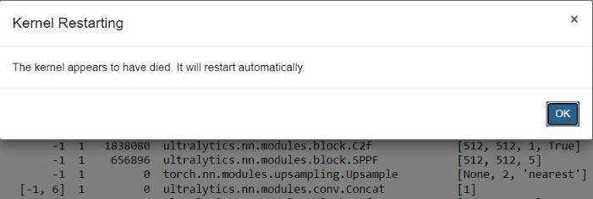
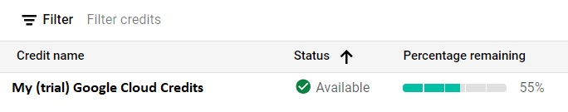

challenges
Difficulties with local training.
Online resources constraints.
Availability of online resources.

Slide 15
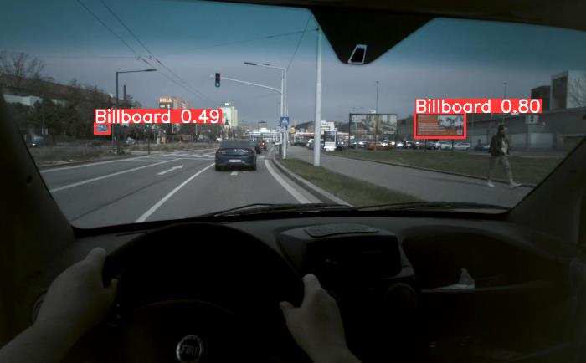
Next steps
Increase dataset size (depends on resources limitation).
Hyperparameter tunning.
Build a classifier (deep learning based).
Assemble the full pipeline.

Slide 16
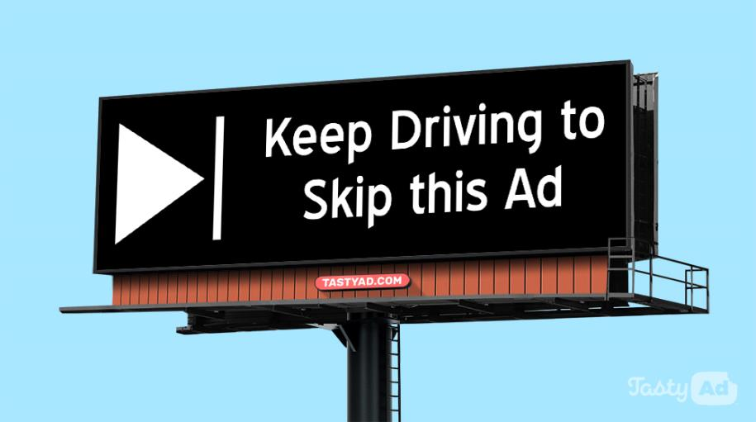
Thank you for your attention
And don’t get distracted while driving!

Slide 17
Scientific articles & GitHub site
Articles:
https://www.sciencedirect.com/science/article/pii/S0965856418310632
https://www.sciencedirect.com/science/article/pii/S136984782100245X
https://www.sciencedirect.com/science/article/pii/S0001457505002149
https://ieeexplore.ieee.org/abstract/document/10308914
https://openaccess.thecvf.com/content_iccv_2017/html/Neuhold_The_Mapillary_Vistas_ICCV_2017_paper.html
https://pure.ulster.ac.uk/en/publications/billboard-detection-in-the-wild
GitHub site:
https://github.com/carlos-p-t/diploma-thesis

