Slide 1
PRESENT PERFECT SIMPLE

Slide 2
FORM
Affirmative
Interrogative
I
You have worked
We have written
They
He
She has worked
It has written
Have I/you/we/they worked?
Have I/you/we/they written?
Has he/she/it worked?
Has he/she/it written?
Negative
I/you/we/they haven’t worked
I/you/we/they haven’t written
He/she/it hasn’t worked
He/she/it hasn’t written

Slide 3
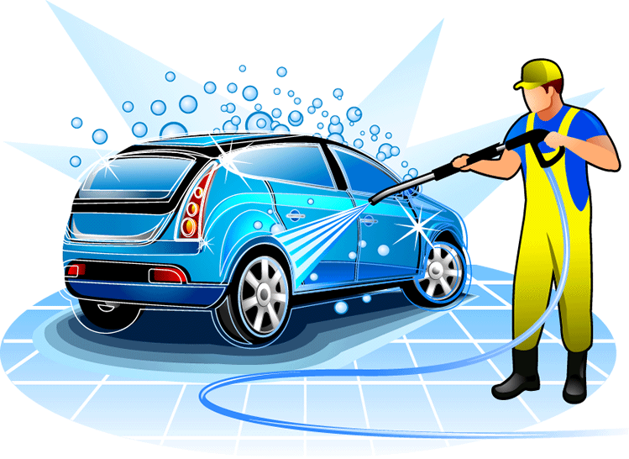
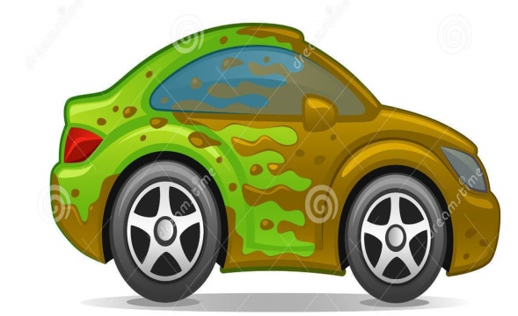

USES
1. For an action that happened in the past but whose results are obvious in the PRESENT.
John’s car is dirty.
He washes the car.
He has washed the car.

Slide 4


2. For an action that has JUST finished.
Marc is having lunch.
He has just had lunch.
Time expression:
just

Slide 5


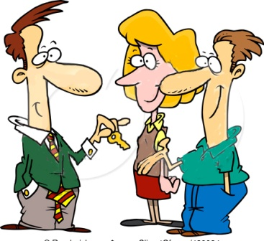
3. For an action that started in the past and hasn’t finished.
2000
2015
We bought the house in 2000.
We still live in the neighborhood.
We have lived here for 15 years.
We have lived here since 2000.
Time expressions: for, since

Slide 6
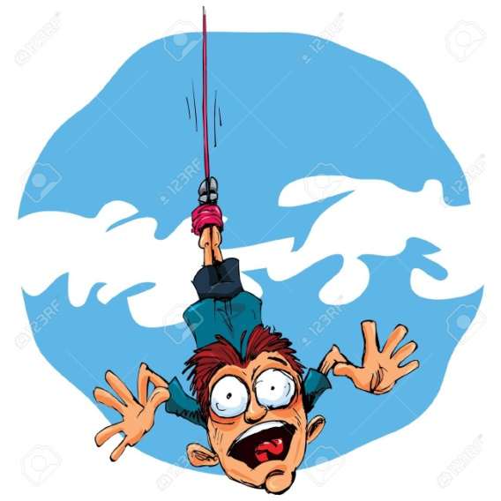



4. For experiences we have/haven’t lived.
He has flown a plane but he has never tried bungee jumping.
Have you ever travelled by plane?
Time expressions: ever, never

Slide 7
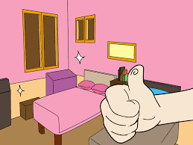
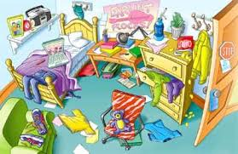

5. For an action that happened in unspecified time.
The children have tidied their room.
WHEN???

Slide 8
Time expressions
Ever
Never
Just
Already
Yet
For
Since
How long…?
So far
Lately/recently
always

Slide 9

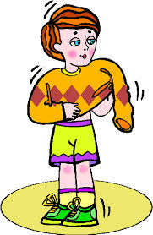

ALREADY/YET
I have already got dressed.
I haven’t done my homework yet.
Has Sarah called yet?

Slide 10
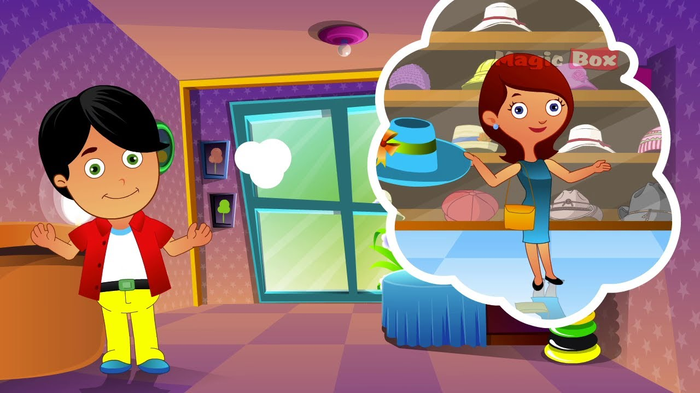
HAVE GONE TO/HAVE BEEN TO
“Mary has gone to London. I miss her so much!”
(=she is still there)

Slide 11
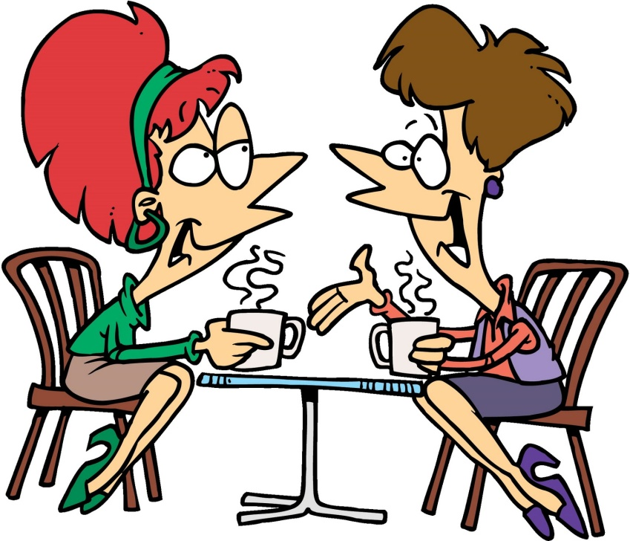
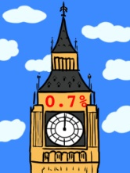
Of course, I’ve been to London a lot of times. It’s such an amazing city!
Have you ever been to London?
I have been to= I have gone and come back

Slide 12
THE END

