Slide 1
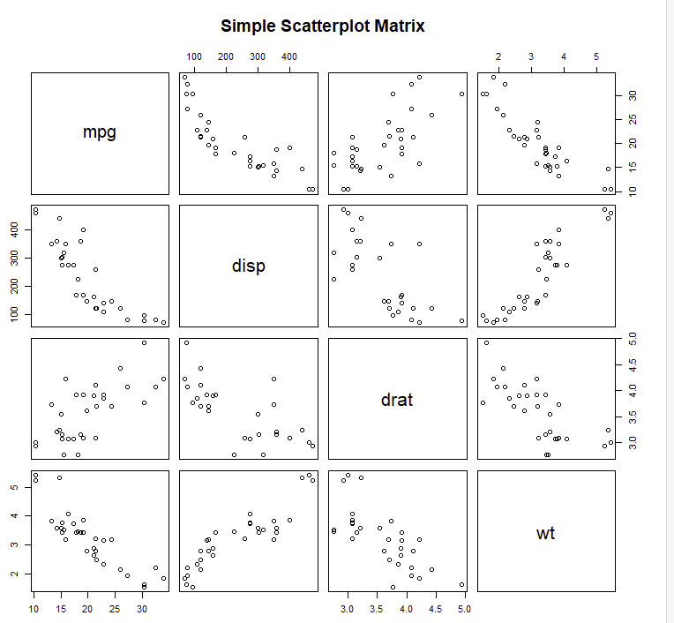
WEIGTH Scale
pairs(~mpg+disp+drat+wt,data=mtcars, main="Simple Scatterplot Matrix")
ALL Variables
They will always appear diagonal

Slide 2
Scale wt
WT vs MPG
As wt increases MPG decreases
2→40
3→20
4→15
Scale MPG
Scale DISP
WT vs DISP
As wt increases disp increases
2→100
3→150
4→400

