Slide 1
Predator
iOS & Android mobile game

Slide 2
Description
Mobile game where main characters will be predators, and the objective of the game will be to capture their preys, obtaining points to continue to next level. All this using the mobile hardware (touchscreen and accelerometer) and more features.

Slide 3
Requirements
UI’s
Persistent Data 1
Data, resources and services access from web
iCloud 1
Messages & email 1
Share scores
iOS 7 standard & Android v4.4

Slide 4
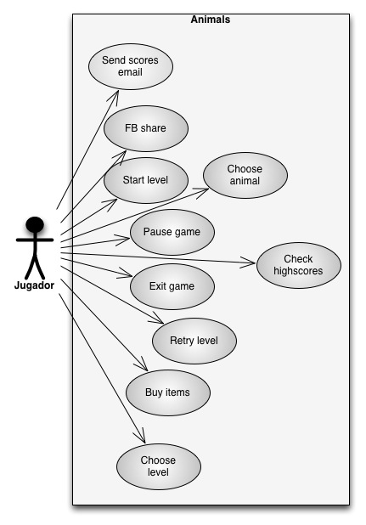
Use cases

Slide 5
Project risks
The main risk of the Project is that we’re learning xCode and Android in the same time we’re making the Project, so we need to beat time and research on our own.

Slide 6
Planning
Period 2
We are and will work on the implementation of the basic interfaces (menus, level select, etc)
Research on the Sprite Kit on iOS and Game Development on Android.
Period 3
Build the logic of the game and implement it, also test the characters designs.
Alpha & Beta tests

Slide 7

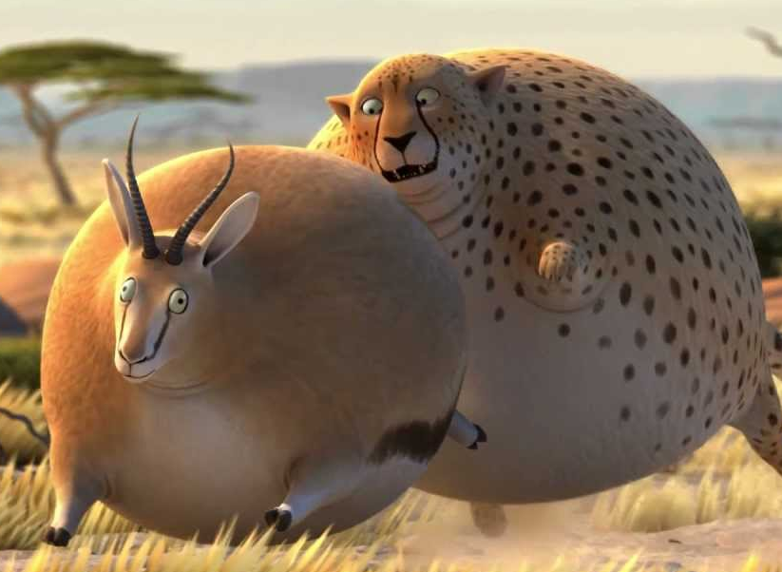
Characters
Predators
Wolf
Penguin
Bear
Lion
T-Rex
Preys
Sheep
Fish
Salmon
Gazelle
Triceratops

Slide 8
Game rules
You obtain points for each prey you capture, there’s an objective score you need to accomplish. If not you lose the level.

Slide 9
worlds
There will be a world for each predator, their environment.
South Pole (Penguin)
Prairie (Wolf)
River (Bear)
Savannah (Lion)
Special Environment (T-Rex)
Each world shall have levels, but in this Project only they will have 1 level per world.

Slide 10
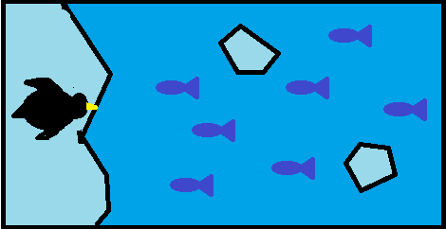

Mechanics
Drag and drop

Slide 11
mechanics
Accelerometer

Slide 12
Current status
We’re designing interfaces and learning the basics on Xcode and Android.
We’re working on the basic interfaces, like the menus and level select.
Next we will learn and apply the game interfaces and behaviors.

Slide 13
demo

