Slide 1
COBB^{(ɑ)}-DOUGLAS^{(1-ɑ)} Function
Mathematical approach
Microeconomic approach
Macroeconomic approach
Econometric approach

Slide 2
Contenents
Mathematic approach
  Algebraic analysis
  Diagram
Microeconomic approach
  Economic properties
Macroeconomic approach
  Growth model
  Solow
Econometric approach
  Simple form
  General form
  Imposing constraint
  An example

Slide 3
Mathematic Approach
Algebraic analysis
diagram

Slide 4
Mathematic Approach
Algebraic Analysis
ECONOMICS
Unlimited Desires = Limited Resources
Output = Input
Y= F(X₁,X₂)

Slide 5
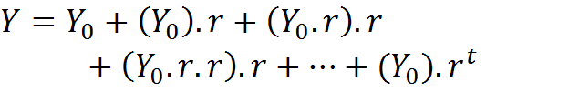
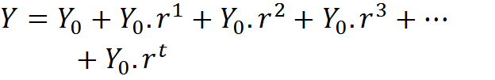

Mathematic Approach
Algebraic Analysis
Geometric progression:

Slide 6




Mathematic Approach
Algebraic Analysis
Duplicating the Periods:
Again Duplicating the Periods:
……….
In a Continues Time Period:

Slide 7




Mathematic Approach
Algebraic Analysis
If m=n/r then

Slide 8


Mathematic Approach
Algebraic Analysis
John Nepaire (100 digits calculation):
2.7182818284 5904523536 0287471352 6624977572 4709369995 9574966967 6277240766 3035354759 4571382178 5251664274

Slide 9





Mathematic Approach
Algebraic Analysis
Substituting:
Since:
Then

Slide 10



Mathematic Approach
Algebraic Analysis
Natural Logarithm:
Simplification:

Slide 11



Mathematic Approach
Algebraic Analysis
By Simplification:
Thus:

Slide 12

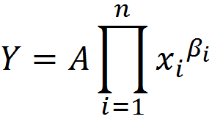
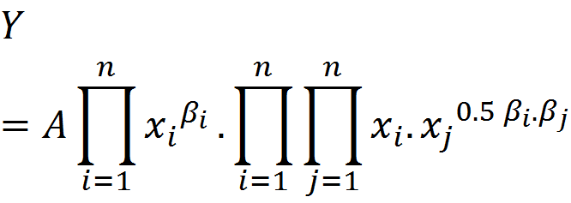
Mathematic Approach
Algebraic Analysis
More general form:
A special case of the transcendental logarithm function, so-called Translog.

Slide 13
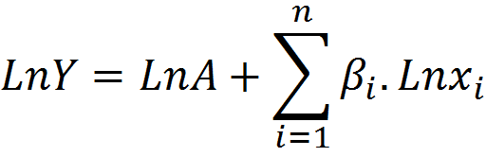
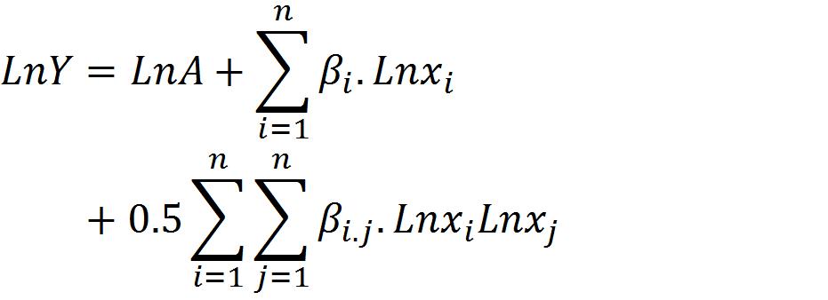
Mathematic Approach
Algebraic Analysis
In logarithmic form:
Cobb-Douglas:
Translog :

Slide 14
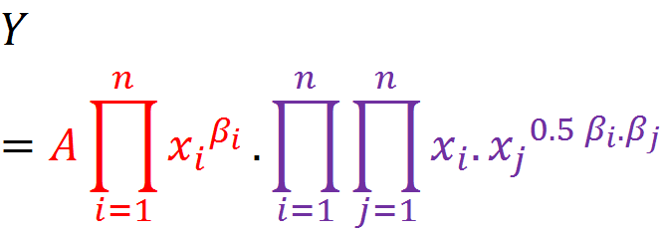
Mathematic Approach
Algebraic Analysis
TRANSLOG
Cobb-Douglas
Generalized Leontif

Slide 15
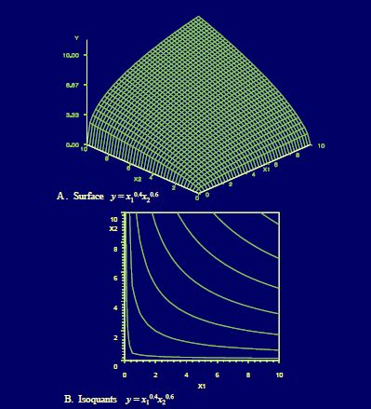
Mathematic Approach
Diagram
Two Inputs

Slide 16
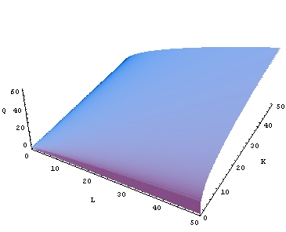
Mathematic Approach
Diagram

Slide 17
Microeconomic Approach
Economic properties

Slide 18




Microeconomic Approach
Economic properties
Charles Cobb and Pole Douglas (1928)
Labour perspective
Capital perspective

Slide 19


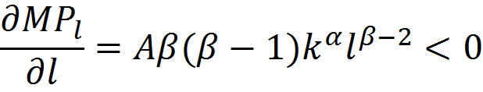
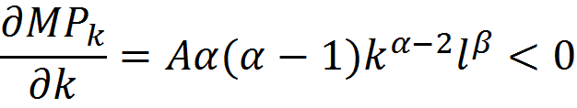
Microeconomic Approach
Economic properties
Marginal productivity of the inputs:

Slide 20
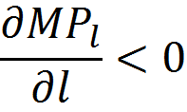
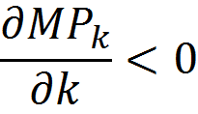
Microeconomic Approach
Economic properties
In 1900s, Thomas Malthus, for the first time, showed the inequalities. He worried that population growth declines the labour productivity. The dark prediction made the Economics to be called as a dismal science. It was not true because the labour productivity not only depends on population growth but also depends on the other inputs growth. In fact, the labour productivity, since then, has raised considerably because capital growth has increased.

Slide 21
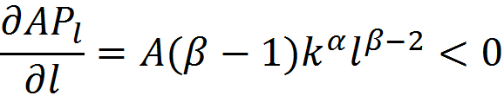
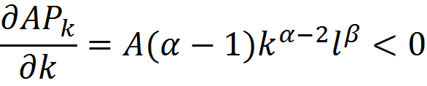
Microeconomic Approach
Economic properties
Average productivity of the inputs:

Slide 22
Microeconomic Approach
Economic properties
𝑙
The nexus between marginal and average productivity of the inputs:

Slide 23
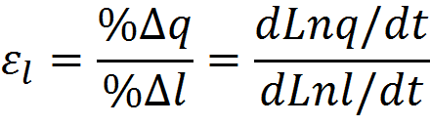
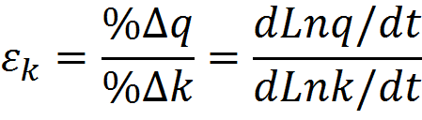





Microeconomic Approach
Economic properties
Elasticities:
Constant return to scale
Increasing return to scale
Decreasing return to scale

Slide 24
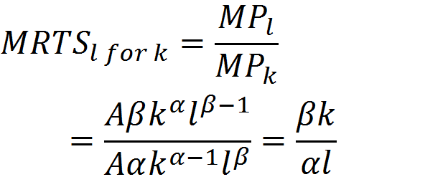
Microeconomic Approach
Economic properties
Marginal rate of technical
Substitution:

Slide 25
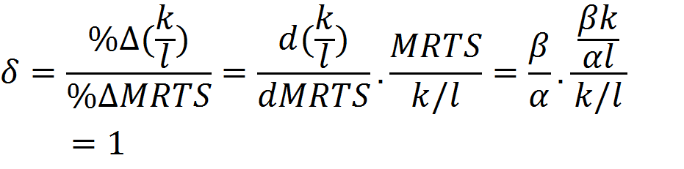
Microeconomic Approach
Economic properties
Substitutional elasticity:
Return to scale:
k
l

Slide 26


Microeconomic Approach
Economic properties
Q=ak+bl
Q=min(ak,bl)
k
k
l
l

Slide 27
Macroeconomic Approach
Growth model
Solow

Slide 28

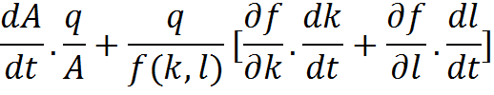


Macroeconomic Approach
Growth Model
Q= A(t).f(k,l)
Growth accounting:
Dividing by q

Slide 29






Macroeconomic Approach
Growth Model
All in all
the output growth:
For Cobb-Douglas form:
Suppose

Slide 30





Macroeconomic Approach
Solow
Simple world
Logarithmic world
1. Solow found out that “ɑ” cannot explain ”y”.
2. In a constant return to scale

Slide 31
Econometric Approach
Simple form
General form
Imposing constraint
An Example

Slide 32









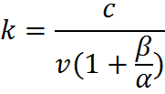

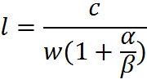

Econometric Approach
Simple Form
Max subject to
Lagrangian function
Differentiation
l & k relationship

Slide 33
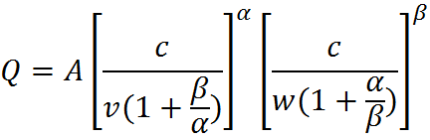
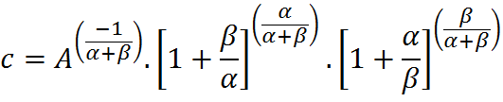




Econometric Approach
Simple Form
Replacing in the
production function
Cost function
Simplified
More general
z

Slide 34





Econometric Approach
Simple Form
Who can estimate it????
Me
by natural logarithm
The nature of the estimators
so

Slide 35
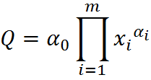
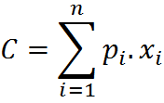


Econometric Approach
General Form
The most general form
By spreading
Lagrangian function

Slide 36





Econometric Approach
General Form
…
…
…
…

Slide 37




Econometric Approach
General Form
…
…

Slide 38




Econometric Approach
General Form
…
…
…

Slide 39






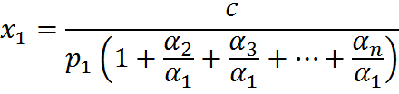
Econometric Approach
General Form
…
By replacing:
By simplification:

Slide 40






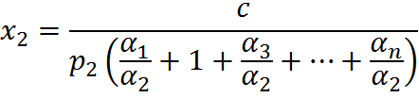
Econometric Approach
General Form
…
By replacing:
By simplification:

Slide 41






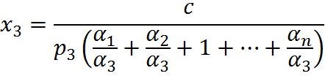
Econometric Approach
General Form
…
By replacing:
By simplification:

Slide 42
Econometric Approach
General Form
…

Slide 43










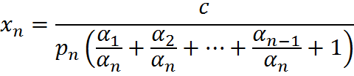
Econometric Approach
General Form
…
By replacing:

Slide 44
Econometric Approach
General Form
+
Xs
…
…
…

Slide 45
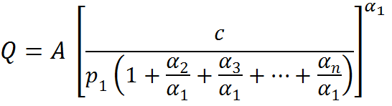
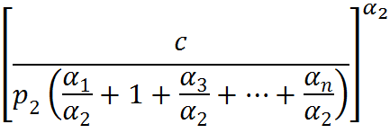
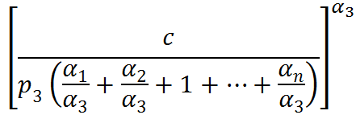
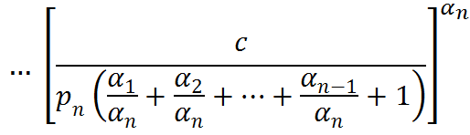
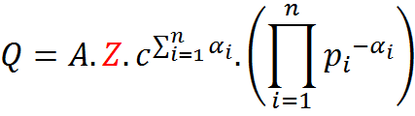
Econometric Approach
General Form
Replacing the Xs in Q
+

Slide 46





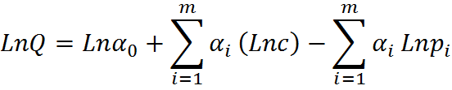
Econometric Approach
General Form
Replacing the Xs in Q
+
By taking natural log,

Slide 47
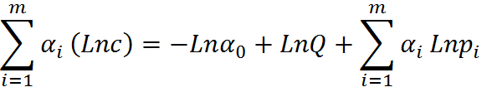

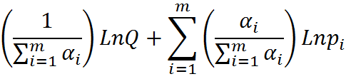
Econometric Approach
General Form
By shifting the elements

Slide 48




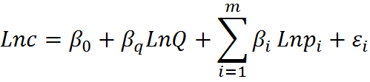
Econometric Approach
General Form
Defining the parameters
The econometric equation
so

Slide 49
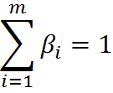
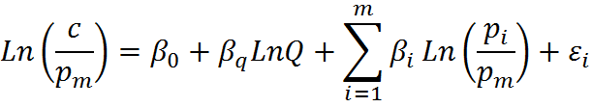

Econometric Approach
Imposing constraint
Imposing constraint (homogeneous of degree one)
Also:
By dropping equation “m”
while

Slide 50
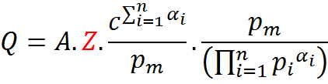

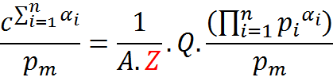
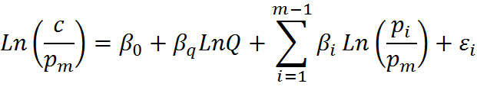
Econometric Approach
Imposing constraint
Remember that:
Multiplying by :
Shifting the elements:
Natural logarithm:
while

Slide 51
Econometric Approach
An Example
Marc Nerlove study is an example
3 inputs
Labour
Capital
Fuel

Slide 52


COBB^{(ɑ)}-DOUGLAS^{(1-ɑ)}
Function
Econometrics by
Dr. Ebrahim Heidari
Master Program
May/2014
Economics Department
Presented by:
Vahid M.Taghvaee
vahidestan@yahoo.com
www.v4t.4t.com

