Slide 1
Symbolic regression

Slide 2
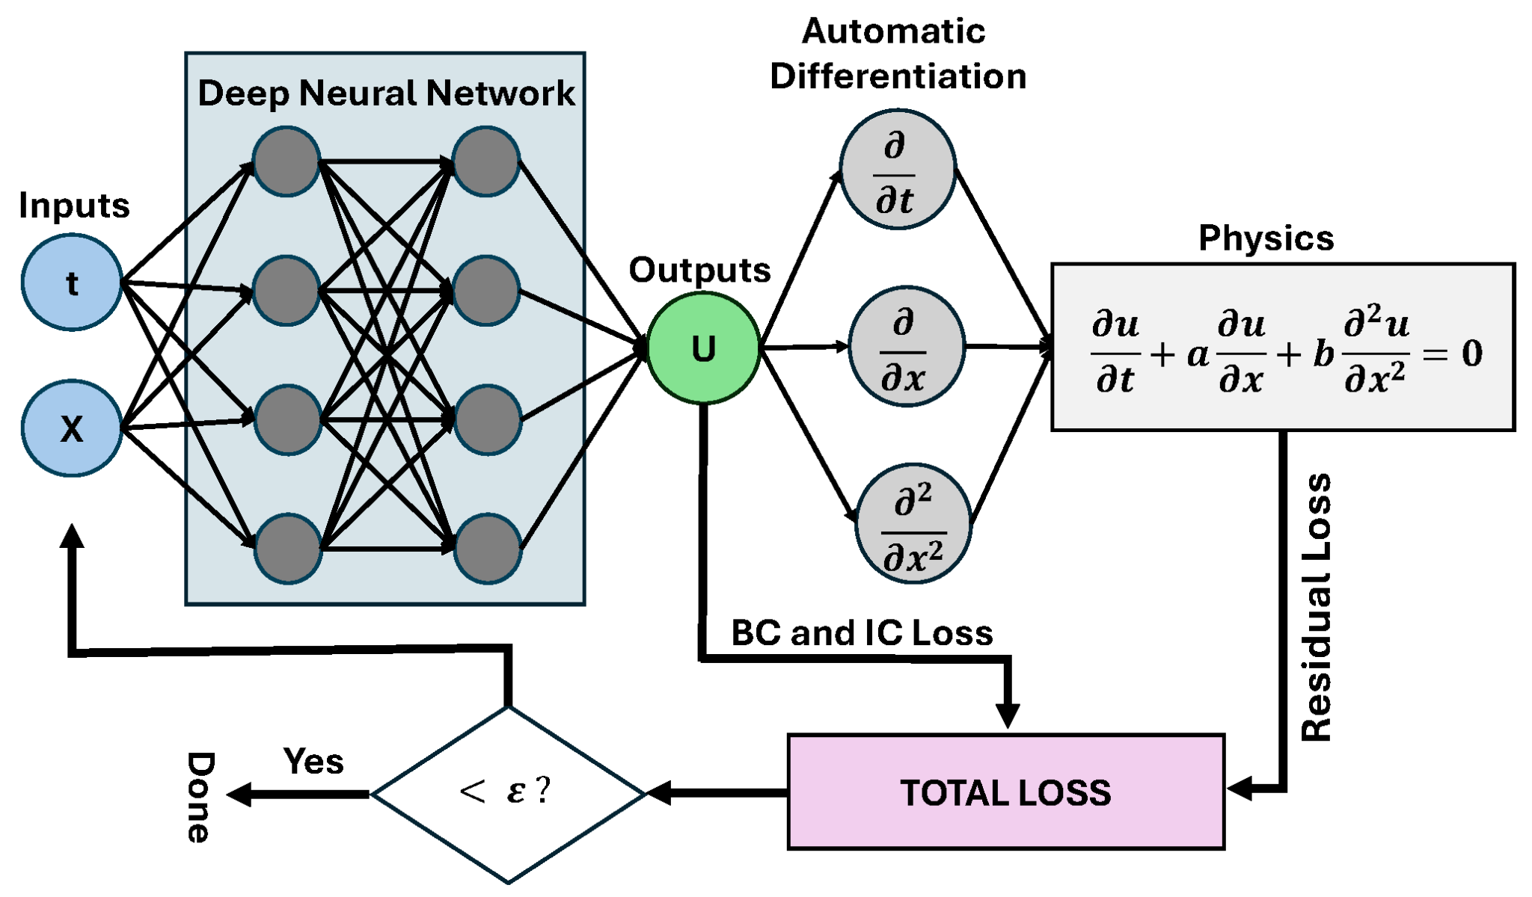
Last class

Slide 3
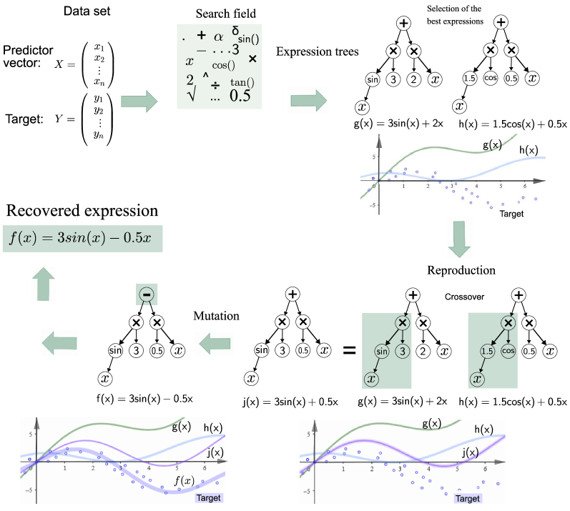
Next step
Knowledge distillation is a machine learning technique that aims to transfer the learnings of a large pre-trained model, the “teacher model,” to a smaller “student model.” It’s used in deep learning as a form of model compression and knowledge transfer, particularly for massive deep neural networks.

Slide 4
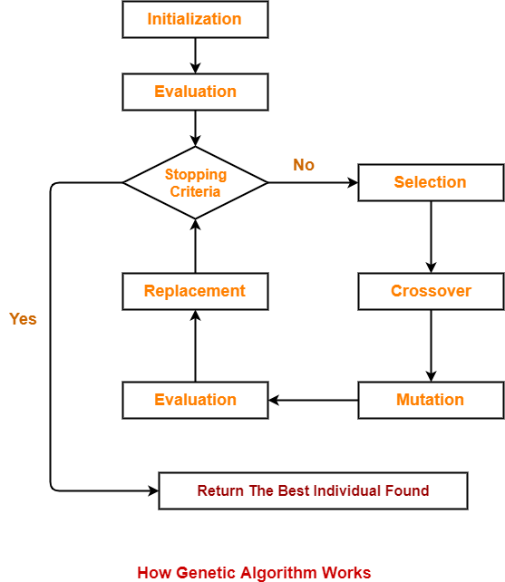
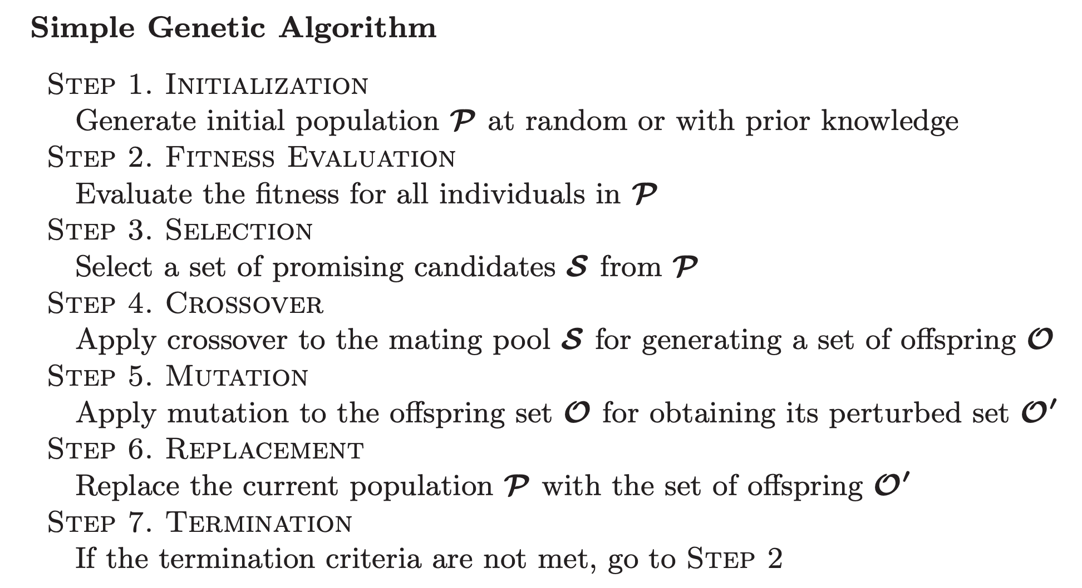
Genetic algorithms

Slide 5
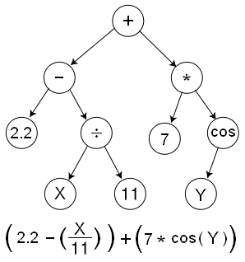
Arithmetic trees

Slide 6
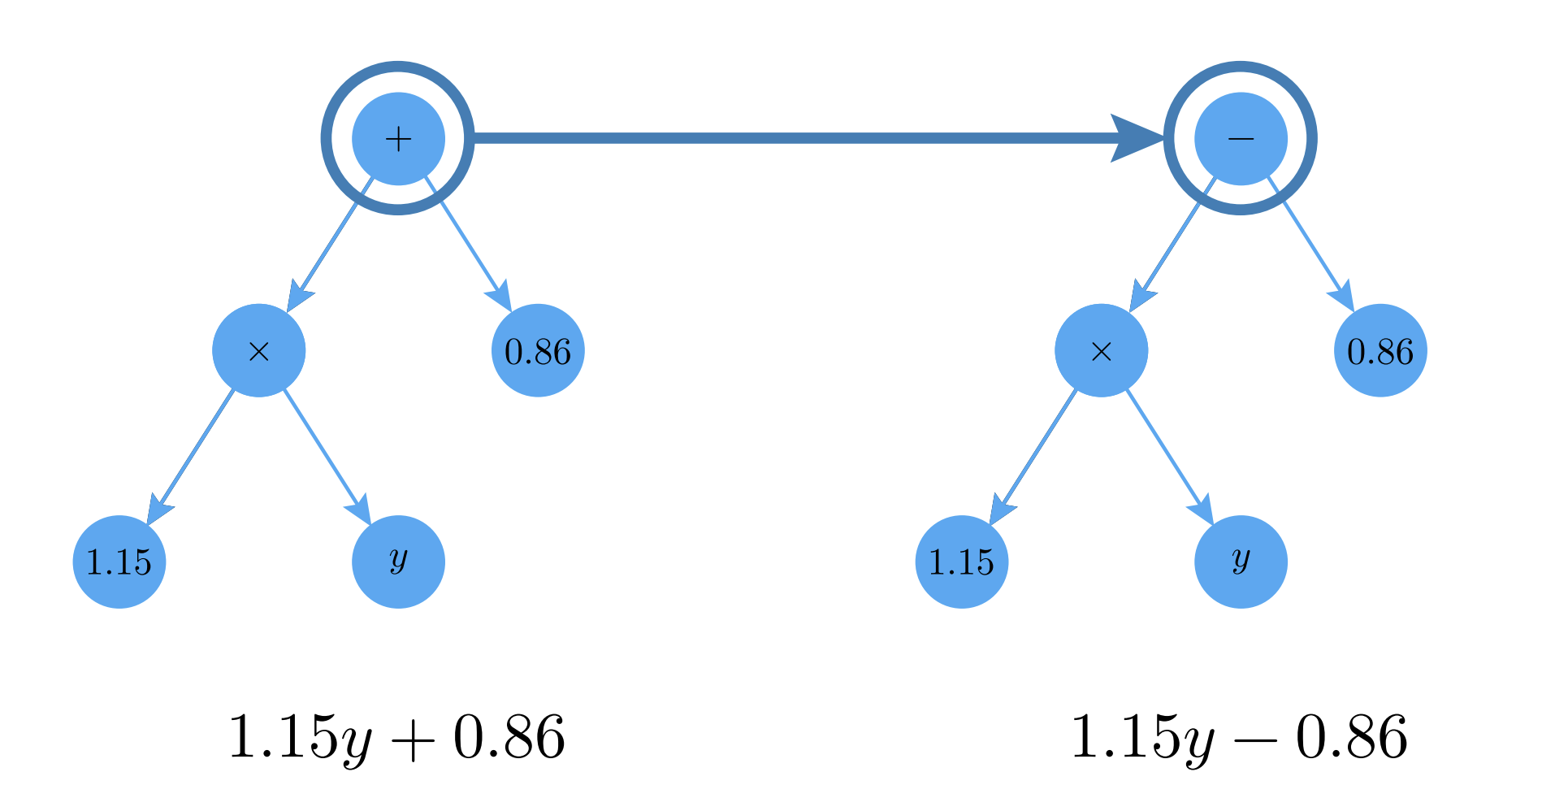
Mutation

Slide 7
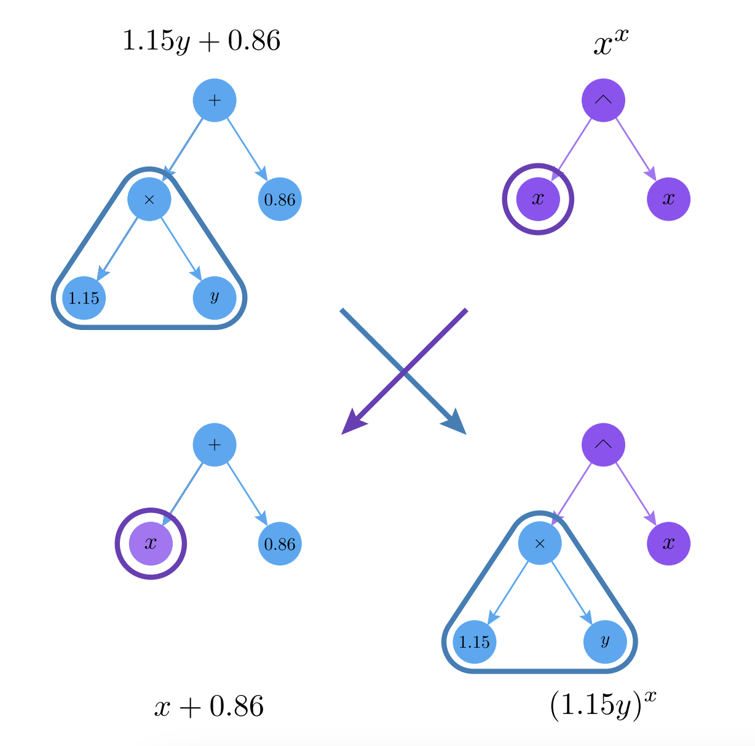
Crossover

Slide 8

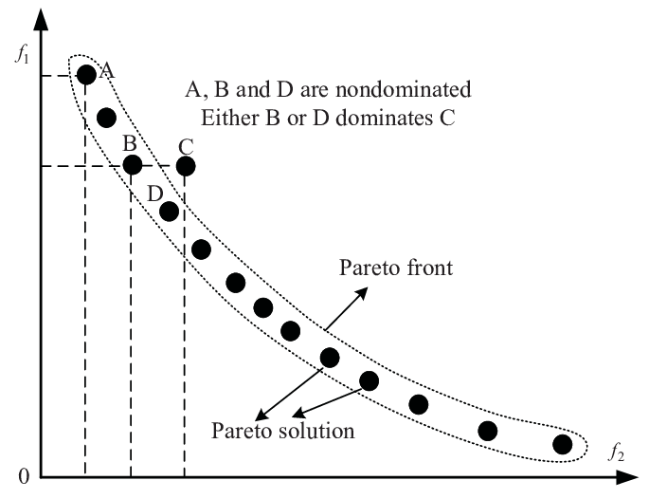
Fitness function

Slide 9
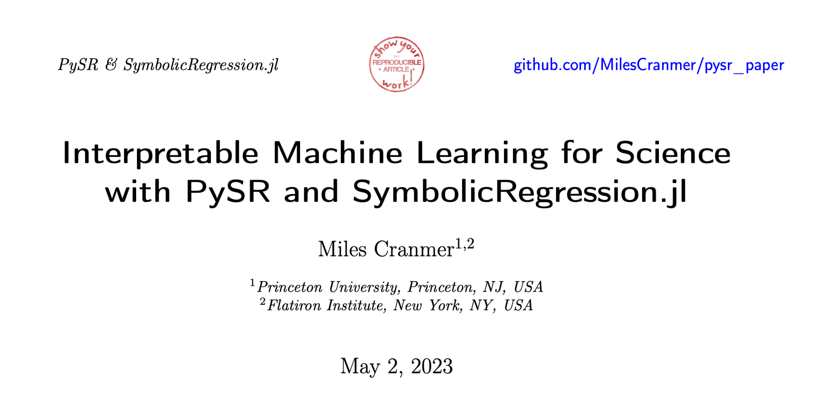
PySR

Slide 10
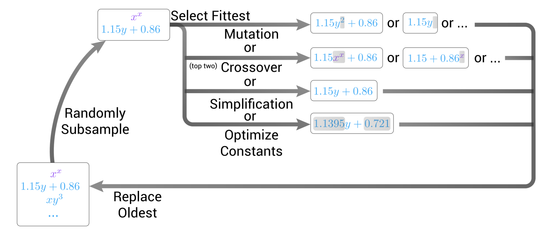
The symbolic regression loop

Slide 11
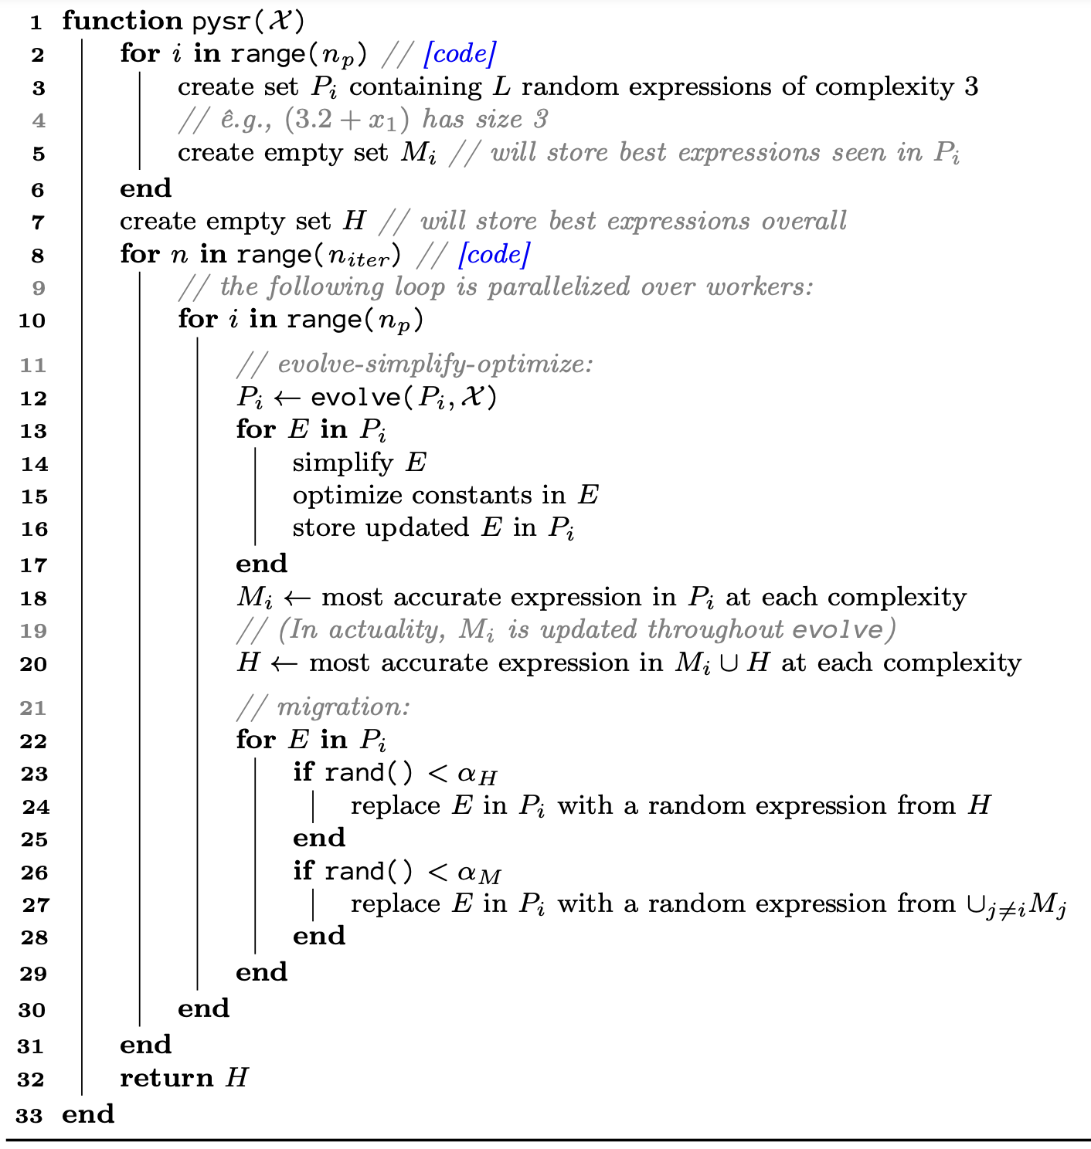
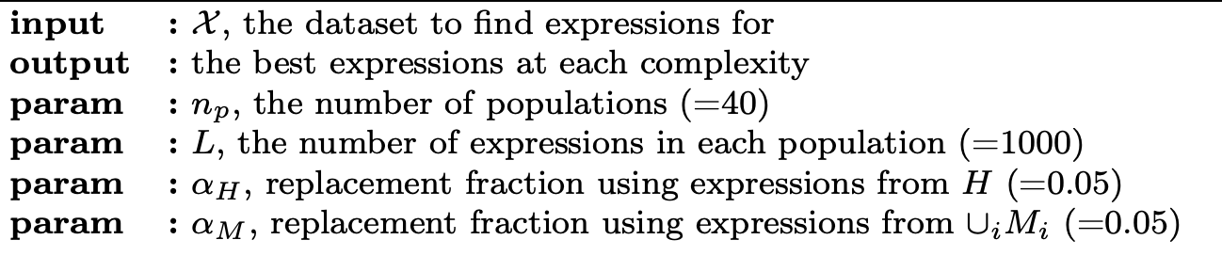
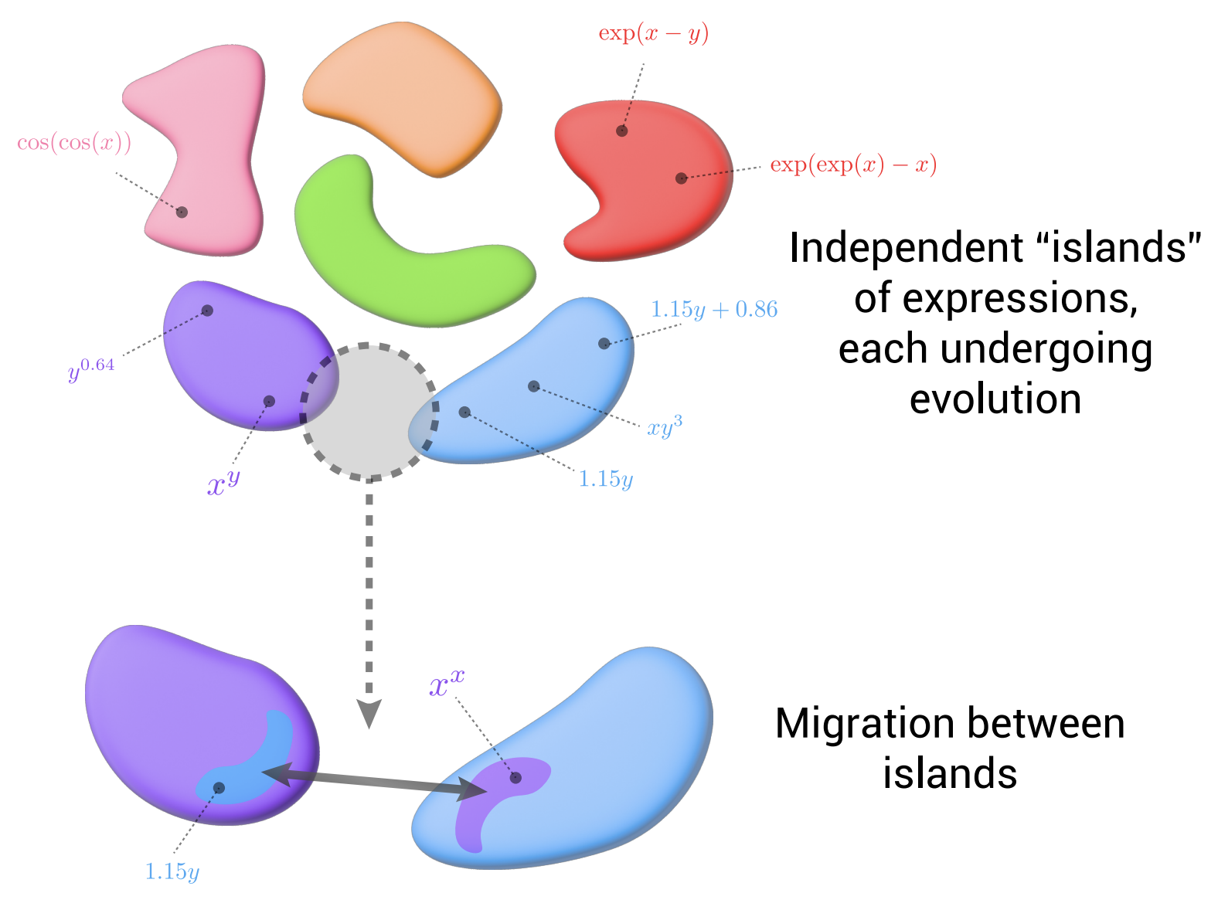
Algorithm

Slide 12
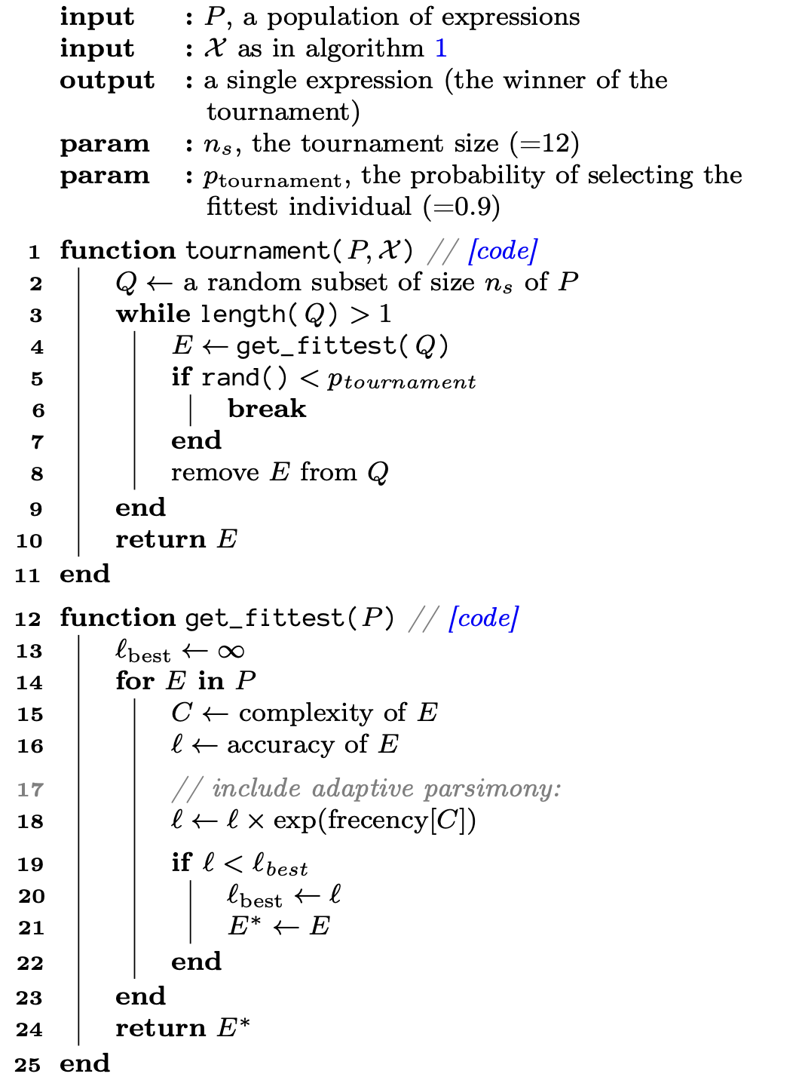
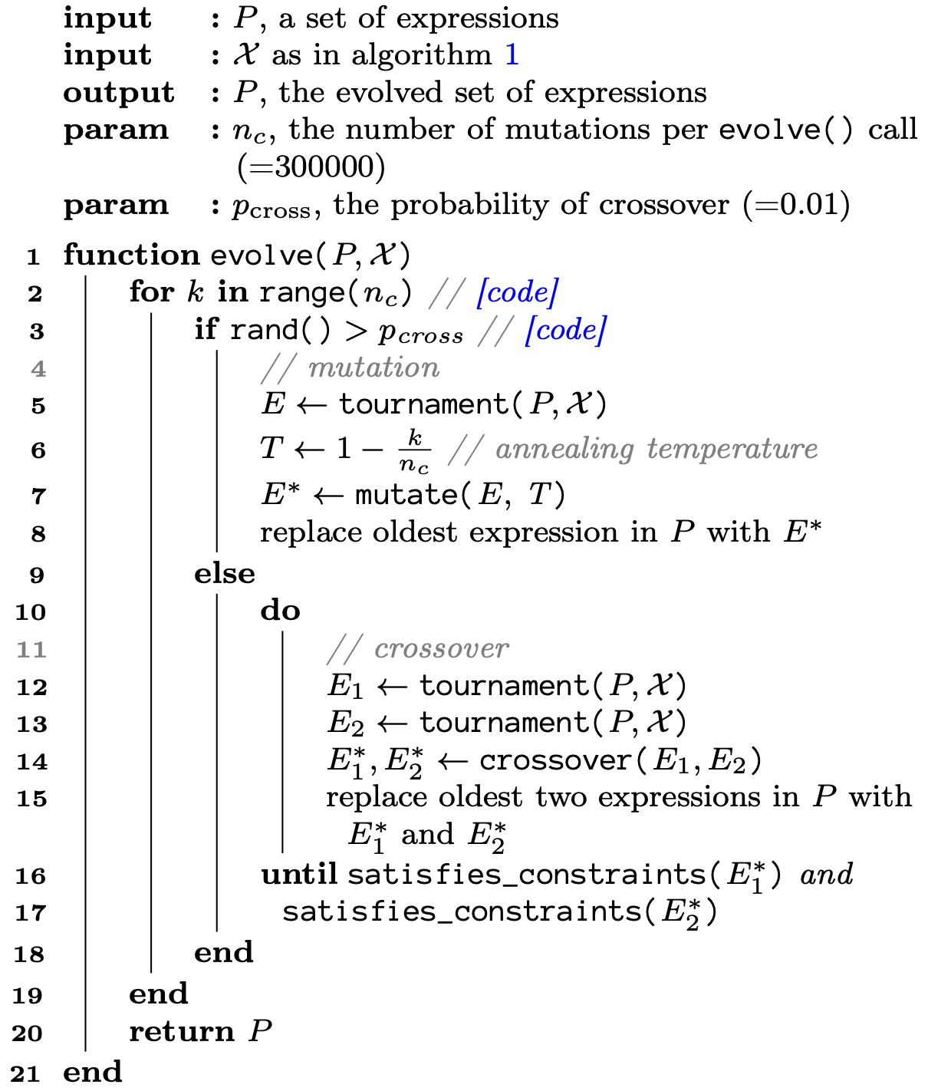
Algorithm

Slide 13
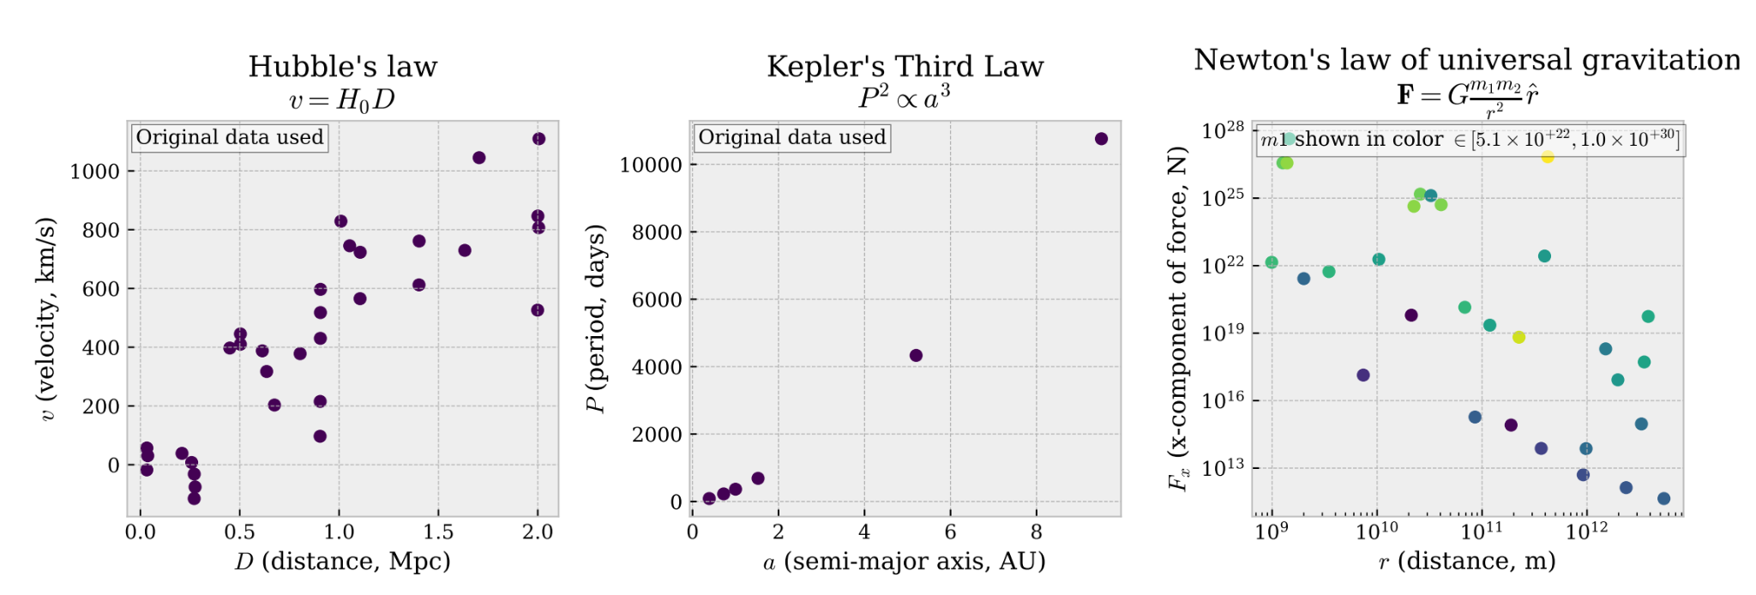
Use cases

Slide 14
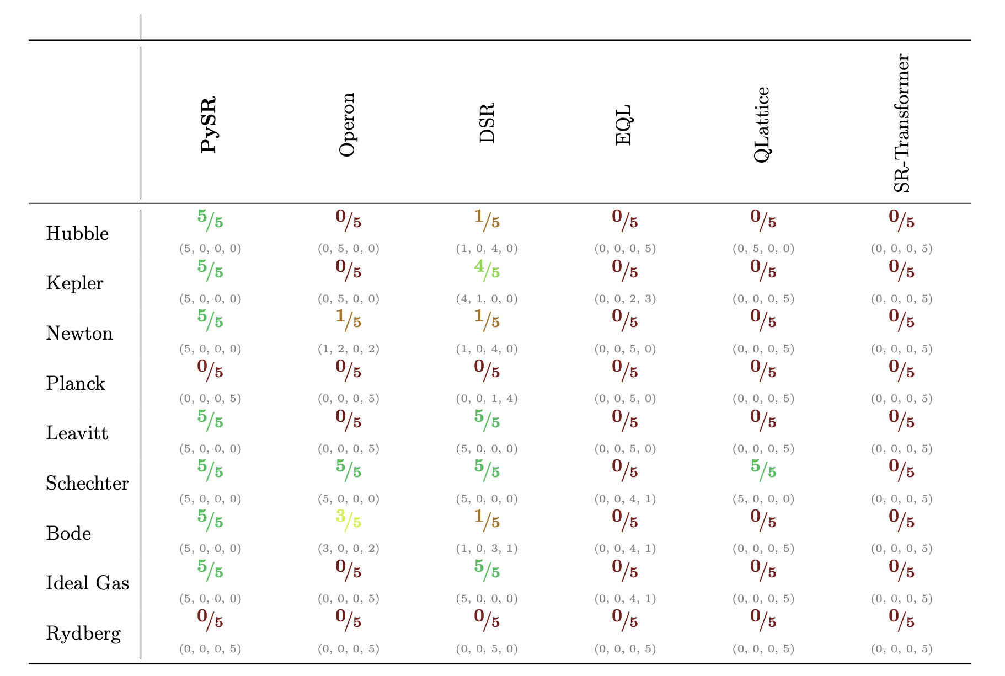
Benchmark

Slide 15
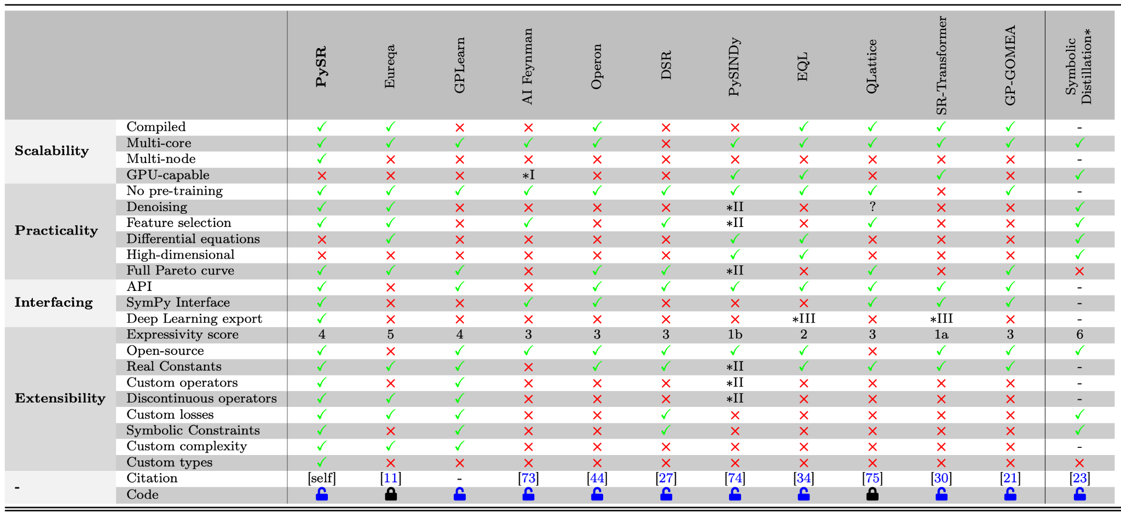
Benchmark

Slide 16
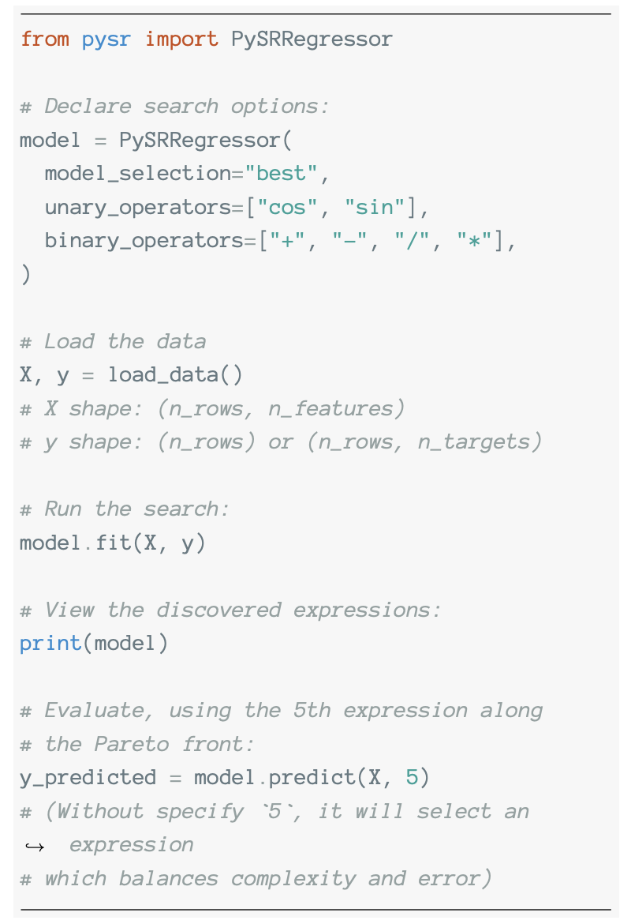
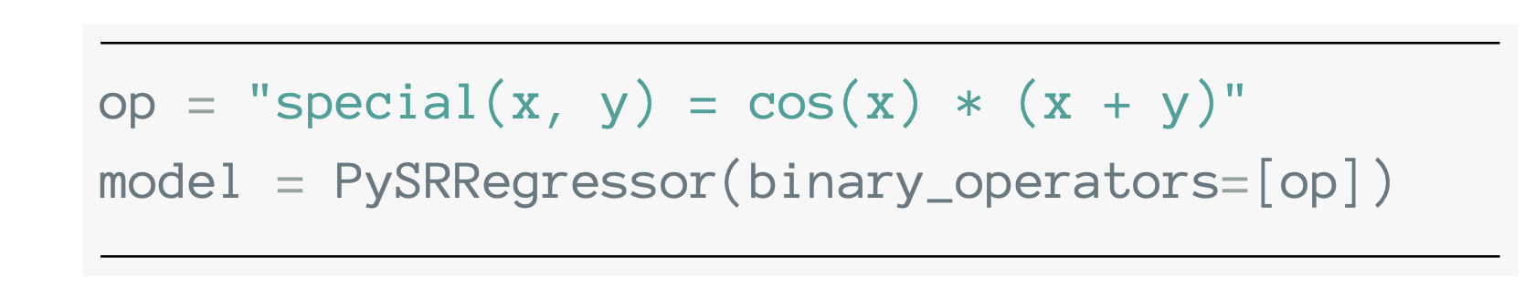
Code example
We can use custom operators!
PySRRegressor Reference - PySR

Slide 17
Coupling with neural networks
y
X

Slide 18
Coupling with neural networks
Symbolic regression
y
X
pick score equation loss complexity
0 0.000000 4.4324794 42.354317 1
1 1.255691 (x0 * x0) 3.437307 3
2 0.011629 ((x0 * x0) + -0.28087974) 3.358285 5
3 0.897855 ((x0 * x0) + cos(x3)) 1.368308 6
4 0.857018 ((x0 * x0) + (cos(x3) * 2.4566472)) 0.246483 8
5 >>>> inf (((cos(x3) + -0.19699033) * 2.5382123) + (x0 *... 0.000000 10

Slide 19
Exercises
Add Gaussian noise to `y_sr` before passing it to PySR. How robust is the symbolic regression?
Change the PINN to solve the Burgers' equation (from Day 1) and try to distill the shockwave equation.
Remove "sin" from the unary_operators list. Can PySR approximate the sine wave using Taylor expansion terms (polynomials)?
pedrogasparetto@ymail.com

