Slide 1
Dialogue Systems for Virtual Environments
Luciana Benotti, Paula Estrella, Carlos Areces
PLN Group, Universidad Nacional de Córdoba
ARGENTINA
NAACL-HLT 2010 Young Investigators Workshop
6 June 2010, Los Angeles, USA

Slide 2
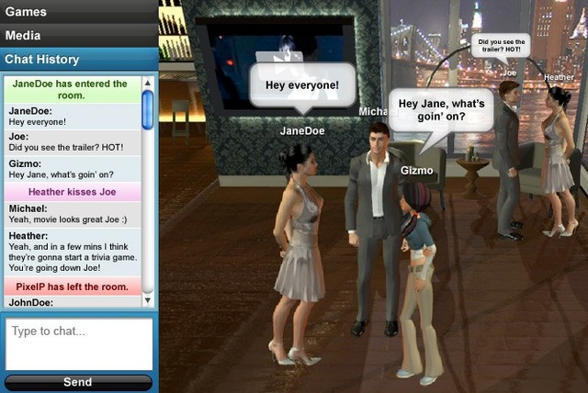
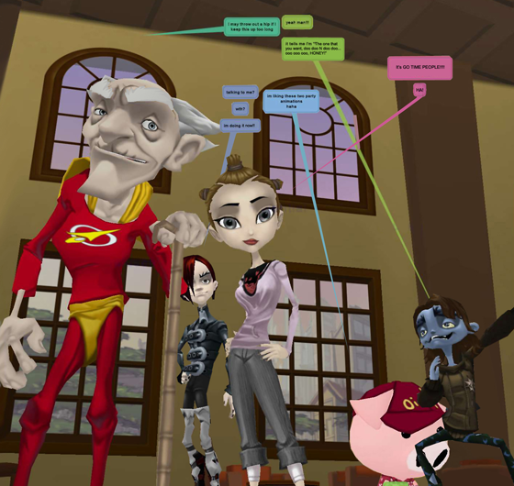
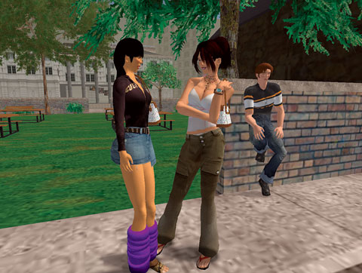
Dialogue systems in
Virtual Environments
Lively
WebFloc
SECOND LIFE

Slide 3
Dialogue systems in
Virtual Environments
Introducing the domain task and resources
Main research topics of the project:
  Dialogue and common ground
  Task-oriented inference in interaction
  Evaluation of dialogue systems
Application in task-based language learning

Slide 4
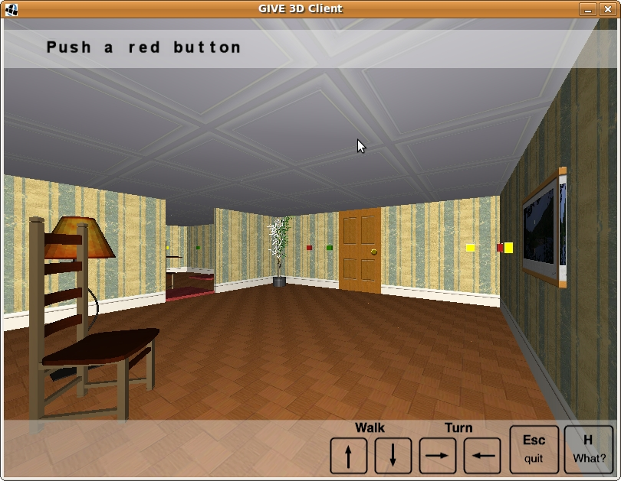
The domain task and resources
  The system generates instructions
  The user follows the instructions by acting in the virtual environment (VE)
  The user can press buttons, open doors, dis-activate alarms, etc.
User's view of the VE

Slide 5
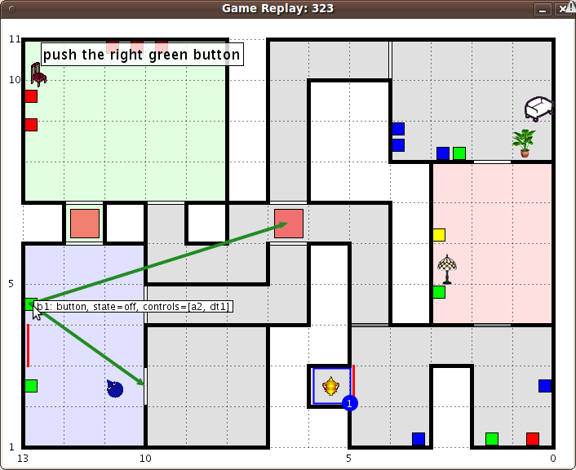
The domain task and resources
There is a wizard of oz platform for collecting human-human corpus
There are english and german corpus
The data is automatically annotated (e.g. visible objects, linguistic/physical action interleaving, etc.)
Wizard's view of the VE

Slide 6
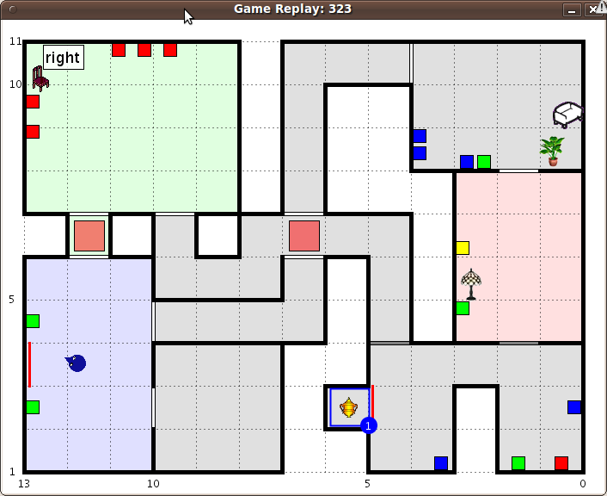
The domain task and resources
There is a wizard of oz platform for collecting human-human corpus
There are english and german corpus
The data is automatically annotated (e.g. visible objects, linguistic/physical action interleaving, etc.)
Wizard's view of the VE

Slide 7
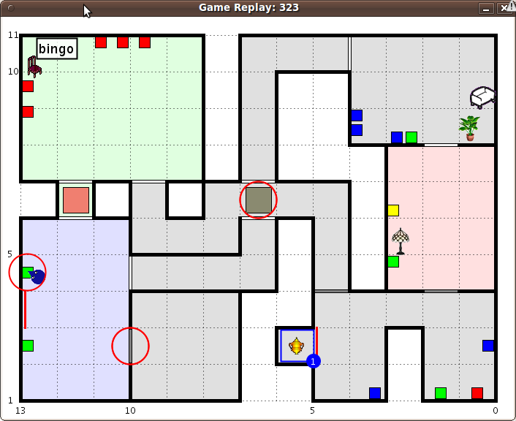
The domain task and resources
There is a wizard of oz platform for collecting human-human corpus
There are english and german corpus
The data is automatically annotated (e.g. visible objects, linguistic/physical action interleaving, etc.)
Wizard's view of the VE

Slide 8


The domain task and resources
The GIVE Challenge is a shared task for generation systems
(endorsed by ACL SIGs)
We have organized two research meetings with the organizers (in Germany and France)
We will have a third meeting in Argentina next September
Challenge
http://www.give-challenge.org/
GERMANY

Slide 9
Dialogue systems in
Virtual Environments
Introducing the domain task and resources
Main research topics of the project:
  Dialogue and common ground
  Task-oriented inference in interaction
  Evaluation of dialogue systems
Application in task-based language learning

Slide 10

Towards Dialogue: common ground
When the interaction starts the user does not know the virtual world
As the user and system interact they build common ground
The system should only refer to things inside the common ground

Slide 11
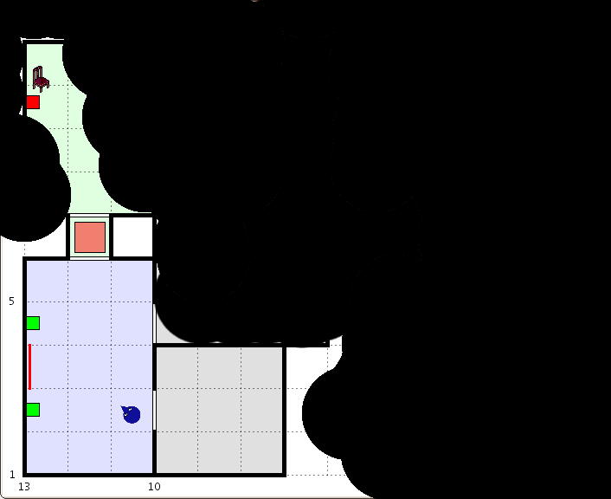
Towards Dialogue: common ground
When the interaction starts the user does not know the virtual world
As the user and system interact they build common ground
The system should only refer to things inside the common ground

Slide 12
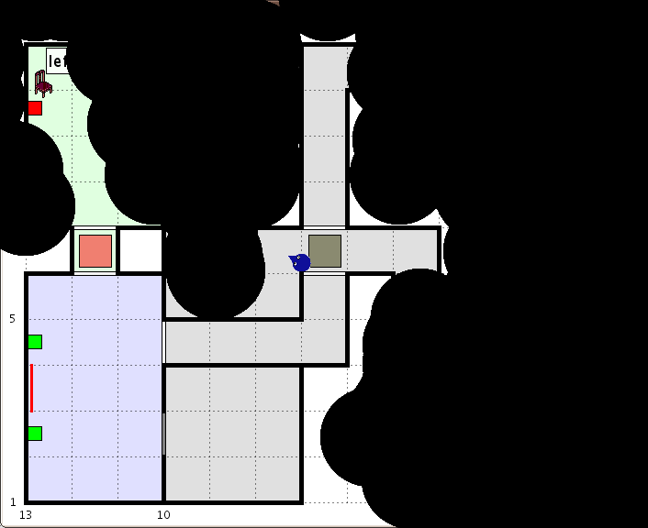
Towards Dialogue: common ground
When the interaction starts the user does not know the virtual world
As the user and system interact they build common ground
The system should only refer to things inside the common ground

Slide 13
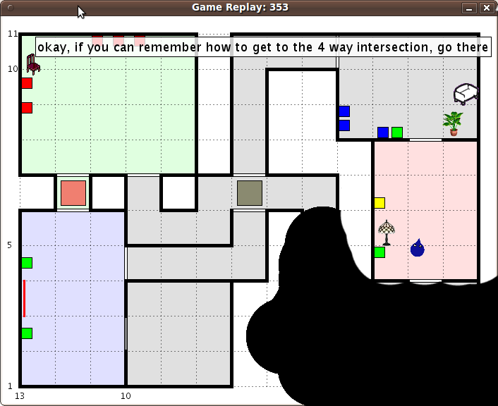
Towards Dialogue: common ground
When the interaction starts the user does not know the virtual world
As the user and system interact they build common ground
The system should only refer to things inside the common ground

Slide 14
Towards Dialogue: common ground
We will investigate the role of common ground in:
  The expected next physical acts
  (e.g. go straight)
  The expected clarification requests uttered by the user
  (e.g. straight?)

Slide 15
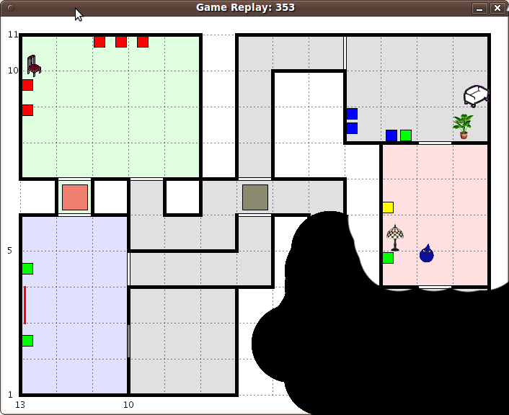
Task oriented inference

Slide 16
Task oriented inference
We will investigate:
  Efficient calculation of alternative plans
  Explanations of no plan result
These are relevant for our purposes and are not classical task oriented inferences

Slide 17
Task oriented inference
We will investigate:
  Efficient calculation of alternative plans
  Explanations of no plan result
These are relevant for our purposes and are not classical task oriented inferences

Slide 18
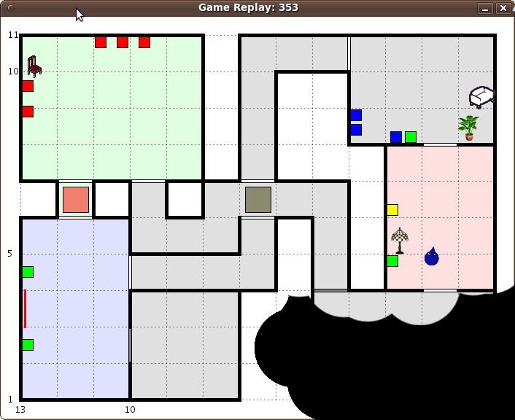
Task oriented inference
We will investigate:
  Efficient calculation of alternative plans
  Explanations of no plan result
These are relevant for our purposes and are not classical task oriented inferences
The room behind you is connected to the intersection

Slide 19
Task oriented inference
We will investigate:
  Efficient calculation of alternative plans
  Explanations of no plan result
These are relevant for our purposes and are not classical task oriented inferences
The room behind you is connected to the intersection

Slide 20
Task oriented inference
We will investigate:
  Efficient calculation of alternative plans
  Explanations of no plan result
These are non-classical inferences
The room behind you is connected to the intersection

Slide 21

Dialogue and inference
With the TALARIS team we are participating in this year GIVE Challenge
The MAIA Team works on task oriented inference (e.g. planning)
We are applying for French-Argentinean funding for mobility
TALARIS Team (NLP, Knowledge Representation, Inference, Semantics)
MAIA Team (Intelligent autonomous agents)
FRANCE

Slide 22
Evaluation of dialogue systems
The GIVE Challenge collects different human evaluation metrics:
  Task success
  Completion time
  Naturalness
  Friendliness
  etc
Evaluation of dialogue systems is difficult
There are no gold like in Machine Translation (MT)
Human evaluation is necessary but expensive
Automatic metrics, borrowed from MT (e.g. BLUE) are starting to be used (CL, Reiter and Belz, 2009)
But need to be correlated with human evaluation

Slide 23

Evaluation of dialogue systems
We plan to investigate:
  Correlation between human evaluation data and automatic metrics
  Migration of evaluation techniques from machine translation to natural language generation.
We collaborate with the Multilingual Information Processing Department on MT Evaluation schemas.
SWITZERLAND

Slide 24
Dialogue systems in
Virtual Environments
Introducing the domain task and resources
Main research topics of the project:
  Dialogue and common ground
  Task-oriented inference in interaction
  Evaluation of dialogue systems
Application in task-based language learning

Slide 25
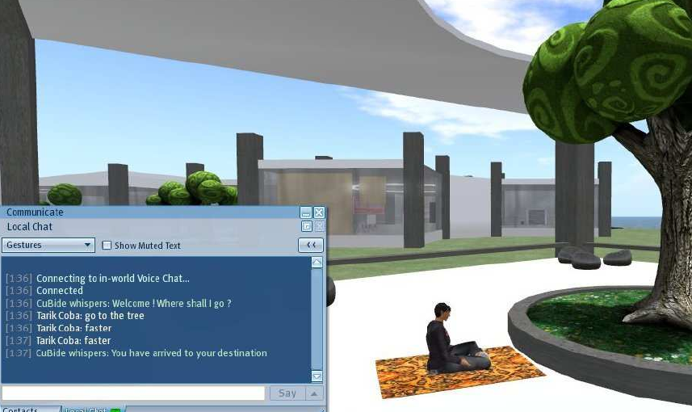

Task-based language learning
We are collaborating with the ALLEGRO project migrating interaction algorithms (from GIVE) into Second Life
With the goal of making a task-based language learning virtual environment (Spanish, French, English)
http://www.allegro-project.eu/

Slide 26



Events we are organizing
Argentinean School in CL
26-31 July
Buenos Aires
22-23 Sep
Tokyo
Japan
http://www.glyc.dc.uba.ar/elic2010/
http://www.yrrsds.org/
Workshop on Natural Language Processing
and Web-based Technologies
Collocated with:
1 November
Bahia Blanca
Argentina
http://cs.uns.edu.ar/iberamia2010/

