Slide 1
Authors Carlos Arenas Gallego Daniel Muñoz Puerta Oriol Vila Clarà

Slide 2
INDEX
Project Overview
Motivation
Objectives
Context
Methodology
Work plan
Bibliography

Slide 3
PROJECT OVERVIEW
Motivation
Study of privacy and security in communications
To know the vulnerability of the system
Progress in the field of pattern recognition related to sounds
Guess written text through the sound of a keyboard

Slide 4
PROJECT OVERVIEW
Objectives
Generate a reliable database
Under controlled conditions
Extract features from the keystroke sounds
Identify each sound reliably
Compare the effectiveness of several methods
Classify the extracted information through SVM
Test clustering techniques
Unsupervised mapping on the best extracted features
Map sounds to keys

Slide 5
INDEX
Project Overview
Context
Sound of a Keystroke
Previous studies
Database generation
Methodology
Work plan
Bibliography

Slide 6
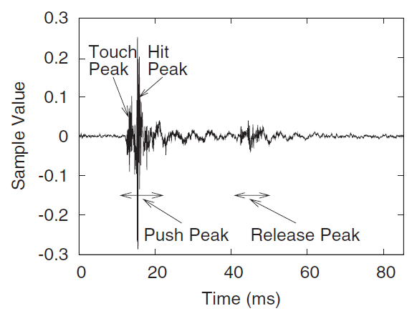
CONTEXT
Sound of a Keystroke
Push peak → Touch peak + Hit peak
Release peak
Duration
Keystroke ≈ 100ms
Push peak ≈ 40ms

Slide 7
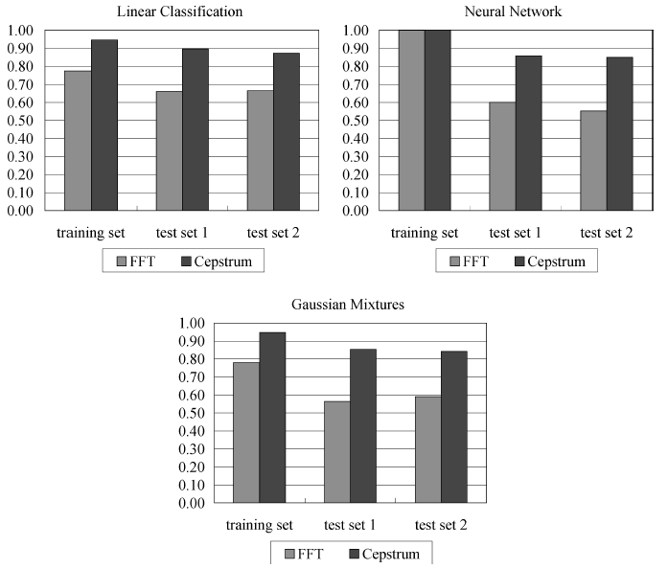


CONTEXT
Previous studies
Best criterion:
Feature Extraction
Cepstrum
Classification method
Linear classification
Recognition rate

Slide 8
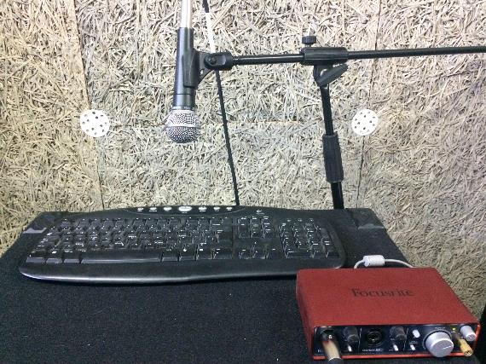
CONTEXT
Database generation
External Keyboard
Logitech K120
Microphone
Shure SM58
Audio interface
Focusrite Scarlett
Laptop
MacBook Pro
Recording software
Logic Pro X

Slide 9
CONTEXT
Database generation
For Method 1 (feature extraction with MFCC)
(A, C, R, M, O, Space, Return) x 100 each one
Test words (CAMA, MARCO ROMA) x 15 each one
For Method 2 (feature extraction with Deep Learning)
2000 mixed keystrokes for keys A and L
A Wikipedia text of about 200 words
Sampling frequency → 44,1 kHz

Slide 10
INDEX
Project Overview
Context
Methodology
Segmentation
Feature extraction
SVM
Clustering
Work plan
Bibliography

Slide 11


METHODOLOGY
Work environment→ Matlab and Keras
Functions and scripts design
Segmentation
Feature extraction
SVM
Clustering

Slide 12
METHODOLOGY
Segmentation
Fix the windows size
Window 1 (≈250 ms)
Window 2 (≈40 ms)
Detect the hit peak
With an energy level threshold
Extract the push peak
Generate an independent audio file
For each keystroke

Slide 13
METHODOLOGY
Feature extraction
Mel Frequency Cepstral Coefficients (MFCC)
Relevant parameters
Frame duration = 10 ms
Frame shift = 2.5 ms
Number of filterbank channels = 32 channels
Number of cepstral coefficients = 13 coefficients
Results
Number of frames/push peak = 14 frames
Feature vector = 182 features/push peak

Slide 14
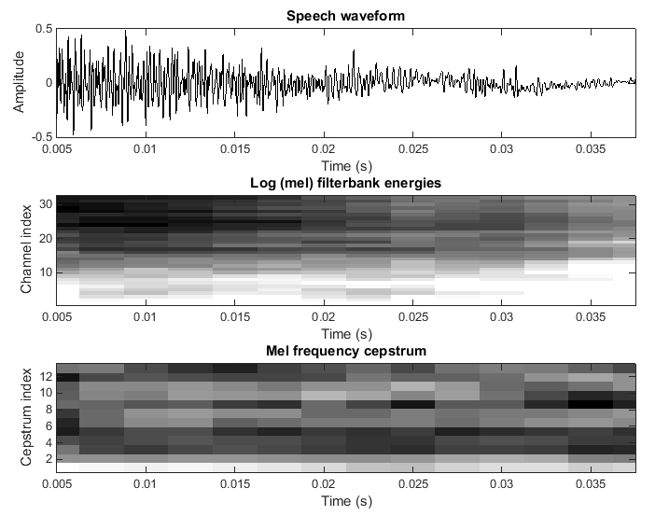
METHODOLOGY
Feature extraction
Mel Frequency Cepstral Coefficients (MFCC)

Slide 15
METHODOLOGY
Feature extraction
Deep learning
Motivation
Deep learning methods currently outperform other conventional methods
Easy to implement and modify already existing CNN structures
Very suited to our problem

Slide 16
METHODOLOGY
Feature extraction
Deep learning
Work environment:
Keras with TensorFlow as back end
PyCharm IDE for developing
Nvidia CUDA + cuDNN with dedicated GTX 1050

Slide 17
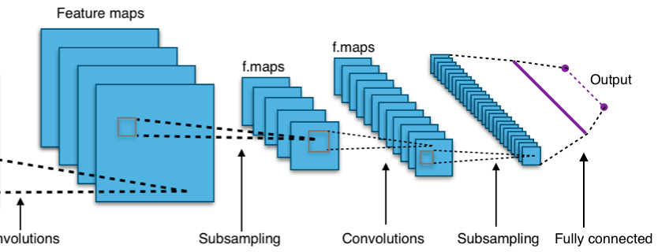
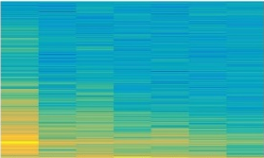
METHODOLOGY
Feature extraction
Deep learning
Methodology
Segment and compute keystroke spectrogram
Train the CNN using sprectrogram images as input
Test with a testing dataset

Slide 18
METHODOLOGY
Feature extraction
Deep learning
Possible drawbacks:
Dataset too small
It may be not enough to train the net properely
Not enough computing power
We may requiere more powerful servers
Spectrogram information is not enough

Slide 19
METHODOLOGY
SVM
Through the SVM (Support Vector Machine) script
Advantages
Does not requiere extensive amount of data
Does not have problems with high dimensionality
Easy to set up and configure
Will provide us the classification accuracy for each feature extraction method
Correct rate parameter
Will allow us to select the best method

Slide 20
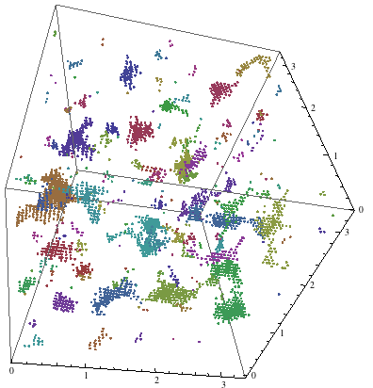

METHODOLOGY
Clustering
Motivation
Show the viability to separate the different key sounds using unsupervised methods.
(Key association using Language models)

Slide 21
INDEX
Project Overview
Context
Methodology
Work plan
Bibliography

Slide 22
WORK PLAN
Achieved so far
Full database generation: Over 2500 labeled keystroke recordings
Automatic segmentation script
MFCC algorithm
Keras+CUDA+cuDNN environment configuration
Clustering algorithm development
Pending
Evaluate the performance of the different feature extraction methods (with SVM)
Train the CNN and evaluate its results
Test the cluster algorithms on real data

Slide 23
INDEX
Project Overview
Context
Methodology
Work plan
Bibliography

Slide 24
BIBLIOGRAPHY
Zhuang, Li, Feng Zhou, and J. Doug Tygar. "Keyboard acoustic emanations revisited." ACM Transactions on Information and System Security (TISSEC) 13.1 (2009): 3.
Calinski, T., and J. Harabasz. "A dendrite method for cluster analysis." Communications in Statistics. Vol. 3, No. 1, 1974, pp. 1–27.
Simonyan, Karen, and Andrew Zisserman. "Very deep convolutional networks for large-scale image recognition." arXiv preprint arXiv:1409.1556 (2014).

Slide 25
THANKS FOR
YOUR ATTENTION

