Slide 1
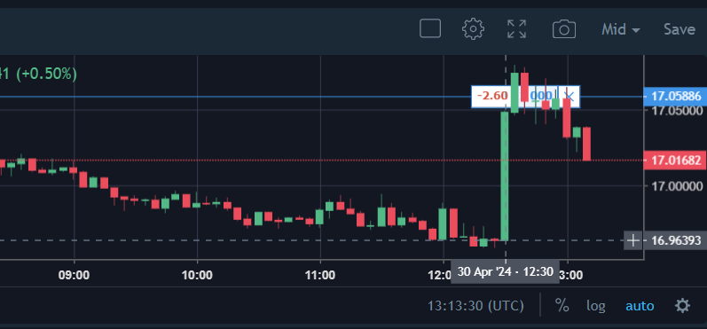
Critical operations:
Closing a trade once it has been decided.
Placing a stop loss when I trade is created.
Monitor Internet Connection.
Stop trade creation after market closes at 5:00 pm NewYork time.
Keep a track of trades
Rules:
1. Bot needs to start with the market 8:30 am NY time or before

Slide 2
Oanda
API
Info scrapper(int rate, FnG, VIX
External
Events
Internet Monitor
Scheduler
Nito
Trade Analyzer
Trade Manager
Orders’
status
AI Modeling
Profit
Controller
Historical Archive
Comms’
Manager
Simulations
Reporting
Manager
Logs
Manager
Nito RT

