Slide 1
Gating

Slide 2
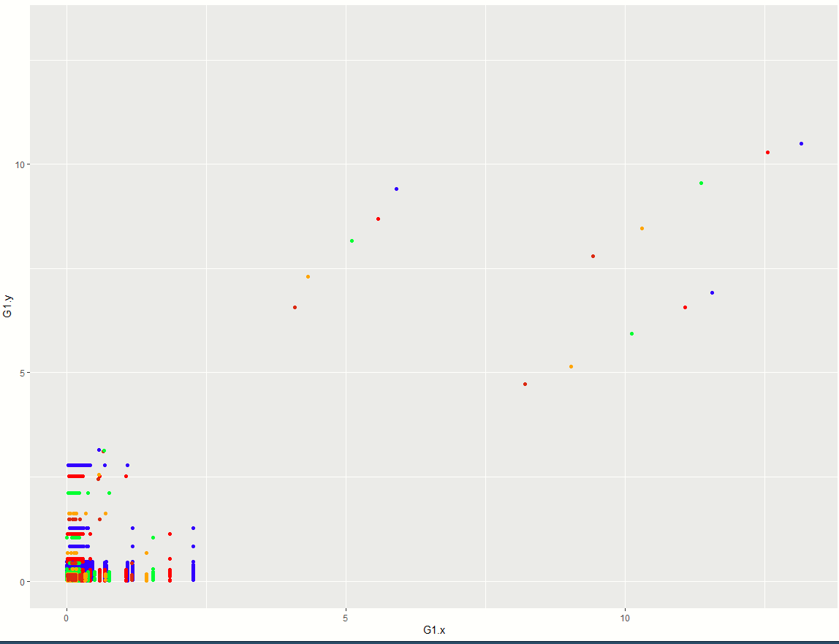

Slide 5
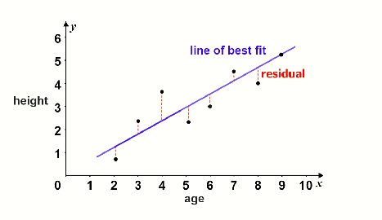

Slide 6
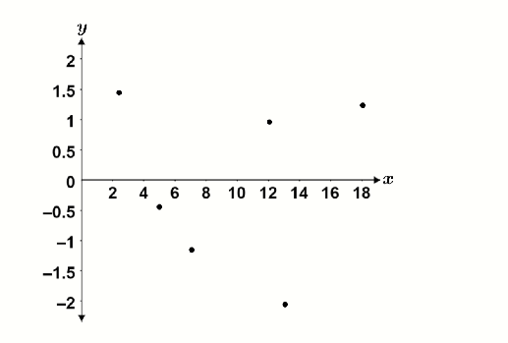
The resulting residual plot is shown in the figure below:

Slide 8
Avg
Avg
Avg
Avg
Avg

Slide 9
Avg
Avg
Avg
Avg
Avg

Slide 10
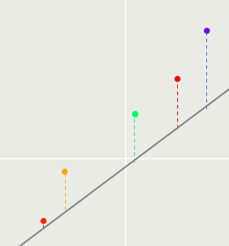

Slide 12
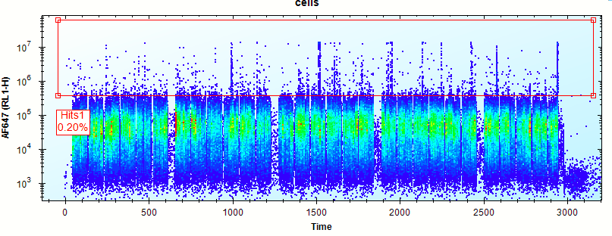

Slide 13
15%
ZZ

Slide 14
15%
ZZ

Slide 15
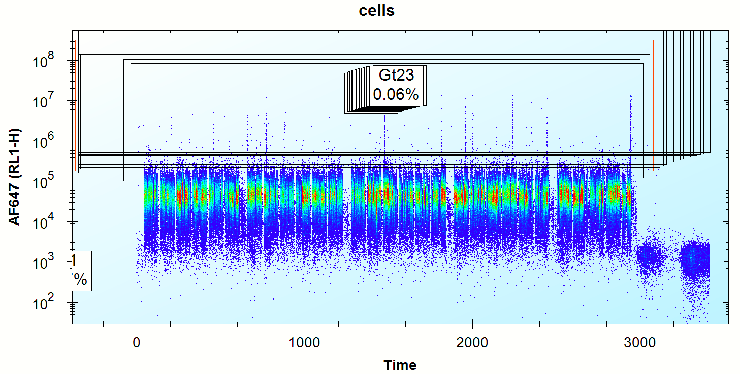
Automate Gate Selection
1 Gate
23 Gates

Slide 16
Automate Gate Selection
23 Gates
1 Gate

Slide 17
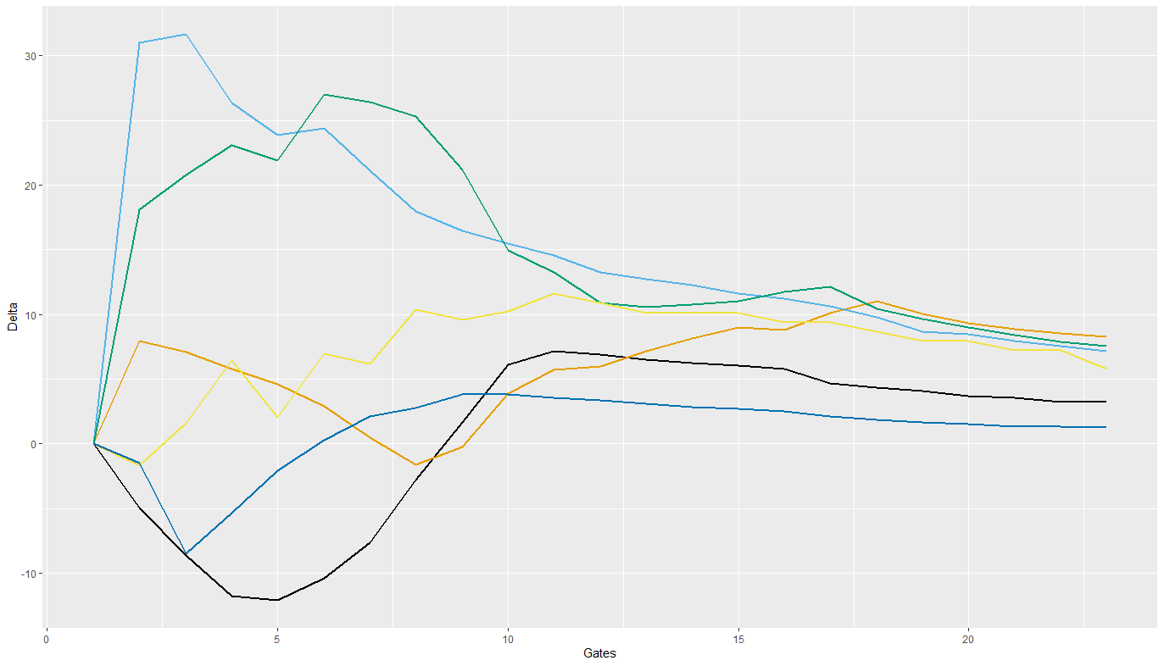
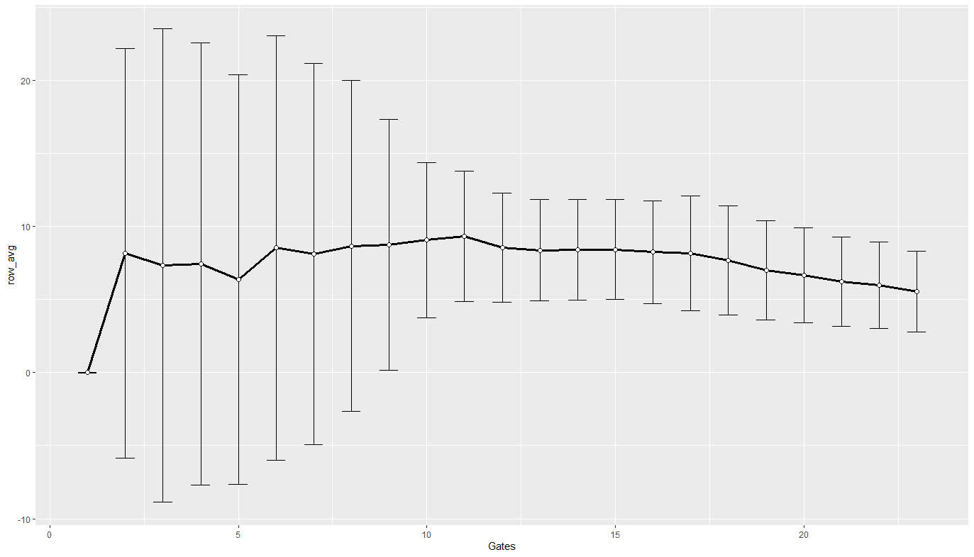
10% step Gating (pUC – ZZ)
All Data
Avg

Slide 18
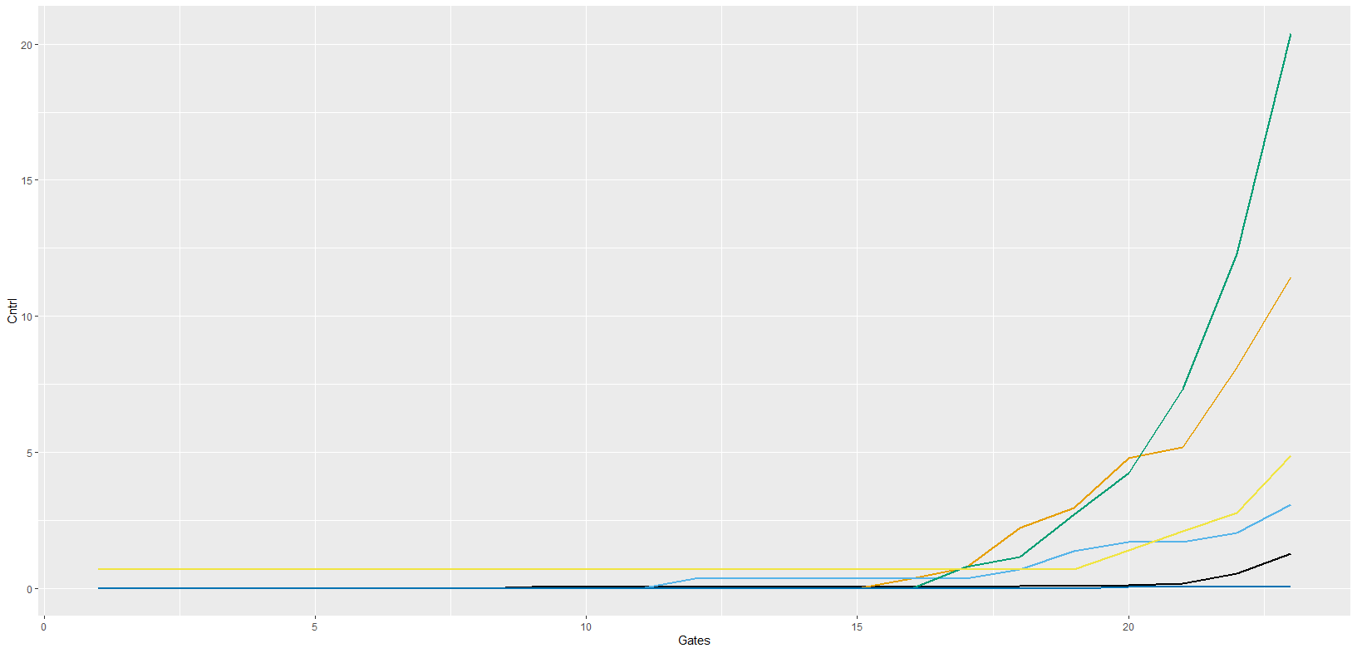
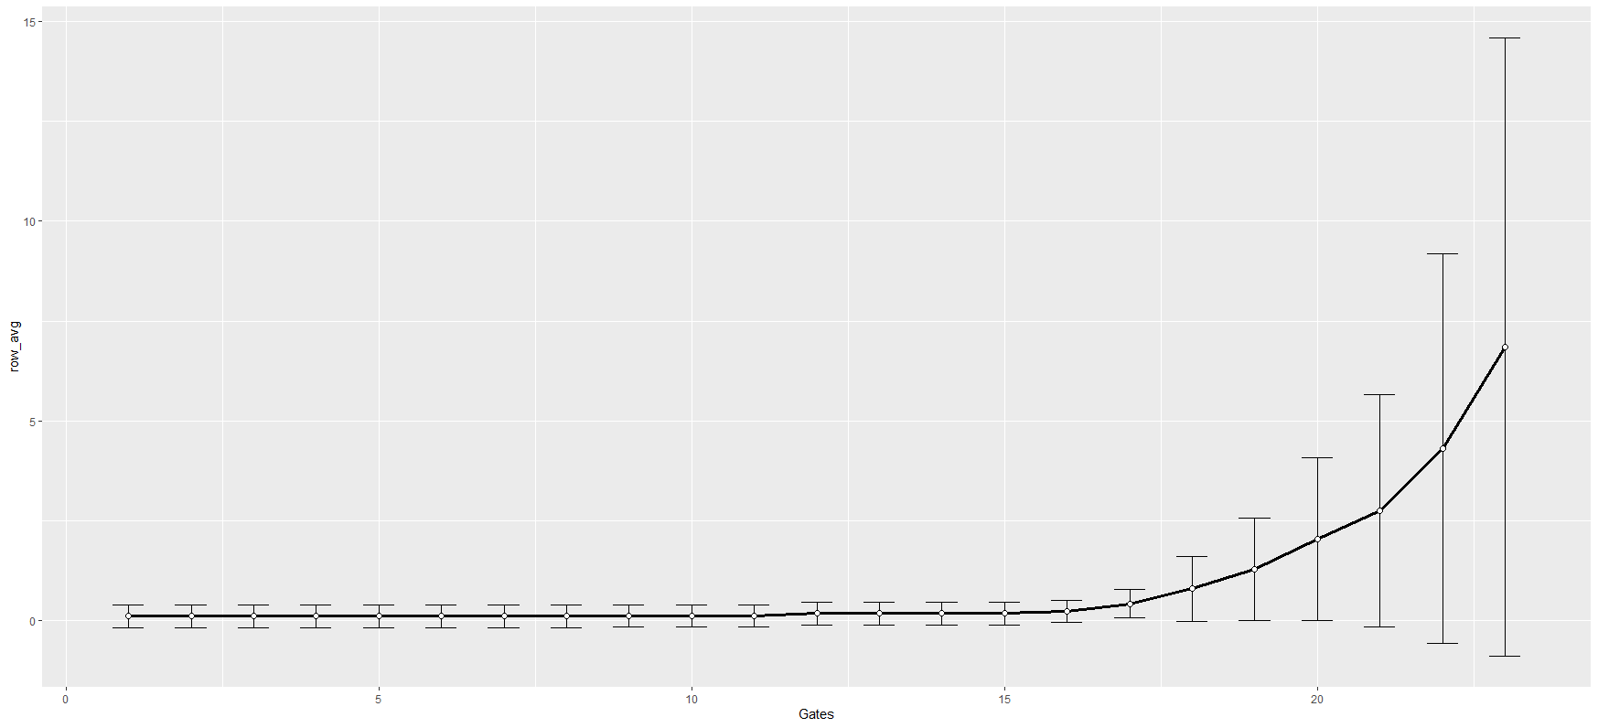
Equal steps Gating pUC Growth

Slide 19
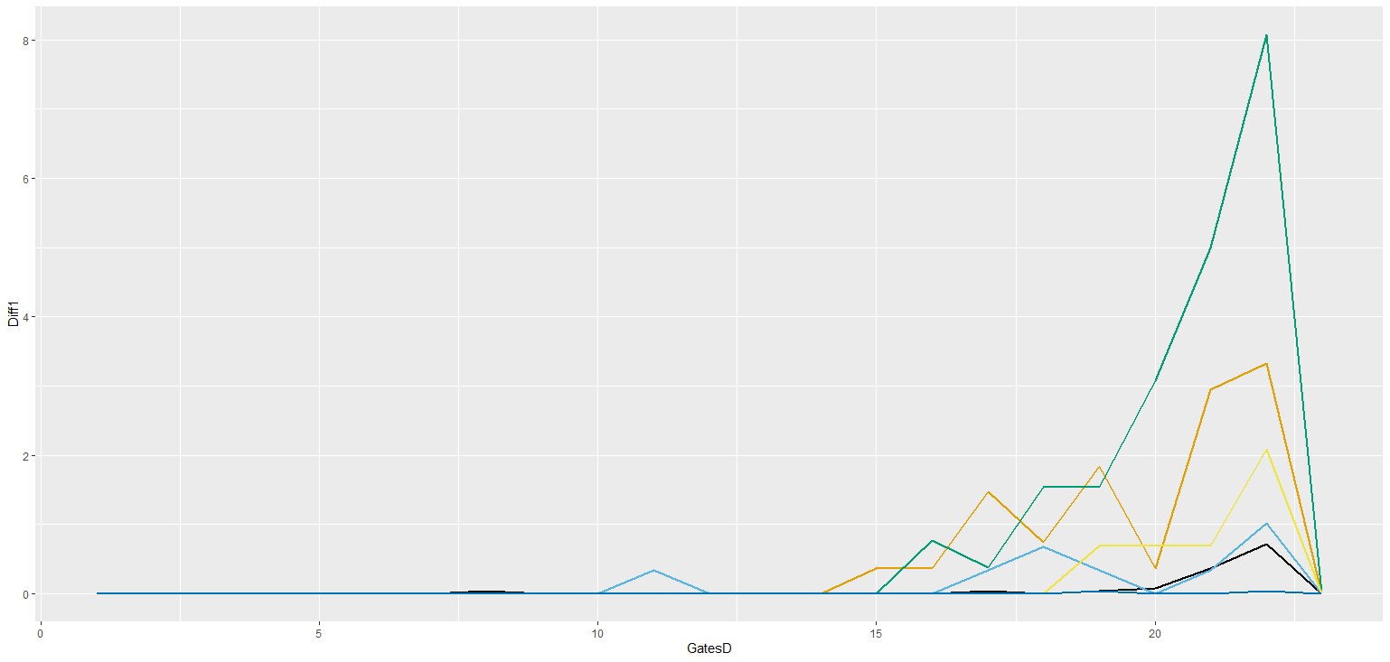
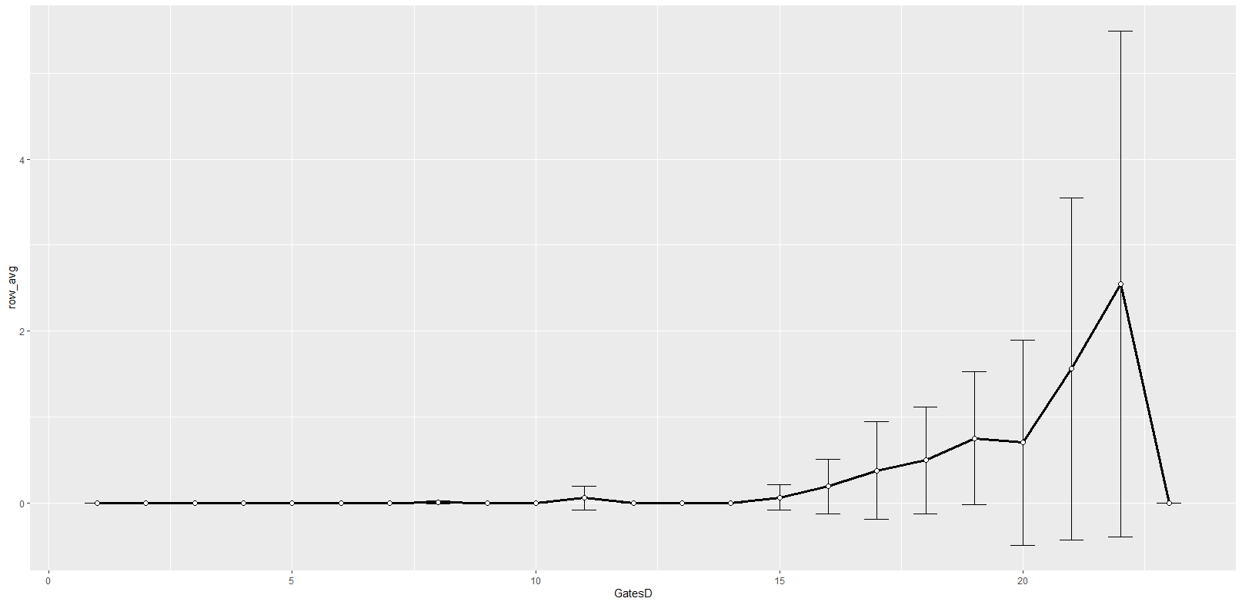
Equal steps Gating pUC speed growth

Slide 20
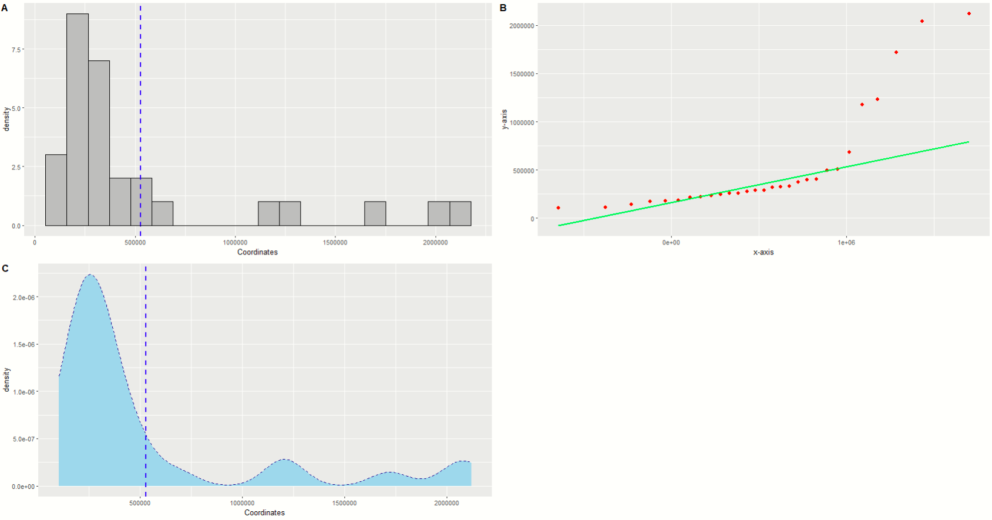
Data Distribution

Slide 21
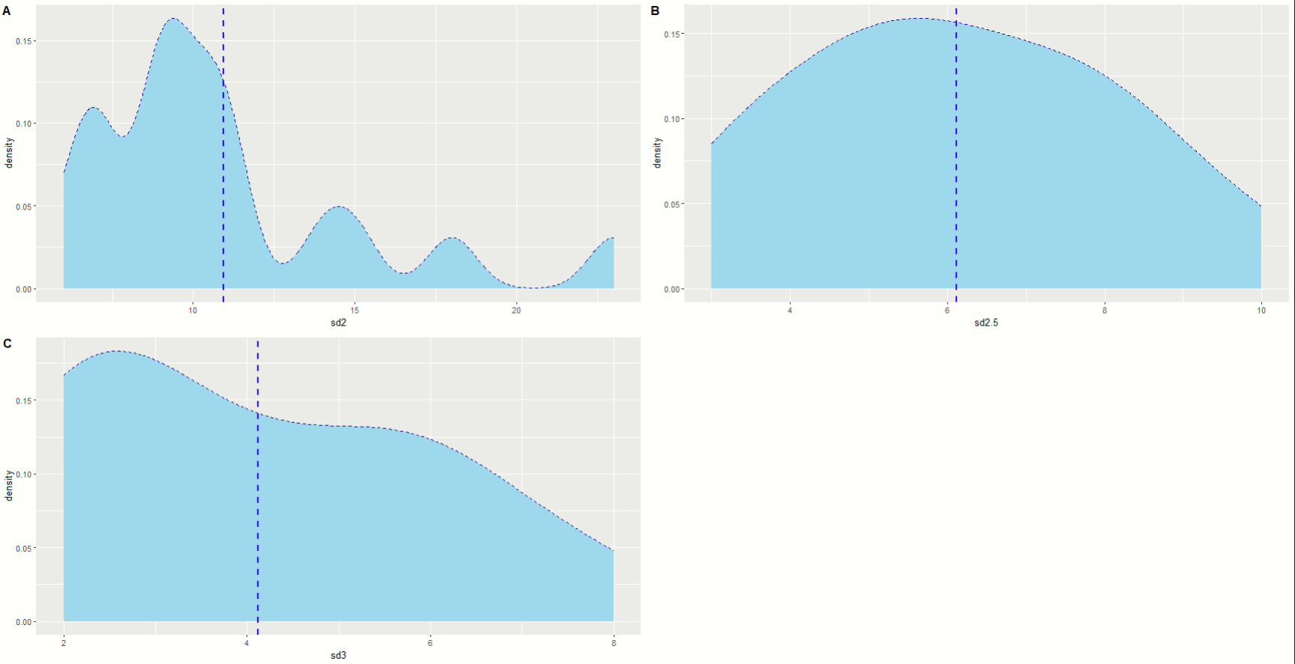
Data Distribution – Above Threshold

Slide 22
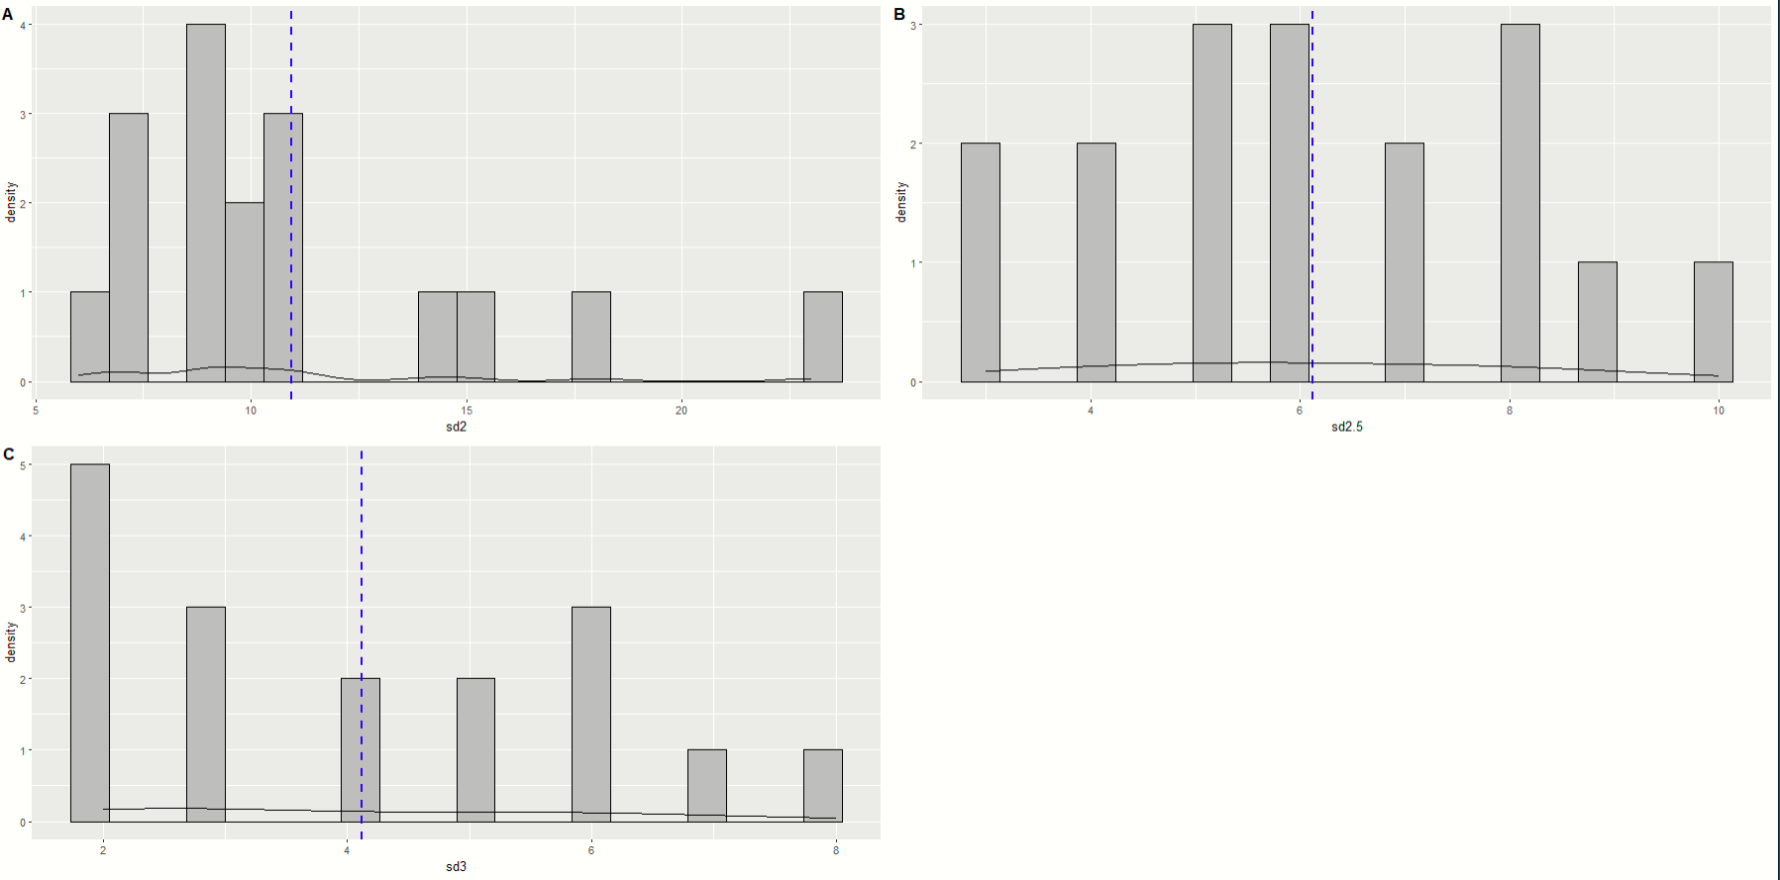
Data Distribution – Above Threshold

Slide 23
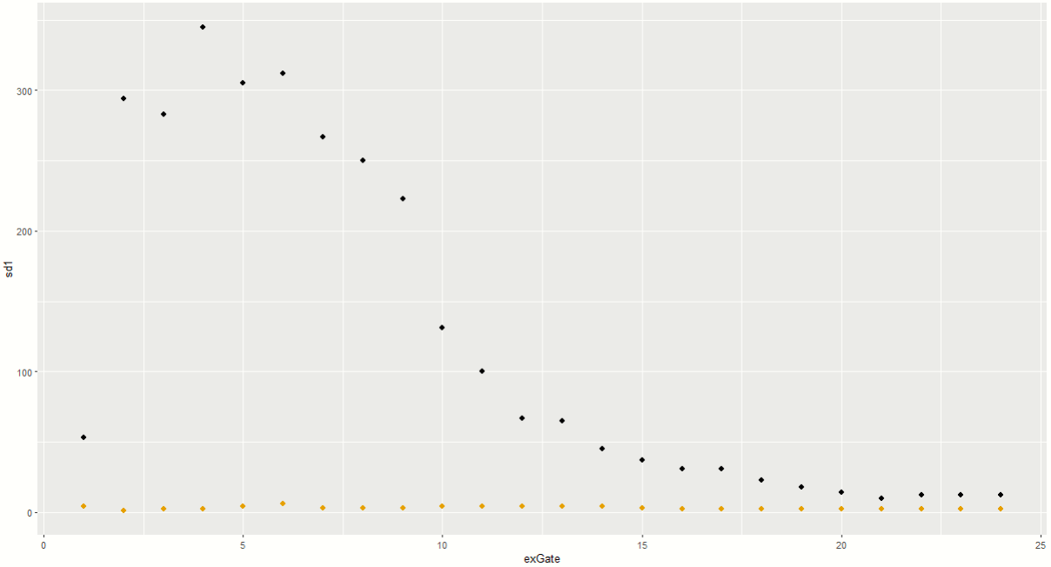

Slide 24
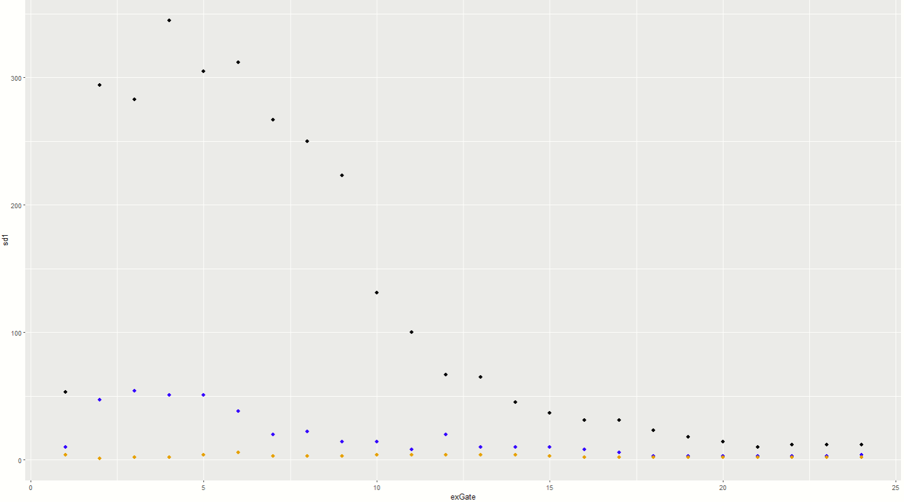

Slide 25
# Hits above Threshold
(1SD, 2SD & 3SD)
Manual Gating
Similar Gate

Slide 26
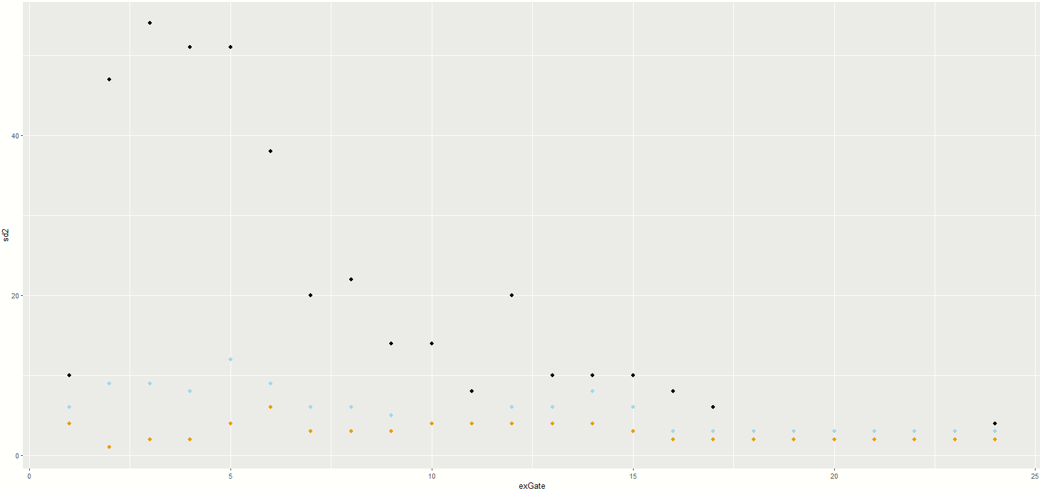
# Hits above Threshold
(2SD, 2.5SD & 3SD)
Manual Gating
Similar Gate

Slide 27
# Hits above Threshold
(2SD, 2.5SD & 3SD)
Similar Gate
Manual Gating

Slide 28
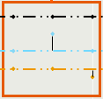
# Hits above Threshold
(2SD, 2.5SD & 3SD)
Similar Gate
Manual Gating

Slide 29
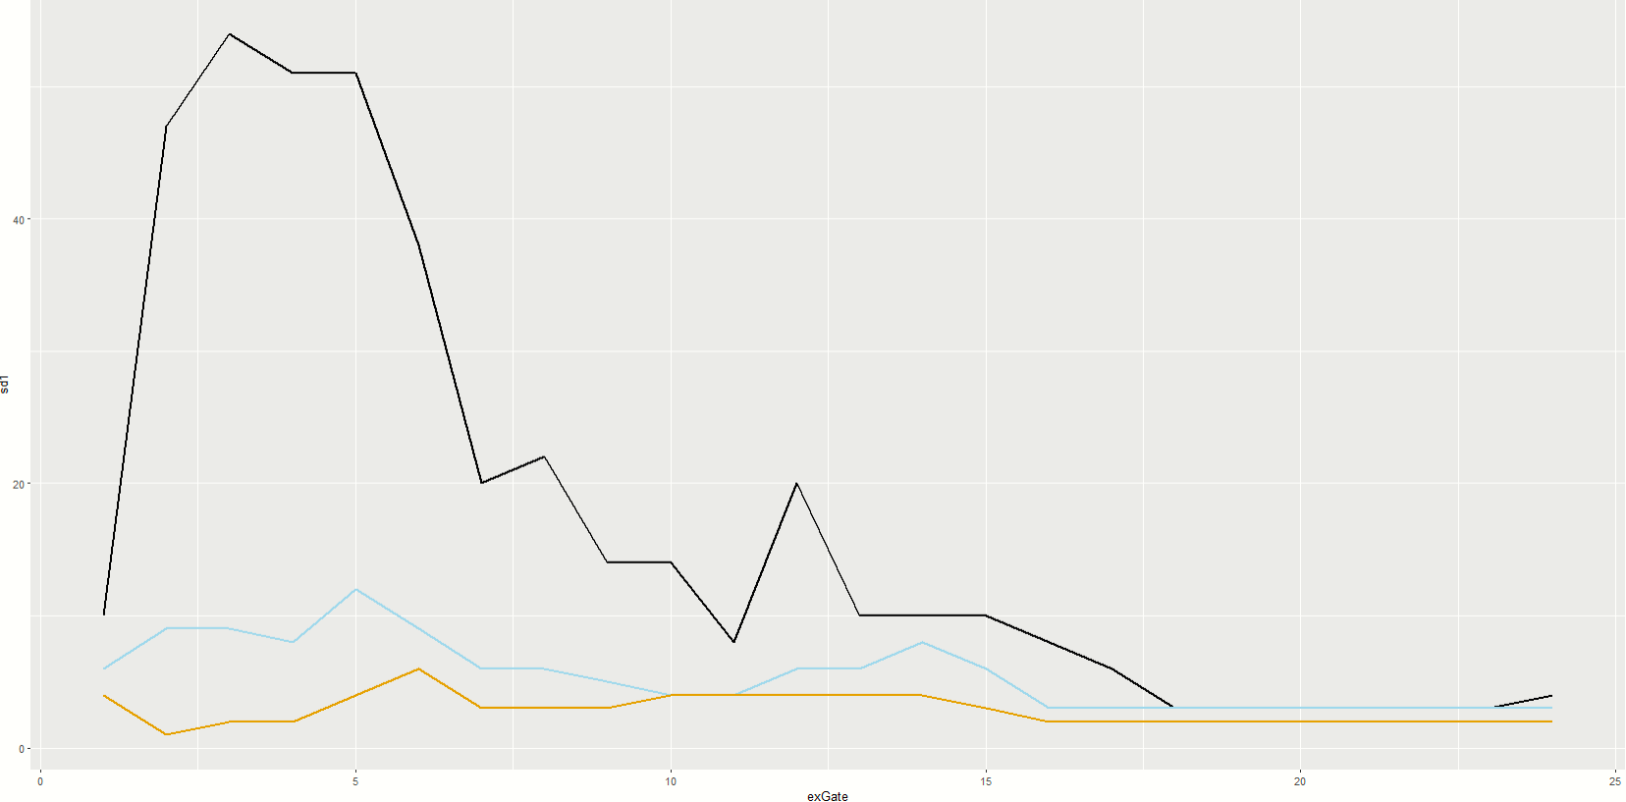

Slide 30
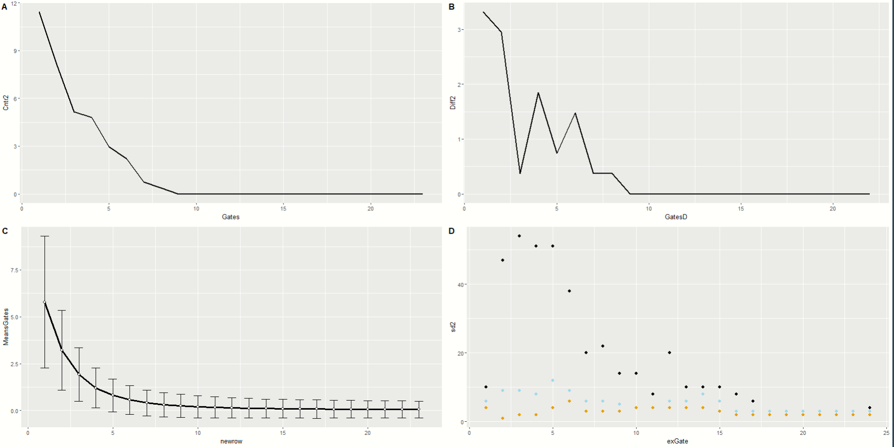
AZ_01

Slide 31
AZ_01
Threshold Gating
Threshold Gating
Threshold Gating
Manual Gating
Threshold Gating

Slide 32
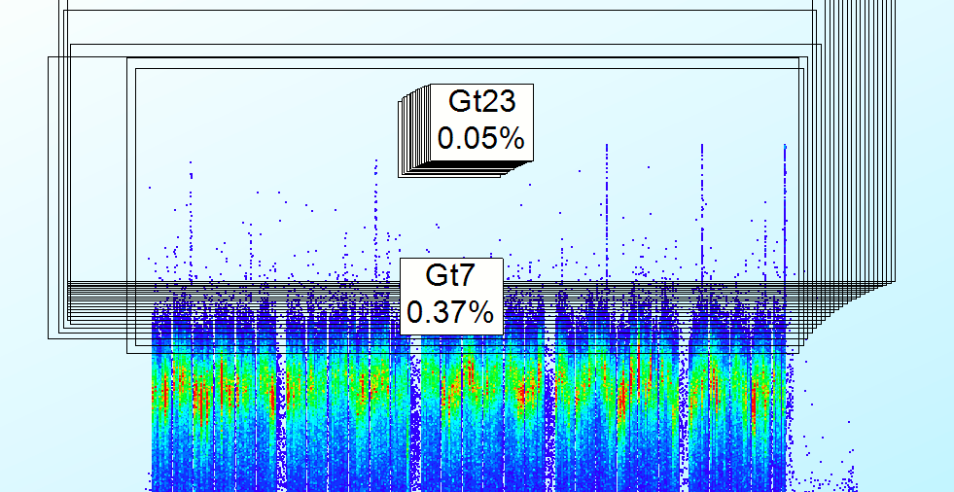
AZ_01
Threshold Gating
Threshold Gating
Threshold Gating
Manual Gating
Threshold Gating

Slide 33
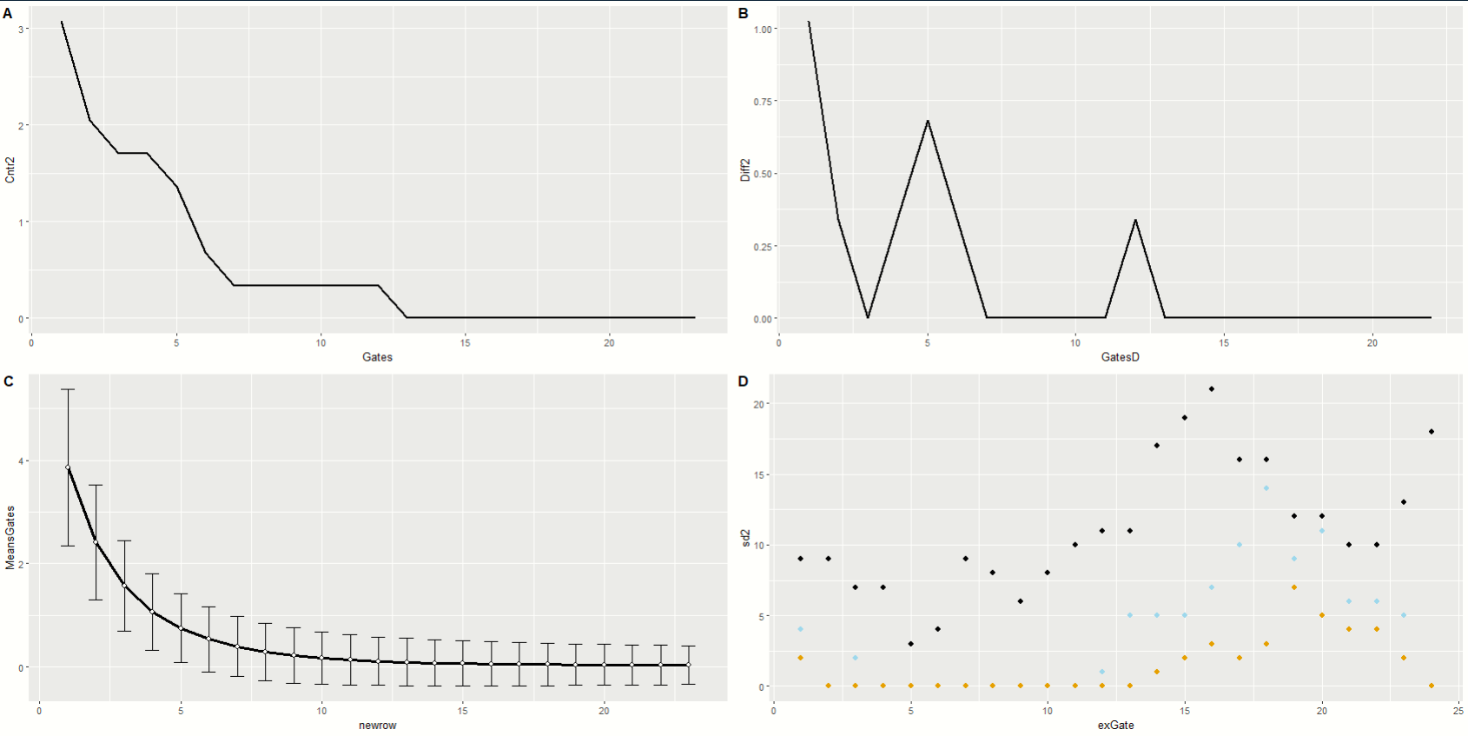
AZ_03
Threshold Gating
Threshold Gating
Threshold Gating
Threshold Gating
Manual Gating

Slide 34
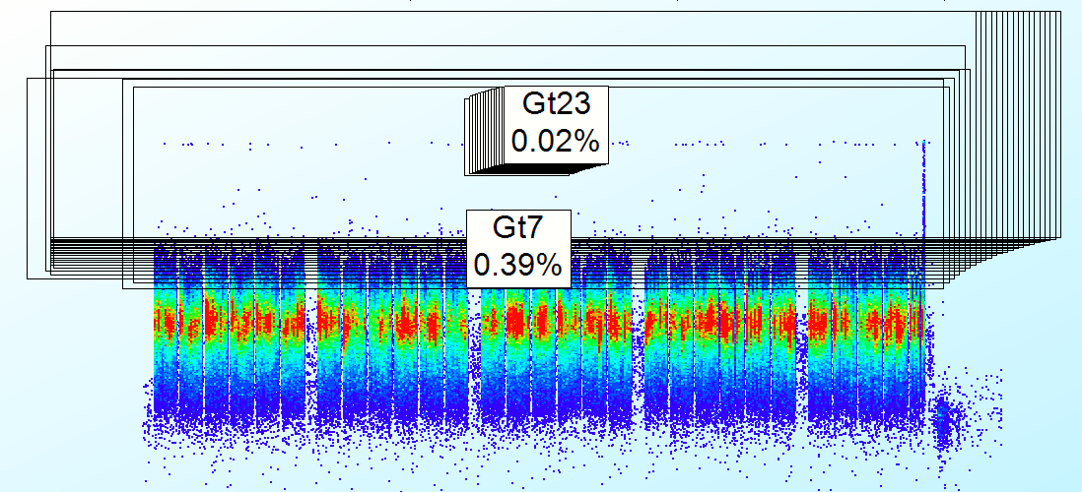
AZ_03
Threshold Gating
Threshold Gating
Threshold Gating
Threshold Gating
Manual Gating

Slide 35
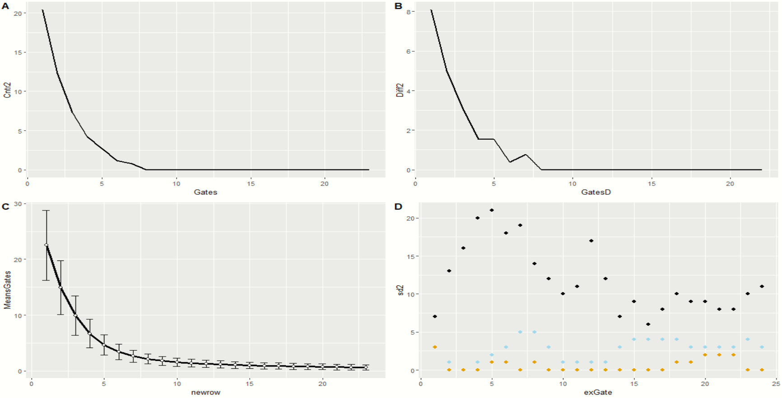
AZ_04
Threshold Gating
Threshold Gating
Manual Gating
Threshold Gating
Threshold Gating

Slide 36
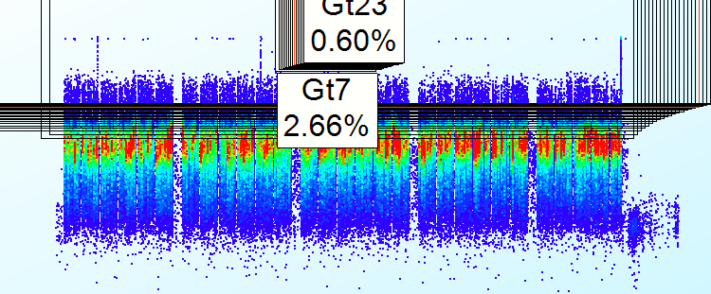
AZ_04
Threshold Gating
Threshold Gating
Manual Gating
Threshold Gating
Threshold Gating

Slide 37
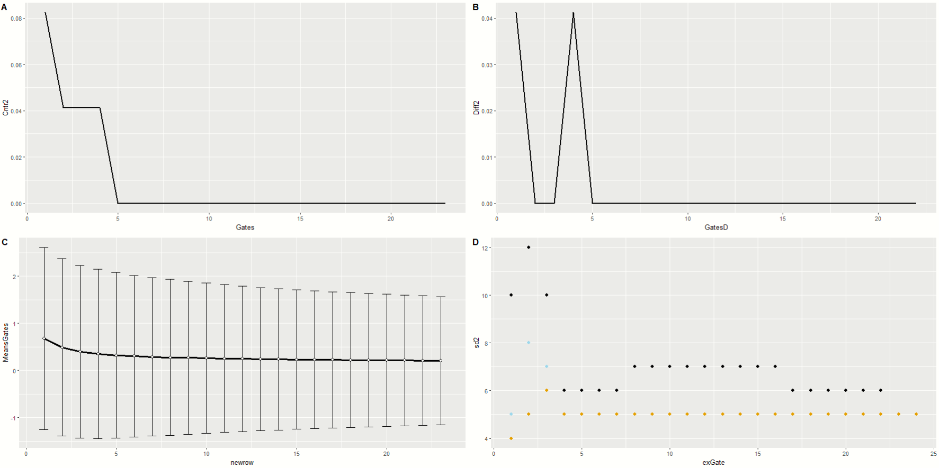
AZ_07
Threshold Gating
Threshold Gating
Threshold Gating
Manual Gating
Threshold Gating

Slide 38
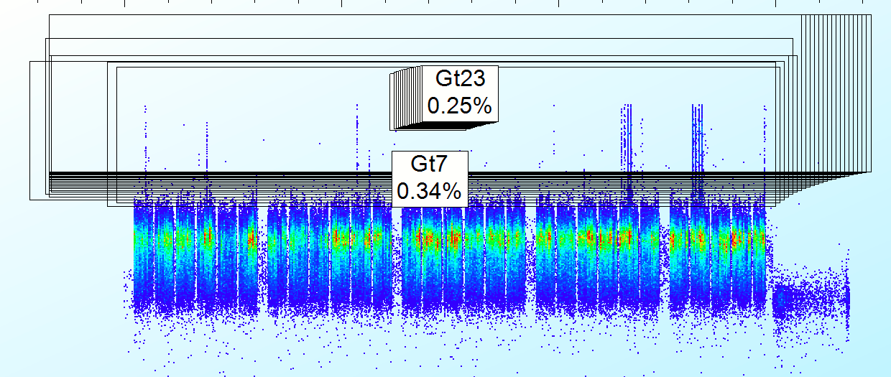
PARA_01
Threshold Gating
Threshold Gating
Threshold Gating
Manual Gating
Threshold Gating

Slide 39
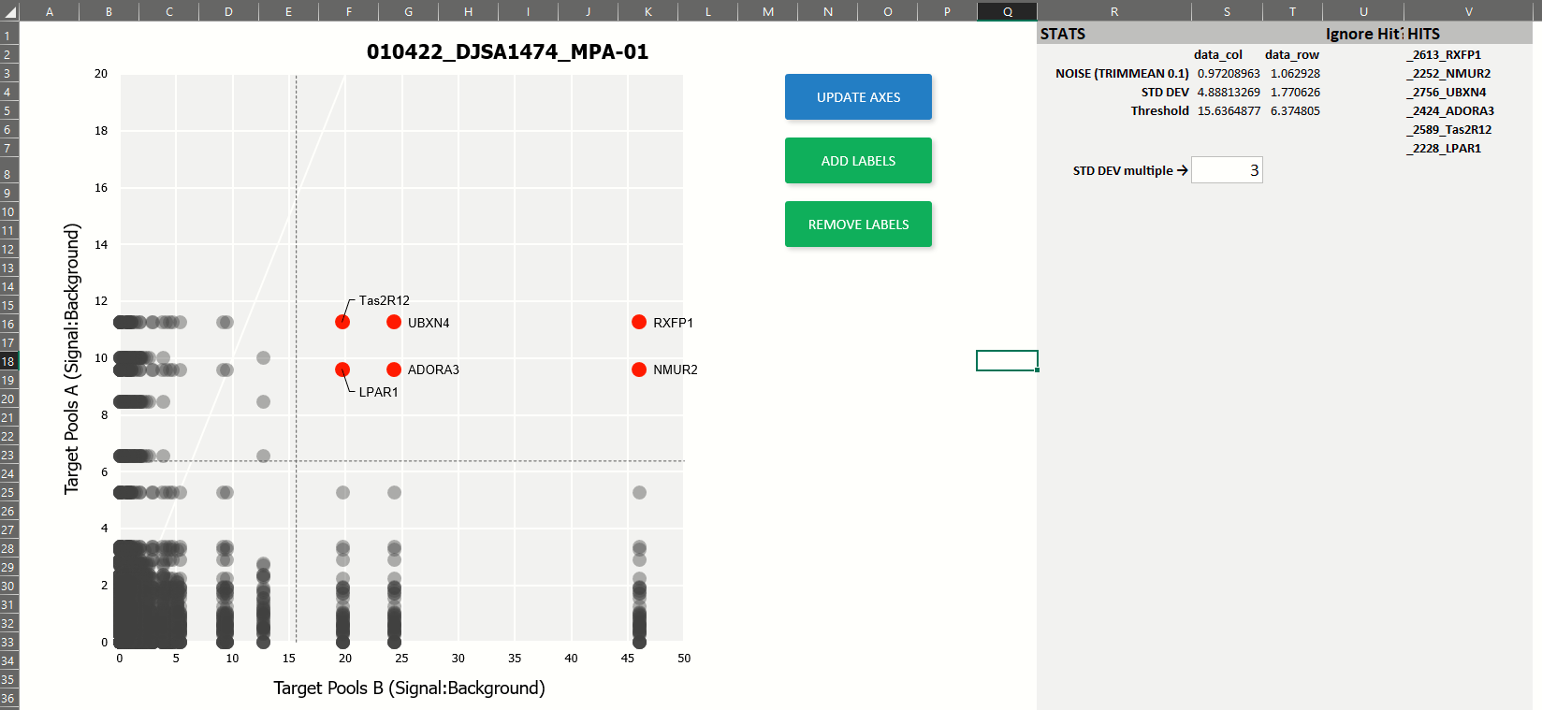

Slide 41
Gate Coordinate Range
23 Gates?
# Gates?
Linear or Logarithmic?
1 Gate

Slide 42
Gating Analysis Decision
Threshold Gating
Threshold Gating
Threshold Gating
Manual Gating
Threshold Gating

Slide 43
2D Analysis Graph
Avg of the hits in the range of gates
SD of the hits in the range of gates
Direction that the gates are going
If in Threshold SD add info but keep gray
If below Threshold size is smaller
Average of Threshold
SD of Threshold
Make the size little and gray

Slide 44
2D Analysis Graph
Avg of the hits in the range of gates
SD of the hits in the range of gates
Direction that the gates are going
If in Threshold SD add info but keep gray
If below Threshold size is smaller
Average of Threshold
SD of Threshold
Make the size little and gray

Slide 45
Legends
RawData
Data
AllGates
R Process
R Shiny
Make graph for Gate selection
Graphs
Dummy Growth & Speed
Avg Growth & Speed
Interactive
Recommended Gates
Manually select range
Min - Max
Manually select # of gate
Give Recommendation for Gate Range
4* Gates
2 - Above when speed is 0
2 - +5 Gates above before
* 4 Gates was randomly picked. It can be more than 4
or
2D Graphs
Avg points
Avg Threshold
Make 2D Graph with 4 gates
2 Graphs
Interactive
Changeable SD for the Threshold
Manually select range
Min - Max
In-depth Hits Graphs
Avg points
SD per point
Vector for directions per gating
Avg Threshold

Slide 46



Slide 47
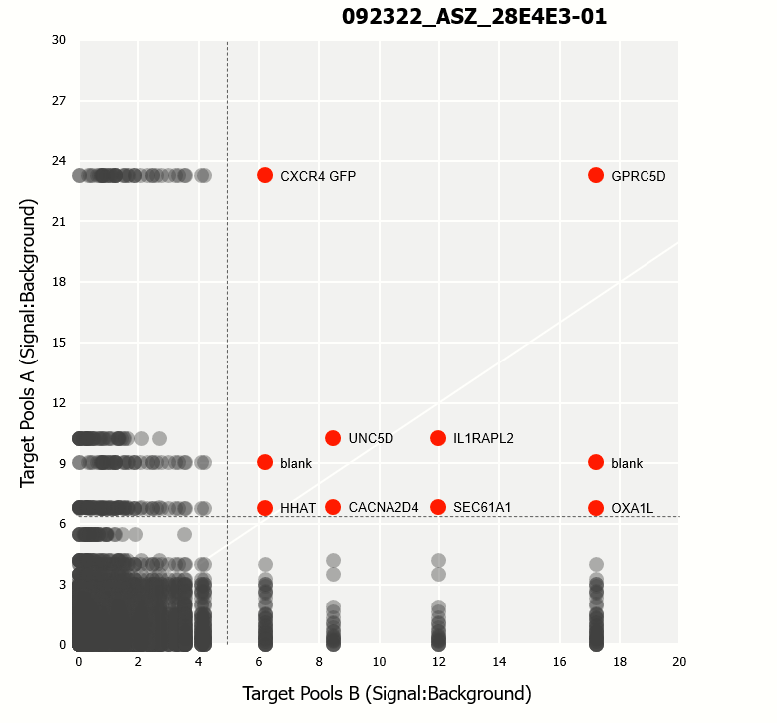

Slide 49
A
1
2
3
4
5
6
7
8
9
10
11
12
13
14
15
16
17
18
19
20
21
22
23
24
B
C
D
E
F
G
H
I
J
K
L
M
N
O
P

