Slide 1
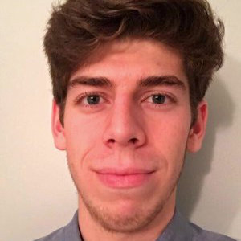
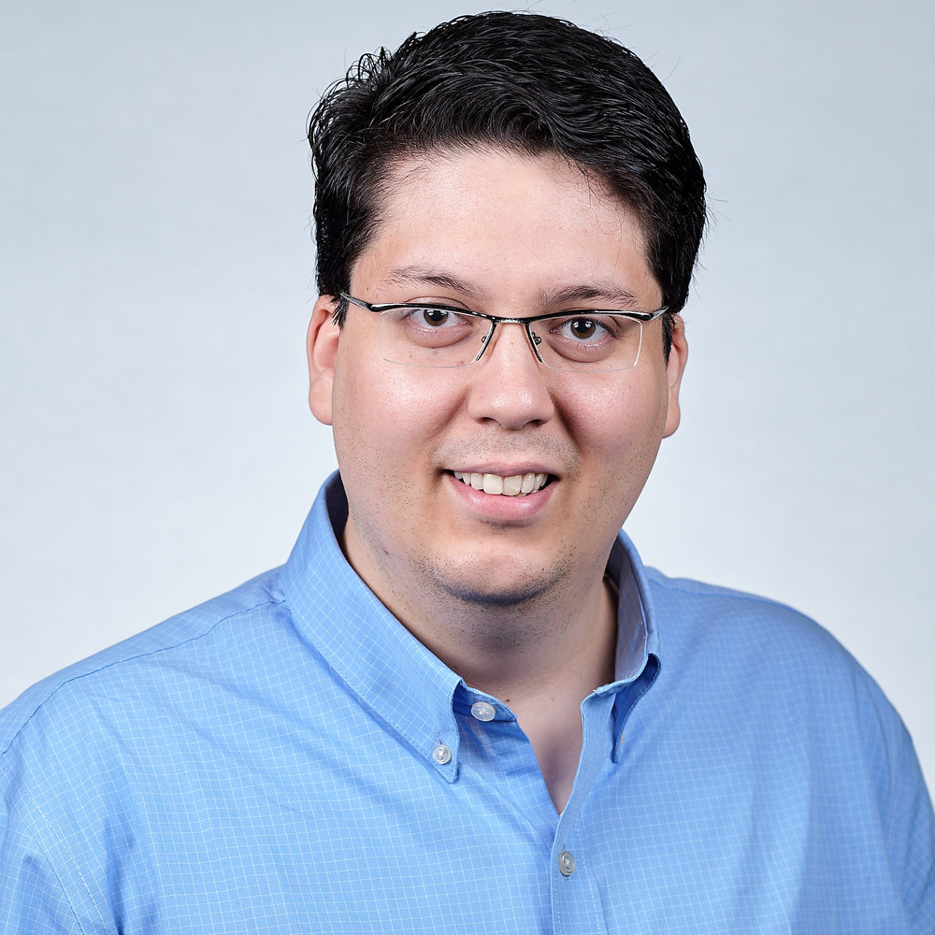
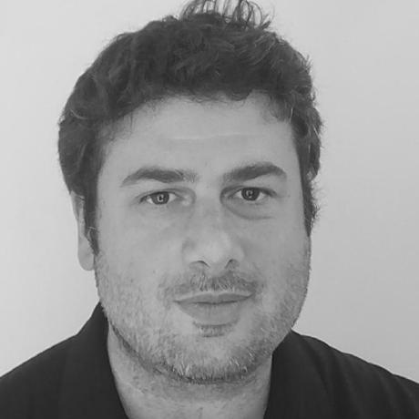




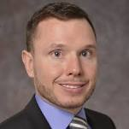
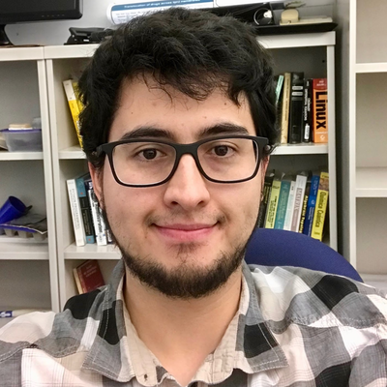
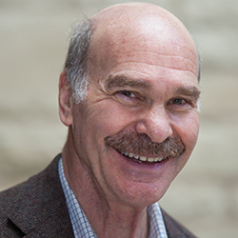
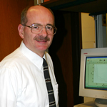
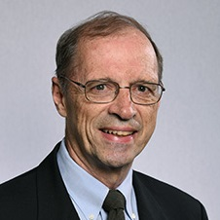

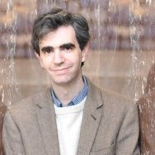





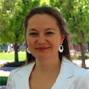
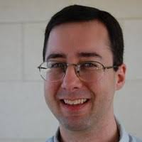
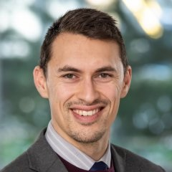
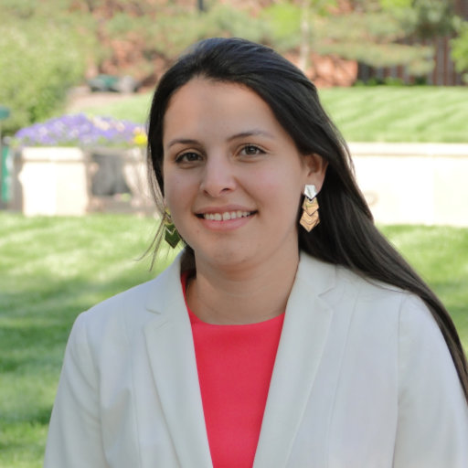
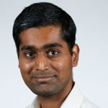


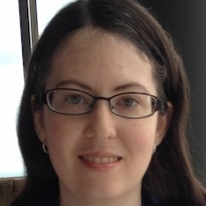
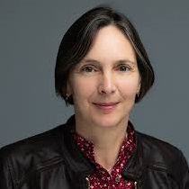
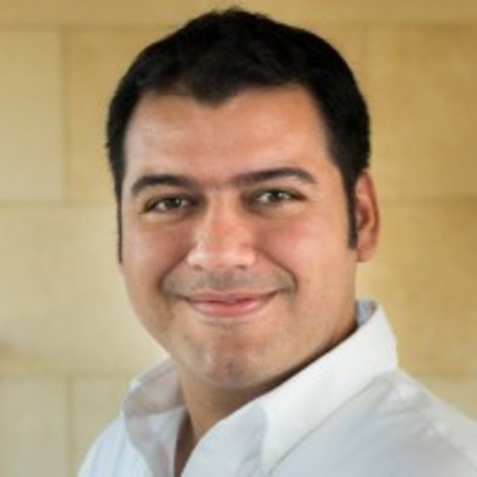

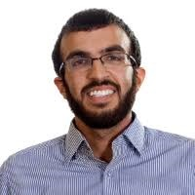

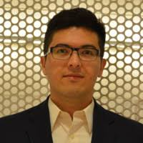
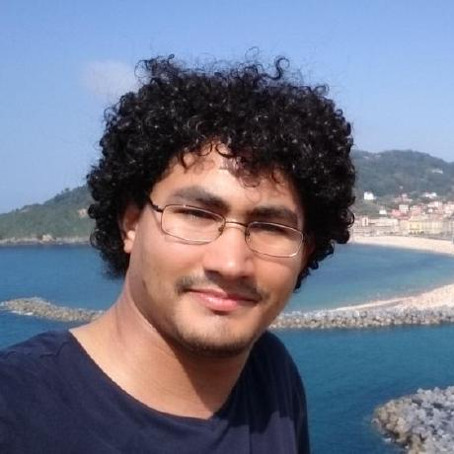
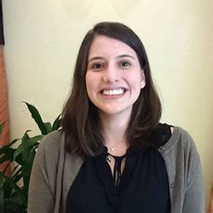
Matthew Tamasi
Scientific
Connections
A.A. Correa
X.I. Andrade
M.A. Ratner
Adam J. Gormley
P.B. Shepson
D.R. McMillin
M.A. Mosquera
G.C. Schatz
A. Wasserman
C.D. Sherrill
L.V. Slipchenko
L.A. Burns
M.A. Webb
L.I. Mosquera
P.K. Gurunathan
B.J. Kippelen
B.W Bakr
L.S. Taylor
V.A. Rodríguez
C.A. Arango
D.R. Nascimiento
A.A. Alenaizan
J.C. Arce
J.F. Rivera
C.I. Víquez Rojas
B.S. in Chemistry
Young Researcher and Innovator
Ph. D. in Chemistry
Postdoctoral Fellow
Chemistry & Biochemistry
Postdoctoral Research Associate
Chemical & Biological Engineering
2004 – 2009
2009 – 2012
2012 – 2017
2017 – 2020
2020 –

Slide 2
Scientific
Connections
A.A. Correa
X.I. Andrade
M.A. Ratner
P.B. Shepson
D.R. McMillin
M.A. Mosquera
G.C. Schatz
A. Wasserman
C.D. Sherrill
L.V. Slipchenko
L.A. Burns
M.A. Webb
L.I. Mosquera
P.K. Gurunathan
B.J. Kippelen
B.W Bakr
L.S. Taylor
V.A. Rodríguez
C.A. Arango
D.R. Nascimiento
A.A. Alenaizan
J.C. Arce
J.F. Rivera
C.I. Víquez Rojas
B.S. in Chemistry
Young Researcher and Innovator
Ph. D. in Chemistry
Postdoctoral Fellow
Chemistry & Biochemistry
Postdoctoral Research Associate
Chemical & Biological Engineering
2004 – 2009
2009 – 2012
2012 – 2017
2017 – 2020
2020 –

