Slide 1
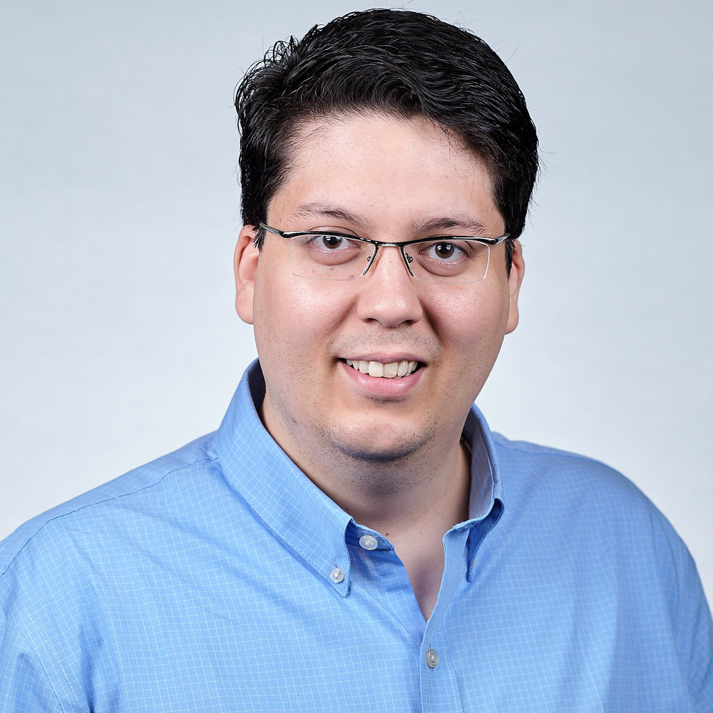
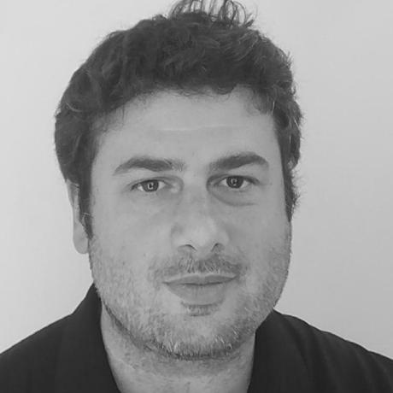

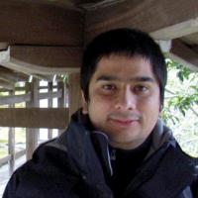

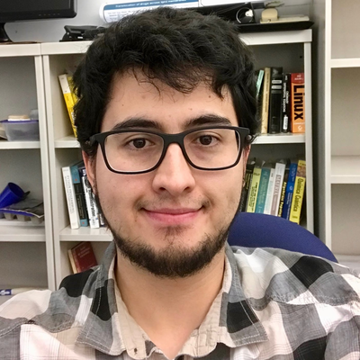
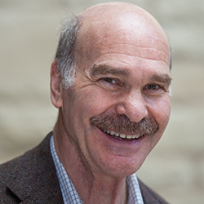
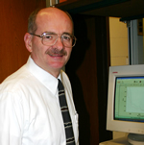
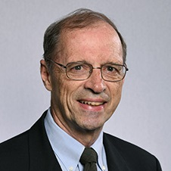

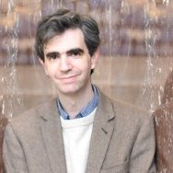





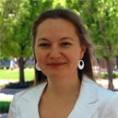
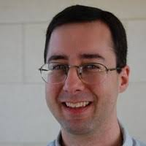
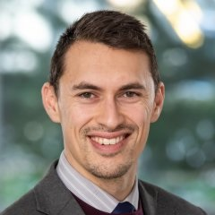
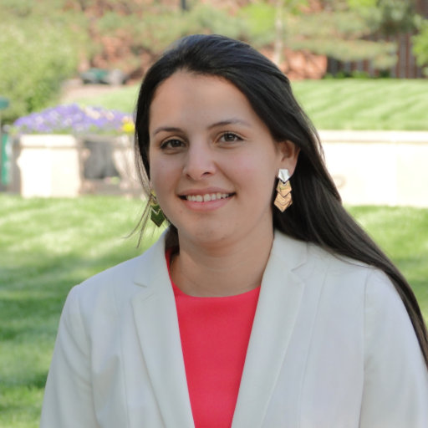
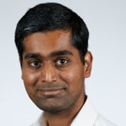
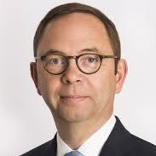
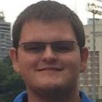
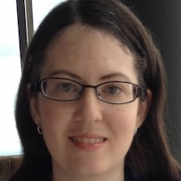
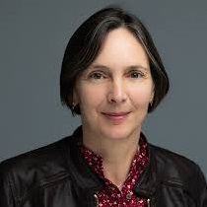
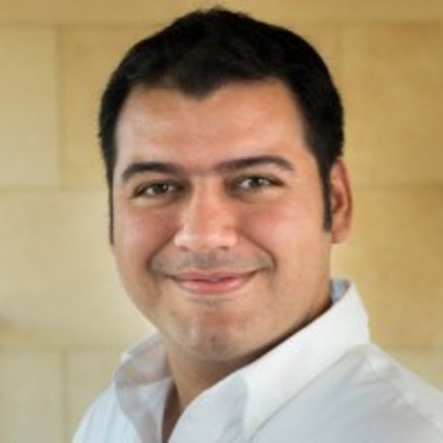
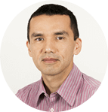
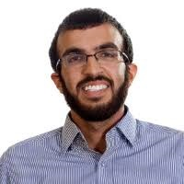

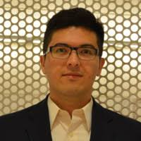
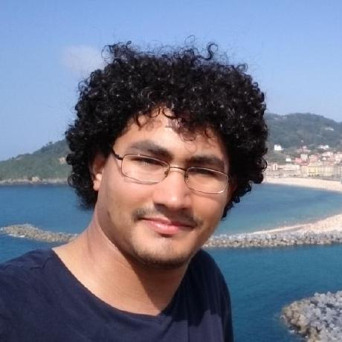
Scientific
Conections
A.A. Correa
X.I. Andrade
M.A. Ratner
P.B. Shepson
D.R. McMillin
M.A. Mosquera
G.C. Schatz
A. Wasserman
C.D. Sherrill
L.V. Slipchenko
L.A. Burns
M.A. Webb
L.I. Mosquera
P.K. Gurunathan
B.J. Kippelen
B.W Bakr
L.S. Taylor
V.A. Rodríguez
C.A. Arango
D.R. Nascimiento
A.A. Alenaizan
J.C. Arce
J.F. Rivera
B.S. in Chemistry
Young Researcher and Innovator
Ph. D. in Chemistry
Postdoctoral Fellow
Chemistry & Chemistry
Postdoctoral Research Associate
Chemical & Biological Engineering
2004 – 2009
2009 – 2012
2012 – 2017
2017 – 2020
2020 –

