Slide 1
Carlos H. Borca
Theoretical and Computational Chemist

Slide 2
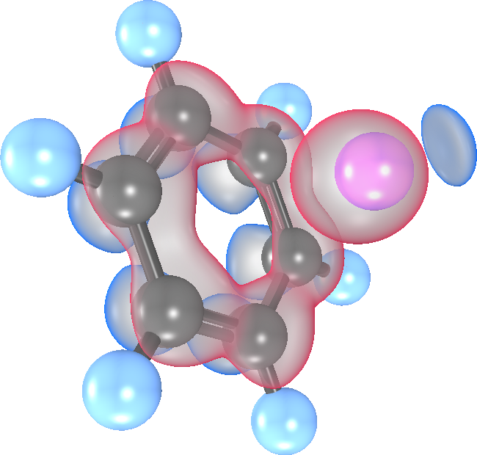
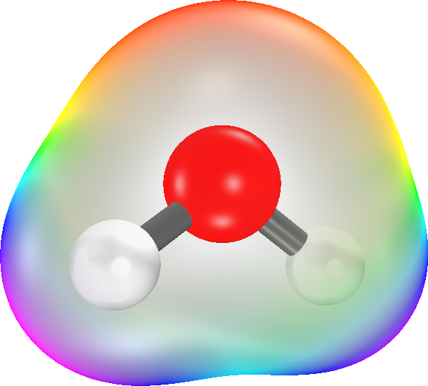
Carlos H. Borca
Theoretical and Computational Chemist

