Slide 2
Carlos H. Borca
Theoretical and Computational Chemist

Slide 3
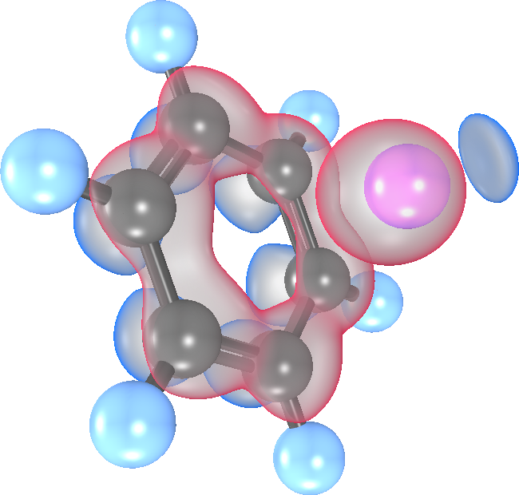
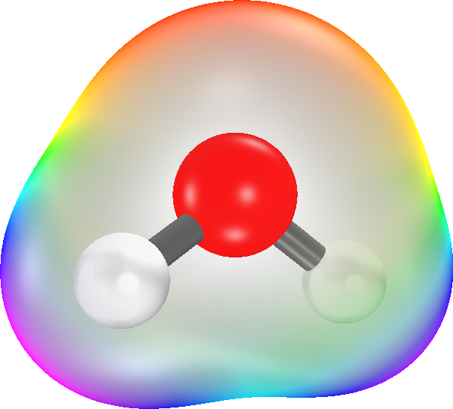
Carlos H. Borca
Theoretical and Computational Chemist

Slide 4
Carlos H. Borca
Theoretical and Computational Chemist

Slide 5
Carlos H. Borca
Theoretical and Computational Chemist

