Slide 1
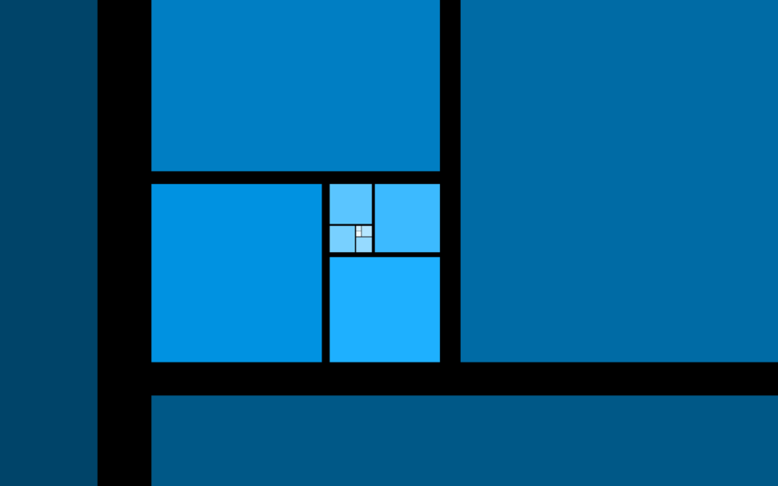
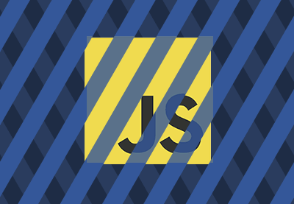

Design patterns in

Slide 2
Agenda
What is a pattern & anti-pattern?
Why do we need them?
Presentation of some of them (most common?)
Small discussion.
Examples (some code :S ).
*Share some (good?)sources
* Some ES6 as well

Slide 3
1. What is a pattern?
Proven solutions.
Can be easily reused.
Can be expressive.
Notes:
Patterns are proven solutions: They provide solid approaches to solving issues in software development using proven techniques that reflect the experience and insights the developers that helped define them bring to the pattern.
Patterns can be easily reused: A pattern usually reflects an out of the box solution that can be adapted to suit our own needs. This feature makes them quite robust.
Patterns can be expressive: When we look at a pattern there’s generally a set structure and vocabulary to the solution presented that can help express rather large solutions quite elegantly.

Slide 4
Important!
Patterns are not an exact solution.
They do not replace good software designers, however, they do support them.
They are (cool) tools.

Slide 5
What is an anti-pattern?
A lesson that has been learned.
Notes:
- Describe a bad solution to a particular problem which resulted in a bad situation occurring.
- Describe how to get out of said situation and how to go from there to a good solution

Slide 6



“The form and(vs?) the context”
Code maintainability
“The form is the solution to the problem;
the context defines the problem”.

Slide 7
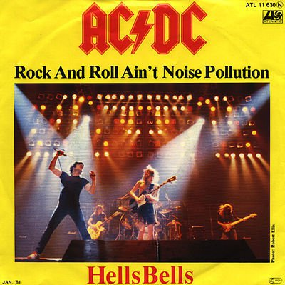
Anti-patterns examples
Extending Object Prototype*.
Pollution of the Global Namespace.
Overblown filtering*
* See code examples

Slide 8
2. Why do we need them?
Code maintainability.
Communication.
Intention.
Code re-use.
Less code.
Tested solutions.
Notes:
Code maintainability: Allows your code to be maintained easier because it is more understandable.
Communication: They help you communicate design goals amongst programmers.
Intention: They show the intent of your code instantly to someone learning the code.
Code re-use: They help you identify common solutions to common problems.
Less code: They allow you to write less code because more of your code can derive common functionality from common base classes.
Tested and sound solutions: Most of the design patterns are tested, proven and sound.

Slide 9
3. Presentation of some of them
Creational Design Patterns.
Structural Design Patterns.
Behavioral Design Patterns.
Notes:
Creational Design Patterns
Creational design patterns focus on handling object creation mechanisms
Structural Design Patterns
Structural patterns are concerned with object composition and typically identify simple ways to realize relationships between different objects.
Behavioral Design Patterns
Behavioral patterns focus on improving or streamlining the communication between disparate objects in a system.

Slide 10
Bit of context.
Classes?
1Classes?.js

Slide 11
The Constructor Pattern
Object Creation
Properties in objects
Singletons (?)
2ConstructorPattern.js
4Singleton

Slide 12
Module pattern
Object Literals (easy right ☺) ➔ Might have issue with encapsulation.
Modules ➔ further emulate the concept of classes.
Our revealing-module pattern
What the $%^ is a Self-Invoking Anonymous Function
SelfInvokingFunction.js
Notes:
The Module pattern was originally defined as a way to provide both private and public encapsulation for classes in conventional software engineering.

Slide 13
“wiring” our modules (revealing API?)
Module1
Module2
Module4
Module3

Slide 14
PubSub
Module2
PubSub
Module1
Module2
Module3
2PubSub.js

Slide 15
Observer Pattern
Observer List
Subject1
Ob1
Ob2
Subject2
Ob3
Ob4

Slide 16
Other examples:
RxJS -> http://reactivex.io/rxjs/
Mutation Observers -> https://developer.mozilla.org/en-US/docs/Web/API/MutationObserver

Slide 17
Some sources
Addy Osmany (Design Patterns) -> https://addyosmani.com/resources/essentialjsdesignpatterns/book
LearnCode.Academy -> https://www.youtube.com/watch?v=HkFlM73G-hk
Kyle simpson (deep in .js) -> https://github.com/getify/You-Dont-Know-JS
GoF Design Patterns -> Legendary book.

