Slide 1
Selecting and Grouping Data for Analysis
Notes:
Schedule: Timing Topic
60 minutes Lecture
60 minutes Practice
05 minutes Quiz
125 minutes Total

Slide 2
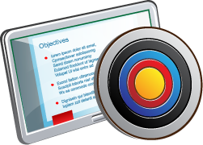
Objectives
After completing this lesson, you should be able to:
  Create and save selections
  Create and save groups and calculated items
Notes:
Oracle BI 12c: Create Analyses and Dashboards 5 - <number>

Slide 3
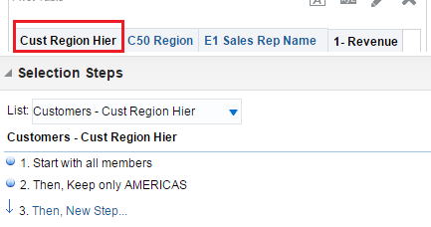


Using Selections to Limit Data in Analysis
Selections limit the display of members for an analysis.
  Only those results that meet selection criteria are shown.
    Members are assembled from selection steps in the order they appear in the Selection pane.
  Selection steps are applied after the query is aggregated.
    Affect only the members displayed, not the resulting values
    Apply to hierarchical columns totals
    Can include groups and calculated items
Select the analysis columns shown in the Selection pane.
Default selection of start with all members of column is added when the column is included in the analysis.
These selection steps sequentially start with all members and keep the “AMERICAS” hierarchical member, excluding the other member regions.
Notes:
Selections are used to limit the members displayed when an analysis is run. Based on the selection steps and criteria that you define, Oracle Business Intelligence shows only those attribute or hierarchical members that match your criteria.
For example, you may have an analysis that searches for your customers and their assigned sales regions and sales representatives. You can use a selection to limit the results of the analysis so that only the AMERICAS region appears in the results while continuing to see the Region total for all regions.
Selections are defined on a per-column basis. Initially, a default selection step containing all attribute or hierarchy members is created when you add a column to the selected columns of an analysis. In this sense, member selections are made whenever you add an attribute or hierarchical column to your analysis. You can then add additional steps and refine the membership criteria to refine your results. Selection steps are used to refine the definition of your query.
Oracle BI 12c: Create Analyses and Dashboards 5 - <number>

Slide 4
Creating Selection Steps
  Create a new step.
  Select the step type.
Notes:
Oracle BI 12c: Create Analyses and Dashboards 5 - <number>

Slide 5
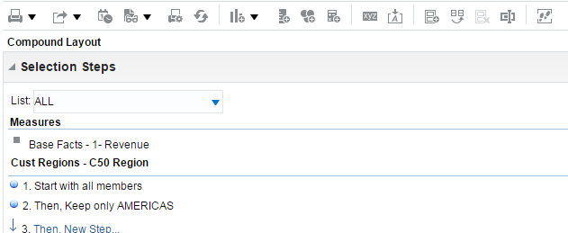








1. Create a New Step
  Use the Selections pane to create and edit selections.
    Available for expansion in the various tabs of the Analysis Editor
    Expand using the Show/Hide Selections Pane button.
  Click the New link in the Selections pane to add a step.
    Steps are evaluated in sequence.
Show/Hide Selections pane
Default selection for the column
Refine list of analysis columns in Selections pane.
Edit step.
Delete step.
Add new step.
Notes:
As you specify data for an analysis, you can create selections. Each selection specifies the criteria for a set of members to be displayed for a particular column. Each selection consists of one or more steps. A step is an instruction that affects the selection, such as keep product members whose values contain the text “ABC” or add members whose revenue is greater than $100,000. The order in which steps are performed affects the members selected, in that each step is applied to the current member set resulting from the previous steps.
You can view and edit the selections pertaining to an analysis by using the Selections pane, which is available in a variety of tabs in the Analysis Editor, including both the Criteria and Results tabs. This allows you to create and refine selections as part of your initial designation of analysis criteria or dynamically in your analysis results. You can create steps by dragging hierarchical column members into your analysis, for example adding members to a pivot table, which would create steps for the relevant members. Alternatively, you can explicitly create a new step by clicking the New link below a column in the Selections pane.
To edit a selection step, place the cursor over it in the Selections pane and click the appropriate icon on the toolbar for the step. You can edit the step in its respective dialog box, delete the step, or change its order in the steps list for the selection.
Oracle BI 12c: Create Analyses and Dashboards 5 - <number>

Slide 6
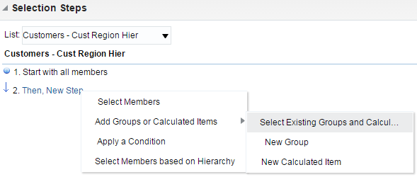


2. Select the Step Type
Depending on the step type, you define different step properties. Step types include:
  Select Members
  Add Groups or Calculated Items
  Apply a Condition
  Select Members based on Hierarchy
Select from Presentation Catalog
Available only for hierarchical columns
Notes:
Selecting from four options:
Select Members: This option displays the New Member Step dialog box, where you can explicitly select members from a list of those available for the attribute or hierarchical column.
Add Groups or Calculated Items: This option allows you to choose either existing groups or calculated items from the Presentation Catalog, or create new ones directly from within the Selections pane. A group can be a list of members or a set of selection steps that can be executed to generate a list of members. A calculated item is a calculation between members, which is represented as a single member. Groups and calculated items are discussed in more detail later in this lesson.
Apply a Condition: This option displays the New Condition Step dialog box, where you can create a condition to determine member qualification using provided templates.
Select Members Based on Hierarchy: This option displays the New Hierarchy Selection Step dialog box, which is used to select members based on level and family relationships.
Oracle BI 12c: Create Analyses and Dashboards 5 - <number>

Slide 7
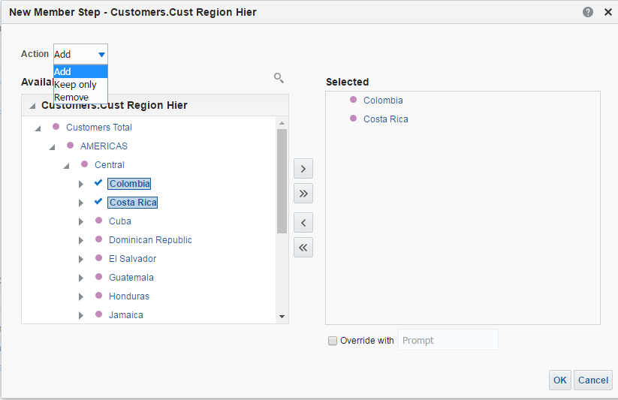





Step Types: Selecting Members
Select members and specify an action for the step.
1
List of selected members
Select members.
3
Check mark indicates that a member is selected.
2
Notes:
In the New Member Step dialog box:
1. Select an action for the member step. You can add the selected members to the selection, keep only the selected members and remove all others, or remove the selected members from the selection. When you edit the default first step in a list, the choices for actions are Start with All Members and Start with Selected Members.
2. In the Available list, select the members that you want to include in the step.
3. Click the Move button to add them to the Selected list of included members.
Oracle BI 12c: Create Analyses and Dashboards 5 - <number>

Slide 8
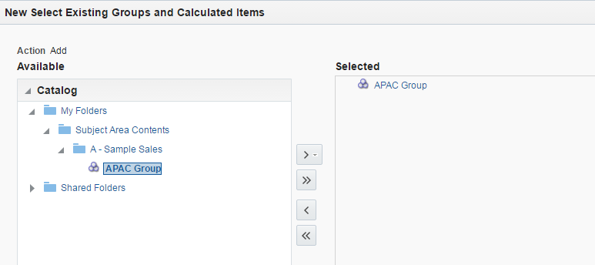
Step Types: Adding Groups and Calculated Items
Add new or existing groups or calculated items.
1
3
2
Notes:
When you choose to add a step using groups or calculated items, you can specify an existing group or item from the Presentation Catalog, as shown in the example in the slide.
1. The only available action when adding groups and calculated items is to add their members to your selection.
2. In the Available list, select the groups or calculated items that you want to include from the Presentation Catalog.
3. Click the Move button to add them to the Selected list of included members.
To create a new group or calculated item, select the respective option in the menu. The New Group or New Calculated Item dialog box appears. Note that until you save a group or calculated item by clicking its link in the Selection pane and selecting the Save As menu item, the group or calculated item is saved only as an implicit (or inline) part of the analysis selection steps.
Set the Override with Prompt option to specify that an analysis prompt or a dashboard prompt can override this member step. In a list of steps for a column, this option should be selected for only one step in the list.
Note that regardless of the step number in the selection, a group still appears at the bottom of the column.
Oracle BI 12c: Create Analyses and Dashboards 5 - <number>

Slide 9
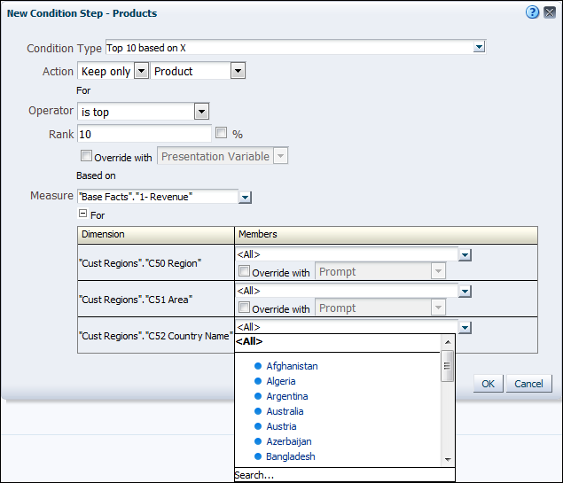
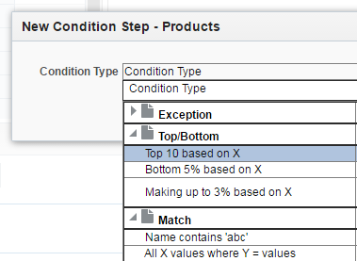




Step Types: Applying Conditions
Select a condition template and specify the conditional step.
2
Override with variables and prompts
1
Totals all area dollars for comparison with the condition
3
Alternatively, select specific members.
Notes:
To specify a conditional step:
1. Select a condition template from the drop-down list. These are grouped by type and your selection determines the parameters you set to create the condition. Each template includes an example to illustrate its usage. Templates fall under four major types: Exceptions (typically measure comparisons), Top/Bottom (for example, top 10 based on sales), Time/Ordinal (for example, last three months), or Match (for example, matching a string for an attribute).
2. Enter the required parameters for the condition in the New Condition Step dialog box. The parameters vary depending on the condition template chosen, but typically, you set an action and an analysis column to measure the condition against, and then specify an operator and an evaluation value (or rank, time range, or string).
Oracle BI 12c: Create Analyses and Dashboards 5 - <number>

Slide 10
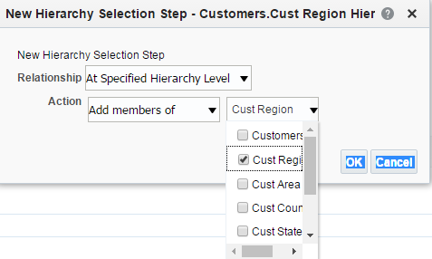



Step Types: Selecting Members Based on Hierarchy
Specify a relationship and an action.
Used for level-based hierarchies
1
2
Members of selected levels are included in the selection step.
3
Notes:
To specify a selection based on hierarchy:
Select one of the following options:
At Specified Hierarchy Level: Available for use with level-based hierarchies, this option allows you to select levels in a hierarchy from a drop-down list and assign an action to determine membership. For example, you can keep only districts.
Based on Level Relationships: Available for use with level-based hierarchies, this option allows you to select levels in a hierarchy from a drop-down list and assign an action to determine membership. In addition, you can refine membership by using available and selected lists of hierarchy levels. For example, you can choose to keep only cities of the available East region.
Select an action (Add, Keep only, and so on).
Select a level or members in a list of available hierarchy members, depending on the relationship you specified.
Oracle BI 12c: Create Analyses and Dashboards 5 - <number>

Slide 11
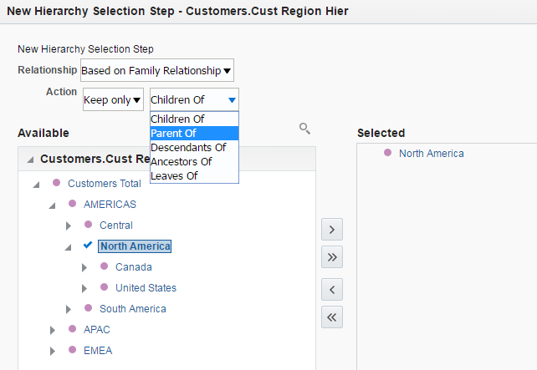



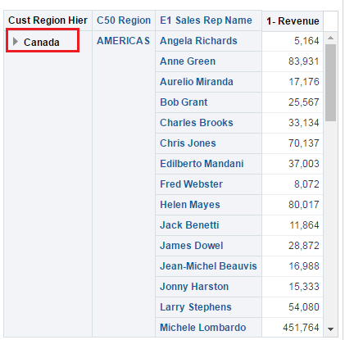
Step Types: Selecting Members Based on Family Relationship
You can include selected members in hierarchy selection steps that are based on family relationships.
Keep only Children of…
…selected member
Results
Notes:
You can include selected members in hierarchy selections steps that are based on family relationships. For a family relationship, you can select one of the following options:
Children of: Selects all the children of the selected member
Parents of: Selects the parent of the selected member
Descendants of: Selects all members that are descended from the selected member
Ancestors of: Selects all members from which the selected member is descended
Siblings of: Selects all members that are on the same level and have the same parent as the selected member. This option is not available for columns in a skip-level hierarchy.
Leaves of: Selects all members that are descended from the selected member and that have no lower levels
Oracle BI 12c: Create Analyses and Dashboards 5 - <number>

Slide 12
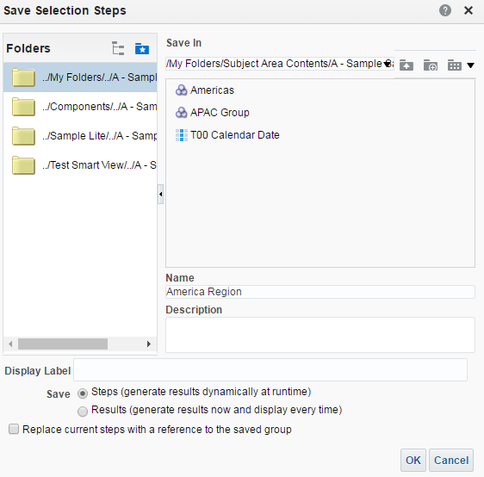

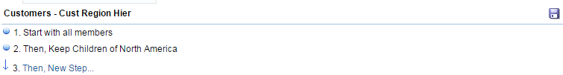
Saving Selection Steps as a Group
Save selection steps as a group in the Presentation Catalog.
Selections pane
1
2
3
4
Notes:
To save selection steps for a column as a group in the Presentation Catalog:
1. Click the Save Selection Steps button for the column whose steps you want to save.
2. In the Save Selection Steps dialog box, enter a name for the group you want to base on the selection. Selection steps can be saved as named groups in a subject area–specific folder path for reuse with other analyses in the same subject area.
3. Specify the behavior of the group. You can save the group as a dynamic set of steps, so that the selection is evaluated at run time for any analysis which includes the group, or alternatively, you can save the current selection of members as a member group (this is similar to selecting them for a group manually as described earlier in the lesson), which will not be re-evaluated in future executions of analyses.
4. Select the option to replace the current steps that appear in the Selections pane with the name of the saved group.
Oracle BI 12c: Create Analyses and Dashboards 5 - <number>

Slide 13

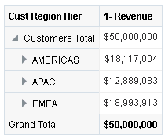

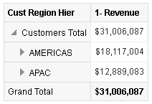

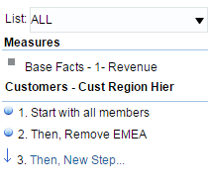
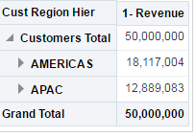



How Do Filters and Selection Steps Differ?
  Filters are applied before the hierarchical column is aggregated.
  Selection steps are applied after the hierarchical column is aggregated.
Before filter
1
2
3
Filter is applied to remove EMEA
The aggregate sum decreases.
1
2
3
Before Selection Steps
The aggregate sum remains the same.
Selection Step is applied to remove EMEA
Notes:
Filters and selection steps are applied on a column-level basis and provide two methods for limiting the data in an analysis. A filter is always applied to a column before any selection steps are applied. Steps are applied in their specified order. Filters and selection steps differ in various ways.
Filters can be applied directly to attribute columns and measure columns. Filters are applied before the query is aggregated and affect the query and thus the resulting values for measures.
For example, the slide shows a list of sales regions, before filtering out the EMEA region, in which the aggregate sums to 50,000,000. After meeting filter criterion only two members meets the filter criteria, the aggregate sum decreases. Later, if we change the filter criterion, the aggregate sum will change accordingly.
Selection steps are applied after the query is aggregated and affect only the members displayed, not the resulting aggregate values.
For example, the slide shows a list of hierarchical members in which the aggregate sums to 50,000,000. If you remove one of the members using a selection step (“EMEA” is removed in this example), then the aggregate sum still remains at 50,000,000.
Oracle BI 12c: Create Analyses and Dashboards 5 - <number>

Slide 14

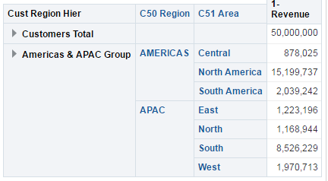
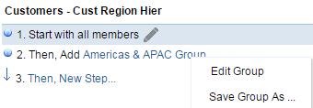


Groups
  Are lists of members or a set of selection steps that can be executed to generate a list of members
  Can be created from selection steps or built manually by selecting members of attribute or hierarchy columns
    Creates a new member for the group
  Can be saved as objects to the Presentation Catalog
  Can be referenced in:
    Selection steps
    Prompts
Selection step referencing Central and West Group
Click to edit or save group.
Americas & APAC Group member in Results
Notes:
Groups allow you to add new “members” to a column, when those members do not exist in the data source. All members of a group must be from the same attribute column or hierarchical column. In a hierarchical column, members can be from different levels. You can nest groups, so that groups can be composed of multiple other groups along with specific members.
A group uses the aggregation rule that is in effect for the measure column to determine the measure values for its group member.
Groups can be named groups, explicitly created and saved to the Presentation Catalog in the subject area–specific directory path, or they can be inline, created in the context of an analysis, for example as one in a series of selection steps. Inline groups created as part of an analysis are not individually available in the Presentation Catalog for reuse. Additionally, any group of selection steps for a column can be saved as a named group for later reuse, an option that is covered in detail later in this lesson.
If a group is applied to a prompt, then the prompt presents either the group as a choice list option or members of the group as choice list options to the user at run time.
Oracle BI 12c: Create Analyses and Dashboards 5 - <number>

Slide 15
Creating Groups
  Create a new member group.
  Define the group properties.
  Apply formatting.
  Verify the results.
Notes:
Oracle BI 12c: Create Analyses and Dashboards 5 - <number>

Slide 16

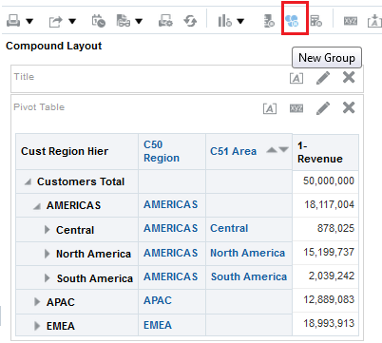
1. Create a New Member Group
Click the New Group button in any view from your analysis results.
New Group button in the Compound Layout view in the Results tab
Notes:
The New Group button is available in several locations. You can also create a group by selecting the More Options buttons in the Layout pane when editing views, which is covered in the lesson titled “Showing Results with Pivot Tables.” As explained later in this lesson, you can also create groups while creating selection steps.
Oracle BI 12c: Create Analyses and Dashboards 5 - <number>

Slide 17
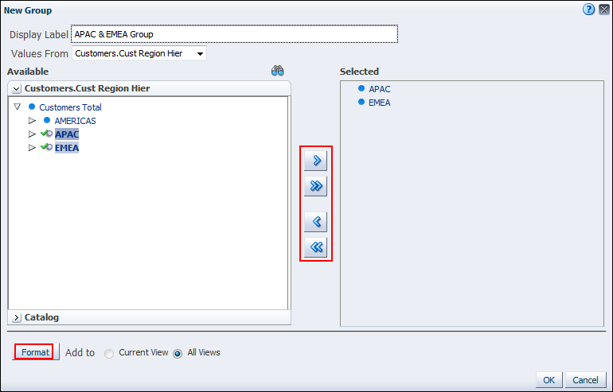




2. Define the Group Properties
Define and name the group in the New Group dialog box.
1
2
Selected members
4
3
Move and remove selected members.
Access the Presentation Catalog to add existing groups.
5
Format the group in results.
Notes:
To define the group properties in the New Group dialog box, perform the following steps:
Enter a label for the group to be used as a member name in analysis views.
In the Values From drop-down list, select the column from the analysis for which you want to group members.
In the Available list, select the hierarchy or attribute members that you want to include in the group. You can also expand the Catalog pane in the available list to select existing named groups from the Presentation Catalog subject area folder, in effect creating groups of groups.
Click the Move button to add them to the Selected list of included members.
Click OK.
To apply formatting to the group, click the Format button.
Oracle BI 12c: Create Analyses and Dashboards 5 - <number>

Slide 18

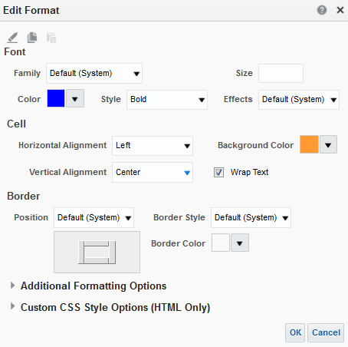
3. Apply Formatting
Click the Format button in the New/Edit Group dialog box.
Copy, paste, and clear cell formats.
1
2
3
Notes:
Set the formatting for the group’s appearance in the Edit Format dialog box. Formatting applies to the top level of the group only, not to group members.
1. Set the font family, style, color, and effects.
2. Set the cell alignment and background color.
3. Customize the cell borders if desired.
Notice that you can copy and paste formatting between different groups and cells, as well as restore defaults.
Oracle BI 12c: Create Analyses and Dashboards 5 - <number>

Slide 19
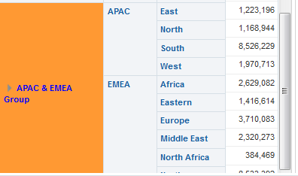

4. Verify the Results
  In the results, navigate to view the group.
  You can also verify the group in the Selections pane.
Child members of the hierarchical column are defined by the group.
Group appears in the results with formatting, always at the bottom of the column.
Group appears as a step in the Selections pane for the column.
Notes:
Oracle BI 12c: Create Analyses and Dashboards 5 - <number>

Slide 20
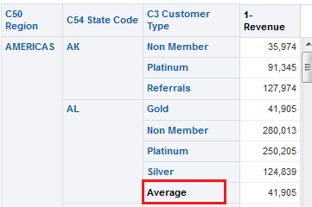
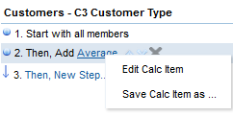
Calculated Items
Are calculations between members, represented as a new single member
  Override:
    Default aggregation rule specified in the repository
    Aggregation rule set for the analysis
  Can be referenced in selection steps and saved as named calculated items
Selection step referencing Average calculated item
Click to edit or save a calculated item.
Calculated item with average for Customer Types
Notes:
A calculated item is a calculation between column members represented as a single member. A calculated item allows you to override the default aggregation rule specified in the Oracle BI repository and, for an existing analysis, the aggregation rule chosen by the designer. A calculated item also allows you to add new “members” to a column, when those members do not exist in the data source. Named calculated items are saved in the unique Presentation Catalog directory for the subject area for reuse in other analyses that use the same subject area.
Internally, calculated items are processed as SQL SELECT statements, and the indicated functions are performed on the result set.
Oracle BI 12c: Create Analyses and Dashboards 5 - <number>

Slide 21
Creating Calculated Items
  Create a new calculated item.
  Define the calculated item properties.
  Verify the results.
Notes:
Oracle BI 12c: Create Analyses and Dashboards 5 - <number>

Slide 22

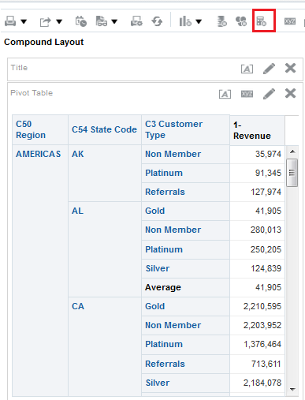
1. Create a New Calculated Item
Click the New Calculated Item button in any view from your analysis results.
The new Calculated Item button in the Compound Layout view in the Results tab
Notes:
The New Calculated Item button is available in several locations. You can also create a calculated item by selecting the More Options button in the Layout pane when editing views, which is covered in the lesson titled “Showing Results with Pivot Tables.” As explained later in this lesson, you can also create calculated items while creating selection steps.
Oracle BI 12c: Create Analyses and Dashboards 5 - <number>

Slide 23
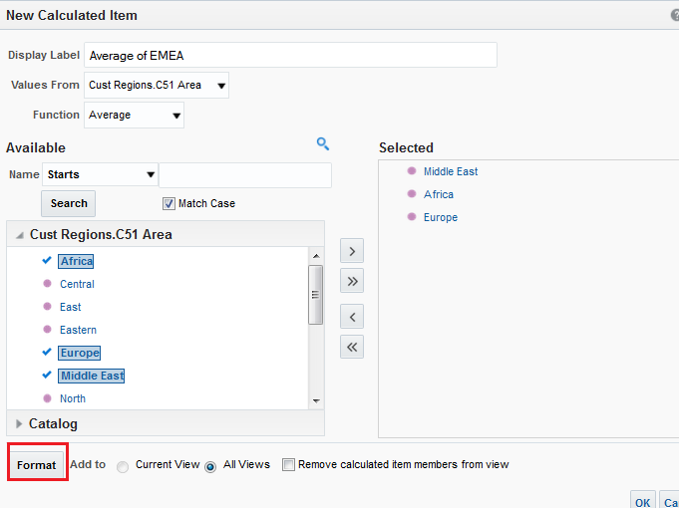
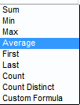


2. Define the Calculated Item Properties
Define and name the group in the New Calculated Item dialog box.
1
Available functions
2
5
3
4
Format the item in results.
Notes:
To define the calculated item properties in the New Calculated Item dialog box, perform the following steps:
1. Enter a label for the calculated item to be used as a member name in analysis views.
2. In the Values From drop-down list, select the column from the analysis for which you want to create a calculation.
3. In the Function drop-down list, select the function for the calculated item, for example, Average. You can also select Custom Formula, which provides a toolbar to build a function using mathematical operators.
Note: A formula creates a dynamic custom grouping within the view. All members referenced in a formula must be from the same column and must be present in the results. Formulas can be inserted into, or combined with, other calculated items.
4. In the Available list, select the hierarchy or attribute members that you want to include in the calculated item. You can also expand the Catalog pane here to include any available named calculated items.
5. Click the Move button to add them to the Selected list of included members.
Oracle BI 12c: Create Analyses and Dashboards 5 - <number>

Slide 24
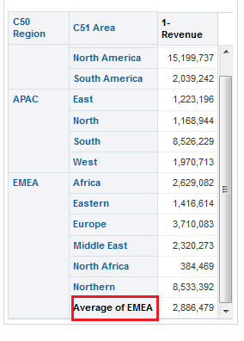

3. Verify the Results
Calculated item appears as a step in the Selections pane for the column.
Measures reflect function or custom formula.
Calculated item appears in the results with formatting, always at the bottom of the column.
Notes:
Oracle BI 12c: Create Analyses and Dashboards 5 - <number>

Slide 25

Quiz: Overview
This quiz examines your knowledge of selections, groups, and calculated items.
Notes:
In this quiz, you answer questions regarding selections, groups, and calculated items.
Oracle BI 12c: Create Analyses and Dashboards 5 - <number>

Slide 26
Quiz
Selections, groups, and calculated items can all be saved in the Presentation Catalog and reused in multiple analyses.
  True
  False
Notes:
Answer: a
Oracle BI 12c: Create Analyses and Dashboards 5 - <number>

Slide 27
Quiz
To select any members of a column, you must create a selection step with an Add action.
  True
  False
Notes:
Answer: b
Selection steps are created automatically when you add new columns or members to the analysis. For example, when you add a column, an automatic first selection step is added to the selection pane to start with all members. To refine your selection, you can drag in specific members in your analysis and Add steps are automatically created.
Oracle BI 12c: Create Analyses and Dashboards 5 - <number>

Slide 28
Quiz
Groups can be created from selection steps or built
manually by selecting members of attribute or hierarchy columns.
  True
  False
Notes:
Answer: a
Oracle BI 12c: Create Analyses and Dashboards 5 - <number>

Slide 29
Quiz
Calculated items cannot be referenced in selection steps.
  True
  False
Notes:
Answer: b
Calculated items can be referenced in selection steps and saved as named calculated items.
Oracle BI 12c: Create Analyses and Dashboards 5 - <number>

Slide 30
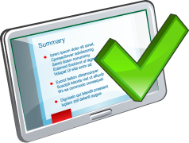
Summary
In this lesson, you should have learned how to:
  Create and save selections
  Create and save groups and calculated items
Notes:
Oracle BI 12c: Create Analyses and Dashboards 5 - <number>

Slide 31

Practice 5: Overview
This practice covers the following topics:
  Using selections to manage analysis results
  Building groups and calculated items
  Including selected members based on family relationships
Notes:
Oracle BI 12c: Create Analyses and Dashboards 5 - <number>

