Slide 1
Showing Results with Pivot Tables
Notes:
Schedule: Timing Topic
45 minutes Lecture
45 minutes Practice
05 minutes Quiz
95 minutes Total

Slide 2

Objectives
After completing this lesson, you should be able to:
  Create and edit pivot tables
  Override default aggregation rules in pivot tables
  Format pivot tables
  Show relative value of an item in a pivot table
  Use calculations in pivot tables
  Display running sums in pivot tables
Notes:
Oracle BI 12c: Create Analyses and Dashboards 7 - <number>

Slide 3
Pivot Table Views
  Provide the ability to pivot rows, columns, sections, prompts, and headings to obtain different perspectives of the same data
  Are interactive:
    Navigable and drillable
    Useful for trend reports
  Provide the ability to couple pivot tables with graphs
Notes:
A pivot table enables you to move and exchange rows, columns, sections, prompts, and headings to obtain different perspectives. You can drag headings to pivot results and preview them, and apply settings to format and manipulate totals and data comparisons. Users can navigate through pivot tables and drill down to information.
Oracle BI 12c: Create Analyses and Dashboards 7 - <number>

Slide 4
Analyzing and Displaying Data in Table and Pivot Table Views
Important differences between table and pivot table views are as follows:
Pivot Table | Table
Default view when analysis contains hierarchical columns | Default view when analysis contains only attribute columns and measures
Can have rows, columns, sections, prompts, and measures as separate drop targets | Has drop targets for sections and prompts, and a single drop target for columns and measures
“Where needed” option not available in the Properties dialog box | “Where needed” option available in the Properties dialog box
Notes:
This table is not a comprehensive list of the differences between tables and pivot tables. For additional information, refer to the Oracle® Fusion Middleware User's Guide for Oracle Business Intelligence Enterprise Edition.
When displaying column and table headings, you can set an alternate format for a table by selecting the “Where needed” option. You cannot do this for pivot tables. That is, a table can display the column names with the folder name from the Subject Area, but only when the column names are not unique.
Oracle BI 12c: Create Analyses and Dashboards 7 - <number>

Slide 5
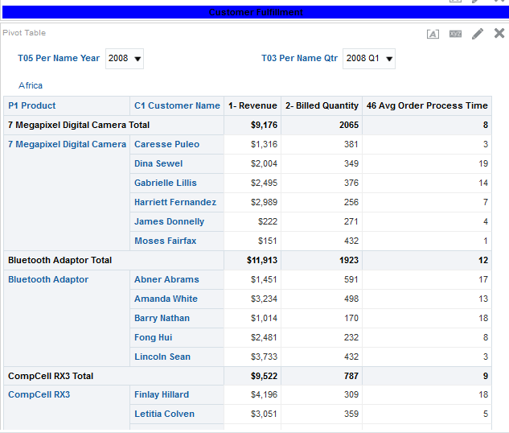







Pivot Table
Prompt
Section and section label
Columns
Measure label
Totals
Measures
Rows
Notes:
Oracle BI 12c: Create Analyses and Dashboards 7 - <number>

Slide 6
Creating a Pivot Table
  Select columns on the Criteria tab.
  Click the Results tab and select the Pivot Table view.
  Open the Pivot Table Editor.
  Rearrange the elements as necessary.
Notes:
Instructor Note
This is a structuring slide. Do not teach the steps or concepts here because the following slides cover them in detail.
Oracle BI 12c: Create Analyses and Dashboards 7 - <number>

Slide 7
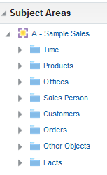
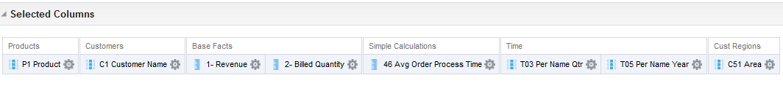
1. Select Columns on the Criteria Tab
Create an analysis by using columns from a subject area.
Notes:
On the Criteria tab of the Analysis Editor, create or modify the analysis with which you want to work.
This slide contains an image of the Criteria (columns) that will be used to create the pivot table. Columns include: Time.T05 Per Name Year, Time.T03 Per Name Qtr, Cust Regions. C51 Area, Products. P1 Product, Customer Name, Base Facts.1-Revenue, Base Facts.2-Billed Quantity, and Simple Calculations.46 Avg Order Process Time.
Had a hierarchical column been selected for the analysis, the Pivot Table view would have been created automatically as the default view in the Compound Layout, but because it is not, the default Table view is created.
Oracle BI 12c: Create Analyses and Dashboards 7 - <number>

Slide 8
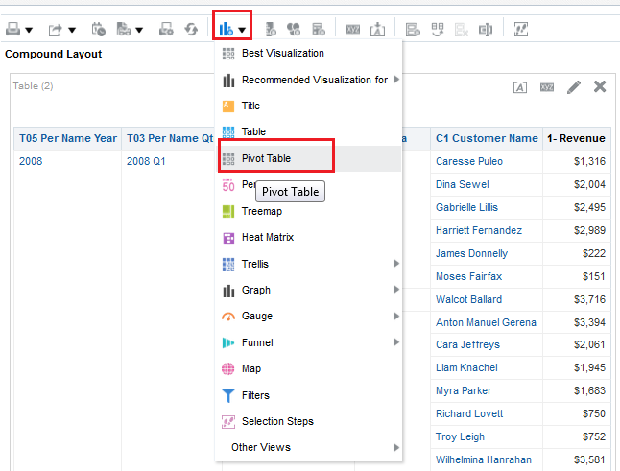
2. Click the Results Tab and Select the
Pivot Table View
The Pivot Table view is accessed from the New View
drop-down list.
Notes:
By default, the Compound view contains both Title and Table views. Delete both of these views in the Compound Layout pane. The Compound Layout pane reflects all views that have been deleted.
In the New View drop-down list, select the Pivot Table view.
Oracle BI 12c: Create Analyses and Dashboards 7 - <number>

Slide 9
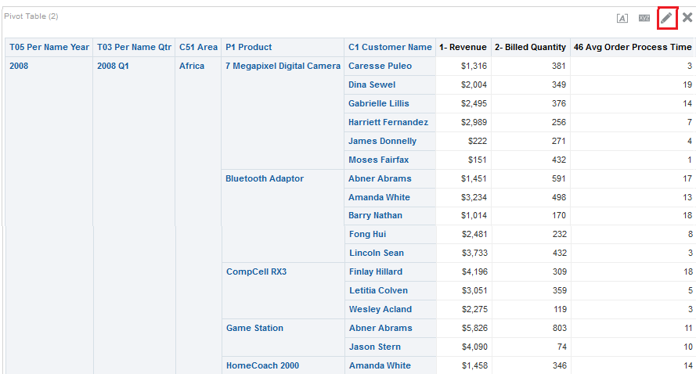
3. Open the Pivot Table Editor
Click the Edit View button.
Notes:
The View Editor mode allows you to manipulate the way the pivot table looks.
Oracle BI 12c: Create Analyses and Dashboards 7 - <number>

Slide 10
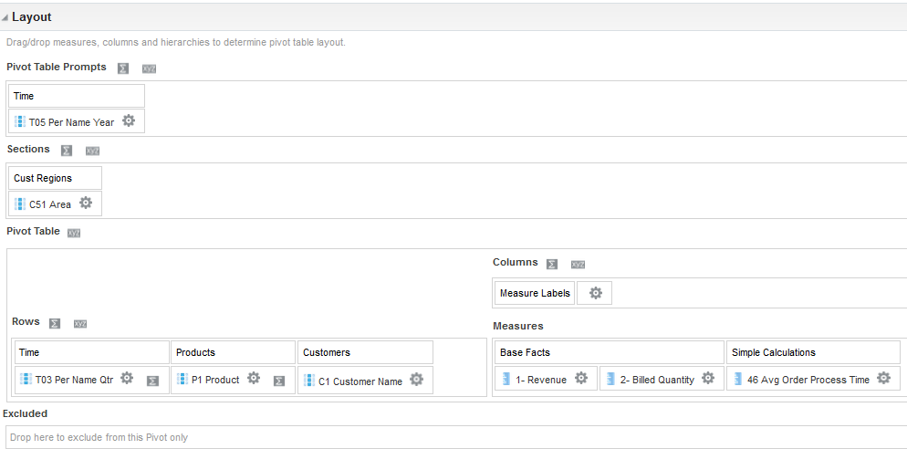




4. Rearrange Elements as Necessary
The columns included in the analysis appear as elements in the pivot table template.
1
2
3
Drag elements.
5
6
4
Notes:
To avoid delays, turn off the analysis results by clicking the Display Results button. After you have finished arranging the elements, click the Display Results button to see the analysis once again. This prevents the pivot table in the preview section pane from redrawing with each change that you make to the template.
1. Prompts: Provides an interactive result set
2. Sections: Displays information in vertical groupings
3. Rows: Shows elements in row orientation
4. Excluded: Excludes elements from results for this analysis (To exclude a column in the analysis, drag it to the Excluded section of the template.)
5. Columns: Shows elements in column orientation
6. Measures: Populates the pivot table with summary data
When you have completed arranging the elements within the pivot table, click Done.
Oracle BI 12c: Create Analyses and Dashboards 7 - <number>

Slide 11
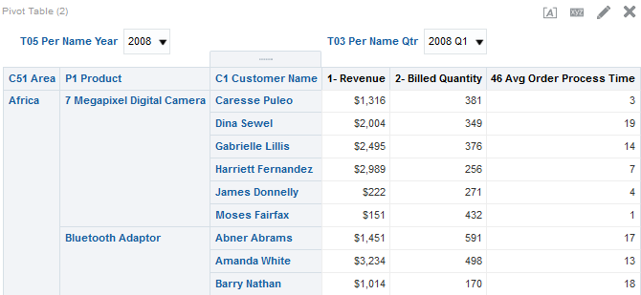
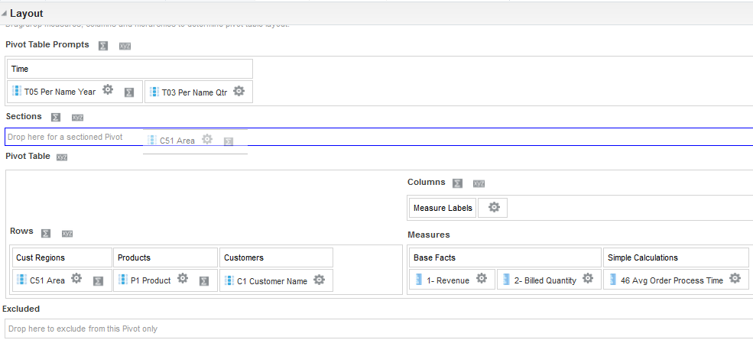
4. Rearrange Elements as Necessary
Drag elements to new position in view.
2
Notes:
There are two other ways to manipulate the elements:
1. Drag the element to the desired location (drop target) when viewing the analysis in the Compound Layout.
2. Drag the element to the desired location (drop target) in a Pivot Table Editor.
Oracle BI 12c: Create Analyses and Dashboards 7 - <number>

Slide 12
Showing Results in Pivot Tables
  Sorting
  Using Hierarchical Columns
  Overriding default aggregation rules
  Using totals
  Adding formatting
  Showing the relative value of an item
  Using calculations
  Displaying running sums
Notes:
Instructor Note
This is a structuring slide. Do not teach the steps or concepts here because the following slides cover them in detail. Instead, provide a high-level description of what is discussed.
Oracle BI 12c: Create Analyses and Dashboards 7 - <number>

Slide 13


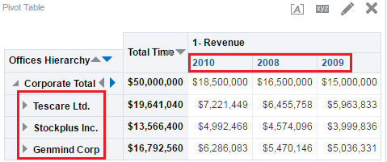
Sorting Data
  Criteria tab sort options serve as the initial sorting state of the analysis.
  You can sort by:
    Column headers on the column or row edges
    Individual members within a row or column edge
  You cannot sort section or prompt edge members.
Descending column header sort of Offices Hierarchy
Descending sort of Total Time columns by the Corporate Total member
Notes:
When you create an analysis, you can specify sorting for the results that are displayed in graphs, pivot tables, tables, and trellises. Graphs, pivot tables, tables, and trellises reflect the sorting that you specify in the Selected Columns pane of the Criteria tab for attribute columns and hierarchical columns, as described in the lesson titled "Working with Oracle Business Intelligence Analyses."
The options that you specify on the Criteria tab serve as the initial sorting state of the analysis. You can modify the sort later in the view when the analysis is used in a table, pivot table, or trellis.
When you sort items in a hierarchical column, you always sort within the parent. That is, children are never sorted outside of their parent. The children are displayed below the parent in the proper sort order; the parent is not sorted within its children.
Remember the following tips:
If you include totals in a view, then those values are not sorted. They remain in the location in which you placed them, regardless of sorting.
If you sort an attribute column or hierarchical column that includes a group, then that group is always displayed at the bottom of the list. If there are multiple groups, then the groups are listed in the order in which their corresponding steps are specified in the Selection Steps pane.
Oracle BI 12c: Create Analyses and Dashboards 7 - <number>

Slide 14

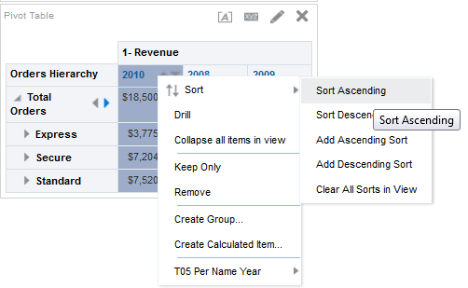

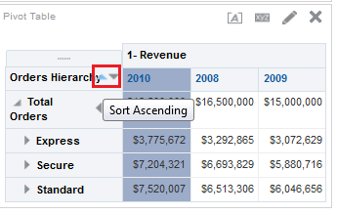
Sorting Data in Views
Right-click a member or column header to access sort options.
Hold the cursor over column headers for ascending and descending sort controls.
Notes:
You can apply sorting to views in the Results pane or while viewing an analysis using the following methods:
Right-click in a pivot table, table, or trellis, select Sort or Sort Column (whichever is available), and then select the appropriate sorting option from the menu.
Hold the cursor over the area to the right of the column name in the header of a pivot table, table, or trellis and click either the upward-facing triangle (Sort Ascending) or the downward-facing triangle (Sort Descending) for that column. These sort specifications override those that you make with the right-click menu.
If you see a shaded-in sort button in the column header or the row header, then you know that the column contains a primary sort. You can add a second-level or third-level sort by holding the mouse cursor over another innermost column header or row header and clicking the appropriate sort button or pressing the right-mouse button.
Note: Any sorting options that you specify in a view override those that were made in the Selected Columns pane.
Oracle BI 12c: Create Analyses and Dashboards 7 - <number>

Slide 15

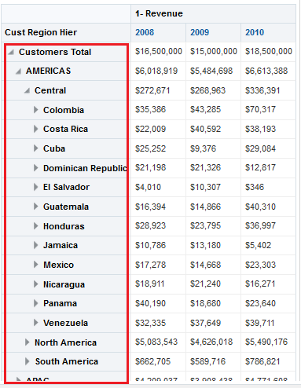
Using Hierarchical Columns
Expand buttons are automatically created.
  To see more detail, use expand and collapse.
  Items can be expanded and collapsed on row, column, or section.
  You can expand items asymmetrically.
Notes:
Because hierarchical columns imply pivot tables, you are able to not only sort on members and measures, but also on rows. Hierarchical items on the row edge can include row sort carat buttons, which you can use to sort the items on the column edge by that row’s data, in either ascending or descending order. These row carat buttons do not appear for attribute columns.
Oracle BI 12c: Create Analyses and Dashboards 7 - <number>

Slide 16


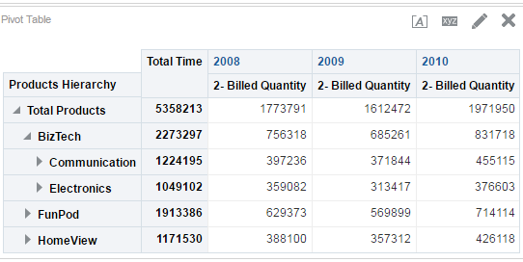


Hierarchical Columns
Product hierarchy with Product on the row edge
Time hierarchy with Years on the column edge
Measure (Billed Quantity)
Total Products parent
Notes:
By default, hierarchy parents are displayed before their children. In the example in the slide, Total Products, a row edge header, is displayed above its children. Total Time, a column edge header, is displayed to the left of its children. Oracle BI EE 12c Release provides a feature to display parent values after children, which is described in the next topic.
Oracle BI 12c: Create Analyses and Dashboards 7 - <number>

Slide 17
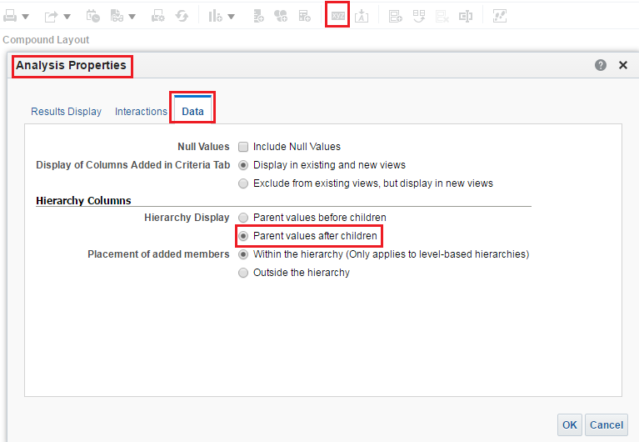

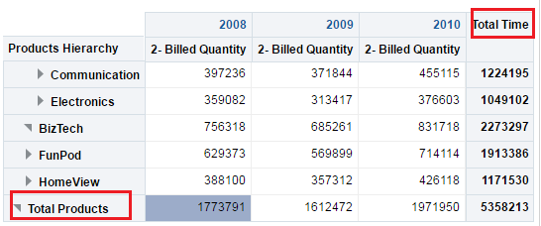
Hierarchical Columns
1
2
3
4
Notes:
Click the Analysis Properties icon in the Results tab.
Click the Data tab in the Analysis Properties dialog box.
Select “Parent values after children” under Hierarchy Columns.
Click OK.
Oracle BI 12c: Create Analyses and Dashboards 7 - <number>

Slide 18

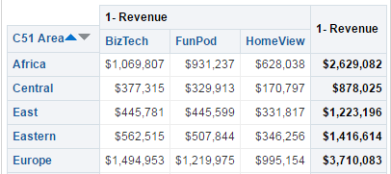
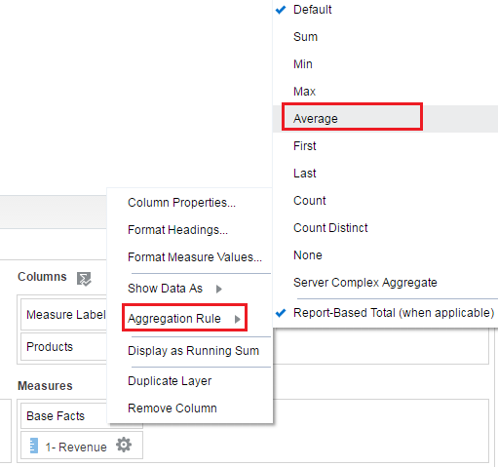

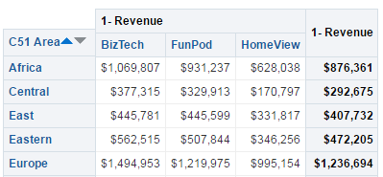

Overriding Default Aggregation Rules
Use More Options to override the default aggregation rule for a measure specified in the BI repository or by the original author of an analysis.
Default aggregation rule is SUM.
Click More Options > Aggregation Rule to override default.
New aggregation rule applied
Notes:
The default aggregation rule for a measure is specified in the Business Intelligence repository or can be set by the report’s author. You can reset the aggregation on a column in the Table and Pivot Table editors. Examples of the uses of aggregations include:
Default: Applies the default aggregation rule
Min: Calculates the minimum value (lowest numeric value) of the rows
Max: Calculates the maximum value (highest numeric value) of the rows
Average: Calculates the average (mean) value of an item in the result set. Averages on pivot tables are rounded to the nearest whole number.
First and Last: Selects the first and last occurrence of the item in the result set
None: Applies no aggregation. Not available for calculated items.
Server Complex Aggregation: Applies the aggregation rule that is determined by the Oracle BI Server (such as the rule that is defined in the Oracle BI repository). The aggregation is performed by the Oracle BI Server, rather than within Presentation Services. Not available for calculated items.
Report-Based Total (when applicable): If not selected, specifies that the Oracle BI Server should calculate the total based on the entire result set, before applying any filters to the measures. It is not available in the Edit Column Formula dialog box or for calculated items; only available for attribute columns.
Oracle BI 12c: Create Analyses and Dashboards 7 - <number>

Slide 19


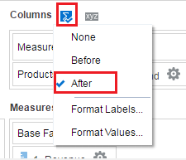
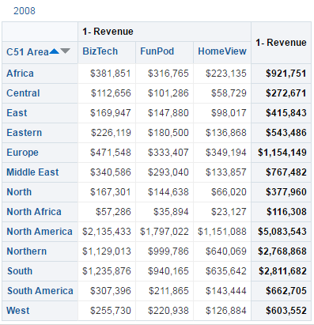


Using Totals
Totals aggregate data on elements other than measures:
  Pivot Table Prompts (Pages)
  Sections
  Columns
  Rows
Section label
Measure label
Row label
Totals for each area
Notes:
To show the total before or after the data items, choose Before or After. For example, if you add a total on a row containing regions and if you specify the Before option, then the total is shown before individual districts in the region are listed.
Default: None
Label and value formatting are available.
Column and row totals include labels. When the Totals button is disabled, no totals are applicable.
Oracle BI 12c: Create Analyses and Dashboards 7 - <number>

Slide 20
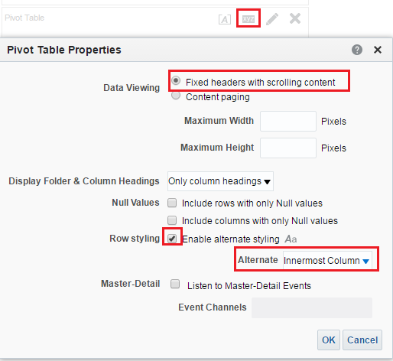
Adding Formatting: Overall Appearance
Customize the overall appearance of a pivot table by applying alternate styling and formatting.
1
2
3
Notes:
Alternate styling shows alternating rows or columns in a light green color. Cosmetic formatting affects the overall appearance of the view and enables you to change the default color.
1. To set overall appearance, click the Pivot Table View Properties button above the pivot table template.
By Default, pivot table is displayed as “Fixed headers with scrolling content,” but you can change it to “Content paging” if required.
Select the “Enable alternate styling” check box. Click the Set alternate format button to access the Edit Format dialog box, which enables you to set fonts, cell alignment, and border properties.
Oracle BI 12c: Create Analyses and Dashboards 7 - <number>

Slide 21
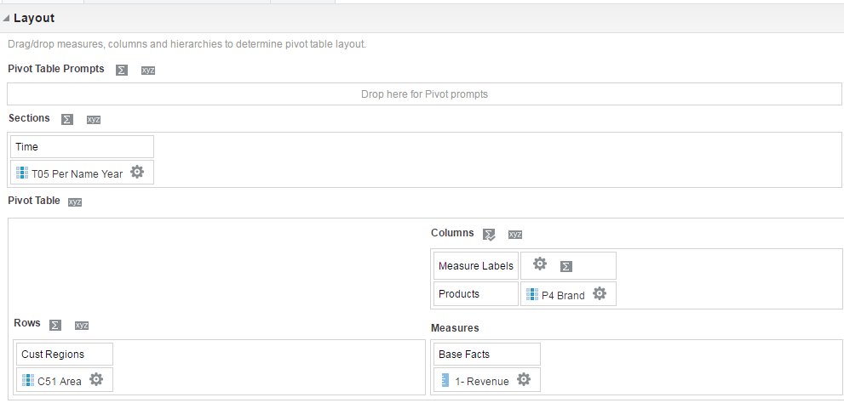




Adding Formatting: Pivot Table Positions
Customize the formatting and appearance of sections, rows, columns, measures, and the content that they contain.
Use the Properties button to customize display headings.
Use the More Options button to format values, duplicate layers, and so on.
Use the Totals button to add totals to the row, and so on.
Measures formatting
Notes:
Formatting for different various areas within the pivot table is accessed by clicking buttons for the specific area.
Click Properties buttons in the Sections, Pivot Table Prompts, Columns, and Rows areas to enable and format headings.
Click the More Options button for individual elements in other areas of the template to format values, create calculated items, duplicate layers, remove columns, aggregate data, and so forth.
Note: Measures formatting overrides Measure Labels formatting.
Oracle BI 12c: Create Analyses and Dashboards 7 - <number>

Slide 22
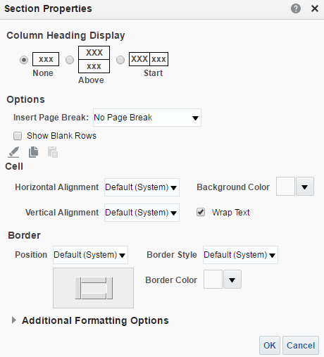


Adding Formatting: Section Options
  Insert page breaks in printed pivot tables.
  Show blank rows.
    Default: Suppress to preserve space in results
Set page breaks between section elements when the pivot table is printed.
Select to show blank rows as white space in results.
Notes:
Using section properties, you can specify whether and how a column heading appears, set page breaks for use in printing pivot tables, and determine whether to suppress blank rows in your results. Additional settings that are available for sections include border definition and style.
Oracle BI 12c: Create Analyses and Dashboards 7 - <number>

Slide 23

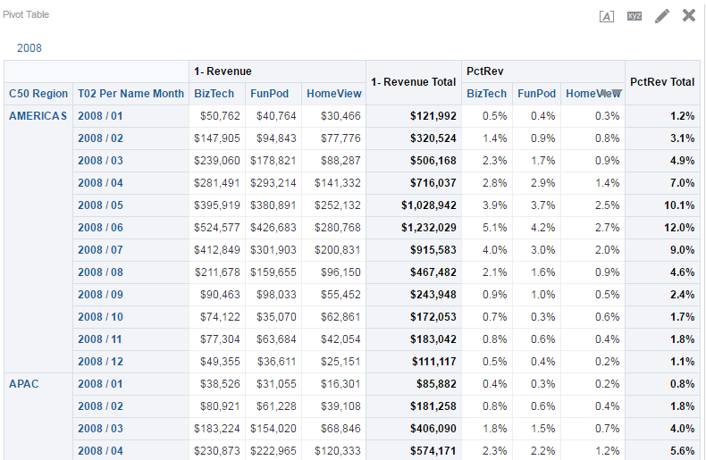





Showing an Item’s Relative Value
You can dynamically convert a stored or calculated measure into a percentage or index and display the relative value of an item compared to the total.
Duplicate Layer
Measure
Section
Relative values: percentage of total for the section
BizTech sales in the APAC region for Jan 2008 = $38,526.
Percentage of BizTech sales in APAC for Jan 2008 relative to the entire year = 0.4%.
Notes:
You can dynamically convert a stored or calculated measure on a pivot table into a percentage or an index. This shows the relative value of the item compared to the total, without the need to explicitly create a calculation for it.
For example, if you are using a pivot table to examine sales by region, you can duplicate the sales measure and view it as a percentage of the total. This enables you to see the actual
sales—and the percentage of sales—that each region contributes.
Oracle BI 12c: Create Analyses and Dashboards 7 - <number>

Slide 24
Using Calculations in Pivot Tables
Using calculations in pivot tables enables you to:
  Override the default aggregation rule specified in the repository or chosen by the author of an analysis
  Create new members with user-defined aggregations or custom formulas
Notes:
Oracle BI 12c: Create Analyses and Dashboards 7 - <number>

Slide 25
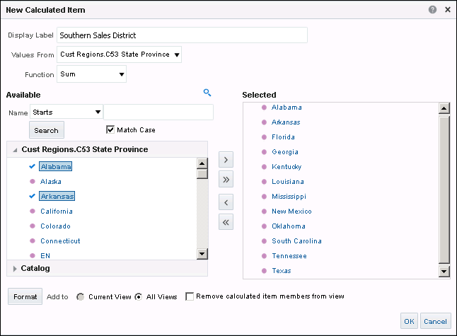
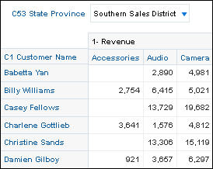
Building Calculations by Using Functions
1
3
2
4
5
Notes:
In the example in the slide, a calculated item is created by using the SUM function to sum the sales revenue of the Alabama, California and Upper South districts to obtain the total for the entire Southern region from an original section that contained revenue.
To build a calculation using functions, select More Options > New Calculated Item for the element on which you want to perform a calculation. The New Calculated Item dialog box appears.
1. Name the calculated item.
2. Select the function from the Function drop-down list.
3. Click values in the Values list to add them to the function.
4. (Optional) Click Format to set formatting options for the results.
Note: The “Remove calculated item members from view” check box, if selected, hides dimension members that are used in calculations from the pivot table.
5. Click OK.
Oracle BI 12c: Create Analyses and Dashboards 7 - <number>

Slide 26
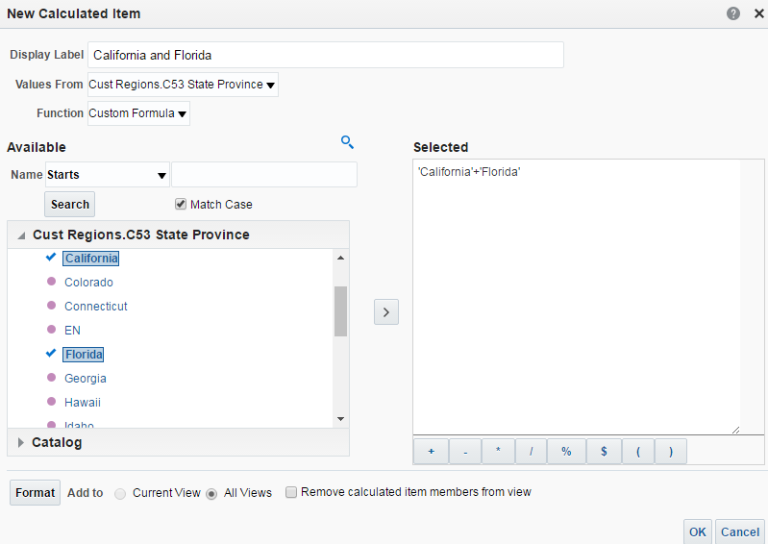
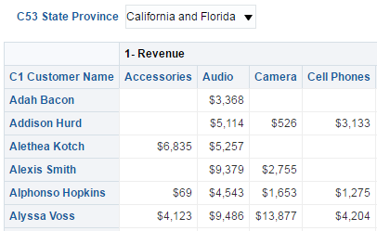
Building Calculations by Using Formulas
1
2
3
4
5
Notes:
In this example, a calculated item is created by using formula operators rather than the SUM function to obtain the same results as in the preceding example. This example is to illustrate the process, and not necessarily the way you would create a sum.
To build a calculation using formulas, select More Options > New Calculated Item for the element on which you want to perform a calculation. The New Calculated Item dialog box appears.
1. Name the calculated item.
2. Select Custom Formula from the Function drop-down list.
The function operator buttons appear below the Function field.
3. Choose a value in the Available pane and use the shuttle button to select it. Then use the appropriate function button from the function operator toolbar to build additional relationships.
4. (Optional) Click Format to set formatting options for the results.
5. Click OK.
Oracle BI 12c: Create Analyses and Dashboards 7 - <number>

Slide 27


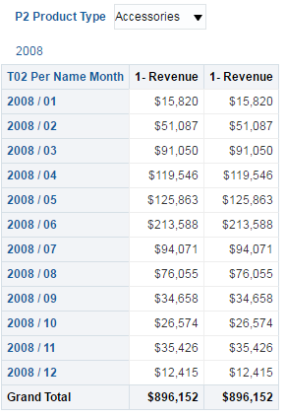
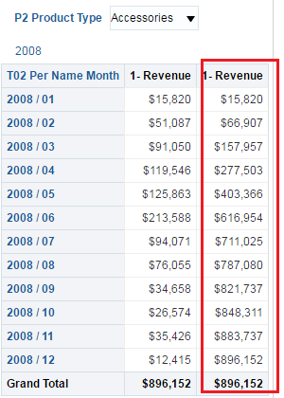

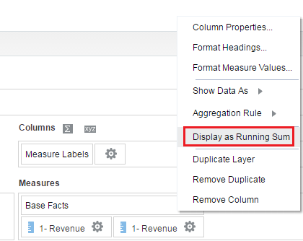
Displaying Running Sums in Pivot Tables
A consecutive cell for a measure displays the total of all previous cells for that measure:
  Running sums are typically displayed for duplicated columns or measures showing data as a percentage.
Results appear as running sum.
Duplicate layer
Select More Options > Display as Running Sum.
Notes:
In this example, a duplicated measure has been created to display a running sum of revenue for each month. To create a running sum on a measure, click its More Options button and then select Display as Running Sum. This option is not available for tables.
Oracle BI 12c: Create Analyses and Dashboards 7 - <number>

Slide 28

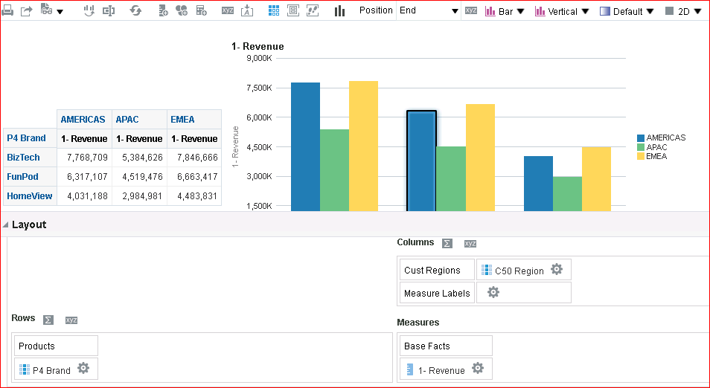
Pivot Table with a Graph
  When you associate a graph with a pivot table, the graph will only represent what is indicated in the pivot and vise versa.
Graph
Notes:
In this example, a duplicated measure has been created to display a running sum of revenue for each month. To create a running sum on a measure, click its More Options button and then select Display as Running Sum. This option is not available for tables.
Oracle BI 12c: Create Analyses and Dashboards 7 - <number>

Slide 29

Quiz: Overview
This quiz examines your knowledge of pivot tables.
Notes:
In this quiz, you answer questions regarding the creation, modification, and manipulation of pivot tables.
Oracle BI 12c: Create Analyses and Dashboards 7 - <number>

Slide 30
Quiz
Tables can have rows, columns, sections, prompts, and measures as separate drop targets, whereas pivot tables can have only columns and measures as drop targets.
  True
  False
Notes:
Answer: b
Pivot tables can have rows, columns, sections, prompts, and measures as separate drop targets, whereas tables can only have columns, measures, prompts, and sections as drop targets.
Oracle BI 12c: Create Analyses and Dashboards 7 - <number>

Slide 31
Quiz
When creating a Pivot Table view, every column must be used in the pivot table.
  True
  False
Notes:
Answer: b
The Pivot Table view contains an Excluded drop target that allows you to exclude an object from the Pivot Table view.
Oracle BI 12c: Create Analyses and Dashboards 7 - <number>

Slide 32
Quiz
Which two of the following applies when building a pivot table from a hierarchical column?
  Sort on members, measures, and rows
  Expand down
  Sort children outside of their parents
Notes:
Answer: a, b
Children cannot be sorted outside of their parents when part of a hierarchy.
Oracle BI 12c: Create Analyses and Dashboards 7 - <number>

Slide 33
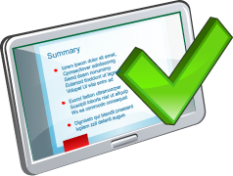
Summary
In this lesson, you should have learned how to:
  Create and edit pivot tables
  Override default aggregation rules in pivot tables
  Format pivot tables
  Show relative value of an item in a pivot table
  Use calculations in pivot tables
  Display running sums in pivot tables
Notes:
Oracle BI 12c: Create Analyses and Dashboards 7 - <number>

Slide 34

Practice 7: Overview
This practice covers the following topics:
  Showing results with pivot tables
  Displaying running sums in pivot tables
Notes:
Oracle BI 12c: Create Analyses and Dashboards 7 - <number>

