Slide 1
Visualizing Data on Maps
Notes:
Schedule: Timing Topic
30 minutes Lecture
30 minutes Practice
05 minutes Quiz
65 minutes Total

Slide 2

Objectives
After completing this lesson, you should be able to add and work with geographical mapping views.
Notes:
Oracle BI 12c: Create Analyses and Dashboards 9 - <number>

Slide 3
MapViewer
  MapViewer is used to create native mapviewer maps and then overlay reporting components/visualizations on top of maps. For example, if you are doing a country-based sales analysis, it’s easy to color code each country across the world right within the maps.
Notes:
Oracle BI 12c: Create Analyses and Dashboards 9 - <number>

Slide 4


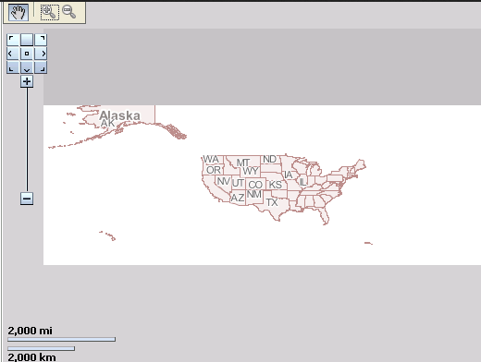




Map Views
Pan
Zoom
Pan and return to the default home view of the map
Zoom in and out through map layers
Hold your cursor for contextual analysis information on map areas or points
Background map
Notes:
You can create a Map view for presenting business data to users in the context of a map. Similar to views such as Tables, Pivot Tables, and Graphs, Map views allow users to see and manipulate data. A Map view presents data in spatial form. When data is visualized on a map, users can easily discover trends and transactions across regions that might not be obvious in tables or graphs. For example, a Map view can show a map of the United States with the states color-coded by sales performance.
When you add a Map view to your analysis, based on the attribute columns, any background maps that have been associated by the administrator are loaded. Map views do not support hierarchical columns.
You can use dashboard prompts to drive map content and perspective, and also use map interactions to drive detail views in other parts of a dashboard in a master–detail relationship.
Instructor Note
Please go through the following OBE on building maps:
http://docs.oracle.com/middleware/1221/biee/BIESG/configmap.htm#BIESG1340
http://docs.oracle.com/middleware/1221/biee/BIESG/configmapadv.htm#BIESG1819
Oracle BI 12c: Create Analyses and Dashboards 9 - <number>

Slide 5

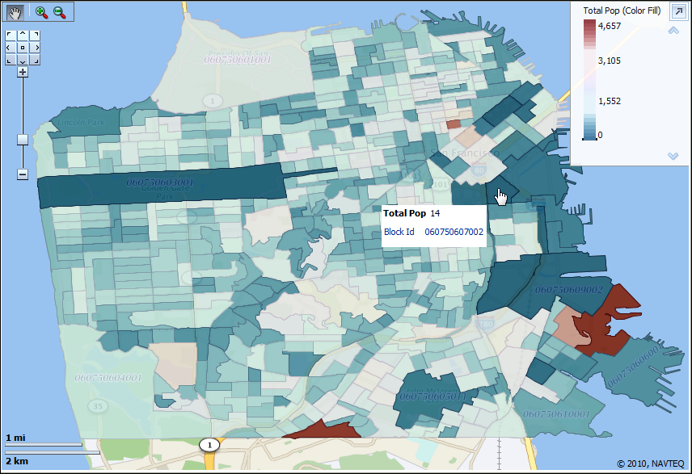
Map View: Example 1
City blocks color coded by population
Notes:
This example is from the Oracle BI Sample Application.
Oracle BI 12c: Create Analyses and Dashboards 9 - <number>

Slide 6
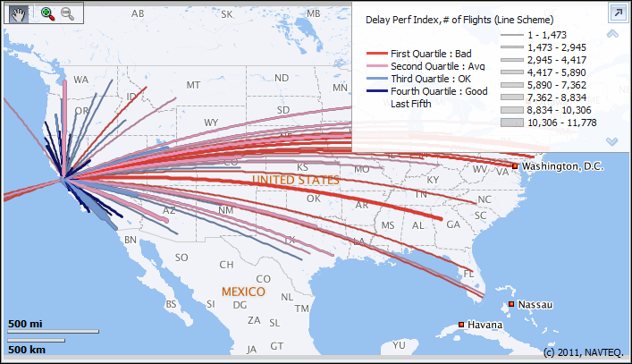
Map View: Example 2
Airline flight routes are displayed as lines on the map. The line color represents a delay performance index, and the line thickness represents the number of flights per route.
Notes:
This example is from the Oracle BI Sample Application.
Oracle BI 12c: Create Analyses and Dashboards 9 - <number>

Slide 7

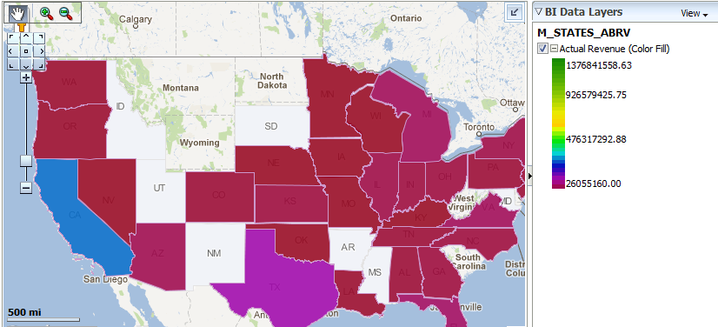
Map View: Example 3
You can choose to display Actual Revenue total.
Notes:
This example is from the Oracle BI Sample Application.
Oracle BI 12c: Create Analyses and Dashboards 9 - <number>

Slide 8
Oracle Spatial Components
  Oracle Database
    Stores the definitions of spatial objects (using special geometry objects)
  Oracle MapViewer
    J2EE application used for rendering interactive map images and features of interest (FOI)
    Provides a layer of caching
  Oracle MapBuilder
    Development tool for MapViewer
    Enables you to define the content and structure of maps and their rendering rules
    Used to create/edit spatial styles, themes, and basemaps
Notes:
Oracle Database: The practices for this course use the sample data bundle from Nokia NAVTEQ. The data is stored locally in the OBIEE_NAVTEQ schema. It contains spatial data structures. For example:
A road map is a 2-dimensional object that contains points, lines, and polygons, which can represent cities, roads, or states.
Data that indicates a particular location (such as latitude and longitude information)
Oracle Database supports 3-D data as well and spatial data can be anything: aircraft wings, buildings, and so on.
Oracle Database stores the definitions of spatial objects using the data type sdo_geometry.
Oracle MapViewer: You can use the following URL to connect to MapViewer: http://host:port/mapviewer. For example: http://localhost:7001/mapviewer. It is used to configure the spatial data source (for example, OBIEE_NAVTEQ), and create and manage tile layers, in addition to other tasks.
Oracle BI 12c: Create Analyses and Dashboards 9 - <number>

Slide 9

Notes:
Oracle MapBuilder: This tool helps to create and manage the mapping data (styles, themes, basemaps, and tile layers) that is stored in the database (the OBIEE_NAVTEQ data source). It is primarily used to create or modify a style and preview the metadata, in addition to other functionalities.
Oracle BI 12c: Create Analyses and Dashboards 9 - <number>

Slide 10
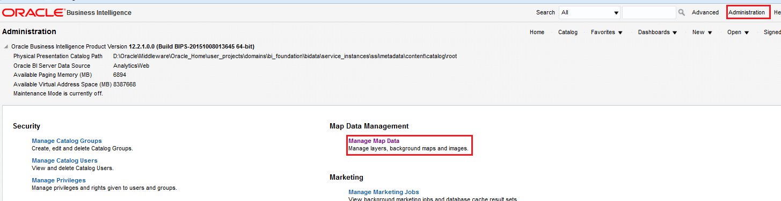
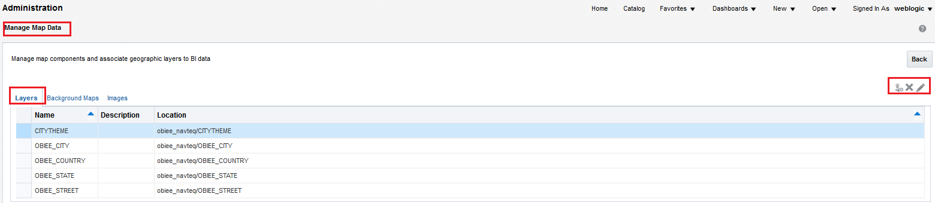

Manage Map Data
Configure map data through the Administration tab.
Import/Delete/Edit Layer Options
Notes:
Maps rendered in Oracle BI EE consist of two components: a background map and map layers.
Background maps can be Oracle internal maps, stored locally in an Oracle database (for example, from the OBIEE_NAVTEQ schema) or external maps or images. Layers are rendered on top of these background maps.
Layers can be either points or polygons. Map views are rendered in analyses depending on the layer formatting (color fill, bar or pie graph, bubble, variable shape, image, or custom point). Additionally, to interact with a subject area, layers must be mapped to corresponding columns in one or more subject areas.
Importing layers, background maps, and images; mapping layers; and adding layers to background maps are all tasks you accomplish by clicking Manage Map Data on the Administration tab.
Note: Most of the components of a Map view are defined for you by an administrator, including the background maps and the metadata mappings to spatial data that supports mapping of attributes and measures in your subject areas.
Oracle BI 12c: Create Analyses and Dashboards 9 - <number>

Slide 11
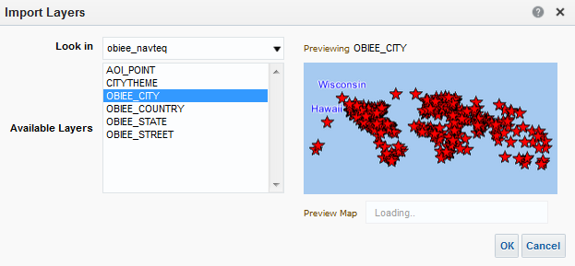



Import Layer
Data Source
Themes from MapBuilder
Base Maps from MapBuilder/Map Tile Layer from MapViewer
Notes:
To use maps with Oracle BI EE, you must have at least one layer.
When you choose to import a new Layer, Oracle BI EE will obtain the Layers that exist within the selected data source. This data source must already be configured through MapViewer by an administrator. The layers listed correspond to the themes defined in the MapBuilder client. You can preview how the map will appear after applying a particular layer.
Oracle BI 12c: Create Analyses and Dashboards 9 - <number>

Slide 12
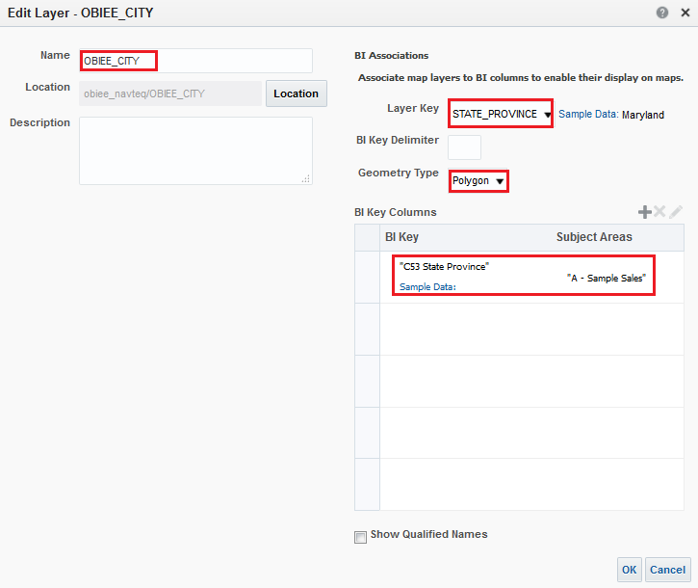



Edit Layer
Layer is keyed to STATE_ PROVINCE
Layer is linked to the “C53 State Code” column in the “A - Sample Sales” subject area
Notes:
After the layer is imported, you can edit it as follows:
Specify Geometry Type (Polygon, Point, or Line).
Specify which subject area columns can be used to join to the spatial data.
Oracle BI 12c: Create Analyses and Dashboards 9 - <number>

Slide 13

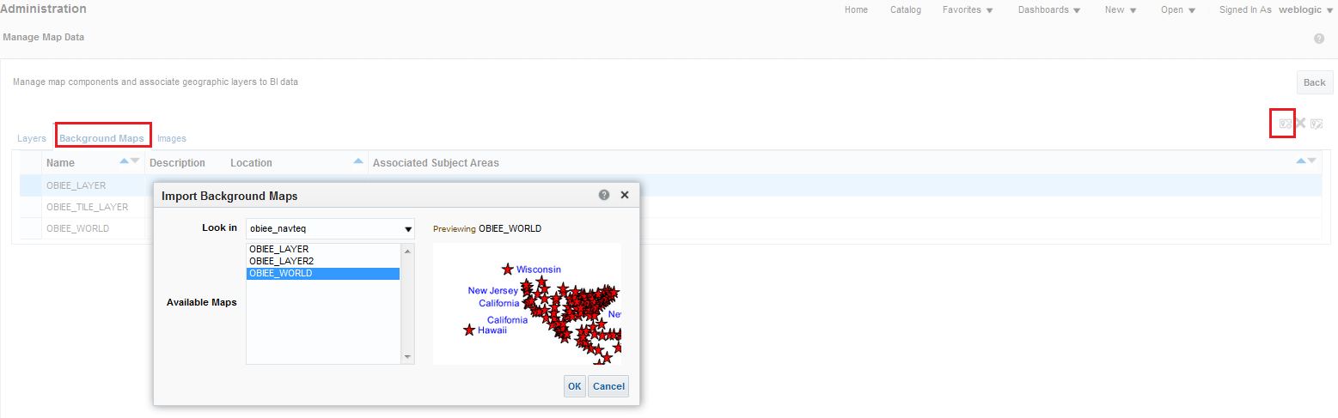


Import Background Map
Import Background Map
Data Source
Base Maps from MapBuilder/Map Tile Layer from MapViewer
Notes:
When you import a new Background Map, Oracle BI EE will obtain the Map Tile Layers that exist within the selected data source. The maps listed correspond to the same Map Tiles that are defined in the MapViewer by an administrator, and are stored in the user_sdo_cached_maps table in the Oracle Database. You can view and edit the tiles from MapViewer.
Oracle BI 12c: Create Analyses and Dashboards 9 - <number>

Slide 14
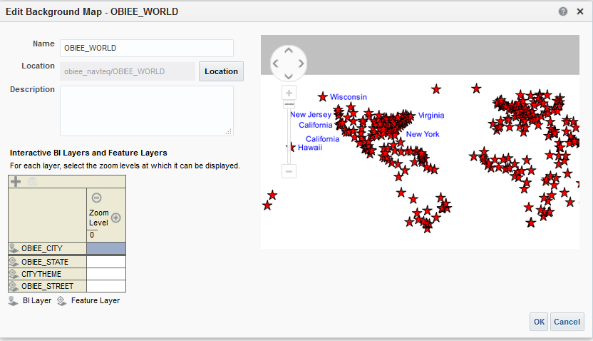



Edit Background Map
Preview
Layer
Zoom level
Notes:
After the Background Map is imported, you can edit it as follows:
Specify which layer will be stacked on top of this background map and at what zoom levels.
Configure the order in which the layers appear on top of each other on a map. In the example in the slide, OBIEE_CITY is displayed on top of the rest of the layers, and the default zoom level is highlighted in yellow.
Oracle BI 12c: Create Analyses and Dashboards 9 - <number>

Slide 15

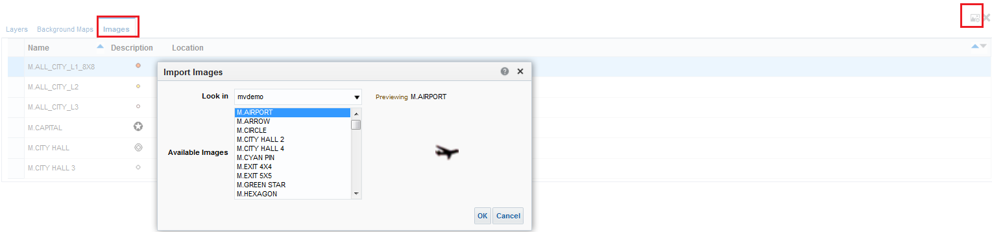
Images
Import image
Notes:
You can import your own custom images for use in maps, in addition to using the predefined images in the database.
Oracle BI 12c: Create Analyses and Dashboards 9 - <number>

Slide 16
Creating and Editing Map Views
  Add a Map view.
  Set properties.
  Edit formats.
Notes:
Instructor Note
This is a structuring slide. Do not teach the steps or concepts here because the following slides cover them in detail. Instead, provide a high-level description of what is discussed.
Oracle BI 12c: Create Analyses and Dashboards 9 - <number>

Slide 17

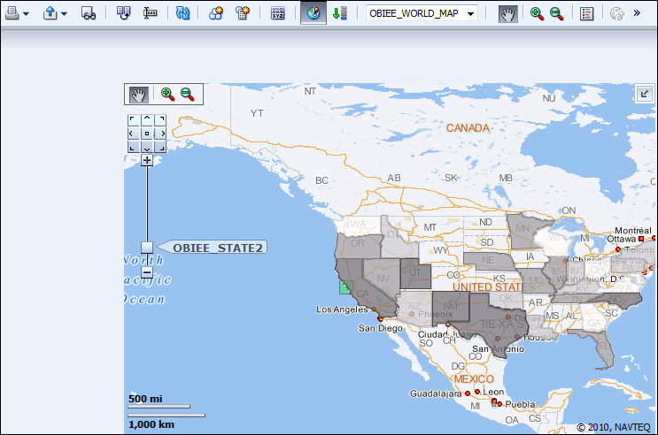




1. Add a Map View
Click New View > Map and then edit the view.
Display legend
Display results
Select from available background maps
Zoom and pan controls
Layer label
Notes:
Create or modify an analysis and click New View > Map. When creating a Map view analysis, remember that you want to select attribute columns related to geography—for example, states, cities, and regions.
Oracle BI 12c: Create Analyses and Dashboards 9 - <number>

Slide 18
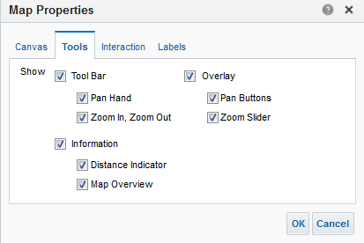

2. Set Properties
Click the Properties button to manage:
  Canvas size and properties
  Available tools
  Interaction settings to add formats when drilling
  Layer labels
Choose tools for display in the map.
Notes:
On the Canvas tab of the Map Properties dialog box, you can specify the size of the map in pixels. On the Tools tab, you can enable or disable zoom and pan controls, as well as the Map Overview pop-up and the Distance Indicator.
On the Interaction tab, select the “Automatically create formats when drilling” option to create new formats based on the initial map layer as users drill in maps. For example, if the initial default layer of a map has formats defined for state color fills and pie graphs, then when a user drills on that layer, the next layer in the map automatically has a new fill color and pie graph color format created for it.
Finally, on the Labels tab, you can determine whether layer labels appear as users zoom in and out of the map by using the zoom tools.
Oracle BI 12c: Create Analyses and Dashboards 9 - <number>

Slide 19
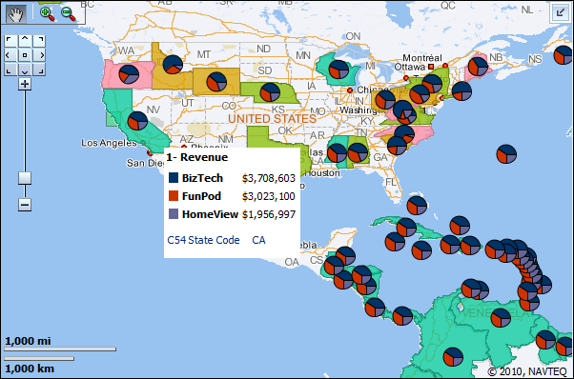

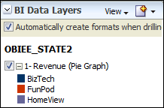


3. Edit Formats: Format Options
Add formats to your map—for example, a pie graph.
Click pie graph…
Create a new format.
…to see results.
Notes:
Click the Add New Map Formats button in the BI Data Layers pane to add a new format. You can create many different formats—for example, color fills for polygon areas of the map, bar and pie graphs, images, and shapes. These formats are displayed depending on their association with a layer and whether the zoom level includes the layer and format. The example in the slide shows a pie graph to display dollars by customer for each state. The results are displayed when you click the pie graph on the map. In this example, the results show revenue from product brands in state California.
When you define formats, you can specify that different formats apply to different measure columns in a layer.
Oracle BI 12c: Create Analyses and Dashboards 9 - <number>

Slide 20
Notes:
You can apply various kinds of formats to map views. The following list describes the options for defining formats to apply to BI layers. You cannot apply formats to non-BI layers.
Color Fill: Render areas in fill colors that indicate that an area meets a particular condition. Color fill formats apply to regions or polygons. For example, a color fill format might identify a range of colors to represent the population in the states of a region or the popularity of a product in the states of a region. A map view can have multiple color formats visible at different zoom levels. For example, a color fill format for the layer at zoom levels 1-5 might represent the population of a state, and the county median income for the layer at zoom levels 6-10. You can also specify different colors to identify a range of data values.
Bar Graph: Render a series of data as a bar graph within an area. Graph formats can show statistics related to a given region such as states or counties. For example, a graph format can display the sales values for several products in a state. Although you can create multiple graph formats for a particular layer, such creation is not recommended because the formats might overlap on the layer and the displayed results might be undesirable.
Pie Graph: Render a series of data as a pie graph within an area.
Shape: Render a measure column that is associated with an area by drawing markers or shapes within the region. You can also specify different colors for the shape to identify a range of data values.
Bubble: Render a bubble within an area, similar to the shape format.
Image: Render an image within an area, similar to the shape format. You can specify different images to identify a range of data values. You select images that have been specified by the administrator.
Line: Render a line on a map. You can include lines on maps to display paths such as highways, railway lines, and shipping routes. You can specify the width of lines and you can use the Map Wrap-Around feature on the Canvas tab in the Map Properties dialog box to allow lines to be unbroken, such as when showing an airline flight path from San Francisco to Tokyo. Starting with Release 11.1.1.7 and later, Map views support the ability to format a line to vary its color based on one measure, but to also vary its thickness by a second measure. For example, an airline route can be color coded based on the number of flights flown, and its thickness based on the average revenue per seat.
Custom Point: Render a point format, such as a bubble, image, or shape in a layer. Custom points are displayed at all zoom levels and on top of all other map formatting. When you create a Custom Point format, you select columns to specify the latitude and longitude.
Oracle BI 12c: Create Analyses and Dashboards 9 - <number>

Slide 21
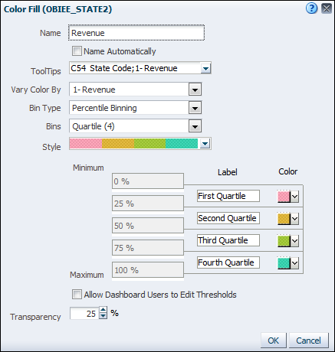






3. Edit Formats: Define Formats
Click the Edit button for a format to specify its properties.
Set the columns that are displayed to users in the map.
Select the measure to vary by.
Select percentile or value binning.
Select the number of bins.
Choose a color scheme.
Set a slider for users to manage thresholds for value or percentile binning.
Notes:
Place the cursor over a format in the list to click its Edit button and change its properties. You can set the size and determine the measures and attributes graphed for the included bar and pie graphs, for example.
In the example in the slide, the Color Fill format is edited. Use the tool tips to display analysis column names to users when they place the cursor over an area layer, for example, a state. In the Vary Color By drop-down list, select an analysis measure to vary the fill colors by. In the Bin Type drop-down list, select percentile or value binning (you can also eliminate binning by selecting Continuous Color Fill, which creates a gradient on the map). In the Bins drop-down list, select the number of bins that you want to break the measure across. In the Style drop-down list, select from several preset color spectrums for use across the bins as various color fills are applied to the map.
You can add labels and specify particular colors in the bin list at the bottom of the dialog box. Select the “Allow Dashboard Users to Edit Thresholds” option, which is set by default, to present a value slider for use in setting binning thresholds. This option is available only for value or percentile binning in fill color formats.
Note: The available formats vary based on the mapped geometry types available in the selected BI Data Layer. For example, Custom Point formats are only available when your layer mapping contains columns that can be used to identify the longitude and latitude of specific points.
Oracle BI 12c: Create Analyses and Dashboards 9 - <number>

Slide 22
Interacting with Map Views
  Drilling
  Master–Detail linking
  Action links
Notes:
Instructor Note
This is a structuring slide. Do not teach the concepts here because the following slides cover them in detail. Instead, provide a high-level description of what is discussed.
Oracle BI 12c: Create Analyses and Dashboards 9 - <number>

Slide 23

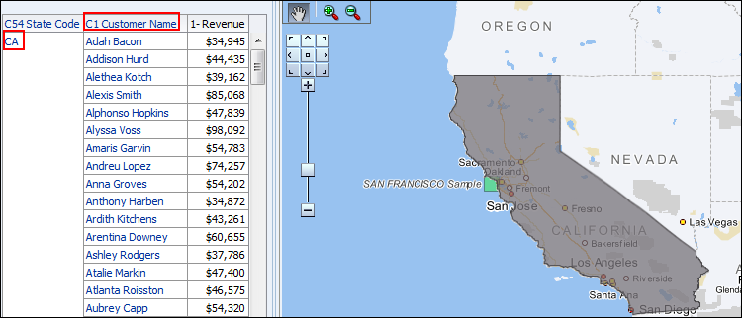
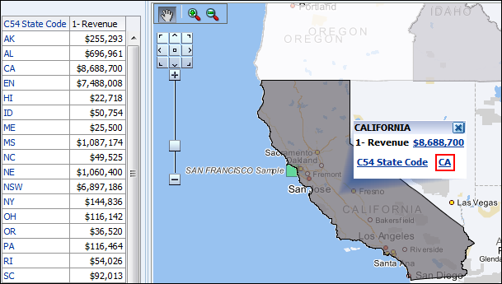

Drilling in Map Views
The map is filtered by the value on which you drilled.
Drill on an attribute value displayed in the pop-up.
Notes:
Similar to other types of views, when you drill on an attribute column in a Map view, the analysis is filtered by the value on which you drilled and an attribute column for the next level of detail is displayed. In the example in the slide, drilling on the state CA in the Map view limits the displayed data in the Table and the Map view to only CA, and displays the C1 Customer Name column in the Table view. Additionally, the Map view zooms in automatically to highlight the selected attribute (CA, in our example). In this example, the C1 Customer Name column is not mapped to a layer on the background map, so Customers are not displayed in the updated Map view.
Oracle BI 12c: Create Analyses and Dashboards 9 - <number>

Slide 24
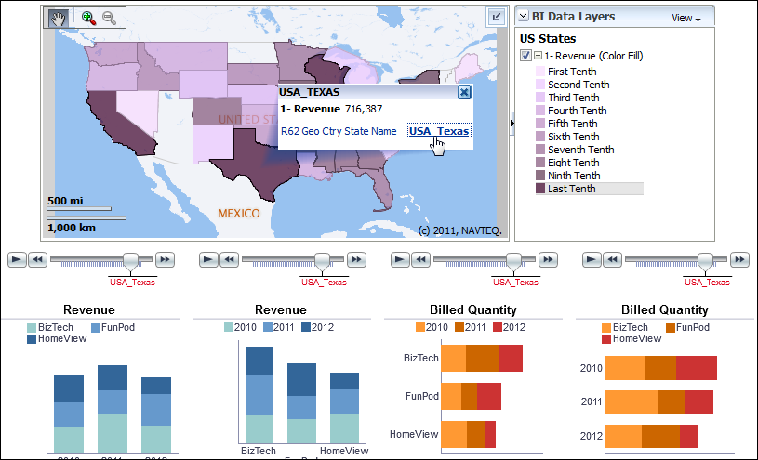


Master–Detail Linking in Map Views
Master view
Detail view
Notes:
Map views support Master–Detail linking. For the example in the slide, from the Oracle BI Sample Application, the Map view acts as a master view, allowing you to filter the four bar graphs based on the value of the selected state.
Oracle BI 12c: Create Analyses and Dashboards 9 - <number>

Slide 25


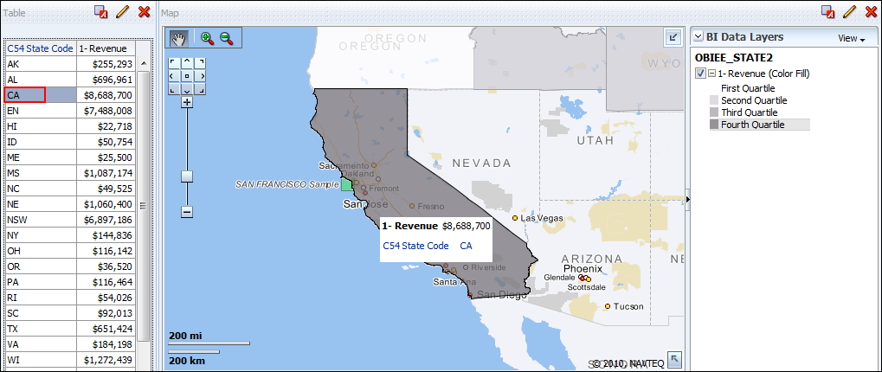
Master–Detail Linking in Map Views
Master view
Detail view
Notes:
A Map view can also act as a detailed view i.e. if you filter the master view (table/graph/pivot table) on a particular area component, the map view is zoomed in to that particular component. For example, in the slide, on clicking “CA” in the master view (table), the map view zooms in to the state of California.
Oracle BI 12c: Create Analyses and Dashboards 9 - <number>

Slide 26
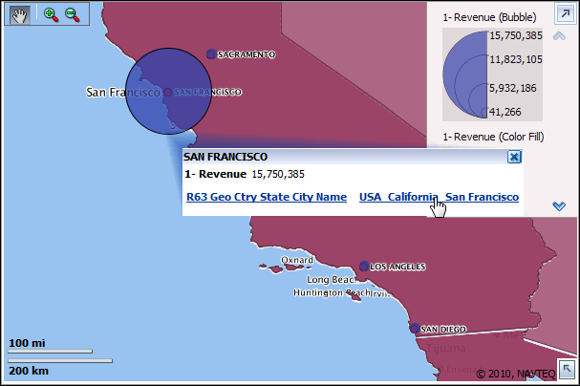

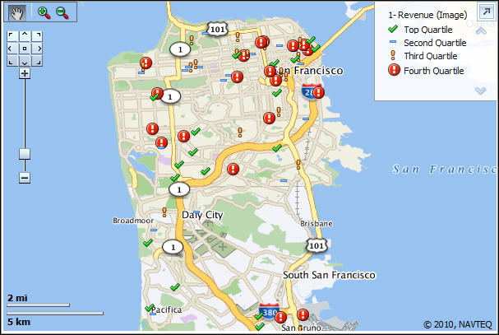

Action Links in Map Views
An action link is defined for the City column in this analysis.
The link opens a new analysis showing a street map of the city.
Notes:
As with other types of views, you can leverage action links in Map views to navigate to other dashboards or analyses.
The example in the slide is from the Oracle BI Sample Application. An analysis that displays revenue bubbles for cities is linked at the City level to open a second analysis that displays a city street map with points identifying customer locations (with revenue indicators) in the city.
Oracle BI 12c: Create Analyses and Dashboards 9 - <number>

Slide 27
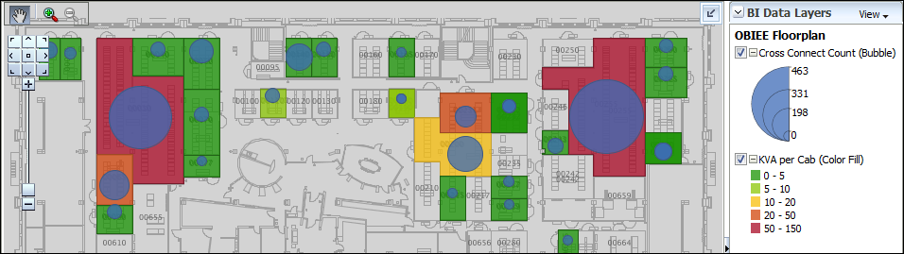
Other Applications for Map Views
  Floorplan metrics
  Addresses
  Custom database calculations
Notes:
In addition to standard geographical data, you can configure MapViewer to display other types of spatial analyses.
Floorplan metrics: For retail analysis, you can create a background map that represents a store floorplan and layer spatial information on top of it to analyze space-related metrics. The example in the slide shows how multiple metrics can be displayed on a floorplan map.
Addresses: You can display specific customer addresses as image data on a street map. For example, display colored flags on a street map that represent in which revenue percentile the customer belongs.
Custom database calculations: You can leverage spatial data to create custom distance-related calculations, for example, to display all competitors within a specified distance of a location, or to calculate the distance between two locations.
Oracle BI 12c: Create Analyses and Dashboards 9 - <number>

Slide 28
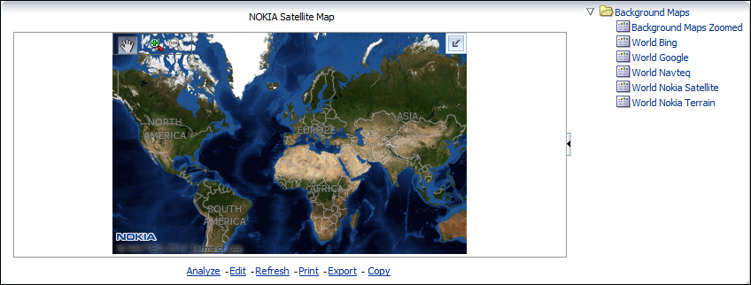
Other Points of Integration
Define map tile layers using internal or external sources.
  Oracle Maps
  Google, Bing, Nokia
Notes:
Nokia NAVTEQ provides a bundle of sample geospatial data that you can download from the Oracle Technology Network (http://www.oracle.com/technetwork). The spatial data and any spatial metadata, including themes and styles, must be stored in an Oracle Database to be accessed by MapViewer for display in Map views.
However, MapViewer enables you to define background maps from a variety of internal (local) and external sources. You can create custom internal maps using the MapBuilder client, and you can enable external maps using a Web Map Service (WMS) provider, such as Google Maps or Bing Maps. Additionally, Oracle BI EE enables users to access hosted maps from Oracle Maps (http://maps.oracle.com).
Note: For more information on using alternative map sources, please see the Oracle Fusion Middleware User's Guide for Oracle MapViewer and the Oracle Fusion Middleware System Administrator's Guide for Oracle Business Intelligence Enterprise Edition.
Oracle BI 12c: Create Analyses and Dashboards 9 - <number>

Slide 29

Quiz: Overview
This quiz examines your knowledge of Map views.
Notes:
In this quiz, you answer questions regarding Map views.
Oracle BI 12c: Create Analyses and Dashboards 9 - <number>

Slide 30
Quiz
Layers are a combination of map features and formats that are associated with zoom levels on a background map.
  True
  False
Notes:
Answer: a
Oracle BI 12c: Create Analyses and Dashboards 9 - <number>

Slide 31
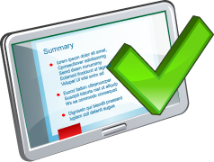
Summary
In this lesson, you should have learned to add and work with geographical mapping views.
Notes:
Oracle BI 12c: Create Analyses and Dashboards 9 - <number>

Slide 32

Practice 9: Overview
This practice covers adding and formatting a Map view.
Notes:
Oracle BI 12c: Create Analyses and Dashboards 9 - <number>

