Slide 1
Scorecards and Key Performance Indicators
Notes:
Schedule Timing Topic
60 minutes Lecture
60 minutes Practice
05 minutes Quiz
120 minutes Total

Slide 2
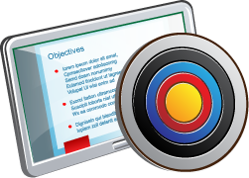
Objectives
After completing this lesson, you should be able to:
  Identify the objects and components of Oracle Scorecard and Strategy Management
  Identify Scorecard Document Type
  Create and measure Key Performance Indicators
  Create a Scorecard
Notes:
Oracle BI 12c: Create Analyses and Dashboards 13 - <number>

Slide 3
Oracle Scorecard and Strategy Management
OSSM provides organizations the necessary tools to:
  Define strategy.
  Establish specific goals and objectives.
  Establish Key Performance Indicators (KPIs) and targets.
  Align behavior and increase focus on priority initiatives.
  Monitor performance through Scorecards and KPI watchlists.
  Take actions.
Notes:
Oracle Scorecard and Strategy Management (OSSM) extends the Oracle BI Suite Enterprise Edition (Oracle BI EE) with capabilities intended at communicating strategic goals across the organization and monitoring their progress over time. The Scorecard and Strategy Management module provides capabilities to establish specific goals, define how to measure their success, and communicate that information down the entire organization. Armed with this insight, employees can understand their impact on achieving success and align their actions accordingly. As they use Scorecards to measure the outcome of their actions, they can quickly make adjustments as needed to successfully achieve the goals.
Users can document accountability, understand who is under- or over-performing and how that performance relates back to the organizational strategy. It provides new business insight, and offers experience-based actions to enable more consistent processes based on user credentials and KPI status.
OSSM enables organizations to:
Provide a framework that aligns strategic thinking and performance measurement
Clarify and build consensus on strategic direction
Communicate strategy and measures of success
Oracle BI 12c: Create Analyses and Dashboards 13 - <number>

Slide 4







Oracle Scorecard and Strategy Management
(Basics and Notes)
Oracle BI EE Repository
Key Performance Indicators (KPI)
Scorecard
Scorecard Document (View)
Notes:
Oracle BI 12c: Create Analyses and Dashboards 13 - <number>
Align behavior and increase focus on priority initiatives
Support strategic planning through metric relationship analysis and organizational learning
Scorecards clearly indicate which metrics are exceeding or not meeting expectations. Thus if few metrics are not doing well as compared to the target/threshold values, corrective actions can be taken through Email alerts, ERP Workflows, and BPEL processes defined within the OBIEE action framework.

Slide 5
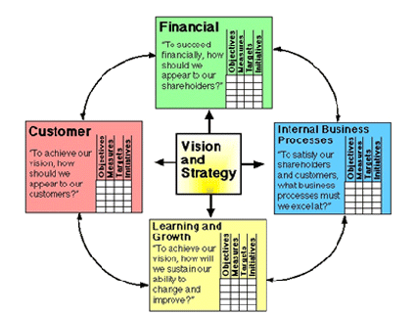
Balanced Scorecard
Methodology that provides four default perspectives to define strategy and ensure stability and success:
  Financial
  Customer
  Internal Process
  Learning and Growth
Notes:
Traditionally, companies focus heavily on financially driven strategies without sufficiently considering other contributing perspectives, such as Customer, Internal Processes, and Learning and Growth. Because financial goals are usually backward looking, tending to be defined in terms of growth over historic numbers, they do not account for future market conditions or leverage objectives. Oracle Scorecard and Strategy Management provides four default perspectives that you can use to define strategies that holistically include all relevant perspectives and to define strategy structures that ensure stability and success in all perspectives. The four default perspectives, which are in support of the balanced scorecard methodology devised by Dr. Robert Kaplan and Dr. David Norton, are:
Financial: Used to identify financial measures that help to answer this question: “How do we look to our shareholders?”
Customer: Used to identify measures that help to answer this question: “How do customers see us?”
Internal Process: Used to identify measures that help to answer this question: “At what processes must we excel?”
Learning and Growth: Used to identify measures that help to answer this question: “How can we continue to improve and create value?”
You can customize the perspectives provided or create your own to best align objectives, key initiatives, and KPIs with your business competencies.
Oracle BI 12c: Create Analyses and Dashboards 13 - <number>

Slide 6
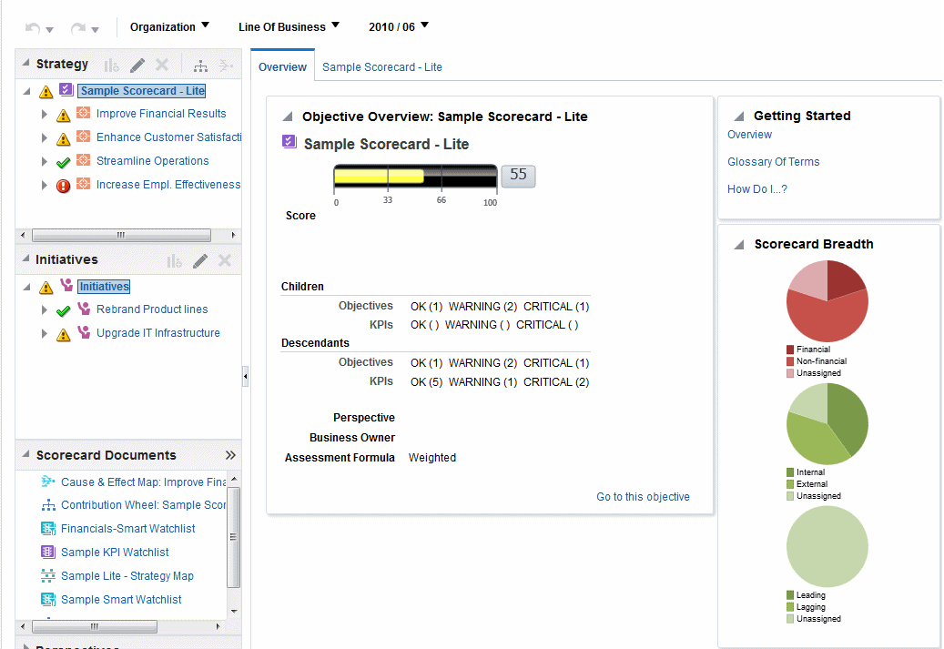


Scorecard Editor
A graphic tool used to create a scorecard for your entire organization or for individual departments
Point of view area
Scorecard Breadth pane
Notes:
The Scorecard editor lets you create a scorecard of your entire organization or of individual departments. It consists of numerous panes and tabs:
On the left side of the editor are the panes that you use to create the objects that comprise your scorecard. For example, it includes the Strategy pane, which you use to create, organize, and leverage the objectives that form the strategic structure of the corporate entity (department, for example) that you want to evaluate.
On the right side of the editor is the tab area. As you create your scorecard objects, detailed tabs are generated dynamically for each object. For example, when you create an objective, a tab is generated for that objective. You use this tab to define the objective and to view detailed information about the objective, such as which KPIs are to be used to evaluate it and which initiatives drive it.
At the top of the editor are toolbar buttons and the point of view area. The point of view area displays the dimensions of the KPIs that are used in the Scorecard to measure the progress and performance of initiatives and objectives. Controls are displayed for each KPI dimension that is referenced in a scorecard with the exception of those that you explicitly prevent from being displayed. If the same dimension is referenced in more than one KPI, then a control can be shared by the KPIs.
Oracle BI 12c: Create Analyses and Dashboards 13 - <number>

Slide 7

Notes:
Use the Scorecard Breadth pane to view pie graphs that show how evenly the objectives that compose your scorecard are distributed among the following categories: Financial versus nonfinancial, Internal versus external, and Leading versus lagging.
Oracle BI 12c: Create Analyses and Dashboards 13 - <number>

Slide 8

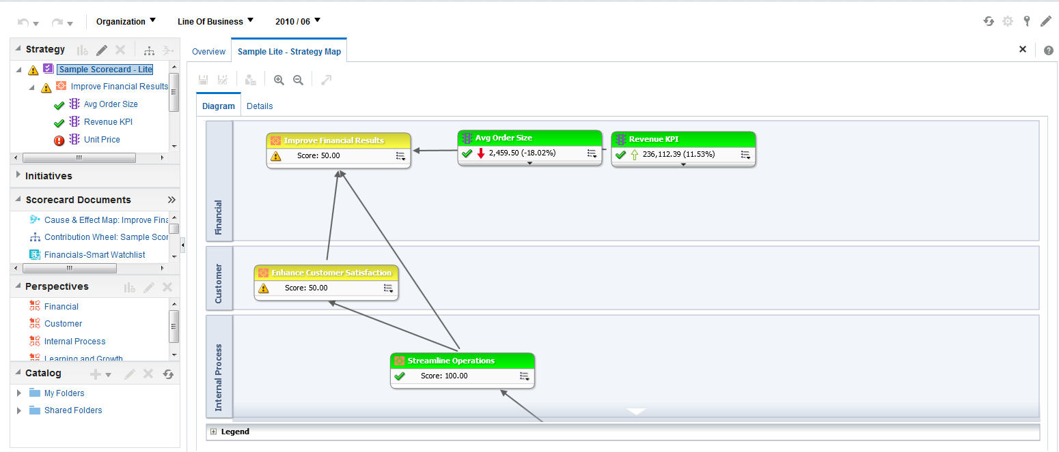









Scorecard Objects
Strategy
Objective
KPIs
Strategy map
Initiatives
Scorecard Views
KPI
Perspectives
Catalog pane to add existing KPIs
Perspective
Notes:
Scorecard objects are items that you create or arrange to:
Represent and evaluate corporate strategy, including:
Objectives: The required or desired outcomes that form your corporate strategy
Initiatives: Time-specific tasks or projects that are necessary to achieve objectives
Perspectives: Categories in your organization with which to associate initiatives, objectives, and KPIs
KPIs: The result of a business measure evaluated against a target for that measure
Present and analyze corporate strategy, including:
Vision statements: Short statements that describe what your organization wants to become sometime in the future
Mission statements: Statements that specify the key business goals and priorities that are required to achieve your vision
Oracle BI 12c: Create Analyses and Dashboards 13 - <number>

Slide 9
Notes:
Oracle BI 12c: Create Analyses and Dashboards 13 - <number>
Strategy trees: Show an objective and its supporting child objectives and KPIs hierarchically
Strategy maps: Show how the objectives that have been defined for a scorecard and the KPIs that measure their progress are aligned by perspectives
Cause and effect maps: Diagrams that are used in scorecards to illustrate the cause and effect relationships of an objective or KPI that is listed in the Strategy pane
KPI watchlists: A set of KPIs whose performance you want to monitor

Slide 10
Scorecard Documents (Views)
  Strategy Tree
    Strategy tree diagram
    Contribution wheel diagram
  Strategy Map
  Cause and Effect Map
  Watchlist and Smart Watchlist
  Custom View
Notes:
Scorecards can be displayed in various formats. In OSMM parlance, these different views are called Scorecard Documents.
In addition to strategy map, cause and effect map, watchlist, smart watchlist and custom view there are two types of diagrams for a strategy tree:
Strategy tree diagram
Contribution wheel diagram
Oracle BI 12c: Create Analyses and Dashboards 13 - <number>

Slide 11
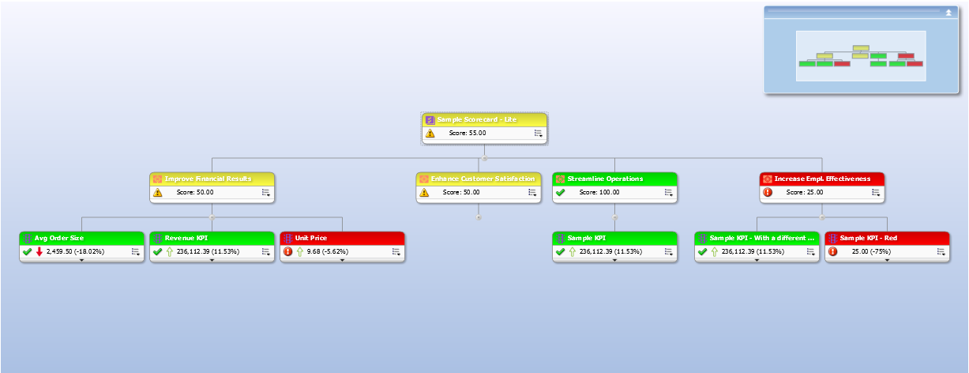


Strategy Tree: Strategy Tree Diagram
A hierarchy of objectives and related KPIs of an organization
Objective
Key Performance Indicators (KPIs)
Notes:
The Strategy Tree shows an objective and its supporting child objectives and KPIs hierarchically. It also provides supporting information for the objective, such as business owner and related documents.
A strategy tree diagram, such as the one shown in the example in the slide, offers the ability to view objectives and their related KPIs in a hierarchical tree diagram view, almost like an organization chart. If you apply some creativity to defining the objectives and KPIs (think one metric repeated many times with a different dimensional filter each time), you can create a custom hierarchy that spans multiple dimensions, as shown above. In this case, nested objectives create custom groupings in one dimension, but ultimately drill down into KPIs filtered across two dimensions.
Oracle BI 12c: Create Analyses and Dashboards 13 - <number>

Slide 12

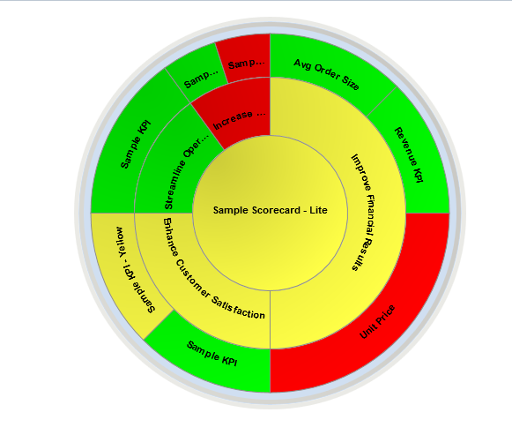


Strategy Tree: Contribution Wheel Diagram
Breadcrumbs
Contribution wheel diagram
Controls to expand or collapse levels
Notes:
You use a contribution wheel diagram to hierarchically view an objective and its supporting child objectives and KPIs in a circular diagram. The contribution wheel diagram makes it easy to see the contribution (or impact) a specific objective or KPI has on a parent objective. It contains the following components:
The contribution wheel: Consists of a center circle (or focus node) that represents the starting objective of the diagram. It is surrounded by concentric circles that are divided into sectors. Each sector is a node that represents a child objective or KPI. The size of a sector is determined by the weight assigned to the represented objective or KPI in its parent's weighted assessment rule. If the parent has no weighted assessment rule, then the child sectors of a parent are all the same size.
The Information pane (not shown in the example in the slide): Displays the following information about the current node:
The status icon and either the score (for an objective) or the actual values and variance percentage (for a KPI)
The status of its children
The weight assigned to it in its parent's weighted assessment rule
Oracle BI 12c: Create Analyses and Dashboards 13 - <number>

Slide 13
Notes:
Breadcrumbs: Consists of a group of small circles that represent the node in the center of the contribution wheel and any of its ancestors that are included in the diagram. Each circle displays the status color of its corresponding node.
Oracle BI 12c: Create Analyses and Dashboards 13 - <number>

Slide 14
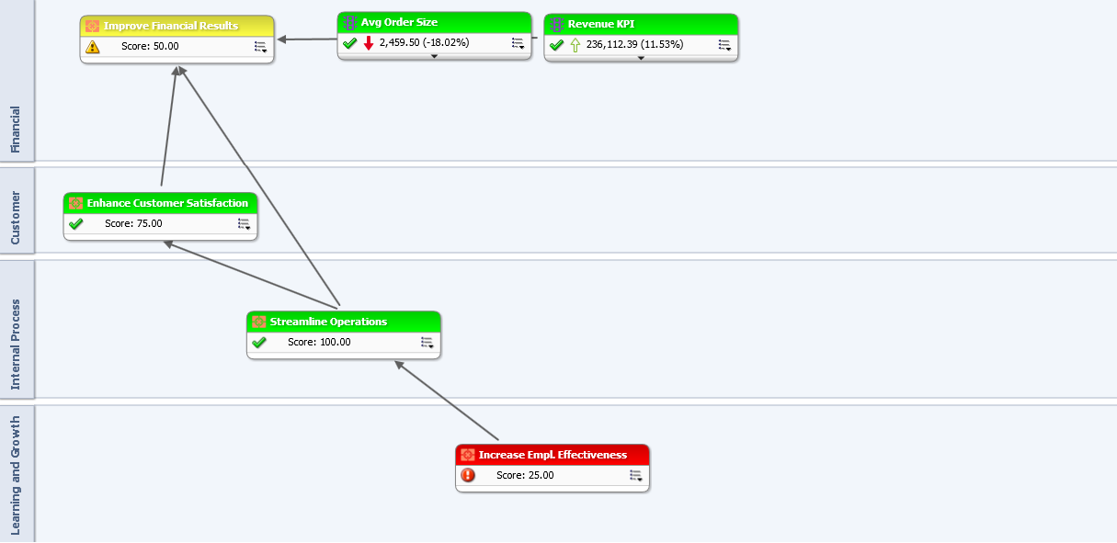
Strategy Map
Depicts relationships between KPIs across perspectives
Notes:
The Strategy Map gives the user visibility to which metric is adversely affecting organizational goals and perspectives. In the example in the slide, Average Order Size KPI is displayed in red which means the actual value is less than the target value and, therefore, adversely impacting the sub-objectives “Reduce Cost” and “Increase Sales.” Because of this, the objective “Improve Financial Results” under Financial perspective is not being met adequately.
Oracle BI 12c: Create Analyses and Dashboards 13 - <number>

Slide 15
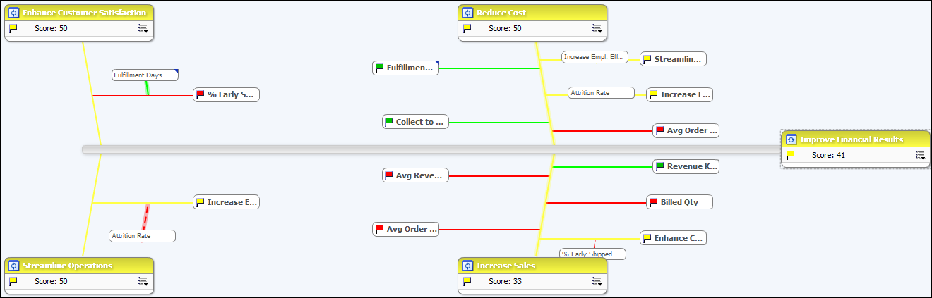
Cause and Effect Map
Designed to highlight reasons why a single KPI might be performing poorly
Notes:
The Cause and Effect Map enables you to illustrate the cause and effect relationships of an objective or KPI that is listed in the strategy pane. The example in the slide shows a cause and effect map for the Improve Financial Results objective.
You create cause and effect relationships for:
An objective when you create or edit the objective and identify:
Other objectives or KPIs that impact or support the objective (causes)
Other objectives or KPIs that this objective impacts or supports (effects)
A KPI when you work with KPI details and identify:
Other objectives or KPIs that impact or support the KPI (causes)
Other objectives or KPIs that this KPI impacts or supports (effects)
A cause and effect map also indicates the proportionality of relationships. That is, whether changes in performance or value in the cause and effect relationship are directly proportional (direct) or inversely proportional (inverse). The strength (strong, moderate, or weak) of cause and effect relationships is indicated with symbols.
A cause and effect map can help you better understand the implications of future strategic changes.
Oracle BI 12c: Create Analyses and Dashboards 13 - <number>

Slide 16
Creating a Scorecard
  Create a new scorecard.
  Create perspectives.
  Create KPIs.
  Create KPI watchlists.
  Create KPI smart watchlists.
  Create and arrange objectives.
  Create and arrange initiatives.
  Assign weights to individual objectives and initiatives.
  Set assessment mappings.
  Graphically depict relationships.
  Use comments.
Notes:
Oracle BI 12c: Create Analyses and Dashboards 13 - <number>

Slide 17
Creating a Scorecard
  Add scorecard views to dashboards.
  Define mission and vision statements.
  Set up point of view controls.
Notes:
To create a scorecard, you perform the tasks listed in the slide. It is recommended that you perform each task in order. Each task is covered in more detail in the slides that follow.
Oracle BI 12c: Create Analyses and Dashboards 13 - <number>

Slide 18
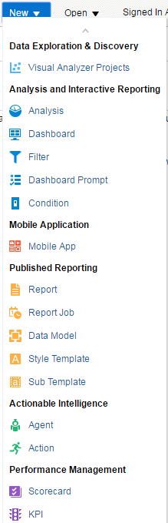
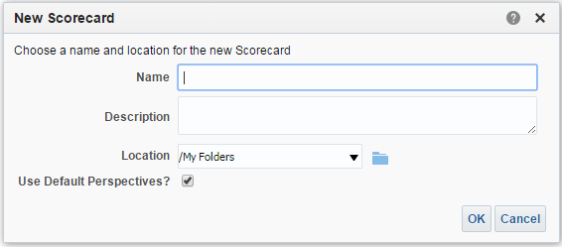
1. Create a New Scorecard
Create a new scorecard to contain the scorecard objects that you must represent, evaluate, present, and use to analyze your corporate strategy.
Notes:
Create a new scorecard to contain the scorecard objects that you must represent, evaluate, present, and use to analyze your corporate strategy, such as objectives, initiatives, perspectives, and so on. You can create a new scorecard from the global header or the Home page. Specify a name, description, and location, and whether to use the default Balanced Scorecard perspectives. After your new scorecard is created, perform the remaining tasks for creating a scorecard.
Oracle BI 12c: Create Analyses and Dashboards 13 - <number>

Slide 19
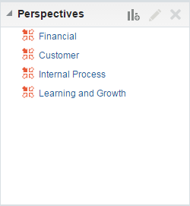
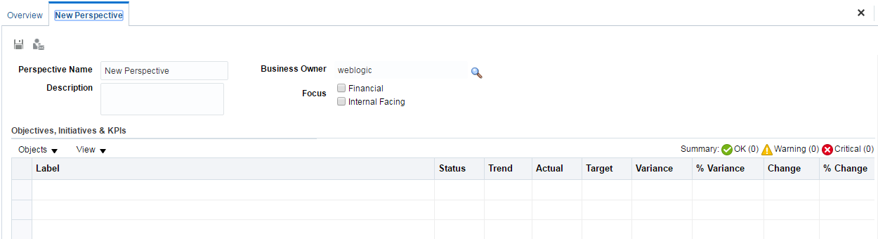
2. Create Perspectives
Create perspectives to represent your key business competencies that you can use to align initiatives and objectives.
Create new perspectives.
Default perspectives
Notes:
Create perspectives to represent your key business competencies (Financial or Research and Development, for example) that you can use to align initiatives and objectives. Perspectives are categories in your organization with which to associate initiatives, objectives, and KPIs. A perspective can represent a key stakeholder (such as a customer, employee, or shareholder/financial) or a key competency area (such as time, cost, or quality).
As stated earlier, there are four standard perspectives that are defined by the Balanced Scorecard Methodology: Financial, Customer, Internal Process, and Learning and Growth. In addition, you can create custom perspectives for your scorecard. When you create a scorecard, you specify whether you want to use the default perspectives that are defined by the Balanced Scorecard Methodology by using the Use Default Perspectives? check box. If you do not use the default perspectives, then you must create your own custom perspectives. If you do use the default perspectives, then you can create one or more custom perspectives to use along with the default perspectives.
Oracle BI 12c: Create Analyses and Dashboards 13 - <number>

Slide 20
3. Create KPIs
  To create a KPI, you must have the Create/Edit KPIs privilege.
  Perform the following steps:
    Create a KPI.
    Define general properties.
    Set the data format and enable trending (optional).
    Define the dimensionality.
    Define statuses and thresholds.
    Define related documents.
    Define custom attributes.
Notes:
A KPI represents the result of a business measure (for example, Product Sales or Operational Costs) evaluated against a target for that measure. You can use KPIs to assess the progress of the objectives and initiatives that form levels of organizational strategy. You can create KPIs that you need outside of a scorecard or within a scorecard. Creating a KPI within a scorecard enables you to create the KPIs as you are creating or editing the scorecard. Creating KPIs outside a scorecard enables you to create the KPIs in advance of creating or editing a scorecard. You can later add these pre-existing KPIs to your scorecard through Catalog Pane.
Oracle BI 12c: Create Analyses and Dashboards 13 - <number>

Slide 21
3.1 Create a New KPI
Create a KPI.
Notes:
You can create KPI inside within a scorecard or independently outside a scorecard.
1. To create a KPI within a scorecard, go to the Scorecard Documents pane, click the New Object icon list, select “Create KPI”, and from the Select Subject Area dialog, select a subject area for the KPI. The KPI editor is displayed.
Oracle BI 12c: Create Analyses and Dashboards 13 - <number>

Slide 22
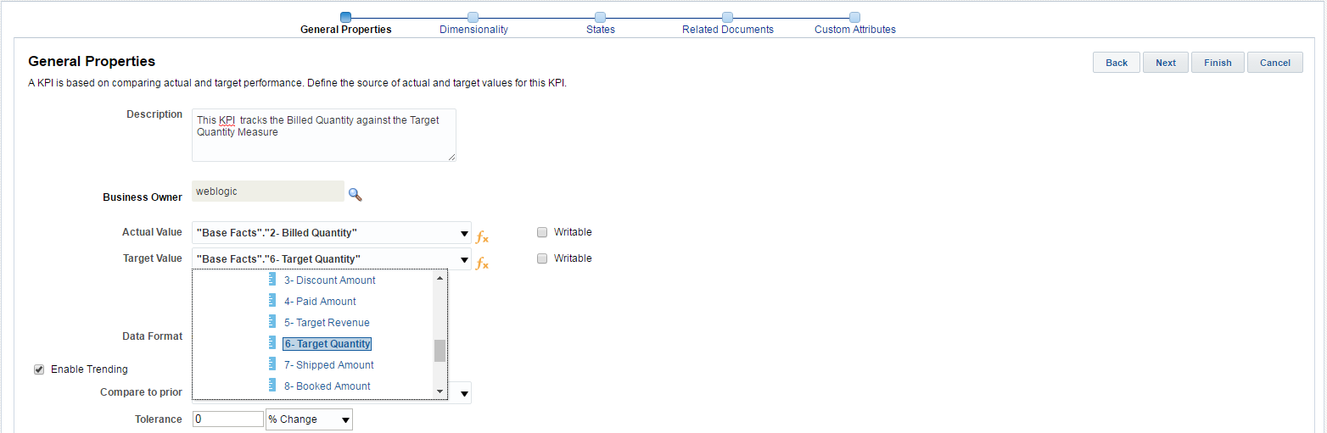





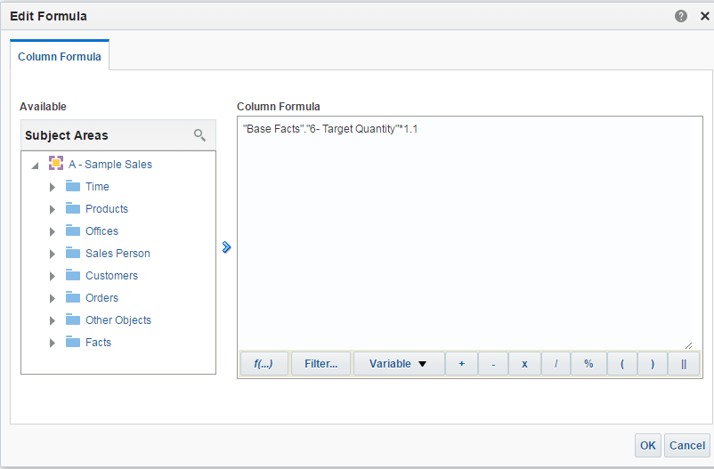
3.2 Define General Properties
Task flow
1
…enter a derived value.
2
Select the Actual and Target values or…
Notes:
Use the General Properties pane to assign the business owner responsible for the KPI, include actual and target values for the KPI, and allow trending.
1. In the General Properties pane, select the Business Owner. The business owner can be either a user or a role. To enter the business owner, click the Set User icon (the magnifying glass) and select a user or role from the Select Business Owner dialog box.
You can use the Search button to find the business owner in a user selection dialog box.
Optionally, enter a description of the KPI.
2. Select the Actual Value and the Target Value for the KPI. The actual value is the currently collected or calculated value, whereas the target value is the desired value for the KPI. You can manually enter a value, select a metric from the subject area, or create a derived formula.
To enter a derived formula, click the Edit Formula button and choose the measures that you want to use in the calculation. Use the features of the Edit Formula dialog box to override the default aggregation rule, enter variables, additional formulas, and mathematical symbols.
Oracle BI 12c: Create Analyses and Dashboards 13 - <number>

Slide 23
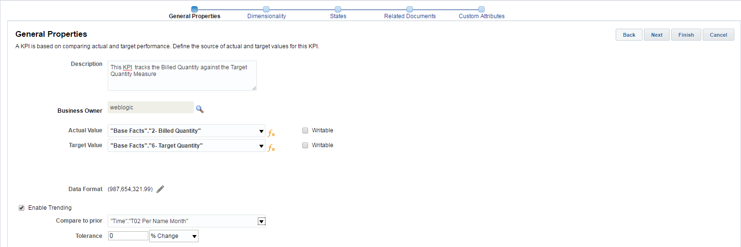



3.3 Set the Data Format and Enable Trending
Set data format.
Enable trending.
Set tolerance as a percent or numeric change.
Notes:
Click the Edit icon for Data Format to open the Data Format dialog box and set the data format for the KPI—for example, numeric, percentage, or currency.
Select the “Enable trending” option to compare KPIs for prior periods and to indicate an increase or decrease in performance. To trend data for analysis, ensure that a Time dimension exists in the subject area. For example, to analyze KPIs by multiple dimensions (Product, Geography, and Time), ensure that the data you use to calculate the actual and target values is also dimensioned by Product, Geography, and Time. An improvement in trending is reported if the “absolute value of the current value minus the current target value” is smaller than the “absolute value of the previous value minus the previous target value.” Change is identified as the “current value minus the previous value.”
Click the “Compare to prior” drop-down list to select the value against which you want to compare the new KPI.
You can also include a tolerance that you consider acceptable, before the performance is considered to be improving or worsening. The tolerance can be entered as a percent or as an actual number that represents a difference (change) from the prior period. To represent the tolerance as a percentage, select % from the drop-down list.
Click Next to advance to the Dimensionality pane or you can click Dimensionality in the task flow.
Oracle BI 12c: Create Analyses and Dashboards 13 - <number>

Slide 24
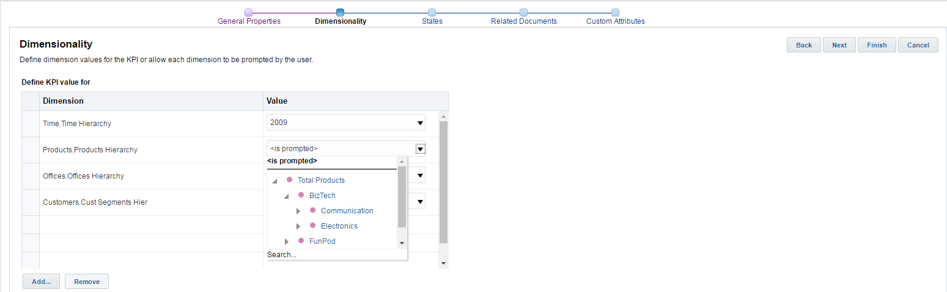


3.4 Define the Dimensionality
Pinned dimension
Add a dimension.
Notes:
Use the Dimensionality pane to aggregate KPI values, target values, and ranges, using dimensions in the subject area, such as Region or Time. For example, a KPI for Forecasted Units could be dimensioned by Region, Year, and Product to evaluate the KPI, using data from different regions, for different products, and from previous years.
You can select one or more columns (including hierarchical columns) to define the dimensionality of the KPI. You can also qualify the selected columns with one or more member values. For example, the Geography dimension might be qualified or pinned with a value of “United States”—pinning a dimension is essentially filtering the dimension.
To add a dimension, click Add and choose the dimension from the Add New Dimension dialog box.
After adding a dimension, use the Value drop-down list to select the actual value or data point for the KPI. Select “<is prompted>” to enable users to specify the value for the dimension elsewhere (for example, when using the Point of View bar) or select a specific value.
Note: For example, if you pin a value to a dimension, the end user will not be allowed to select another value when using the KPI on a watchlist.
Click Next or navigate using the task flow to the States pane.
Oracle BI 12c: Create Analyses and Dashboards 13 - <number>

Slide 25
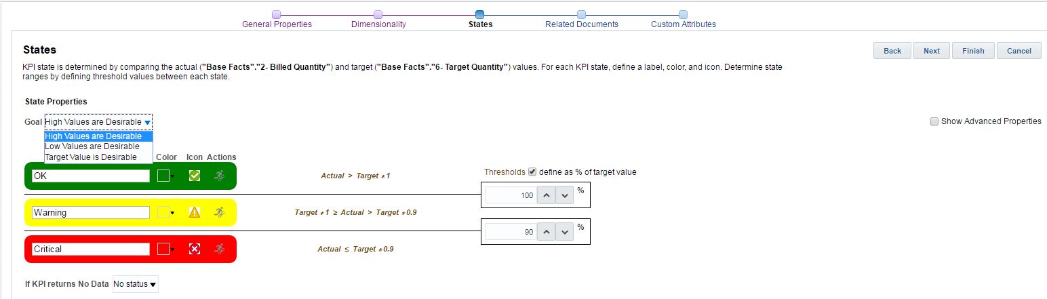

3.5 Define States and Thresholds
Select which values are desirable.
Notes:
The States pane enables you to indicate whether high, low, or target values are desirable; to specify statuses, symbols, and range thresholds for evaluating performance; to create or assign actions based on KPI status; and so on.
You use the States pane to do the following:
Indicate whether high KPI values are desirable.
Specify the ranges and statuses and related symbols that gauge and represent KPI performance.
Create or assign actions that can be performed based on KPI status.
Override the mappings used to calculate a normalized KPI score. (Select the “Show Advanced Properties” check box.)
The Goal section of the Thresholds pane provides a drop-down list that indicates a specific level of performance. You specify whether high, low, or target values are desirable. For example, select “High Values are Desirable” for a Customer References KPI. Conversely, select “Low Values are Desirable” for an Unresolved Support Calls KPI, because the smallest number of calls in which customer issues are not resolved is preferable.
Oracle BI 12c: Create Analyses and Dashboards 13 - <number>

Slide 26


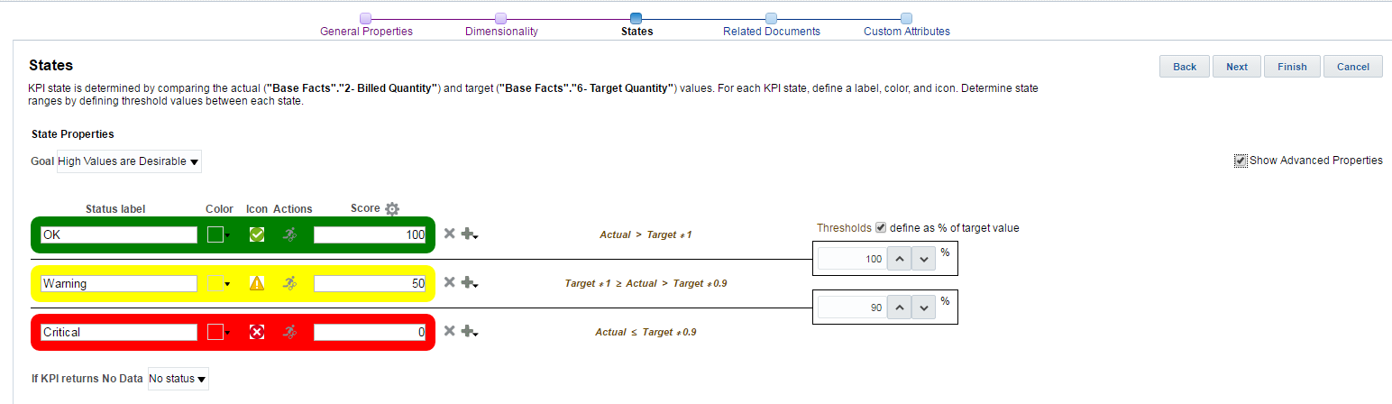




3.5 Define States and Thresholds
Specify colors, icons, and so on.
Display scores and Add/Remove Status icons.
Enter a
status label.
Edit normalized scores associated with each status.
Add or delete a status.
Set threshold values, expressed as either a measure or a % of the target value.
Notes:
As noted in the States pane summary text, KPI state is determined by comparing the actual value against the target value and by placing the result in a corresponding range that defines levels of performance status (OK, Warning, or Critical, for example), which has a corresponding label, color, icon, and (optionally) an associated action.
By default, OK, Warning, and Critical statuses are created. Use the fields and drop-downs for each status to specify or edit labels and colors or choose icons from a library of options
Identify the numerical values or measures that separate performance levels using thresholds. These can be represented as numeric values or percentages of target by toggling the “define as % of target value” option for the thresholds.
Select the “Show Advanced Properties” check box to add additional statuses or remove existing ones. Click the Add icon and select “Add above” or “Add below” to add a status. A threshold is generated automatically between each status. Click the Delete icon to remove a status and its corresponding threshold.
The Show Advanced Properties check box also toggles display of Status scores mapped for each KPI status. These are normalized across all the statuses, so, for example, a KPI with three statuses displays assessment scores of 100, 50, and 0 by default. These scores can be edited and are used in Oracle BI Scorecard to determine the scores of objectives and initiatives. Click Next to navigate to the Related Documents pane.
Oracle BI 12c: Create Analyses and Dashboards 13 - <number>

Slide 27
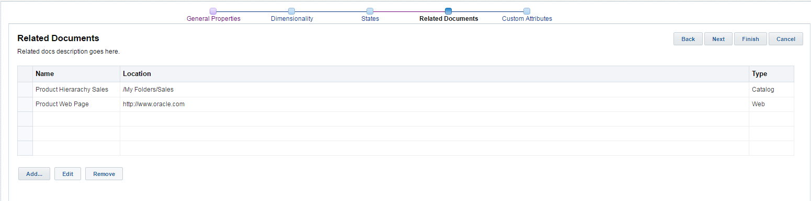

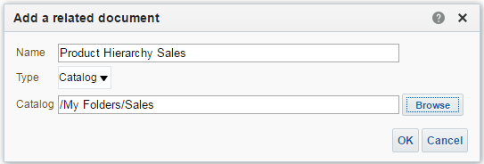
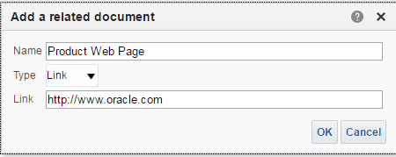

3.6 Define Related Documents
1
2
3
Notes:
Use the Related Documents pane to view and add links to BI objects in the Presentation Catalog and webpages that provide additional information about the KPI.
1. Click Add.
2. In the “Add a related document” dialog box, enter a name for the document and specify a type of either Catalog or Link.
3. If you select Catalog as the type, browse the Presentation Catalog to locate the object to display and click OK. Alternately, select the Link type and specify a URL.
Oracle BI 12c: Create Analyses and Dashboards 13 - <number>

Slide 28
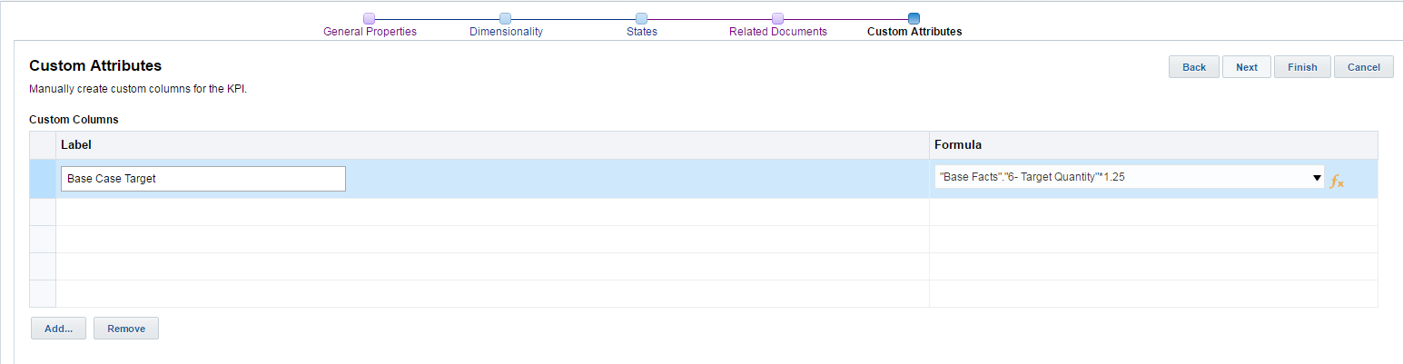
3.7 Define Custom Attributes
3
2
1
Notes:
Use the Custom Attributes pane to add up to a maximum of five custom columns to your KPI. For example, you might add a column that shows units from a year ago. To add a custom column, perform the following steps:
1. Click Add.
2. Enter a label for the column.
3. Perform one of the following tasks:
Click the down-arrow button under Formula to access the subject area list and select a measure or a column that contains a measure-based formula.
Click the Edit Formula button and, in the Edit Column Formula dialog box, create a formula that calculates the column values. For example, ((Sales - Cost)/Sales) * 100.
When you have completed your work in the task flow, click Finish to save the KPI.
Oracle BI 12c: Create Analyses and Dashboards 13 - <number>

Slide 29
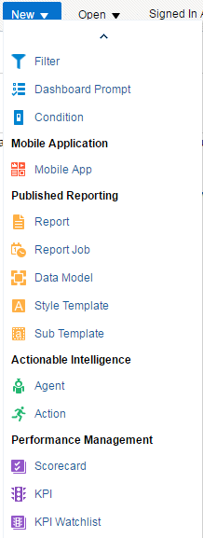
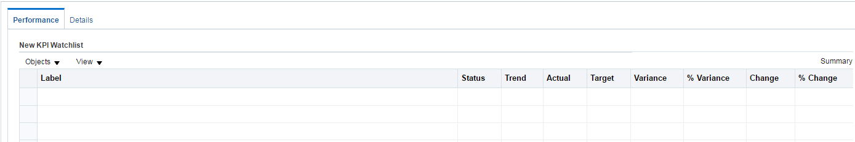
4. Create KPI Watchlists
You can create KPI watchlists outside of a scorecard or within a scorecard.
Notes:
A KPI watchlist is a set of KPIs whose performance you want to monitor. You can create KPI watchlists outside of a scorecard or within a scorecard. Creating a KPI watchlist within a scorecard helps you view and investigate the progress of the objectives and initiatives. Watchlists that you create within scorecard are saved as part of the scorecard. Creating KPI watchlists outside a scorecard enables you to create a KPI watchlist in advance of creating or editing a scorecard. Watchlists that you create outside a scorecard are saved as stand-alone objects in the Oracle BI Presentation Catalog.
To create a KPI watchlist from within a scorecard, go to the Scorecard Documents pane, click the New Object icon list, select KPI Watchlist, and from the Select Subject Area dialog box, select a subject area for the KPI. The KPI Watchlist editor is displayed.
Note: For more information on creating and managing stand-alone KPI watchlists, see the lesson titled “Using KPIs and KPI Watchlists” in Oracle Fusion Middleware User's Guide for Oracle Business Intelligence Enterprise Edition.
Oracle BI 12c: Create Analyses and Dashboards 13 - <number>

Slide 30
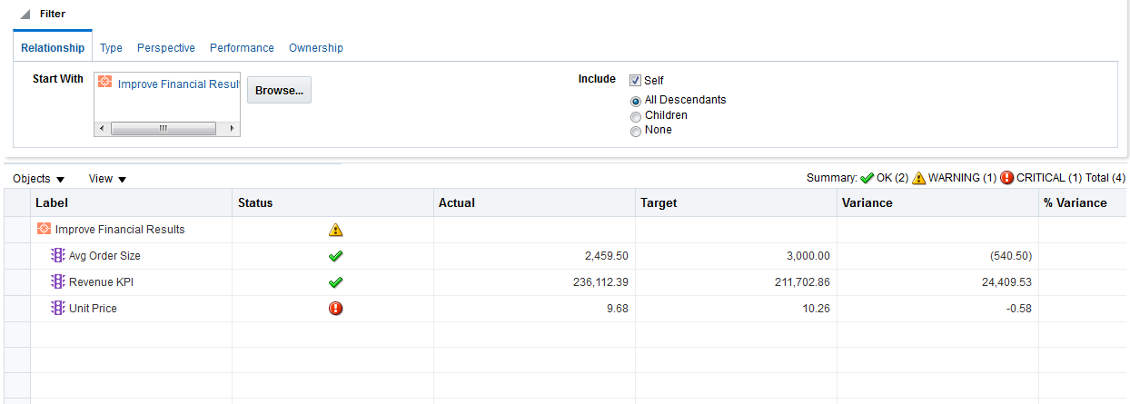
5. Create KPI Smart Watchlists
A smart watchlist is a view into a particular scorecard based on criteria that you specify.
Notes:
A smart watchlist is a view into a particular scorecard based on criteria that you specify. For example, a smart watchlist might show the top 10 KPIs in a scorecard based on best performance or all the objectives, initiatives, and KPIs in a scorecard that are owned by a specific business owner.
You can create smart watchlists within scorecards in Edit mode only. In View mode, you can view a smart watchlist and, if the smart watchlist was saved with the Filter pane displayed as a control panel, you can specify filter criteria to dynamically change what is shown in the smart watchlist.
You can also add smart watchlists to dashboards. If the smart watchlist was saved with the Filter pane displayed as a control panel, end users will be able to specify filter criteria to dynamically change what is shown in the smart watchlist.
Oracle BI 12c: Create Analyses and Dashboards 13 - <number>

Slide 31
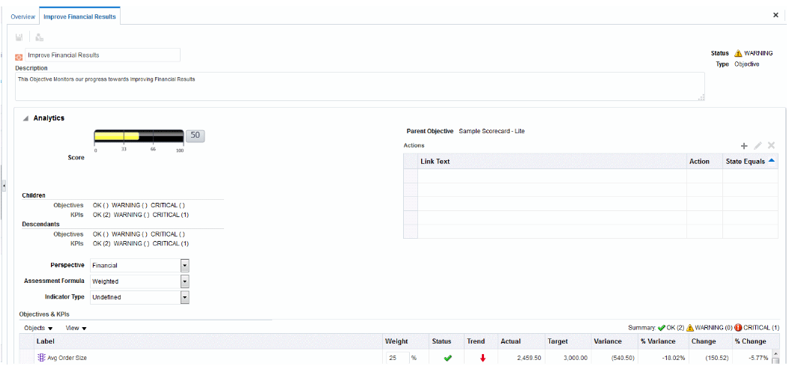


6. Create and Arrange Objectives
Objectives are the required or desired outcomes that form your corporate strategy.
Objective
KPI
Notes:
Objectives are the required or desired outcomes that form your corporate strategy. You can create an objective for an entire organization, for example, Oracle Corporation, or for a department, for example, Sales department.
When you create an objective, you assign it one or more KPIs that are to be used to measure its progress and performance.
For example, you might create an objective named Enhance Customer Satisfaction to improve overall customer satisfaction scores. To support this objective, you might assign KPIs to track the percent of orders that are shipped early, and the number of days to fulfill orders.
Objectives that you create are displayed hierarchically in the Strategy pane. The root objective represents the entity that you are scorecarding, that is the entire organization or a department. The KPIs that are assigned to assess the performance of objectives are displayed below the objectives in the Strategy pane. The Strategy pane also shows the statuses of objectives and KPIs using the appropriate colors and icons that you specified for assessment mappings.
You can create one or more objectives. Objectives that you create should be strategically relevant and measurable using KPIs.
Oracle BI 12c: Create Analyses and Dashboards 13 - <number>

Slide 32
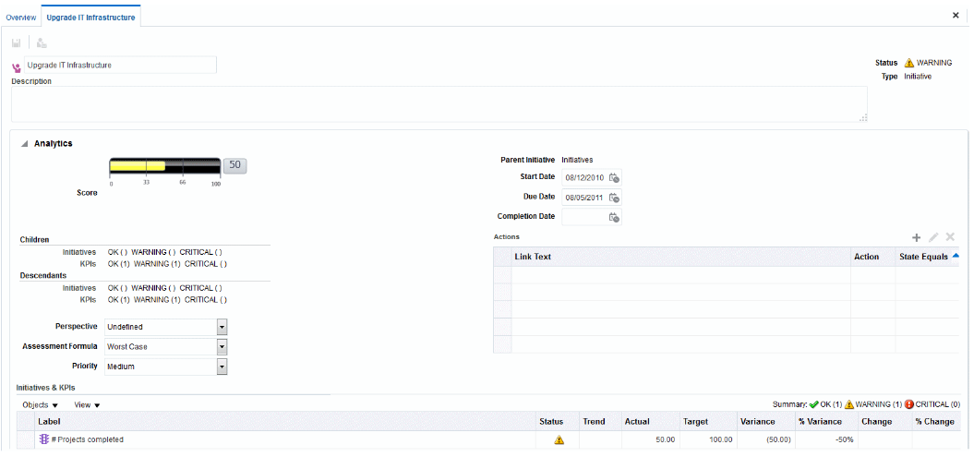


7. Create and Arrange Initiatives
Initiatives are time-specific tasks or projects that are necessary to achieve objectives.
Initiative
KPIs
Notes:
Initiatives are time-specific tasks or projects that are necessary to achieve objectives. As such, you can use initiatives that support objectives as milestones as they reflect progress toward strategy targets.
Generally, an initiative supports multiple objectives. When you create an initiative, you assign it KPIs that are to be used to measure its progress. For example, your company might implement an initiative to modernize your IT infrastructure to support a more streamlined supply chain, customer service, and online ordering structure. To support those objectives, you might assign KPIs to track the number of orders, the percent of orders that are shipped early, and the number of days taken to fulfill orders.
Initiatives that you create are displayed hierarchically in the Initiatives pane. The root initiative represents all the initiatives that you implement to achieve objectives and goals. The KPIs that are assigned to an initiative are displayed below the initiative in the Initiatives pane. The Initiatives pane also shows the statuses of initiatives and KPIs using the appropriate colors and icons that you specified for assessment mappings. You can create one or more initiatives. Initiatives that you create should be measurable using KPIs and be strategically relevant.
Oracle BI 12c: Create Analyses and Dashboards 13 - <number>

Slide 33
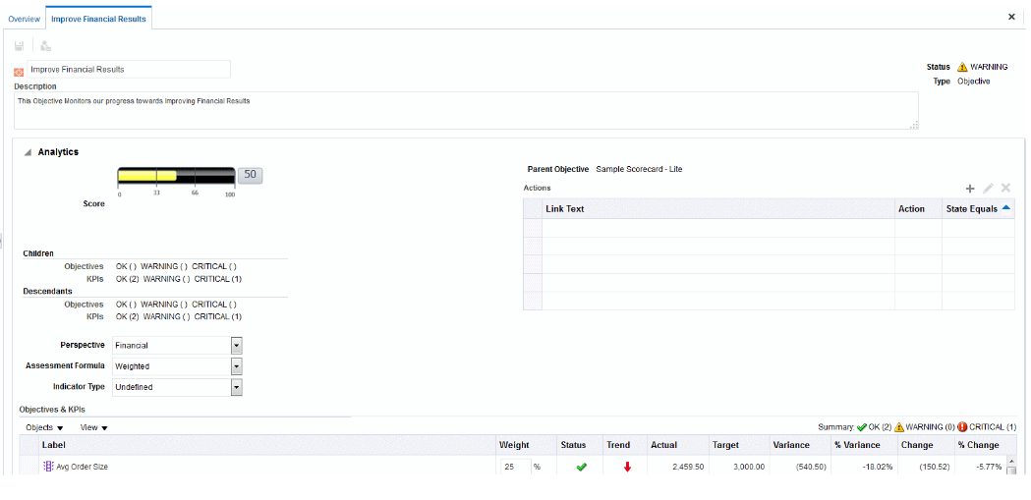


8. Assign Weights to Individual Objectives and Initiatives
Oracle BI assesses the performance of an initiative or objective by aggregating the assessments of its children.
Assessment formula: Weighted
Weights
Notes:
Oracle Business Intelligence assesses the performance of an initiative or objective by aggregating the assessments of its children. In the process, it uses:
Scorecard assessment mappings that you define: Assessment mappings are the score thresholds and assessment ranges that Oracle Business Intelligence uses to assess the performance of objectives and initiatives.
Assessment formulas (such as Weighted or Best Case) assigned to all objectives and initiatives: You assign assessment formulas when you create an objective or initiative. The assessment formulas include:
Worst case: Specifies that the status of the worst performing child KPI or objective is to be used
Best case: Specifies that the status of the best performing child KPI or objective is to be used
Most Frequent (Worst Case): Specifies that, if half the child KPIs and objectives have high performance and half have low performance, then the status of the worst performing child KPI or objective is to be used
Oracle BI 12c: Create Analyses and Dashboards 13 - <number>

Slide 34
Notes:
Most Frequent (Best Case): Specifies that, if half the child KPIs and objectives have high performance and half have low performance, then the status of the best performing child KPI or objective is to be used
Weighted: Specifies to use a weighted average based on the weights you have assigned to the child KPIs and objectives
Weights that you assign to child initiatives, objectives, and KPIs (but only if the parent’s assessment rule is set to Weighted) to identify the extent to which each child contributes to the overall performance of the parent. You assign weights to the child objectives, initiatives, and KPIs of an objective or initiative to indicate how much it affects the performance of its parent objective. To assign weights to child objectives, initiatives, and KPIs, the Assessment Rule for the parent objective or initiative must be set to Weighted. In the Objectives and KPIs or Initiatives and KPIs table of the “Analytics pane”, enter a weight for each child objective, initiative, or KPI.
Oracle BI 12c: Create Analyses and Dashboards 13 - <number>

Slide 35

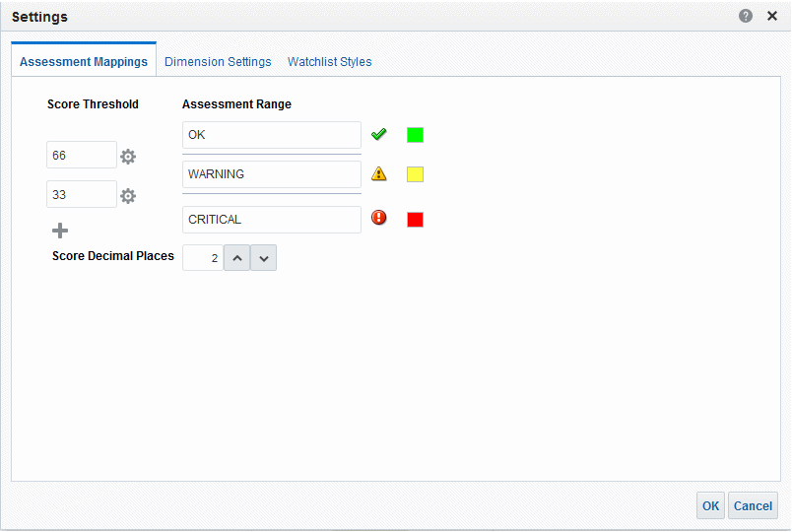
9. Set Assessment Mappings
Notes:
Assessment mappings are used to assess performance of objectives and initiatives. To define assessment mappings, click the Scorecard Settings toolbar button in the Scorecard editor to open the Settings dialog box: Assessment Mappings tab. In the Score Threshold fields, enter the numeric values that set the boundaries for the assessment ranges. In the example in the slide, 33 and 66 are used to set the boundaries for three assessment ranges: Critical, Warning, and OK. Any KPI score from 0 to 33 would fall in the Critical assessment range, any KPI score from 34 to 66 would fall in the Warning assessment range, and any KPI score from 66 to 100 would fall in the OK assessment range. In the Assessment Range boxes, specify the name of each assessment range (for example, Critical) and, for each range, specify the icon and the color to be used to represent the range.
Oracle BI 12c: Create Analyses and Dashboards 13 - <number>

Slide 36

10. Graphically Depict Relationships
There are four graphic views to assist in depicting relationships: Strategy map, Cause and Effect map, Strategy tree, and Custom view.
Strategy map
Notes:
There are four graphic views to assist in depicting relationships: Strategy map, Cause and Effect map, Strategy tree, and Custom view.
Strategy map: Shows how the objectives that have been defined for a scorecard and the KPIs that measure their progress are aligned by perspectives. It also indicates cause and effect relationships between objectives and other objectives or KPIs with connecting lines. You create cause and effect relationships when you create (or edit) an objective or work with KPI details. You can also create cause and effect relationships in a strategy map.
Cause and effect map: Lets you illustrate the cause and effect relationships of an objective or KPI that is listed in the Strategy pane
Strategy tree: Shows an objective and its supporting child objectives and KPIs hierarchically. It also provides supporting information for the objective, such as business owner and related documents.
Custom view: Lets you display a customized view of your business and strategy data. For example, you might present information about objectives and KPIs on a background image of your choice, such as your company logo.
The screenshot shows an example of a strategy map.
Oracle BI 12c: Create Analyses and Dashboards 13 - <number>

Slide 37
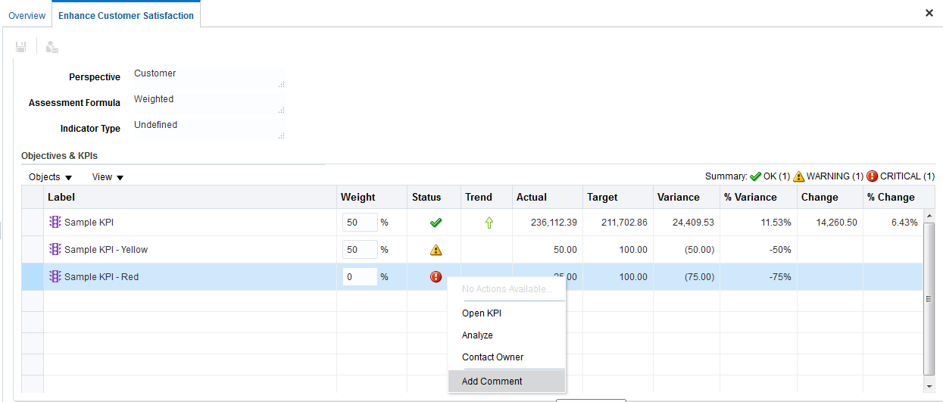
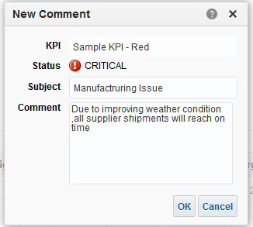
11. Use Comments
Comments (also known as annotations) allow you to discuss changes in performance and progress for an initiative, objective, or KPI.
Notes:
Comments (also known as annotations) enable you to discuss changes in performance and progress for an initiative, objective, or KPI for a specific set of dimension values (that is, for a specific point of view). You can add, view, and reply to comments in many places in a scorecard. For example, you can add a comment directly to an objective in the "Scorecard editor: Objective Details tab". You can also add a comment to an objective in a view, KPI watchlist, or perspective in which its referenced.
A comment is associated with:
An initiative, objective, or KPI that measures the progress of an initiative and objective
A certain column
A specific point of view
Any dimension pinnings on the KPI
The screenshot shows an example of adding a comment in the collaboration section of an objective.
Oracle BI 12c: Create Analyses and Dashboards 13 - <number>

Slide 38
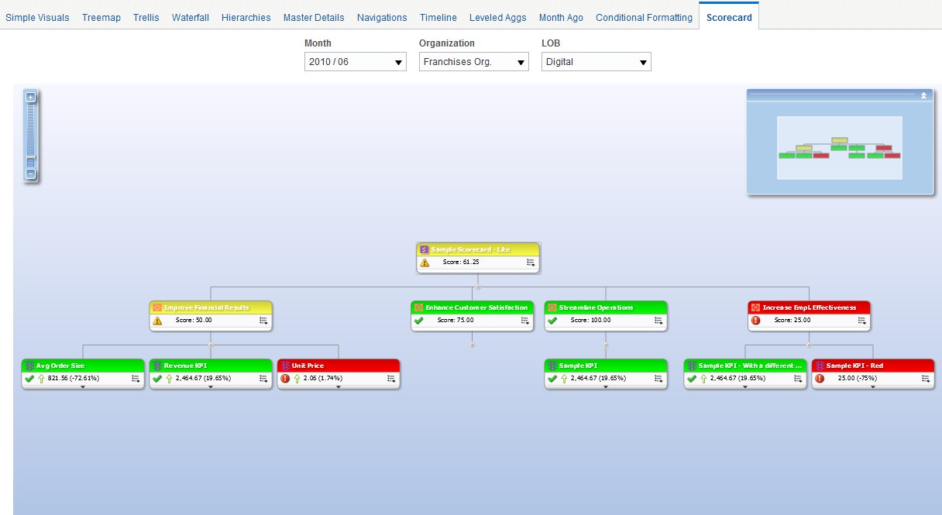
12. Add Scorecard Views to Dashboards
You can add scorecard objects to dashboards.
Notes:
You can add the following scorecard objects to dashboards:
Cause and effect maps
Strategy maps
Strategy trees
KPI watchlists
You add a scorecard object to a dashboard in the same way you would add any object to a dashboard. The screenshot shows a strategy map added to the Scorecard page of a dashboard.
Oracle BI 12c: Create Analyses and Dashboards 13 - <number>

Slide 39
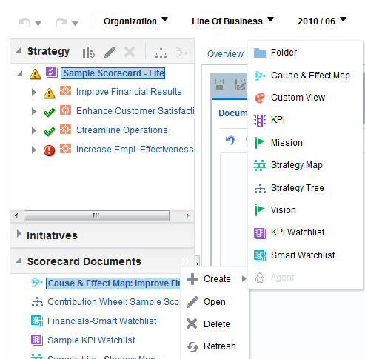
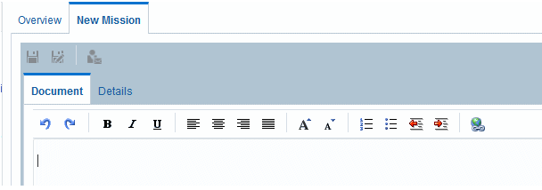
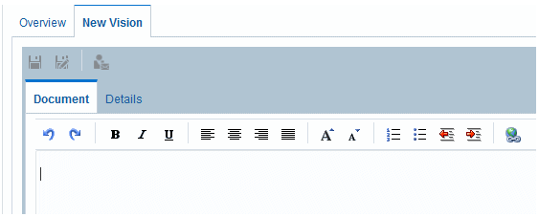
13. Define Mission and Vision Statements
  A vision statement is a short statement that describes what your organization wants to become sometime in the future.
  A mission statement specifies the key business goals and priorities that are required to achieve your vision.
Notes:
You can optionally define the mission and vision statements that translate your corporate direction into overarching strategic themes and thrusts that you later support by creating objectives.
A vision statement is a short statement that describes what your organization wants to become sometime in the future. For example, it might want to become the most successful business in the South America Polypropylene market. Often, from this statement, you define the key goals and priorities that form your mission statement.
A mission statement specifies the key business goals and priorities that are required to achieve your vision.
To define a mission or vision statement, click the Create Object toolbar button In the Scorecard Documents pane, and then select Mission or Vision.
Oracle BI 12c: Create Analyses and Dashboards 13 - <number>

Slide 40

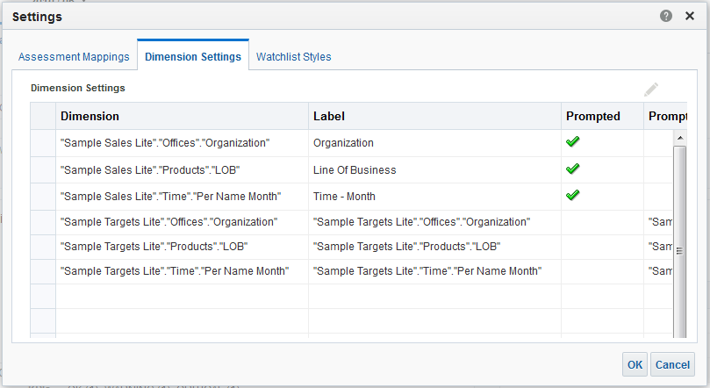
14. Set Up Point of View Controls
The point of view area displays controls for the dimensions of KPIs that are used in the Scorecard to measure the progress and performance of initiatives and objectives.
Click Scorecard Settings.
Notes:
The point of view area of the Scorecard editor displays controls for the dimensions of KPIs that are used in the Scorecard to measure the progress and performance of initiatives and objectives. Controls are displayed for each KPI dimension that is referenced in a scorecard with the exception of those that you explicitly prevent from being displayed. If the same dimension is referenced in more than one KPI, then a control can be shared by the KPIs.
Each control includes a label and a down-arrow button that displays a list of the dimension values from which you can select. The label is the database name for the dimension (by default), a user-friendly label, if specified for the control, or a specific value, if the dimension is pinned to a value.
You use this area to temporarily pin (that is, set values) for the dimensions. When you pin a dimension, the data in the scorecard is filtered to give you a new point of view (that is, a new view of the data). This enables you to focus on specific data of interest to you, such as the area of business for which you are responsible. The point of view area settings are temporary and are not persisted when the scorecard is saved.
To set up the point of view controls, click the Scorecard Settings toolbar button in the Scorecard editor, click the Dimension Settings tab, and set up the controls for each dimension as desired.
Oracle BI 12c: Create Analyses and Dashboards 13 - <number>

Slide 41
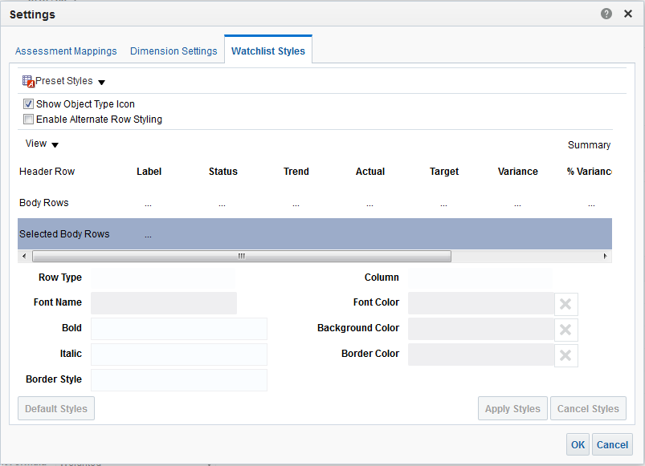
14. Set Up Point of View Controls
The point of view area displays watchlist style in the Scorecard to set custom styles for each watchlist, and rename and change the order and visibility of the watchlist columns.
Notes:
Oracle BI 12c: Create Analyses and Dashboards 13 - <number>

Slide 42
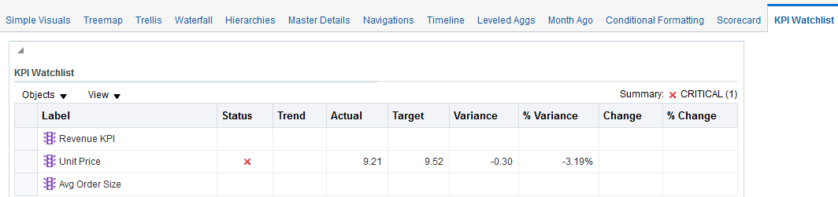
Attach KPI Watchlist to Dashboard
You can add KPI Watchlist to dashboards.
Notes:
Oracle BI 12c: Create Analyses and Dashboards 13 - <number>

Slide 43
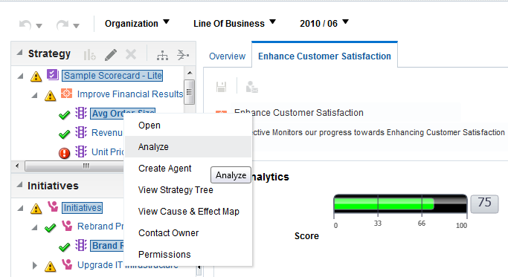
Working with Objects in the Scorecard Editor
Use the right-click menu options to work with objects in the Strategy and Initiatives panes.
Notes:
The right-click menu for objects in the Initiatives pane or the Strategy pane provides a number of options that allow you to work with the objects in the pane. For example, you can open objects, delete objects, or reorder objects using cut and paste operations. The options vary depending on the type of object, whether the object is in the Initiatives pane or Strategy pane, and whether the Scorecard editor is in edit or read-only mode. A list of right-click menu options is provided below:
Open: Displays the object for editing or viewing, depending on the current mode
View Strategy Tree: Displays the strategy tree for the selected object
View Cause and Effect Map: Displays the cause and effect map for the selected object
Oracle BI 12c: Create Analyses and Dashboards 13 - <number>

Slide 44
Notes:
Analyze: This option is available only when you select a KPI. Use this option to create an analysis based on the KPI. The analysis is automatically saved in the catalog in the My Folders/Drills folder.
Create Agent: This option is available only when you select a KPI. Use this option to display the Create New Agent dialog box, where you create an agent from the KPI.
Contact Owner: Displays the Contact Owner dialog box, where you can contact the business owner of the object
Permissions: Displays the Permission dialog box, where you can set permissions for an object
Oracle BI 12c: Create Analyses and Dashboards 13 - <number>

Slide 45

Quiz: Overview
This quiz examines your knowledge of scorecards and KPIs.
Notes:
Quiz: Overview
In this quiz, you answer questions regarding scorecards and KPIs.
Oracle BI 12c: Create Analyses and Dashboards 13 - <number>

Slide 46
Quiz
You can create KPI-smart watchlists outside of a scorecard or within a scorecard.
  True
  False
Notes:
Answer: b
You can create smart watchlists within scorecards only in Edit mode.
Oracle BI 12c: Create Analyses and Dashboards 13 - <number>

Slide 47
Quiz
Which scorecard object is used to represent key business competencies that you can use to align initiatives and objectives?
  Strategy
  KPI
  Perspective
  KPI Watchlist
Notes:
Answer: c
Oracle BI 12c: Create Analyses and Dashboards 13 - <number>

Slide 48
Quiz
Mission statements are required and must be included in scorecards.
  True
  False
Notes:
Answer: b
Oracle BI 12c: Create Analyses and Dashboards 13 - <number>

Slide 49
Quiz
KPIs are metrics to measure the performance of an organization relative to its strategic objectives.
  True
  False
Notes:
Answer: a
Oracle BI 12c: Create Analyses and Dashboards 13 - <number>

Slide 50
Quiz
A KPI Threshold is an assessment rule to determine the KPI’s status at any given time and must be defined as a simple number that can be used during evaluation.
  True
  False
Notes:
Answer: b
A KPI Threshold can be a simple number, a percentage of target, or a complex expression.
Oracle BI 12c: Create Analyses and Dashboards 13 - <number>

Slide 51
Quiz
Which task is performed on the KPI Dimensionality page?
  Aggregation of KPI values
  Change of icons for statuses
  Association of related documents that describe the KPIs
Notes:
Answer: a
Oracle BI 12c: Create Analyses and Dashboards 13 - <number>

Slide 52
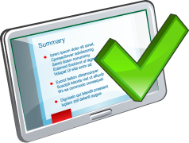
Summary
In this lesson, you should have learned how to:
  Identify the objects and components of Oracle Scorecard and Strategy Management
  Identify Scorecard Document Type
  Create and measure Key Performance Indicators
  Create a Scorecard
Notes:
Oracle BI 12c: Create Analyses and Dashboards 13 - <number>

Slide 53

Practice 13: Overview
This practice covers the following topics:
  Creating and measuring KPIs
  Building a scorecard
Notes:
Oracle BI 12c: Create Analyses and Dashboards 13 - <number>

