Slide 1
Visual Analyzer, BI Ask, and Data Mashup
Notes:
Schedule Timing Topic
30 minutes Lecture
40 minutes Practice
05 minutes Quiz
70 minutes Total

Slide 2

Objectives
After completing this lesson, you should be able to:
  Develop and visualize reports using Visual Analyzer
  Explain BI Ask
  Describe Data Mashup
Notes:
Oracle BI 12c: Create Analyses and Dashboards 14 - <number>

Slide 3
Visual Analyzer
Visual Analyzer is a very intuitive and interactive web-based tool to explore and analyze your data. Visual Analyzer allows you to create different analyses and reports in the same place (like a combination of Answers and Dashboards).
Notes:
In Visual Analyzer, just drag and drop the columns (or double-click them) from the data elements panel. It offers interactive visualizations, showing the results immediately on the same page. It acts as a complement to Answers and Dashboards for data exploration and discovery pattern.
Oracle BI 12c: Create Analyses and Dashboards 14 - <number>

Slide 4
Visual Analyzer Login Page
  Sign in to Oracle BI with the given credentials. The Home page is displayed.
  Click VA Projects on the left.
  Visual Analyzer is launched in a separate tab. Log in with the required credentials.
Notes:
Oracle BI 12c: Create Analyses and Dashboards 14 - <number>

Slide 5


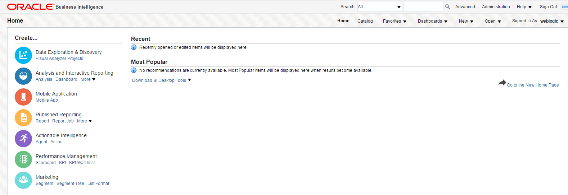
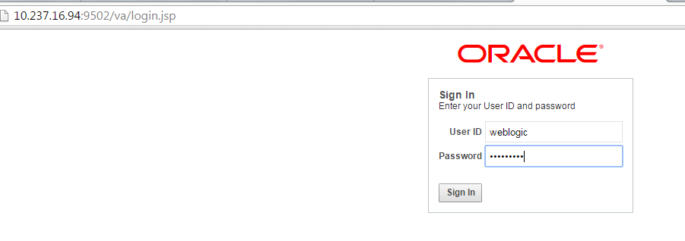


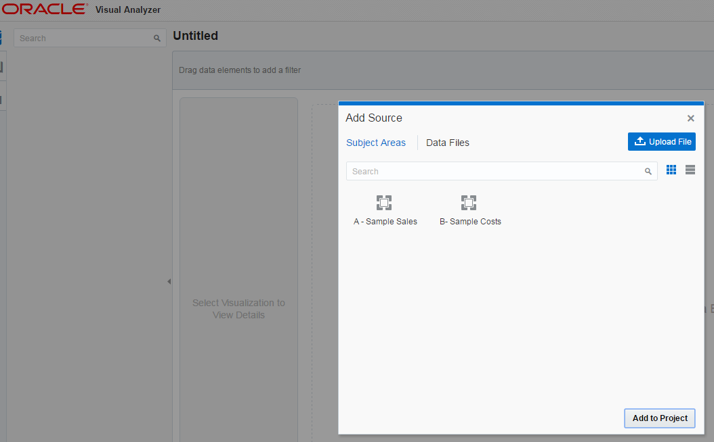
Visual Analyzer Login Page
Navigate to the Visual Analyzer Login Page.
Enter Login Details.
2
1
3
Notes:
Oracle BI 12c: Create Analyses and Dashboards 14 - <number>

Slide 6
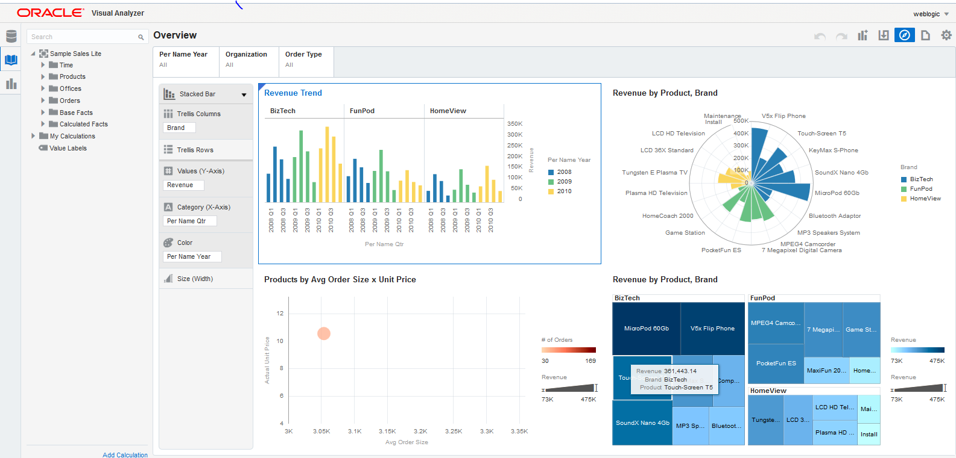
Visual Analyzer Projects
Notes:
Visual Analyzer projects are composed of one or more visualizations. Each visualizations can have different content and different visualizations type (Graph, Table, Map and so on).The first time that you drag columns onto an empty canvas, a visualization is automatically created.
Oracle BI 12c: Create Analyses and Dashboards 14 - <number>

Slide 7
Creating Visual Analyzer Projects
Perform the following steps:
  Select the data source.
  Select Content.
  Set Visualization Type.
  Add More Visualization.
  Rearrange the Visualizations in a VA project.
  Filter the data in Visual Analyzer.
  Create Calculations.
Notes:
Oracle BI 12c: Create Analyses and Dashboards 14 - <number>

Slide 8
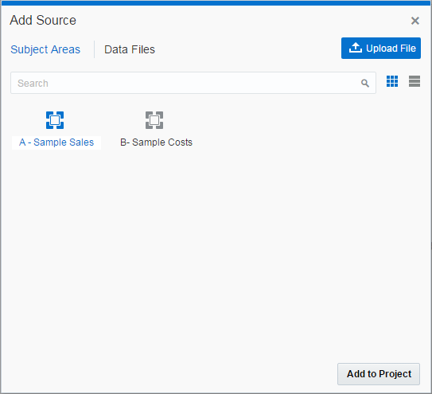
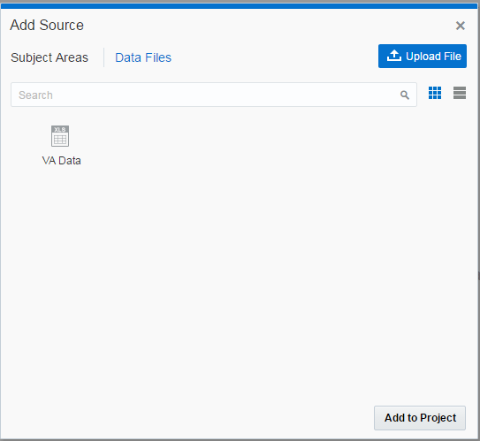
Select the Data Source
Notes:
For creating VA projects, you need to select data source. The data source could be a subject area, a data file (Excel file) already uploaded, or a new Excel file to upload.
Oracle BI 12c: Create Analyses and Dashboards 14 - <number>

Slide 9
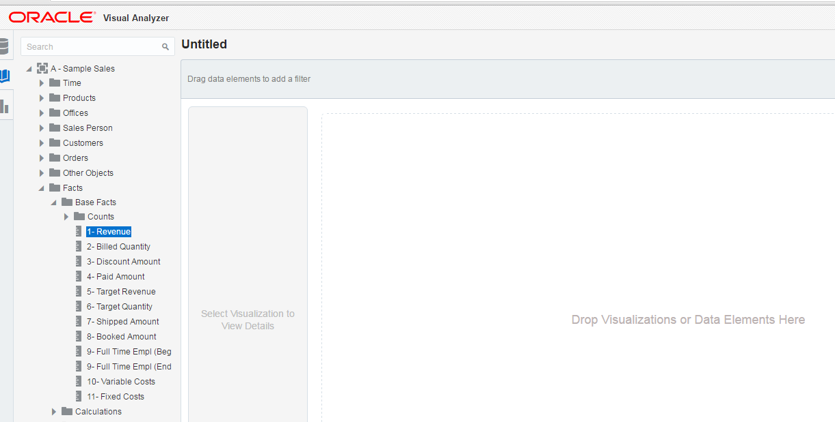

Select Content
Notes:
To select the content you can either double-click the columns from Data element panel or drag and drop the columns.
Oracle BI 12c: Create Analyses and Dashboards 14 - <number>

Slide 10
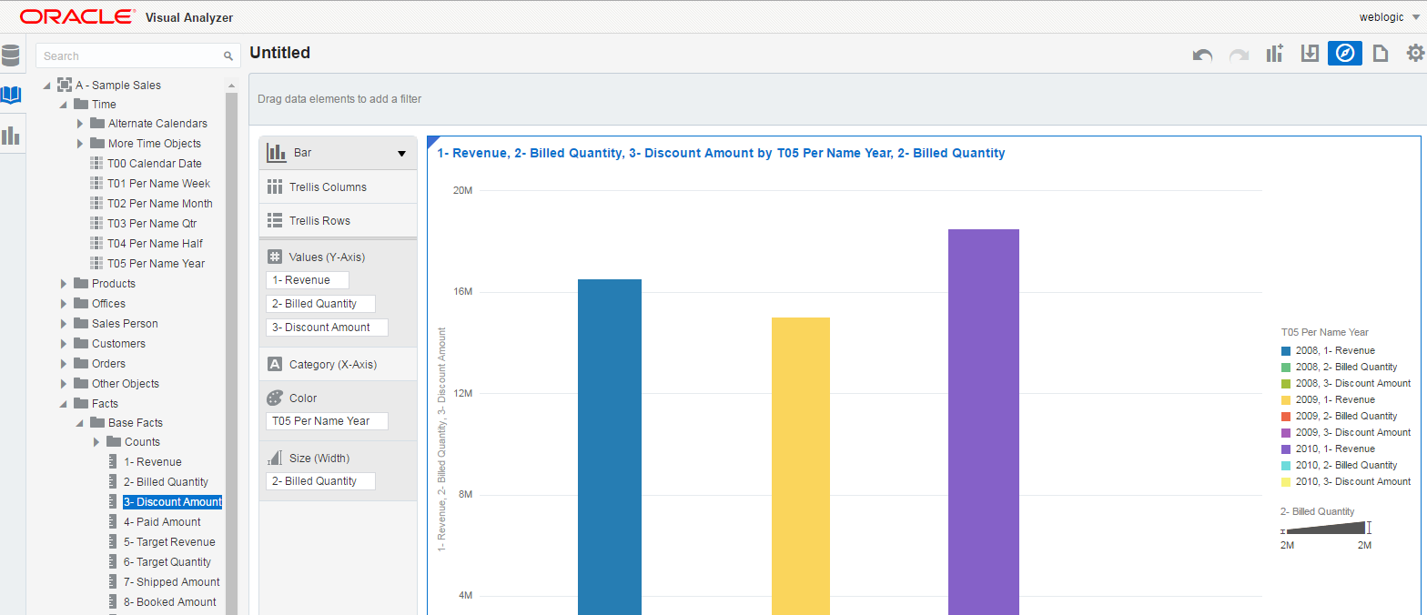


Select Content
Visualization type
Columns as content
Notes:
Oracle BI 12c: Create Analyses and Dashboards 14 - <number>

Slide 11


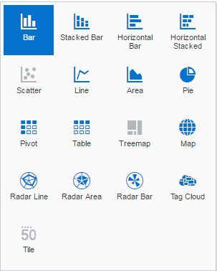
Set Visualization Type
Different Visualization Type
Notes:
Visual Analyzer will choose the best visualization type depending upon the selected data. Visualization type can be changed.
Oracle BI 12c: Create Analyses and Dashboards 14 - <number>

Slide 12

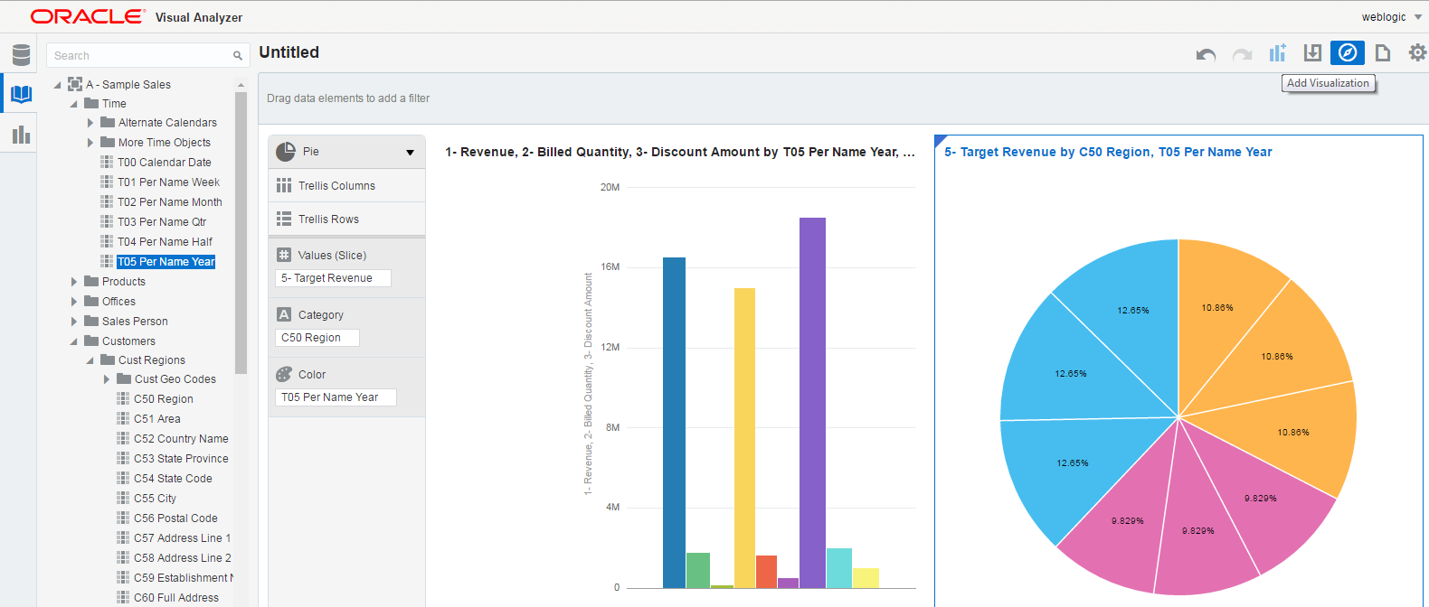

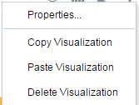


Add More Visualization
Add Visualization
Bar Graph Visuals
Pie Chart Visuals
Notes:
More visualizations can be added in VA to show the same or different data like a dashboard.
Oracle BI 12c: Create Analyses and Dashboards 14 - <number>

Slide 13
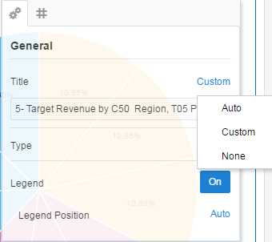
Rearrange the Visualizations in a VA project
Notes:
Visualization can be rearranged just dragging and dropping on the VA canvas and can be resized. Visualization properties allow you to modify the visualizations titles, axis titles in graphs and other views. Default aggregation and number format can be changed for measures.
Oracle BI 12c: Create Analyses and Dashboards 14 - <number>

Slide 14
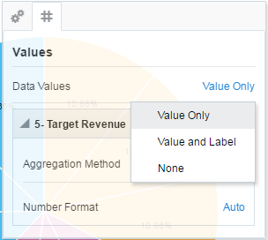
Rearrange the Visualizations in a VA project
Notes:
Oracle BI 12c: Create Analyses and Dashboards 14 - <number>

Slide 15

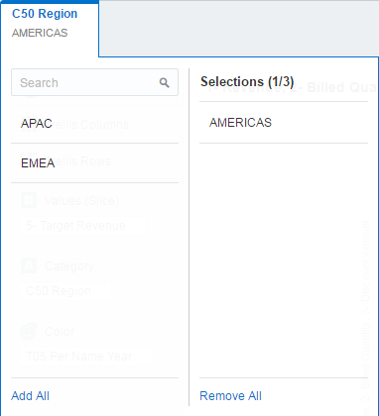
Filter the Data in Visual Analyzer
Add filters.
Select Filter Value.
Notes:
Data can be filtered by explicitly selecting one or more columns and creating the condition in filter area. A visual Analyzer project can be shared as any other object in the web catalog.
Oracle BI 12c: Create Analyses and Dashboards 14 - <number>

Slide 16
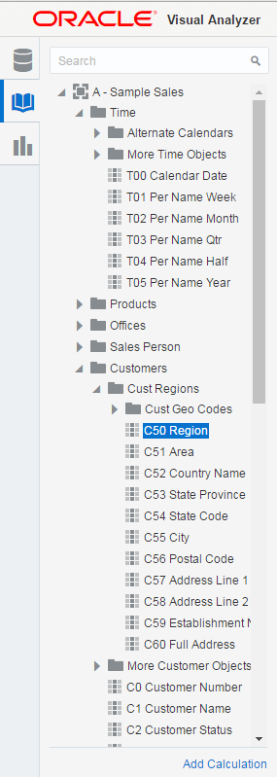
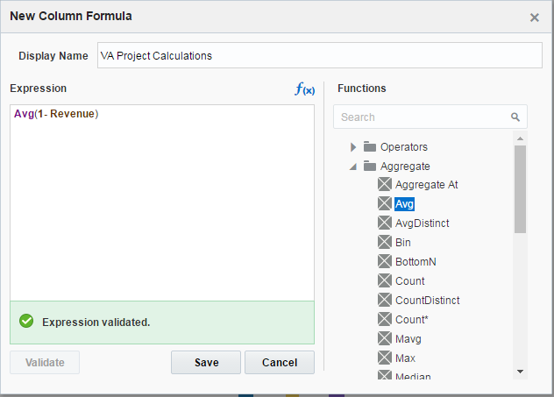


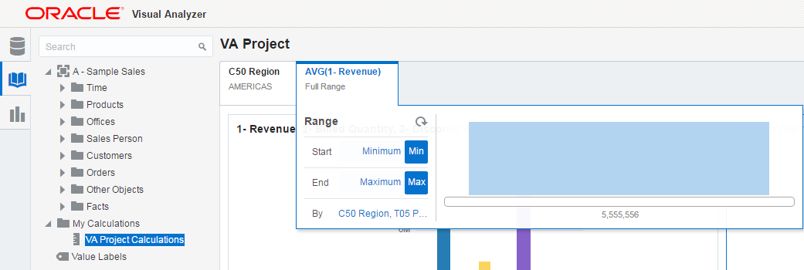



Create Calculations
2
Avg on Revenue Column
1
3
Saved Calculations
Adding Calculation like Avg, Sum
Notes:
Calculations can be added in Visual Analyzer. Wide variety of functions are used. Columns can be added by double-clicking them in the Data Element Panel.
Oracle BI 12c: Create Analyses and Dashboards 14 - <number>

Slide 17
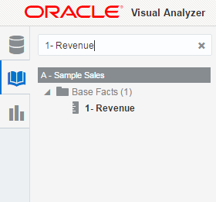
BI Ask
  Is a search-based infrastructure that comes with Visual Analyzer
  Allows creation of content based on text interaction
Notes:
Oracle BI 12c: Create Analyses and Dashboards 14 - <number>

Slide 18
Data Mashups
  Is the process of connecting or relating two or more sources in OBIEE 12c
  Provide flexibility to business users to merge their own data with the RPD subject area
  Is available in Visual Analyzer as well as in Answers
Notes:
Oracle BI 12c: Create Analyses and Dashboards 14 - <number>

Slide 19
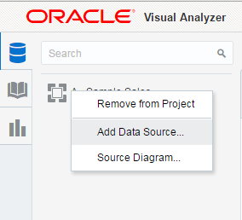
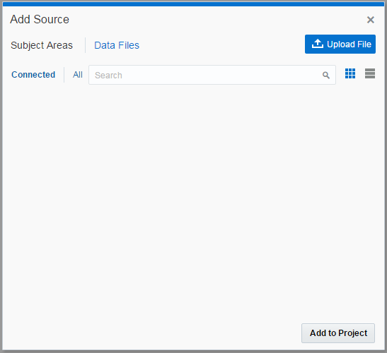
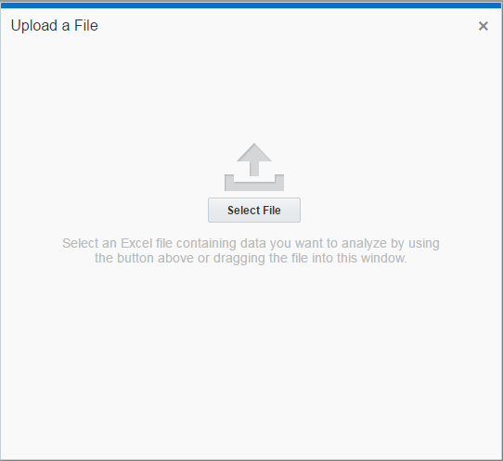
Adding a New Data Source
3
2
1
Notes:
Oracle BI 12c: Create Analyses and Dashboards 14 - <number>

Slide 20
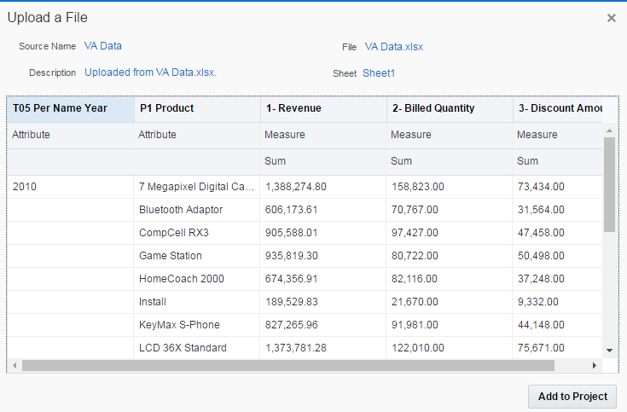
Adding a New Data Source
The Excel sheet is uploaded with automatically classified columns as attributes and measures.
Notes:
Oracle BI 12c: Create Analyses and Dashboards 14 - <number>

Slide 21
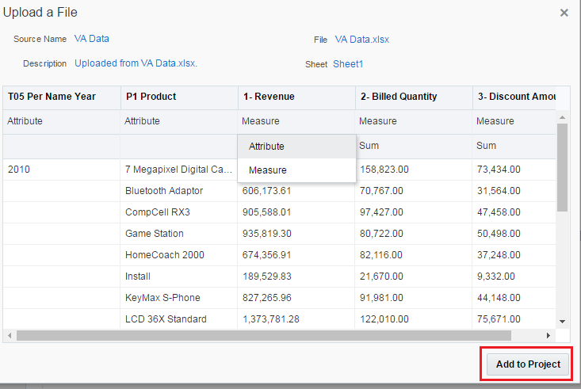

Adding a New Data Source
Change the Revenue from Measure to Attribute.
Notes:
Oracle BI 12c: Create Analyses and Dashboards 14 - <number>

Slide 22

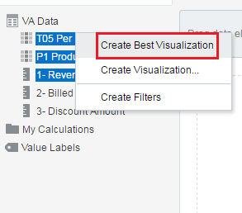
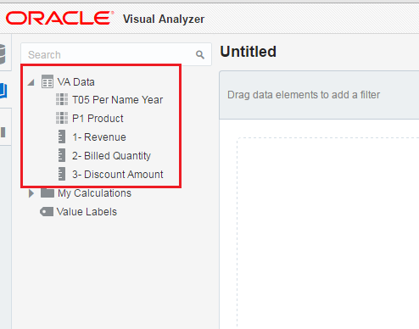

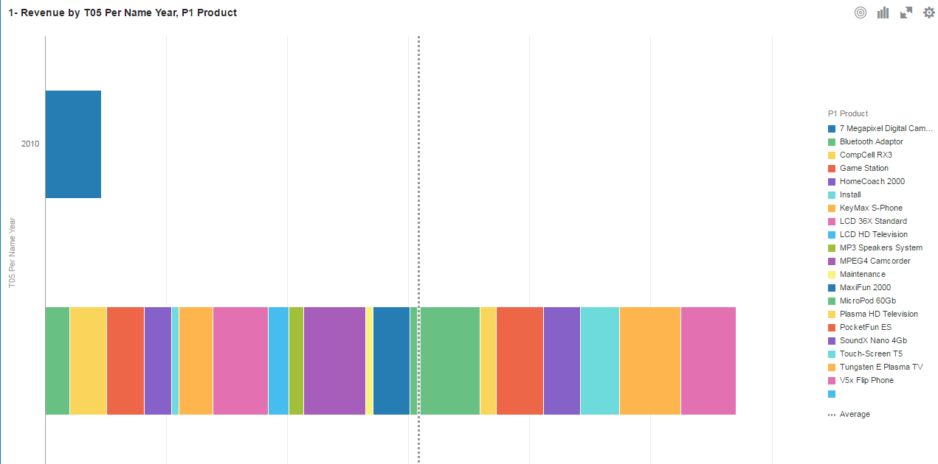

Subject Area in the Visual Analyzer
Create Visualization.
1
2
Subject Area from Excel file
3
Visualization in Horizontal Stacked
Notes:
Oracle BI 12c: Create Analyses and Dashboards 14 - <number>

Slide 23

Quiz: Overview
This quiz examines your knowledge on Visual Analyzer and Data Mashups.
Notes:
In this quiz, you answer questions regarding Visual Analyzer and Data Mash-ups.
Oracle BI 12c: Create Analyses and Dashboards 14 - <number>

Slide 24
Quiz
Visual Analyzer is a very intuitive and interactive web-based tool for:
  Self-service reporting
  Data exploration
  Data discovery
  Data navigation
Notes:
Answer: a, b, c
Oracle BI 12c: Create Analyses and Dashboards 14 - <number>

Slide 25
Quiz
Data Mashups is the process of:
  Connecting two data sources
  Relating two data sources
Notes:
Answer: a, b
Oracle BI 12c: Create Analyses and Dashboards 14 - <number>

Slide 26
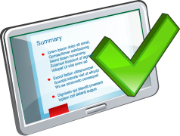
Summary
In this lesson, you should have learned how to:
  Develop and visualize reports using Visual Analyzer
  Explain BI Ask
  Describe Data Mashup
Notes:
Oracle BI 12c: Create Analyses and Dashboards 14 - <number>

Slide 27

Practice 14: Overview
This practice covers the following topics:
  Using Visual Analyzer
  Adding Data Mashups
Notes:
Oracle BI 12c: Create Analyses and Dashboards 14 - <number>

