Slide 1
Using Oracle Business Intelligence Delivers
Notes:
Schedule Timing Topic
40 minutes Lecture
25 minutes Practice
05 minutes Quiz
70 minutes Total

Slide 2
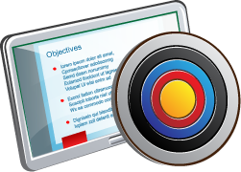
Objectives
After completing this lesson, you should be able to:
  Configure delivery devices
  Add delivery profiles
  Build alerts
  Create agents
  Create and use conditions
Notes:
Oracle BI 12c: Create Analyses and Dashboards 17 - <number>

Slide 3
Oracle Business Intelligence Delivers
  A content delivery interface that automates Business Intelligence, creating alerts based on results
    Detects specific results and immediately notifies the appropriate person or group through web, wireless, mobile, and voice communications channels
  The overall process of creating a proactive BI environment by using alerts and delivering content based on agents includes:
    Configuring devices and profiles
    Adding an Alert section to dashboards
    Creating agents
    Reiteratively:
      Reviewing dashboards and devices for problems and opportunities
      Managing agents and agent subscriptions
Notes:
Oracle Business Intelligence Delivers (Delivers) is a content delivery interface where users with appropriate privileges can create Intelligent Agents (agents) to access, filter, and perform analytics on data based upon specific criteria. Agents dynamically detect information-based problems and opportunities, determine the appropriate individuals to notify, and deliver information to them through a wide range of devices (such as email, telephone, and so on).
An alert is a notification generated by an agent that delivers personalized and actionable content to specified recipients and to subscribers to the agent.
As mentioned in the lesson titled “Creating Oracle Business Intelligence Delivers,” the Alerts Section contains alerts generated by agents. You can use the content displayed in the Alerts Section to monitor the health of your business, simulate a proactive approach to problem solving, and identify opportunities to increase ROI, and so forth.
In addition to the overall process annotated in the slide, you can optionally create scripted jobs using Oracle BI Scheduler. This is discussed briefly later in this lesson.
Oracle BI 12c: Create Analyses and Dashboards 17 - <number>

Slide 4
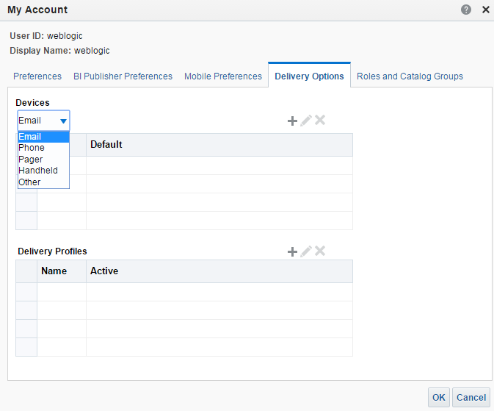
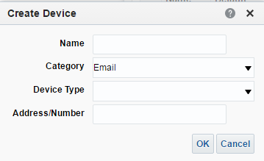
Delivery Devices
  Combine with delivery profiles to determine how users are reached when an alert is generated.
  Deliver content to a device as an email or SMS.
  Deliver BI content to a variety of devices:
    Any device that can handle standards-based communication
    Web browser
    Email
    Pager or digital cell
    phone
    Wireless PDA
Notes:
The content of an agent can be delivered to a range of devices, such as an email or SMS (Short Message Service) message. SMS is commonly known as text messaging.
Depending on the destinations specified for an agent, content can be delivered to the following:
Home page and dashboard
Active delivery profile or specific devices
When the destinations are specific devices, content is delivered to the devices you have configured rather than to the devices in your active delivery profile. For example, if an Agent is defined to be delivered to email devices, the default email device you configured will be used rather than any email devices you configured in your active delivery profile. If a specific device or active delivery profile cannot be found, then delivery content is automatically pushed to the dashboard.
Delivery content is assigned a specific priority. The default priority is normal. When you select devices for your active profile, you can indicate what priority content should be sent to that device. For example, if you have added a cell phone to your delivery profile, then you might associate it with high-priority content only.
You configure your delivery devices by using the My Account option > Delivery Options tab. For a complete list of devices, see Oracle Fusion Middleware System Administrator's Guide for Oracle Business Intelligence Enterprise Edition 12c Release 1 (12.2.1).
Oracle BI 12c: Create Analyses and Dashboards 17 - <number>

Slide 5
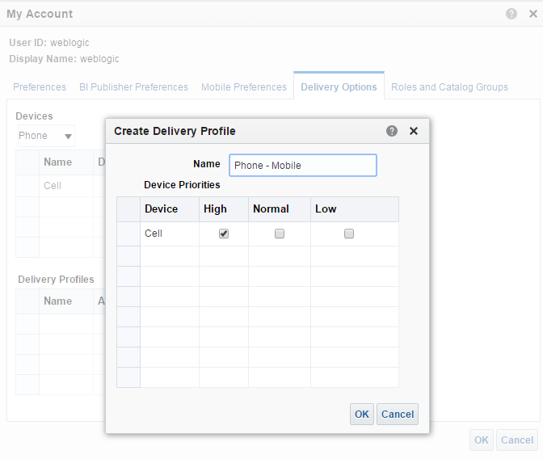
Delivery Profiles
  Determine which device receives content, based on priority.
  Examples:
    “Office” profile that delivers content to web browser and office email
    “On the Road” profile that delivers content to a pager, cell, or PDA
Notes:
Delivers uses your active delivery profile to determine which devices should receive delivered content. Profiles specify which device to use based on the priority of the content being delivered. You can define several delivery profiles to meet your needs and switch between them.
Your active delivery profile (along with your specified delivery devices) controls how you will be reached when an alert is triggered by an Agent.
You use the My Account option > Delivery Options tab, to not only specify your devices, but also your delivery profiles.
Delivery content is assigned a specific priority. The default priority is normal. When you select devices for your active profile, you can indicate what priority content should be sent to that device. For example, if you have added a cell phone to your delivery profile, then you might associate it with high-priority content only. When you know that you will be away from the office frequently, and out-of-email range, you can select to receive only low-priority content through your office email.
You configure your delivery devices by using the My Account option > Delivery Options tab.
For a complete list of devices, refer to Oracle Fusion Middleware System Administrator's Guide for Oracle Business Intelligence Enterprise Edition 12c Release 1 (12.2.1).
Oracle BI 12c: Create Analyses and Dashboards 17 - <number>

Slide 6


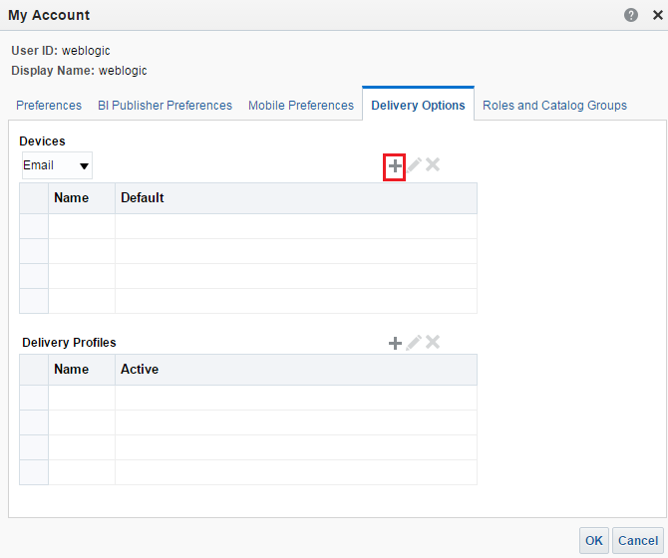

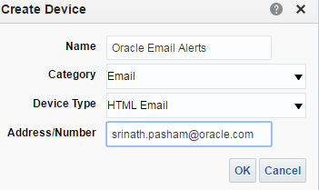




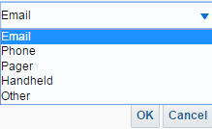

Creating a Delivery Device
1
2
3
4
Create device.
Choose a device type from the drop-down list.
5
Choose the device category.
Notes:
1. Click <Your User ID> on the global header and then select My Account. The My Account dialog box appears.
2. Select the Delivery Options tab to configure your delivery profile.
3. Click the Create Device button.
4. Define the device by completing the following:
Enter a Name for the device.
Select a device Category from the drop-down list. Items include Email, Phone, Pager, Handheld, and Other (defined by your Administrator).
Select the Device Type from the drop-down list. This list is governed by the Category. For example, if Email is selected as the Category, then two choices, HTML Email and Plaintext Email, are the possible selections.
Enter the Address/Number. For example, if you select Email as the Category, then enter your email address. If you select Phone as the Category, then enter the telephone number without punctuation such as spaces, dashes, or parentheses.
5. Click OK.
Note: To view other devices, select a device from the Devices drop-down list.
Oracle BI 12c: Create Analyses and Dashboards 17 - <number>

Slide 7
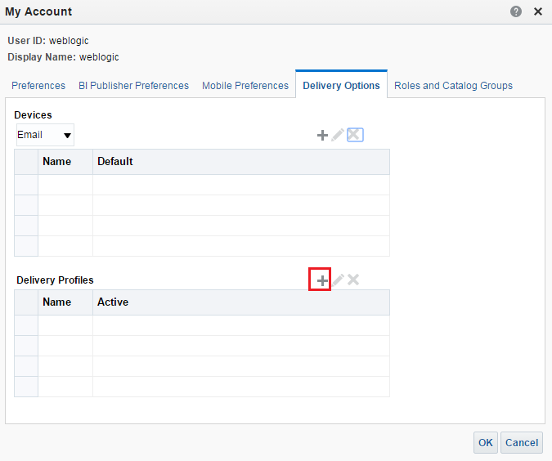
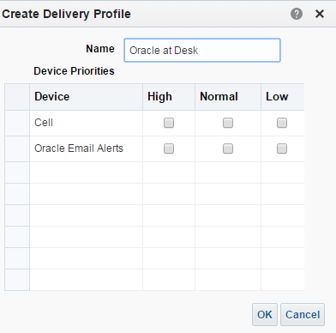


Creating a Delivery Profile
2
1
All defined device types appear in the table.
Create delivery profile.
3
Notes:
1. Click the Create Delivery Profile button.
2. Define the profile by completing the following:
Enter a meaningful Name for the profile.
Select one or more appropriate priorities for each device listed in the table that you want to use when this profile is the active profile. For example, if you have a pager as one of your delivery devices, you might associate it with high-priority content only. When you know that you will be away from your office frequently and out of email range, you might associate your email device with low-priority content.
3. Click OK.
Note: Do not set the priority for devices that you do not want to use. Devices that do not have a priority selected are not used by the profile.
Oracle BI 12c: Create Analyses and Dashboards 17 - <number>

Slide 8
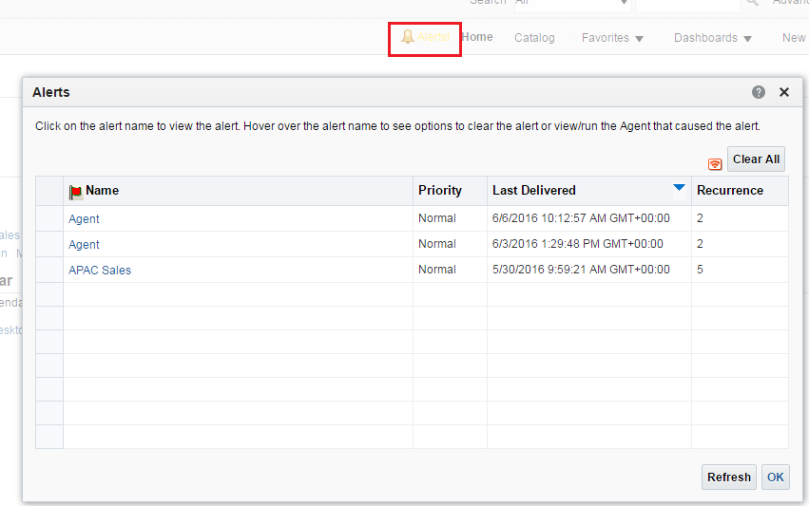
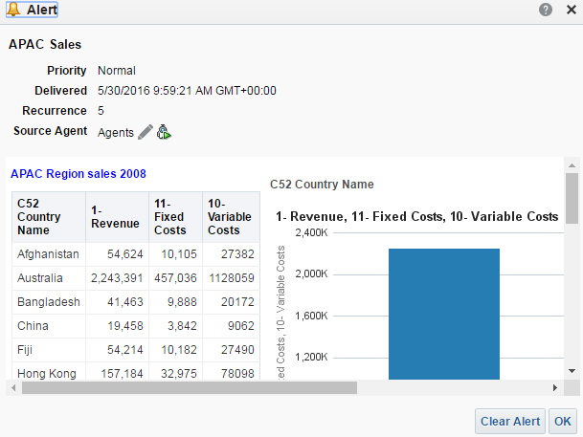
Business Intelligence Alerts
  Alerts are triggered when conditions configured in the agents are met.
  The Alerts! link appears on the Interactive Dashboard page when an alert is generated.
  The Alert Section can be added to any dashboard page.
    Appears automatically on the first page of My Dashboard
Notes:
An alert is a notification generated by an agent that delivers personalized and actionable content to specified recipients and to subscribers of the agent.
Alerts are the results of a specified Oracle BI Presentation Catalog analysis, based on a defined schedule.
You can see the alerts that have been delivered to you in the following places:
In the Alerts Section of the Home page
On the first page of My Dashboard (An Alerts Section is automatically added to the first page of My Dashboard, if you do not manually place one there.)
On a dashboard page, if the content designer adds an Alerts Section to the page
In the Alerts dialog box displayed from the Alerts! button on the Global Header
Specified delivery
Oracle BI 12c: Create Analyses and Dashboards 17 - <number>

Slide 9
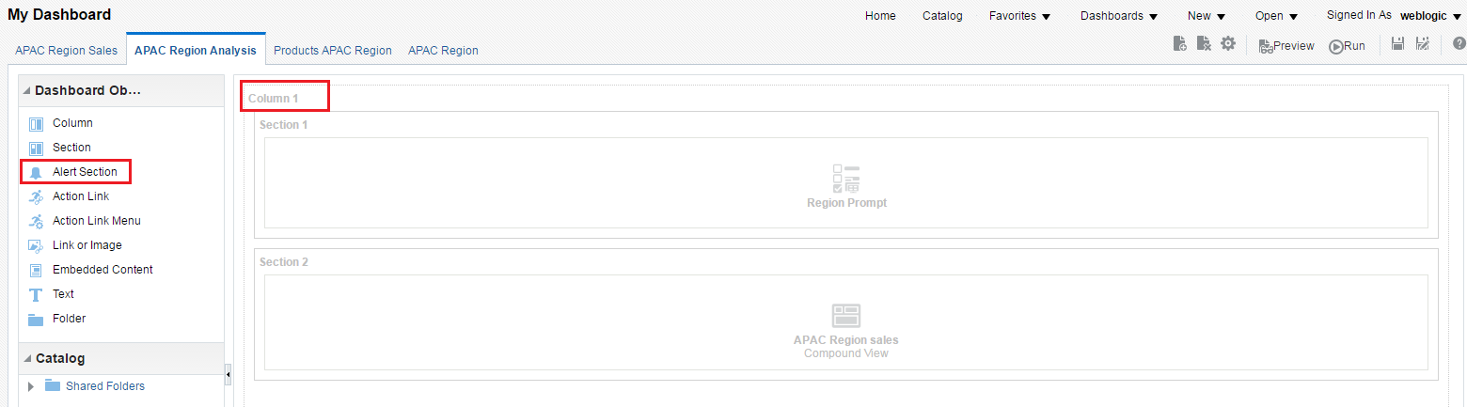
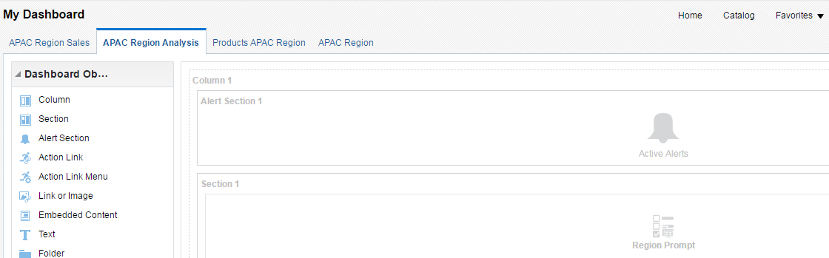
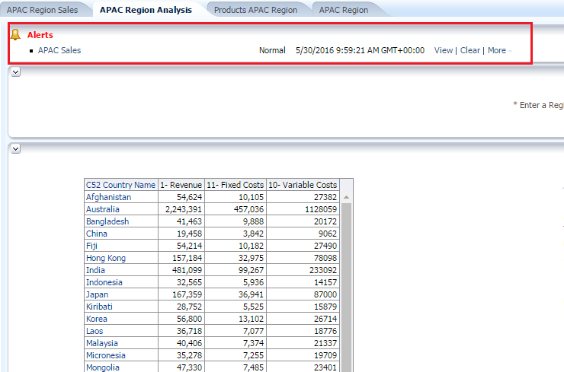
Adding an Alert Section to a Dashboard
3
1
2
Notes:
An Alert Section is added to a dashboard page in the same manner that you would add any other object.
1. Add a Column object.
2. Drag the Alert Section object to the Page Layout pane.
3. Save the dashboard page.
When an alert is generated, it will appear in the Alerts Section.
Oracle BI 12c: Create Analyses and Dashboards 17 - <number>

Slide 10
Agents
  Access, filter, and perform analysis on data based on specified criteria.
  Dynamically detect information-based problems and opportunities.
  Determine the appropriate individuals to notify and deliver information through a variety of devices.
  Generate alerts.
Notes:
You use agents to proactively deliver real-time, personalized, and actionable content throughout the business network. Agents deliver analysis, dashboards, briefing books, and alerts to end users and are configured and submitted for execution using Delivers. You can also use agents to pass information and context to other agents and applications, allowing automation of multistep, multipurpose analytic processes. Agents can be scheduled or can be triggered by a specific condition (data driven) and, therefore, deliver timely information to users via alerts. Oracle BI EE delivers alerts based on the options set up in a user's account (for example, Home page, default dashboard, email, cell phone, PDA, and so on).
Instructor Note
In previous releases of Oracle BI, you were able to create iBots that were conditionally triggered based on the results of requests. In this release, to create agents that are conditionally triggered, you use conditions. An iBot that was conditionally triggered in a previous release will be upgraded to use an inline condition with the default name of AgentCondition1. This inline condition will evaluate even if the number of rows returned by the selected request is greater than zero.
Oracle BI 12c: Create Analyses and Dashboards 17 - <number>

Slide 11















How Agents Work: Simplified Format
  Analyze
  Detect
  Problem
  Opportunity
  Generate
Agent
  Agent performs catalog analysis based on a defined schedule.
  It dynamically detects information-based problems and opportunities.
  Alert is generated and delivered to specified recipients and subscribers using delivery options specified by each person.
Notes:
To handle more complex requirements, agents can invoke actions that trigger other agents, scripts, Java programs, or applications. Results can be passed between agents, and to other applications or services through XML, HTML, or plain text. For example, an agent might run an analysis to identify all current product orders over a specified dollar amount that cannot be filled from a regional warehouse. The results can be passed to another agent that runs an analysis to locate alternative sources for these products. A final agent might be triggered to feed information into a corporate CRM system, and notify the appropriate account representatives of the alternative sourcing.
You might automatically receive some agents, and others might be available to which you can subscribe. You can also create your own agents if you have the appropriate permissions and responsibilities. Depending on the level of authority that you have, you can selectively share agents with others or make agents available for all users.
Oracle BI 12c: Create Analyses and Dashboards 17 - <number>

Slide 12
Configuring an Agent
  Configure the General tab.
  Configure the Schedule tab.
  Configure the Condition tab.
  Configure the Delivery Content tab.
  Configure the Recipients tab.
  Configure the Destinations tab.
  Configure the Actions tab.
Notes:
You create and configure agents in the Agent Editor. To configure or change an existing agent, open it and follow the steps in the slide. To create a new agent, click New > Agent to open the Agent Editor.
The Agent Editor lets you create agents to deliver personalized and actionable content to users. It also lets you view a summary of the current settings. Access to agents is available to all Oracle BI users (the Everyone group in Oracle BI Presentation Services) by default. If you have the appropriate authority, you can grant or deny explicit access to a variety of agent privileges, using the Manage Privileges page in the Administration option, including the following:
Create agents
Publish agents for subscription
Deliver agents to specified or dynamically determined users
Chain agents
Modify current subscriptions for agents
Within these tabs, you can also set visibility and execute scripts. For specifics and detailed information about all the options and features available on the tabs of the Agent Editor, refer to the Oracle® Fusion Middleware User's Guide for Oracle Business Intelligence Enterprise Edition.
Oracle BI 12c: Create Analyses and Dashboards 17 - <number>

Slide 13
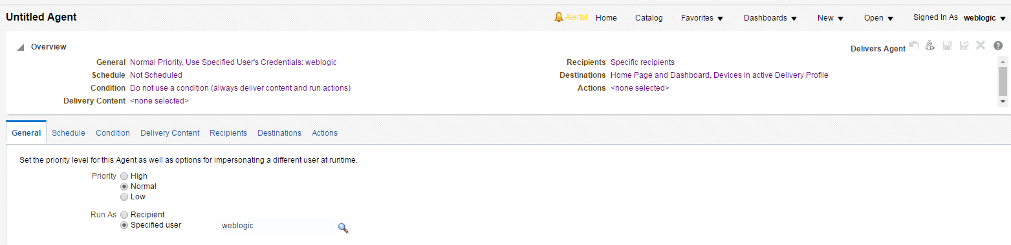

1. Configure the General Tab
Specify the priority of the delivery content that an agent is to deliver and how to send the delivery content.
Specified information appears in the Overview section.
Notes:
Select the option button for Priority. Use this option to specify the priority of the delivery content—High, Normal, Low. The priority works with the delivery profile for a user to determine the destination for delivery content of different priorities.
Select the option button for Run As. Use this option to specify how to send the delivery content:
Recipient: Select this option to use the credentials of each recipient to send the delivery content.
Specified User: This option is available only to the administrator. Select this option to use the credentials of a specified user to send the delivery content. All recipients receive the same content as if they were the specified user. Then specify the user by typing the user's name in the text box to the right of the option or by clicking the Set User icon to display the Select User dialog box where you can search for the user.
Use Agent Owner’s Credentials: This option is not available to administrators. Select this option to use the credentials of the agent owner to send the delivery content. All recipients receive the same content as if they were the agent owner.
Created By, Last Modified (date), and Description are available after the agent is saved.
Oracle BI 12c: Create Analyses and Dashboards 17 - <number>

Slide 14
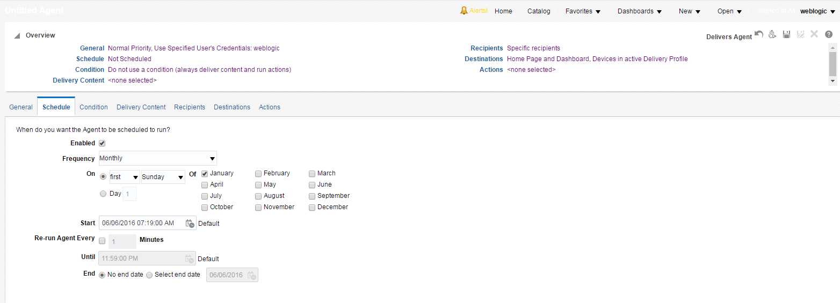



2. Configure the Schedule Tab
Specify when an agent runs, how often it runs, and when it should be discontinued.
Frequency
Start
End
Notes:
Agents can execute based on a specified schedule. You can define a starting date and time for the agent, a recurrence schedule, and an ending date. You can also create a nonscheduled agent by deselecting the Enabled option or by selecting Never as the Frequency. This is useful when you want to create an agent that runs only as part of an agent chain, or an agent that is initiated by an external process.
There are three parts to an Agent schedule:
Start date and time
Frequency
End date and time
The time reference is for the Oracle BI Scheduler server rather than the local machine. Select the Enabled check box to run the agent as scheduled. To make this a nonscheduled agent (as noted above), deselect the check box. To later disable an agent, open it and deselect the Enabled option.
Use the Frequency drop-down list to specify how often the agent runs. Selecting Never creates a nonscheduled agent.
Oracle BI 12c: Create Analyses and Dashboards 17 - <number>

Slide 15
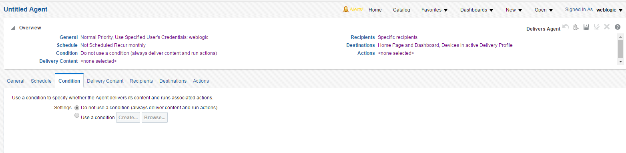

3. Configure the Condition Tab
Specify whether an agent always or conditionally delivers its content and executes its actions.
Create a new inline condition or browse the Catalog for a named condition.
Notes:
Use the “Do not use a condition (always deliver content and run actions)” setting to specify that the agent should always deliver its content and execute its actions.
Use the “Use a condition” setting to specify that the agent should conditionally deliver its content and execute its actions. Click the Create button to display the Create Condition dialog box that allows you to create an inline condition, using an analysis or KPI. Click the Browse button to display the Select Condition dialog box that allows you to select a named condition.
The Edit Condition button is available only if you created an inline condition. The Customize button is available only if you selected a named condition that is based on an analysis, which includes one or more prompted filters.
Use the Test Condition button to test whether the condition evaluates to true or false.
Use the Save To Catalog button to save the new inline condition to the Catalog.
Oracle BI 12c: Create Analyses and Dashboards 17 - <number>

Slide 16
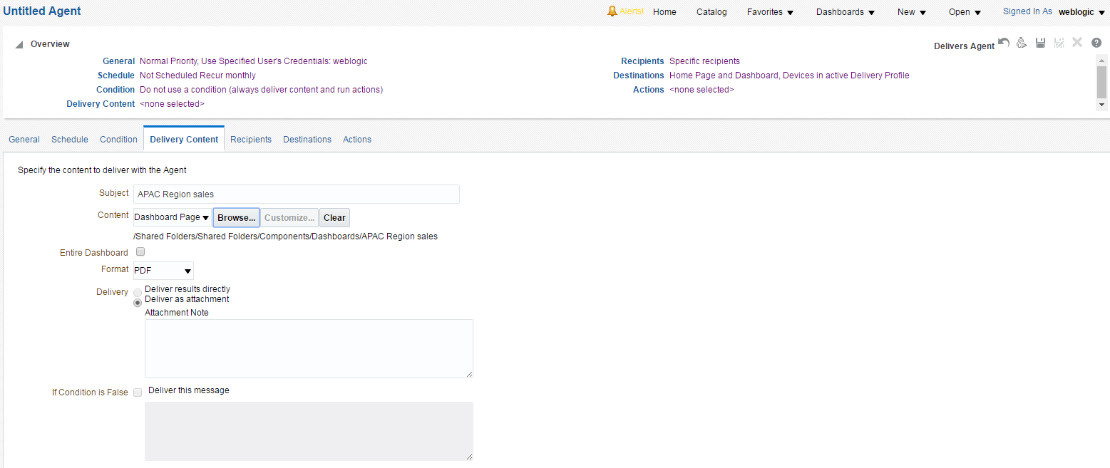
4. Configure the Delivery Content Tab
Specify the content to be delivered by the agent.
Notes:
You can specify the following:
The delivery format for the content, such as HTML, PDF, XLS, CSV, or txt
A subject line to include with the content
A text message to provide context for an agent attachment
A narrative text description of the conditional analysis (but only when you specify that the conditional analysis is also the delivery content)
A message to be delivered, in the case of a conditional agent, in the event that the condition evaluates as false
Delivery content can be specified as any of the following: Analysis (shared and private), Dashboard Page (My Dashboard or public [shared] dashboards), Briefing Book, Discoverer Worksheet, or Condition Analysis. (This option is available only if you have specified a condition on the Conditions tab. Use this option to deliver the results of the analysis on which the condition is based.)
You can deliver content directly or as an attachment. When delivered as an attachment, you can also specify a note to be sent with it. Select the “If Condition is False” check box to specify whether to deliver a text message to recipients when there is no agent content to deliver to them and then enter the text message to be delivered.
Oracle BI 12c: Create Analyses and Dashboards 17 - <number>

Slide 17
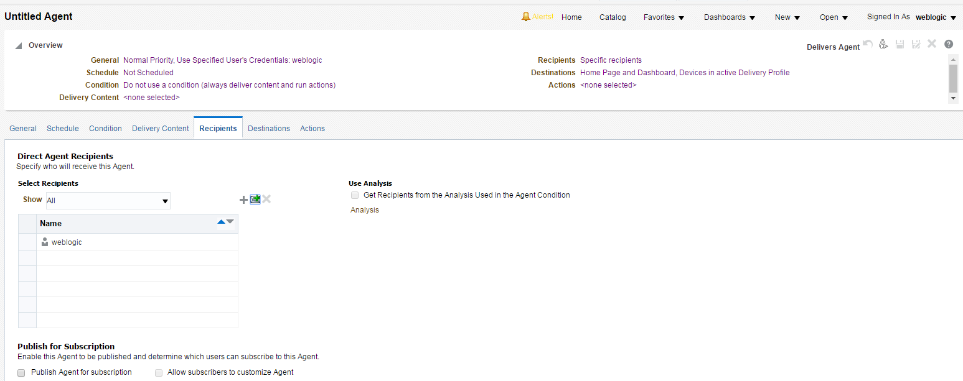
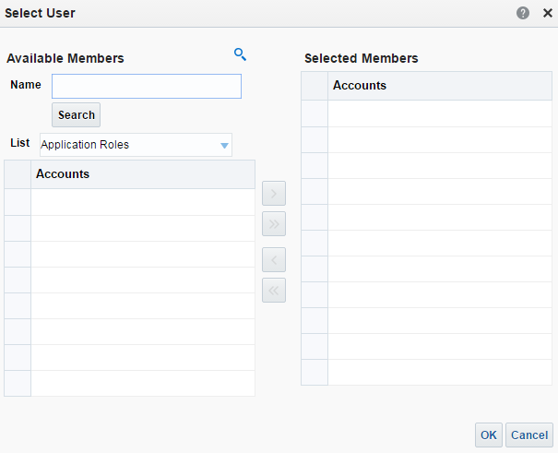


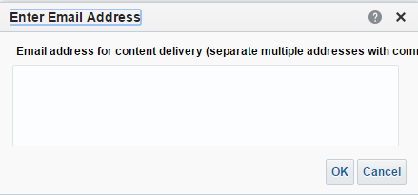
5. Configure the Recipients Tab
Specify who should receive the delivery content of the agent and who is allowed to subscribe to the agent.
1b
Add email recipient.
2a
1a
Add recipient.
2b
Notes:
Some agents are delivered automatically based on group membership, whereas others require users to subscribe to receive them.
1a. To add the users, application roles, and catalog groups for content delivery, click Add
Recipient.
2a. Search for one or more recipients using the Select User dialog box. Click OK when all
recipients have been added.
Or,
1b. To add email recipients, click Add Email Recipient.
2b. Enter one or more email addresses, separated by commas, and click OK.
You can use the Show drop-down list to restrict the recipients’ set.
The Get Recipients from the Analysis or Worksheet Used in the Agent Condition check box is enabled only if a condition based on an analysis or Discoverer worksheet has been specified for the agent. You use this check box to specify whether recipients should be determined dynamically from the results of a conditional analysis or from a Discoverer worksheet.
Oracle BI 12c: Create Analyses and Dashboards 17 - <number>

Slide 18
Notes:
Note: If you select the option to allow the recipients to be determined from the results of a conditional analysis and choose to show only relevant rows to each user, then it is assumed that you want the results of the conditional analysis set as the delivery content. If the content has been set to something else by clicking Clear or Browse, then a message appears asking if you want to update the delivery content to be the results of the conditional analysis.
If you selected the Get Recipients from the Analysis or Worksheet Used in the Agent Condition check box, you can then select the Column Containing Recipients check box to choose the column in the conditional analysis or Discoverer worksheet that contains the desired recipients.
If you selected the Get Recipients from the Analysis or Worksheet Used in the Agent Condition check box, you can then select the Only Return Rows Relevant to the User Running the Agent check box. You use this check box to specify whether all rows or only rows relevant to the user running the agent will be sent.
Use the Publish for Subscription section to specify whether the agent is to be published so that users can subscribe.
When you deselect the “Publish Agent for subscription” check box, any selected subscribers are disabled, and the “Allow subscribers to customize Agent” check box is deselected and disabled.
You can only publish agents that have content that can be shared.
The “Allow subscribers to customize Agent” check box is enabled only when the Recipient check box is selected on the General tab. You use this check box to specify whether subscribers can customize their subscription of the agent—for example, by providing values for a prompted filter associated with an analysis or for parameters associated with a Discoverer worksheet.
When the “Publish Agent for subscription” check box is selected, the Agent Subscribers table is available. You use this area to view and specify who is allowed to subscribe to this agent. The Name column identifies the users, application roles, and catalog groups that are allowed to subscribe to the agent and the Currently Subscribed column identifies (with a check mark) those users, application roles, and catalog groups that are currently subscribed.
Oracle BI 12c: Create Analyses and Dashboards 17 - <number>

Slide 19
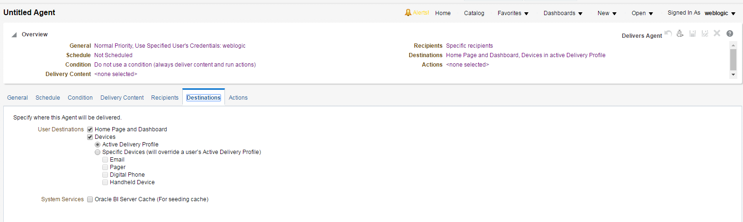
6. Configure the Destinations Tab
Specify where the content of the agent is delivered.
Notes:
If both the Active Delivery Profile and a specific device are selected, the Active Delivery Profile is overridden.
Use the Home Page and Dashboard check box to specify whether content is to be delivered to the Home page and dashboard pages.
Use the Devices check box to have content delivered to specific devices. When this check box is selected, you must select one of the following options:
Active Delivery Profile: Content is delivered to the devices specified in the active delivery profile.
Specific Devices: Content is delivered to specific devices. You must also select one or more devices, namely email, pager, digital phone, or handheld device.
If you select a specific device, then the default device selected in the My Account dialog box, Delivery Options tab, overrides the devices that are set in the active delivery profile. Devices that are specified here are used instead of the devices specified in the active delivery profile.
If you are an administrator, you can select the “Oracle BI Server Cache (For seeding cache)” check box to specify whether to seed the cache.
Oracle BI 12c: Create Analyses and Dashboards 17 - <number>

Slide 20
6. Configure the Destinations Tab
System Services:
  BI administrators can create an Oracle BI Server cache for individual users.
  A cache-seeding operation enables administrators to run analyses on dashboard pages (or analyses stored in the Oracle BI Presentation Catalog) and create an Oracle BI Server cache.
  Cache-seeding speeds up response time for users when they run the analyses on the dashboards.
  If data already exists in the cache for a given query, the data is deleted and refreshed when the agent runs.
Notes:
Typically, agents that are set up for cache seeding or for creating the Disconnected Applications cache are not used for any other purpose.
For the Disconnected Applications cache, the preprocessed synchronization mode is the recommended data download mode for users. It avoids the potential overhead that can occur from running data creation requests in online mode during normal business hours and reduces wait time for the download. Preprocessed data is stored under each user’s directory on the machine running Oracle BI Presentation Services. If you decide to use this mode to schedule data cache creation, make sure that adequate disk space is available.
Note: The cache for the analysis or the dashboard page is created according to the appropriate schedule for the indicated set of users. To have the cache created for each user, select the Run As Recipient or Run As Specified user check box on the General tab.
Oracle BI 12c: Create Analyses and Dashboards 17 - <number>

Slide 21
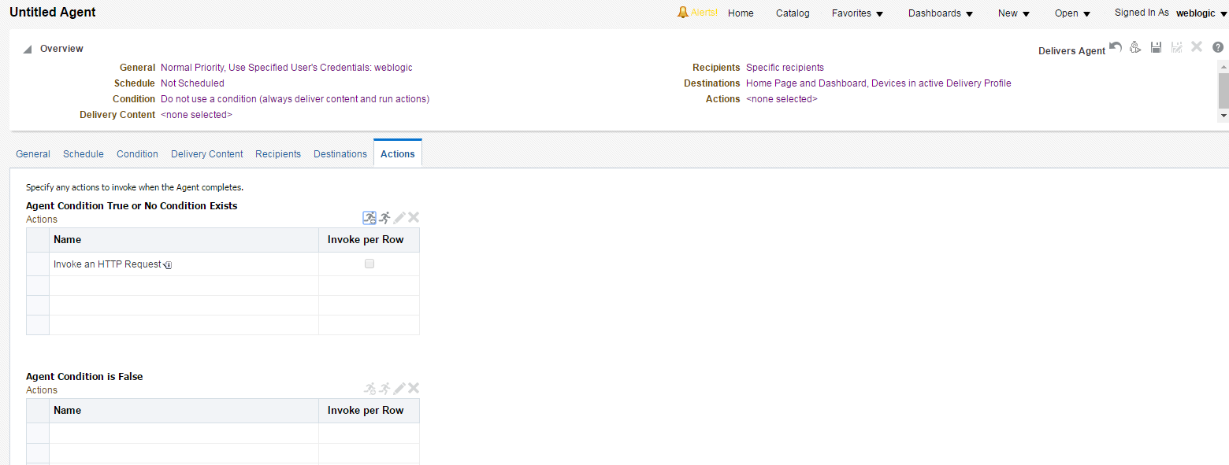




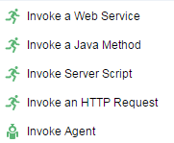


7. Configure the Actions Tab
Specify one or more actions to execute when an agent finishes.
3
Action: Agent condition evaluates to true or no condition exists.
Run agent to test.
Save
1a
Open an HTML page and perform another action (chained Agent).
2
Action: Agent condition evaluates to false.
1b
Used with conditional agents to determine an action when a condition evaluates to False
Notes:
1a. Click the Add New Action or Add Existing Action icon in the Agent Condition True or No Condition Exists section to specify one or more actions to execute if the agent condition evaluates to true or if there is no condition associated with the agent.
Or,
1b. Click the Add New Action or Add Existing Action icon in the Agent Condition is False section to specify one or more actions to execute if the agent condition evaluates to false.
Use the Invoke per Row check box to specify whether to execute the action for each row returned by the condition or only once, regardless of the number of rows returned.
2. Select one of the following actions:
Invoke a Web Service: Invokes a Web Service operation or any service-oriented architecture (SOA) service that is exposed as a Web Service (for example, a Business Process Execution Language [BPEL] process in the Oracle SOA that is exposed as a Web Service)
Invoke a Java Method: Invokes an Enterprise Java Bean (EJB)
Oracle BI 12c: Create Analyses and Dashboards 17 - <number>

Slide 22
Notes:
Invoke Server Script: Executes, on the Oracle BI Server, a custom script (either JavaScript or VBScript) that was configured in a previous release of Oracle BI. Note that Server Script actions cannot be executed per row of the result set.
Invoke an HTTP Request: Invokes a URL on the server
Invoke Agent (also known as chaining agents): Invokes another agent
Each action has a corresponding dialog box that you must complete.
3. Save the agent to the Catalog.
Building conditional agents is covered in detail later in the lesson.
Instructor Note
If Oracle BI Scheduler fails, Agent executions maintain their state in the Oracle BI Scheduler tables. Therefore, when Oracle BI Scheduler becomes available again, the state of the job instances is read by Oracle BI Scheduler and execution continues. Consequently, agents will only deliver to those recipients that they did not deliver to prior to the failure. Scripted jobs will re-execute from the beginning with a new instance.
Oracle BI 12c: Create Analyses and Dashboards 17 - <number>

Slide 23
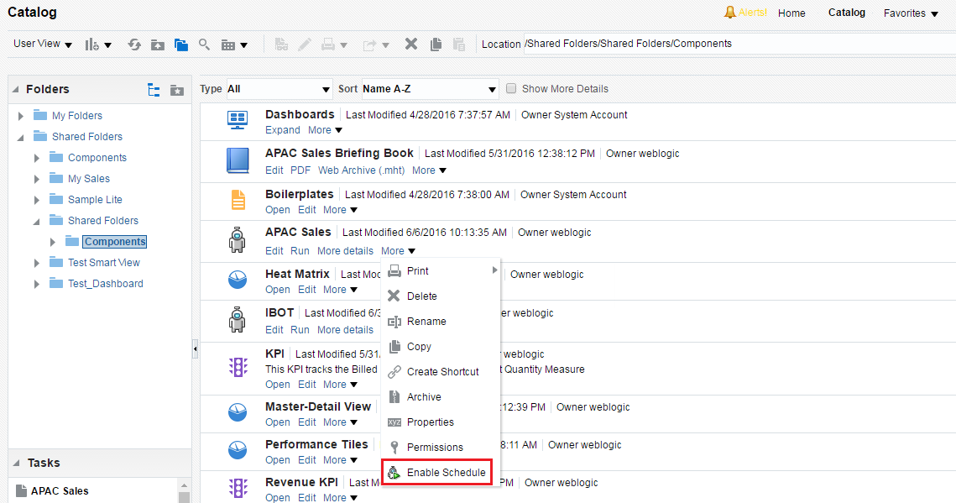
Subscribing to an Agent
To subscribe to an agent that another user has created, perform the following steps:
  On the Global Header, click Catalog.
  Navigate to the agent to which you want to subscribe.
  Click the More link for the agent and select Enable Schedule.
Notes:
If the “Publish Agent for subscription” check box is selected on the Recipients tab of the Agent Editor for an agent, and if you have been included in the Agent Subscribers table, you can subscribe to an agent. Subscription in the Agent Subscribers table is determined by username, application role, or Catalog group.
Note: You can unsubscribe using the same process as annotated in the slide; however, you select the Unsubscribe option rather than Subscribe.
Oracle BI 12c: Create Analyses and Dashboards 17 - <number>

Slide 24
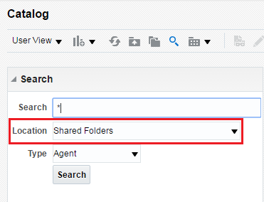
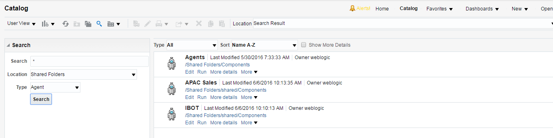
Listing Your Agents
To find all agents that you own, perform the following steps:
  On the Home page, click Catalog.
  Select a Location.
  Click Search.
Notes:
You can also search for agents to which you subscribe by selecting My Agent Subscriptions.
Oracle BI 12c: Create Analyses and Dashboards 17 - <number>

Slide 25
Using Agents to Deliver Content
  You use conditions to determine whether agents deliver their content and execute their actions.
  You use the filter operator to be prompted to have finite control of output.
  You use agents to proactively respond to KPI performance.
Notes:
The remainder of this lesson further examines the use of agents to conditionally deliver content and react to KPI performance.
Review: As mentioned earlier in this lesson, you use agents to deliver real-time, personalized, and actionable content to end users. Agents can be scheduled or they can be data driven and triggered by a specific condition. In the lesson titled “Showing Results with Pivot Tables,” dashboard sections were hidden based on the results of conditions. In the lesson titled “Creating Oracle Business Intelligence Dashboards,” you were exposed to the dashboard prompt as a mechanism to manipulate and govern your requests embedded in a dashboard. Also recall from the lesson titled “Creating Oracle Business Intelligence Dashboards” that a dashboard prompt filters embedded requests that contain the same columns as the filter.
Example for conditional and agent processing: A sales manager wants to deliver a Monthly Sales Report to his direct reports only when sales drop below $2 million. You create a condition that is based on an analysis and shows sales that are below $2 million. You add it to an agent whose delivery content is the Monthly Sales Report. When the condition evaluates to true (that is, the analysis contains rows where sales are below $2 million), the agent is triggered to deliver the Monthly Sales Report.
Oracle BI 12c: Create Analyses and Dashboards 17 - <number>

Slide 26
Using Conditions to Deliver Content
  Create a new agent and assign an analysis for its condition.
  Define how the condition evaluates to “True.”
  Test the results.
Notes:
You can use conditions (evaluated by row count and the operator that is applied to the row count) to govern what actions are to be taken by an agent.
Oracle BI 12c: Create Analyses and Dashboards 17 - <number>

Slide 27
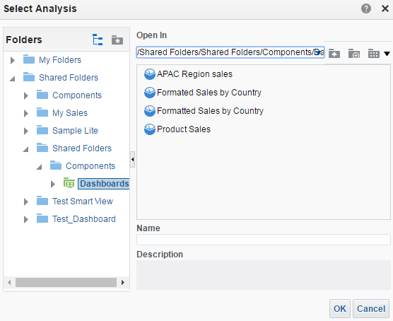
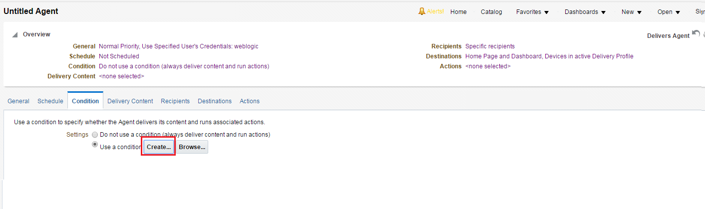


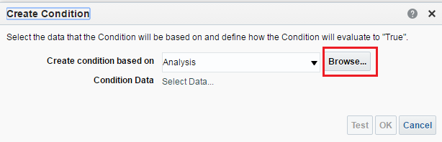


1. Create a New Agent and Assign an Analysis for Its Condition
Use the Condition tab.
Select Use a condition and click Create.
Locate the Analysis in the Catalog.
Browse the catalog to select the Analysis.
Notes:
You can specify whether an agent always delivers its content and executes its actions, or conditionally delivers its content and executes its actions.
The “Create condition based on” drop-down list contains two options: Analysis and KPI.
Oracle BI 12c: Create Analyses and Dashboards 17 - <number>

Slide 28
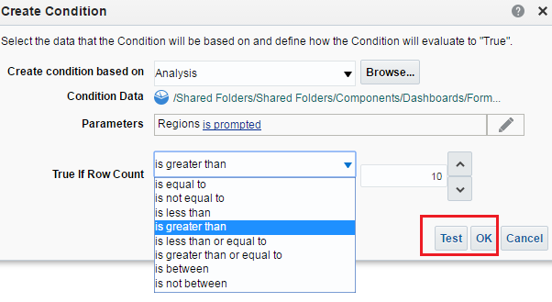



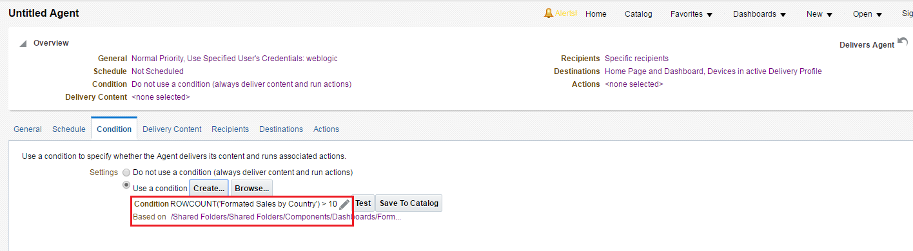
2. Define How the Condition Evaluates to “True”
Set the value.
Test the condition and then click OK.
Select the evaluation operator.
Notes:
You can use the Save To Catalog option to create a named condition, which can then be used elsewhere (for example, in other analyses). If you do not save the condition to the Catalog, it is an inline condition.
Oracle BI 12c: Create Analyses and Dashboards 17 - <number>

Slide 29
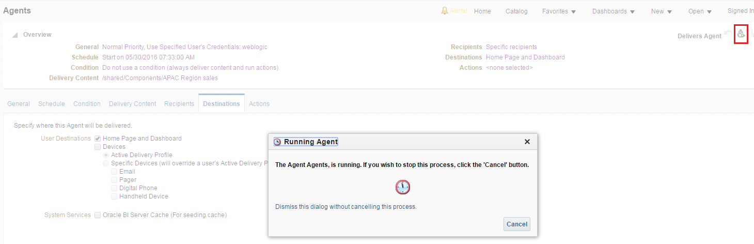


3. Test the Results
After completing agent details (schedule, recipients, and actions for true and false evaluations of the condition), test the results.
Click Run Agent Now.
Agent’s delivery content is delivered to the default device and to the dashboard.
Notes:
In this scenario, the agent evaluates to True, that is, the Formatted Sales by Country, APAC Region 2008 analysis is greater than 10. Therefore, the agent’s content is delivered to the specified destination, in this case, a dashboard.
Oracle BI 12c: Create Analyses and Dashboards 17 - <number>

Slide 30
Using Agents to Proactively Respond to
KPI Performance
  Create a new agent and assign a KPI for its condition.
  Define how the condition evaluates to “True.”
  Test the results.
Notes:
KPIs allow you to evaluate metrics against their targets and alert the appropriate users when targets are not met. To ensure that you can quickly and appropriately react to certain ranges of KPI performance, such as warning or critical, create agent-driven alerts for KPI performance ranges that notify you of changes in KPI values and their corresponding performance levels. For example, you can define an agent that notifies you when the value of an Internal Costs KPI exceeds a certain dollar amount, which indicates a warning level of internal spending.
Oracle BI 12c: Create Analyses and Dashboards 17 - <number>

Slide 31
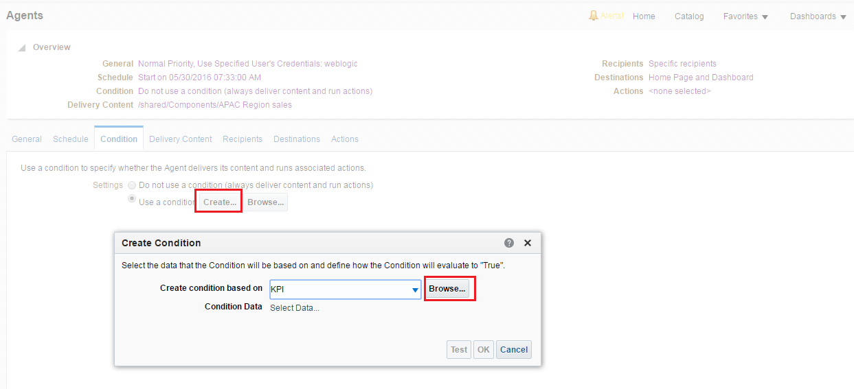


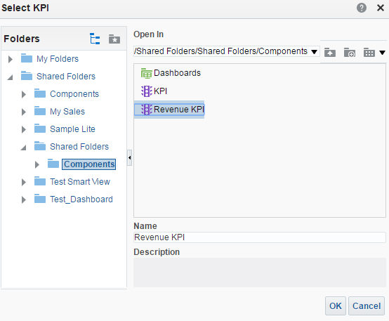


1. Create a New Agent and Assign a KPI for Its Condition
Use the Condition tab.
Select “Use a condition” and click Create.
Locate the KPI in the Catalog.
Browse the catalog to select the KPI.
Notes:
You can use conditions to determine whether sections are displayed in dashboard pages. You can specify whether an agent always delivers its content and executes its actions, or conditionally delivers its content and executes its actions.
The “Create condition based on” drop-down list contains two options: Analysis and KPI.
Oracle BI 12c: Create Analyses and Dashboards 17 - <number>

Slide 32
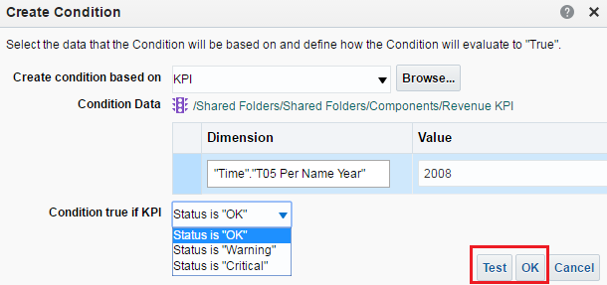

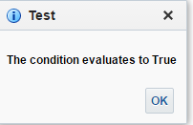

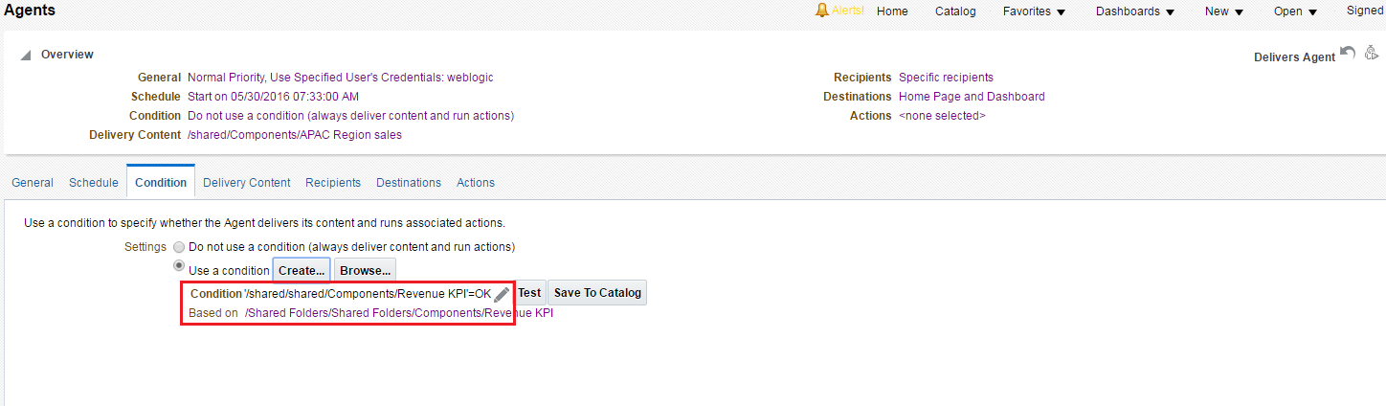
2. Define How the Condition Evaluates to “True”
Test the condition.
Select the status.
Notes:
Oracle BI 12c: Create Analyses and Dashboards 17 - <number>

Slide 33
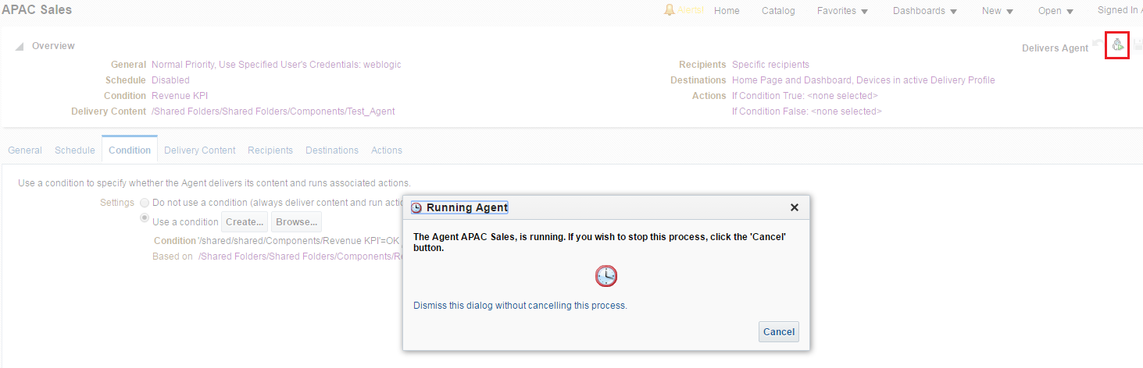

3. Test the Results
After completing agent details (schedule, recipients, and actions for true and false evaluations of the condition), test the results.
Run the agent to test the results.
Notes:
Oracle BI 12c: Create Analyses and Dashboards 17 - <number>

Slide 34

Quiz: Overview
This quiz examines your knowledge of delivery devices, agents, and conditions.
Notes:
In this quiz, you answer questions regarding delivery devices, agents, and conditions.
Oracle BI 12c: Create Analyses and Dashboards 17 - <number>

Slide 35
Quiz
To which three of the following devices can the content of an agent be delivered?
  Web browser
  SMS
  PDA
  Pager
Notes:
Answer: a, c, d
SMS is not a device. The actual content of an agent can be delivered as an email or SMS (Short Message Service).
Oracle BI 12c: Create Analyses and Dashboards 17 - <number>

Slide 36
Quiz
You specify your default delivery profile and devices using the My Account dialog box.
  True
  False
Notes:
Answer: a
Oracle BI 12c: Create Analyses and Dashboards 17 - <number>

Slide 37
Quiz
Oracle BI Scheduler processes jobs and executes agent requests.
  True
  False
Notes:
Answer: a
Oracle BI 12c: Create Analyses and Dashboards 17 - <number>

Slide 38
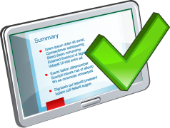
Summary
In this lesson, you should have learned how to:
  Configure delivery devices
  Add delivery profiles
  Build alerts
  Create agents
  Create and use conditions
Notes:
Oracle BI 12c: Create Analyses and Dashboards 17 - <number>

Slide 39

Practice 17: Overview
This practice covers creating and running agents.
Notes:
Oracle BI 12c: Create Analyses and Dashboards 17 - <number>

