Slide 1
Administering the Presentation Catalog
Notes:
Schedule: Timing Topic
60 minutes Lecture
50 minutes Practice
05 minutes Quiz
115 minutes Total

Slide 2
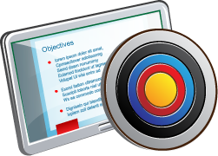
Objectives
After completing this lesson, you should be able to:
  Describe the use of roles in administering permissions
  Administer Oracle Business Intelligence Presentation Catalog permissions
  Administer system privileges
  Explain Oracle BI Briefing Books
  Work with Favorites
Notes:
Oracle BI 12c: Create Analyses and Dashboards 18 - <number>

Slide 3
Security Goal: Access and Actions
  Users can access only the objects that are appropriate for them.
    Achieved by applying access control in the form of catalog permissions
    Performed on the Catalog and Home pages
  Users can perform only those actions that are appropriate to them.
    Achieved by applying user rights in the form of privileges
    Performed on the Administration page
Notes:
Oracle BI 12c: Create Analyses and Dashboards 18 - <number>

Slide 4
Oracle BI Security and Catalog Security
  Users, groups, and roles control:
    Catalog object permissions (for example, analyses and dashboards)
    Privileges for BI feature access
  Login rights, user authentication, groups, and roles are:
    Governed through components in the Fusion BI Domain
    Provided with default groups and roles for most initial security needs
Notes:
Securing Oracle Business Intelligence can be broken down into two broad areas:
Controlling access to the components within the BI domain (resource access security)
Controlling access to business source data (data access security)
Controlling access to system resources is achieved by requiring users to authenticate at login and by restricting users to only those resources for which they are authorized. The Oracle Business Intelligence default security model is available for immediate implementation after installation. This model includes controls for administrators to manage user identities, credentials, and permission grants. This allows system access control by validating identity at login (authentication), and access to specific Oracle Business Intelligence components and features according to a user’s permission grants (authorization). The procedures for administering authentication, groups, and roles are covered in the Oracle BI 12c: Build Repositories course. Note that groups in this sense refer to logical groups of users that are aligned and then associated with roles, from which permissions and privileges are derived. Fusion administrators work with groups to streamline their allocation of roles, but for the purposes of this course, the focus will be on roles.
Oracle BI 12c: Create Analyses and Dashboards 18 - <number>

Slide 5
Notes:
This course highlights the security components that relate to managing users and default roles, to drive catalog object permissions and BI feature access privileges. However, OBI Security is a complex subject that involves installation and configuration tasks that are beyond the scope of this course. The creation and management of nondefault groups and roles and other aspects of the Fusion BI Domain are covered in other courses. Detailed information is also available in the Security Guide for Oracle Business Intelligence Enterprise Edition.
Oracle BI 12c: Create Analyses and Dashboards 18 - <number>

Slide 6
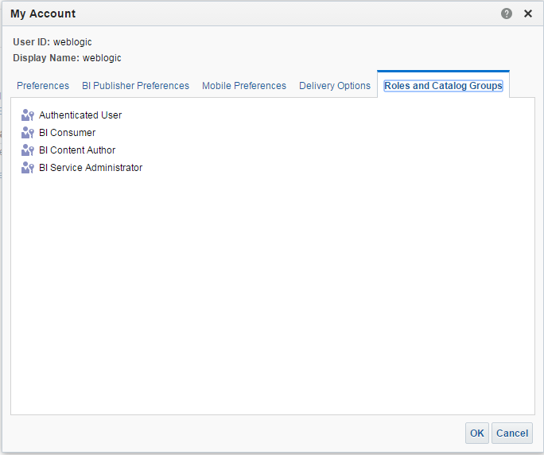
Default BI Roles
  Roles drive permissions and privileges.
  Oracle BI provides default roles and privilege settings.
Administrative user
Default application roles
Notes:
An application role defines a set of permissions granted to a user or group. Application roles are defined in Fusion Middleware Control Enterprise Manager by a Fusion administrator, who can also create and assign users and groups.
Default application roles have corresponding default system user groups that are used in assigning catalog permissions and system privileges. They include the following:
The BI Service Administrator role grants administrative permissions necessary to configure and manage the Oracle Business Intelligence installation. Any member of the BI Administrators group is explicitly granted this role and implicitly granted the BI Author and BI Consumer roles.
The BI Content Author role grants the permissions necessary to create and edit content for other users to use, or to consume. Any member of the BI Authors group is explicitly granted this role and implicitly granted the BI Consumer role.
The BI Consumer role grants the permissions necessary to use, or to consume, content created by other users. By default, every Oracle Business Intelligence authenticated user is part of the BI Consumers group and does not need to be explicitly added to the group or role.
Oracle BI 12c: Create Analyses and Dashboards 18 - <number>

Slide 7
Notes:
Applying roles is the preferred method to administer catalog permissions and system privileges. This approach allows streamlined management of users and their access, so that if policies change, you can administer entire groups of users easily.
To check the roles and groups that are assigned to a user, as shown in the preceding example, click the user’s name in the Global Header and click My Account to display account information, including the Roles and Groups tab where the information is shown.
Oracle BI 12c: Create Analyses and Dashboards 18 - <number>

Slide 8
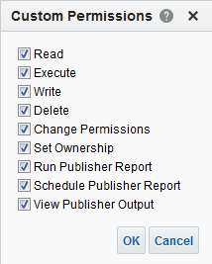
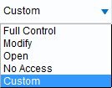
Presentation Catalog
Folder and Object Permissions
  Permissions control access to shared information in catalog objects and interactive dashboards.
  Permission types can be customized and include:
    Full Control
    Modify
    Open
    Traverse
    No Access
Notes:
Folder and object permissions can be set for users and roles. It is advised that you use roles to manage permissions for ease of management. Available permission types include:
Full Control: Includes all permissions
Modify: Read, write, and delete
Open: Read and, in the case of catalog folders, Traverse
No Access: Denies all permissions
By default, when a catalog folder is created or an object is saved to the Presentation Catalog, the parent folder’s permissions are applied.
Oracle BI 12c: Create Analyses and Dashboards 18 - <number>

Slide 9
Permission Inheritance
  Permissions granted explicitly to a user have precedence over privileges granted through application roles.
  Permissions granted explicitly to an application role take precedence over any privileges granted through other application roles.
  If security attributes conflict at the same level, a user or application role is granted the least restrictive security attribute.
Notes:
Users can have explicitly granted permissions. They can also have permissions granted through membership in application roles that, in turn, can have permissions granted through membership in other application roles, and so on. Permissions granted explicitly to a user have precedence over permissions granted through application roles, and permissions granted explicitly to the application role take precedence over any permissions granted through other application roles.
If there are multiple application roles acting on a user or application role at the same level with conflicting security attributes, the user or application role is granted the least restrictive security attribute. Any explicit permissions acting on a user take precedence over any permissions on the same objects granted to that user through application roles.
Filter definitions, however, are always inherited. For example, if User1 is a member of Role1 and Role2, and Role1 includes a filter definition but Role2 does not, the user inherits the filter definition defined in Role1.
Oracle BI 12c: Create Analyses and Dashboards 18 - <number>

Slide 10
Default Application Role Hierarchy: Example
BI Consumers Group
BI Consumer App Role
Permission: access analyses
User1, User2, User3
BI Authors Group
BI Author App Role
Permission: create analyses
User4, User5
BI Administrators Group
BI Administrator App Role
Permission: manage repository
User6, User7
User Name | Group Membership: Explicit/Inherited | Application Role Membership: Explicit/Inherited | Permission Grants: Explicit/Inherited
User1 User2 User3 | BI Consumers: Explicit | BI Consumers: Explicit | Access analyses: Explicit
User4 User5 | BI Authors: Explicit BI Consumers: Inherited | BI Authors: Explicit BI Consumers: Inherited | Create analyses: Explicit Access analyses: Inherited
User6 User7 | BI Administrators: Explicit BI Authors: Inherited BI Consumers: Inherited | BI Administrators: Explicit BI Authors: Inherited BI Consumers: Inherited | Manage repository: Explicit Develop analyses: Inherited Access analyses: Inherited
Notes:
This example is provided to illustrate the relationships between users, groups, application roles, and permissions. In Oracle Business Intelligence, the members of a default application role include both groups and other application roles. The result is a hierarchical role structure where permissions can be inherited, in addition to being explicitly granted. A group that is a member of a role is granted both the permissions of the role and the permissions for all roles descended from that role.
The graphic in the slide shows these relationships between the default application roles and how permissions are granted to members. The result is that, by nature of the role hierarchy, a user who is a member of a particular group is granted both explicit permissions and any additional inherited permissions. Note that by themselves, groups and group hierarchies do not enable any privilege to perform any action within an application. Those privileges are conveyed through the application roles and their corresponding permission grants.
The table in the slide details the roles and permissions granted to all group members (users). The default BI Administrator role is a member of the BI Author role, and the BI Author role is a member of the BI Consumer role. The result is, members of the BI Administrators group are granted all the permissions of the BI Administrator role, the BI Author role, and the BI Consumer role. In this example, only one of the permissions granted by each role is used for demonstration purposes.
Oracle BI 12c: Create Analyses and Dashboards 18 - <number>

Slide 11
Setting Object Permissions
To set permissions on a catalog folder or object, perform the following steps:
  Click Permissions.
  Add roles.
  Set permissions.
Notes:
Object and folder permissions are set by the object owner, content designers, or administrators.
Oracle BI 12c: Create Analyses and Dashboards 18 - <number>

Slide 12
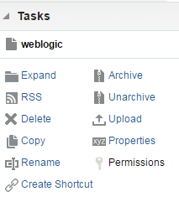

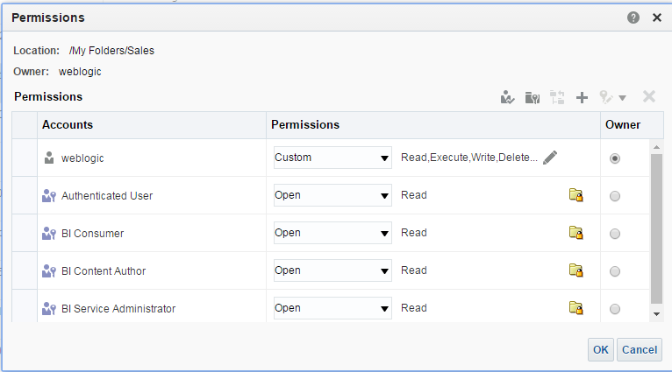


1. Click Permissions
Select a folder or catalog folder and click Permissions.
Permissions toolbar
Owner and location
Assign owner.
Notes:
Select a folder or object, and click Permissions in the Tasks pane of the Catalog page. Alternatively, click the More link for an object on the Catalog or Home page and select Permissions to open the Permissions dialog box. The Accounts list in the dialog box lists the accounts and roles that have permissions. In this list, you can set individual permissions in the Permissions column and, in the case of a Custom permissions setting, click the Edit button to open the Custom Permissions dialog box to select more granular permissions. Set owner in the Owner column.
The Permissions toolbar in the dialog box allows you to add users and apply permissions to the object and its parent folders. These buttons include:
Apply effective permissions: Applies permissions based on the selected user’s group and role assignments
Replace with parent folder’s permissions: Applies permissions from the highest level folder in the object or folder’s catalog location hierarchy
Set parent folder’s permissions to Traverse Folder: Applies Traverse permissions to the parent folder to ensure access to the object for the selected account or role
Oracle BI 12c: Create Analyses and Dashboards 18 - <number>

Slide 13
Notes:
Add users/roles: Allows you to add users and roles to the Permissions list for the object
Apply Permissions: Allows you to select permissions for the object for the selected user or role. You can use Ctrl + click to select multiple users and roles in the list and apply permissions.
Delete: Deletes selected users or roles from the Permissions list
Oracle BI 12c: Create Analyses and Dashboards 18 - <number>

Slide 14

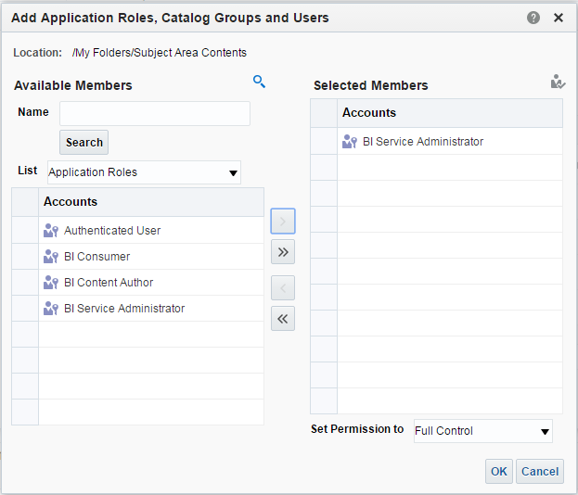





2. Add Roles
Add users or roles to the Permissions list.
Search for users and roles.
Limit search to users or roles.
1
Selected role is added to the Permissions list.
2
3
Default application roles
Notes:
To add roles and users, click the Add Users/Roles button in the Permissions toolbar of the Permissions dialog box. The Add Application Roles, Catalog Groups, and Users dialog box appears.
1. Click the Search button to display search options, which include the ability to filter the list for users or roles and to search using strings. You can click the Effective Permissions button to display the current permissions assigned to the users and roles in the Available and Selected Members lists.
2. In the resulting Available Members list, select the role or user that you want to add permissions for.
3. Click the Move button to add the selected role or user to the Selected Members list and click OK.
Oracle BI 12c: Create Analyses and Dashboards 18 - <number>

Slide 15
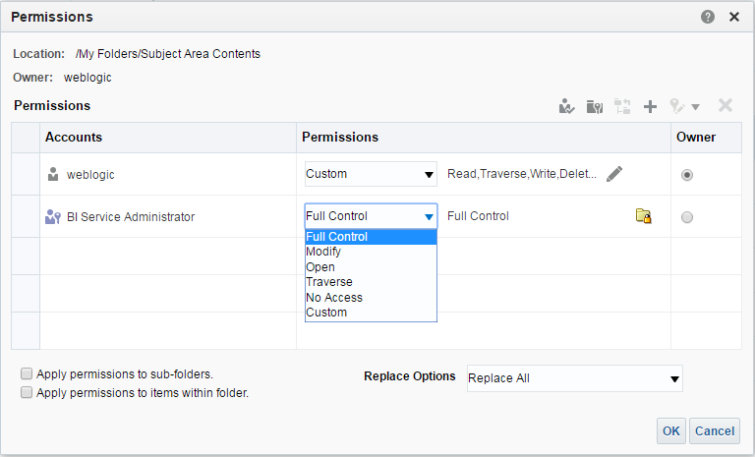
3. Set Permissions
Set object permissions.
Notes:
To set permissions, click the Permissions drop-down list for a user or role and select the permission setting. Then click OK to save. As described earlier in the lesson, available permission types include:
Full Control: Includes all permissions
Modify: Read, write, and delete
Open: Read and, in the case of catalog folders, Traverse
Traverse: Applies only to folders, allowing movement through the folder to reach other objects or folders
No Access: Denies all permissions
Oracle BI 12c: Create Analyses and Dashboards 18 - <number>

Slide 16
Recommendations for Setting Permissions
  Take care when assigning permissions to ensure that you do not inadvertently lock the object.
  Assign permissions through Application roles.
  For Application roles that are going to be modifying the dashboards and dashboard content accessible to the role, set the permissions for the role to Full Control.
  For each Subject Area, ensure that the BI Consumer and Authenticated User roles have No Access permission.
  For roles that should be able to save analyses for public use against a given Subject Area, grant them Full Control to the Subject Area folder.
  Do not set explicit permissions for the Authenticated User role.
Notes:
Take care when assigning permissions to ensure that you do not lock the object, thereby preventing you, an administrator, or any other user from modifying the object. Assign permissions through Application roles, even if you must assign permissions only for a single user.
For Application roles (Catalog groups or users, if necessary) that are going to be modifying the dashboards and dashboard content accessible to the role, set the permissions for the role to Full Control. While allowing change and delete control, Full Control also enables the specified role to set permissions and to delete the object, folder, or dashboard.
For each Subject Area, ensure that the BI Consumer and Authenticated User roles have No Access permission to the Subject Area folder.
For roles that should be able to save analyses for public use against a given Subject Area, grant them Full Control to the Subject Area folder and everything it contains, and likewise for the Common folder.
To ensure that only members of the designated roles have access to Oracle BI Presentation Catalog folders, folder content, and dashboards, do not set explicit permissions for the Authenticated User role. See Oracle Fusion Middleware Security Guide for Oracle Business Intelligence Enterprise Edition for more information.
Oracle BI 12c: Create Analyses and Dashboards 18 - <number>

Slide 17
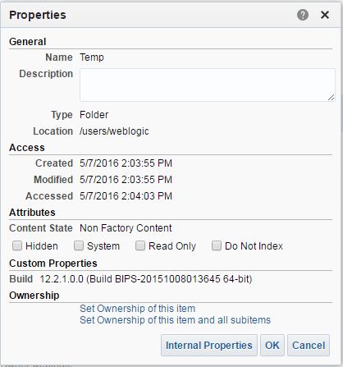
Viewing and Setting Properties
Properties control object attributes.
Notes:
To view and edit properties for an object or folder, select it on the Catalog page and click Properties in the Task pane or click its More link and select Properties. You can edit properties. Properties include details about when the object was created, modified, and last accessed. You can edit attributes to affect the behavior of the object.
Hidden: Hides the object in the catalog. Administrative users can select the Show Hidden Items option on the Catalog page’s toolbar to display hidden items.
System: Specifies that the object is a system object
Read Only: Sets the object as read-only
Do Not Index: Excludes the object and its contents from the index that is used by the full-text search. The item is still available through normal search.
Oracle BI 12c: Create Analyses and Dashboards 18 - <number>

Slide 18
Setting System Privileges
To set system privileges, perform the following steps:
  Click the Administration and Manage Privileges links.
  Pick users and roles.
Notes:
Oracle BI 12c: Create Analyses and Dashboards 18 - <number>

Slide 19
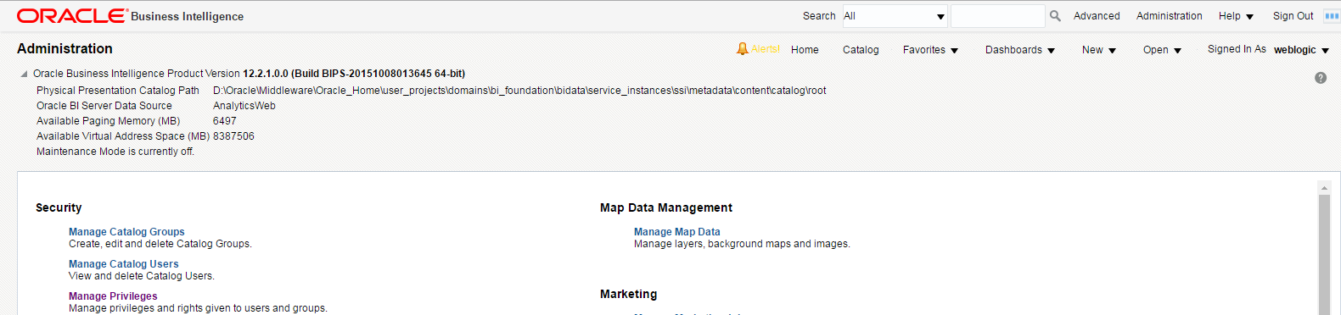
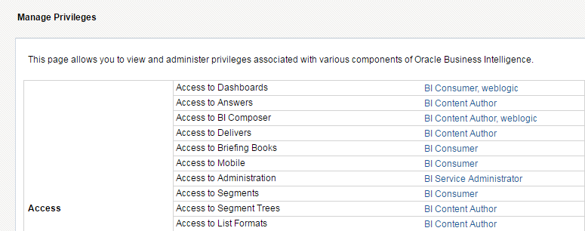
1. Click the Administration and Manage Privileges Links
Notes:
To access the Manage Privileges page, click the Administration link in the Global Header. You must be signed in as a user with administrative privileges to access the link. On the Administration page, click the Manage Privileges link under Security. The Manage Privileges page appears.
Oracle BI 12c: Create Analyses and Dashboards 18 - <number>

Slide 20


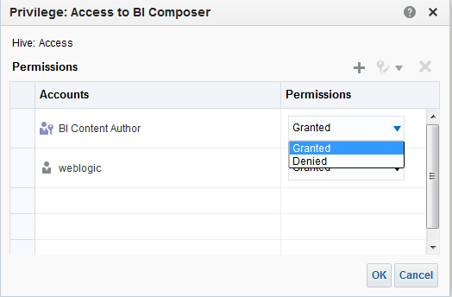

2. Pick Users and Roles
1
Add Users/Roles button
2
3
Notes:
The Manage Privileges page lists privileges for many aspects of the system. To set a privilege, perform the following steps:
1. Click the link associated with a privilege.
2. In the Privilege: Access to BI Composer dialog box, click the Add Users/Roles button on the Privileges toolbar to open the Add Application Roles, Catalog Groups and Users dialog box, which allows you to add roles and users, similar to how you do it with permissions. After you have completed your list of included roles and users, click OK.
3. In the resulting Permissions list, select the role or user that you want to edit privileges for, and set the privilege in the Permissions column.
Oracle BI 12c: Create Analyses and Dashboards 18 - <number>

Slide 21
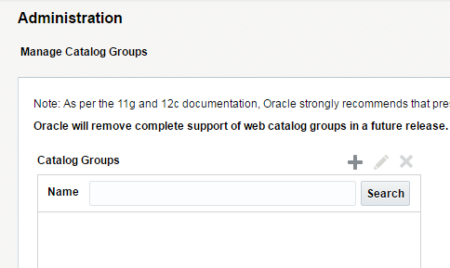



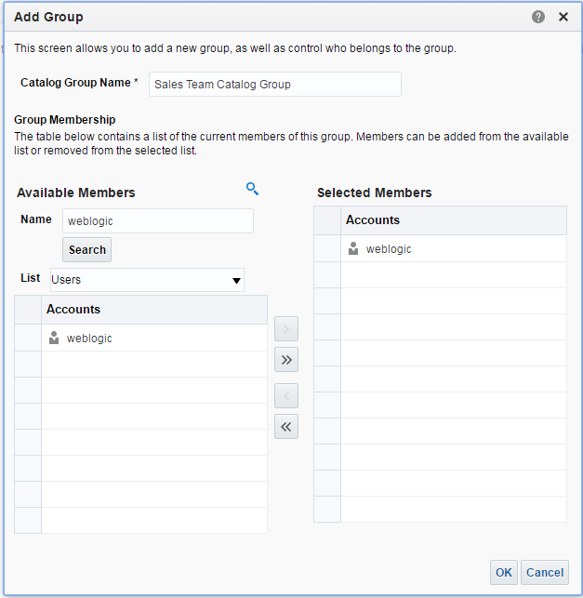
Catalog Groups
Create and manage groups specific to the Presentation Catalog.
Create new group.
Delete group.
Edit group.
Notes:
Catalog groups are maintained on the Manage Catalog Groups page. Catalog groups can be constructed and permissions may be assigned to them in the same way that you assign permissions to roles and users; however, this is not the best approach. It is preferable, from an administrative perspective, to manage users and groups from the perspective of Fusion applications as a whole, rather than segregate groups and security specifically to the Presentation Catalog. This ability is, however, provided for compatibility with previous releases.
On the Manage Catalog Groups page, you can add, edit, or delete Catalog groups. To create a catalog group, first click the Manage Catalog Groups link on the Administration page, and then perform the following steps:
1. Click the Administration link in the Global Header.
2. Click the Manage Catalog Groups link.
3. Click the Create New Group button.
4. In the Add Group dialog box, enter a Catalog Group Name.
5. Select users in the Available Members list and add them to the Selected Members list. Then click OK.
When you add a Catalog group, a default shared folder is created in the Catalog for use by the group.
Oracle BI 12c: Create Analyses and Dashboards 18 - <number>

Slide 22
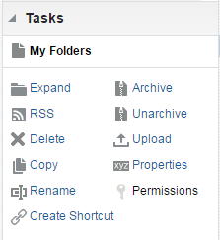
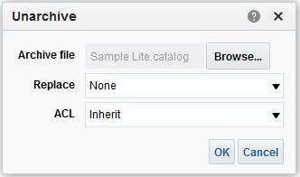
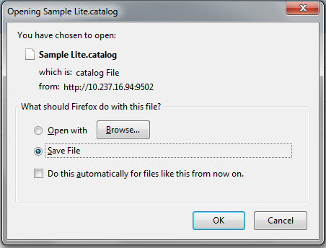
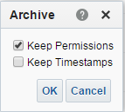
Archiving Catalog Items
Select an object in the catalog and click Archive.
Notes:
To archive an object or folder, select it on the Catalog page and click Archive in the Tasks pane or, alternatively, click the object or folder’s More button to select Archive. Select options to keep or discard permissions and time stamps, and then save the resulting file. To import an archive into the catalog, click the Unarchive task. Then browse for the .catalog archive file in the Unarchive dialog box, and click OK.
In the Unarchive dialog box, the Replace drop-down list allows you to specify if and how to replace any existing folders or objects with the same name. Options include:
All: Replace any existing folders or objects with the same names.
Old: Replace folders or objects except those that already exist and are older than the source.
None: Add any new folders or objects, but preserve any existing folders or objects.
Force: Add and replace all folders or objects.
Oracle BI 12c: Create Analyses and Dashboards 18 - <number>

Slide 23
Notes:
The ACL drop-down list allows you to specify how the folders or objects are assigned permissions via Access Control Lists (ACLs) when unarchived. Options include:
Inherit: Inherits the folder or object's permissions (ACL) from its new parent folder
Preserve: Preserves the folder or object's permissions (ACL) as they were in the original, mapping accounts as necessary
Create: Preserves the folder or object's permissions (ACL) as they were in the original, creating and mapping accounts as necessary
Oracle BI 12c: Create Analyses and Dashboards 18 - <number>

Slide 24
Oracle BI Briefing Books
  Store static or updatable snapshots of dashboard pages, individual analyses, or BI Publisher reports
  Can be downloaded and shared for offline printing and viewing in PDF or Mime HTML (MHTML) format
  Can be added to a dashboard page as a list
  Can be updated, scheduled, and delivered by using agents
Notes:
The Adobe Reader application is required to view or print an Oracle BI Briefing Book PDF file.
Oracle BI 12c: Create Analyses and Dashboards 18 - <number>

Slide 25
Working with Oracle BI Briefing Books
Tasks:
  Add content to a new or existing Oracle BI Briefing Book.
  Edit an Oracle BI Briefing Book.
  Download an Oracle BI Briefing Book.
Notes:
Instructor Note
This is a structuring slide. Do not teach the tasks here because the following slides cover them in detail.
Oracle BI 12c: Create Analyses and Dashboards 18 - <number>

Slide 26
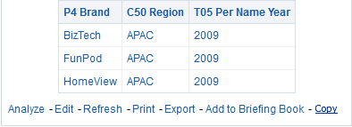

Add Content to a New or Existing
Oracle BI Briefing Book
On a dashboard page, you can create an Oracle BI Briefing Book in either of the following ways:
  Navigate to the dashboard page (to add the entire contents of the dashboard page), click the Page Options toolbar button, and select the Add to Briefing Book link.
  Navigate to the specific analysis and click the Add to Briefing Book link on the specific analysis.
1
Add
Notes:
You can add the content of dashboard pages (including pages that contain BI Publisher reports) or individual analyses to existing or new Oracle BI Briefing Books.
Perform one of the following actions:
Navigate to the dashboard page and select Add to Oracle BI Briefing Book from the Page Options toolbar to add the entire contents of the dashboard page.
Navigate to the analysis and click the Add to Oracle BI Briefing Book link on the specific analysis.
Note: The Add to Briefing Book link on the specific analysis on a dashboard page appears only if that option was selected in the Dashboard Report Links dialog box.
Oracle BI 12c: Create Analyses and Dashboards 18 - <number>

Slide 27
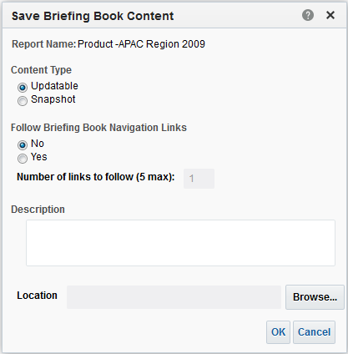
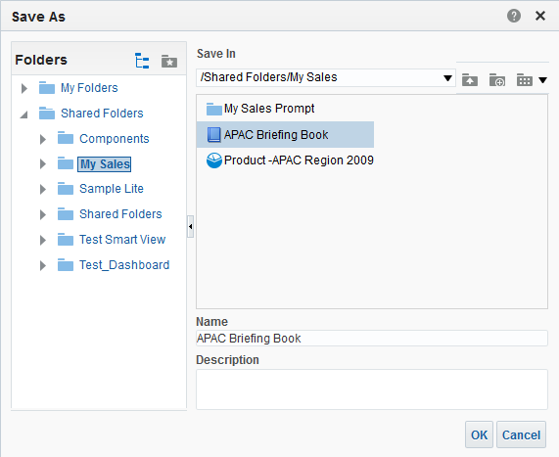


Add Content to a New or Existing
Oracle BI Briefing Book
Browse for an existing Briefing Book or add a new one.
2
Browse
3
Notes:
2. In the Oracle BI Save Briefing Book Content dialog box, complete the following details:
Content Type:
Updatable: Refreshes the content whenever the Oracle BI Briefing Book is downloaded, or when it is specified as the delivery content for an agent
Snapshot: Adds the content in its current state. Snapshot content preserves the original data and is not updated when the Oracle BI Briefing Book is rerun. Snapshot content will not be updated when using agents.
Follow Briefing Book Navigation Links (applies only to Updatable content type):
No: Specifies that Oracle BI Briefing Book navigation links are not to be followed
Yes: Specifies that Oracle BI Briefing Book navigation links are to be followed. If you select this option, then you must also specify the number of links to follow.
Number of links to follow (5 max): Specifies the number of Oracle BI Briefing Book navigation links to be followed, if you selected the Yes option. The default value for the maximum number of links to follow is 5.
3. Click Browse to display the Save As dialog box. If you are creating a new Oracle BI Briefing Book, enter a name in the Name text box or select an existing Oracle BI Briefing Book, add an optional description, and click OK.
Oracle BI 12c: Create Analyses and Dashboards 18 - <number>

Slide 28
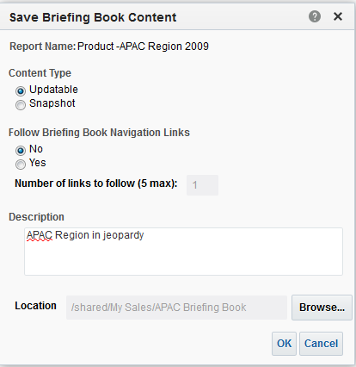
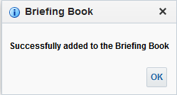
Add Content to a New or Existing
Oracle BI Briefing Book
4
Notes:
4. When the Oracle BI Briefing Book confirmation message box appears, click OK.
Oracle BI 12c: Create Analyses and Dashboards 18 - <number>

Slide 29
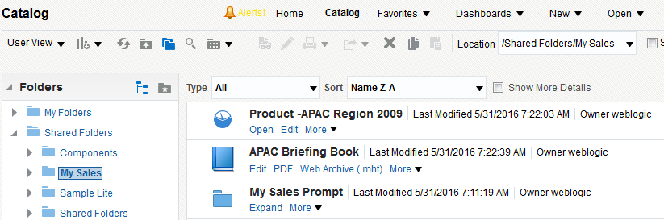
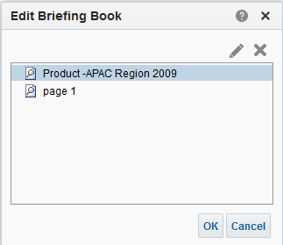
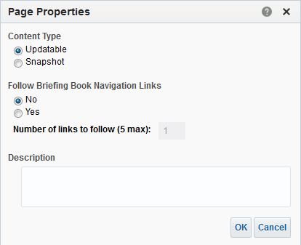

Edit an Oracle BI Briefing Book
1
2
3
Delete
Edit
4
Notes:
Oracle BI 12c: Create Analyses and Dashboards 18 - <number>

Slide 30
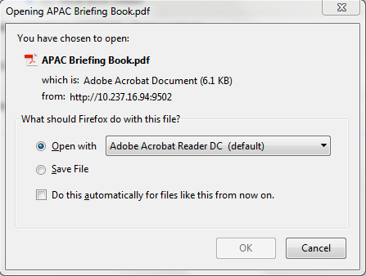
Download an Oracle BI Briefing Book
1
2
3
Notes:
You can download Oracle BI Briefing Books to your computer in MHTML format and then share them for offline viewing, or you can download Oracle BI Briefing Books in PDF format and print them.
1. To download an Oracle BI Briefing Book, in the Global Header, select the Catalog tab.
2. Navigate to the Oracle BI Briefing Book that you want to download.
3. To download the Oracle BI Briefing Book in PDF format, click PDF, and then open or save the file. (The Adobe Reader application is required to view or print a briefing book PDF file.)
To download the Oracle BI Briefing Book in MHTML format, click Web Archive (.mht) and then open or save the file. These downloaded Oracle BI Briefing Books can be opened in a browser. They can then be emailed or shared.
Note: BI Publisher reports that are contained in the Oracle BI Briefing Book are included in the PDF file only if the reports themselves are enabled for PDF output.
Oracle BI 12c: Create Analyses and Dashboards 18 - <number>

Slide 31
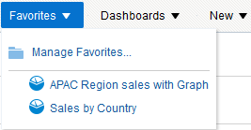
Working with Favorites
  Bookmark as favorites the catalog objects that you view regularly or want to view again at another time.
  Organize favorites by creating categories and rearranging your favorites.
  Access a list of favorites and any categories that you created by clicking Favorites in the Global Header.
Notes:
The Favorites functionality allows you to bookmark as favorites the catalog objects that you view regularly or want to view again at another time. After you flag objects as favorites, you can use the Manage Favorites dialog box to organize your favorites by creating categories and rearranging your favorites into the order that you find most intuitive. You can access a list of the objects that you marked as favorites, and any categories that you created, by clicking Favorites in the Global Header.
Oracle BI 12c: Create Analyses and Dashboards 18 - <number>

Slide 32

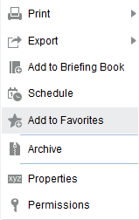
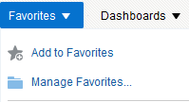

Adding Objects to Favorites
  Add objects to favorites using the Home or Catalog page.
  Add objects to favorites while viewing or editing an object.
Select More > Add to Favorites.
In the Global Header, move the cursor over Favorites and click Add to Favorites.
Favorite objects have a gold star.
Notes:
There are a couple of methods for adding an object to Favorites.
To add an object to your favorites list by using the Home page or Catalog page, perform the following steps:
Go to the Home page or Catalog page and browse for the object that you want to add to your favorites list.
Click the More link, and then click Add to Favorites. The object is added to your favorites list.
To add an object to your favorites list while viewing or editing the object, perform the following steps:
Open the object in its designated viewer or editor.
In the Global Header, place the cursor over Favorites and click Add to Favorites. The object is added to your favorites list.
After you add an object to your favorites list, the object’s icon is updated to include a gold star.
Oracle BI 12c: Create Analyses and Dashboards 18 - <number>

Slide 33
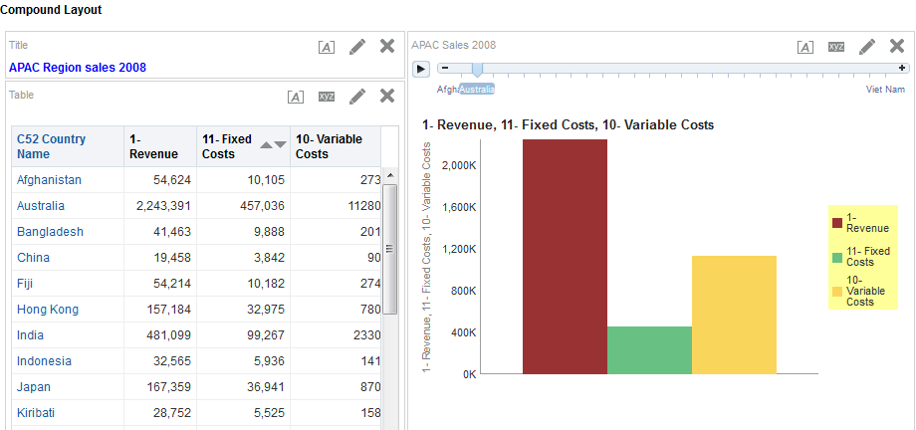
Accessing Favorite Objects
In the Global Header, place the cursor over the Favorites menu to display the list of objects marked as favorites.
Select favorite object.
Object is displayed based on permissions.
Notes:
After you tag objects as favorites, you can use the Favorites menu in the Global Header to view your list of favorites and browse for and select a favorite object.
To view your favorites list, perform the following steps:
In the Global Header, place the cursor over the Favorites menu. The list of the objects that you marked as favorites appears.
Scroll through the list of objects and categories to find a specific object.
Click the object to select it. Oracle BI EE displays the selected object based on your permissions. For example, if you open an analysis to which you have write permission, then Oracle BI EE opens the object in the Analysis Editor.
Oracle BI 12c: Create Analyses and Dashboards 18 - <number>

Slide 34



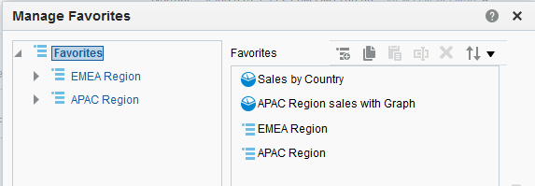



Organizing Favorites
  Select Favorites > Manage Favorites to open the Manage Favorites dialog box.
  Organize favorites by creating categories and rearranging objects.
Select Manage Favorites to open a dialog box.
Create categories.
Copy, paste, and rename objects.
Sort objects.
Delete objects.
Drag and drop objects into categories.
Notes:
Select Favorites > Manage Favorites to open the Manage Favorites dialog box, where you can organize the items on your favorites list by creating categories of favorite objects, and arranging categories and objects. In the Category Tree area, browse to the location where you want to add a new category. When you select a category in the Category Tree, any subcategories or favorite objects nested in that category appear in the Selected Category area. You can perform any of the following actions to rearrange your favorites:
Select an object or category and click the Move buttons (not shown in the screenshot) to move the object up or down in your favorites list.
Drag objects to categories. Drag categories into other categories to nest them. Note that depending on how you want to nest categories, you can drag and drop categories within the Category Tree or the Selected Category area.
Copy objects or categories from one location and paste them into another location.
Rename categories.
Sort the selected categories or objects within a category by ascending or descending alphabetic order.
Oracle BI 12c: Create Analyses and Dashboards 18 - <number>

Slide 35
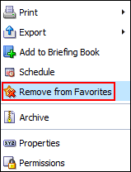
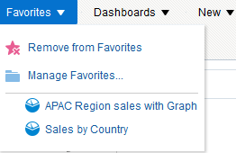
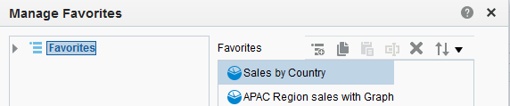
Removing Favorites
  Remove an object by using the Home or Catalog pages.
  Remove objects while viewing or editing an object.
  Remove objects by using the Manage Favorites dialog box.
Click More.
Remove from Favorites.
Delete object.
Notes:
You can remove objects from your favorites list by using the Home or Catalog pages, while viewing or editing an object, or by using the Manage Favorites dialog box. Note that if you have flagged an object as a favorite and you or someone else deletes that object from the Catalog, then the object will be removed from your favorites list. After you remove an object from your favorites list, the object’s icon changes from an icon with a gold star to the object’s standard icon.
Oracle BI 12c: Create Analyses and Dashboards 18 - <number>

Slide 36

Quiz: Overview
This quiz examines your knowledge of the Presentation Catalog and managing permissions.
Notes:
In this quiz, you answer questions regarding the Presentation Catalog, and object and folder administration in Oracle Business Intelligence.
Oracle BI 12c: Create Analyses and Dashboards 18 - <number>

Slide 37
Quiz
Which of the following are ways to access the permissions for an object?
  Use the Permissions task in the Tasks pane in the Catalog page.
  Click the More link for the object in the Home page and select Permissions.
  Click the object’s Edit link and open its properties in the Analysis Editor.
Notes:
Answer: a, b
Oracle BI 12c: Create Analyses and Dashboards 18 - <number>

Slide 38
Quiz
If there are conflicting security attributes for an object, a user or an application role is granted the least restrictive security attribute.
  True
  False
Notes:
Answer: a
Oracle BI 12c: Create Analyses and Dashboards 18 - <number>

Slide 39
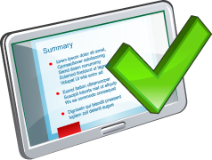
Summary
In this lesson, you should have learned how to:
  Describe the use of roles in administering permissions
  Administer Oracle Business Intelligence Presentation Catalog permissions
  Administer system privileges
  Explain Oracle BI Briefing Books
  Work with Favorites
Notes:
Oracle BI 12c: Create Analyses and Dashboards 18 - <number>

Slide 40

Practice 18: Overview
This practice covers the following topics:
  Administering Presentation Catalog Objects and Permissions with Users and Roles
  Working with Oracle BI Briefing Books
  Working with Favorites
Notes:
Oracle BI 12c: Create Analyses and Dashboards 18 - <number>

