Slide 1
Expressions
Notes:
Schedule: Timing Topic
30 minutes Lecture
35 minutes Practice
05 minutes Quiz
70 minutes Total

Slide 2

Objectives
After completing this lesson, you should be able to use:
  SQL Syntax and Semantics
  Aggregate functions
  Time series functions
  Advance analytics functions
Notes:
Oracle BI 12c: Create Analyses and Dashboards 20 - <number>

Slide 3
Notes:
The Oracle BI Server accepts SQL SELECT statements from client tools. The Oracle BI Administration Tool enables you to define the logical abstraction provided by the Presentation layer and the Business Model and Mapping layer enables clients to query data with Logical SQL only, so that the interaction with actual physical sources is handled by the Oracle BI Server columns with complex expressions. In Answers, you can view the Logical SQL queries issued by Oracle BI Presentation Services for particular analyses by viewing the SQL Issued section of the Advanced tab of the Analysis Editor. If you have the appropriate privileges, then you can also view SQL by displaying the Manage Sessions page on the Administration tab. Click View Log from the Manage Sessions page to see further details. In Answers, there are also several places where you can issue Logical SQL. If you have the appropriate privileges, then you can use the Issue SQL page on the Administration tab to enter any SQL code to send to the Oracle BI Server.
Oracle BI 12c: Create Analyses and Dashboards 20 - <number>

Slide 4
SQL Syntax and Semantics
  Basic Syntax for the SELECT Statement
SELECT [DISTINCT] select list
FROM from clause
[WHERE search condition]
[GROUP BY column {, column}
[HAVING search condition]]
[ORDER BY column {, column}]
Where:
Select list is the list of columns specified in the request.
FROM clause is the list of tables in the request.
A WHERE clause acts as a filter.
Search condition specifies any combination of conditions to form a conditional test.
GROUP BY column {, column} specifies a column (or alias) belonging to a table defined in the data source.
HAVING search condition specifies any combination of conditions to form a conditional test.
ORDER BY column {, column} specifies the columns to order the results by.
Notes:
The SELECT statement, or query specification, is the way to query a decision support system through the Oracle BI Server. A SELECT statement returns a table to the client that matches the query. It is a table in the sense that the results are in the form of rows and columns. The SELECT statement is the basis for querying any structured query language (SQL) database. The Oracle BI Server accepts logical requests to query objects in a repository, and users (or query tools) make those logical requests with ordinary SQL SELECT statements. The server then translates the logical requests into physical queries against one or more data sources, combines the results to match the logical request, and returns the answer to the end user.
Oracle BI 12c: Create Analyses and Dashboards 20 - <number>

Slide 5
Aggregate Functions
  Aggregate functions perform operations on multiple values to create summary results.
  Aggregate functions include:
    AGGREGATE AT
    AVG
    AVGDISTINCT
    BOTTOMN
    COUNT
    MAX
    SUM
    TOPN
Notes:
Oracle BI 12c: Create Analyses and Dashboards 20 - <number>
These functions aggregate columns based on the level or levels you specify.
AGGREGATE AT: Guarantees that the aggregate for the measure always occurs at the levels specified after the keyword AT, regardless of the WHERE clause
SELECT month, year, AGGREGATE(sales AT Year) FROM table A WHERE year = 1994 AND month = 12
AVG: Calculates the average (mean) value of an expression in a result set. It must take a numeric expression as its argument. Example: AVG(numExpr).
AVGDISTINCT: Calculates the average (mean) of all distinct values of an expression. It must take a numeric expression as its argument.
BOTTOMN: This function ranks the lowest n values of the expression argument from 1 to n, 1 corresponding to the lowest numeric value. The BOTTOMN function operates on the values returned in the result set. Example: BOTTOMN(numExpr, integer).
COUNT: This function calculates the number of rows having a nonnull value for the expression. The expression is typically a column name, in which case the number of rows with nonnull values for that column is returned. Example: COUNT(expr).

Slide 6

Notes:
MAX: This function calculates the maximum value (highest numeric value) of the rows satisfying the numeric expression argument.
SUM: This function calculates the sum obtained by adding up all values satisfying the numeric expression argument.
TOPN: This function ranks the highest n values of the expression argument from 1 to n, 1 corresponding to the highest numeric value. The TOPN function operates on the values returned in the result set. A request can contain only one TOPN expression. Example: TOPN(numExpr, integer)
Oracle BI 12c: Create Analyses and Dashboards 20 - <number>

Slide 7
Running Aggregate Functions
  Running Aggregate functions perform operations on a set of records as input, but instead of outputting a single aggregate for the entire set of records, they output the aggregate based on records encountered so far.
  Running Aggregate functions include:
    MAVG
    MSUM
    RSUM
    RCOUNT
    RMAX
    RMIN
Notes:
Oracle BI 12c: Create Analyses and Dashboards 20 - <number>
MAVG: This function calculates a moving average (mean) for the last n rows of data in the result set, inclusive of the current row. Example: MAVG(numExpr, integer).
MSUM: This function calculates a moving sum for the last n rows of data, inclusive of the current row. Example: MSUM(numExpr, integer).
RSUM: This function calculates a running sum based on records encountered so far. The sum for the first row is equal to the numeric expression for the first row. The sum for the second row is calculated by taking the sum of the first two rows of data. The sum for the third row is calculated by taking the sum of the first three rows of data, and so on. Example: RSUM(numExpr)
RCOUNT: This function takes a set of records as input and counts the number of records encountered so far.
RMAX: This function takes a set of records as input and shows the maximum value based on the records encountered so far. The specified data type must be one that can be ordered.
RMIN: This function takes a set of records as input and shows the minimum value based on the records encountered so far. The specified data type must be one that can be ordered.

Slide 8
Time Series Functions
  Time Series functions operate on time-oriented dimensions.
  Time Series functions include:
    AGO
    PERIODROLLING
    TODATE
Notes:
Oracle BI 12c: Create Analyses and Dashboards 20 - <number>
AGO: This function is a time series aggregation function that calculates the aggregated value from the current time grain (as determined by the measure grain and predicates) back to a specified time period. For example, AGO can produce sales for every month of the current quarter and the corresponding quarter-ago sales. The grain at which the time shift occurs is determined by the measure grain and predicates. For example, in the following query, the time shift occurs at the quarter level and goes back one year: Select year, quarter, Ago(sales, year_level, 1).
PERIODROLLING: This function computes the aggregate of a measure over the period starting x units of time and ending y units of time from the current time. For example, you can use PERIODROLLING to compute sales for a period that starts at a certain quarter before and ends at a certain quarter after the current quarter. Example: PERIODROLLING(measure, x ,y [,hierarchy]).
TODATE: This function aggregates a measure from the beginning of a specified time period to the currently displayed time. For example, this function can calculate Year to Date sales. Example: TODATE(expr, time_level)

Slide 9
Conversion Functions
  Conversion functions convert a value from one form to another.
  Conversion functions include:
    CAST
    IFNULL
    TO_DATETIME
Notes:
Oracle BI 12c: Create Analyses and Dashboards 20 - <number>
CAST: This function changes the data type of an expression or a null literal to another data type. For example, you can cast a customer_name (a data type of Char or Varchar) or birthdate (a datetime literal). The following are the supported data types to which the value can be changed: CHARACTER, VARCHAR, INTEGER, FLOAT, SMALLINT, DOUBLE PRECISION, DATE, TIME, TIMESTAMP, BIT, and BIT VARYING.
IFNULL: This function tests if an expression evaluates to a null value, and if it does, assigns the specified value to the expression.
TO_DATETIME: This function converts string literals of dateTime format to a DateTime data type.

Slide 10
Database Functions
  Users and administrators can create requests by directly calling database functions from either Oracle BI Answers or by using a logical column within the metadata repository.
  Database functions include:
    EVALUATE
    EVALUATE_ANALYTIC
    EVALUATE_AGGR
    EVALUATE_PREDICATE
Notes:
Oracle BI 12c: Create Analyses and Dashboards 20 - <number>
EVALUATE: This function passes the specified database function with optional referenced columns as parameters to the back-end data source for evaluation. This function is intended for scalar calculations, and is useful when you want to use a specialized database function that is not supported by the Oracle BI Server, but that is understood by the underlying data source. The embedded database function may require one or more columns. These columns are referenced by %1 ... %N within the function. The actual columns must be listed after the function. Example: SELECT EVALUATE('instr(%1, %2)', address, 'Foster City') FROM employees.
EVALUATE_ANALYTIC: This function passes the specified database analytic function with optional referenced columns as parameters to the back-end data source for evaluation.
The embedded database function may require one or more columns. These columns are referenced by %1 ... %N within the function. The actual columns must be listed after the function.

Slide 11
Notes:
Example: EVALUATE_ANALYTIC('dense_rank() over(order by %1 )' AS INT,sales.revenue).
EVALUATE_AGGR: This function passes the specified database function with optional referenced columns as parameters to the back-end data source for evaluation. This function is intended for aggregate functions with a GROUP BY clause. The embedded database function may require one or more columns. These columns are referenced by %1 ... %N within the function. The actual columns must be listed after the function. Example: EVALUATE_AGGR('REGR_SLOPE(%1, %2)', sales.quantity, market.marketkey).
EVALUATE_PREDICATE: This function passes the specified database function with optional referenced columns as parameters to the back-end data source for evaluation. This function is intended for functions with a return type of Boolean. The embedded database function may require one or more columns. These columns are referenced by %1 ... %N within the function. The actual columns must be listed after the function. Example: EVALUATE_PREDICATE('dense_rank() over (order by 1% ) < 5', sales.revenue)
Oracle BI 12c: Create Analyses and Dashboards 20 - <number>

Slide 12
Advance Analytics Internal Logical SQL Functions
  Oracle BI Server supports Logical SQL functions that allow Visual Analyzer users to explore data using models such as binning and trend lines.
  Internal Logical SQL functions include:
    BIN
    WIDTH_BUCKET
    TRENDLINE
Notes:
Oracle BI 12c: Create Analyses and Dashboards 20 - <number>
BIN: With the BIN function, the user can select any numeric attribute (INT, FLOAT, DOUBLE, NUMERIC) from a dimension or fact table or a measure containing the data values and place them into a discrete number of bins. The BIN function classifies a given numeric expression into a specified number of equal width buckets. The function can return either the bin number or one of the two end points of the bin interval. The output of the BIN function is then used as a GROUP BY expression for other measures included in the query. For example, suppose the user is analyzing the sales performance for a retail store. One way to look at sales is in the form of a histogram so that you can see sales less than $500, between $500 and $1000, and so on. To build a histogram, first you would classify the sales total values into bins. The BIN function is treated like a new dimension attribute for purposes such as aggregation, filtering, and drilling.
WIDTH_BUCKET: The WIDTH_BUCKET function classifies a given numeric expression into a specified number of equal width buckets. The WIDTH_BUCKET function operates on top of the base query result set as a display function. The function can return either the bin number or one of the two end points of the bin interval.
TRENDLINE: The TRENDLINE function measures data across time and shows a line chart of a metric by ordered records.

Slide 13
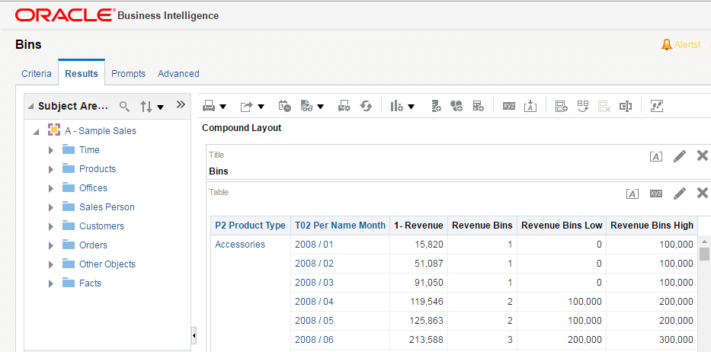



BIN Function
  The BIN function returns Number, Low Range, and High Range.
Low Range
Number
High Range
Notes:
Oracle BI 12c: Create Analyses and Dashboards 20 - <number>
Formulas for calculating the BIN number and the low and the high value of the BIN interval are as follows:
Number: BIN("Base Facts"."1- Revenue" BY "Products"."P2 Product Type" ,"Time"."T02 Per Name Month" into 4 bins).
Low Range: BIN("Base Facts"."1- Revenue" BY "Products"."P2 Product Type" ,"Time"."T02 Per Name Month" into 4 bins Returning RANGE_LOW).
High Range: BIN("Base Facts"."1- Revenue" BY "Products"."P2 Product Type" ,"Time"."T02 Per Name Month" into 4 bins Returning RANGE_HIGH).

Slide 14
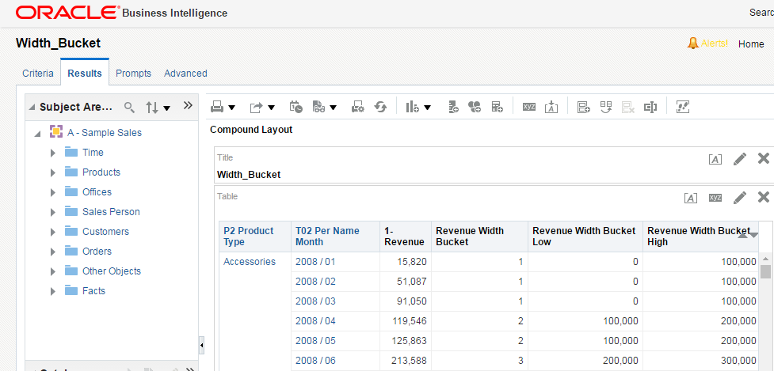
WIDTH_BUCKET Function
  WIDTH_BUCKET returns either the bin number or one of the two end points of the bin interval.
Number
Low Range
High Range
Notes:
Oracle BI 12c: Create Analyses and Dashboards 20 - <number>
The Bin number or the lower or the high value of the Bin interval. Formula are as follows:-
Number: WIDTH_BUCKET("Base Facts"."1- Revenue", NUMBER, 4 ,0, 400000).
Low Range: WIDTH_BUCKET("Base Facts"."1- Revenue", RANGE_LOW, 4 ,0, 400000).
High Range: WIDTH_BUCKET("Base Facts"."1- Revenue", RANGE_HIGH, 4 ,0, 400000).

Slide 15
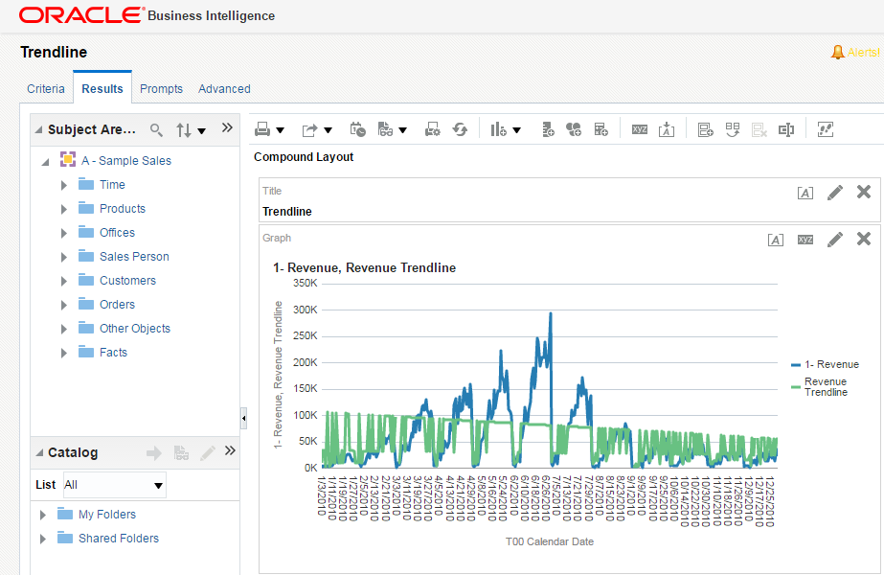
TRENDLINE Function
Notes:
Oracle BI 12c: Create Analyses and Dashboards 20 - <number>
The TRENDLINE function measures data across time and shows a line chart of a metric by ordered records. Currently the TRENDLINE function can model data as linear and exponential regression.
Trendline: TRENDLINE("Base Facts".“1- Revenue", ("Time"."T00 Calendar Date") BY ("Products"."P2 Product Type"), 'LINEAR','VALUE')

Slide 16
Advance Analytics External Logical SQL Functions
  Oracle BI Server supports Logical SQL functions that allow Visual Analyzer users to explore data with models such as forecast, cluster, and outlier.
  External Logical SQL functions include:
    EVALUATE_SCRIPT
    FORECAST
    CLUSTER
    OUTLIER
    REGR
Notes:
Oracle BI 12c: Create Analyses and Dashboards 20 - <number>
Oracle BI Server supports external Logical SQL functions that allow Visual Analyzer users to explore data with models such as forecast, cluster, and outlier. The External Logical SQL functions feed the input data to the stand-alone R-process or ORE. These functions are basically used for sentiments and predictive analysis. To work with these functions in OBIEE 12c, you first need to install and configure R analytics.

Slide 17
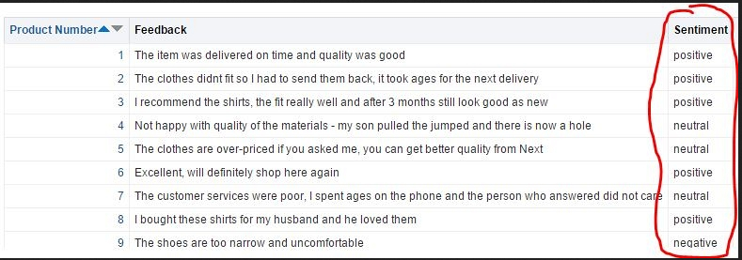
EVALUATE_SCRIPT
If you run your analysis, you can see the sentiment analysis being performed.
Notes:
Oracle BI 12c: Create Analyses and Dashboards 20 - <number>
EVALUATE_SCRIPT: Add a new column to your analysis with the following formula:
EVALUATE_SCRIPT('filerepo://peak.Sentiment.xml', 'sentiment', 'id=%1;text=%2', [ID Column], [Text Column])
You need to replace the parts in square brackets with the two corresponding columns from your analysis (you can supply expressions such as CASE..WHEN and also string literals instead of column names).
For example:
EVALUATE_SCRIPT('filerepo://peak.Sentiment.xml', 'sentiment', 'id=%1;text=%2', "Products"."Product Number", "Products"."Feedback")
NOTE: Sentiment Analysis is never 100% perfect. You can customize the R package to improve accuracy, or consider alternative packages.

Slide 18
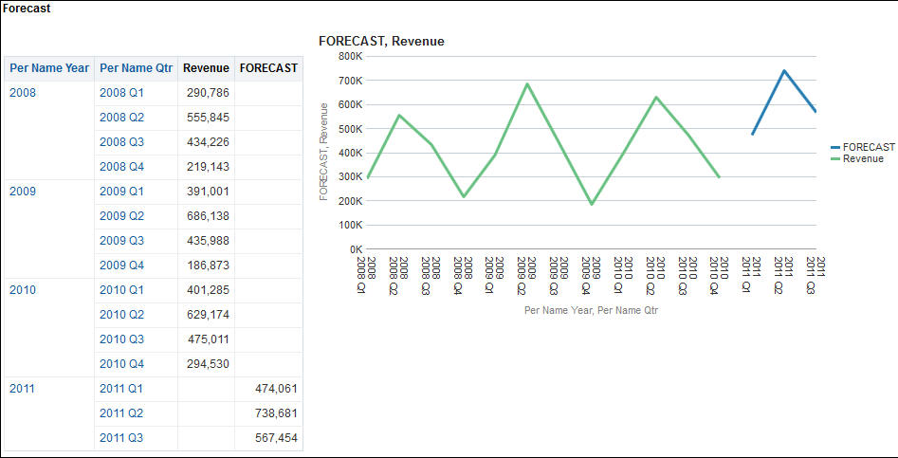
FORECAST
Creates a time-series model of the specified measure over the series
Notes:
The Forecast function is hiding with the Time Series Calculations (unlike the Analytics). It makes sense since it includes time-series components.
The FORECAST function creates a time-series model of the specified measure over the series using either Exponential Smoothing or ARMIA. This function outputs a forecast for the set of periods as specified by numPeriods.
Syntax
FORECAST(numeric_expr, ([series]), output_column_name, options, [runtime_binded_options])])
Where:
numeric_expr indicates the measure to forecast. For example, revenue data to forecast.
series indicates the time grain at which the forecast model is built.
FORECAST("Base Facts".“1- Revenue", ("Time".“T05 Per Name Year" timeYear, "Time".“T03 Per Name Qtr" timeQuarter),'forecast','modelType=arima;numPeriods=%1;predictionInterval=70;', 3)
Oracle BI 12c: Create Analyses and Dashboards 20 - <number>

Slide 19
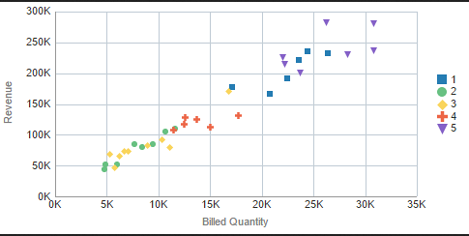
CLUSTER
Collects a set of records into groups based on one or more input expressions
Notes:
CLUSTER: A "cluster" algorithm will attempt to form groups (clusters) within your data. Once the groups have been formed, it is up to you as the user to determine if there is any business relevance.
CLUSTER(("Time".“T02 Per Name Month"), ("Base Facts".“1- Revenue","Base Facts".“2- Billed Quantity"),'clusterName', 'algorithm=k-means;numClusters=%1;maxIter=%2;useRandomSeed=FALSE;enablePartitioning=TRUE', 5, 10)
Oracle BI 12c: Create Analyses and Dashboards 20 - <number>

Slide 20
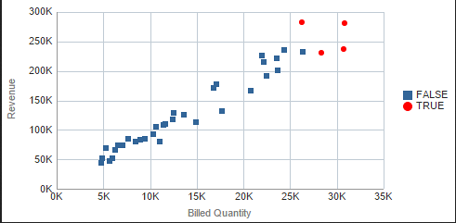
OUTLIER
  The function just returns TRUE or FALSE.
Notes:
Outlier: An Outliers algorithm can identify the outliers or exceptions within your data. The function actually returns just TRUE or FALSE, depending on whether the record is determined to be an outlier.
OUTLIER(("Time".“T05 Per Name Year","Time".“T02 Per Name Month"), ("Base Facts".“1- Revenue","Base Facts".“2- Billed Quantity"), 'isOutlier', 'algorithm=mvoutlier')
Oracle BI 12c: Create Analyses and Dashboards 20 - <number>

Slide 21
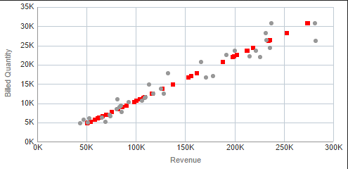
REGR
  Determines correlations or relationships within the data
Notes:
REGR: A "Regression" algorithm can be used to determine correlations or relationships within your data. It can also be used to make forecast predictions.
The results can be viewed on a scatter and, in the example in the slide, you can see a very close "positive" correlation between Revenue and Billed Quantity.
Obviously, there is no surprise that Revenue increases in line with Billed Quantity.
The linear regression is highlighted by the red dots. The original Revenue/Billed Quantity values are shown in gray.
REGR("Base Facts".“1- Revenue", ("Base Facts".“2- Billed Quantity"), ("Time".“T02 Per Name Month", "Time".“T05 Per Name Year"), 'fitted', '')
Oracle BI 12c: Create Analyses and Dashboards 20 - <number>

Slide 22

Quiz: Overview
This quiz examines your knowledge of the various functions in Oracle Business Intelligence.
Notes:
In this quiz, you answer questions regarding the various functions in Oracle Business Intelligence.
Oracle BI 12c: Create Analyses and Dashboards 20 - <number>

Slide 23
Quiz
Which of the following can be achieved through Advance Analytics?
  Predicting customer behavior
  Analyzing “market baskets” to discover associations, patterns, and relationships
  Anticipating future product demand
Notes:
Answer: a, b, c
Oracle BI 12c: Create Analyses and Dashboards 20 - <number>

Slide 24
Quiz
The PERIODROLLING function does not have a time series grain.
  True
  False
Notes:
Answer: a
Oracle BI 12c: Create Analyses and Dashboards 20 - <number>

Slide 25

Summary
In this lesson, you should have learned how to use:
  SQL Syntax and Semantics
  Aggregate functions
  Time series functions
  Advance analytics functions
Notes:
Oracle BI 12c: Create Analyses and Dashboards 20 - <number>

Slide 26

Practice 20: Overview
This practice covers using/creating expressions.
Notes:
Oracle BI 12c: Create Analyses and Dashboards 20 - <number>

