Slide 1
Introduction to Oracle Business
Intelligence Enterprise Edition
Notes:
Schedule: Timing Topic
75 minutes Lecture
30 minutes Practice
05 minutes Quiz
110 minutes Total

Slide 2

Objectives
After completing this lesson, you should be able to:
  Explain Oracle Business Intelligence
  Describe Oracle Business Intelligence Foundation Suite
  Identify and describe the major components of the Oracle Business Intelligence 12c architecture
  Describe Oracle Essbase
Notes:
This lesson provides foundational information to set the context for the remainder of this course. An understanding of the architecture components and the role of Oracle Business Intelligence in the enterprise prepares you to work with the tools included. Being familiar with the different types of variables used throughout the product prepares you to understand their roles in the different Oracle Business Intelligence Enterprise Edition (Oracle BI EE) tools and how they are initialized, updated, and used in BI analyses and dashboards.
Oracle BI 12c: Create Analyses and Dashboards 2 - <number>

Slide 3
What Is Business Intelligence?
  It provides you with the data and tools to answer questions that are important to running the part of the business for which you are responsible. It helps you to:
    Determine whether the business is running as planned.
    Identify where things are going wrong.
    Take and monitor corrective actions.
    Identify trends.
  Examples include:
    Show me sales for each district by month.
    Show me the average sales amount for this quarter.
    Compare sales this quarter with sales a year ago.
    Show me the lowest-ranked product this year.
Notes:
Oracle BI 12c: Create Analyses and Dashboards 2 - <number>

Slide 4
Oracle Business Intelligence Enterprise Edition
  Analysis and Dashboards
  Actionable Intelligence
  Mobile Access
  MS Office Integration
  Multiple Data Sources
  Bigger Data (Hive, HBase, Cloudera Impala)
  Compatible with Cloud
  Advanced Analytics (Predictive and Statistical)
  Advanced Visualizations
  In-Memory Computing and Processing
  Visual Analyzer
  Rich Data Mashups
Notes:
Oracle Business Intelligence Foundation Suite is a complete, open, and architecturally unified business intelligence solution for the enterprise that delivers best-in-class capabilities for reporting, ad hoc query and analysis, OLAP, dashboards, and scorecards. All enterprise data sources—as well as metrics, calculations, definitions, and hierarchies—are managed in a Common Enterprise Information Model, providing users with accurate and consistent insight, regardless of where the information is consumed. Users can access and interact with information in multiple ways, including web-based dashboards, collaboration workspaces, search bars, mobile devices, and MS Office applications. In OBIEE 12c, new features, such as Advance Analytics, Advance visualizations, support for bigger data, visual analyzer, and Data Mashups, have been introduced. This is the era of predictive analyses and sentiment analyses based on the sampling of bigger volume of data, especially in retail chain (for a particular product, how are the sentiments of users) and meteorology department (how the weather will be today). Therefore, for predictive and statistical analyses, different types of functions have been introduced in OBIEE 12c (Forecast, Cluster, Regression, and so on). Advance visualization, such as Treemap and Heat Matrix, has been introduced. Using Data Mashup concepts, you can develop reports based on Excel data, in addition to other data sources. You can use Bigger Data (Hive and HBase) for larger volume of data to sample and perform predictive and statistical analyses.
Oracle BI 12c: Create Analyses and Dashboards 2 - <number>

Slide 5











Oracle BI 12c Highlights
Oracle Business Intelligence Upgrade
Oracle Data Visualization
Simplify Administration and
Lower TCO
Enhance
User Experience
Enable Advanced
Analytics for Everyone
Visual Analysis
Better Performance
Enhance Mobile
Experience
Support More
Data Sources
Rich
Data Mashups
Notes:
Oracle BI 12c: Create Analyses and Dashboards 2 - <number>

Slide 6
Many More Usability Improvements
Enhanced Subject Area pane:
  Search, reorder, refresh, and reload metadata elements
  Improved view rendering
  New Heat Matrix view type
  HTML-5 graphics
  Directly edit view properties
  New Graph and Pivot Table sorting capabilities
  Easily create new Groups, Calculated Items, and Measures
Notes:
Oracle BI 12c: Create Analyses and Dashboards 2 - <number>

Slide 7
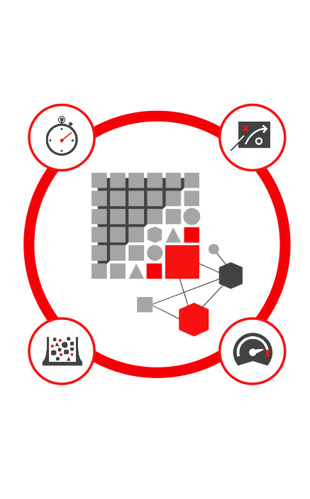
New Advanced Analytics Capabilities
Built into Oracle BI
  Can add custom R scripts without heavy IT
  Can be run online or in batched mode
  Instantly answer predictive and statistical questions
Notes:
Oracle BI 12c: Create Analyses and Dashboards 2 - <number>

Slide 8
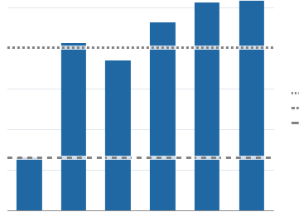
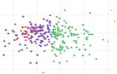

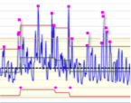
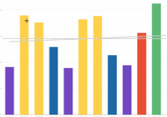


Prebuilt Functions
All accessible via expression editor
Reference Line
How does the metric vary from average and median?
Clustering
What are the inherent groupings in data?
Trend Line
What direction are we headed in?
Outliers
What data elements stand apart from others?
Bin/Histogram
What buckets should I use to chart my data?
Regression Analysis
How are the various factors correlated?
Forecast
What is likely to happen based on history?
Notes:
Oracle BI 12c: Create Analyses and Dashboards 2 - <number>

Slide 9
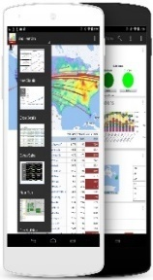
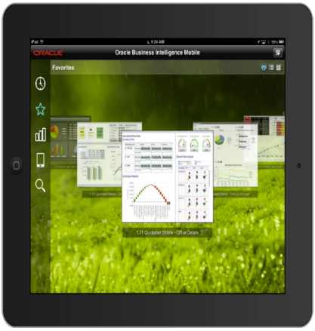
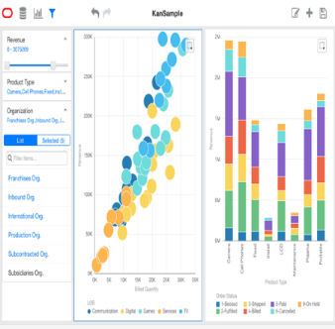
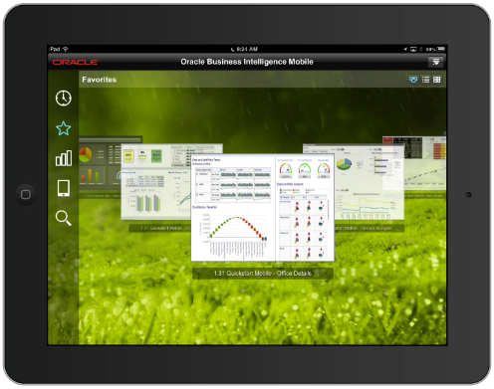
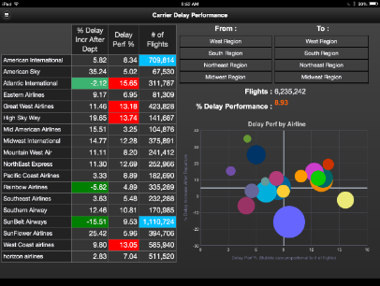


Oracle Mobile BI
  One application for cloud and on-premise
  Oracle Mobile Security Suite certification with continued updates
  Supports rich sharing use cases with a deep integration into native OS-sharing frameworks
Notes:
Oracle BI 12c: Create Analyses and Dashboards 2 - <number>

Slide 10

More Data Sources Supported Now
  EPM Data Sources
    Full fidelity reporting
    Single sign-on
  Cloudera Impala
    Optimized Query Support
  Spark
    Native Spark SQL generation
    Caching on Spark
cloudera
IMPALA
Spark
Notes:
Oracle BI 12c: Create Analyses and Dashboards 2 - <number>

Slide 11



OBIEE 12c In-Memory Analytics
Spark
In-Memory Computing
in OBIEE
In-Memory Databases
Oracle DB and Essbase
Offloading Computing to
Spark
Faster rollups, sorting,
in-memory compression, and so on
Certified with Oracle 12c
In-Memory Option
Spark as an
in-memory cache for the BI server
(a roadmap item)
Notes:
Oracle BI 12c: Create Analyses and Dashboards 2 - <number>

Slide 12
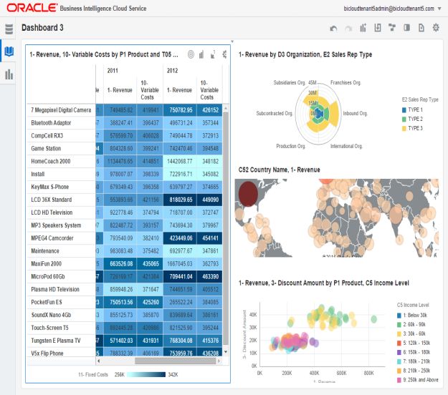
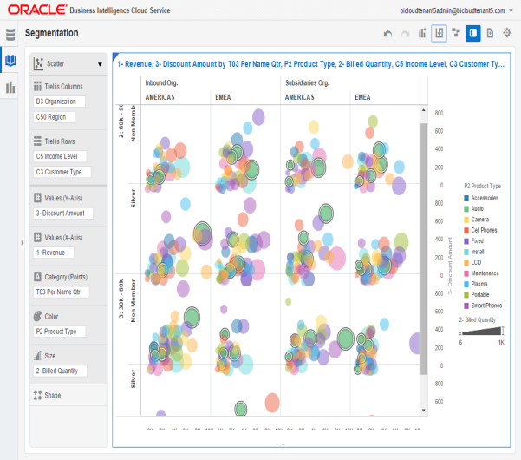
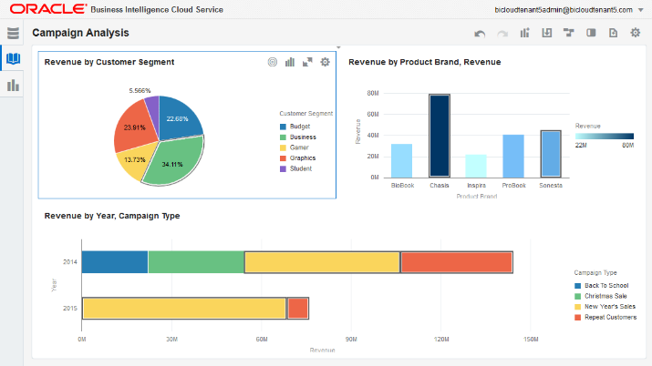
Visual Exploration for Everyone
  Intuitive unified experience during analysis
  Seamless blending of reporting and developing dashboard
  Automatic highlighting of related data enables discovery of new patterns
  Consumer-style filtering and exploration
  Rich library of visual components
  Advanced trellising exposes hidden patterns in data
Notes:
Oracle BI 12c: Create Analyses and Dashboards 2 - <number>

Slide 13


Rich Data Mashup
  Extend dimensions within an existing subject area.
  Add facts to an existing subject area.
  Stand-alone analysis outside of subject areas
  Support Excel-based data mashup; subsequent releases add more data sources
Notes:
Oracle BI 12c: Create Analyses and Dashboards 2 - <number>

Slide 14

Oracle BI 12c Architecture
Oracle BI Domain
Admin Server
Managed Server
Oracle Platform
Security Services
BI System Component
End Point Registry
BI Server
BI Scheduler
BI Java Host
Identity Store
Essbase
Cluster Controller
BI Presentation Server
ODL
DLS
WLST
Metadata
Configurations, RPD
Service Instance
Database-RCU Schema
Credential Store
Policy Store
Notes:
This lesson provides a high-level overview of the Oracle BI architecture components. An understanding of these components and their relationships will help to ensure successful completion of this course.
Instructor Note
Each subbullet is discussed in more detail in the slides that follow. The simplified architecture graphic is used consistently throughout the lesson. Emphasize that this lesson does not provide an exhaustive discussion of Oracle BI architecture components. It discusses only a subset of the components that are critical to understanding the subject matter in this course.
Oracle BI 12c: Create Analyses and Dashboards 2 - <number>

Slide 15
Oracle BI Components
  The BI domain consists of Java components that are deployed into one or more Java EE (JEE) containers within a single WebLogic server domain, system (non-JEE) components and processes, required configuration files, metadata repositories, and infrastructure.
  Admin Server is deployed as a JEE container that runs in a dedicated Java virtual machine that contains Java components for administering the system. These components include Oracle WebLogic Server Administration Console, Oracle Fusion Middleware Control, and JMX MBeans.
Notes:
Oracle BI 12c: Create Analyses and Dashboards 2 - <number>
Administration Server: Manages configuration and runtime settings for Oracle Business Intelligence for a single or multinode (distributed) BI domain by using:
Fusion Middleware Control: An administrative user interface that is used to manage the BI domain
WebLogic Server Administration Console: An administrative user interface that provides advanced management for WebLogic, JEE components, and security
Managed Server: Manages the following components:
Action Service: Provides dedicated web services that are required by the Action Framework and that enable an administrator to manually configure which web service directories can be browsed by users when they create actions
Visual Analyzer: Provides a simple-to-use visual analytical interface.
BI Publisher: Provides an enterprise reporting solution for authoring, managing, and delivering all types of highly formatted documents to employees, customers, and suppliers
Security: Provides dedicated web services that enable the integration of Oracle BI Server with the Oracle Fusion Middleware security platform

Slide 16
Oracle BI Components
  Managed Server: Deployed as a JEE container that runs in a dedicated Java virtual machine and provides the runtime environment for the Java-based services and applications within the system. These services and applications include BI Publisher and Visual Analyzer.
  Node Manager: Provides process management services for the Administration Server, Managed Server processes, and system components
  System Components: Deployed as server processes and provide the core services that enable Oracle Business Intelligence
  Other Domain Contents: Includes all the necessary software, configuration files, metadata, WLST commands, security, and connection and database configuration
Notes:
Oracle BI 12c: Create Analyses and Dashboards 2 - <number>
SOA Web Service: This component provides dedicated web services for objects in the Oracle BI Presentation Catalog, to invoke analyses, agents, and conditions. These services make it easy to invoke Oracle Business Intelligence functionality from Business Process Execution Language (BPEL) processes.
Presentation Services: This component is a Java EE application that routes HTTP and SOAP requests to Oracle BI Presentation Services.
Oracle Platform Security Services (OPSS): OPSS provides enterprise product development teams, systems integrators, and independent software vendors with a standards-based, portable, integrated, enterprise-grade security framework for Java SE and Java EE applications. It also provides an abstraction layer in the form of application programming interfaces (APIs) that insulates developers from security and identity management implementation details.

Slide 17
BI System Components
  BI Presentation Server (OBIPS): Provides the framework and interface for the presentation of business intelligence data to web clients. It maintains an Oracle BI Presentation Catalog service on the file system for the customization of this presentation framework.
  BI Server (OBIS): Provides the query and data access capabilities at the heart of Oracle Business Intelligence and provides services for accessing and managing the enterprise semantic model (stored in a file with an .rpd extension)
  BI Scheduler (OBISCH): Provides extensible scheduling for analyses to be delivered to users at specified times
Notes:
Oracle BI 12c: Create Analyses and Dashboards 2 - <number>
Policy Store: It is a repository of system- and application-specific policies and roles. Application roles can include enterprise users and groups specific to the application (such as administrative roles). A policy can use any of these groups or users as principals. A policy store provider provides access to application roles and application policies, which forms a core part of the security policy and determines what users can and cannot see and do in Oracle Business Intelligence.
Credential Store: It is a repository of security data (credentials) that certifies the authority of users, Java components, and system components. A credential can hold username and password combinations, tickets, and public key certificates. A credential store provider is responsible for storing and providing access to credentials required by Oracle Business Intelligence.

Slide 18
BI System Components
  BI Java Host (OBIJH): Provides component services that enable Oracle BI Presentation Services to support various components such as Java tasks for Oracle BI Scheduler, Oracle BI Publisher, and graph generation. It also enables Oracle BI Server query access to Hyperion Financial Management.
  Essbase: Provides support for Essbase
  Cluster Controller (OBICCS): Distributes requests to the BI Server, ensuring that requests are evenly load balanced across all BI Server process instances in the BI domain
Notes:
Oracle BI 12c: Create Analyses and Dashboards 2 - <number>

Slide 19

BI Presentation Services
Presentation Services include end-user tools that provide access to business intelligence information.
  Oracle BI Analysis Editor: A set of graphical tools used to build, view, and modify Oracle BI analyses
  Oracle BI Dashboards: Display the results of analyses and other items
Course focus
Presentation Catalog
Repository
Presentation Services
  Analysis Editor
  Dashboards
Oracle BI Presentation
Server
Oracle
BI Server
Data
sources
Notes:
Oracle BI 12c: Create Analyses and Dashboards 2 - <number>
Oracle BI Analysis Editor and Oracle BI Dashboards are examples of end-user tools that provide access to business intelligence information via a web browser.
Oracle BI Analysis Editor
Oracle BI Analysis Editor is a set of graphical tools used to build, view, and modify Oracle BI analyses. The analyses are queries against an organization’s data.
Oracle BI Dashboards
An Oracle BI dashboard is used to display the results of analyses that are embedded in the dashboard, and other items, such as links to saved analyses, links to websites, Active-X objects, HTML text, and links to documents. Dashboards are typically created by users with administrator permissions. However, dashboards are simple to create by using the
user-friendly Oracle BI interface. After dashboards are created, they can be shared by common groups of users or can be personal (not shared).

Slide 20
Oracle BI Presentation Server and Catalog
The Presentation Server provides processing to visualize information for end-user consumption.
  Uses Presentation Catalog to store saved content
  Receives data from Oracle BI Server and provides it to the end-user tool that requested it
Presentation Catalog
Repository
Presentation Services
  Analysis Editor
  Dashboards
Oracle BI Presentation
Server
Oracle
BI Server
Data
sources
Notes:
Oracle BI 12c: Create Analyses and Dashboards 2 - <number>
Oracle BI Presentation Server is an extension to an existing web server:
It receives processing instructions from an Oracle BI Presentation Services end-user tool, retrieves the requested information from Oracle BI Server, and then renders the information inside the requesting tool.
It uses the Presentation Catalog to store saved content, such as analyses, dashboards, and other Oracle BI objects.

Slide 21
BI Server
Oracle BI Server is the core server behind Oracle Business Intelligence.
  Provides efficient processing to access physical data sources and structure information. It:
    Uses metadata to direct processing
    Generates dynamic SQL to query data in the physical data sources
    Structures results to satisfy requests
    Provides BI data to Oracle BI Presentation Services
Presentation Catalog
Repository
Presentation Services
  Analysis Editor
  Dashboards
Oracle BI Presentation
Server
Oracle
BI Server
Data
sources
Notes:
Oracle BI Server is the core server behind Oracle Business Intelligence. It is an optimized query engine that receives analytical requests, intelligently accesses multiple physical data sources, generates SQL to query data in the data sources, and then structures the results to satisfy the requests. It also handles requests from a variety of front ends, including Oracle BI applications and third-party tools. Oracle BI Server allows a single-information request to query multiple data sources, thereby providing information access to members of the enterprise and, in web-based applications, to suppliers, customers, prospects, or any authorized user with web access.
Oracle BI Server serves as a portal to structured data that resides in one or more data sources, such as multiple data marts, Oracle BI Data Warehouse, an enterprise data warehouse, an operational data store, transaction system databases, unstructured data (such as data from Endeca), personal databases, and so on. Transparent to both end users and query tools, Oracle BI Server functions as the integrating component of a complex decision support system by acting as a layer of abstraction and unification over the underlying databases. This offers users a simplified query environment in which they can ask business questions that span information sources across the enterprise and beyond.
Oracle BI 12c: Create Analyses and Dashboards 2 - <number>

Slide 22
Oracle BI Repository
The BI repository stores the metadata used by Oracle BI Server.
  Accessed and configured using Oracle BI Administration Tool, which is used by administrators to:
    Import metadata from databases and other data sources.
    Simplify and reorganize the metadata into business models.
    Structure the business model for presentation to analysis and dashboard users.
Presentation Catalog
Repository
Presentation Services
  Analysis Editor
  Dashboards
Oracle BI Presentation
Server
Oracle
BI Server
Data
sources
Notes:
Oracle BI Server stores metadata in repositories. The Oracle BI Administration Tool has a graphical user interface that allows server administrators to set up these repositories. For more information about the Oracle BI repository and the creation and management of repository metadata, see the Oracle BI 12c: Build Repositories course.
Oracle BI 12c: Create Analyses and Dashboards 2 - <number>

Slide 23
Data Sources
Data sources contain the business data that users want to analyze. They can be:
  Accessed by Oracle BI Server
  In any format, such as:
    Relational databases
    Online analytical processing (OLAP) databases
    XML for Analysis (XMLA)
    Flat files
    Spreadsheets
    Hive, HBase, Impala, and Amazon Red shift
Presentation Catalog
Repository
Presentation Services
  Analysis Editor
  Dashboards
Oracle BI Presentation
Server
Oracle
BI Server
Data
sources
Notes:
Data sources are the physical sources where the business data is stored. They can be in any format, including transactional databases, online analytical processing databases, text files, XMLA, spreadsheets, unstructured data sources, and so on. A connection to the data source is created and then used by Oracle BI Server. The data source connection can be defined to use native drivers or Open Database Connectivity (ODBC).
SQL is generated by Oracle BI Server against the data sources by using the data source connection, information from the repository, and database-specific features and parameters. Thus, Oracle BI Server is not just a SQL generator. It determines the best source and the optimal way to access data. In some cases, Oracle BI Server performs operations more efficiently than the physical data sources.
Oracle BI 12c: Create Analyses and Dashboards 2 - <number>

Slide 24
Sample Analysis Processing
  The user views a dashboard or submits an analysis.
  Oracle BI Presentation Server makes a request to Oracle BI Server to retrieve the requested data.
  Using the repository file, Oracle BI Server optimizes functions to request the data from the data sources.
  Oracle BI Server receives the data from the data sources and processes it as necessary.
  Oracle BI Server passes the data to Oracle BI Presentation Server.
  Oracle BI Presentation Server formats the data and sends it to the Presentation Services end-user tool.
Presentation Services
  Analysis Editor
  Dashboards
2
Oracle BI Presentation
Server
2
Oracle
BI Server
3
Data
sources
6
5
4
Notes:
The slide shows a simplified example of how an Oracle BI analysis is processed. A user accesses a dashboard or submits an analysis. The analysis is received by the Oracle BI Presentation Server, which routes the request to the Oracle BI Server. Oracle BI Server uses the repository to determine the best way to access the requested data. Then it sends the SQL or other requests to the sources and combines the results or provides further processing.
The Oracle BI Server sends the data back to Oracle BI Presentation Server, which formats the data as appropriate and sends it to the end-user tool for display.
Oracle BI 12c: Create Analyses and Dashboards 2 - <number>

Slide 25
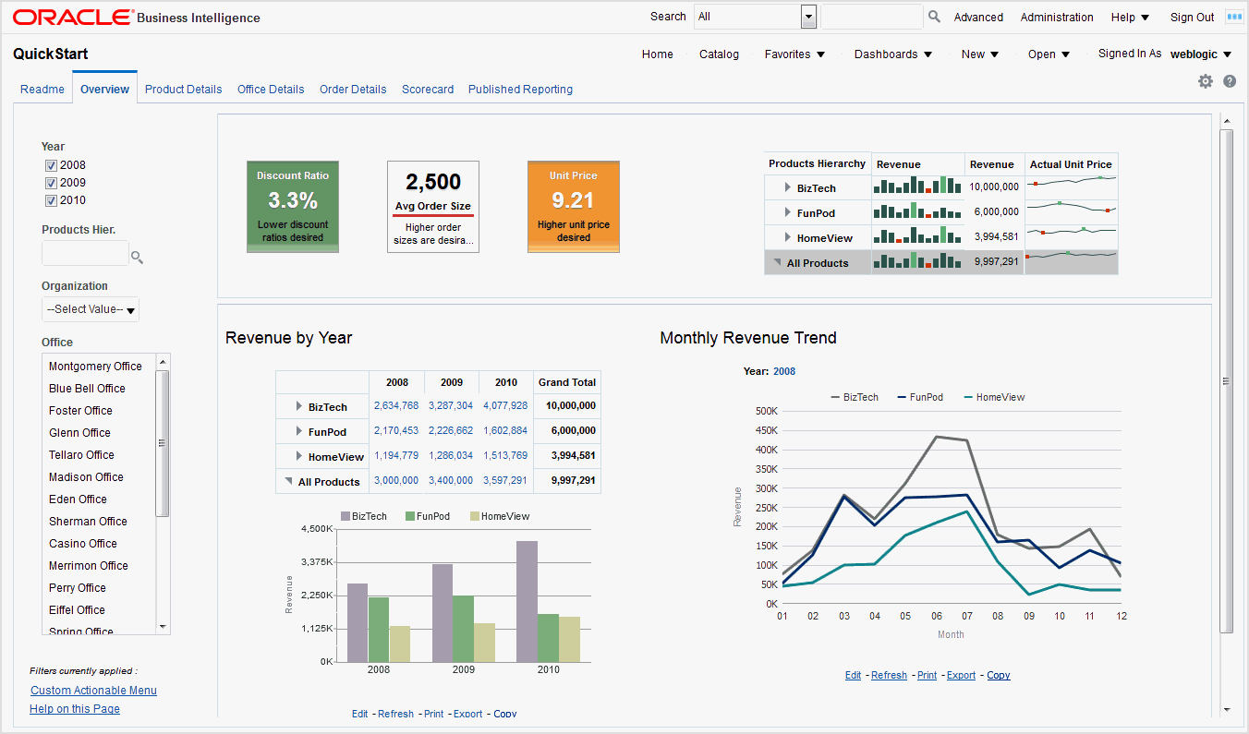
Oracle BI EE Dashboard
Notes:
Oracle BI 12c: Create Analyses and Dashboards 2 - <number>

Slide 26
Oracle BI EE Terminology
  Analyses: Analyses are queries against an organization’s data that provide answers to business questions. Analyses enable you to explore and interact with information by presenting data in easy-to-understand formats (such as tables and graphs). This area of Oracle BI EE is also known as Answers.
  Dashboards: Dashboards provide personalized views of corporate and external information. A dashboard consists of one or more pages that contain analyses, links, and so on. Dashboards allow end users with access to analytics information.
Notes:
Oracle BI 12c: Create Analyses and Dashboards 2 - <number>

Slide 27
Oracle BI EE Terminology
  Filters, Selection Steps, and Prompts: Filters, selection steps, and prompts limit or specify the data that is displayed in dashboards and analyses.
  Agents: Agents enable you to automate business processes. Agents can be used to provide event-driven alerting, scheduled content publishing, and conditional event-driven action execution. Agents can be scheduled or triggered by a specific condition, which helps in delivering timely information to users.
Notes:
Oracle BI 12c: Create Analyses and Dashboards 2 - <number>

Slide 28
Oracle BI EE Terminology
  Actions: Actions provide functionality to navigate to related content or to invoke operations, functions, or processes in external systems. Actions allow users to take proper action based on the business insight that they gained from the data.
  Scorecards: Scorecards allow users to model the objectives and initiatives that comprise corporate strategy, evaluate their performance by assigning KPIs, and determine and display overall performance.
  Conditions: Conditions are objects that return a single Boolean value that is based on the evaluation of an analysis or of a Key Performance Indicator (KPI).
Notes:
Oracle BI 12c: Create Analyses and Dashboards 2 - <number>

Slide 29
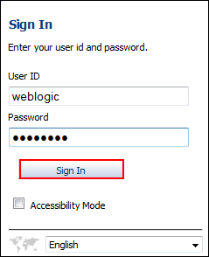
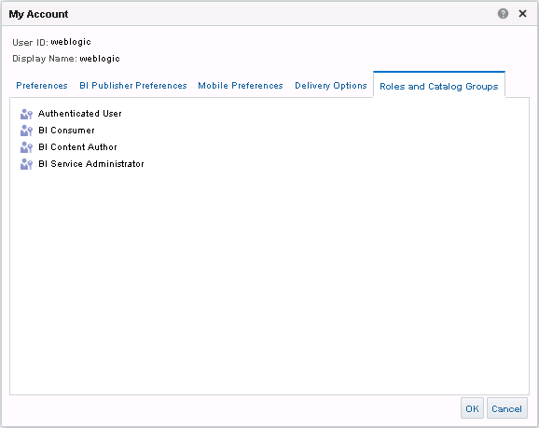
Signing In to Presentation Services
Signing in to Presentation Services authenticates you as a user.
Notes:
When you sign in to Presentation Services, you are by default a member of the Authenticated User role. The permissions and privileges that you have are determined by your role. You will learn more about users, groups, roles, and their use in managing catalog permissions and system privileges in the lessons titled “Working with Oracle Business Intelligence Analyses” and “Administering the Presentation Catalog.”
Oracle BI 12c: Create Analyses and Dashboards 2 - <number>

Slide 30

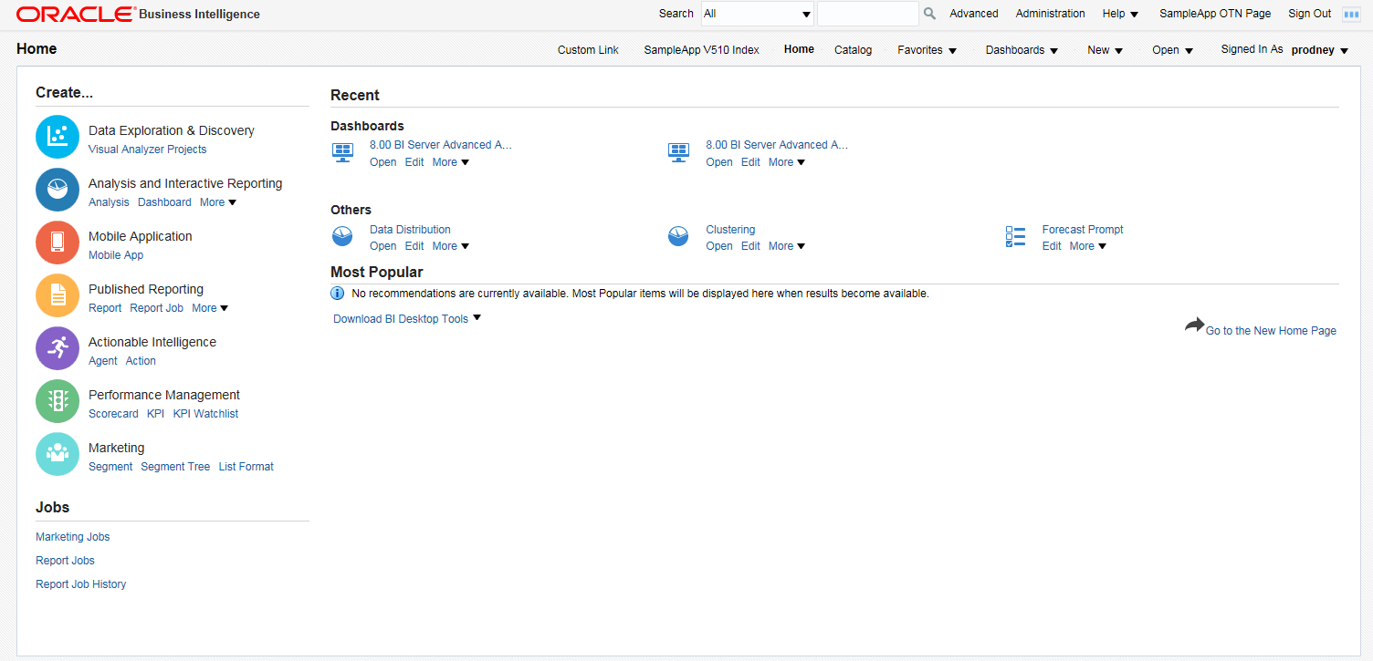

Oracle BI Enterprise Edition Home Page
Search catalog.
Create new object.
Notes:
The Home page provides an intuitive, task-based entry into the functionalities of Oracle BI EE. It is divided into sections that you can use to quickly begin a specific task and locate or create a new object.
In the Create section, you can access Data Exploration & Discovery that is specific to visual analyzer (a new feature in OBIEE 12c), or access Analysis and Interactive Reporting to create analysis, dashboard, filters, dashboard prompts and conditions, and so on. Under the Create… list is a set of shortcuts for browsing or managing your jobs (Marketing Jobs, Reports jobs, and so on). The area to the right of this panel shows at the top, your recent dashboards and other objects, and below that, the most Popular ones accessed by others on your system. Under each of these objects are links to open the object, edit it, print it, and perform other tasks. There are buttons for Home (to go back to the home page), Catalog for opening the common Catalog page, buttons to create New reports and Open existing ones, and a link with your logged-in name on it for opening the My Account page. Clicking New displays a list of the objects that you have permission to create. The most commonly used ones include Analysis, which opens Answers to create a new report, Dashboard, to create a new dashboard, and Dashboard Prompt for a drop-down list for the dashboard.
Oracle BI 12c: Create Analyses and Dashboards 2 - <number>

Slide 31





Global Header
Provides access throughout Presentation Services to all objects, dashboards, and the Presentation Catalog
Search items based on search criteria.
Navigate to Administration.
Create new object.
Open object.
Notes:
Global Header contains links and options to begin a task or locate an object—for example, an analysis or a dashboard—in Presentation Catalog. Many of the options that are available on the Home page are duplicated in Global Header, which appears in all editors and on all pages of the Presentation Services end-user tools. For example, when you are working with an analysis in the Analysis Editor or Dashboard Editor (both of which are covered later in the course), you can always save your work and easily navigate from Global Header to access saved analyses, dashboards, or other content, or to create new objects.
Global Header includes the Home link, which is used to navigate to the Home page from any other part of the user interface. It also includes the Catalog link, which allows you to navigate to the Catalog page, in which you can navigate and work with objects in the Presentation Catalog. You are introduced to the Catalog page and its tools in the lesson titled “Working with Oracle Business Intelligence Analyses.”
Oracle BI 12c: Create Analyses and Dashboards 2 - <number>

Slide 32

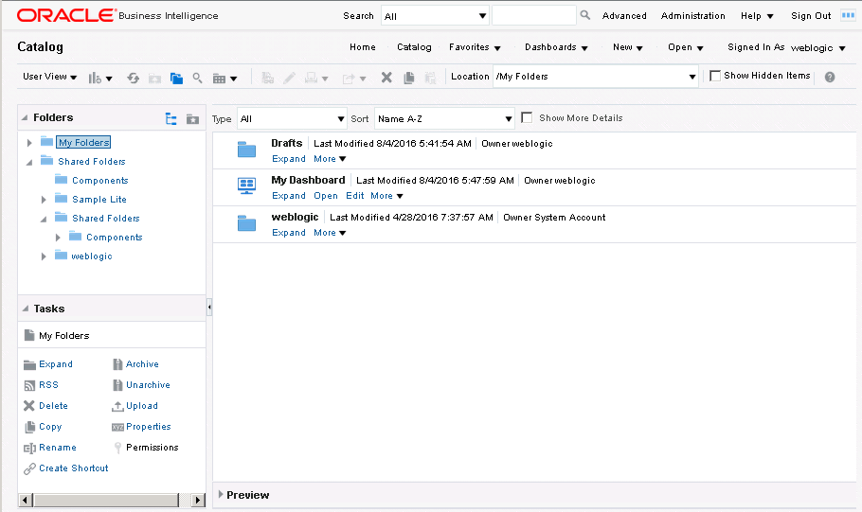








Administering Objects in the Presentation Catalog
Toggle to admin view.
New
Search
Refresh
Sort by name, type, modified date, and owner.
Folders pane
Tasks pane
Selected object
Available tasks for the selected object
Notes:
Oracle BI Presentation Catalog stores business intelligence objects and provides an interface where users create, access, and manage objects. In this interface, users perform object-specific tasks, such as exporting, printing, editing, and setting permissions. The catalog is organized into folders that are either shared or personal.
Objects in the catalog can be accessed from the Home page, Global Header, and the Catalog page, which is accessed from the Catalog link in the Global Header. Catalog provides a centralized place to navigate and administer catalog objects.
Users of the catalog can be classified into three roles: administrators, content designers, and content consumers. Depending on their roles, object permissions, and system privileges assigned to users and roles, different options and objects are made available on the Catalog page. For example, only users with an administrative role can toggle to the Administrator view, which displays the catalog’s root folder and allows access to multiple personal user folders.
Oracle BI 12c: Create Analyses and Dashboards 2 - <number>

Slide 33
Essbase: Overview
  Essbase: A multithreaded OLAP database software that takes advantage of symmetric multiprocessing hardware platforms
  OLAP Database
    Dimensional “cube” of information
    The “By’s” of the company
    How you “see” the Business
    Ability to “slice n dice” the data
Notes:
Oracle BI 12c: Create Analyses and Dashboards 2 - <number>
Essbase is primarily used as a data source for OBIEE that comprises Essbase cubes to add measures and attributes in a report. Essbase data source can be combined with relational as well as Hadoop system data sources. Essbase calculations are used for forecasting BI Data.
Essbase:
Acts as Query Accelerator for OBIEE
Enables faster analysis and calculations
Provides business agility
Provides immediate visibility
Is adapt to changes
Enables accurate models

Slide 34
Essbase: Key Features
  Combine multiple sources of disparate data
  Speed-of-thought analysis for thousands of concurrent users
  Premium performance and optimized storage
  Write-back capability
  Time and financial intelligence
  Mission-critical applications
    Powerful querying and complex calculations
    Enterprise scale forward-looking applications
    Robust write-back and security
Notes:
Oracle BI 12c: Create Analyses and Dashboards 2 - <number>

Slide 35

Quiz: Overview
This quiz examines your knowledge of Oracle Business Intelligence and its architecture.
Notes:
Oracle BI 12c: Create Analyses and Dashboards 2 - <number>

Slide 36
Quiz
The Analysis Editor is a tool used to save content in the Presentation Catalog.
  True
  False
Notes:
Answer: b
The Analysis Editor is a set of graphical tools used to build, view, and modify Oracle BI analyses.
Oracle BI 12c: Create Analyses and Dashboards 2 - <number>

Slide 37
Quiz
Which of the following stores the Oracle BI objects that you create?
  Repository
  Presentation Catalog
  Oracle BI Server
Notes:
Answer: b
Oracle BI 12c: Create Analyses and Dashboards 2 - <number>

Slide 38
Quiz
From which of the following can you create Oracle BI objects, including analyses, filters, and agents?
  Home page
  Sign-in page
  Global Header
Notes:
Answer: a, c
Using the Global Header’s New button, you can create objects from any editor or page in Oracle BI EE Presentation Services. The Home page organizes content so that it is easy to access content that you have recently worked with, providing an intuitive, task-based entry into the functionalities of Oracle BI EE. You can create new objects in the Create section of the Home page.
Oracle BI 12c: Create Analyses and Dashboards 2 - <number>

Slide 39
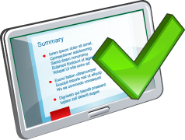
Summary
In this lesson, you should have learned how to:
  Explain Oracle Business Intelligence
  Describe Oracle Business Intelligence Enterprise Edition
  Identify and describe the major components of the Oracle Business Intelligence 12c architecture
  Describe Oracle Essbase
Notes:
Oracle BI 12c: Create Analyses and Dashboards 2 - <number>

Slide 40

Practice 2: Overview
This practice covers exploring Oracle BI Presentation Services.
Notes:
Instructor Note
Solution files are provided for each practice in this course. Each practice has one or more archive (.catalog) files for each of the relevant folders in the practice. For example, most practices have one solution file (.catalog) for each object (analyses, prompts, filters, and so on) created in the My Folders/Folder name (Ex-My Sales folder) or Shared Folders/Folder Name (My share sales folder) for that practice.
To unarchive the object:
1. Select the parent folder (My Folders-Folder Name/Shared Folders-Folder Name) on the Catalog page.
2. Click Unarchive in the Tasks pane.
3. Browse to, for example, D:\SolutionFiles\CreateAnalysesDashboards, for the appropriate solution archive file.
4. Click OK.
5. Verify that the expected objects from the practice are unarchived to the respective folder.
Use a similar approach to unarchive any other solution folders that are provided for a practice. For example, to unarchive any objects saved to a shared folder, perform the preceding steps by using the shared folder as the parent folder and then browse to the appropriate solution archive for the practice.
Oracle BI 12c: Create Analyses and Dashboards 2 - <number>

