Slide 1
Working with Oracle Business
Intelligence Analyses
Notes:
Schedule: Timing Topic
50 minutes Lecture
50 minutes Practice
05 minutes Quiz
105 minutes Total

Slide 2

Objectives
After completing this lesson, you should be able to:
  Identify the important elements of analyses
  Use Analysis Editor
  Construct, modify, and save analyses by using the three available types of columns
  Apply advanced formatting to analyses
Notes:
Oracle BI 12c: Create Analyses and Dashboards 3 - <number>

Slide 3
Oracle Business Intelligence Analysis Editor
  Enables you to query an organization’s data
  Provides a set of graphical tools to create and execute analyses by using subject areas and their columns
  Saves, organizes, shares, and integrates analysis results with other content
  Retrieves and displays analytical information through analyses
  Provides the building blocks of dashboards
Notes:
Oracle BI Analysis Editor enables you to create and edit analyses to explore and interact with information. You can save, organize, and share results. Analyses created in Analysis Editor can be saved in the Oracle BI Presentation Catalog and integrated into any Oracle Business Intelligence dashboard. Results can be enhanced by using views with graphing, varying result layouts, calculations and grouping, formatting, and hierarchy expansion features.
Oracle BI 12c: Create Analyses and Dashboards 3 - <number>

Slide 4
Key Terms
Term | Definition
Analysis | Answers a query against an organization’s data
Column | Represents data that an analysis returns. Measure columns contain numeric measures, attribute columns contain descriptive data, and hierarchies represent relationships.
Filter | Mechanism that restricts the result set returned by an analysis
Prompt | A special kind of filter that interactively restricts the result set returned by an analysis; can be used to populate variables
Selection | Mechanism that determines column membership included in an analysis
Criteria | Set of columns, filters, formatting, and properties specified for an analysis
Results | Output returned from Oracle BI Server for a specified analysis
Subject Area | Logical object that organizes and presents data about a business
Dashboard | Page in a Business Intelligence application that displays content
Dashboard Prompt | Filter object that interactively filters all content on a dashboard page and can be used to populate variables
Query | Underlying SQL issued to the Oracle BI Server for the specified analysis
Notes:
The slide introduces the terminology used in this lesson and the remainder of the course. These key terms are covered in more detail in the following slides.
Oracle BI 12c: Create Analyses and Dashboards 3 - <number>

Slide 5
Key Terms
Term | Definition
Actionable Intelligence (Agent) | Agents automate processes, such as scheduling reports and delivering alerts.
Published reporting | A report contains multiple layouts for pixel-perfect printable documents or for viewing online.
Mobile Application | Mobile App is a purposeful, discrete application that provides a new touch-optimized way of presenting data with rich interaction and visualization for mobile devices, such as iPhone, iPad, Android phone, and tablet.
Notes:
Oracle BI 12c: Create Analyses and Dashboards 3 - <number>

Slide 6
Key Terms
Term | Definition
Visual Analyzer | Visual Analyzer (VA) is a very intuitive and interactive web-based tool for self-service reporting, data exploration, and data discovery. Some of the complex features that are present in Answers are not allowed in VA; that is, VA cannot work with hierarchy columns or groups, VA projects cannot be included in dashboard, and so on.
BI Ask | A search-based infrastructure that comes with Visual Analyzer. In Android or iOS mobiles, the user can literally type the keywords to get a specific result.
Data Mashup | Data Mashup allows business users to merge their own data with corporate data.
Notes:
Oracle BI 12c: Create Analyses and Dashboards 3 - <number>

Slide 7

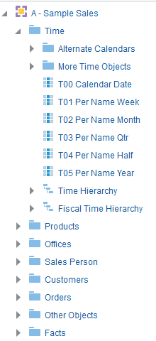


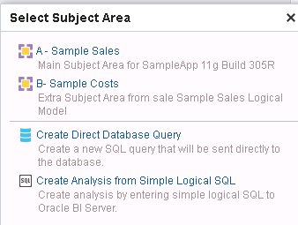

Subject Areas
Subject area
  Contain information about the areas of your organization’s business
  Are organized into folders and columns
  Have names that correspond to the type of information they contain
Folder
Column
Select a subject area to create a new analysis.
Notes:
A subject area is the view of the data that end users see when they create or edit analyses. A subject area contains folders, measure columns, attribute columns, hierarchical columns, and hierarchy levels that represent information about the areas of an organization's business or about groups of users with an organization. Subject areas usually have names that correspond to the types of information that they contain, such as Marketing Contracts, Service Requests, and Orders.
When you create a new analysis, filter, or dashboard prompt, you first select the subject area with which you want to work. This is known as the primary subject area and is displayed in the Subject Areas pane. If, as you work, you find that you need more data, you can add columns from additional subject areas that are related to the primary subject area that you have chosen.
Oracle BI 12c: Create Analyses and Dashboards 3 - <number>

Slide 8
Columns
  Represent the pieces of data that an analysis will return
  Are organized into folders and subject areas
  Can be of three types:
    Attribute columns: A list of members that describe a measure
    Hierarchical columns: A list of members representing different levels in a level-based or parent/child hierarchy
    Measure columns: Numeric values that are aggregated for attributes and hierarchical members and levels
Notes:
Attribute Columns
Attribute columns are similar to columns in a table in a relational data source. They contain a simple list of members, which function as attributes, similar to a dimension. They represent entities by which you can slice and dice measure data. Attribute columns can also participate in a hierarchy, which allows the columns to be expanded in analysis results.
Hierarchical Columns
Hierarchies allow you to expand levels of data, for more detailed information. Hierarchical columns, like other columns, are associated with a folder in the subject area. A folder can have multiple hierarchical columns defined, but you can include only one hierarchical column per folder in an analysis. Hierarchical column members, depending on the type of hierarchy, can have shared or differing attributes.
Measure Columns
Measure columns, also called facts, contain a simple list of data values, usually numeric, of entities that can change for each record and can be added up or aggregated in some way (for example, sales revenue or units sold).
Oracle BI 12c: Create Analyses and Dashboards 3 - <number>

Slide 9

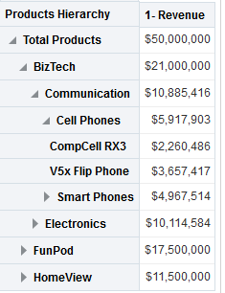




Hierarchies
Are definitions of contained-by or belongs-to relationships of members
  Nested levels of these many-to-one relationships
  Corresponding rollup of measure values
  Either level-based or parent/child (value-based)
Parent/child hierarchy column
Measure column
Collapse hierarchy.
Child members indent below their parent.
Expand hierarchy.
Notes:
A hierarchy is a definition of the relationship between hierarchy members. For example, in a hierarchy of sales representatives, different representatives can be grouped together for aggregation of sales measure data. Another example is a time hierarchy, in which a specific day belongs to a particular month, which in turn belongs to a particular year. Hierarchies allow you to expand (in the case of hierarchical columns) or drill (in the case of attribute columns) deeper into the data, to view more detailed information.
There are two subtypes of hierarchical columns:
Level-based hierarchies: These consist of one or more levels with different names and level-specific attributes. In a level-based hierarchy, members are grouped into named levels in the hierarchy, each of which share specific attributes. For example, in a time hierarchy, a Quarter level has an attribute of Quarter-Days, whereas the Month level has an attribute of Month-Days. Level-based hierarchies can be represented in analyses by drillable levels of a hierarchy. In analysis results, when you drill on or expand a parent member (aggregate member) that is associated with a level in a level-based hierarchy, the next level in the hierarchy is displayed.
Parent/child hierarchies: Members represent the same type of information throughout the hierarchy. For example, in a parent/child hierarchy of a company’s organization you might have a President at the top and Executive Officers below that and then Directors and regional managers and so on. However, at every level the members are employees with Names, Employee numbers, Start dates, Salaries, etc.
Oracle BI 12c: Create Analyses and Dashboards 3 - <number>

Slide 10



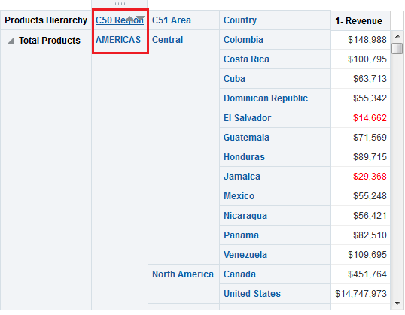



Oracle Business Intelligence Analysis
Drilling the C50 Region attribute column adds the C51 Area column to the analysis because the attributes are a part of a region hierarchy defined in the BI repository metadata.
Hierarchical column
Measure column
Custom column name
Expand hierarchy to view members.
Revenue less than $50,000 is highlighted.
Notes:
An analysis is a query against an organization’s data that provides answers to business questions. A query contains the underlying SQL statements that are issued to the Oracle BI Server. Analyses let you explore and interact with information by visually presenting data in tables, graphs, pivot tables, and so on. You can save, organize, and share the results of analyses. Analyses that you create can be saved in the Oracle BI Presentation Catalog and integrated into any Oracle BI EE dashboard. Analyses can be enhanced by using features such as graphs, result layout, calculated items, and drilling.
Oracle BI 12c: Create Analyses and Dashboards 3 - <number>

Slide 11
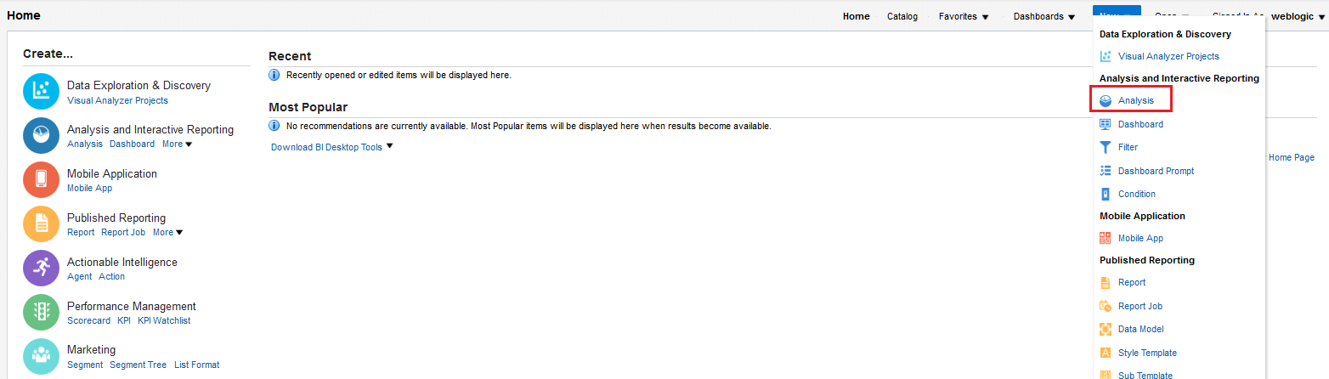

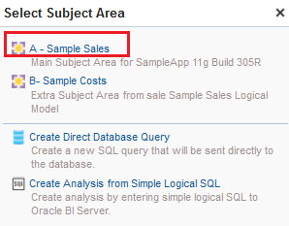

Creating and Editing Analyses
Create or open analyses from the Home page.
1
2
Notes:
When starting Oracle Business Intelligence Presentation Services, you are prompted for a user ID and a password provided by your organization. After you have signed in to Presentation Services, there are multiple ways to navigate to begin working with and creating analyses. You can either create a new analysis or open an existing analysis that you have recently used, or that exists in the Presentation Catalog.
1. To open Analysis Editor, perform one of the following steps:
On the Global Header toolbar, select New > Analysis to create a new analysis.
In the Create pane of the Home page, click Analysis to create a new analysis.
In the Recent or Most Popular pane, click the Edit link for an object to open existing analyses.
If you are creating a new analysis, select a subject area to navigate to Analysis Editor.
Oracle BI 12c: Create Analyses and Dashboards 3 - <number>

Slide 12
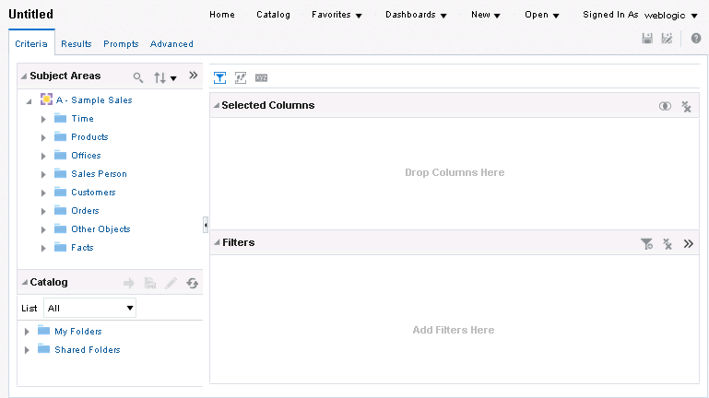







Analysis Editor
Provides an area to create, modify, and save analyses, filters, groups, calculated items, and selections
Subject Area pane
Save Analysis.
Remove all columns.
Selected Columns pane
Catalog pane
Filters pane
Create and remove filters on columns from the analysis.
Notes:
Analysis Editor provides a list of the available subject areas in the Subject Areas pane on the Criteria and Results tabs. After selecting a subject area to work with, you can create an analysis. The subject area you selected appears in the Subject Areas pane with the folders and columns that the subject area contains.
Folders are representative objects in the Business Intelligence metadata of physical database tables accessed by Oracle Business Intelligence.
Expand a folder to see its columns. Double-click or drag a column to add it to the Selected Columns pane on the Criteria tab or the analysis results on the Results tab. You can use Ctrl-click to select multiple columns in a subject area, and then click the “Add columns” button in the Subject Areas pane to add them to your analysis.
To remove all of the currently selected columns from your analysis, click the “Remove all columns from the Criteria” button in the Selected Columns pane.
To close a folder in the Subject Areas pane, double-click or minimize the folder button next to it.
Oracle BI 12c: Create Analyses and Dashboards 3 - <number>

Slide 13
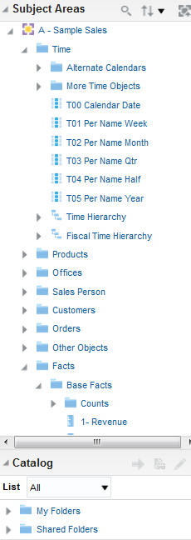




Subject Areas and Catalog Panes
  The Subject Areas pane:
    Shows folders and columns to construct analyses
    Organizes column content into presentation folders
  The Catalog pane:
    Provides access to named filters, groups, and calculated items in the Presentation Catalog
Attribute column
Hierarchical column
Measure column
Catalog folders and objects
Notes:
Oracle BI 12c: Create Analyses and Dashboards 3 - <number>

Slide 14

Analysis Editor Tabs
Contain on-screen information and buttons to create, access, and manage analyses
View or change columns and filters for analyses.
View or modify results of analyses.
Create prompts to filter analyses.
Work directly with XML and SQL generated for an analysis.
Notes:
Analysis Editor contains the following tabs:
Criteria: To specify and modify the criteria, formatting, and other aspects of an analysis, including columns, filters, and selection steps
Results: To create different views of the analysis results such as graphs, tickers, and pivot tables. Criteria setting impacts all views of an analysis.
Prompts: To create prompts that allow users to select values to limit an analysis. Prompts allow users to select values that dynamically filter all views within the analysis.
Advanced: To examine or edit the XML and logical SQL generated for an analysis
Although analysis columns, filters, and selection steps are usually created on the Criteria tab, you can also add columns and selection steps to your analyses on the Results tab. In later lessons, you learn about filters, selection steps, prompts, groups, calculated items, and the various views that you can use with the results of your analyses.
Oracle BI 12c: Create Analyses and Dashboards 3 - <number>

Slide 15
Working with Analyses in Oracle Business Intelligence
  Construct an analysis.
  Modify analysis criteria.
    Sorting columns
    Formulas
    Style
    Column format
    Data format
    Conditional format
    Interaction
    Write Back
  Change column order.
  Display analysis results.
  Save an analysis.
Notes:
Instructor Note
When working in Analysis Editor, note that there are buttons and user interface elements that are displayed only when you move the cursor over an interface element or an object. Elements and objects appear in this and following lessons whose manipulation requires hovering with your mouse. Examples of these include:
The More Options button for columns
Buttons to edit and manipulate filters in the Filters pane of Analysis Editor
Buttons in the Dashboard Editor and the Compound Layout pane that allow you to manipulate and edit properties for dashboard and layout objects.
You do not need to detail, at this point in the course, all of the various areas where hovering is used to make changes to objects; however, periodically in this and other lessons, it bears repeating.
This is a structuring slide identifying the steps for working with analyses. Do not teach the steps or concepts here because the following slides cover them in detail. Instead, you can provide a high-level description of what is discussed.
Oracle BI 12c: Create Analyses and Dashboards 3 - <number>

Slide 16
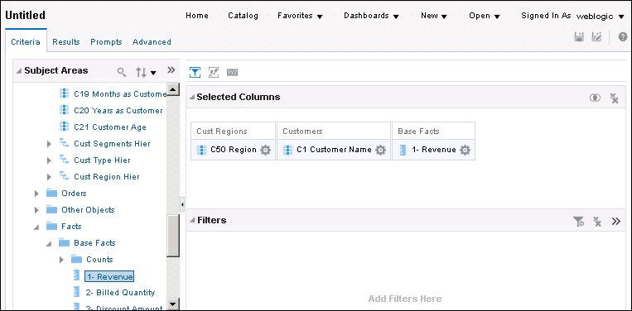






1. Construct an Analysis
Select columns from the subject area folders in the Subject Areas pane to create analysis criteria.
Attribute columns
More Options button
“Remove all Columns from Criteria” button
Hierarchical columns
Analysis criteria are displayed in the Selected Columns pane.
Measure columns
Notes:
When you select a subject area, the Subject Areas pane automatically refreshes and displays the content (folders and columns) of the subject area. You construct an analysis by selecting columns from the folders in a subject area.
1. Expand the folder to display the corresponding columns. You can also double-click elements in the pane to expand and collapse them or, in the case of columns, to add them to your criteria.
2. Drag the appropriate columns to select analysis criteria. The columns appear in the Selected Columns pane. You can also double-click columns to add them.
In the right pane, each column box has two sections. The upper section displays the name of the folder (Customer and Fact-Sales in this example). The lower section shows the name of the column (Customer – Region, City, Customer, and Dollars in this example) and the More Options button, which provides access to options for formatting, adding formulas, and setting other properties of analysis columns. Click the More Options button to view or modify the properties of the column.
In the Selected Columns pane, to remove all selected columns, you can click the “Remove all Columns from Criteria” button.
Oracle BI 12c: Create Analyses and Dashboards 3 - <number>

Slide 17
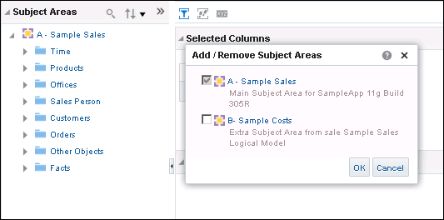

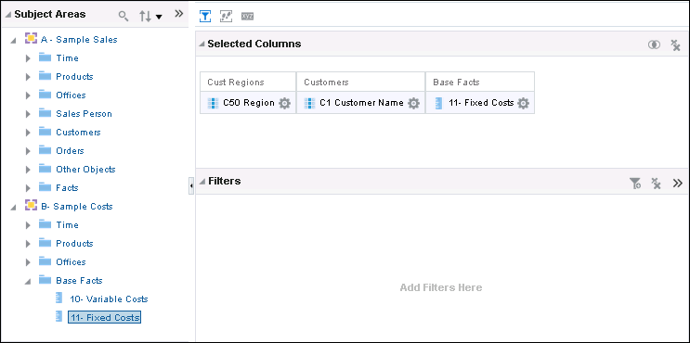



1. Construct an Analysis using Multiple Subject Areas
Click to Add/Remove Subject Areas.
Add or remove subject areas that are related to the primary subject area.
From Subject Area
A – Sample Sales
From Subject Area
B – Sample Costs
Construct analysis using multiple subject areas.
Notes:
In addition to the primary subject area that you select when you create a new analysis, filter, or dashboard prompt, you can include additional subject areas that are related to the primary subject area with which to work.
Typically, when you query a single subject area, all the measure columns that are exposed in that subject area are compatible with all the attribute columns and hierarchical columns that are exposed in the same subject area. However, when you combine columns from multiple subject areas, you must ensure that you do not include combinations of measure columns with attribute columns and hierarchical columns that are incompatible with one another.
Oracle BI 12c: Create Analyses and Dashboards 3 - <number>

Slide 18
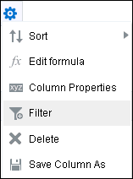
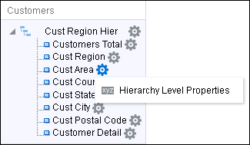
2. Modify Analysis Criteria
Click the More Options button to modify analysis criteria by using the following options:
Determine sort order.
Add a new function (such as ranking or moving averages).
Edit Column Properties to control appearance and behavior.
Remove column from analysis.
Limit data that appears
in a column.
Edit Level Properties to control appearance and behavior.
Save the column as an object in the catalog.
Hierarchical column
Notes:
Oracle BI 12c: Create Analyses and Dashboards 3 - <number>
Click the More Options button for a column or hierarchical level to open a menu of options to modify analysis criteria:
Sort specifies the order in which results should be returned: ascending or descending. You can order results by more than one column by selecting the Additional Sort options after you have set an initial sort. If you choose more than one column, a different image appears on the columns to indicate primary and secondary sorting.
Edit formula enables you to change the folder and column headings as well as any formula that was applied to the column. Formulas are functions and conditional expressions that present result data in a variety of ways. For more information about SQL functions, see the Metadata Repository Builder’s Guide for Oracle Business Intelligence Enterprise Edition.
Column Properties and Hierarchy Level Properties enable you to edit the format for a column or hierarchical level, respectively. For example, you can change the folder and column headings, the number of decimal places, the alignment, and so on.
Filter enables you to create a filter for the column. In the background, the filter is translated into a WHERE clause in the SELECT statement that is issued to the Oracle Business Intelligence Server. Filters and selections steps are covered in detail in the lessons titled “Filtering Data for Analyses” and “Selecting and Grouping Data for Analyses.”
Delete removes the column from the analysis and from the Selected Columns pane.
Save Column As enables you to save this measure as a new object in the catalog to be reused in other analyses

Slide 19
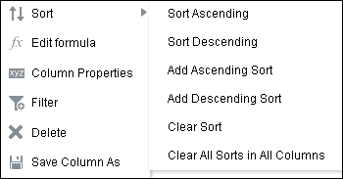
2. Modify Analysis Criteria (Sorting Columns)
  Use the Sort option to choose a sort order for the desired column.
  Select the appropriate option to set the sort order.
Choose a sort option for the desired columns in your analysis.
This is the primary ascending column sort.
This column sort occurs after the primary sort in descending sequence.
This column sort occurs after the secondary sort and in ascending sequence.
Notes:
To set the primary sort, select from the first two options, depending on whether you want the sort to be ascending or descending. To add subsequent sorts on other columns in your analysis, select the Add Ascending Sort and Add Descending Sort options. To clear a sort for a particular column, select the Clear Sort option for a specific column. To clear all sorts for the analysis, select Clear All Sorts in All Columns.
Oracle BI 12c: Create Analyses and Dashboards 3 - <number>

Slide 20
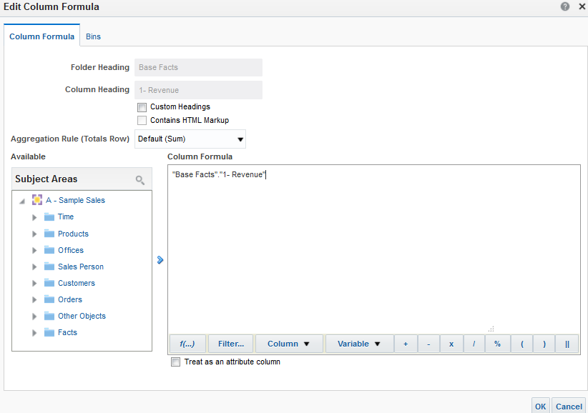
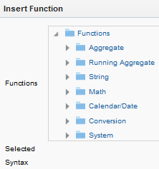





2. Modify Analysis Criteria (Formulas)
Use complex formulas in your analyses (operators, functions, filters, and variables).
Select a function to add it to the column formula.
Calculation Builder
Insert filters.
Insert variables.
Select columns from the subject area.
Notes:
Formulas support a wide variety of functionality. Using the elements available in the Calculation Builder, you can create complex logic for the column that you are modifying in your analysis. For detailed explanations of an available function, click the Function button and select the desired function in the Insert Function dialog box. Syntax and a description are displayed.
To apply a function to an expression in the Edit Column Formula dialog box, select the expression in the Formula field and then apply the function by using the Insert Function dialog box.
Click the Filter button to build column filters in your formula. You can create filters on a column by selecting them in the selection pane on the left.
Click the Column button to quickly access columns that are already included in your analysis criteria for use in your formula. You can also select columns from the selection pane to add them to your formula.
Oracle BI 12c: Create Analyses and Dashboards 3 - <number>

Slide 21
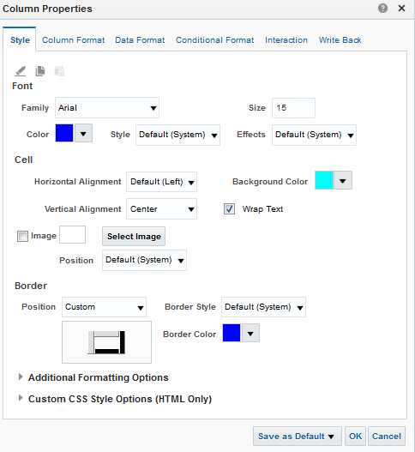

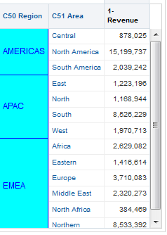


2. Modify Analysis Criteria (Style)
Override formatting and style defaults for font, cell (including alignment), border, and style sheets.
Clear, copy, and paste formats.
Save as column default.
Point to custom style sheets.
Notes:
You can set formatting and style options for columns or levels of a hierarchical column. Formatting options applied on this tab are static and apply globally to all views based on the analysis. Conditional formatting and view-based formatting are covered later.
The options you select on the Style tab of the Column Properties dialog box apply to all the contents of the selected column, but not the column headers; you set styles for column headers on the Column Format tab. The Style tab includes the following options:
In the Font area, you can specify the font family, size, and color, as well as style and effect options such as bold, italic, underline, and strikethrough.
In the Cell area, you can specify text alignment (both horizontal and vertical), cell background color or image, whether to wrap text, and cell borders.
In the Additional Formatting Options, you can specify cell width, height, and padding.
In the Advanced Style Options (CSS) area, you can override style and class elements that are specified in Oracle Business Intelligence style sheets. This capability is for users who know how to work with cascading style sheets. Click the settings you want to use, and then provide the location of the class, style, or style sheet.
Additionally, the icons at the top of the tab enable you to clear formats (restore defaults), copy custom formats, and paste formats copied from another column.
Instructor Note
The ability to save default column properties is described in detail later in this lesson. The functionality is shown here to ensure that it is present in the procedural flow.
Oracle BI 12c: Create Analyses and Dashboards 3 - <number>

Slide 22
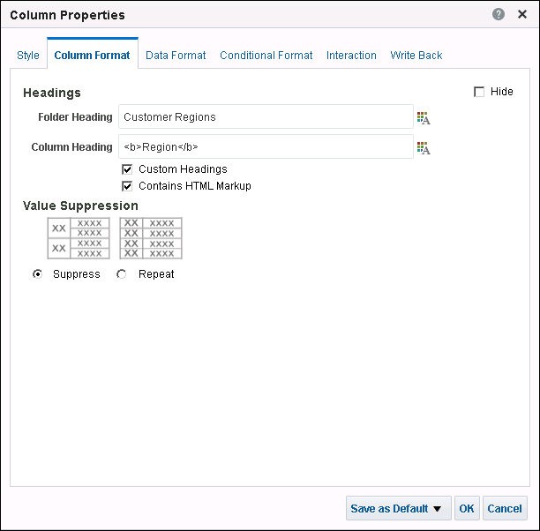


2. Modify Analysis Criteria (Column Format)
Override formatting defaults for column visibility, headings, data duplication, and interaction.
1
2
Open the Edit Format dialog box.
3
Notes:
1. Select the Hide check box to hide the column in the analysis results.
2. Select the Custom Headings check box, and perform at least one of the following actions to change the default folder and column headings:
Enter custom text in the Folder Heading or Column Heading text boxes to change the column or heading text.
Click the button to the right of the text field to open the Edit Format dialog box and change the formatting options for the Folder Heading or Column Heading. The Edit Format dialog box contains the same formatting options found on the Style tab, but the options you select only apply to the selected heading text.
Select the Contains HTML Markup check box to include HTML tags in your text. You can add HTML that contains formatted text and, depending on the security settings of the servers, Active-X controls or JavaScripts, sound bites, animation, a background image, and so on. The HTML code can contain anything that is supported by the browser.
3. In the Value Suppression area, choose the appropriate option to control the display of duplicate data:
Select Suppress to display repeating data only once and suppress duplicate rows.
Select Repeat to display repeating data for every row.
Oracle BI 12c: Create Analyses and Dashboards 3 - <number>

Slide 23
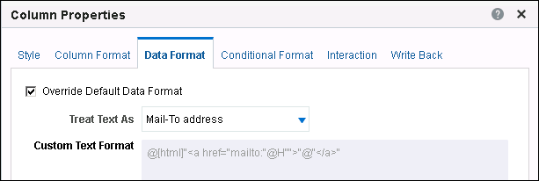
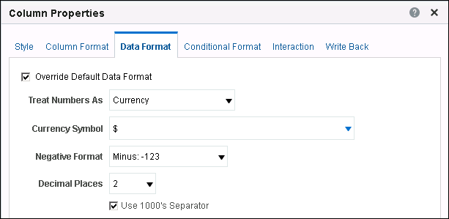
2. Modify Analysis Criteria (Data Format)
Override the way data appears based on the data type.
Text data: Treat as plain text, HTML, link, and so on.
Numeric data: Treat as number, percentage, currency, and so on.
Notes:
Select the Override Default Data Format check box to override the default display characteristics. The selections that you see will vary based on the data type.
If the column contains text, you can choose how to treat the text (such as plain text, HTML, or a link). Based on your selection, the Custom Text Format text box displays the applicable HTML string that is used to display the data.
If the column contains numeric data, you can choose how you want the numbers treated (such as percentages, month names, or dates). You can choose the number of decimal places to display, the display for negative numbers, the number of digits to show, and the type of thousands separator to use.
If the column contains date and time-zone data, you can choose from different date and time formats (for example, putting the time first or rearranging the order of month, day, and year).
In addition, you can specify that the data be displayed based on the local time zone of the initializing session. To do this, set the Date Format to either “Locale Short Date/Time” or “Locale Long Date/Time.” Finally, you can force the data to be displayed in a specified time zone by selecting it in the Display Time Zone field.
Oracle BI 12c: Create Analyses and Dashboards 3 - <number>

Slide 24

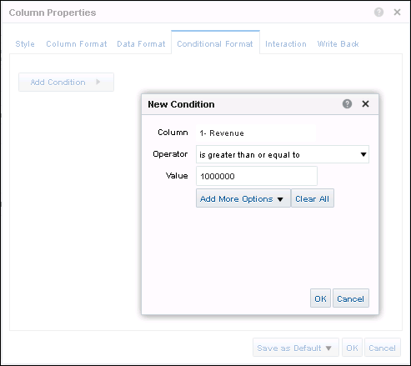

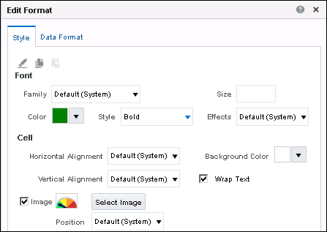



2. Modify Analysis Criteria (Conditional Format)
Direct attention to a data element that meets a certain condition.
Click Add Condition for each condition.
Specify an operator and a value to create a condition.
Specify a style for data meeting the condition.
Use a Presentation variable.
Select an image
to display.
Notes:
Conditional formatting helps direct attention to a data element if it meets a certain condition. For example, you can show below-quota sales figures in a certain color. Or, you can display an image, such as a trophy or finish flag, next to the name of each salesperson who exceeds quota by a certain percentage. Or, you can color part of a graph green if it exceeds goals, or another part red if it falls below a threshold.
Select one or more columns in the analysis to use, specify the condition to meet, and then make selections for font, cell, border, and style sheet options to apply when the condition is met. Conditional formats can include colors, fonts, images, and so on for the data and for the table cell that contains the data. In addition, you can use the Data Format tab in the Edit Format dialog box to specify a nondefault data format for elements that meet the condition.
The example in the slide shows a graphic image being used conditionally. Oracle BI is shipped with several different images that can be used for graphically representing data.
Oracle BI 12c: Create Analyses and Dashboards 3 - <number>

Slide 25
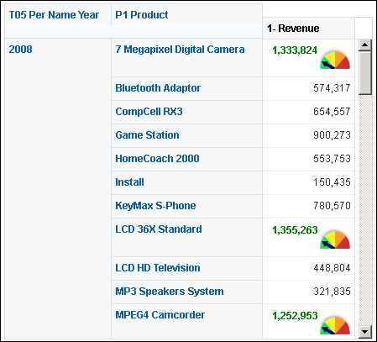
2. Modify Analysis Criteria (Conditional Format)
The Report column looks like the following after conditional formatting for a specific column:
Notes:
The example in the slide shows a graphic image being used conditionally. Oracle BI is shipped with several different images that can be used for graphically representing data.
Oracle BI 12c: Create Analyses and Dashboards 3 - <number>

Slide 26
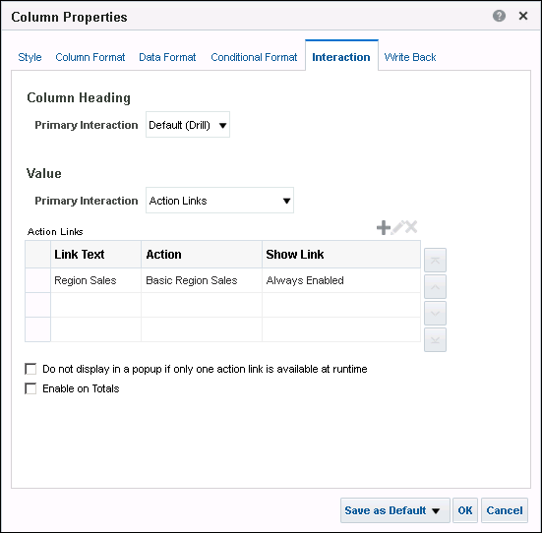
2. Modify Analysis Criteria (Interaction)
Specify behavior when a user drills on a column heading or a data value.
1
Set an action to navigate to another saved analysis.
Notes:
Specify what you want to happen when a user clicks a heading or value in an analysis. For example, by default, a hierarchy is expanded by drilling, showing the list of lower-level values or adding the next level in a hierarchy to the results as a new column.
To specify what should happen when users click the column headings or column values, select the appropriate option:
Default: Performs the default interaction, which is initially set to drill systemwide. Note,
however, that you can change the default for a column by using the “Save as Default”
button. To do this, select the desired interaction, then save it as the default for that
column or data type.
None: Disables drilling or navigation
Drill: Drills or expands to the next level in a hierarchy through a path for an attribute column
Action Links: Enables you to specify a variety of interactions, including navigating to other BI analyses in the Presentation Catalog or, for example, navigating to a webpage
Note: The Value section of the Interaction tab is displayed only for columns that include numeric data.
Oracle BI 12c: Create Analyses and Dashboards 3 - <number>

Slide 27
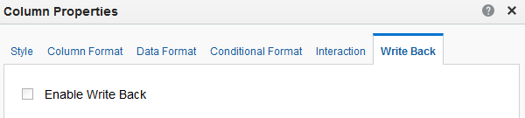
2. Modify Analysis Criteria (Write Back)
Set write back settings for a column in the Column Properties dialog box.
Notes:
If configured, the data in an analysis column within your results in Oracle BI can be modified. When you update a value in a view, it is written back to the record in the data source. You can also delete existing records or insert a new record. Write back is available only for columns configured by the administrators in the BI Server metadata repository, and can be used for only columns with a data type of measure, text, or date, and time. Hierarchies are defined in the metadata and cannot be overwritten. After the write back capability is configured in the repository, you can manage write back capabilities of a column on the Write Back tab of the Column Properties dialog box. It is also possible to set write back properties for tables and pivot tables.
Write back configuration includes the following steps:
Administrators of the Oracle BI metadata repository configure the columns in the repository to allow for write back.
Administrators set privileges for write back and prepare a write back template, and administrators and content designers configure for write back from table views in dashboards and analyses.
End users modify records in views.
Note that write back is not configured for this training environment.
Oracle BI 12c: Create Analyses and Dashboards 3 - <number>

Slide 28

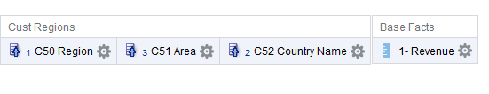
3. Change Column Order
Drag columns to change column order.
Drag a column to another location to reorder the columns.
Notes:
Drag a column to change the order in which columns appear. If sorting has been set explicitly by using the Sort button, changing the order of the columns does not change the sorting.
You can also drag an entire folder to change the order of the columns.
Oracle BI 12c: Create Analyses and Dashboards 3 - <number>

Slide 29

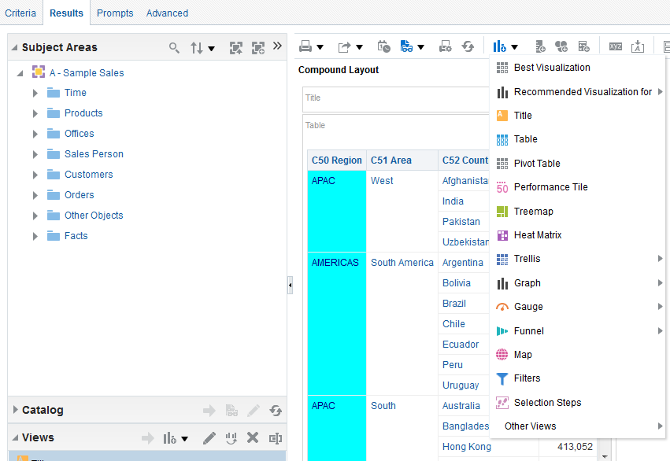


4. Display Analysis Results
  Click the Results tab to see the results of an analysis.
  An analysis can be displayed in many formats.
Select additional views.
Title view
Table view
Notes:
After constructing an analysis by selecting columns, click the Results tab in the right pane to view the results.
When you run an analysis, its logical SQL is sent to the Business Intelligence Server, which uses the BI metadata to execute physical SQL statements against its data sources, returning results to Presentation Services, which are displayed by default in a Compound Layout. The Compound Layout consists of a Title view and a Table view in the case of analyses containing attribute and measure columns. For analyses with hierarchical columns, the default Compound Layout contains a title and a pivot table.
You can add more views and format the results by using the New View button or by using the Views pane. Additional views and graphs and formatting are covered in detail in later lessons.
For performance reasons, a subset of any large data set is initially returned. You can use the scroll bar to display more results. By default, the data is sorted by the first column and then sorted by the second column; however, you can override the default behavior by creating column-specific sort rules. Repeating values are suppressed by default.
Oracle BI 12c: Create Analyses and Dashboards 3 - <number>

Slide 30
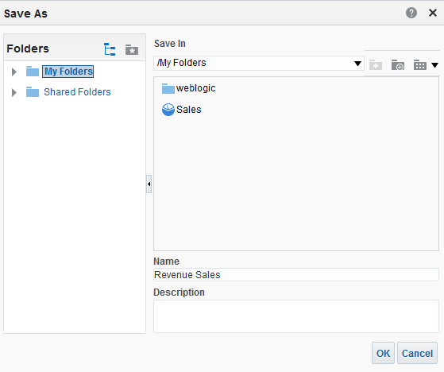





5. Save an Analysis
Click the Save Analysis button on the toolbar.
New Folder
2
1
3
Notes:
Analyses are saved in folders that are either personal or shared. To save an analysis:
1. Click the Save button to display the Save As dialog box. You can also click the Save As button to the right of the Save button to save an analysis with a new name or location.
2. Select a folder in which to save the analysis, using the left selection pane and the folders and objects list. To create a new folder, click the New Folder button, enter a name for the folder, and click OK.
3. In the Name field, enter a name for the analysis and click OK.
In the Catalog pane, expand the catalog folders to locate and verify the saved analysis.
When an analysis is saved in one of the personal folders, only the owner can access it. When it is saved in a shared folder, any user with permission to access that folder can access it.
The top-level personal folder is called “My Folders.” Every user with a unique username has a folder with the same “My Folders” name.
Oracle BI 12c: Create Analyses and Dashboards 3 - <number>

Slide 31
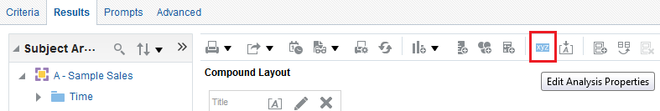
Setting Analysis Properties
Use the Analysis Properties dialog box to specify analysis-level properties:
  Results Display: Specify how to handle results that are returned from an analysis.
  Interactions: Specify which interactions are available for an analysis when you right-click in a table view or pivot table view at run time.
  Data: Specify how data is to be handled in an analysis.
Edit Analysis Properties
Notes:
Analysis Properties can be used to specify behavior for your analysis.
Use the Results Display tab to specify how results that are returned from an analysis are to be handled.
Use the Interactions tab to specify which interactions (for example, Drill) are available for an analysis when you right-click in a table view or pivot table view at run time.
Use the Data tab to specify how data is to be handled in an analysis.
Each tab is covered in more detail in the slides that follow.
Oracle BI 12c: Create Analyses and Dashboards 3 - <number>

Slide 32
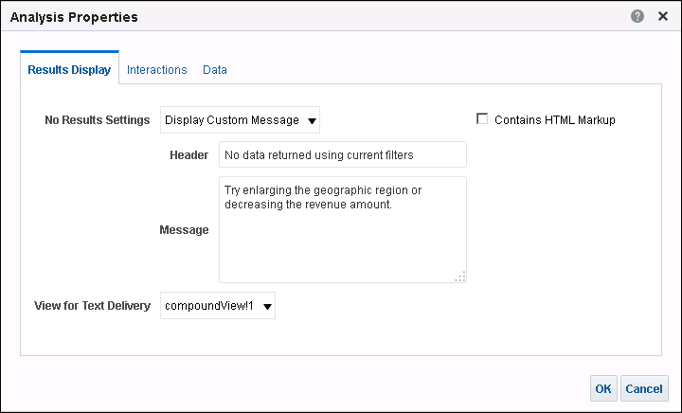




Analysis Properties: Results Display Tab
Specify how to handle results that are returned from an analysis.
Set default or custom message type.
Provide message header.
Provide custom message.
Select compound layout for text delivery.
Notes:
You use this tab to specify how results that are returned from an analysis are to be handled.
No Results Settings: Use this drop-down list to select the type of message (default or custom) that is displayed if no results are returned from an analysis. You might see the message, for example, if you have a very restrictive filter placed on the columns in the analysis. You do not see the custom message if you simply create the analysis and include no columns.
Header: Edit the header to use for the custom message. This is available only when you specify a custom message for No Results Settings.
Message: Edit the message to use for the custom message. Available only when you specify a custom message for No Results Settings.
View for Text Delivery: Use this box to manually control which compound layout, including its associated views, is sent to a particular destination.
Oracle BI 12c: Create Analyses and Dashboards 3 - <number>

Slide 33
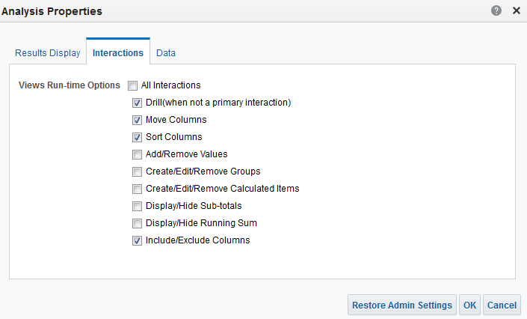
Analysis Properties: Interactions Tab
Specify which interactions are available for analysis when you right-click a table or pivot table at run time.
Notes:
Use this tab to specify which interactions (for example, Drill) are available for an analysis when you right-click in a table or pivot table at run time. Note that the administrator can specify defaults for these right-click interactions.
Oracle BI 12c: Create Analyses and Dashboards 3 - <number>

Slide 34
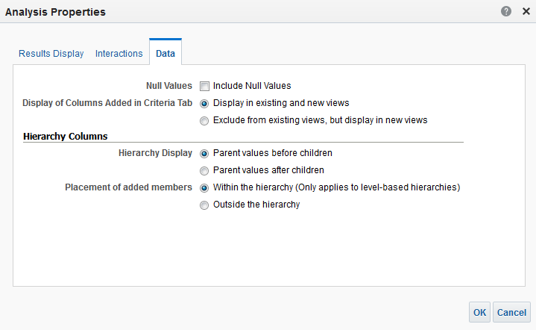
Analysis Properties: Data Tab
Use the Data tab to specify how data is to be handled in an analysis.
Notes:
The Data tab enables you to specify how to handle null values and how to handle columns that are added to an analysis from the Criteria tab after displaying the analysis results. The options are:
Include Null Values: Use this check box to include null values in your analysis when the entire row or column contains all nulls (by default, null measure values are suppressed for all analyses). When this check box is selected, null values are not suppressed for all views in the analysis.
Display in existing and new views: Use this option to specify that newly added columns are to be included in any existing views, as well as in any new views that are added.
Exclude from existing views, but display in new views: Select this option to specify that newly added columns are to be excluded from any existing views (that is, placed in the Excluded drop target), but included in any new views that are added. Placing newly added columns in the Excluded drop target was introduced in Oracle BI 11g. These options are included in the latest product release to enable users to choose between 11g and pre-11g functionality.
Oracle BI 12c: Create Analyses and Dashboards 3 - <number>

Slide 35
Notes:
Also on the Data tab, in the Hierarchy Columns area, you can control how parent members are displayed in hierarchies and how added members are placed into hierarchy columns:
Hierarchy Display – Parent values before children: Use this option to place the member total before the children.
Hierarchy Display – Parent values after children: Use this option to place the member total after the children.
Placement of added members – Within the hierarchy: This does option not display duplicate members within all hierarchies in the analysis. If the member is in the view, within the hierarchy, then this setting is ignored. This setting applies only to level-based hierarchies.
Placement of added members – Outside the Hierarchy: Members, groups, and calculated items are added below the last members at the top level of the hierarchy, in the order in which they are added.
Oracle BI 12c: Create Analyses and Dashboards 3 - <number>

Slide 36

Adding Basic Formatting to Table Views
View-level formats override analysis-level formats. Add formatting to:
  View container
  Column headers
  Column values
Preview how your formatting will be displayed in a Dashboard.
Notes:
The table is the default view for most new analyses (analyses with hierarchy columns use pivot tables for their default view). You can format the view container (the cell that surrounds the view), and you can edit the view to apply formatting to column headers and column values. The View Editor enables you to apply formatting that affects only the selected view; other views in the analysis are not changed. In later lessons, you learn to use the View Editor to add calculations, prompts, and sections, and to change the layout of columns and measures.
To check your formatting, you can preview how the analysis will be displayed in a Dashboard by clicking the “Show how results will look in a Dashboard" button.
Oracle BI 12c: Create Analyses and Dashboards 3 - <number>

Slide 37
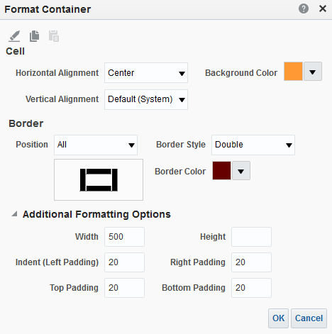
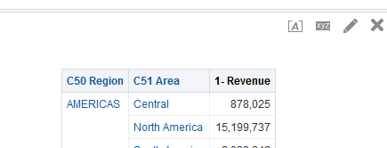

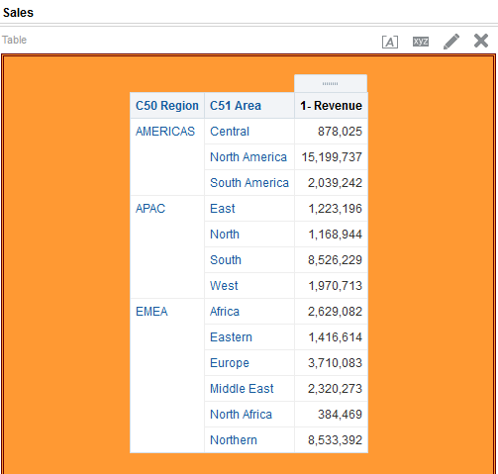
Formatting Containers
Format Container
Notes:
To format a view container:
1. On the Results tab, click the Format Container button for the view.
2. In the Format Container dialog box, define custom cell and border styles, and then click OK.
Oracle BI 12c: Create Analyses and Dashboards 3 - <number>

Slide 38
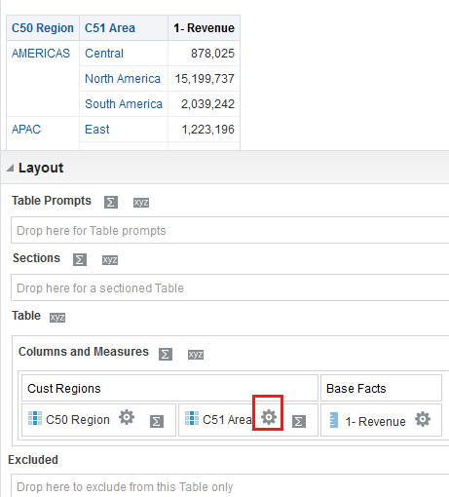

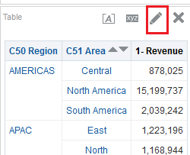


Formatting Column Headers and Values
View Editor
Edit View
More Options: format headings and values
Notes:
To format table column heading and values:
1. On the Results tab, click the Edit View button for the table.
2. The View editor is displayed. In the Layout pane, under Columns and Measures, click the More Options button for a column and select one of the following options:
Format Headings
Format Values
3. In the Edit Format dialog box, define custom font, cell, or border styles, and then click OK.
4. At the top-right corner of the View editor, click Done to return to the Results tab.
Oracle BI 12c: Create Analyses and Dashboards 3 - <number>

Slide 39
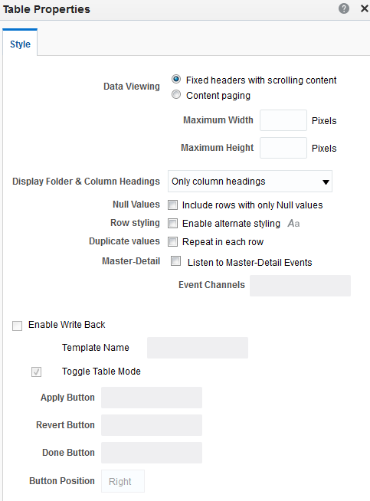
Setting Table Properties
Access Table Properties from the toolbar in the Table editor.
  Style tab
    Fixed headers with scrolling content or content paging
    Display Folder & Column Headings
    Null Values
    Row Styling
    Duplicate Values
    Enable Write Back
    Toggle Table Mode
    Other options
Notes:
You can control how data is displayed in tables by editing the table properties. You can access the table properties button by opening the View Editor:
1. On the Results tab, click the Edit View button for the table.
2. The Table editor is displayed. In the editor toolbar, click the Table View Properties icon.
Oracle BI 12c: Create Analyses and Dashboards 3 - <number>

Slide 40
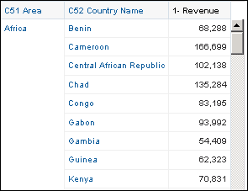
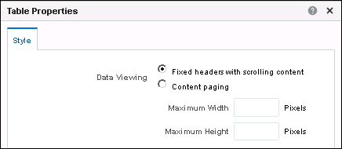
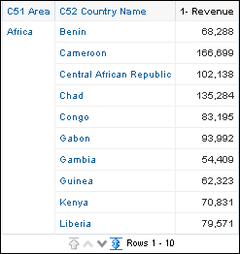
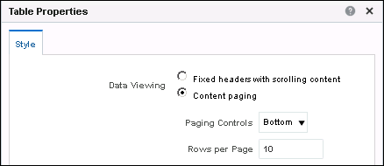
Data Viewing Properties
  Fixed headers with scrolling content
  Content paging
Notes:
You can use data viewing properties to control how the rows in your table are displayed:
Fixed headers with scrolling content: This is the default display. Table data is displayed in a default table area with a maximum height and width of 700 pixels. For rows or columns that do not fit in the default table area, horizontal and vertical scroll bars are displayed as necessary.
Content paging: Table data is displayed on multiple pages with a fixed number of rows. The default number of rows per page is 25, but you can customize the number of rows. You can also control where to display the paging controls (Bottom, Top, or Hide).
Oracle BI 12c: Create Analyses and Dashboards 3 - <number>

Slide 41
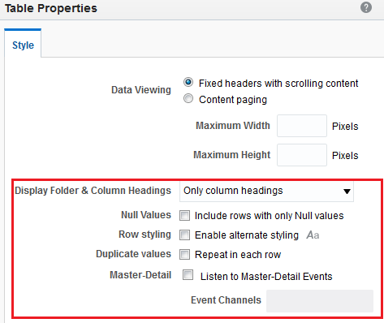
Other Style Properties
  Display folder and column headings
  Enable alternate row styling
  Listen to Master-Detail events
  Include rows with only null values
Notes:
In addition to data viewing properties, the Style tab enables you to:
Control how column headings are displayed, and whether to display the folder name with the column name
Add alternate “green bar” styling to the view (show alternating rows or columns in a light green or custom color)
Specify that the table is to act as a detail view in a master-detail relationship (master-detail linking of views is covered in the lesson titled “Working with Additional Views in Analyses”)
Include null values in your table when the entire row contains all nulls
Oracle BI 12c: Create Analyses and Dashboards 3 - <number>

Slide 42
Advanced Formatting
  Saving column settings as systemwide defaults
  Copying and pasting formatting attributes
  Using a saved analysis as a style template
  Using custom date-format strings
Notes:
Instructor Note
This is a structuring slide identifying the advanced formatting options that are presented in the following slides. Do not teach the concepts here because the following slides cover them in detail. Instead, provide a high-level description of what is discussed.
Oracle BI 12c: Create Analyses and Dashboards 3 - <number>

Slide 43
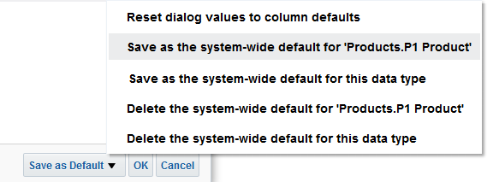
Saving Column Settings as Systemwide Defaults
Settings on Column Properties tabs can be saved as systemwide defaults:
  Save defaults for particular columns or data types.
  A user must have appropriate permissions to save.
  Delete defaults for particular columns or data types.
  Subsequent users see new default settings.
Save as defaults for column.
Save as defaults for data type.
Notes:
If your user ID has the appropriate permissions, you can save your settings in the column properties for use as the systemwide defaults for this particular column (or for columns of this particular data type). Anyone who uses this column (or columns of this data type) in subsequent analyses, will use the settings on these tabs by default.
Oracle BI 12c: Create Analyses and Dashboards 3 - <number>

Slide 44
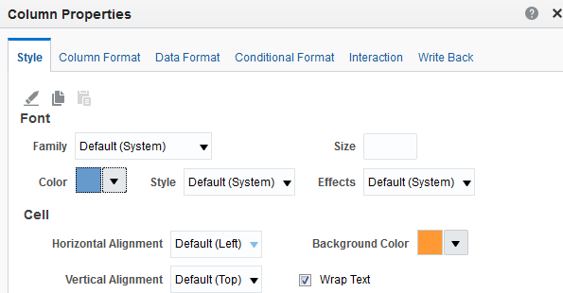



Copying and Pasting Formatting Attributes
Copy a range of formatting attributes that are applied to an object and then paste them to an object of the same type.
Restore defaults
Paste
Copy
Notes:
To copy and paste a formatting attribute, perform the following steps:
1. Select the column whose formatting you want to copy.
2. Access the Style tab of the Column Properties dialog box and click the Copy Formatting button.
3. Select the column to which you want to paste the formatting, access the Style tab of the Column Properties dialog box, and click the Paste Formatting button.
To restore the default appearance, click the Clear Formatting button.
Oracle BI 12c: Create Analyses and Dashboards 3 - <number>

Slide 45
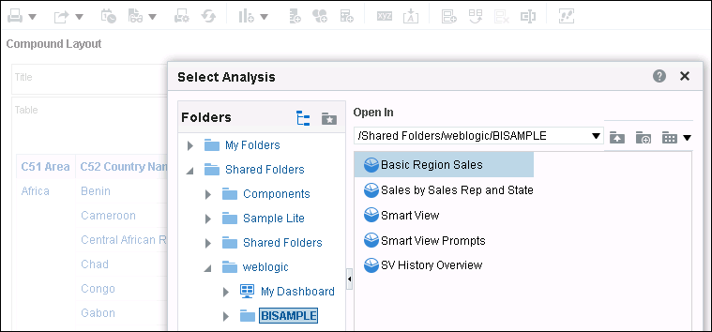
Using a Saved Analysis as a Style Template
  Use a customized saved analysis as a cosmetic style template.
  Apply formatting from a template to new or existing analyses.
    Supported in Table, Pivot Table, and Graph views
1
2
Notes:
You can apply formatting from a saved analysis to tables, pivot tables, and graphs. To use a saved analysis as a template, perform the following steps:
1. Click the Import Formatting button near the top of the workspace.
2. In the Select Analysis dialog box, navigate to a saved analysis and click OK.
Oracle BI 12c: Create Analyses and Dashboards 3 - <number>

Slide 46
Customized Date and Time Format Strings
  Provide additional options for formatting columns that contain time stamps, dates, and times.
  Examples of general customized format strings:
Term | Result | Example
[FMT:dateShort] | Formats date in locale’s short-date format | 2/3/2008
[FMT:dateLong] | Formats date in locale’s long-date format | Monday, February 3, 2008
[FMT:time] | Formats time in locale’s time format | 12:00:00 AM
[FMT:timeHourMin] | Formats time in locale’s time format but omits seconds | 12:00 AM
Notes:
For a complete list of date and time format strings, see the Oracle Fusion Middleware User’s Guide for Oracle Business Intelligence Enterprise Edition.
Oracle BI 12c: Create Analyses and Dashboards 3 - <number>

Slide 47
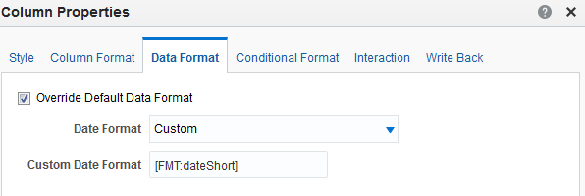
Applying a Customized Format String to a Column
Example: Using a customized date format string for a
date column
1
2
3
Notes:
To enter a custom date/time format string for a column that contains a time stamp, date, or time, perform the following steps:
1. In the Column Properties dialog box, select Override Default Data Format.
2. In the Date Format field, select Custom from the drop-down list.
3. In the Custom Date Format field, enter the custom format string in the format shown in the previous slide, including the left and right brackets ([ ]).
Oracle BI 12c: Create Analyses and Dashboards 3 - <number>

Slide 48

Quiz: Overview
This quiz examines your knowledge of Oracle BI and Analysis Editor.
Notes:
In this quiz, you answer questions regarding the BI user interface and the creation and modification of analyses.
Oracle BI 12c: Create Analyses and Dashboards 3 - <number>

Slide 49
Quiz
Which of the following apply when setting properties for levels in a hierarchical column?
  You can set different properties for levels within the hierarchy.
  To set properties, you expand the results to the level that you want to change.
  By expanding the hierarchical column in the Selected Columns pane, you can use the More Options button for each level to set properties.
Notes:
Answer: a, c
Oracle BI 12c: Create Analyses and Dashboards 3 - <number>

Slide 50
Quiz
Formatting and style options must be applied and saved individually for each column or hierarchical level.
  True
  False
Notes:
Answer: b
You can either copy formatting from one object and paste it to another of the same type or import formatting from another saved analysis, using it as a formatting template. You can also save defaults for columns or data types.
Oracle BI 12c: Create Analyses and Dashboards 3 - <number>

Slide 51
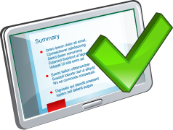
Summary
In this lesson, you should have learned how to:
  Identify the important elements of analyses
  Use Analysis Editor
  Construct, modify, and save analyses by using the three available types of columns
  Apply advanced formatting to analyses
Notes:
Oracle BI 12c: Create Analyses and Dashboards 3 - <number>

Slide 52

Practice 3: Overview
This practice covers the following topics:
  Creating an analysis in Oracle BI EE
  Formatting analyses
  Controlling the display of columns added to analyses
Notes:
Oracle BI 12c: Create Analyses and Dashboards 3 - <number>

