Slide 1
Filtering Data for Analyses
Notes:
Schedule: Timing Topic
45 minutes Lecture
45 minutes Practice
05 minutes Quiz
95 minutes Total

Slide 2

Objectives
After completing this lesson, you should be able to:
  Describe the use of filters in limiting the results of analyses
  Design and build filters in Oracle Business Intelligence analyses
  Add filter prompts to an analysis
  Use a saved analysis as a filter
  Edit the SQL for a column filter in an analysis
Notes:
Oracle BI 12c: Create Analyses and Dashboards 4 - <number>

Slide 3
Filters
  Filters can be applied directly to attribute columns and measure columns.
  Filters are applied before a query is aggregated and affect the query, and thus the resulting values for measures.
    For example, suppose you have a list of members in which the aggregate sums to 100. Over time, more members meet the filter criteria and are filtered in, which increases the aggregate sum to 200.
Notes:
Oracle BI 12c: Create Analyses and Dashboards 4 - <number>

Slide 4
Applying Filters to Attribute Columns to Affect Hierarchical Columns
A filter can be applied on a related attribute column to affect the display of members in a hierarchical column.
  For example, suppose a hierarchical column contains the levels Year, Quarter, and Month.
  If you create a filter on Year to limit it to 2015 and 2016, then when the hierarchical column is displayed in a view, only those two years are visible.
Notes:
Oracle BI 12c: Create Analyses and Dashboards 4 - <number>

Slide 5
Inline Objects vs. Named Objects?
  Inline objects:
  As you work with an analysis, you can create other objects that are contained within that analysis, such as filters.
  When an object is contained within another, that object is called an “inline” object.
  You can create inline filters, groups, and calculated items within an analysis.
  Named objects:
  Named objects differ from “inline” objects in that they are saved as separate files in the Presentation Catalog and can be used in other analyses or objects.
Notes:
Oracle BI 12c: Create Analyses and Dashboards 4 - <number>

Slide 6
EVALUATE_PREDICATE Function with a Filter
The EVALUATE_PREDICATE function:
  Is used with the inline filter clause
  Is not supported with hierarchical columns (for example, Product Hierarchy)
  Is intended for database functions with a return type of Boolean, and can be used only for SQL functions
  Does not work with XML data sources
Notes:
Oracle BI 12c: Create Analyses and Dashboards 4 - <number>

Slide 7
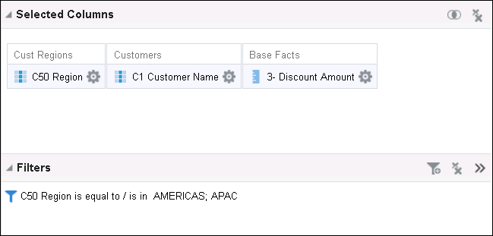





Using Filters to Limit Data in Analyses
Filters limit results when an analysis is run.
  Only those results that match filter criteria are included.
This inline filter limits the results to customers in these regions.
Remove all filters.
Filters pane
Create a new inline filter.
Save an inline filter as a named filter.
Notes:
A filter is used to limit results. Based on the filter criteria that you define, Oracle Business Intelligence shows only those results that match your criteria.
For example, you may have an analysis that searches for your customers’ assigned sales representatives (reps). You can use a filter to limit the results of the analysis so that only the customer sales reps in Atlanta, Boston, and Chicago (plus any favorite city) appear in the results.
Filters are applied on a per-column basis.
The filter is translated into a WHERE clause in the SQL SELECT statement that is issued to the Oracle Business Intelligence Server. The WHERE clause is used to limit the returned rows to those that fit the specified constraints. Advanced users can type the SQL for a filter directly.
Note that filters impact the aggregates in your results for hierarchical columns.
Oracle BI 12c: Create Analyses and Dashboards 4 - <number>

Slide 8
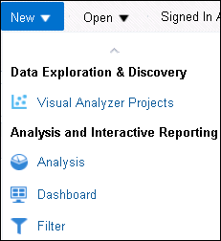
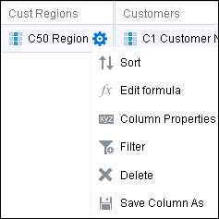
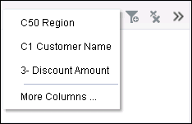
Creating and Editing Filters
  You can create named filters by using the New button in Global Header or save them from within analysis criteria.
  You can create, display, and manage inline filters in the Filters pane for the analysis that they are associated with.
Creating a new inline filter from the Selected Columns pane of the Criteria tab
Filter on a column that is not in the analysis.
Create a new Named Filter
Notes:
Both named and inline filters are created using the Create/Edit Filter dialog box.
Named Filter
A named filter is a saved filter in the Presentation Catalog, which can be applied to an analysis that shares the same subject area. To create a new named filter, click New in the Global Header and select Filter. You are prompted to select a subject area, which appears in the Subject Areas pane. You can then double-click columns from the subject area to filter on, and build and edit the filter in the New Filter dialog box. When you save a named filter, you save it in a folder in the Presentation Catalog reserved for its subject area, so that you can easily use the filter with other analyses. An example of the folder structure is Subject Area Contents/<Subject Area>.
Inline Filter
An inline filter is created on the Criteria tab of an analysis. To create a filter on a column, click the More Options button for the column in your analysis and select Filter. Alternatively, in the Filters pane, you can click the funnel icon and select the analysis column. Note that you can save an inline filter as a named filter for use with other analyses. To do this, click the More Options button in the Filters pane on the Criteria tab and select Save Filters. After you have saved a filter, it can be opened and edited in the same way as any other named filter.
Oracle BI 12c: Create Analyses and Dashboards 4 - <number>

Slide 9
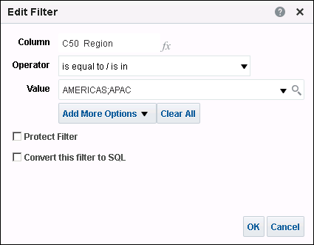
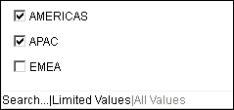

Creating and Editing Filters
Use the Create/Edit Filter dialog box to create and edit both named and inline filters.
Search values for the column.
Notes:
The New Filter dialog box appears when you create a new named or inline filter. The Edit Filter dialog box appears when you edit an existing inline or named filter. To edit a filter in the Edit Filter dialog box, place the cursor over a named or inline filter and click the Edit Filter icon. A column filter consists of the following elements:
A column to filter, such as City
A value to use when applying the filter, such as Houston or New York. You can expand the drop-down list to select values from the column for your filter, or enter values directly. Multiple values are separated by a semicolon.
An operator that determines how the value is applied, such as “is equal to / is in.” To use an example of filtering a measure, if the column contains the number of units sold, the operator is less than, and if the value is 10, the results include order quantities for which fewer than 10 units were sold.
Oracle BI 12c: Create Analyses and Dashboards 4 - <number>

Slide 10

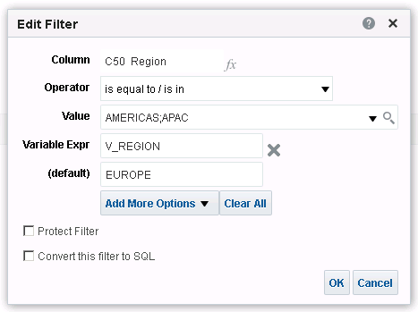


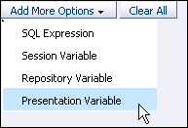

Creating and Editing Filters
  Include SQL expressions and variables
  Protect filters from override
Set a formula.
Edit Filter icon opens Edit Filter dialog box.
Protect the filter from override by a prompt.
Notes:
Oracle BI 12c: Create Analyses and Dashboards 4 - <number>
Advanced users can click the Add More Options button to include SQL expressions and presentation, session, and repository variables to define or limit the value and to base results on other analyses.
Note:
Filters are translated into a WHERE clause in the SQL SELECT statement that is issued to the Oracle Business Intelligence Server. The WHERE clause is used to limit the returned rows to those that fit the specified constraints. Advanced users can enter the SQL for a filter directly.
You can protect a filter for an analysis from being overridden by named or inline prompts by selecting the Protect Filter option. Prompts, which are discussed later in the lesson, allow you to select filter values from a variety of options. You may protect a filter for an analysis to prevent prompts or navigation from impacting results.

Slide 11

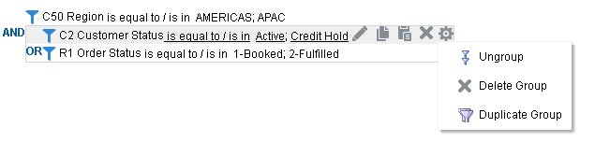
Grouping Filters
  Grouping filters allows you to create nested filters with an AND operator.
  The OR operator enables you to build complex ungrouped filters.
  Grouped filters appear in a bounded box.
To group filters,
click the operator.
Grouped filters
Notes:
Analysis results are determined by first processing grouped filters and then outer filter requirements. This is visually represented in the Filters pane of Analysis Editor by visually nesting the grouped filters in a sequence of filters.
The AND operator means that the criteria specified in each filter must be met. This is the default method for combining column filters for an analysis. The OR operator means that the criteria that is specified in at least one of the column filters must be met. Click the default AND operator to create grouped filters. The first click creates a group with an OR operator. To create a group with an AND operator, click the OR operator for the bounded group.
To ungroup filters, click the Edit Filter Group button and select Ungroup. You can also delete or duplicate groups to create additional filters and groupings.
Oracle BI 12c: Create Analyses and Dashboards 4 - <number>

Slide 12
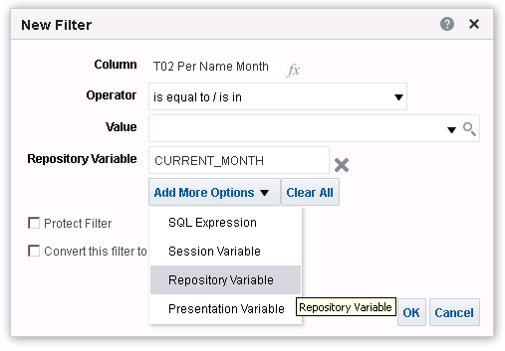



Dynamic Filtering
Filters (such as Current Month and Previous Month) can be created to limit changing data.
3
1
2
Notes:
You can reference variables to create dynamic filters. To do this:
1. Click Add More Options.
2. Select a variable type.
3. Enter the variable name in the text box.
In the example in the slide, the CURRENT_MONTH repository variable is being used in a filter. At run time, the results of any analysis that included this filter would be filtered for the current month, so that results would vary depending on which month in the year the analysis is run.
To reference session and repository variables, you must know which ones have been constructed in the repository. You can also call any presentation variables that have been instantiated. The construction of session and repository variables is discussed in the course titled Oracle BI 12c: Build Repositories.
Oracle BI 12c: Create Analyses and Dashboards 4 - <number>

Slide 13
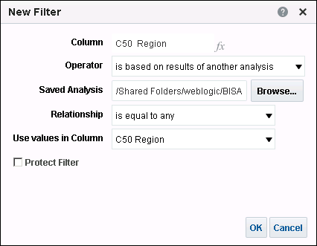
Using a Saved Analysis as a Filter
Use any saved analysis that returns a column of values to filter a selected column in an analysis.
1
2
3
4
Indicates that the filter is comparing with the saved analysis
Notes:
Filters can be combined with other filters, and they can also be based on the values returned by another analysis. Any saved analysis that returns a column of values can be used to filter the selected column in your analysis. For example, if a Western Region analysis returns two cities, San Francisco and Los Angeles, using this analysis as the basis for a filter for another analysis is like adding a filter for City = San Francisco or Los Angeles.
To create a filter based on the results of another saved analysis, perform the following steps:
1. Select is based on results of another analysis as the operator.
2. For saved analysis, click Browse to select an analysis in the Presentation Catalog.
3. In the Relationship drop-down list, select the appropriate relationship between the results and the column to be filtered.
4. In the “Use values in Column” drop-down list, select the appropriate column to compare from the saved analysis. If the saved analysis contains a matching column name, it appears by default. If you want to use another column, select it instead.
Oracle BI 12c: Create Analyses and Dashboards 4 - <number>

Slide 14
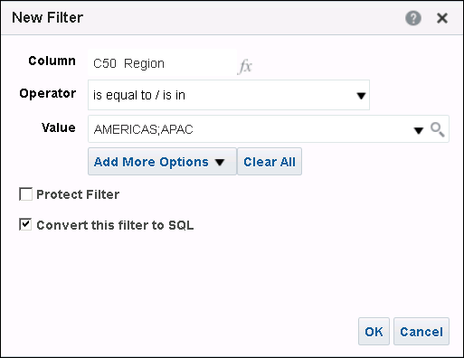
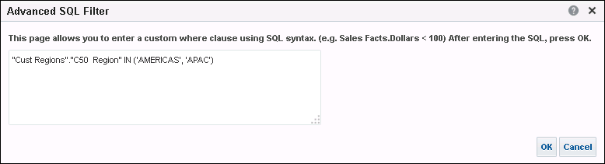
Editing SQL for a Column Filter
Edit the logical SQL WHERE clause to be used as a filter.
1
2
Notes:
Editing SQL is usually unnecessary, but it is available for use when you need advanced filtering capability. After you convert a filter to SQL, you cannot undo the conversion.
To edit SQL, perform the following steps:
1. Select the “Convert this filter to SQL” check box in the Create/Edit Filter dialog box.
2. In the Advanced SQL Filter dialog box, enter your modifications and click OK.
The converted and edited SQL statement appears in the Filters pane.
Oracle BI 12c: Create Analyses and Dashboards 4 - <number>

Slide 15
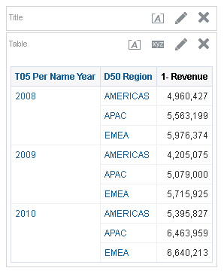
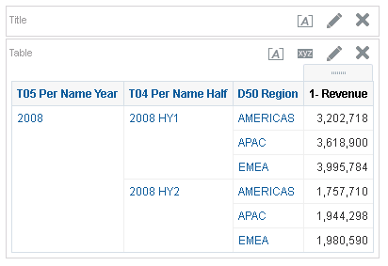
Drilling and Filters
  Drilling on attribute columns on the Results tab automatically filters results.
  The drill path corresponds to level-based hierarchies that are defined in the metadata.
Results include the next level in the time hierarchy.
Drill on the results page to filter on the drilled value.
The filter is automatically added to criteria.
Notes:
To add a filter to your analysis in the results, you can simply drill down on the linked drillable dimension. Your results are immediately filtered to include only the selected value.
You can examine the filter that was created when you drilled on the Criteria tab.
Oracle BI 12c: Create Analyses and Dashboards 4 - <number>

Slide 16
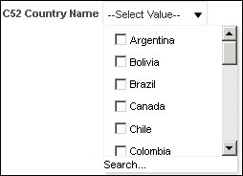

Analysis Prompts
  Provide general filtering columns in an analysis
  Allow you to constrain choices for a column
  Example: An inline filter on the Americas region constrains the prompt options to countries within that region.
Inline filter on
Americas
Prompt shows only countries in the Americas region
Notes:
An analysis prompt provides general filtering of columns in an analysis, exposed through a variety of different user interface prompts. An analysis prompt can present all choices for a column or it can present constrained choices. For example, if an analysis contains a Region=Central filter, constraining choices for the State column restrict the selections to states in the Central region only. This eliminates the selection of a mutually exclusive filter that could result in no data.
Use the Match drop-down list and text box to constrain the choices.
You also have the ability to skip prompts, combine prompts, or be constrained by previous prompts.
Inline prompts are initial prompts embedded in an analysis and are not stored in the catalog for reuse. An inline prompt provides general filtering of a column within the analysis and, depending on how it is configured, can work independently from dashboard filter prompts, which determine values for all matching columns on a dashboard, encompassing multiple analyses. An inline prompt is an initial prompt. When the user selects the prompt value, the prompt field disappears from the analysis. To select different prompt values, the user must rerun the analysis.
Dashboard prompts affect dashboards and are covered in detail in the lesson titled “Creating Dashboard Prompts and Variables.”
Oracle BI 12c: Create Analyses and Dashboards 4 - <number>

Slide 17
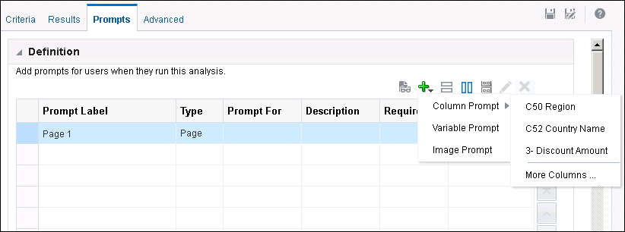
Adding an Inline Prompt to an Analysis
Create or edit an analysis to which you want to add an inline prompt, and then click the Prompts tab to open the Definition pane.
1
Add a new prompt.
2
3
Notes:
1. Click the Prompts tab.
2. Click the New icon and select Column Prompt.
3. Select the analysis column that you want to prompt on. The New Prompt dialog box, in which you set the properties of the prompt, appears.
Oracle BI 12c: Create Analyses and Dashboards 4 - <number>

Slide 18
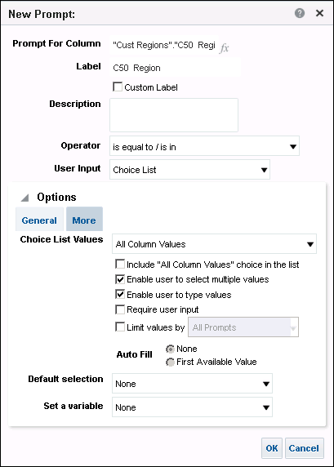


Defining Prompt Properties
1
  Enter a label for the prompt.
  Select the operator.
  Indicate how you want the choices to appear in User Input.
  Click OK.
2
Constrain values for the prompt
3
4
Notes:
You use the New/Edit Prompt dialog box to select options for the prompt, label the prompt, choose defaults, and so on.
The Label text box enables you to enter a meaningful label for the prompt.
The Description item enables you to display a tool tip to end users when they place the cursor over the item.
The User Input drop-down list provides you with the option to determine the User Input method—that is, you specify which of the following the user is presented with: choice list, slider (available only for numerical values), check boxes, option buttons, or a list box. You use this item in conjunction with the Choice List Values item to specify which data values appear for selection. For example, if you selected the User Input method of Choice List and the Choice List Values item of All Column Values, the user will select the prompt’s data value from a list that contains all of the data values contained in the data source.
Oracle BI 12c: Create Analyses and Dashboards 4 - <number>

Slide 19

Notes:
The choices you make in the dialog box have dependencies and requirements, and are available for different applications with different prompt types, all of which are managed using the Prompt Definition pane. In-depth coverage of all of the prompt types and their respective options and requirements are provided in the lesson titled “Creating Dashboard Prompts and Variables”.
Oracle BI 12c: Create Analyses and Dashboards 4 - <number>

Slide 20

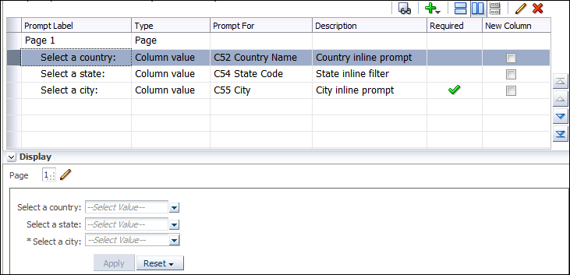



Multiple Column Filter Prompts
Create multiple prompts per analysis:
  Executed in the order listed
  Each prompt constrained by previous prompts (if configured)
Test prompts in a separate window.
Edit and delete a selected prompt.
Use arrows to sequence the prompts.
Preview prompts in the Display pane. An asterisk indicates that user input is required for the prompt.
Notes:
If you create multiple column prompts, they constrain each other as the user selects values for each prompt, unless you specify otherwise. Set the prompts to enable users to skip a prompt; this avoids forcing users to constrain values if they prefer not to.
In the example in the slide, in the Display pane, you first encounter a Country filter prompt. If you select United States, the next prompt (on state) is constrained so that you can select only those states in the United States. Finally, after you select a state, you are prompted to select a city, but the only available selections are those cities present in the selected state.
Oracle BI 12c: Create Analyses and Dashboards 4 - <number>

Slide 21

Quiz: Overview
This quiz examines your knowledge of filters and analysis prompts.
Notes:
In this quiz, you answer questions regarding filters and analysis prompts.
Oracle BI 12c: Create Analyses and Dashboards 4 - <number>

Slide 22
Quiz
Filters can all be saved in the Presentation Catalog and reused in multiple analyses.
  True
  False
Notes:
Answer: a
Oracle BI 12c: Create Analyses and Dashboards 4 - <number>

Slide 23
Quiz
Drilling in a hierarchical column that is based on a level-based hierarchy automatically creates a filter on the Criteria tab.
  True
  False
Notes:
Answer: b
Oracle BI 12c: Create Analyses and Dashboards 4 - <number>

Slide 24
Quiz
An inline analysis prompt is created outside of a specific analysis and saved in the catalog as a prompt object for reuse.
  True
  False
Notes:
Answer: b
An inline column prompt is created at the analysis level. A dashboard prompt is created outside of a specific analysis and saved in the catalog as a prompt object for reuse.
Oracle BI 12c: Create Analyses and Dashboards 4 - <number>

Slide 25
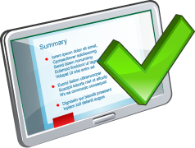
Summary
In this lesson, you should have learned how to:
  Describe the use of filters in limiting the results of analyses
  Design and build filters in Oracle Business Intelligence analyses
  Add filter prompts to an analysis
  Use a saved analysis as a filter
  Edit the SQL for a column filter in an analysis
Notes:
Oracle BI 12c: Create Analyses and Dashboards 4 - <number>

Slide 26

Practice 4: Overview
This practice covers the following topics:
  Adding filters to an analysis
  Adding inline prompts to an analysis
  Using a saved analysis as a filter
  Editing SQL for a column filter
Notes:
Oracle BI 12c: Create Analyses and Dashboards 4 - <number>

