Slide 1
Advanced Visualization in Analyses
Notes:
Schedule: Timing Topic
70 minutes Lecture
60 minutes Practice
05 minutes Quiz
135 minutes Total

Slide 2

Objectives
After completing this lesson, you should be able to:
  Add additional views of the data that is returned
  by an analysis
  Modify and format views
  Work with Compound Layouts
  Perform common tasks in views
Notes:
Oracle BI 12c: Create Analyses and Dashboards 6 - <number>

Slide 3
Oracle Business Intelligence Views
  Help users look at results in meaningful ways
  Help identify trends and relationships in data when you use multiple views
  Have a many-to-one relationship with analyses
  Can be added to Compound Layouts for display
  Are available for selection in the Analysis Editor
    On the Results tab
    In the Views pane
Notes:
Views present analysis data in meaningful, intuitive ways. An analysis that is created on the Criteria tab of the Analysis Editor can be displayed on the Results tab in multiple formats by adding or changing views. You can add a variety of views to analysis results, such as graphs and maps that allow drilling down to more detailed information, explanatory text, a list of filters that were used to limit the results, and more.
When you display the results of a new analysis, the following views are displayed by default in the Compound Layout in the Results tab:
A title view, which displays the name of the saved analysis
A table or pivot table view, which displays the results of the analysis, depending on the types of columns that the analysis contains:
If the analysis contains only attribute columns, only measure columns, or a combination of both, then a table is the default view.
If the analysis contains at least one hierarchical column, then a pivot table is the default view.
Oracle BI 12c: Create Analyses and Dashboards 6 - <number>

Slide 4
Descriptions of Views
  Table view types
    Table
    Pivot Table
  Graphical view types
    Graph
    Funnel
    Gauge
    Trellis
    Performance Tile
    Map
    Tree Map
    Heat Matrix
  Other view types
    Title
    Filters
    Selection Steps
    Column Selector
    View Selector
    Legend
    Narrative
    Ticker
    Static Text
    Logical SQL
    Create Segment
    Create Target List
Notes:
Table View Types
Table: Displays results in a visual representation of data organized by rows and columns. A table provides a summary view of data and enables users to see different views of data by dragging and dropping rows and columns.
Pivot Table: Displays results in a pivot table, which provides a summary view of data in cross-tab format and enables users to see different views of data by dragging and dropping rows and columns
Graphical View Types
Graph: Displays numeric information visually, in a variety of graph types, which makes it easier to understand large quantities of data. Graph types are discussed in detail in the lesson titled “Working with Additional Views in Analyses.”
Funnel: Displays results as a three-dimensional graph that represents target and actual values using volume, level, and color
Gauge: Shows results of a single data value as dial-, bar-, and bulb-style gauges
Oracle BI 12c: Create Analyses and Dashboards 6 - <number>

Slide 5
Notes:
Trellis: Displays multidimensional data shown as a set of cells in a grid, where each cell represents a subset of data using a particular graph type. Data can be represented with graphs, microcharts, and numbers. This view was first introduced in OBIEE 11.1.1.6.2+ release.
Performance Tile: Displays a single aggregate measure value in a simple tile
Map: Displays results overlaid on a map. Depending on the data, the results can be overlaid on top of a map as formats such as images, color fill areas, bar and pie graphs, and variably sized markers.
Tree Map: Displays a space-constrained,two-dimensional visualization for hierarchical structure with multiple levels
Heat Matrix: Displays multidimensional data shown as a set of cells in a grid, where each cell represents a subset of data using a particular graph type. Data can be represented with graphs, micro charts, and numbers. The trellis view has two subtypes Simple Trellis and Advanced Trellis.
Other View Types
Title: Displays a title, subtitle, logo, link to Help page, and time stamp
Filters: Displays the filters that are in effect for an analysis
Selection Steps: Displays the selection steps in effect for an analysis
Column Selector: Enables users to dynamically change the columns that appear in the results
View Selector: Enables users to select a specific view of the results from among the saved views
Legend: Documents the meaning of special formatting used in results
Narrative: Displays results as one or more paragraphs of text
Ticker: Displays analysis results as a ticker or marquee (similar to stock market tickers)
Static Text: Adds static text to the results
Logical SQL: Displays the logical SQL that is generated for an analysis
Create Segment: Displays a Create Segment link in the results. Users can click this link to create a segment in their Oracle's Siebel Marketing operational application, based on the results data.
Create Target List: Displays a Create Target List link in the results. Users can click this link to create a target list, based on the results data, in their Oracle's Siebel operational application.
Oracle BI 12c: Create Analyses and Dashboards 6 - <number>

Slide 6




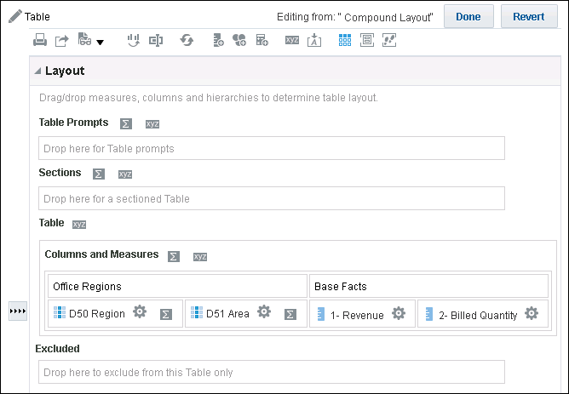






View Editors
Export analysis or data in various formats.
Show or hide Layout pane and Results preview.
Save changes.
Print as PDF or HTML.
Set prompt properties.
Layout pane
Drop columns to create prompts.
Drop columns to create sections.
Set formatting and other options for columns.
Drop columns to exclude them from the view.
Notes:
To open a view editor, click the Edit View button for a view in the Compound Layout in the Results tab. Alternatively, you can select an analysis view in the Views pane in the Results tab and click the Edit View button on that pane. Editors share common elements, including, where appropriate, the Layout pane and its drop targets, which allow you to arrange columns and data elements.
In the example, the Table editor contains analysis attribute and measure columns in the Columns and Measures drop target. You can arrange columns among the drop targets to specify prompts and sections defined by columns, and use the editor options to set formatting properties for view elements as well as to specify totals.
The editor toolbar contains relevant tool buttons depending on the editor. Note that you can print PDF or HTML formats or export your analysis in a variety of common formats, including saving in Microsoft Office formats, or as XML, or tab-delimited formatted data.
When you are done making changes in a view editor, click Done to save your changes and close the editor. Click Revert to discard your changes and revert to the saved or default version of the view and continue working in the editor.
A selection of views and editors are covered in more detail later in this lesson.
Oracle BI 12c: Create Analyses and Dashboards 6 - <number>

Slide 7
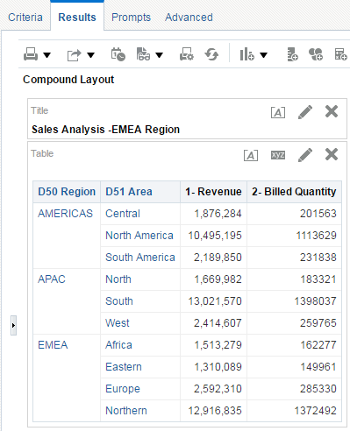
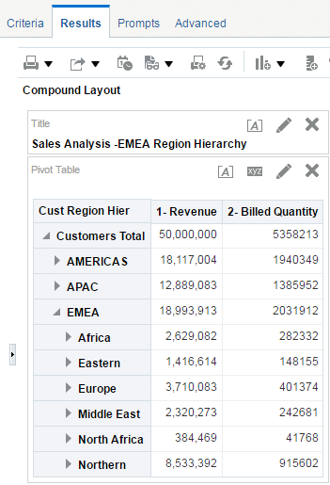


Compound Layout Pane
  Contains one or more Compound Layouts, which contain and arrange views
  Includes, by default, Title and Table or Pivot Table views
  Enables the display of analysis results in multiple formats
Attribute Column
Hierarchy Column
Notes:
You can add a variety of views to results: graphs and pivot tables (to enable drilldown to more detailed information), explanatory text, a list of filters that were used to limit the results, and more.
When you run a new analysis, Oracle Business Intelligence displays results in the Compound Layout pane.
Initially, the Compound Layout displays a Title and a Table view for analyses with attribute columns and measures. If an analysis contains a hierarchical column, the default is to display a Title and a Pivot Table view. By default, the Title view displays the name of the saved analysis.
You can customize or delete these existing views for an analysis, add other views to the layout, and combine and position views anywhere in the workspace.
Preparing multiple views of results can help you identify trends and relationships in data.
If you are customizing results for display on a dashboard, you can preview how the combination and position of views look when viewed on a dashboard.
Oracle BI 12c: Create Analyses and Dashboards 6 - <number>

Slide 8

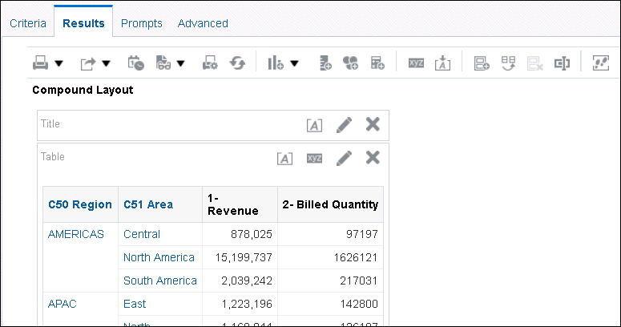



Working with Views in Compound Layouts
  Use the New View button to create another view.
  Edit or drag views as necessary.
Edit Analysis Properties.
Preview button
New View
Import formatting from another analysis.
Notes:
You can use the New View button in either the Results tab toolbar or the Views pane to add a view to an analysis. The Views pane is described later in this lesson. When you add a view by using the New View button in the Results tab toolbar, it is added to the analysis as well as the currently active Compound Layout.
1. Click the Edit View button to work with the properties that are specific to a view in a Compound Layout. The view is opened in its editor.
2. Drag views within the Compound Layout to adjust the layout. In the example in the slide, the title is moved from the top of the Table view to the right of it in the Compound Layout. When you drag an element, a bar indicates where it will appear.
Elements can be dragged to any of the following locations:
Four sides of a specific view in the Compound Layout
Four sides of the Compound Layout itself (spans all views)
Click the “Import formatting from another analysis” button to import formatting options from another saved analysis. Attributes such as background color, borders, positioning, and page control location are imported.
Oracle BI 12c: Create Analyses and Dashboards 6 - <number>

Slide 9
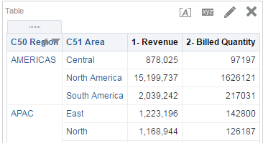


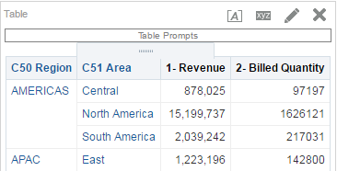
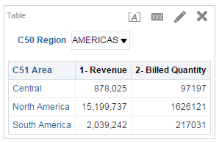

Directly Editing Table and Pivot Table Views in Compound Layouts
Table and Pivot Table views can be edited directly in Compound Layout.
  Place the cursor over a column to display the handle.
  Drag columns to drop targets.
Grab handle to arrange column.
Table prompt is added.
Drag column to move it or add it to a drop target.
Notes:
When you are working in a Compound Layout with a Table or Pivot Table view, you can drag the analysis columns to order the columns or to place them on different edges of the pivot table, thus allowing you to dynamically configure and experiment with the views.
To select a column, place the cursor over it with your mouse. When the handle appears, drag the column to a valid insertion point in the view. You can also use the view editors’ drop targets, for example, to create sections and prompts. In the example in the slide, the Region column is dragged from the table to the Prompts drop target, resulting in a user prompt that allows the user to filter on the selected region.
Using this functionality, users can directly manipulate tables in their analysis results and dashboards.
Oracle BI 12c: Create Analyses and Dashboards 6 - <number>

Slide 10
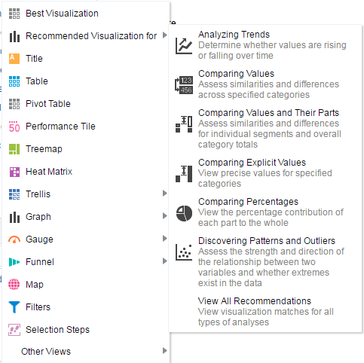
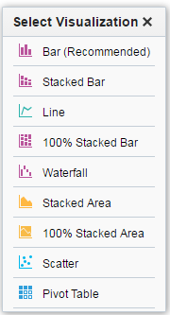
Recommended Visualizations
Notes:
In release 11.1.1.7 and higher, Oracle BI EE provides recommendation functionality whenever you create a view. As you are in the process of creating a new view in the Analysis editor, you can select an option from the “Recommended Visualization for” submenu to view a ranked list of view-type suggestions in a dialog box.
In the “Recommended Visualization for” submenu, you can specify what type of data you intend to illustrate with the view you are creating:
Analyzing Trends: Determine whether values are rising or falling over time.
Comparing Values: Assess similarities and differences across specified categories.
Comparing Values and Their Parts: Assess similarities and differences for individual segments and overall category totals.
Comparing Explicit Values: View precise values for specified categories.
Comparing Percentages: View the percentage contribution of each part to the whole.
Discovering Patterns and Outliers: Assess the strength and direction of the relationship between two variables and whether extremes exist in the data.
View All Recommendations: View visualization matches for all types of analyses.
Oracle BI 12c: Create Analyses and Dashboards 6 - <number>

Slide 11
Notes:
Oracle BI 12c: Create Analyses and Dashboards 6 - <number>
Each possible view receives a score based on a predefined set of rules. Certain view types are excluded as possibilities based on their scores. With scores above a certain level, the recommended visualizations feature then builds an ordered list of view recommendations.
If you want to skip the step of choosing from a ranking of suggested views, you can instead select the Best Visualization option from the Create View menu, to have the best view created for you immediately, without being presented with a list of recommendations.

Slide 12
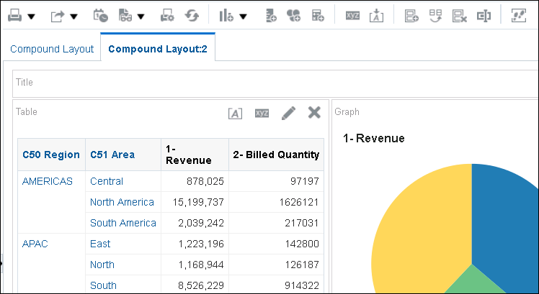


Creating and Copying Compound Layouts
Create additional Compound Layouts to vary presentation of analyses. For example, different Compound Layouts can be used in different dashboards or for different devices.
Create, duplicate, delete, and rename Compound Layouts.
New Compound Layout with additional graph included.
Notes:
You can create and duplicate Compound Layouts for different presentation requirements. Toolbar buttons include:
Create Compound Layout: Create a new instance of the Compound Layout. A new Compound Layout appears in a tab in the “Compound Layout pane” and contains only a title.
Duplicate Compound Layout: Use this button to create a copy of the current Compound Layout. The copy appears in a tab in the Compound Layout pane and contains the same views as the Compound Layout that you copied. Additional copies of the analysis or its views are not created. The analysis and views exist only once. Any changes that you make to the analysis or its views are reflected in the multiple instances of the Compound Layout.
Delete Compound Layout: Delete the current Compound Layout. The views on the layout are not deleted from the analysis. This button is not available if you attempt to delete the last Compound Layout in the analysis.
Oracle BI 12c: Create Analyses and Dashboards 6 - <number>

Slide 13
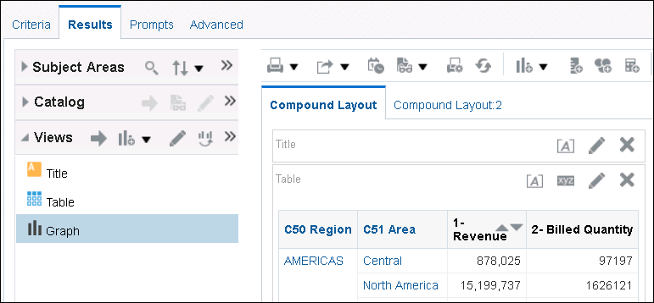






Views Pane
  Lists views associated with the analysis
  Allows you to add, edit, duplicate, delete, and rename views
Selected compound layout
Add
New
Duplicate
Edit
Rename/
Remove
Notes:
Use the Views pane to add views to or remove views from an analysis. Analysis views can then be associated with one or more Compound Layouts. Each view associated with an analysis is listed in the Views pane. In the example, notice that though the Views pane lists many views associated with the analysis, only two of these, the default Title and Table views, are currently associated with the selected Compound Layout. Analysis views may be associated with one or more Compound Layouts. Use the Compound Layout’s tools to edit and remove analysis views that are associated with it. The Views pane toolbar contains the following buttons:
Add View: Add a view selected in the Views pane’s list of analysis views, to a Compound Layout selected in the Compound Layout pane.
New View: Add a new view to the analysis. Click New View and then select the type of view that you want to add. The new view is opened in its editor, where you can edit and save the view, which is then added to the Views list. Note: The view will not show up in a Compound Layout until you add it using the Add button.
Oracle BI 12c: Create Analyses and Dashboards 6 - <number>

Slide 14
Notes:
Duplicate View: Create a copy of a view selected in the View list. When you create a duplicate, it is appended with a numeral 2. Duplication of views is useful when you want to make changes to a view while preserving the original view, or when you want to create a new view based on an existing view.
Remove View from Analysis: Remove a view selected in the View list from the analysis. The view is removed from the analysis as well as from any Compound Layout to which it belongs.
Rename View: Provide a new name for the view.
Oracle BI 12c: Create Analyses and Dashboards 6 - <number>

Slide 15

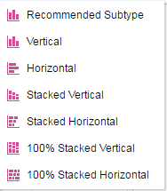



Descriptions of Graph Views
  Bar
  Line
  Area
  Pie
  Time Series Line
  Line-Bar
  Pareto
  Scatter
  Bubble
  Radar
  Waterfall
Bar graph subtypes
Area graph subtypes
Line-Bar graph subtypes
Notes:
Many of the available views that you can add to an analysis and its Compound Layouts are graphs. There are a variety of different available graphs, as described in the table in the slide, each of which is edited using the Graph editor, whose tools and layout vary slightly depending on the requirements of the graph being designed or edited.
Bar: Shows quantities associated with categories. Bar graphs show quantities as bar lengths and categories as bars or groups of bars. Bar graphs are useful for comparing differences among like items (for example, competing product sales, same product sales over different time periods, or same product sales over different markets). You can use bar graphs to compare measure columns by showing bars in a horizontal or vertical direction.
Note: 100% Stacked Vertical and 100% Stacked Horizontal graph subtypes are available only in release 11.1.1.7 and higher.
Line: Shows quantities over time or by category. Line graphs are useful for showing trends over time and you can use them to plot multiple measure columns.
Oracle BI 12c: Create Analyses and Dashboards 6 - <number>

Slide 16
Notes:
Area: Shows the trend of the contribution of each value over time or by category. An area graph is a line graph for which the regions between lines are filled in. Regions are stacked up, adding up to the total value for each time period or category. In 100% stacked graphs, each category is displayed as a percentage contribution to the total value.
Note: 100% Stacked area graphs are available only in release 11.1.1.7 and higher.
Pie: Shows data sets as percentages of a whole. Pie graphs are useful for comparing parts of a whole, such as sales by region or by district.
Time Series Line: Plots time series data, scaling the X-axis based on the time that has elapsed between data points
Line-Bar: Plots two sets of data with different ranges, one set as bars, and one set as lines overlaid on the bars. Line-bar graphs are useful for showing trend relationships between data sets.
Pareto: Displays criteria in descending order in a form of bar graph and line graph, with the line showing a cumulative total of the percentages. Pareto graphs are useful for identifying significant elements, such as best and worst or most and least.
Scatter: Displays x-y axis values as discrete points, scattered within an x-y grid. Scatter graphs plot data points based on two independent variables. This enables you to plot large numbers of data points and observe the clustering of data points. Scatter graphs are useful for observing relationships and trends in large data sets.
Bubble: Displays data elements as circles. In a variation of a scatter graph, bubble graphs show three variables in two dimensions. One value is represented by the location of the circle on the horizontal axis. Another value is represented by the location of the circle on the vertical axis. The third value is represented by the radius of the circle. Bubble graphs are useful for plotting data with three variables, and for displaying financial data over a period of time.
Radar: Plots the same information as a bar graph, but instead displays data radiating from the center of the graph. Each data element has its own value axis. Radar graphs are useful for examining overlap and distribution.
Waterfall: A waterfall graph lets you visualize how a value increases or decreases sequentially and cumulatively. Waterfall graphs focus the user's attention on how each measure contributes to the overall total and communicates through simple formatting by using color. In a waterfall graph, an initial value is summed with subsequent values (both negative and positive changes) to arrive at a total. There is only one total per waterfall graph and subtotals can be added. Waterfall graphs are available only in release 11.1.1.7 or later.
Oracle BI 12c: Create Analyses and Dashboards 6 - <number>

Slide 17


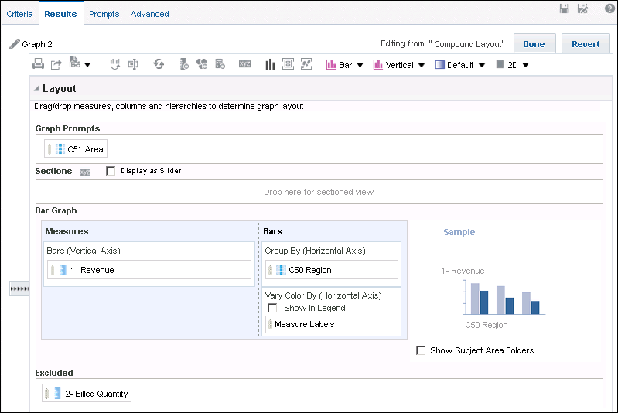
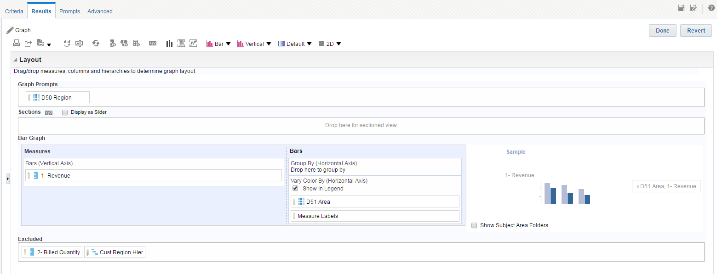






Graph Editor
Edit graph properties.
Set graph type and style 2D/3D.
Show/hide selection step pane.
Display section as a slider in graph.
Break column by section.
Drop targets control graph layout.
Drop target to set the measure on the vertical axis.
Analysis columns excluded from the graph
Notes:
The Graph editor’s appearance and behavior varies slightly depending on the type of graph that is selected. To select another graph type or subtype, use the buttons on the right of the editor’s toolbar. Using these buttons you can also specify, for appropriate graphs, shapes and gradients as well as change the default setting of 2D to 3D display.
To create or edit a graph, specify its type and then drag analysis columns to the appropriate drop targets to specify what is being measured and the grouping for the graph. In the preceding example, the City attribute and the Units Shipped measure are excluded from the graph. The Dollars measure is specified as the vertical axis measure (this is a default vertical bar graph). The State column is specified for the horizontal column, and the Region column is specified as a slider section for the graph.
Using sliders with sections can save space on a Compound Layout and consequently, analyses and dashboards. In the example in the slide, a section is designated based on the Region column being dropped on the Sections drop target of the Graph editor.
Notice that as appropriate for the view type, similar tools are available throughout View editors, and shared with the Results tab toolbar. For example, similar to the earlier example of the Table editor, you can show or hide the Layout pane of the editor as well as the Results preview to manage space while working in the editor.
Oracle BI 12c: Create Analyses and Dashboards 6 - <number>

Slide 18
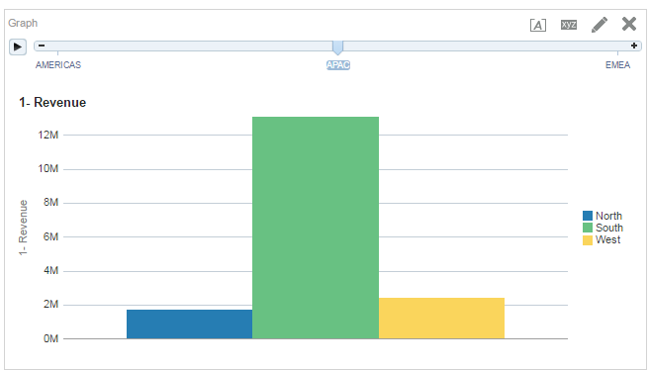



Graph Slider
Section slider
Axis label
APAC areas
(group by attribute)
Notes:
The example in the slide is the simple graph created on the previous slide in the Graph editor. Notice that the inclusion of the slider with the Region section that was designated in the editor’s Section drop target dramatically saves space in the analysis view.
If the Display as Slider option is not selected, the graph appears once for each of the regions in the analysis. In this case, because there is no filter on region in the analysis, this would result in three graphs, one each for AMERICAS, APAC, and EMEA. The use of a slider presents only one graph, which allows users to dynamically select a region section for current display. This way, users don’t have to scroll in the Compound Layout or dashboard to view the information they are looking for.
Graphing Best Practices
A general guideline is to keep graphs as simple as possible. More complex graphs can make it difficult for users to comprehend the information; more detail leads to more distraction. Some guidelines, as illustrated in the simple default graph in the slide, include the following:
Use simple graphs where possible.
Two-dimensional graphs can be easier to interpret than three-dimensional graphs.
For example, use a bar graph rather than a pie graph if it conveys the information that you want to communicate. The Recommended Visualization menu can help you select the best graph for the data you are presenting.
Oracle BI 12c: Create Analyses and Dashboards 6 - <number>

Slide 19
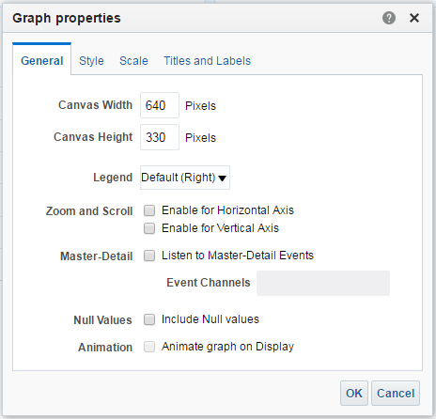





Graph Properties: General
Enables you to set canvas size, overall appearance, and zooming and scrolling
Set canvas size.
Set location of legend in graph canvas.
Enable zooming and scrolling.
Include null values in graph data
By default, graph rendering in views is animated.
Notes:
To open the Graph properties dialog box, click the Edit Graph Properties button in the View editor toolbar.
In the General tab of the Graph properties dialog box, you can set the size of the graph canvas and specify the location of the Legend.
When you enable zooming and scrolling for an axis, the Zoom button appears in the graph area when you place the cursor over the graph. To zoom and scroll, click the Zoom button, select an axis, and select the Zoom In or Zoom Out option. When you zoom in on an axis, a scroll bar appears that you can use to scroll through elements on the zoomed axis.
The use of Master-Detail events and linking is covered in the lesson titled “Working with Additional Views in Analyses.”
Note that some options in the Graph properties dialog box are not available for specific graphs, depending on applicability of the features. For details on specific exceptions, refer to the Oracle Fusion Middleware User’s Guide for Oracle Business Intelligence Enterprise Edition.
Instructor Note
This and following slides detail the options available in Graph properties to control the appearance and interactivity of graphs. It may help to demonstrate some of these features to show their effect on a graph.
Oracle BI 12c: Create Analyses and Dashboards 6 - <number>

Slide 20
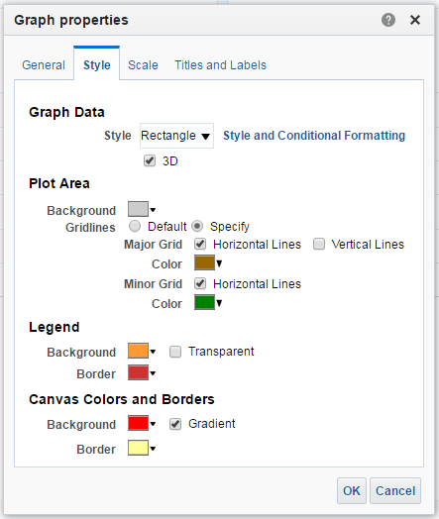



Graph Properties: Style
Enables you to set graph data style and plot area, legend, and canvas colors
Set style of graph elements.
Set formatting options for the plot area.
Set formatting options for the legend and the background canvas.
Notes:
On the Style tab of the Graph properties dialog box, you can set properties that control the appearance of the graph. Each section of the dialog box has options to control different aspects of the graph, including data style and the available 3D rendering, which can also be set in the Graph editor’s toolbar.
In the Plot Area section, you can specify and format colors for the graph’s background and any horizontal or vertical grid lines. In the Legend and Canvas Colors and Borders sections, you can determine the colors and settings for backgrounds and borders. Select the Transparent option to make the Legend’s background transparent so that the graph’s plot area and canvas is not interrupted. Set the Gradient option if you want the canvas background color to gradually fade from the specified color at the top to white at the bottom.
You can also set position and conditional formatting on graph data in the Style tab. These options are covered in detail later in this lesson.
Oracle BI 12c: Create Analyses and Dashboards 6 - <number>

Slide 21
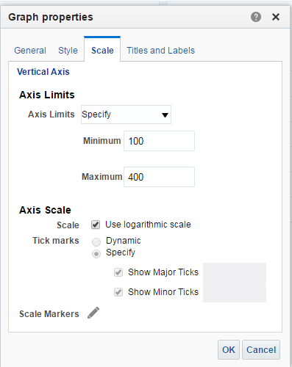



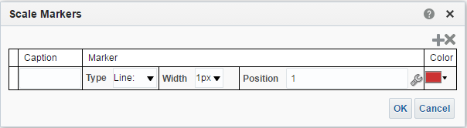
Graph Properties: Scale
Enables you to specify scale, markers, and tick marks in the graph
Set maximum and minimum limits for axis.
Specify number of ticks in the graph and their distribution.
Set scale marker properties.
Notes:
On the Scale tab of the Graph properties dialog box, you can set properties that control axis limits and tick marks. Axis limits are the minimum and maximum points on the vertical and horizontal axes. Tick marks are value markers along the axes of the graph that can identify regular intervals, for example, from the minimum value to the maximum value. If you leave the defaults set to Dynamic for these options, the graph will automatically be scaled by the system.
Use the options in the Scale and Limits section to set a specific range for the graph’s possible scale. In the Scale Type and Tick Marks section, you can choose to specify required numbers of both major and minor tick marks for the graph. You can also apply a logarithmic scale to your graph.
Click the Scale Markers Edit button to open the Scale Markers dialog box, where you can specify advanced settings for the tick markers, including custom captions, settings for the type of marker, line or shaded range, and reference static values, column names, and variables to specify the location and length of line or range ticks.
Oracle BI 12c: Create Analyses and Dashboards 6 - <number>

Slide 22
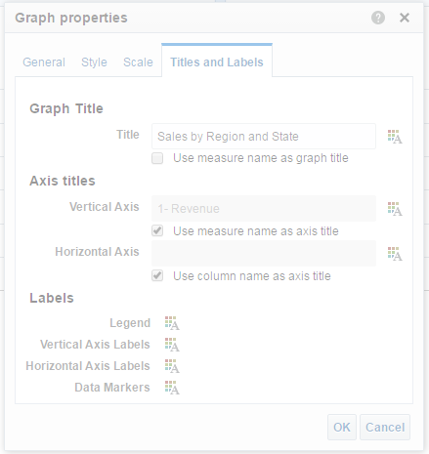


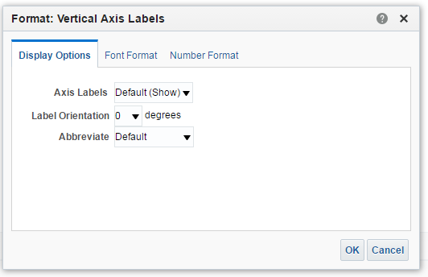

Graph Properties: Titles and Labels
Enables you to customize graph titles, axis titles, and labels
Specify custom graph title and axis titles.
Set font and data formats.
Set axis label options.
Notes:
On the Titles and Labels tab of the Graph properties dialog box, you can customize the graph title, axis titles, and format and customize graph labels. Click the Format buttons for the different labels to specify fonts and styling. In the example in the slide, you can see that the Vertical axis labels include options pertaining to numeric values, including the Number Format tab, which allows you to override default data formats similarly to setting column properties. In addition, in the Display Options tab of the Format: Vertical Axis Labels dialog box, where appropriate for the label being edited, you can set label orientation in degrees and use the Abbreviate drop-down list to select an abbreviation for numeric data labels. In the preceding example, selecting Millions(m) would abbreviate a scale label of 75,000,000 to the shorter
75 m.
Oracle BI 12c: Create Analyses and Dashboards 6 - <number>

Slide 23
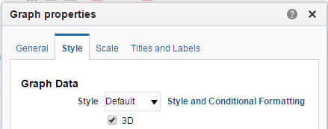
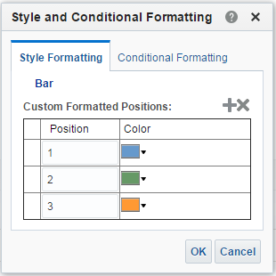


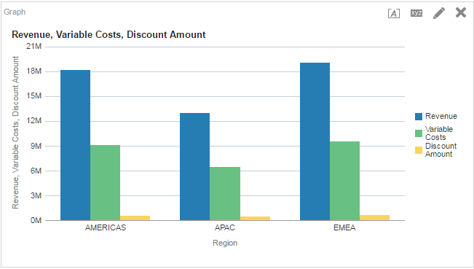



Formatting Graphs by Position
You can format graphs based on position.
1
3
2
4
Results
5
Reflects in legend
Notes:
Using the Style and Conditional Formatting option in the Style tab of the Graph properties dialog box, you can set position and conditional formatting. In the example in the slide, three positions are defined for the graph, each with different bar colors. The available formatting options depend on the type of graph you are working with.
To set position formatting in the Graph Properties dialog box, perform the following steps:
1. Click the Style tab.
2. Click the Style and Conditional Formatting button.
3. In the Style and Conditional Formatting dialog box, click the Style Formatting tab and click the Add New Position button to add each position you want to format.
4. Set the color for each position.
5. Verify your results.
Oracle BI 12c: Create Analyses and Dashboards 6 - <number>

Slide 24
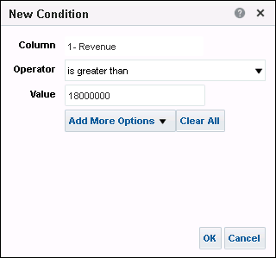
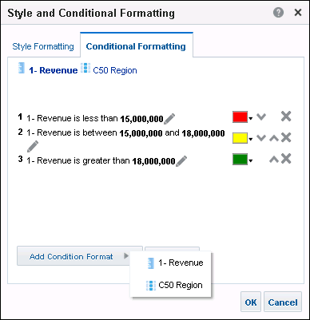
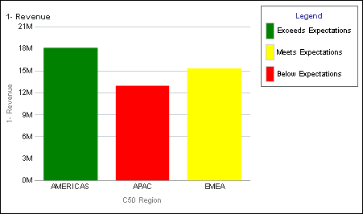

Formatting Graphs Conditionally
You can format graphs based on conditions.
3
1
4
5
2
Legend view added for clarity
Notes:
To set conditional formatting in the Style tab of the Graph Properties dialog box, perform the following steps:
1. Click the Style and Conditional Formatting button.
2. In the Style and Conditional Formatting dialog box, select the Conditional Formatting tab.
3. Click the Add Condition Format button and select an analysis column to base the condition on.
4. In the New Condition dialog box, specify a condition operator and a value. You can click Add More Options to reference a Presentation variable and optionally set a default value.
5. Set a color for each condition you define.
6. Verify your results.
In the example in the slide, the graph is formatted so that if dollars for a region are less than 15 million, that graph segment is red. If dollars for a region are between 15 million and 18 million, the graph segment is yellow. And if the region has more than 18 million dollars, the graph segment is green. A separate Legend view was added so that the viewer would be understand the color coding.
Oracle BI 12c: Create Analyses and Dashboards 6 - <number>

Slide 25
Performing Common Tasks in Views
  Previewing how views appear in dashboards
  Specifying totals
  Managing aggregation
  Combining values into bins
Notes:
Instructor Note
This is a structuring slide. Do not teach the steps or concepts here because the following slides cover them in detail. Instead, provide a high-level description of what is discussed.
Oracle BI 12c: Create Analyses and Dashboards 6 - <number>

Slide 26
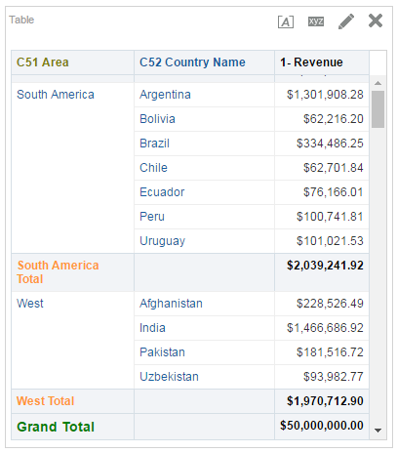



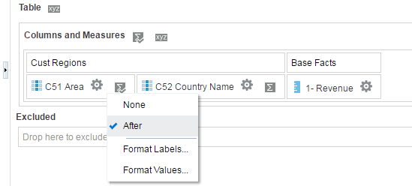



Specifying Totals
Specify grand totals or totals for attribute columns.
Set grand total for entire analysis.
Totals are available only for hierarchy and attribute columns that describe measures.
Formatted values
Set break total for a column.
Format labels and values.
Formatted labels
Notes:
To add grand totals or column totals to a result, use Total buttons in the Layout pane of the Table and Pivot Table editors. Break total values are calculated every time the value in the selected column changes. In the example in the slide, a grand total appears for the analysis, and subtotals are displayed for each region.
Note that the Total button appears only for columns that describe measures, not for measures themselves. For example, there is no Total button for the Dollars measure in the Columns and Measures drop target in the Table editor in the slide.
For a hierarchical column, by default, the total is the top level of the hierarchy. However, remember that the values that are displayed in the view might not add up to the total for the hierarchical column because higher-level members are not affected by any query selections that are made either via direct manipulation or through the use of selection steps.
Oracle BI 12c: Create Analyses and Dashboards 6 - <number>

Slide 27
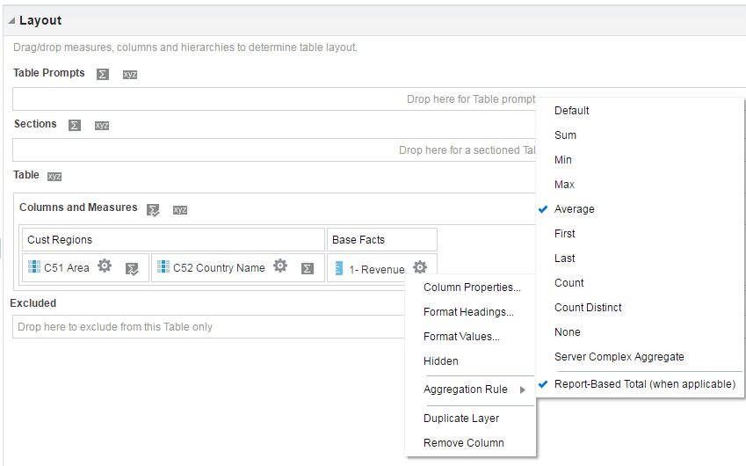



Managing Aggregation
  The default aggregation is Sum (set in repository).
  Set the aggregation type for measures to affect grand totals.
Default aggregation rule is Sum.
Measure
Aggregate after applying analysis filters.
Notes:
The grand total for columns with an Average aggregation rule differs in Table and Pivot Table views.
Table view: The grand total for a column with an Average aggregation rule is calculated from the database (as a sum divided by a count).
Pivot Table view: The grand total is the average of the rows in the result set.
The default aggregation is Sum unless it is reset globally in the repository.
The Report-Based Total option ensures that the BI Server calculates the total based on the report with applied filters and not on the entire result set.
You can have different aggregation set for different columns in an analysis.
Oracle BI 12c: Create Analyses and Dashboards 6 - <number>

Slide 28

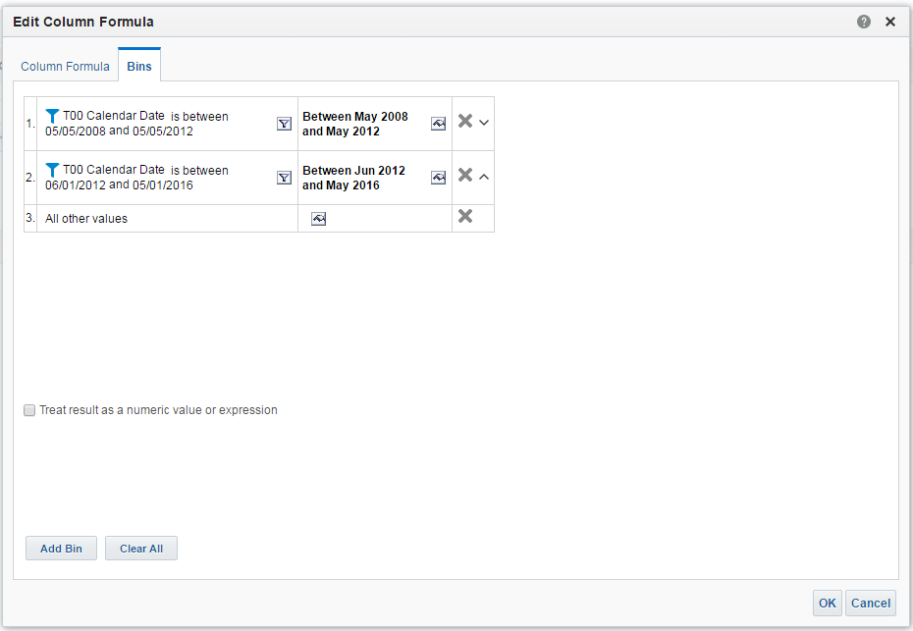

Combining Values into Bins
Use bins to combine multiple values or ranges of values from a given column.
The first bin combines day dollar values between May 2008 and May 2012.
The second bin combines day dollar values between June 2012 and May 2016.
Notes:
On the Bins tab of the Edit Column Formula dialog box, you can combine multiple values or ranges of values from a given column into bins. You can name the bins, and then the bin name replaces all instances of the different values that make up the bin in the result set. Note that aggregations are performed at the bin level in the analysis.
Binning differs from groups in that groups allow the view to display each member that is part of the group.
Oracle BI 12c: Create Analyses and Dashboards 6 - <number>

Slide 29
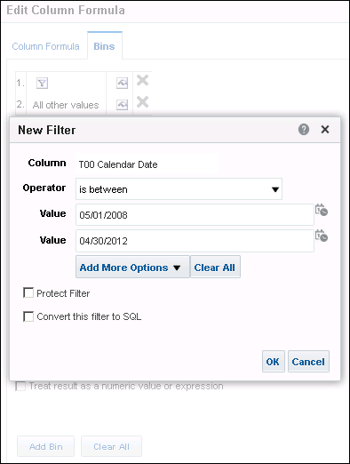
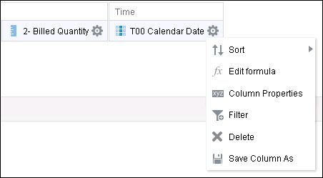

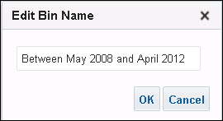

Creating Bins: Add Bins
Use the Bins tab in the Edit Column Formula dialog box.
2
1
4
5
3
Notes:
To add bins, perform the following steps:
1. On the Criteria tab, click the Edit Formula button for a column.
2. In the Edit Column Formula dialog box, click the Bins tab.
3. Click Add Bin.
4. In the New Filter dialog box, create a bin filter and click OK.
In the example, the filter specifies a range between May 1, 2008 and April 30, 2012 for the bin.
5. In the Edit Bin Name dialog box, enter a name for the bin and click OK.
Oracle BI 12c: Create Analyses and Dashboards 6 - <number>

Slide 30

Quiz: Overview
This quiz examines your knowledge of modifying and formatting views.
Notes:
In this quiz, you answer questions regarding modifying and formatting views.
Oracle BI 12c: Create Analyses and Dashboards 6 - <number>

Slide 31
Quiz
A Compound Layout includes, by default, a Title view, a Table view, and a Graph view.
  True
  False
Notes:
Answer: b
A compound layout includes, by default, a Title view, and a Table view or Pivot Table view.
Oracle BI 12c: Create Analyses and Dashboards 6 - <number>

Slide 32
Quiz
Which of the following is not an available Oracle BI view?
  Gauge
  Legend
  Column Selector
  Physical SQL
Notes:
Answer: d
Oracle BI 12c: Create Analyses and Dashboards 6 - <number>

Slide 33
Quiz
If an analysis contains a hierarchical column, the default is to display a Title view and a Table view.
  True
  False
Notes:
Answer: b
If an analysis contains a hierarchical column, the default is to display a Title view and a Pivot Table view.
Oracle BI 12c: Create Analyses and Dashboards 6 - <number>

Slide 34
Quiz
Which of the following is not an available graph type?
  Scatter
  Piccolo
  Area
  Radar
Notes:
Answer: b
Oracle BI 12c: Create Analyses and Dashboards 6 - <number>

Slide 35
Quiz
The default aggregation for a column is Average and it cannot be changed unless it is reset globally in the repository.
  True
  False
Notes:
Answer: b
The default aggregation rule is typically Sum. The default aggregation rule must be reset in the repository. However, you can manually set different aggregation rules for different columns in an analysis.
Oracle BI 12c: Create Analyses and Dashboards 6 - <number>

Slide 36
Quiz
Totals are available for hierarchy and attribute columns that describe measures or dimensions.
  True
  False
Notes:
Answer: b
Totals are available only for hierarchy and attribute columns that describe measures.
Oracle BI 12c: Create Analyses and Dashboards 6 - <number>

Slide 37
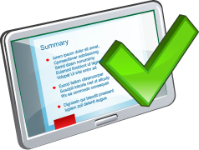
Summary
In this lesson, you should have learned how to:
  Add additional views of the data that is returned
  by an analysis
  Modify and format views
  Work with Compound Layouts
  Perform common tasks in views
Notes:
Oracle BI 12c: Create Analyses and Dashboards 6 - <number>

Slide 38

Practice 6: Overview
This practice covers the following topics:
  Modifying and formatting views
  Using the Table view
Notes:
Oracle BI 12c: Create Analyses and Dashboards 6 - <number>

