Slide 1
Working with Additional Views in Analyses
Notes:
Schedule: Timing Topic
60 minutes Lecture
90 minutes Practice
05 minutes Quiz
115 minutes Total

Slide 2
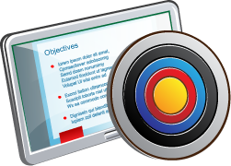
Objectives
After completing this lesson, you should be able to:
  Build a Trellis view
  Build a Performance Tile view
  Build a Treemap View
  Build a Heat Matrix View
  Use Master–Detail linking in views
Notes:
Oracle BI 12c: Create Analyses and Dashboards 8 - <number>

Slide 3
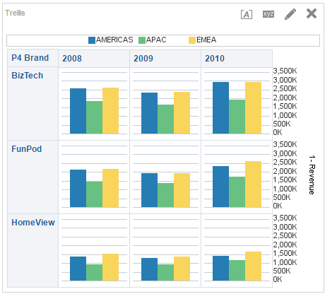
Trellis View
A view type that presents multidimensional data laid out in a set of cells in a grid, with each cell displaying a subset of data shown as numbers or as graphs
Support Action Links for Trellis view including legend and axis labels.
Notes:
A Trellis view allows users to display multiple views all together for quick comparison, and to display data that reveals trends.
A Trellis view is especially useful for comparing like to like, monitoring trends, and spotting patterns in a data set. A Trellis displays a core inner graph multiplied across row sets and column sets, rendering many small multiples that are ideal for comparing and contrasting.
There are two Trellis view types:
A Simple Trellis view displays inner visualizations that are all the same type, such as all scatter graphs. The inner visualizations all use a common axis, also known as a synchronized scale.
An Advanced Trellis view displays multiple visualization types within its grid, for example, spark lines, spark bars, and numbers. Each visualization type displays a different measure. All visualizations of the same type within an advanced Trellis are synchronized; that is, they are synchronized per measure. This facilitates comparison across all visualizations showing the same metric. The visualizations contained in an advanced Trellis are microcharts.
OBIEE 12.2.1 now supports action links for legend, axis labels, and data in both Simple and Advanced Trellis views to provide contextual functionality to users within visualizations.
Oracle BI 12c: Create Analyses and Dashboards 8 - <number>

Slide 4
Creating a Simple Trellis View
  Select columns on the Criteria tab.
  Click the Results tab and add a Simple Trellis view.
  Open the Trellis Editor.
  Rearrange the elements as necessary.
Notes:
Oracle BI 12c: Create Analyses and Dashboards 8 - <number>

Slide 5
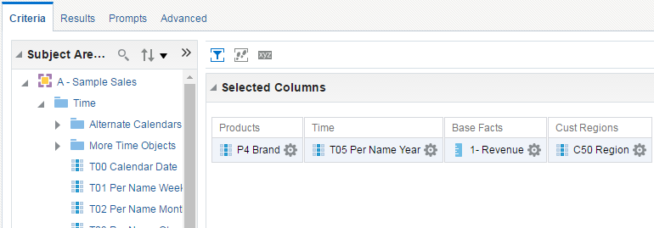
1. Select Columns on the Criteria Tab
Create an analysis by using columns from a subject area.
Notes:
Oracle BI 12c: Create Analyses and Dashboards 8 - <number>

Slide 6
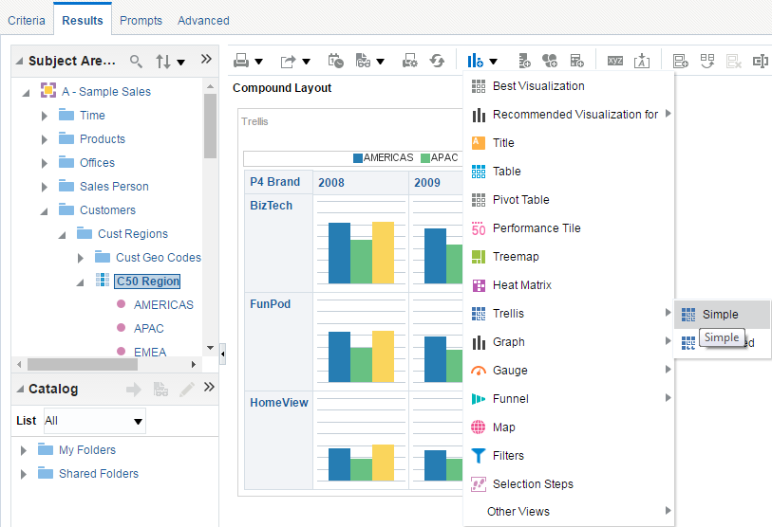
2. Click the Results Tab and Add a Simple Trellis View
The Simple Trellis view is accessed from New View > Trellis > Simple.
Notes:
Oracle BI 12c: Create Analyses and Dashboards 8 - <number>

Slide 7
3. Open the Trellis Editor
Click the Edit View button.
Notes:
Oracle BI 12c: Create Analyses and Dashboards 8 - <number>

Slide 8
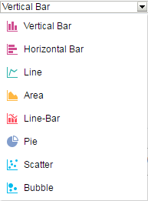
4. Rearrange Elements as Necessary
The columns included in the analysis appear as elements in the Trellis view template.
Notes:
Oracle BI 12c: Create Analyses and Dashboards 8 - <number>

Slide 9
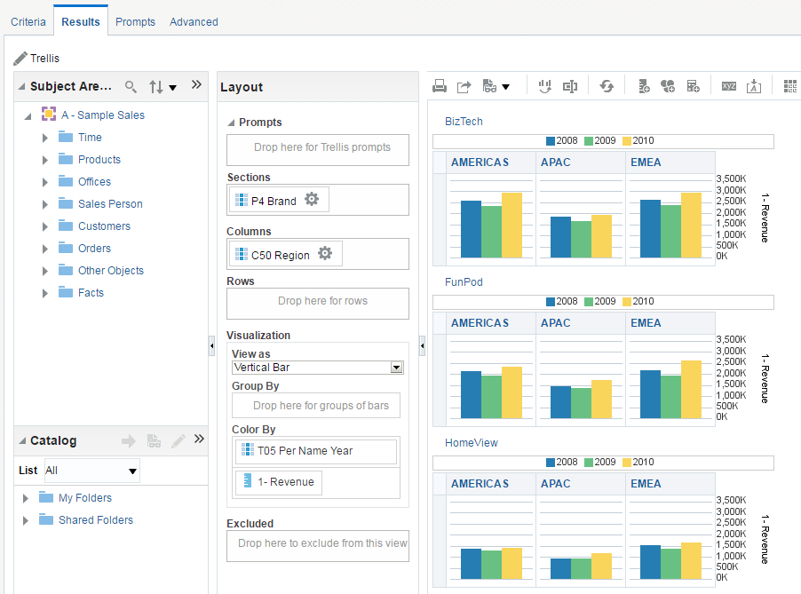

4. Rearrange Elements as Necessary
Notes:
Prompts: Provides an interactive result set
Sections: Displays information in vertical groupings
Columns: Shows elements in column orientation
Rows: Shows elements in row orientation
Visualization: Enables you to select any visual graphic from the “View as” drop-down list, as displayed above, that is, Vertical, Horizontal, Line, Area, Pie, Scatter, Bubble, and so on. You can “Group By” and “Color By” one or more columns.
Excluded: Excludes elements from results for this analysis (To exclude a column in the analysis, drag it to the Excluded section of the template.)
When you have completed arranging the elements within the Trellis, click Done.
Oracle BI 12c: Create Analyses and Dashboards 8 - <number>

Slide 10
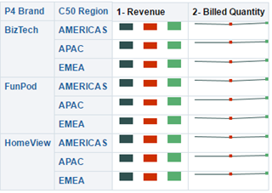
Advanced Trellis View
The Advanced Trellis view displays multiple visualization types within its grid: spark lines, spark bars, spark areas, and numbers.
Notes:
An Advanced Trellis view displays multiple visualization types within its grid, for example, spark lines, spark bars, spark areas, and numbers. Each visualization type displays a different measure. Thus, it is suitable for displaying multiple measures in the same grid. All visualizations of the same type within an advanced Trellis are synchronized; that is, they are synchronized per measure. This facilitates comparison across all visualizations showing the same metric. The visualizations contained in an advanced Trellis are microcharts.
A microchart is a tiny graph displayed in a grid along with other tiny graphs and numbers, comprising the data cell contents of a Trellis view. A microchart can be of the graph subtype Spark Line, Spark Bar, or Spark Area. Used exclusively in the Trellis view, this graph type allows users to easily see how like compares to like, and to discover trends.
For the most part, a Trellis view behaves like a pivot table, and the main difference between a Trellis and a pivot table is the way the data cells appear.
Oracle BI 12c: Create Analyses and Dashboards 8 - <number>

Slide 11
Creating an Advanced Trellis View
  Select columns on the Criteria tab.
  Click the Results tab and add an Advanced Trellis view.
  Open the Trellis Editor.
  Rearrange the elements as necessary.
Notes:
Oracle BI 12c: Create Analyses and Dashboards 8 - <number>

Slide 12
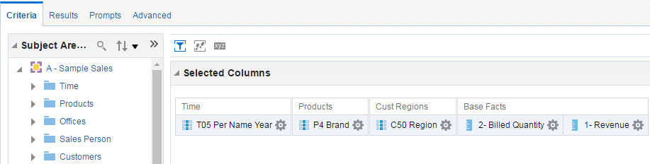
1. Select Columns on the Criteria Tab
Create an analysis by using columns from a subject area.
Notes:
Oracle BI 12c: Create Analyses and Dashboards 8 - <number>

Slide 13
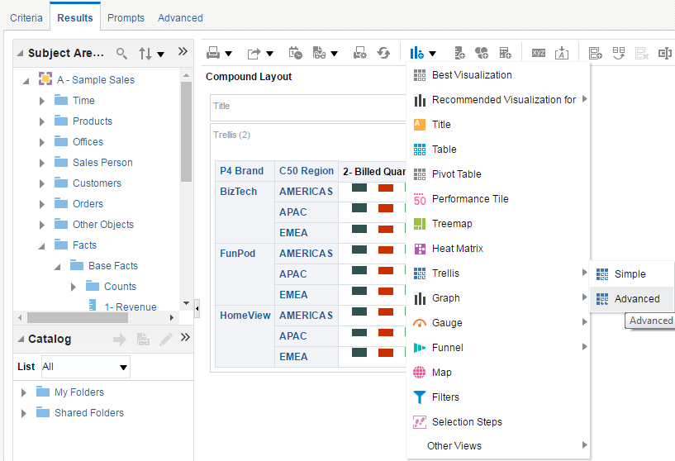
2. Click the Results Tab and Add an
Advanced Trellis View
The Advanced Trellis view is accessed from New View > Trellis > Advanced.
Notes:
Oracle BI 12c: Create Analyses and Dashboards 8 - <number>

Slide 14
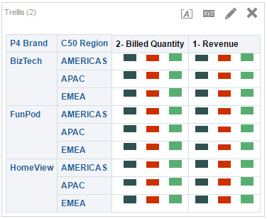
3. Open the Trellis Editor
Click the Edit View button.
Notes:
Oracle BI 12c: Create Analyses and Dashboards 8 - <number>

Slide 15
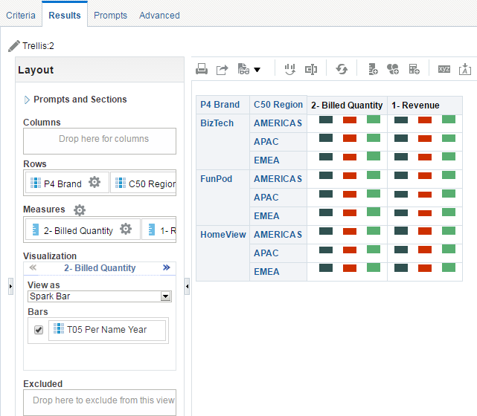

4. Rearrange Elements as Necessary
The columns included in the analysis appear as elements in the Trellis view template.
Notes:
Oracle BI 12c: Create Analyses and Dashboards 8 - <number>

Slide 16
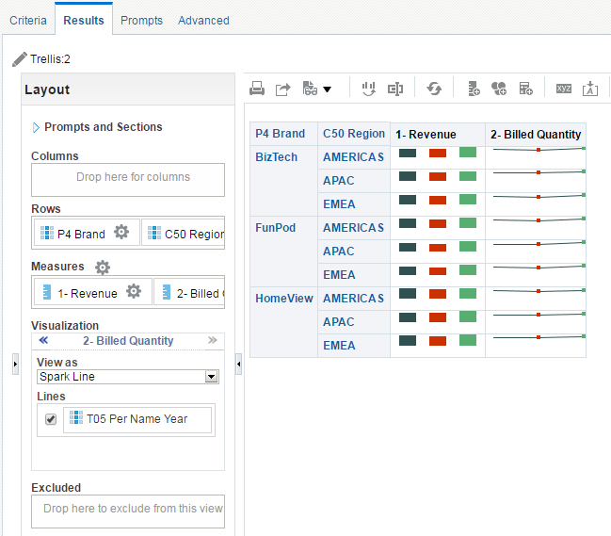
4. Rearrange Elements as Necessary
Notes:
In addition to dragging the element to the desired location, you can click the double arrow icon in the Visualization section to traverse through various measures. Select the corresponding ‘View as’ type from the drop-down list. You can also drag the element to the desired location (drop target) when viewing the analysis in the Compound Layout.
Oracle BI 12c: Create Analyses and Dashboards 8 - <number>

Slide 17
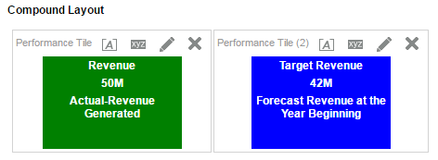
Performance Tile View
The purpose of a performance tile is to draw your attention to a single piece of high-level aggregate data in a simple and prominent manner.
Notes:
In the example in the slide, the performance tile gives a clear snapshot of whether the actual revenue is more than the forecast revenue or not.
Oracle BI 12c: Create Analyses and Dashboards 8 - <number>

Slide 18
Creating a Performance Tile
  Select columns on the Criteria tab.
  Click the Results tab and add a performance tile.
  Open the Performance Tile Editor.
  Make the formatting changes.
Notes:
Oracle BI 12c: Create Analyses and Dashboards 8 - <number>

Slide 19
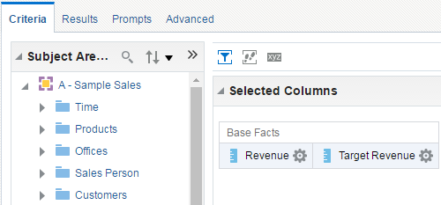
1. Select Columns on the Criteria Tab
Create an analysis by using columns from a subject area.
Notes:
A Performance Tile view can be used only for measure columns.
Oracle BI 12c: Create Analyses and Dashboards 8 - <number>

Slide 20
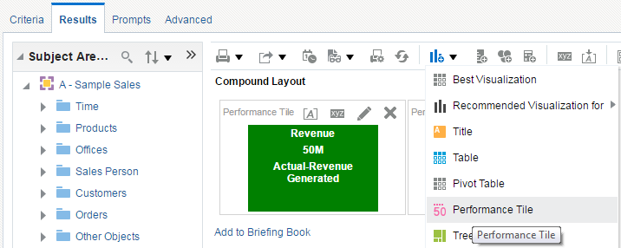
2. Click the Results Tab and Add a Performance Tile
The Performance Tile view is accessed from the New View
drop-down list.
Notes:
Oracle BI 12c: Create Analyses and Dashboards 8 - <number>

Slide 21
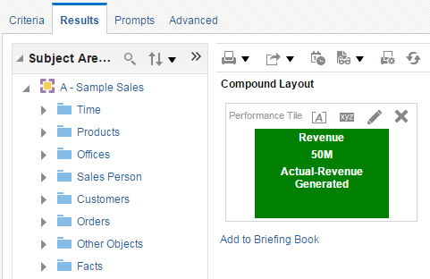
3. Open the Performance Tile Editor
Click the Edit View button.
Notes:
Oracle BI 12c: Create Analyses and Dashboards 8 - <number>

Slide 22
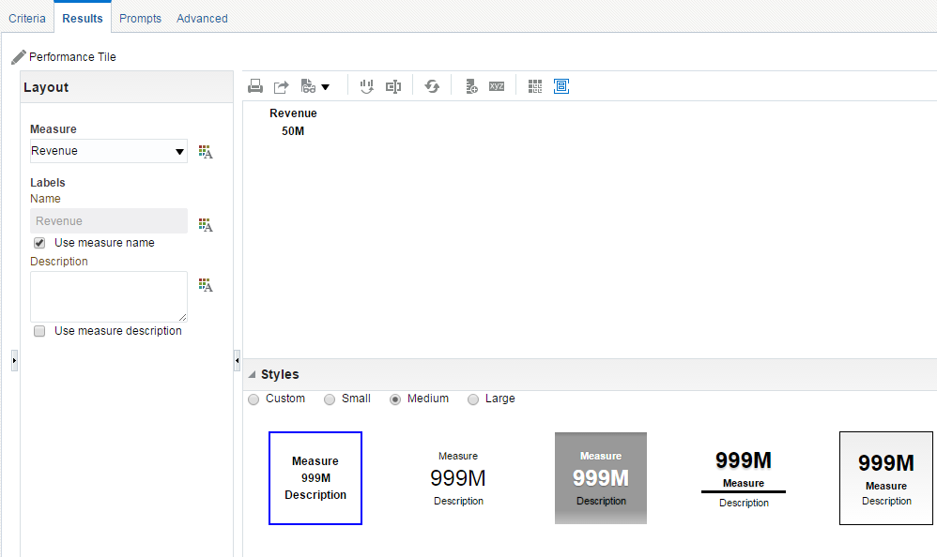



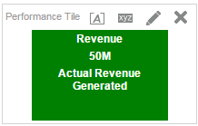

4. Make the Formatting Changes
5
1
2
3
4
Notes:
Modify the background color of the performance tile.
You can modify the name of the measure.
Add the brief description to explain what performance tile is meant for.
You can make a performance tile look smaller or bigger than the default style.
When you have completed the formatting changes, click Done.
Oracle BI 12c: Create Analyses and Dashboards 8 - <number>

Slide 23
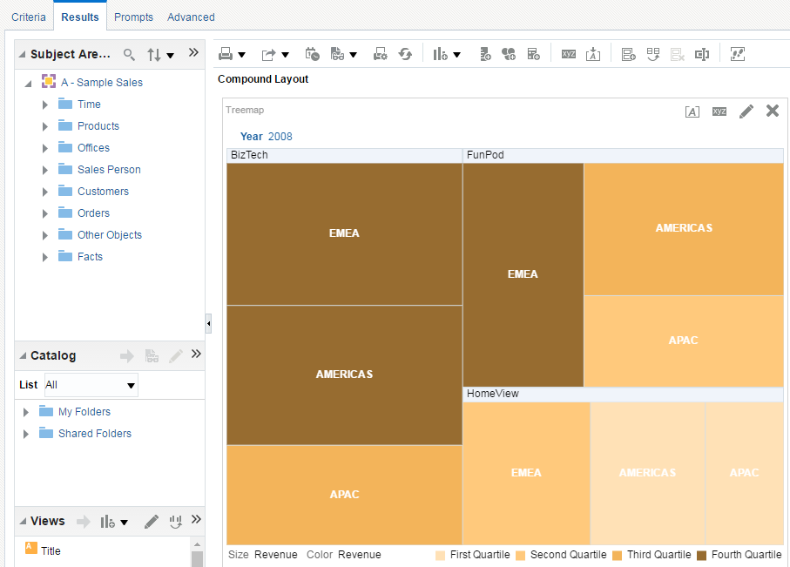
Treemap View
A view type that presents a space-constrained, two-dimensional visualization for hierarchical structures with multiple levels
Notes:
Limited by a predefined area and displays two levels of data
Contains rectangular tiles. The size of the tile is based on a measure, and the color of the tile is based on a second measure.
Similar to a scatter plot graphs in that the map area is constrained, and the graph allows you to visualize large quantities of data and quickly identify trends and anomalies within that data.
Oracle BI 12c: Create Analyses and Dashboards 8 - <number>

Slide 24
Creating a Treemap
  Select columns on the Criteria tab.
  Click the Results tab and add a Treemap.
  Open the Treemap Editor.
  Make the formatting changes.
Notes:
Oracle BI 12c: Create Analyses and Dashboards 8 - <number>

Slide 25
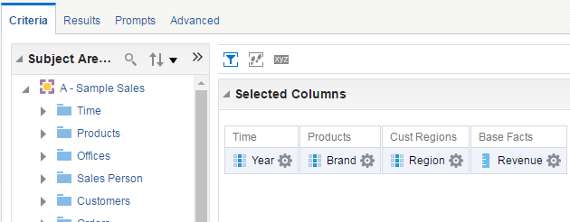
1. Select Columns on the Criteria Tab
Create an analysis by using columns from a subject area.
Notes:
Oracle BI 12c: Create Analyses and Dashboards 8 - <number>

Slide 26
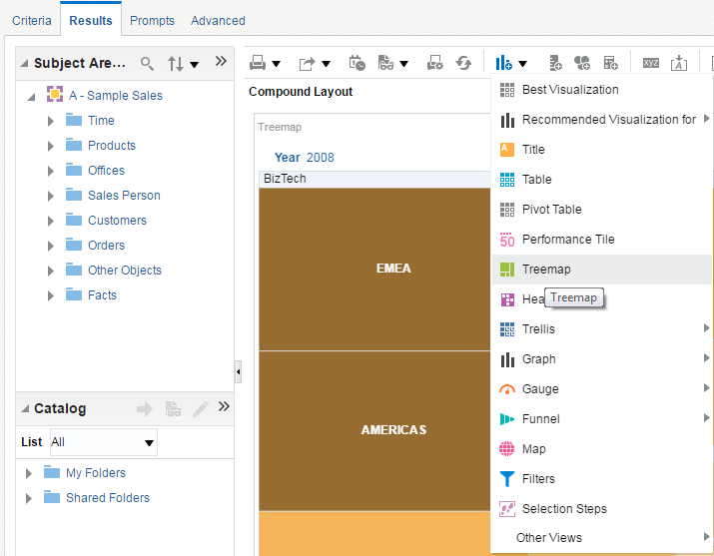
2. Click the Results Tab and Add a Treemap
The Treemap view is accessed from the New View drop-down list.
Notes:
Oracle BI 12c: Create Analyses and Dashboards 8 - <number>

Slide 27
3. Open the Treemap Editor
Click the Edit View button.
Notes:
Colored tiles are formed by the grouping and intersection of the columns placed in the Prompts, Sections, Group By, Size By, and Color By drop targets
Levels of data are displayed within a predefined, rectangular-shaped, confined space for two measures.
Attribute and hierarchical columns are supported. Skip-level hierarchies are not supported in the Group By area of treemap.
Tiles are displayed as percentile bins or as a continuous color.
A legend (that can be hidden) displays below the treemap and contains:
Two measures (those selected in the Size By and Color By lists) and their corresponding labels.
Number of specified bins (for example, quartile), color coded and labeled, or a gradient bar that is displayed as a continuous color fill and is labeled "low" to "high.“
Oracle BI 12c: Create Analyses and Dashboards 8 - <number>

Slide 28
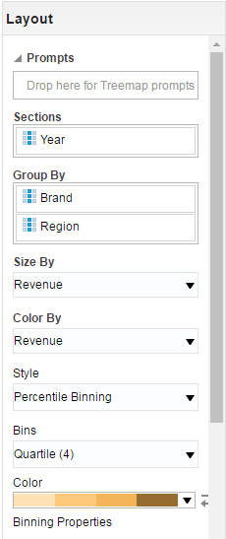
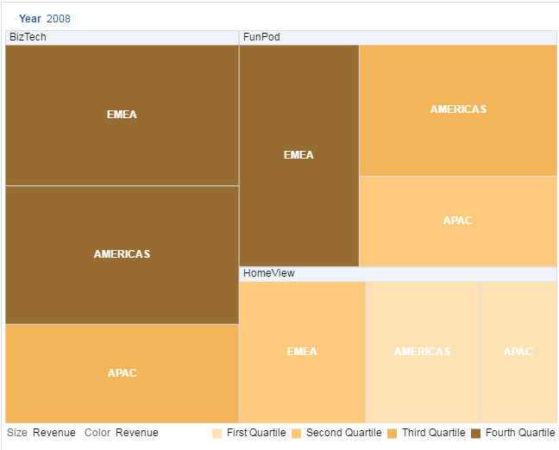
4. Rearrange Elements as Necessary
The columns included in the analysis appear as elements in the treemap view template.
Notes:
Oracle BI 12c: Create Analyses and Dashboards 8 - <number>

Slide 29
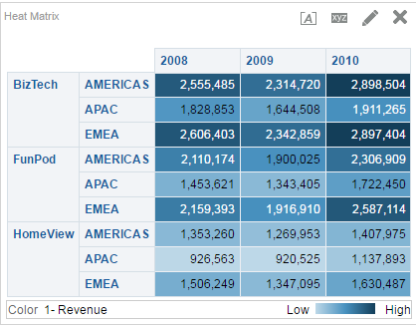
Heat Matrix View
A view type that presents a two-dimensional depiction of data in which values are represented by a gradient of colors that are well suited for analyzing large amounts of data and identifying outliers
Notes:
Displays a two-dimensional depiction of data in which values are represented by a gradient of colors that are well suited for analyzing large amounts of data and identifying outliers
Heat matrixes structure data similarly to pivot tables in that they are formed by the grouping and intersection of rows and columns.
Oracle BI 12c: Create Analyses and Dashboards 8 - <number>

Slide 30
Creating a Heat Matrix
  Select columns on the Criteria tab.
  Click the Results tab and add a Heat Matrix.
  Open the Heat Matrix Editor.
  Make the formatting changes.
Notes:
Oracle BI 12c: Create Analyses and Dashboards 8 - <number>

Slide 31
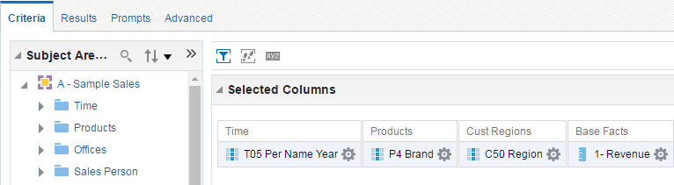
1. Select Columns on the Criteria Tab
Create an analysis by using columns from a subject area.
Notes:
Oracle BI 12c: Create Analyses and Dashboards 8 - <number>

Slide 32
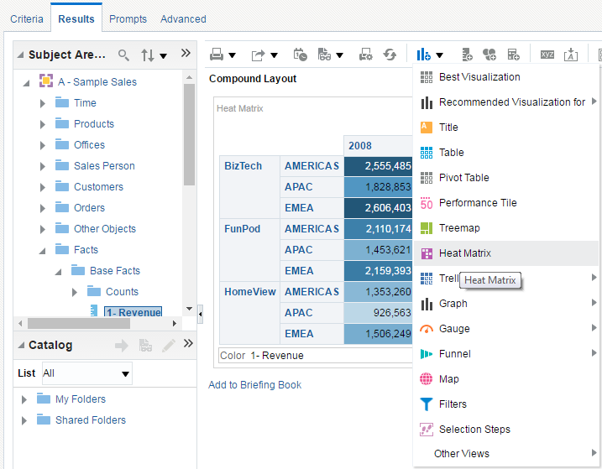
2. Click the Results Tab and Add a Heat Matrix
The Heat Matrix view is accessed from the New View drop-down list.
Notes:
Oracle BI 12c: Create Analyses and Dashboards 8 - <number>

Slide 33
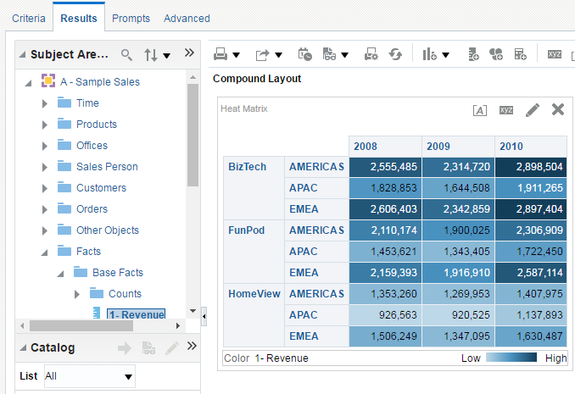
3. Open the Heat Matrix Editor
Click the Edit View button.
Notes:
Oracle BI 12c: Create Analyses and Dashboards 8 - <number>

Slide 34
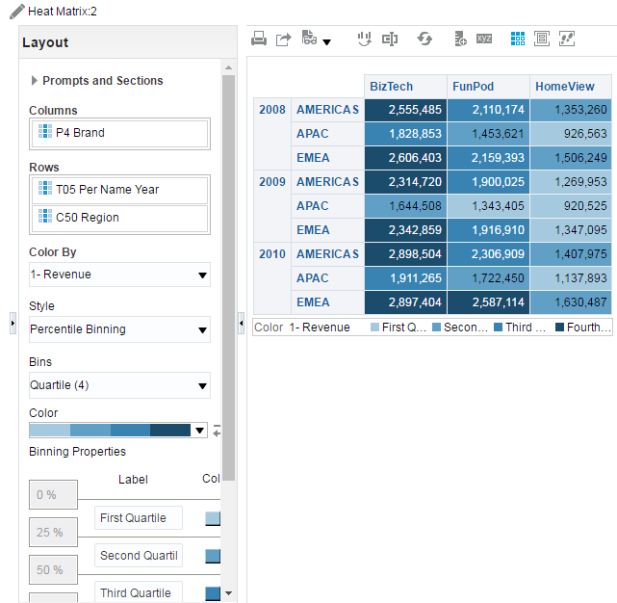

4. Rearrange Elements as Necessary
The columns included in the analysis appear as elements in the heat matrix view template.
Notes:
Colored cells are formed by the grouping and intersection of the columns and rows placed in the Prompts, Sections, Rows, Columns, and Color By drop targets.
Only one measure is visualized.
Attribute and hierarchical columns are supported.
Cells display as percentile bins or as a continuous color.
Cells display uniformly, in that each cell has the same width, and each cell has the same height. Cell height and cell width do not have to be the same.
A legend (that can be hidden) is displayed below the heat matrix and contains:
One measure (selected in the Color By list) and its corresponding label
Number of specified bins (for example, quartile), color-coded and labeled, or a gradient bar that is displayed as a continuous color fill and is labeled "low" to "high"
Oracle BI 12c: Create Analyses and Dashboards 8 - <number>

Slide 35
Linking Master–Detail Views
Allows you to specify a master–detail relationship between two or more views
  Changes in the master view drive changes in the detail views.
    Driven by the master column
    Example: Selection of a region in a master view changes the region selected in its detail views.
  Changes in detail views are initiated by master–detail events.
    Transmitted on Master–Detail channel
Notes:
When a master view and a detail view are linked and a user clicks a cell or item in the master column, a master–detail event is generated on the designated channel, and the master–detail event information is passed to the detail view. The detail view, which is listening on the designated channel for master–detail events, receives the event and the master–detail event information. It reviews the master–detail event information to determine which column in this information matches the detail column. When it finds a match, it takes the column values in the master–detail event information, updates the detail column, and then refreshes the entire detail view.
Oracle BI 12c: Create Analyses and Dashboards 8 - <number>

Slide 36
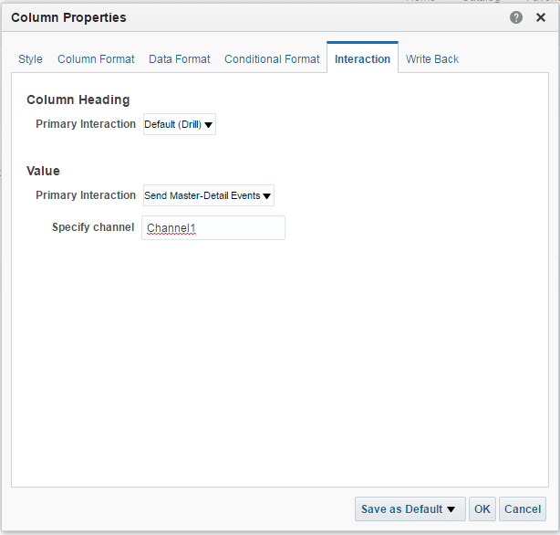
Defining the Master View
Specify the channel name in the column properties of the column that will act as the master column.
1
2
3
4
Notes:
To define a master view, open the Column Properties dialog box as usual by clicking its More Options button in the Selected Columns pane of the Criteria tab and selecting Column Properties. Then perform the following steps:
In the Column Properties dialog box for the column that is to be the master column, click the Interaction tab.
The Value section allows you to specify the interaction that occurs when a user clicks the column value. Select Send Master-Detail Events.
In the Specify channel field, enter a name for the channel on which the master view will send master–detail events. You can use any name you want. Channels are case-sensitive when you reference them in the detail.
Click OK.
Add the view that you want to use as a master view to the Compound Layout on the Results tab. Any view that includes the master column can be used as a master view.
Oracle BI 12c: Create Analyses and Dashboards 8 - <number>

Slide 37
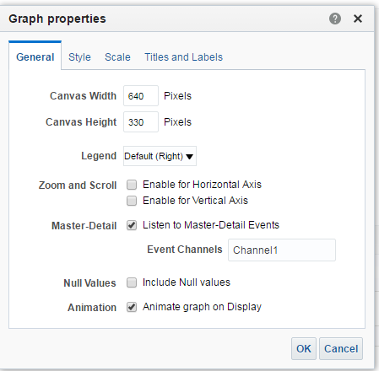



Defining the Detail View
Specify the channel name in the view properties of the view that will listen to master–detail events. In this case, it is a graph view.
1
2
3
4
Notes:
To define a detail view, open the view’s Properties dialog box by using the Edit Properties button in the view’s editor toolbar, and then perform the following steps:
Click the General tab of the Properties dialog box for the view.
Select the Listen to Master–Detail Events option.
In the Event Channels field, enter the name of the channel on which the detail view is to listen for master–detail events. The name must match the name of the channel on which the master view will be sending master–detail events, and is case-sensitive.
Click OK.
Oracle BI 12c: Create Analyses and Dashboards 8 - <number>

Slide 38
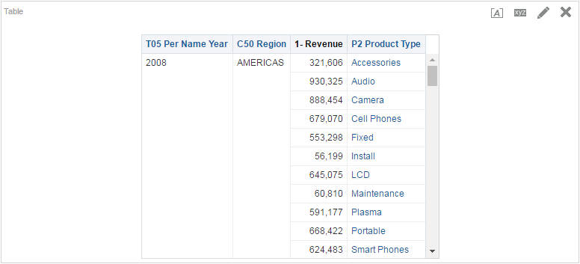
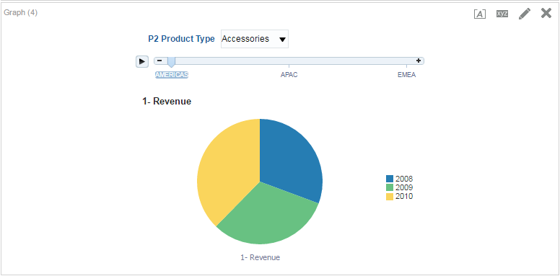
Master–Detail Linking of Views
Notes:
Here, Year is the master column and Graph view is listening to the master column.
Click the “Product Type” heading in the table view to drill down.
Both Table and Graph views are updated to reflect the drill.
Oracle BI 12c: Create Analyses and Dashboards 8 - <number>

Slide 39

Quiz: Overview
This quiz examines your knowledge of working with views in analyses.
Notes:
In this quiz, you answer questions regarding working with views in analyses.
Oracle BI 12c: Create Analyses and Dashboards 8 - <number>

Slide 40
Quiz
Which view would you use for displaying a single piece of
high-level aggregate data in a prominent manner?
  Trellis
  Ticker
  Performance Tile
  Treemap
Notes:
Answer: c
Oracle BI 12c: Create Analyses and Dashboards 8 - <number>

Slide 41
Quiz
Which one of the following statements does not describe
master–detail relationships?
  Changes in the master view drive changes in the detail view.
  Changes in master–detail views are driven by a master column.
  Changes in detail views are initiated by specialized views.
  Changes in master–detail views are transmitted on a
  Master–Detail channel.
Notes:
Answer: c
Oracle BI 12c: Create Analyses and Dashboards 8 - <number>

Slide 42
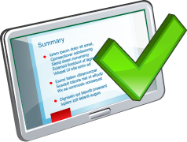
Summary
In this lesson, you should have learned how to:
  Build a Trellis view
  Build a Performance Tile view
  Build a Treemap View
  Build a Heat Matrix View
  Use Master–Detail linking in views
Notes:
Oracle BI 12c: Create Analyses and Dashboards 8 - <number>

Slide 43

Practice 8: Overview
This practice covers the following topics:
  Using the Trellis view
  Creating Performance Tiles
  Using Treemap
  Using Heat Matrix
  Using master–detail linking in views
Notes:
Oracle BI 12c: Create Analyses and Dashboards 8 - <number>

