Slide 1
Creating Oracle Business
Intelligence Dashboards
Notes:
Schedule: Timing Topic
75 minutes Lecture
30 minutes Practice
05 minutes Quiz
110 minutes Total

Slide 2
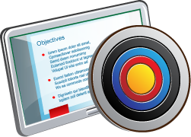
Objectives
After completing this lesson, you should be able to:
  Distinguish between different types of dashboard objects
  Build a dashboard
Notes:
Oracle BI 12c: Create Analyses and Dashboards 10 - <number>

Slide 3
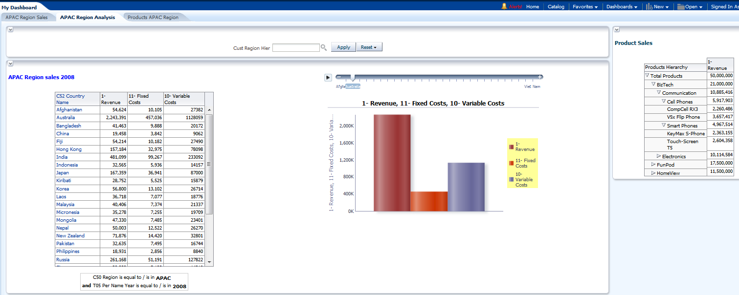




Dashboards
Oracle Business Intelligence Dashboards display the results of analyses to users.
Prompt
Dashboard page
Dashboard column
Business Intelligence analysis with Title and Pivot Table views
Notes:
Oracle Business Intelligence Dashboards provide personalized views of corporate and external information. Dashboards can display anything that you can access or open with a web browser, including analyses, alerts, and so on. Based on your permissions, you can view preconfigured dashboards or create your own. Users with administrative privileges can create shared dashboards for groups of users with common responsibilities or job functions.
Personalized views can be created based on a user’s permission. You can view your personalized views by selecting My Dashboard from the Dashboards drop-down list. You can also set My Dashboard as your default dashboard (subsequently discussed in this lesson).
Preconfigured views appear in the Dashboards drop-down list. They can be created by administrators and shared with groups of users with common responsibilities or job functions.
If you have recently accessed a dashboard, it will appear as an item in the Recent grouping on the Home page. To open the dashboard, click the Open link found below the dashboard name.
Note: My Dashboard is a dashboard that you create and save as your default personal starting page.
Oracle BI 12c: Create Analyses and Dashboards 10 - <number>

Slide 4

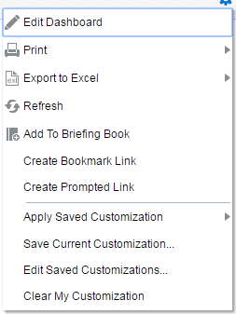
Dashboard Pages
Dashboard pages:
  Are identified by tabs across the top of the dashboard
  Provide the Page Options toolbar to print, refresh, edit, and so on
Page Options
Dashboard pages
Notes:
When you open a dashboard, the content appears in one or more dashboard pages, each represented by a tab in the dashboard. Pages contain the columns and sections that hold the content of a dashboard and every dashboard has at least one page.
Multiple pages are used to organize content. For example, you might have one page to store analysis results that you refer to every day, another that contains links to the websites of your suppliers, and one that links to your corporate intranet.
Note: To create or edit a dashboard, you need to have the Manage Dashboard Privilege.
On the top-right of the dashboard page, the Page Options toolbar drop-down list allows you to do the following:
Edit the dashboard, if you have the appropriate permission, using Dashboard Builder.
Display various options for working with a dashboard page, such as printing the current page (HTML or PDF) or adding the content to your Briefing Book.
Work with customizations.
Oracle BI 12c: Create Analyses and Dashboards 10 - <number>

Slide 5
Notes:
Oracle BI 12c: Create Analyses and Dashboards 10 - <number>
Specifically, the Page Options toolbar menu contains the following options:
Edit Dashboard: Use this option to open an existing dashboard to make modifications.
Print: Use this option to print the current dashboard page as either PDF or HTML.
Refresh: Use this option to refresh the results of analyses included in the dashboard page.
Export to Excel: Use this option to export the entire dashboard or dashboard page into excel.
Add to Briefing Book: Use this option to add the contents of a dashboard page to a Briefing Book.
Create Bookmark Link: Use this option to create a bookmark link to the page (a bookmark link captures the path to a dashboard page and all aspects of the page state).
Create Prompted Link: Use this option to create a prompted link to the page (a prompted link captures the path to a dashboard page and a simplified presentation of the dashboard prompts).
Apply Saved Customization: Use this option to apply a saved customization—either a personal, saved customization or a shared saved customization. Saved customizations allow users to view dashboard pages with their most frequently used or favorite choices for filters and prompts preselected, without the need to make choices manually for prompts and filters that appear on the dashboard. Users can save multiple customizations with different combinations of prompt and filter choices, and switch between them.
Save Current Customization: Use this option to save your current customization for yourself or others. You can also set permissions for this customization.
Edit Saved Customizations: Use this option to modify your customizations.
Clear My Customization: Use this option to clear all customized formats, and so forth, and return the dashboard page to its default state.
Prompted links must be enabled by your administrator. Refer to Oracle Fusion Middleware System Administrator's Guide for Oracle Business Intelligence Enterprise Edition 12c Release for additional information.

Slide 6
Creating and Editing a Dashboard
  Create a new dashboard using the Global Header or the Create pane of the Home page.
    Opens in the Dashboard Builder
  Open existing dashboards in the Dashboard Builder to design pages in the following ways:
    Click the Edit link on an empty dashboard page.
    Click the Page Options button for a dashboard page and select Edit Dashboard.
    Open from the catalog using the Catalog link on the Global Header.
Notes:
Oracle BI 12c: Create Analyses and Dashboards 10 - <number>

Slide 7
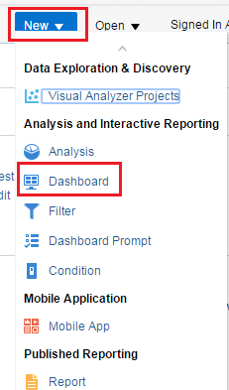
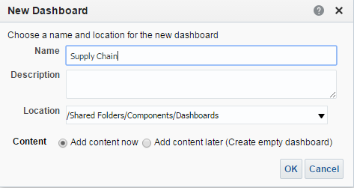
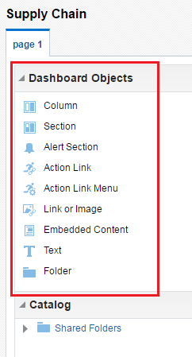


Creating a New Dashboard from Global Header
Users with appropriate permissions and privileges can create a new dashboard.
2
1
3
Notes:
To build a new dashboard, perform the following steps:
1. In the Global Header, click New and select Dashboard.
2. In the New Dashboard dialog box, perform the following steps:
Enter a new dashboard name.
Optionally, enter a description.
Select the location where you will store the dashboard definition, and choose whether you will add content now or later.
Click OK.
3. If you select "Add content now," the Dashboard Builder appears with one blank page available. Drag the content from the Dashboard Objects or Catalog panes to the Page Layout pane on the right.
Note: If you select "Add content later," you must use the Catalog to add dashboard objects.
Oracle BI 12c: Create Analyses and Dashboards 10 - <number>

Slide 8

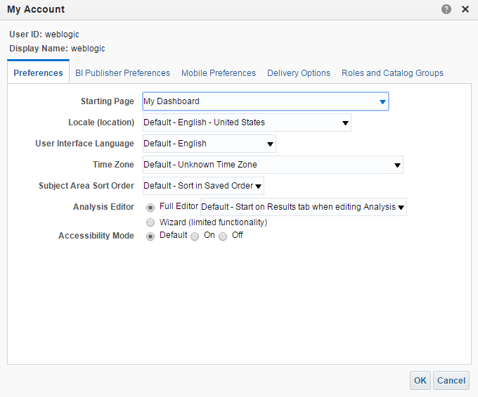
Global Header: Setting Preferences for Your Default Dashboard View
Select My Account.
Select default starting page.
Notes:
You can set a default dashboard that appears when you first start your session.
1. Click <Your User ID> on the Global Header and then select My Account. The My Account dialog box appears. You use the Preferences tab in the My Account dialog box to specify your personal preferences, such as dashboard starting page, locale, and time zone. The options that are displayed in this dialog box depend upon your privileges.
2. You can make your selection from the Starting Page drop-down list. Some of the default pages include Home Page, My Dashboard, or a specific dashboard for which you have privileges.
Other tabs in the My Account dialog box include the following:
BI Publisher Preferences: Use this tab to view the default profile for BI Publisher.
Delivery Options: Use this tab to configure your delivery profiles for the delivery of alerts by agents, and so on.
Roles and Catalog Groups: Use this tab to view a list of the groups to which you have been assigned by the Oracle BI Administrator.
Oracle BI 12c: Create Analyses and Dashboards 10 - <number>

Slide 9
Notes:
If you have chosen My Dashboard as your default, then you use dashboard template pages to populate your personal dashboards (My Dashboard) when you first log in as a new user. This allows you to see one or more dashboard pages with content, rather than an empty dashboard when you first log in. It also gives you a starting point to build your own dashboard pages. These template pages are saved in subfolders of /Shared Folders and have a default name of default.
Oracle BI EE searches for dashboard template pages in all dashboards that are named default, copies all dashboard template pages for which you have permission to your My Dashboard folder, and displays them in your My Dashboard dashboard.
Note: You must have appropriate permissions to create dashboard template pages.
If your company has designated a name other than default for the name of dashboards that contain dashboard template pages, then Oracle BI EE searches for dashboard template pages in dashboards with that name (for example, Templates) rather than default in subfolders of /Shared Folders. To designate a name other than default for the name of dashboards that contain dashboard template pages, your administrator must set the DefaultName element in the instanceconfig.xml file.
Oracle BI 12c: Create Analyses and Dashboards 10 - <number>

Slide 10


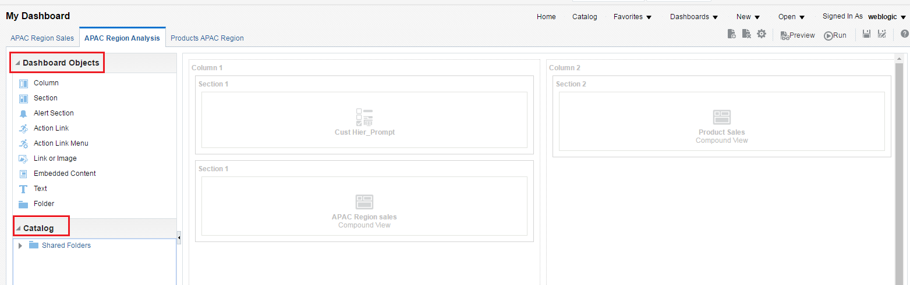






Using Dashboard Builder
Preview or run dashboard.
Add or delete a page.
Tools
Dashboard Objects pane
Save dashboard.
Drag objects to the Page Layout pane.
Page Layout pane
Catalog pane
Notes:
The Dashboard Builder enables you to add dashboard pages to a dashboard, and add objects to and control the layout of dashboard pages. The objects that you can add to a dashboard page include:
Dashboard objects: Items that are used only in a dashboard. Examples of dashboard objects are sections to hold content, action links, and embedded content that appears in a frame on a dashboard.
Catalog objects: Items that you or someone else has saved to the Oracle BI Presentation Catalog, for example, analyses, prompts, and so on. In a dashboard, the results of an analysis can be shown in various views, such as a table, graph, or gauge. Users can examine and analyze results, save or print them, or download them to a spreadsheet.
If the dashboard contains at least one dashboard page, Dashboard Builder will also contain a toolbar from which you can add content to a dashboard page, set dashboard page properties, and so on. The Tools toolbar is discussed next.
Oracle BI 12c: Create Analyses and Dashboards 10 - <number>

Slide 11
Using the Dashboard Builder Toolbar
You can perform the following actions using the Dashboard
Builder’s Tools toolbar:
  Add a dashboard page.
  Delete a dashboard page.
  Select an option from the Tools toolbar.
  Preview a dashboard page.
  Run the dashboard.
  Save a dashboard page.
  Save the dashboard page in another name.
  Access Help.
Notes:
If you leave the page on which you are working in the Dashboard Builder by selecting one of the actions listed in the slide, your changes are saved if you add or edit another page, change dashboard properties, or modify a prompt, filter, or analysis.
To exit the Dashboard Builder and return to the dashboard, click Run.
Saving a Dashboard Page
You can save a dashboard by its current name or another name. To save a dashboard by another name, perform the following steps:
1. Click the Save As icon on the Dashboard Builder toolbar.
2. Provide a new name for the dashboard (one which does not already exist).
3. Save the dashboard anywhere in the Oracle BI Presentation Catalog.
If you save a dashboard within any subfolder named Dashboards, then that dashboard’s name appears in the list of dashboards on Global Header’s Dashboard link.
If you want a dashboard to be hidden from other users, then save that dashboard in a location other than a subfolder named Dashboards.
Each of the options available in the Tools toolbar is covered in detail later in this lesson.
Oracle BI 12c: Create Analyses and Dashboards 10 - <number>

Slide 12
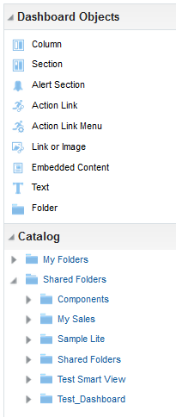
What Can I Add to a Dashboard?
Dashboard objects:
  Column
  Section
  Alerts Section
  Action Link
  Action Link Menu
  Link or Image
  Embedded Content
  Text
  Folder
Catalog objects:
  Catalog Tree
  Folder
  Dashboard page
  KPIs
  Scorecard
  Prompts
  Analyses
Notes:
Dashboard objects include the following:
Column: Used to align content on a dashboard. (Sections within columns hold the actual content.) You can create as many columns on a dashboard page as you need.
Section: Used within columns to hold the content, such as action links, analyses, and so on. You can drag as many sections as you need to a column.
Alerts Section: Used to add a section in which you display Alerts from Agents, if any. An Alerts Section is added automatically to the first page of My Dashboard, if you do not manually include one. You cannot disable the appearance of an Alerts Section on the first page of My Dashboard. You can add an Alerts Section to an additional dashboard page so that the section will then appear on both dashboard pages.
Instructor Note
The Column and Section dashboard objects are covered in this lesson because they are highlighted in the subsequent slides as layout elements for a dashboard page. The remaining objects are covered in the lesson titled “Configuring Oracle Business Intelligence Dashboards”.
Oracle BI 12c: Create Analyses and Dashboards 10 - <number>

Slide 13
Notes:
Action Link: Used to add an action link. An action link is a link that you embed in an analysis, dashboard page, or Key Performance Indicator (KPI). When you click the link, an associated action is run.
Action Link Menu: Used to add an action link menu. An action link menu provides the user with a list of actions from which to choose.
Link or Image: Used to add text and image links and to specify what should happen when a user clicks one of the links. For example, you can direct users to another website or dashboard, open documents, launch applications, or perform any other action that the browser supports. You can also add an image or text without any links.
Embedded Content: Used to add embedded content. Embedded content is any content that appears within a window (called a frame) inside the dashboard, as opposed to content that is accessed by clicking a link. Content that you might want to embed includes analyses, Excel charts, documents, websites, tickers from websites, and so on. When you embed content into a dashboard, the required HTML is automatically added to the target content. Analyses are embedded by default. Embedding an analysis in a dashboard causes it to execute automatically and to display the results within the dashboard. This provides access to current results.
Text: Used to add plain text or, if allowed in your site, HTML
Folder: Used to add a view of a Catalog folder and its contents. For example, you might add a folder that contains a collection of saved analyses that you run frequently. Then, from the dashboard, you can open the folder, navigate to a saved analysis, and select it to run.
Catalog objects comprise anything that you have saved to the catalog, including analyses, prompts, scorecards, KPIs, dashboard pages, and so forth.
Oracle BI 12c: Create Analyses and Dashboards 10 - <number>

Slide 14
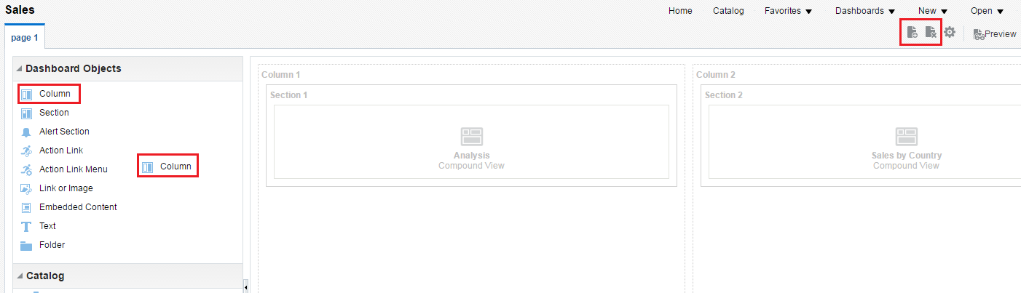

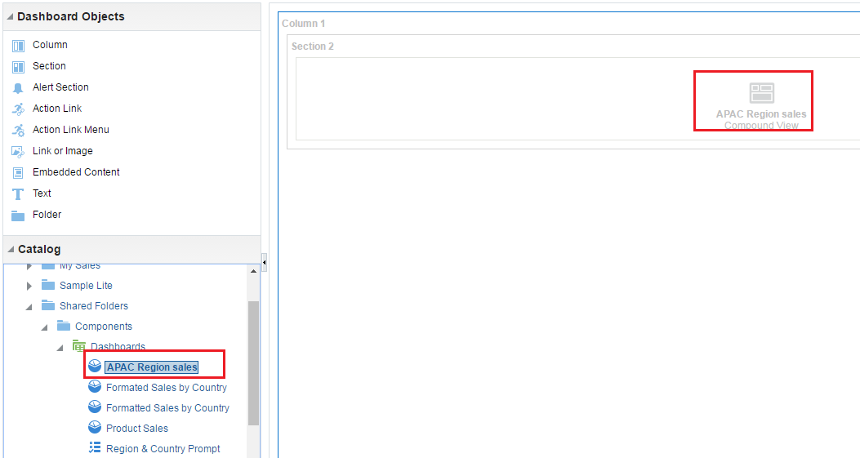

Adding Objects to a Dashboard Page
To add an object to a dashboard page, drag the object from either the Dashboard Objects or Catalog panes.
Add or delete a page.
1
2
Notes:
1. A column object is dragged to the Page Layout pane.
2. The Product Sales analysis is dragged to Column 1 of the Page Layout pane.
Note: When you delete an object container, all other objects within that container are deleted and other columns on the page are automatically resized. If an object is saved in the Catalog, it is deleted only from the dashboard.
Oracle BI 12c: Create Analyses and Dashboards 10 - <number>

Slide 15
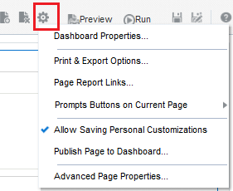
Dashboard Builder Tools Toolbar: Layout
Options on the Tools toolbar include:
  Dashboard Properties
  Print and Export Options
  Page Report Links
  Prompts Buttons on Current Page
  Allow Saving Personal Customizations
  Publish Page to Dashboard
  Advanced Page Properties
Notes:
Oracle BI 12c: Create Analyses and Dashboards 10 - <number>

Slide 16
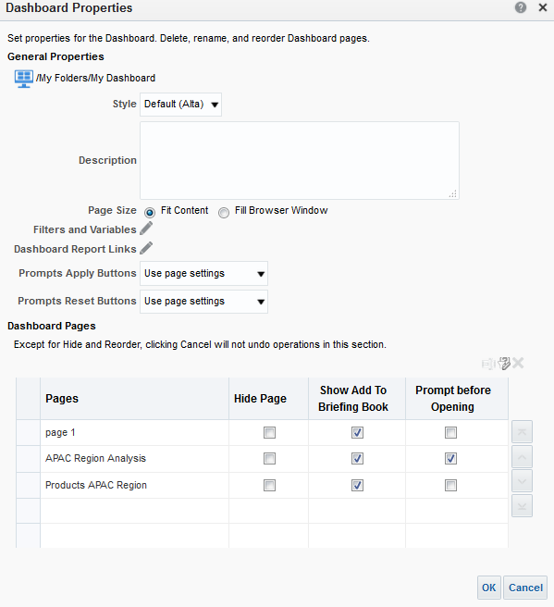
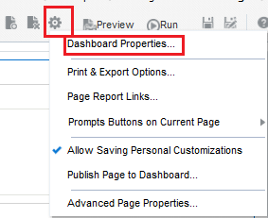
Tools Toolbar: Dashboard Properties
Determine how the dashboard pages and results are formatted and displayed.
1
3
2
4
Notes:
To change the dashboard properties, perform the following steps:
1. Click the Tools toolbar drop-down list.
2. Select Dashboard Properties.
3. Make the modifications.
4. Click OK.
In the Dashboard Properties dialog box, you can:
Change the style: Styles control how dashboards and results are formatted for display, such as the color of text and links, the font and size of text, the borders in tables, the colors and attributes of graphs, and so on. Styles are organized into folders that contain Cascading Style Sheets (.css), images, and graph templates. Administrators can customize some style sheets and create new style sheets.
Change skins: Skins control the way the Oracle BI Enterprise Edition interface appears, such as background colors and corporate logos. Skins can be automatically assigned to users when they log on. Administrators can customize the default skin and create new skins. For additional information about skins, refer to Oracle Fusion Middleware System Administrator's Guide for Oracle Business Intelligence Enterprise Edition 12c Release 1 (12.2.1).
Oracle BI 12c: Create Analyses and Dashboards 10 - <number>

Slide 17
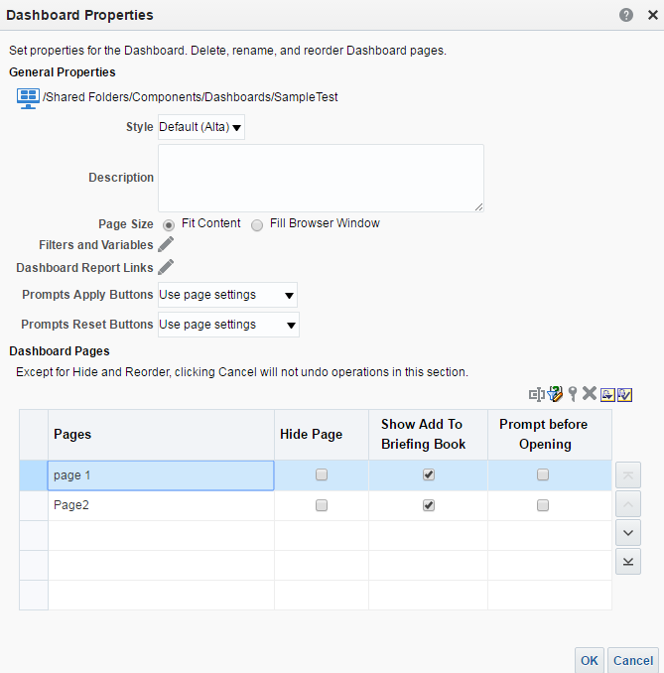






Tools Toolbar: Dashboard Properties
Style drop-down list
Filters and Variables link
Dashboard Report Links
Control prompt functionality.
Rename, hide, reorder, and delete pages, and specify who can save shared customizations.
Dashboard page controls
Notes:
Add filters and variables: Use this link to add hidden prompts, filters, and variables. This will be covered in the lesson titled “Creating Dashboard Prompts and Variables.”
Specify dashboard report links: Use this dialog box to specify the links that will be displayed with analyses on a dashboard page. This setting is global for the dashboard but can be overridden for a dashboard page using the Page Report Links option in the toolbar. This option is covered in detail later in the lesson. It can also be overridden for specific analyses.
Set up prompts: Choose to show or hide a prompt’s apply and reset buttons at run time, and control prompt auto-complete functionality. These topics are covered in detail in the lesson titled “Creating Dashboard Prompts and Variables.”
Rename, hide, reorder, set permissions for, and delete pages.
Specify embedded prompts and default values.
The look of a dashboard, such as background colors and the size of text, is controlled by cosmetic formatting. Cosmetic formatting affects the visual appearance of results and dashboards. You can apply cosmetic formatting to results, columns, and sections.
Oracle BI 12c: Create Analyses and Dashboards 10 - <number>

Slide 18
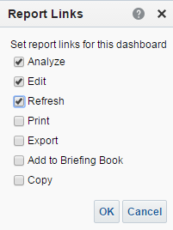
Dashboard Properties: Dashboard Report Links
Allows you to specify analysis links
1
2
3
Notes:
You can specify these link settings at the following levels:
Dashboard level: The link settings apply to all analyses in the dashboard, unless customized settings have been specified for an individual dashboard page or analysis.
Dashboard page level: The link settings apply to all analyses in the dashboard page, unless customized settings have been specified for particular analyses.
Analysis level: The link settings apply only to the particular analysis.
To specify a report link at the dashboard level, perform the following steps:
1. Click the Dashboard Report Links link in the Dashboard Properties dialog box.
2. Select the appropriate check boxes for the analyses.
3. Click OK to return to the Dashboard Properties dialog box.
Oracle BI 12c: Create Analyses and Dashboards 10 - <number>

Slide 19
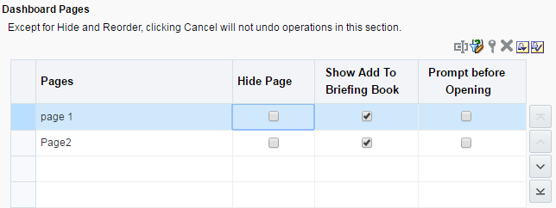


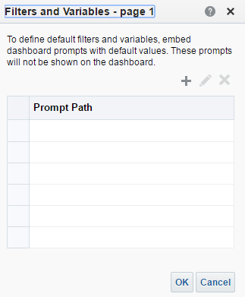
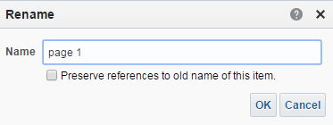
Dashboard Properties: Dashboard Page Controls
Page control toolbar
1
Reorder pages
2
Notes:
You use this area of the Dashboard Properties dialog box to rename, hide, reorder, and delete pages, and to specify embedded prompts and default values.
1. Select the page. When the page is selected, the Page control toolbar is enabled. If the dashboard has more than one page, the reorder icons will be enabled.
2. You can then perform any of the following:
Click the Rename icon to change the name of your dashboard.
Click the Filters and Variables icon to add a hidden prompt.
Click the Delete icon to delete the selected page. Dashboard pages are permanently deleted.
Oracle BI 12c: Create Analyses and Dashboards 10 - <number>

Slide 20
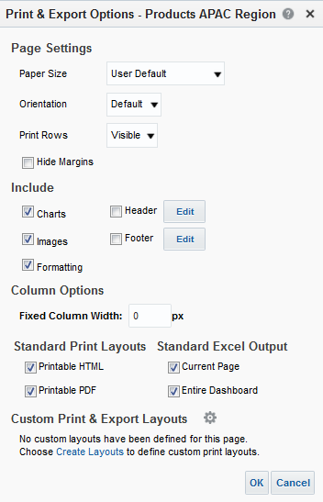
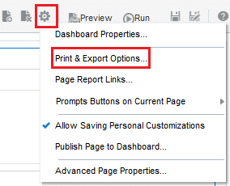



Tools Toolbar: Print Options
Specify the page settings and header and footer content for the HTML or PDF output when printing a dashboard or a view.
2
1
Specify and format header and footer.
Select HTML and/or PDF format.
Create Customized Print Layouts in BI Publisher.
Notes:
Dashboards are printed in Adobe Acrobat PDF format, which requires Adobe Reader 6.0 or higher. Header and footer formatting will appear in HTML and PDF output. The print selections that you specify apply to PDF output only. If you print the PDF on a local or network printer, the print selections that you have specified in the browser are in effect, such as the selection for paper size.
The options include the following:
Paper size includes US letter, A3–A5, Folio, and legal.
Orientation is standard: landscape or portrait.
Print all rows or visible rows.
Header, footer, or both can be included in the PDF format.
Custom Print Layouts: Users can get high-fidelity print outputs of their dashboards by selecting or creating multiple templates associated with the dashboard. Thus, users can take an entire dashboard and export it to a BI Publisher format layout. The underlying data model and BI Publisher reports are automatically created in the background, as are all supported views and styles.
To change the print properties, perform the following steps:
1. Click Tools > Print Options.
2. Make your modifications and click OK.
Oracle BI 12c: Create Analyses and Dashboards 10 - <number>

Slide 21
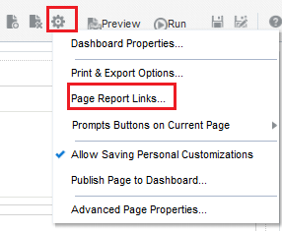
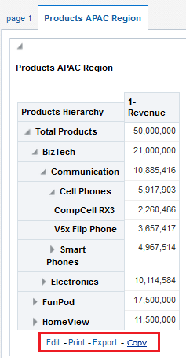
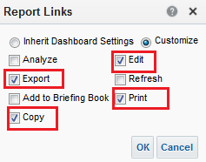
Tools Toolbar: Page Report Links
Identifies the link options that will appear for each analysis on the dashboard page
1
2
3
Notes:
Use this option to display the Report Links dialog box, where you specify the links to apply to all analyses on the dashboard page, unless customized settings have been specified for particular analyses. Settings made for Page Report links override the wider dashboard-level settings made using the Dashboard Report Links link in the Dashboard Properties dialog box. Note however that you can select the Inherit Dashboard Settings option to override any
page-level customizations and revert to the dashboard-level settings.
To set the report links available for a dashboard page, perform the following steps:
1. Select Tools > Page Report Links. The Report Links dialog box appears.
2. Make your modifications.
3. Click OK. The selected report links are displayed.
Oracle BI 12c: Create Analyses and Dashboards 10 - <number>

Slide 22
Notes:
The components of this dialog box include:
Inherit Dashboard Settings: Select this option when you are specifying the link settings at the dashboard level.
Customize: Select this option to customize the link settings for a particular dashboard page or analysis. This option is available only when you are specifying the link settings for a dashboard page or an analysis.
Add to Briefing Book: This option adds a link that allows the user to add the analysis to a Briefing Book.
Analyze: This option adds a link that allows the user to view (in a new browser window) the KPI, analysis, and so on. Formatting, such as stoplight or threshold, appears as well.
Copy: This option adds a link that allows the user to copy the analysis to Microsoft Office applications. This option is available to only those users who have been granted the Access to Oracle BI Office Add-In privilege by the Administrator.
Edit: This option adds a link that allows the user to modify the analysis.
Export: This option adds a link that allows the user to download the analysis in various formats, such as Excel.
Print: This option adds a link that allows the user to print the analysis in HTML or PDF formats.
Refresh: This option adds a link that allows the user to refresh the analysis.
Oracle BI 12c: Create Analyses and Dashboards 10 - <number>

Slide 23
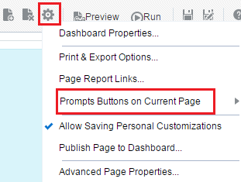


Tools Toolbar: Prompts Buttons on Current Page
Specifies whether to include or exclude the prompt’s Apply and Reset buttons on the dashboard page at run time
Notes:
You can choose to show or hide a prompt’s Apply and Reset buttons at run time. If you choose to hide the Apply button, then the specified prompt value is immediately applied to the dashboard or analysis. You can specify these settings in the Dashboard Properties dialog box, by using a drop-down list in the Dashboard Editor, for individual dashboard pages, and individual prompts. This feature is discussed in more detail in the lesson titled “Creating Dashboard Prompts and Variables.”
At the dashboard level, there are three options for both Apply and Reset buttons:
Use Prompt Setting: Choose this option to use the buttons as defined in the prompt definition. These settings are specified in the Prompt editor.
Show All (Apply/Reset) Buttons: Choose this option to show the buttons for the prompts. This setting overrides the prompt definition button settings or dashboard properties button settings unless the Prompts Apply Button and Prompts Reset Button fields in the Dashboard Properties dialog box are set to Use Page Settings.
Hide All (Apply/Reset) Buttons: Choose this option to hide the buttons for the prompts. This setting overrides the prompt definition button settings or dashboard properties button settings unless the Prompts Apply Button and Prompts Reset Button fields in the Dashboard Properties dialog box are set to Use Page Settings.
Oracle BI 12c: Create Analyses and Dashboards 10 - <number>

Slide 24
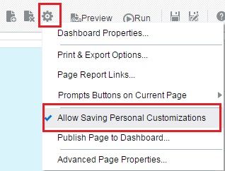
Tools Toolbar: Allow Saving Personal Customizations
Saved customizations allow users to save and view dashboard pages with their most frequently used or favorite choices.
  Examples: Filters, prompts, column sorts
  Preselect and save filters and prompts without having to manually choose these selections each time.
Notes:
Saved customizations allow users to save and view dashboard pages with their most frequently used or favorite choices for items such as filters, prompts, column sorts, drills in analyses, and so forth. They can preselect and save filters and prompts, without having to manually choose these selections each time they access the dashboard page.
Users with the proper permissions can:
Save various combinations of choices for their personal use or for use by others
Specify which saved customization is the default view, for their personal use or for use by others
To allow a user to save a personal, customized view of the dashboard page, click the Tools toolbar drop-down list and select Allow Saving Personal Customizations.
Oracle BI 12c: Create Analyses and Dashboards 10 - <number>

Slide 25
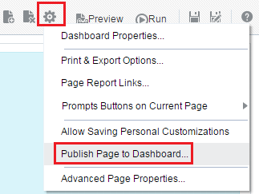
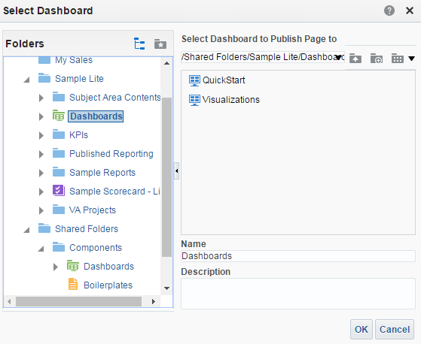
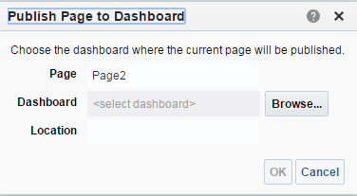
Tools Toolbar: Publishing Dashboard Pages
Publish a dashboard to share the page.
1
2
3
4
Notes:
You can publish the current dashboard page to a shared dashboard location so that you can share the page with others. When you publish a dashboard page:
Personal content (such as analyses, prompts, and so on) is copied to a destination location that you specify and references are updated as appropriate
References to shared content are retained
If you have made changes to the page but have not saved them, then the unsaved changes are published along with the saved changes
To publish a dashboard, perform the following steps:
1. Click the Tools toolbar drop-down list.
2. Select Publish Page to Dashboard.
3. Click Browse to navigate to the location where you will publish the dashboard page.
4. Click OK to save the dashboard page.
Oracle BI 12c: Create Analyses and Dashboards 10 - <number>

Slide 26
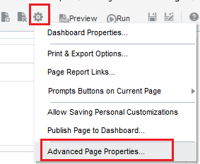
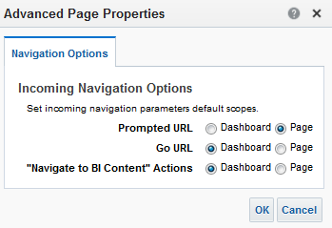
Tools Toolbar: Advanced Page Properties
You can set advanced page properties to specify incoming navigation parameters that you want to set on the current dashboard page. This enables you to control how parameters associated with the navigation actions are applied.
1
2
3
Notes:
Oracle BI 12c: Create Analyses and Dashboards 10 - <number>

Slide 27
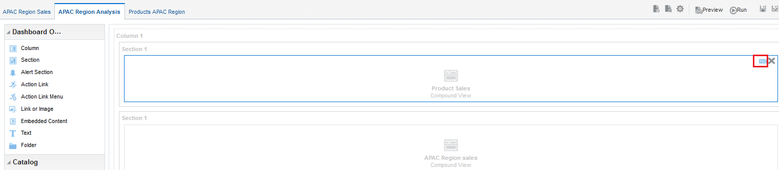
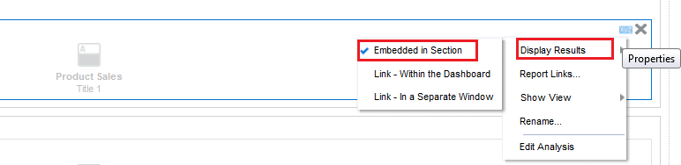
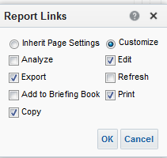
Exploring Dashboard Object Properties
1
2
3
Notes:
To edit an object’s properties, perform the following steps:
1. Click the Properties icon.
2. Select an option from the Properties menu.
3. Make your modifications and click OK.
It should be noted that the Properties menu (item 2 in the slide) will vary depending upon the specific type of object. In the example in the slide, many options are available for the analysis. Step 3 is the Report Links dialog box, invoked by selecting the Report Links option in the Quarterly Rev by Product analysis’ properties dialog box. Notice that at the object level, instead of inheriting the report link settings for the entire dashboard, you have the option to inherit the page-level settings using the Inherit Page Settings option.
Select the Inherit Page Settings option to specify that the link settings for the dashboard page are to be used. This option is available only when you are specifying the link settings at the analysis level.
Column and section properties are discussed in this lesson. Other property items will be explored in the lesson titled “Configuring Oracle Business Intelligence Dashboards.”
Instructor Note
This slide begins a more in-depth look at column and section objects.
Oracle BI 12c: Create Analyses and Dashboards 10 - <number>

Slide 28
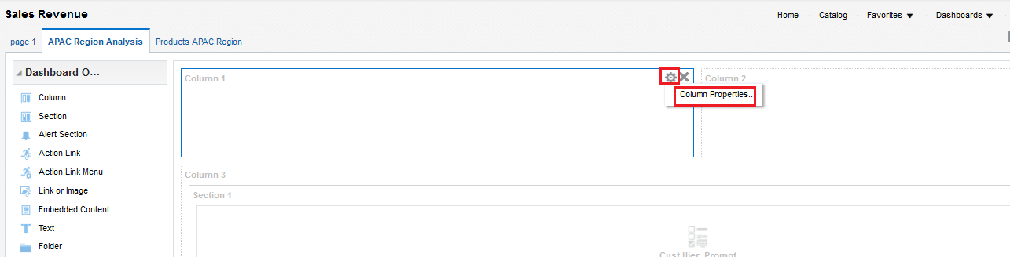
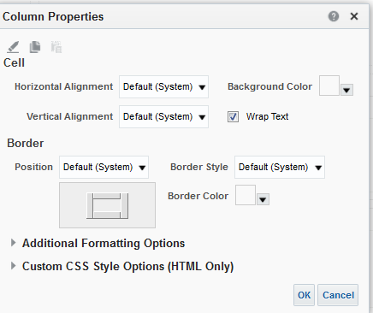
Exploring Column Properties
Used to align content on a dashboard; columns can also be formatted in detail
1
2
3
Notes:
Columns are used to align content on a dashboard (sections within columns hold the actual content). You can create as many columns on a dashboard page as you need. Every new dashboard page automatically contains one empty column with one empty section. In this release, if there is more than one column, you can freeze a column at an edge (top or left) of a dashboard page layout.
You click the column’s Properties icon and select Freeze Column. As in the above screenshot, where columns are lying next to one another, the frozen column will be anchored at the left of the page layout.
To edit a column’s properties, perform the following steps:
1. In the Page Layout pane, click the Column Properties icon and select Column Properties from the menu.
2. Along with typical formatting options, you can add or remove columns and set the width either in pixels or as a percentage of the dashboard page. You change the appearance of the cells, border, width, height, and so on using this dialog box. You can also apply a custom style sheet. Make your modifications.
Click OK.
Oracle BI 12c: Create Analyses and Dashboards 10 - <number>

Slide 29
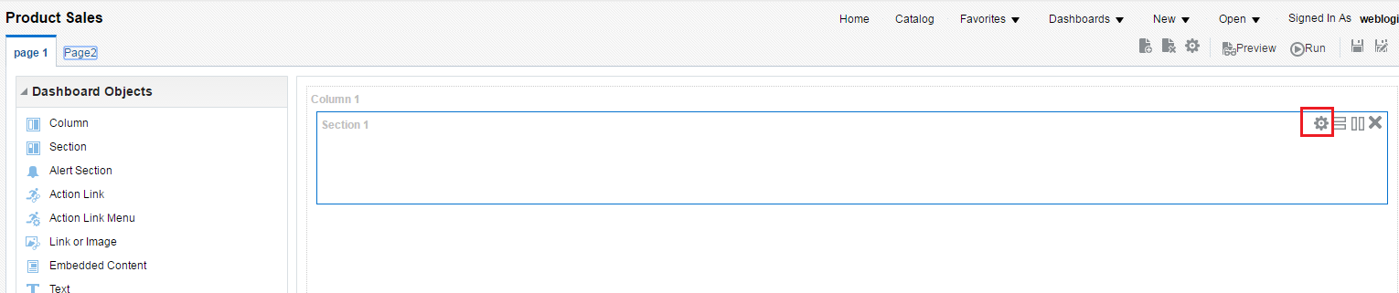
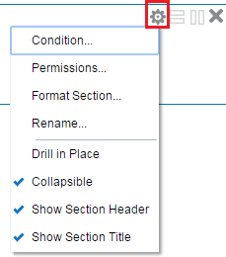
Exploring Section Properties
  Sections appear in columns in the dashboard layout.
  They hold content dragged from the selection pane and are used to organize content in a column.
1
2
Notes:
Sections appear within columns in the dashboard layout. They hold the content dragged from the selection pane and are used to organize content within a column.
You can drag as many sections to a column as you need. If you drag content to a column without first adding a section to hold the content, a section is created automatically. If you drag a section from one column to another column, any content in that section is also moved.
To edit section properties, perform the following steps:
1. In the Page Layout pane, click the Section Properties icon.
2. Select an option from the Section Properties menu.
The Section Properties menu contains the following options:
Condition: Use this option to display the Section Condition dialog box. This dialog box specifies the condition or filter that drives the delivery of section content to the dashboard.
Oracle BI 12c: Create Analyses and Dashboards 10 - <number>

Slide 30
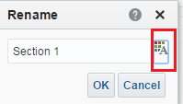

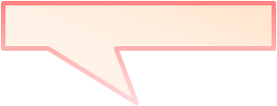
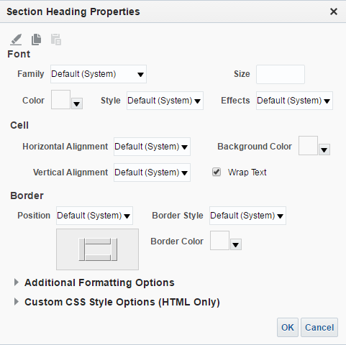
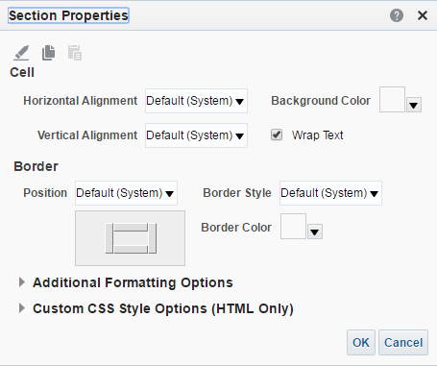
Exploring Section Properties
Rename and format the heading for the section.
Format the section.
Notes:
Format Section: Use this option to display the Section Properties dialog box, where you specify the properties for the section, such as cell alignment and border color.
Rename: Use this option to display the Rename dialog box, which allows you to rename the section.
Drill in Place: Use this option to specify how the results appear when a user drills in an analysis. If the option is selected, the original analysis is replaced when the user drills (the section will automatically resize to fit the new analysis). If the option is not selected, the entire dashboard content is replaced. Use this option for prompts that are created for hierarchical columns.
Note: You can use the Back button of the browser to view the original analysis.
Collapsible: Use this option to specify whether the user can expand and collapse this section on a dashboard page or whether the section is always expanded. If the Collapsible option is selected, you can expand and collapse the section.
Show Section Header: Use this option to specify whether to display the header for the section, which initially includes the title of the section. You can hide the title using the Show Section Title option.
Show Section Title: Use this option to specify whether to display the title of the section.
Oracle BI 12c: Create Analyses and Dashboards 10 - <number>

Slide 31
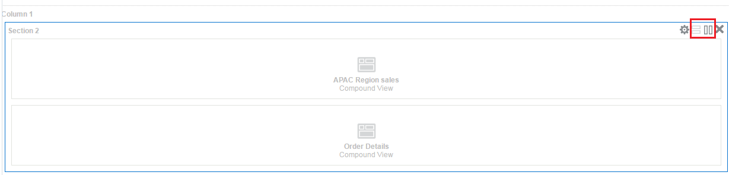
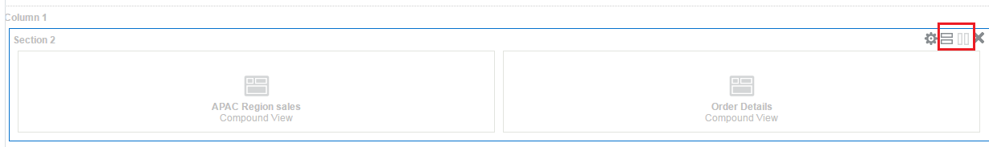
Exploring Section Properties: Arranging
Sections Horizontally
Default alignment for objects in sections is vertical.
1
2
Notes:
To arrange objects in a section horizontally, perform the following steps:
Move the cursor over the upper-right corner of the specific section until the Section toolbar appears, and then click the horizontal alignment icon.
To align the section vertically once again, repeat the process but click the vertical alignment icon this time.
Oracle BI 12c: Create Analyses and Dashboards 10 - <number>

Slide 32
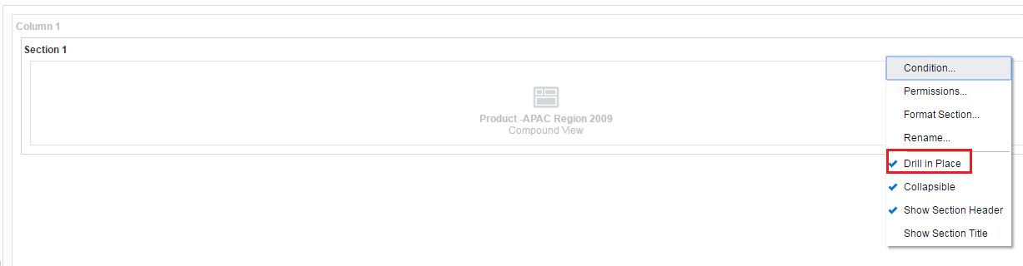
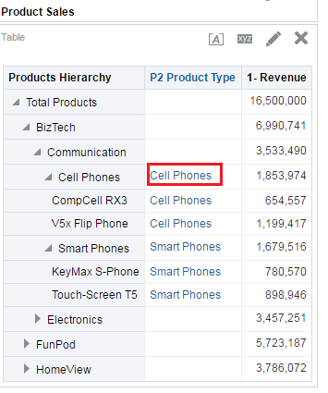
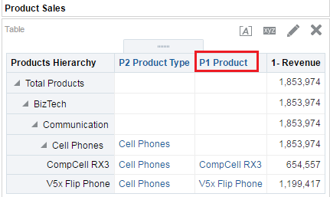
Exploring Section Properties: Controlling the Drilldown Display
Notes:
This option is set at the section level, which means that it applies to all drillable reports in the section. Users can click the browser’s Back button to return to the original report or the dashboard.
When users drill down on an embedded analysis, there are two options for displaying results:
Directly in the dashboard (replacing the original analysis)
In a new window (replacing the entire dashboard)
To control how results display when a user drills, perform the following steps:
1. Click the Properties toolbar for the section and select the Drill in Place option:
To show the new results directly in the dashboard, select the Drill in Place option. A check mark appears next to this option when it is selected. This is the default behavior.
To replace the dashboard with the new results, ensure the check mark does not appear in front of the Drill in Place option.
2. When you run the dashboard with the corresponding analyses, a link will appear beneath the columns on which you can drill. Click the link to drill down on the analysis.
Oracle BI 12c: Create Analyses and Dashboards 10 - <number>

Slide 33
Section Properties: Conditions
  Conditions: Objects that return a single Boolean (true or false) value based on evaluation of an analysis or KPI
  Evaluation dependency:
    Analysis is dependent upon row count.
    KPIs are dependent upon status or thresholds.
  You use conditions to determine whether:
    Agents deliver their content and execute their actions
    Action links appear on dashboard pages
    Sections in dashboards and their content appear on the dashboard
Notes:
A condition might evaluate whether an analysis returns a number of rows greater than zero:
If the analysis returns at least one row, then the condition evaluates to true.
If the analysis does not return any rows, then the condition evaluates to false.
Oracle BI 12c: Create Analyses and Dashboards 10 - <number>

Slide 34
Section Properties: Conditions
  Two types of conditions:
    Named: Saved in the Catalog as an object and can be reused
    Inline: Created at the point of use and saved as part of the dashboard, agent, or KPI
  Conditions consist of the following elements:
    An analysis or KPI
    A value to use when applying the condition (either the number of rows or KPI status or threshold)
    An operator that determines how the value is applied
    Values for any condition parameters
Notes:
Because inline conditions are saved as part of the dashboard, KPI, or agent, when one of these objects is deleted, the condition is also deleted, simplifying Catalog management.
Condition parameters are values that are used in the evaluation of an analysis or KPI as follows:
For an analysis, the condition parameters correspond to any prompted filter values that the analysis contains. (A prompted filter is a filter whose operator is set to is prompted.)
For a KPI, the condition parameters correspond to KPI property values.
When you create or edit a condition, you can:
Specify values for the condition parameters (if any)
Specify whether a parameter is fixed or hidden:
A fixed parameter can be seen, but its value cannot be set by a user.
A hidden parameter cannot be seen and its value cannot be set by a user.
Oracle BI 12c: Create Analyses and Dashboards 10 - <number>

Slide 35
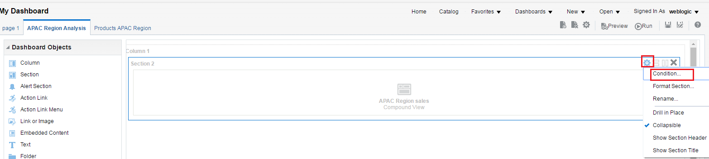
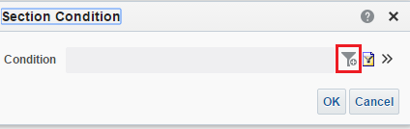
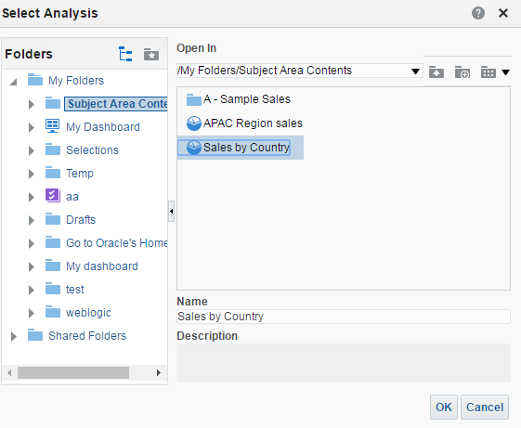

Section Properties: Adding an Inline
Condition for an Analysis
1
2
3
4
5
Notes:
You can use a condition to determine if a section should appear on a dashboard page.
1. Click the Section Properties icon in the Page Layout pane.
2. Select Condition from the Properties menu. The Section Condition dialog box appears.
3. Click the New Condition icon to add an inline condition for an analysis.
4. From the “Create condition based on” drop-down list in the New Condition dialog box, select Analysis and click Browse to locate the analysis on which to base this condition.
5. Navigate through the catalog to locate the analysis and click OK.
Oracle BI 12c: Create Analyses and Dashboards 10 - <number>

Slide 36



Section Properties: Adding an Inline
Condition for an Analysis
6
7
8
9
Notes:
6. Set your condition to a meaningful value. (You can click the Condition Data icon to view the analysis in a new browser.)
7. Click Test to evaluate your filter.
8. Click OK.
9. The Section Condition dialog box appears with the condition specified. Click OK, and then save and run the dashboard.
When the inline condition is set for this specific section and the evaluation is true (that is, if there are more than 15 rows), the Customer by Region analysis appears on the dashboard page in the appropriate section. In case the condition evaluates to false (that means if Product Sales analysis returned less than 15 rows), this section will not appear on the dashboard at all.
Oracle BI 12c: Create Analyses and Dashboards 10 - <number>

Slide 37




Section Properties: Adding an Inline
Condition for a KPI
1
2
3
4
5
Notes:
1. Click the Section Properties icon in the Page Layout pane.
2. Select Condition from the Properties menu. The Section Condition dialog box appears.
3. Click the New Condition icon to add an inline condition for a KPI.
4. From the “Create condition based on” drop-down list, select KPI and click Browse to locate the KPI on which to base this condition.
5. Navigate through the catalog to locate the KPI, select the KPI, and click OK.
Oracle BI 12c: Create Analyses and Dashboards 10 - <number>

Slide 38




Section Properties: Adding an Inline
Condition for a KPI
6
7
8
10
9
Notes:
6. Choose a value for the Dimension or accept the default originally set up. (You can click the Condition Data icon to view the KPI in a new browser.)
7. Choose a condition from the “Condition true if KPI’ drop-down list.
8. Click Test to evaluate your condition.
Click OK.
The Section Condition dialog box appears with the condition specified. Click OK.
Note: The Edit condition icon (two right-facing arrows) allows you to test, edit, or delete an inline condition, or create a named condition.
Save and run the dashboard page. The KPI evaluates to true; therefore the section and analysis appear on the dashboard page.
Oracle BI 12c: Create Analyses and Dashboards 10 - <number>

Slide 39




Section Properties: Adding a Named Condition
1
2
3
5
4
Notes:
1. Click the Section Properties icon in the Page Layout pane.
2. Select Condition from the Properties menu. The Section Condition dialog box appears.
3. Click the Select Condition icon to browse for an existing named condition stored in the Catalog.
Navigate the Catalog to locate the named condition. Select the named condition and click OK.
Click OK in the Select Condition dialog box, and then save and run the dashboard page.
The dashboard page appears with the analysis. The named condition allows the analysis to appear on the dashboard page when the row count exceeds 15.
Oracle BI 12c: Create Analyses and Dashboards 10 - <number>

Slide 40






Section Properties: Formatting and Renaming
Format the section.
1
3
2
4
5
6
Formatted Section Heading
Notes:
1. Click the Section Properties icon in the Page Layout pane.
2. Select Rename from the Properties menu. The Rename dialog box appears.
3. Click the Format Section Heading icon to modify the appearance of the header in the Section Heading Properties dialog box.
4. Click OK to save your changes and close the Section Heading Properties dialog box.
5. Give the section a relevant name and click OK.
6. Verify your changes.
You can also perform similar formatting to the section itself using the Format Section option of the Properties menu.
Oracle BI 12c: Create Analyses and Dashboards 10 - <number>

Slide 41


Miscellaneous Dashboard Page Functionality
Dashboard Page Options toolbar
Notes:
The dashboard Page Options toolbar contains the following options:
Print
Export to Excel
Refresh
Add To Briefing Book
Create Bookmark Link
Create Prompted Link
Apply Saved Customization
Save Current Customization
Edit Saved Customizations
Clear My Customization
The Global Header Signed In As functionality contains My Account preferences and the Act As surrogate option. The Act As option must be enabled by your administrator to be visible in the drop-down list. Refer to Oracle Fusion Middleware User's Guide for Oracle Business Intelligence Enterprise Edition 12c Release 1 (12.2.1) for additional information.
Instructor Note
This is a setup slide for the subsequent slides. Do not teach.
Oracle BI 12c: Create Analyses and Dashboards 10 - <number>

Slide 42




Page Options Toolbar: Creating Personal Customizations
Create a customized view.
1
2
3
This customization includes a filter for Country.
4
Notes:
To create a personal, customized view of the dashboard page, perform the following steps:
1. From the dashboard link on the Global Header, select your dashboard.
2. When the dashboard appears, set your prompts and any other customizations.
3. Select Save Current Customization from the Page Options toolbar.
4. Enter a Name for the customization and then select the Me option button in the Save for section or allow others to use your customization by selecting Others and clicking Set Permissions. You can also make this your default page by selecting the corresponding check box. Click OK to save the customization for later use.
Note: From the Page Options toolbar, you can apply, edit, or clear existing customizations. When you use the Apply option, a list of customizations appears. Your personal, saved customizations appear at the beginning of the list, whereas shared, saved customizations are listed next. Your current default customization is shown in bold type.
Oracle BI 12c: Create Analyses and Dashboards 10 - <number>

Slide 43




Page Options Toolbar: Creating Shared Customizations
Set permissions for others to use a customization.
3
1
4
2
5
Notes:
To set permissions for others to use customizations, perform the following steps:
1. Select the Others option and click Set Permissions.
2. When the Saved Customization Permissions and Defaults dialog box appears, click Add Users/Groups.
3. When the Add Groups dialog box appears, enter a partial or full Name in the search text box or click the Search for users and groups icon, select All from the List drop-down list, and click Search.
4. Select the accounts that will have access to this customization and use the shuttle buttons (Move or Move All) to move these accounts from the Available Groups pane to the Selected Groups pane on the right, and then click OK.
5. You can set this as the default dashboard page for these accounts by selecting Group Default in the Saved Customization Permissions and Defaults dialog box. Click OK twice to save the customization.
Oracle BI 12c: Create Analyses and Dashboards 10 - <number>

Slide 44
Page Options Toolbar: Creating Links to Dashboard Pages
  Shortcut links to a dashboard page:
    Can be emailed to other users with appropriate permissions and access
    Facilitate sharing of dashboard content among users
  Two types:
    Bookmark link: Captures the path to a dashboard page and all aspects of the page state
    Prompted link: Captures the path to a dashboard page and a simplified presentation of the dashboard prompts
Notes:
There are two types of links that you can create: bookmark and prompted.
Bookmark link: A bookmark link captures the path to a dashboard page and all aspects of the page state. After you create a bookmark link, you can save the link as a bookmark so that you can return to the same page content at a later time, or you can copy and send the link to other users who can then view the same content that you are viewing. (Note: They must have the same permissions that you have and must have access to the page.) When you create a bookmark link, the state of a dashboard page is saved in the Catalog as a hidden bookmark object for a period of time specified by your site (the default is 30 days).
Prompted link: When you create a prompted link, you can manually or programmatically manipulate the link, for example, by adding different values for the prompts. For example:
...Action=Navigate&col1=Products.Color&val1="Armory"+"Clear"&col2=Periods."Month“ op2=gt&val2="05/01/2008%2012:00:00%20AM“
The prompted link syntax is as follows:
…Action=Navigate, Column1 (col1), Operator1 (op1), Values1 (val1), Column2 (col2), Operator2 (op2), Values2 (val2)…
Use the same operators as those for the Go URL. For a list of these operators, refer to Oracle Fusion Middleware Developer’s Guide for Oracle Business Intelligence Enterprise Edition 12c Release 1 (12.2.1).
Oracle BI 12c: Create Analyses and Dashboards 10 - <number>

Slide 45


Page Options Toolbar: Creating Links to Dashboard Pages
1
2
Notes:
To create a bookmark link, perform the following steps:
1. Select Create Bookmark Link from the Page Options toolbar.
2. The bookmark link is placed in the Address Bar of your browser, where you can modify, save, or manipulate it.
Note: To create a Prompted Link, select the Create Prompted Link option from the Page Options toolbar and then programmatically or manually manipulate the link.
Oracle BI 12c: Create Analyses and Dashboards 10 - <number>

Slide 46



Page Options Toolbar: Adding Content to a Briefing Book
1
2
3
5
4
Notes:
A briefing book is a collection of static or updatable snapshots of dashboard pages, individual analyses, and BI Publisher reports.
To add the dashboard page content to a Briefing Book, perform the following steps:
1. Select Add To Briefing Book from the Page Options toolbar.
2. Select the Content Type. If you want the Briefing Book content to remain static, select Snapshot; otherwise, select Updatable.
3. Provide Briefing Book navigation links, if you so choose (and identify the location for this link through the Browse capability).
4. Click OK.
5. A confirmation message appears. Click OK.
Oracle BI 12c: Create Analyses and Dashboards 10 - <number>

Slide 47


Page Options Toolbar: Export to Excel
Export an entire dashboard or a single dashboard page to Microsoft Excel 2007+.
2
1
3
Notes:
To export an entire dashboard or a single dashboard page to Microsoft Excel 2007+, perform the following steps:
1. Select Export to Excel from the Page Options toolbar.
2. Select the Export Current Page option.
3. A dialog box is displayed. You can either save the file or just open it. Click OK.
If users export an entire Dashboard, the individual dashboard pages appear as separate Microsoft Excel worksheets in the generated export.
Oracle BI 12c: Create Analyses and Dashboards 10 - <number>

Slide 48

Quiz: Overview
This quiz examines your knowledge of dashboards.
Notes:
In this quiz, you answer questions regarding dashboards.
Oracle BI 12c: Create Analyses and Dashboards 10 - <number>

Slide 49
Quiz
Oracle Business Intelligence Dashboards display results of analyses to users and provide two types of views for corporate and external information: personalized and preconfigured.
  True
  False
Notes:
Answer: a
Oracle BI 12c: Create Analyses and Dashboards 10 - <number>

Slide 50
Quiz
The Dashboard Builder allows you to add dashboard pages and catalog objects to a dashboard.
  True
  False
Notes:
Answer: a
Oracle BI 12c: Create Analyses and Dashboards 10 - <number>

Slide 51
Quiz
Which of the following objects can be added to a dashboard when using the Dashboard Builder?
  Column
  Section
  Analysis
  Folder
Notes:
Answer: a, b, c, d
Other objects that can be added to a dashboard include Alerts Sections, action links, action link menus, links or images, text, catalog objects, and so on.
Oracle BI 12c: Create Analyses and Dashboards 10 - <number>

Slide 52
Quiz
A named condition is created at the point of use and can be reused by other dashboard pages.
  True
  False
Notes:
Answer: b
A named condition is saved in the Catalog and can be reused, whereas an inline condition is created at the point of use and saved as part of the dashboard.
Oracle BI 12c: Create Analyses and Dashboards 10 - <number>

Slide 53
Quiz
You can customize your dashboard and share it with everyone in your organization.
  True
  False
Notes:
Answer: b
Although you can create a customized dashboard, you can only share it with those business users who have the same or more privileges than you.
Oracle BI 12c: Create Analyses and Dashboards 10 - <number>

Slide 54
Quiz
Which three of the following options are available within the Dashboard Builder Tools toolbar?
  Saving personal customizations
  PDF printing
  Publishing the dashboard page
  Setting preferences for your default dashboard page
Notes:
Answer: a, b, c
Setting preferences for your default dashboard page is available on the Global Header.
Oracle BI 12c: Create Analyses and Dashboards 10 - <number>

Slide 55

Summary
In this lesson, you should have learned how to:
  Distinguish between different types of dashboard objects
  Build a dashboard
Notes:
Oracle BI 12c: Create Analyses and Dashboards 10 - <number>

Slide 56

Practice 10: Overview
This practice covers the following topics:
  Creating a dashboard page
  Adding content to a dashboard page
  Publishing a dashboard page
Notes:
Oracle BI 12c: Create Analyses and Dashboards 10 - <number>

