Slide 1
Configuring Oracle Business
Intelligence Dashboards
Notes:
Schedule Timing Topic
20 minutes Lecture
20 minutes Practice
05 minutes Quiz
45 minutes Total

Slide 2
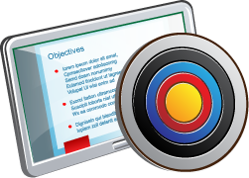
Objectives
After completing this lesson, you should be able to describe and use dashboard content other than analyses.
Notes:
Oracle BI 12c: Create Analyses and Dashboards 11 - <number>

Slide 3
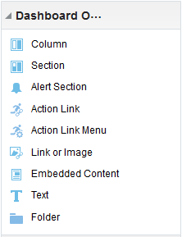
Dashboard Objects
  Alerts Section
  Action Link
  Action Link Menu
  Link or Image
  Embedded Content
  Text
  Folder
Notes:
Instructor Note
This is a structuring slide. Do not teach the concepts here because the subsequent slides cover the steps in detail.
Oracle BI 12c: Create Analyses and Dashboards 11 - <number>

Slide 4
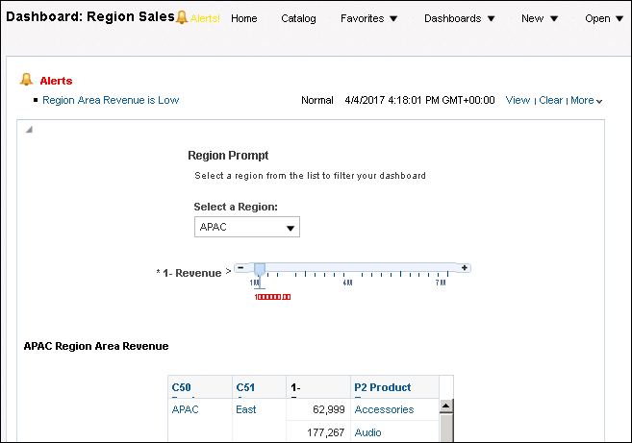
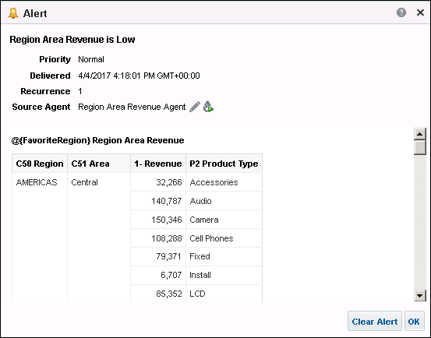
Alerts Section
Alerts can be sent to a dashboard page and allow a proactive response to business issues.
Notes:
An Intelligent Agent (or Agent) allows you to access, filter, and perform analytics on data based upon defined criteria. The Alerts Section is one in which you display Alerts from Agents. Agents allow you to provide proactive delivery of real-time, personalized, and actionable intelligence throughout the business network. Agents are discussed in greater detail in the lesson titled “Using Oracle Business Intelligence Delivers.”
On the My Dashboard page, an Alerts Section is added automatically to the first page (if you do not manually place one there). You cannot disable the appearance of an Alerts Section on the first page of My Dashboard, but you can add an Alerts Section to an additional dashboard page, enabling the section to appear on both dashboard pages.
You can see the alerts that have been delivered to you in the following places:
On the first page of My Dashboard
On a dashboard page, if the content author adds an Alerts Section to the page
In the Alerts dialog box displayed from the Alerts! button on the global header
Alerts are discussed in detail in the lesson titled “Using Oracle Business Intelligence Delivers”.
Oracle BI 12c: Create Analyses and Dashboards 11 - <number>

Slide 5
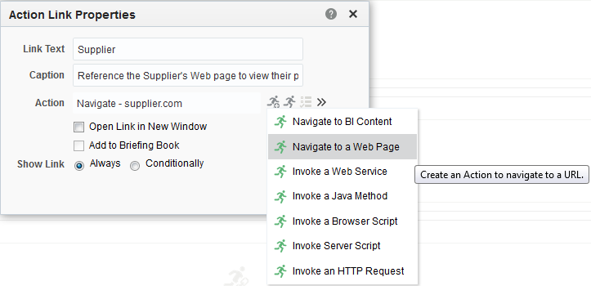



Action Link and Action Link Menu
  Add a hotspot or link to execute an action.
  Available types of action links include the following:
    URL Navigation
    Web Service Action
    Java Action
    Browser Script Action
    Server URL Action
    Server Script Action
    BI Navigation
    Chained Agent
    ADF Contextual
    Event Action
Available actions from the dashboard
Static action link
Notes:
An action link is a link to an action that you have embedded in an analysis, dashboard page, scorecard objective, scorecard initiative, or KPI that, when clicked, runs an associated action such as navigating to a saved analysis or invoking an Enterprise Java Bean (EJB).
Action links that have been added to analyses appear in Table, Pivot Table, Graph, Funnel, Heat matrixes, Performance Tiles, Trellises, Treemaps, Map views, and Gauge views.
On a dashboard page and within an analysis, you can group multiple action links together in an action link menu. An action link menu lets users choose the right action to be executed, based on the business insight they have gained from information on their dashboard page. Additionally, you can conditionally show each action link on an action link menu, depending on the data in the row. This allows you to show the appropriate actions to users for the data in an analysis, dashboard page, or KPI.
Oracle BI 12c: Create Analyses and Dashboards 11 - <number>

Slide 6
Notes:
Action links can be either:
Named
Saved in Catalog
Reused in analyses, dashboard pages, Agents, and KPIs, or as a template to create another named action
Types: URL Navigation, Web Service Action, Java Action, Browser Script Action, and Server URL Action
Inline
Defined at point of use
Not saved in Catalog
Saved as part of the analysis, dashboard page, Agent, or KPI
Automatically deleted when the analysis, dashboard page, Agent, or KPI is deleted
Types: Server Script Action, BI Navigation, and Chained Agent
Oracle BI 12c: Create Analyses and Dashboards 11 - <number>

Slide 7
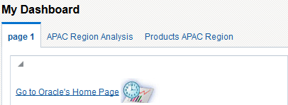
Link or Image
Links and images can be placed on a dashboard page.
Link text
Image file
Notes:
The example in the slide shows the result of adding a link and an image to a dashboard.
Oracle BI 12c: Create Analyses and Dashboards 11 - <number>

Slide 8
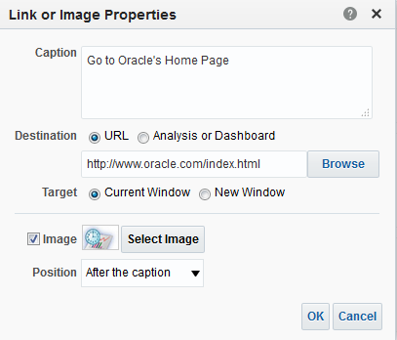
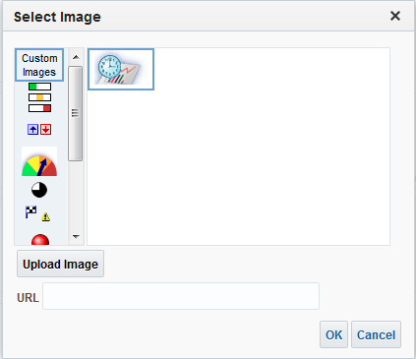
Link or Image
  Access content when users click a link or image
  Provide “lists” of choices
  Are used for content that cannot be displayed in a frame
    Example: Some websites prohibit content from appearing in a frame.
Link text
Path to content
Select Image link
Upload Image link
Notes:
A link is defined as any URL that your browser can interpret. URLs can point to websites, documents, images, FTP sites, newsgroups, email forms (to launch an email message with the To field already filled in), and so on.
You can add text links and image links to a dashboard and specify what happens when a user clicks them. For example, you can direct users to another website or dashboard, open documents, launch applications, or perform any other action that your browser supports. You can also add an image or text only, without any links.
Use Select Image link for image location. It is a shortcut to refer to the default image list as well as image loaded in the memory of the OBI Presentation Server. If you have an image located in: D:\Oracle\Middleware\Oracle_Home\user_projects\domains\bi_foundation\servers\bi_server1\tmp\_WL_user\analytics\za01ic\war\res\s_blafp\images\report_trends.jpg,
you can upload custom image by providing the image path using the Upload Image link.
Oracle BI 12c: Create Analyses and Dashboards 11 - <number>

Slide 9
Notes:
Note: It is recommended that the Presentation Server Administrator set up a virtual directory (named \DashboardFiles) on the Oracle BI Presentation Server for shared documents that maps to a shared network directory of the same name. This enables users with the appropriate permissions to publish files to this folder and reference these files by their relative URL names rather than by their fully qualified network share names.
Example:
\DashboardFiles\AnnualReport.doc
instead of
\\SharedServer\CommonShare\DashboardFiles\AnnualReport.doc
Oracle BI 12c: Create Analyses and Dashboards 11 - <number>

Slide 10
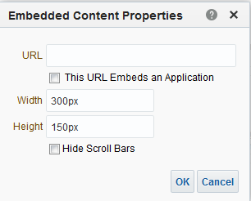
Embedded Content
  Embedded content can be any file that is accessed
  by a URL.
  The dashboard allocates frame size based on content properties, not on the content’s dimensions.
    Default frame size is 600 × 440 pixels.
  The dashboard adds scroll bars to the frame if the content is larger than the allocated frame size.
Path to content
Notes:
Embedded content is any content that appears in a window (named a frame) inside the dashboard, as opposed to content that is accessed by clicking a link. Content that you might want to embed includes reports, Excel charts, documents, websites, tickers from websites, and so on.
Reports are embedded by default. Embedding a report in a dashboard causes the report to execute automatically and display its results in the dashboard, thereby providing access to current results. When you embed content in a dashboard, Oracle BI automatically adds the required HTML to the target content.
The default size of the window is 300 pixels by 150 pixels. You can change the size of the window to make it larger or smaller. To accept the default, leave the width and height fields empty.
Oracle BI 12c: Create Analyses and Dashboards 11 - <number>

Slide 11

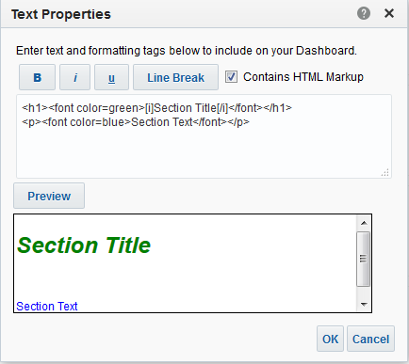

Text
  Can contain formatted text using tags, ActiveX controls, Java scripts, sound bites, animation, and so on
  Can contain anything that is supported by your browser
1
2
Notes:
You can add HTML (formatted text), ActiveX controls, Java scripts, sound bites, animation, a background image, variables, and so on. The name you assign in the Dashboard Builder is the name that is used for the Text object in the Oracle BI Presentation Catalog. The Text object may contain anything that is supported by your browser.
1. Click the formatting buttons to insert common HTML tags. Select the Contains HTML Markup option if your text should be interpreted as HTML.
2. Click Preview to view the results.
Oracle BI 12c: Create Analyses and Dashboards 11 - <number>

Slide 12
Text: ActiveX
ActiveX objects must be self-contained.
  Paste or type the object into the Text window.
  Ensure that you include the beginning and ending tags <object...> and </object>.
Notes:
Examples are available in the online Help. These ActiveX objects give you browser-supported functionality for your dashboards.
Oracle BI 12c: Create Analyses and Dashboards 11 - <number>

Slide 13
Text: Scripts
JavaScript and VBscript objects must be self-contained.
  Paste or type the script into the Text window.
  Ensure that you include the beginning and ending tags <script> and </script>.
Notes:
Examples are available in the online Help. Scripting objects give you browser-supported functionality for your dashboards.
Oracle BI 12c: Create Analyses and Dashboards 11 - <number>

Slide 14
Text: Audio
Audio clips must be located on a network drive that is accessible to all users if it is in a shared environment.
  Use the HTML <embed> tag to add audio to your dashboard.
  Example:
  <embed src="audio" autostart="true" loop="true" hidden="true"> </embed>
    Where audio is the location and name of the audio clip on a network drive
Notes:
The following HTML tags are examples of the <embed> tag:
To add an audio clip located on your hard drive, specify the following HTML:
<embed src=“c:\mycomputer\midifiles\wakeup.mid” autostart=“true” loop="true" hidden="true"></embed>
To add the same audio clip from a shared location on your Oracle BI Presentation Server, specify the following HTML:
<embed src="/dashboardfiles/wakeup.mid" autostart=“true” loop="true" hidden="true"></embed>
Oracle BI 12c: Create Analyses and Dashboards 11 - <number>

Slide 15

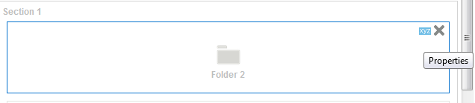
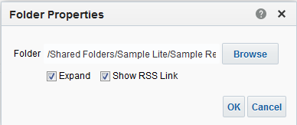



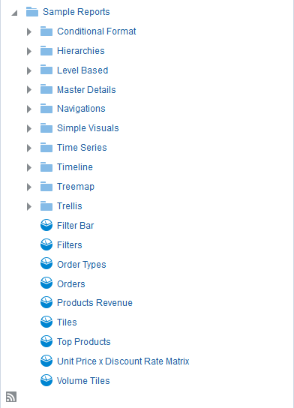

Folder
Provides the ability to view an Oracle BI Presentation Catalog folder and its contents (such as saved analyses)
Browse to locate Catalog folder.
Select Folder Properties.
Display an XML RSS link.
Automatically expand folder contents when displayed.
XML RSS link
Notes:
You can add a view of an Oracle BI Presentation Catalog folder and its contents (such as saved analyses) to an Interactive Dashboard. For example, suppose that you have a collection of saved analyses that you run often. You can open the folder in the dashboard, navigate to a saved analysis, and click to run it.
Note: If you have nested folders more than one level deep, the Expand option shows only one level under the selected folder.
Select the Show RSS Link option if you want to display a link for RSS (Really Simple Syndication) content in the specified folder. If this option is selected, an XML button appears with the folder in the dashboard. Users can enter the associated link into RSS reader software to subscribe to XML feeds of new catalog content because it is saved in the specified folder. RSS readers are used by clients to subscribe to RSS data.
Note: RSS is a family of web-feed formats. Programs known as feed readers or aggregators can check a list of feeds on behalf of a user and display any updated articles that they find.
Oracle BI 12c: Create Analyses and Dashboards 11 - <number>

Slide 16
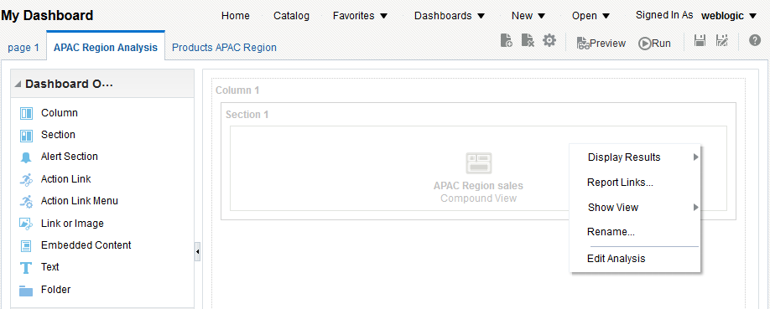
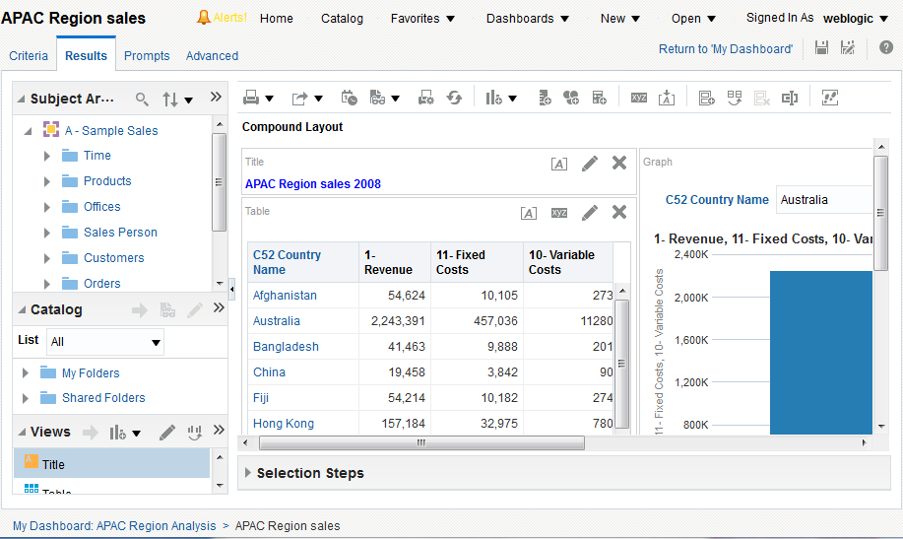
Breadcrumbs
In Dashboard Builder, a user might want to modify an analysis present in the current dashboard. Breadcrumbs appear in the bottom-left corner.
Notes:
Breadcrumbs have been added to help you understand your current location within Oracle BI content and the path that you have used to navigate Oracle BI content. They are active links that you can click to return to the place from which you navigated and to the state of the content when you left it.
Oracle BI 12c: Create Analyses and Dashboards 11 - <number>

Slide 17

Quiz: Overview
This quiz examines your knowledge of dashboard content.
Notes:
In this quiz, you answer questions regarding the various types of dashboard content.
Oracle BI 12c: Create Analyses and Dashboards 11 - <number>

Slide 18
Quiz
Which of the following can dashboard objects include?
(Select all that apply)
  Embedded content
  Folders
  Text
  Dashboard prompts
Notes:
Answer: a, b, c, d
Additionally, you can also include Alerts Sections, Action links, and Action link menus.
Oracle BI 12c: Create Analyses and Dashboards 11 - <number>

Slide 19
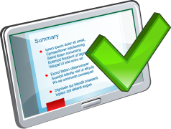
Summary
In this lesson, you should have learned how to describe and use dashboard content other than analyses.
Notes:
Oracle BI 12c: Create Analyses and Dashboards 11 - <number>

Slide 20

Practice 11: Overview
This practice covers embedding content in a dashboard.
Notes:
Oracle BI 12c: Create Analyses and Dashboards 11 - <number>

