Slide 1
Creating Dashboard
Prompts and Variables
Notes:
Schedule Timing Topic
60 minutes Lecture
45 minutes Practice
05 minutes Quiz
110 minutes Total

Slide 2

Objectives
After completing this lesson, you should be able to:
  Explain the different variable types supported by Oracle BI
  Describe and build dashboard prompts
Notes:
Oracle BI 12c: Create Analyses and Dashboards 12 - <number>

Slide 3
Variables
Variables are referenced throughout different BI EE objects, tools, and editors, and are available in four types:
  Session
  Repository
  Presentation
  Request
Notes:
You can reference variables in several Oracle BI objects, including analyses, dashboards, Key Performance Indicators, filters, agents, and conditions.
Oracle BI 12c: Create Analyses and Dashboards 12 - <number>

Slide 4
Session Variables
  Session variables are initialized upon sign-in for all authenticated users.
    Upon sign-in, the BI Server instantiates the session variable.
      One instance per user active on the system
  Two types:
    System:
      Uses reserved names
      Is used by Oracle BI Server and Presentation Services
    Nonsystem:
      Is created by the administrator in the BI repository by using the Administration Tool
      Has a unique name
The DISPLAYNAME system session variable
Notes:
Session variables are initialized for each user upon sign-in. When a user begins a session, the BI Server creates a new instance of a session variable and initializes it. There are as many instances of a session variable as there are active sessions on the server, each possibly with its own value. Session variables are primarily used when authenticating users against external sources such as database tables or LDAP servers. If a user is authenticated successfully, session variables can be used to set filters and permissions for that session.
An example of the use of a system session variable is the DISPLAYNAME variable. Upon
sign-in, this variable is initialized for the user, and then referenced when creating the Owner designation for objects saved to the Presentation Catalog, and also displayed as the current user in Presentation Services. For a complete list of the system session variables employed by Oracle BI, refer to the Metadata Repository Builder's Guide for Oracle Business Intelligence Enterprise Edition.
Oracle BI 12c: Create Analyses and Dashboards 12 - <number>

Slide 5
Repository Variables
  Have a single value on the BI Server at any time
  Are created by the administrator in the BI repository by using the Administration Tool
  Are of two types:
    Static
      Value is set in the Administration Tool.
      Value persists until it is updated in the repository.
    Dynamic
      They can be refreshed by data returned from queries.
      Refresh can be scheduled on the BI Server.
Notes:
Repository variables can be used instead of literals or constants in Expression Builder in the Administration Tool. The Oracle BI Server substitutes the value of the repository variable for the variable itself in the metadata. For more information about creating and using repository variables, see the Oracle BI 12c: Build Repositories course.
Oracle BI 12c: Create Analyses and Dashboards 12 - <number>

Slide 6
Presentation Variables
Presentation variables are created in Presentation Services by using dashboard prompts.
  Can be assigned default values
  Are updated when a user selects a value in a dashboard prompt
    Can be based either on a column in an analysis or on specified values
Notes:
The value of a presentation variable is populated by the column or variable prompt with which it was created. Each time a user selects a value in the column or variable prompt in a dashboard, the value of the presentation variable is updated.
Oracle BI 12c: Create Analyses and Dashboards 12 - <number>

Slide 7
Request Variables
Request variables override specified session variables.
  They update a specified session variable based on a dashboard prompt.
  The override duration is the life of the specific analysis or query.
Notes:
Request variables are similar to presentation variables.
Oracle BI 12c: Create Analyses and Dashboards 12 - <number>

Slide 8
Referencing Variables
  Variables can be used in the following objects and contexts:
    Analyses and their views
    Conditional formats
    Column formulas
    Filters and selections
    Dashboard:
      Object headers and footers
      Links, images, and text
  Variables are available in the following analysis views: Title, Narrative, Ticker, Static Text, Graph, Gauge.
Notes:
You can reference variables in analyses, dashboards, KPIs, and agents. How you reference a variable depends on the task that you are performing. For tasks where you are presented with fields in a dialog box, you must specify only the type and name of the variable (not the full syntax), for example, referencing a variable in a filter definition. For other tasks, such as referencing a variable in a title view, you specify the variable syntax. The syntax you use depends on the type of variable as described in the following slides.
Oracle BI 12c: Create Analyses and Dashboards 12 - <number>

Slide 9
Syntax for Referencing Variables
Type of Variable | Syntax | Example
Session | @{biServer.variables ['NQ_SESSION.variablename']} where variablename is the name of the session variable, for example, DISPLAYNAME | @{biServer.variables['NQ_SESSION.USER']}
Repository | @{biServer.variables.variablename} or @{biServer.variables['variablename']} where variablename is the name of the repository variable, for example, prime_begin | @{biServer.variables.prime_begin} or @{biServer.variables['prime_begin']}
Notes:
In the syntax, if the “at” sign (@) is not followed by a brace ({), then it is treated as an “at” sign.
For a list of system session variables that you can use, see “About System Session Variables” in Oracle Fusion Middleware Metadata Repository Builder's Guide for Oracle Business Intelligence Enterprise Edition.
Oracle BI 12c: Create Analyses and Dashboards 12 - <number>

Slide 10
Syntax for Referencing Variables
Type of Variable | Syntax | Example
Presentation or Request | @{variables.variablename} [format]{defaultvalue} or @{scope.variables['variablename']} where: variablename is the name of the presentation or request variable, for example, MyFavoriteRegion. (optional) format is a format mask that is dependent on the data type of the variable, for example #,##0, MM/DD/YY hh:mm:ss. (optional) defaultvalue is a constant or variable reference indicating a value to be used if the variable referenced by variablename is not populated. scope identifies the qualifiers for the variable. You must specify the scope when a variable is used at multiple levels (analyses, dashboard pages, and dashboards) and you want to access a specific value. | @{variables.MyFavoriteRegion} {EASTERN REGION} or @{dashboard.variables ['MyFavoriteRegion']}
Notes:
Oracle BI 12c: Create Analyses and Dashboards 12 - <number>

Slide 11
Dashboard Prompts
  Filter the results of embedded analyses to show only those results that match the prompt criteria:
    Filter all analyses embedded in a dashboard or only the analyses on certain dashboard pages
  Set or update variables:
    Presentation variables are populated by prompts.
    Repository and session variables can be overwritten by prompts.
  Are of four types:
    Column
    Currency
    Image
    Variable
Notes:
A dashboard prompt is a special kind of filter that filters analyses embedded in a dashboard. A dashboard prompt filters embedded analyses that contain the same columns as the filter.
Oracle BI 12c: Create Analyses and Dashboards 12 - <number>

Slide 12
Dashboard Prompts: Column Prompts
Two types of column prompts:
  Named:
    Created outside of a specific dashboard and saved in the Catalog as a Prompt object for reuse
    Can be applied against any dashboard or dashboard page that contains the specified column
    Filters all or some analyses embedded on the same dashboard page
    Appears on the dashboard page. Therefore, you can choose different values for the prompt without rerunning the dashboard.
    Can be saved to a private or shared folder
  Inline:
    Created at the analysis level in Analysis Editor
Notes:
Named prompts: Named prompts can also be hidden. At run time, the hidden named prompts set the default values for all of the corresponding prompts on the dashboard or dashboard page and the unprotected inline prompts that are located in the analyses on the dashboard or dashboard page.
A named column dashboard prompt can also interact with selection steps. You can specify a dashboard prompt to override a specific selection step. The step will be processed against the dashboard column with the user-specified data values collected by the dashboard column prompt, whereas all other steps will be processed as originally specified.
A named prompt is interactive and will always appear on the dashboard page so that the user can prompt for different values without having to rerun the dashboard.
Oracle BI 12c: Create Analyses and Dashboards 12 - <number>

Slide 13

Notes:
Inline prompts: A prompt that is created at the analysis level is called an inline prompt because the prompt is embedded in the analysis and is not stored in the Oracle BI Presentation Catalog and, therefore, cannot be added to other analyses. Inline prompts allow end users to specify the data values that determine the content of the analysis. An inline prompt can be a column prompt, variable prompt, image prompt, or currency prompt. When you create an inline prompt, you select the columns and operators for the prompt and specify how the prompt is displayed to a user and how a user selects values. The user’s choices determine the content of the analyses that are embedded in the dashboard. An inline prompt is an initial prompt, which means that it displays only when the analysis is rendered. After the user selects the prompt value, the prompt fields disappear from the analysis and the only way for the user to select different prompt values is to
re-run the analysis.
Oracle BI 12c: Create Analyses and Dashboards 12 - <number>

Slide 14
Dashboard Prompts: Other Prompts
  Currency:
    Allows the user to change the currency type that appears in the currency columns on an analysis or dashboard
    Is specified in the My Account settings
  Image:
    Provides an image with sections that users click to select criteria (specific prompt value) for an analysis or dashboard
    Image map definitions created using the HTML <map> tag
  Variable:
    Allows the user to select a relevant name or value to display on the dashboard that is not associated with a specific column
    Sets or updates variables
Notes:
Currency prompt: The Currency prompt option is available only if the administrator has configured the userpref_currencies.xml file as described in the Oracle Fusion Middleware System Administrator's Guide for Oracle Business Intelligence Enterprise Edition 12c Release 1 (12c). This file is located in the Oracle BI Presentation Services Component directory. It should also be noted that currency and exchange rate tables must also be configured for the currency prompt to work properly.
Image prompt example: An image prompt can be a map of the United States with sections that represent the North, South, East, West, and Central sales divisions. Users can then click the divisions that correspond to the sales information that they want to view on the dashboard.
Variable prompt: A variable prompt allows the user to select a value that is specified in the variable prompt to display on the dashboard or to use in manipulating column data. For example, a prompt can populate a variable that is used to add or multiply the column data in an analysis.
Oracle BI 12c: Create Analyses and Dashboards 12 - <number>

Slide 15
Adding a Named Column Prompt to a Dashboard
  Create a new named column prompt.
  Select the prompt type.
  Select the subject area and column.
  Select the operator and other options.
  Save the prompt.
  Preview the prompt.
  Add the prompt to a dashboard.
  Set the scope for the prompt.
  Test the results.
Notes:
Instructor Note
This is a structuring slide. Do not teach the steps or concepts here because the subsequent slides cover them in detail. Instead, provide a high-level description of what is discussed.
Oracle BI 12c: Create Analyses and Dashboards 12 - <number>

Slide 16
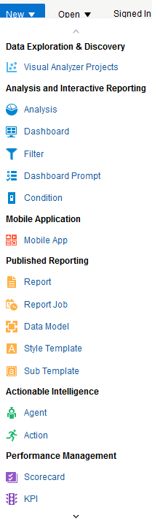
1. Create a New Named Column Prompt
To add a named column prompt to a dashboard, click New > Dashboard Prompt and select the subject area.
Notes:
Oracle BI 12c: Create Analyses and Dashboards 12 - <number>

Slide 17
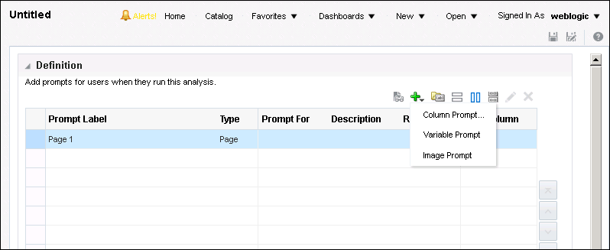

2. Select the Prompt Type
Click the Add icon and select Column Prompt from the
drop-down list.
Add a new prompt.
Notes:
The Definition pane enables you to add, organize, and manage a prompt’s columns. You can use column prompts, image prompts (maps), currency prompts, and variable prompts. The Definition table lets you view high-level information about the prompt’s columns. You can also use this table to select columns for editing or deleting, arrange the order in which the prompts appear to the user, or insert row or column breaks between prompt items.
The Display pane allows you to view the prompt’s layout and design.
Oracle BI 12c: Create Analyses and Dashboards 12 - <number>

Slide 18
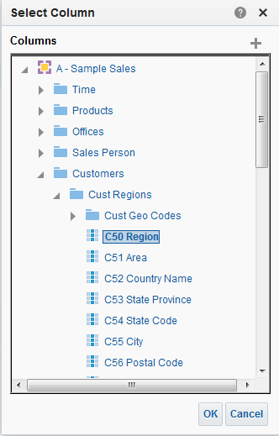
3. Select the Subject Area and Column
Select the subject area and column, and then click OK.
Notes:
The selected column corresponds to the filter created on the analyses. The prompt drives the content displayed when the user enters a value from the dashboard.
You can add and remove subject areas for selection or search for items by using this dialog box. Click the appropriate icon in the upper-right column.
The number of prompted columns can affect performance. Ensure that you prompt only for necessary columns.
Oracle BI 12c: Create Analyses and Dashboards 12 - <number>

Slide 19
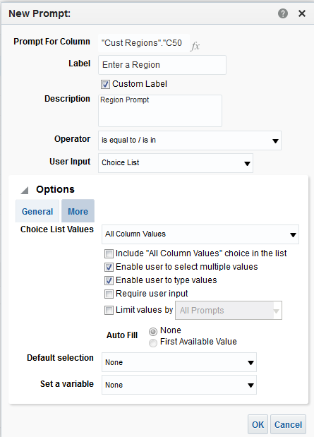

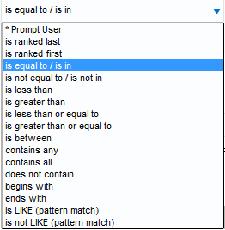


4. Select the Operator and Other Options
  Enter a label for the prompt.
  Choose the operator.
  Indicate how you want the choices to appear on the dashboard page in User Input.
  Click OK.
1
2
3
4
Notes:
You use the New/Edit Prompt dialog box to select options for the prompt, label the prompt, choose defaults, and so on.
The Prompt For Column item is for variable prompts only.
The Label text box allows you to enter a meaningful label that appears on the dashboard next to the prompt.
The Description item allows you to display a tool tip to the end user when he or she moves the cursor over the item.
The User Input drop-down list appears for column and variable prompts and provides you with the option to determine the User Input method—that is, the user will see one of the following: check boxes, option buttons, a choice list, or a list box. You use this item in conjunction with the Choice List Values item to specify which data values appear for selection. For example, if you selected the User Input method of Choice List and the Choice List Values item of All Column Values, then the user will select the prompt’s data value from a list that contains all of the data values contained in the data source.
Oracle BI 12c: Create Analyses and Dashboards 12 - <number>

Slide 20
Notes:
The following should be noted for the Choice List Values item:
For attribute and measures column, all Choice List Values are available.
For double columns, the choice list contains the display value and the ID value for each column value. For example, if a column value has a display value of East and an ID value of 1, then East(1) appears in the list.
The Options section provides you with the opportunity to constrain values available for selection based on a previous prompt. The Options section includes the following details:
Choice List Values—This options includes:
All Column Values (Choose from a list that contains all existing values or members for the prompt.)
Custom Values (Choose from a list of prompt values that you create.)
Specific Column Values (For attribute and measure columns, choose from a preselected list of values, whereas for hierarchical columns, choose from a preselected list of members within the hierarchy.)
SQL Results (Choose from a list of values specified through a SQL statement.)
Members of Groups (Choose from a list of members associated with the group; not available for hierarchical columns; available only for the operator value of is equal to/is in or is not equal to/or in.)
All Column Values and Specific Groups (Choose from a list of all column values and preselected groups; available only for the operator value of is equal to/is in or is not equal to/or in.)
The Select Values or Clear Values icon (not shown) appears when Custom Values, Specific Column Values, Members of Groups, or All Column Values, and Specific Groups is selected. The Select Values icon presents a list of values to the user and is useful to provide a limited, intuitive list of choices. The Clear Values icon removes all groups and selected values.
The SQL Statement item (not shown) appears when SQL Results is chosen. You use this item to create or edit a SQL statement.
The Include All Choices choice list item (not shown) appears when you select the Radio Button User Input method.
Limit Values by: Use this to select an existing prompt column to limit the values that appear in the select list for the prompt column being created. It appears when Check Box, Choice List, List Box, or Radio Buttons is chosen for the User Input method. This limits the values by constraining the column.
Enable user to select multiple values (Use this check box to select an existing prompt column to limit the values that appear in the select list for the prompt column being created. Appears when Check Box, Choice List, List Box, or Radio Buttons is chosen for the User Input method.)
Enable user to type values (Use this check box to allow user entry into the selection field. It is available when Choice List is chosen for the User Input method.)
Oracle BI 12c: Create Analyses and Dashboards 12 - <number>

Slide 21
Notes:
Require user input (Use this check box to make the prompt required.)
Slider Values (For numeric column data only. Use this item to specify the prompt values and value ranges that appear on the slider. When the User Input method is Slider, the Options section contains Slider Values rather than Choice List Values, as well as various other check boxes related to a Slider. Specifically, you can enter an upper and lower limit for the values, show a spinbox that allows the user to click arrows for slider value selection, compress values to remove trailing zeroes in thousands and millions, choose slider orientation [horizontal or vertical], choose where the label for the slider appears, and choose the slider size [small, medium, or large].)
Default selection (Use this item to specify the initial value displayed to the user.)
Values include the following:
None (Nothing specified as an initial default value)
Specific Values (Preselected values from the prompt list that Oracle BI generates based on the option selected in Choice List Values)
All Column Values (Specifies the All Choices default value)
Variable Expression (Specifies a string as a default value)
Server Variable (Specifies a session or repository variable as the default. When using a session variable, prefix the name with NQ_SESSION. Note that if a request variable exists with the same name as the session variable, the value of the request variable is used instead of the value of the session variable.)
SQL Results (Specifies a SQL statement to generate a list of values. On a double column, prompting occurs on display values, not code values.)
Set a variable (Use to create a new variable that this column prompt will populate)
Other items not shown in the slide include:
Enable user to select by Code Column (Appears only for double columns. Use this item to view the column’s code column name. For example, DESCRIPTOR_ IDOF("SnowFlakeSales".Category.CategoryName.), which when translated into a prompt value, would provide a value such as 1 - Beverages where the 1 is the descriptor ID and Beverages is the category name.)
Label (Appears only for double columns. Use this to provide a caption for the check box that allows the user to toggle between viewing the column prompt value and the column prompt category name.)
Column (Appears when All Column Values, Specific Column Values, or Members of Groups is chosen for the User Input method)
Oracle BI 12c: Create Analyses and Dashboards 12 - <number>

Slide 22

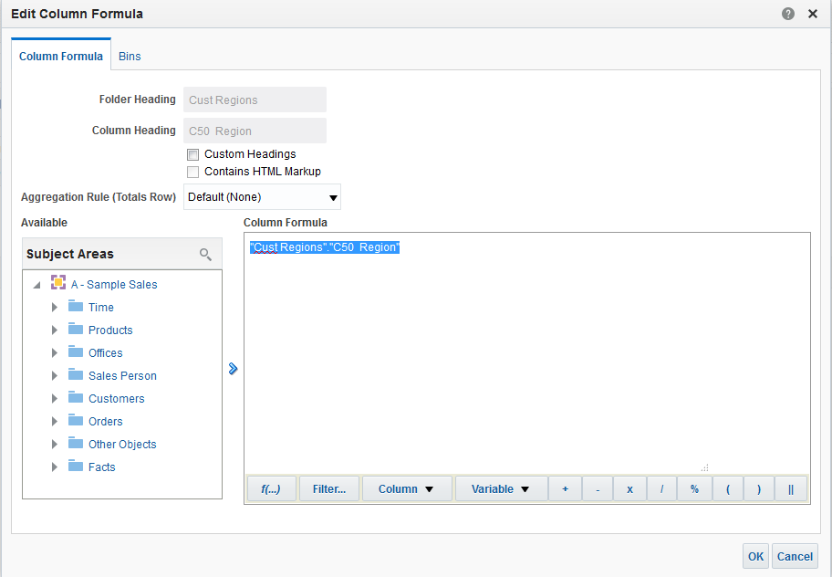



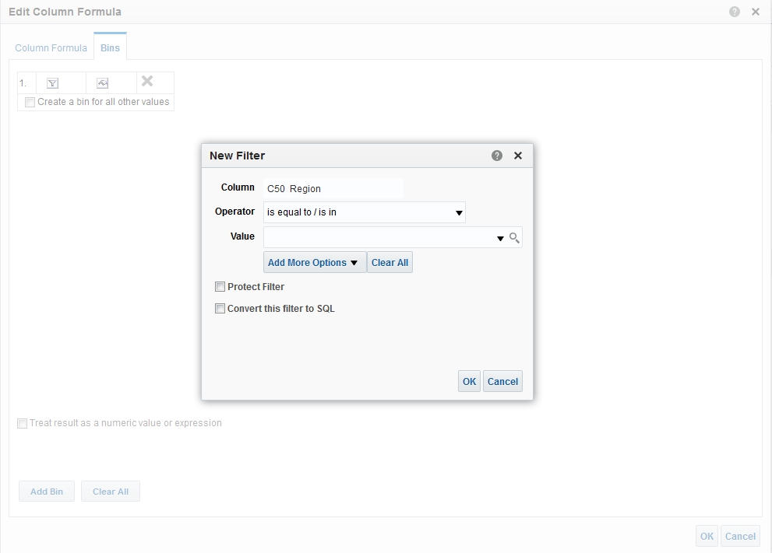

4. Select the Operator and Other Options
Two tabbed pages: Formula and Bins
Click the Formula icon in the Edit Prompt dialog box.
Customize headings, specify an aggregation rule, and so on.
Binning creates a filter.
Notes:
You use the Formula tabbed page of the Edit Column Formula dialog box to customize headings, specify the aggregation rule, and edit the formula for a column. Click the Edit Formula icon to add or edit a formula for use with the column prompt that you are creating. This icon will be displayed only for attribute and measure column types. If you are creating a column or variable prompt and choose to modify the formula, you can specify a hierarchical column in the column’s formula.
You use the Bins tabbed page of the Edit Column Formula dialog box to build a formula for the column using a CASE statement. Binning allows you to display a representative value for a group of related, atomic values for ease of processing and analysis. You can combine multiple values or ranges of values from a given column into bins. When you add and name the bins, all instances of the different values that comprise the bin in the result set are replaced by the bin name. Aggregations are performed accordingly as well.
Oracle BI 12c: Create Analyses and Dashboards 12 - <number>

Slide 23
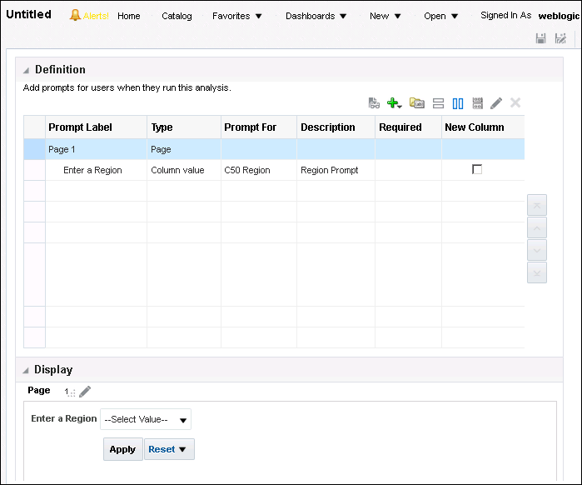


5. Save the Prompt
Save the prompt to the Catalog.
Preview the prompt in the Display pane.
Notes:
The Definition pane consists of the following table items:
Prompt Label: This is a read-only column created in the Prompt dialog box. To modify, click the Edit icon.
Type: This is a read-only column, which displays the prompt type (column, currency, image, or variable).
Prompt For: This is a read-only column created in the Prompt dialog box. To modify, click the Edit icon.
Description: This is the description entered in the Prompt dialog box. Click the column and overwrite any unwanted information.
Required: A green check mark appearing in this column indicates that the user must select or enter a value for the prompt. This is a read-only column. To modify, click the Edit icon.
New Column: This check box indicates that a new column will be created for the item on the page immediately to the right of the item before it in the table.
Oracle BI 12c: Create Analyses and Dashboards 12 - <number>

Slide 24
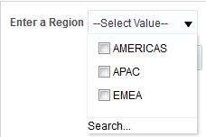

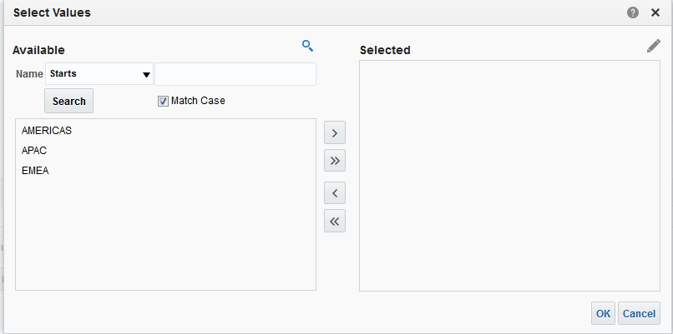


6. Preview the Prompt
1
Search from the Display section.
2
Enter a partial string and click Search.
3
4
Notes:
1. Click the Search button in the Display pane.
2. In the Select Values dialog box, you can enter a partial string in the Name text box and click Search or you can load all Available items.
3. Use the Move buttons to move the items from Available to Selected.
4. Click OK.
Oracle BI 12c: Create Analyses and Dashboards 12 - <number>

Slide 25
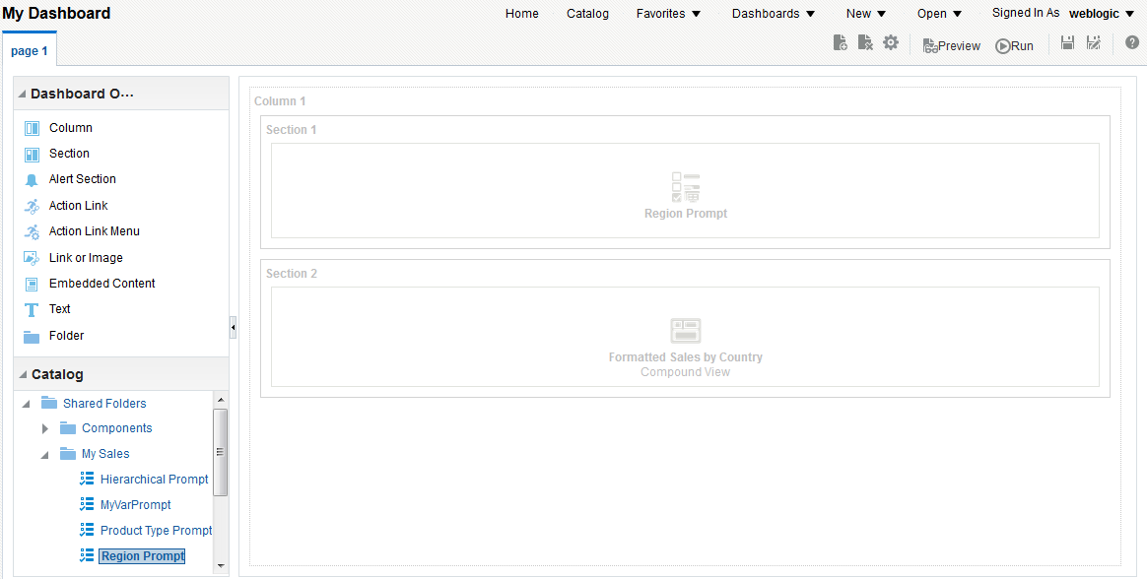



7. Add the Prompt to the Dashboard
1
3
Drag the prompt to the desired section.
Navigate to the new prompt in the Catalog.
2
Notes:
1. Open the dashboard page to which you want to add the new prompt. For example, you can click Home on the Global Header and click the Edit hotlink under the desired dashboard.
2. Navigate to the new prompt in the catalog.
3. Drag the prompt to the desired section. Often, the prompt is added directly above the analysis in the same section.
Oracle BI 12c: Create Analyses and Dashboards 12 - <number>

Slide 26
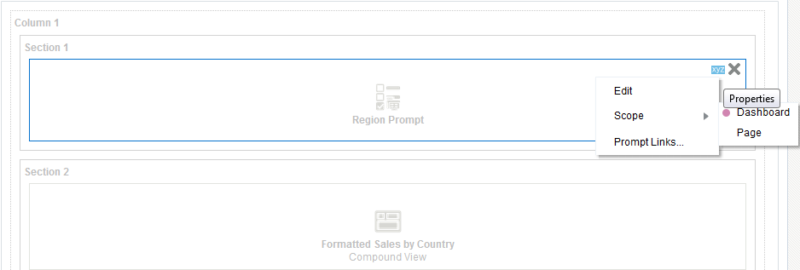

8. Set the Scope for the Prompt
Scope determines whether the dashboard prompt filters a page or the entire dashboard.
1
2
Select Scope > Dashboard or Page.
Notes:
If you select Dashboard, every page in the dashboard is filtered. If you select Page, only the active dashboard page is filtered.
1. Click the Properties icon for the prompt.
Select the appropriate Scope (either Dashboard or Page).
Save the dashboard.
Oracle BI 12c: Create Analyses and Dashboards 12 - <number>

Slide 27
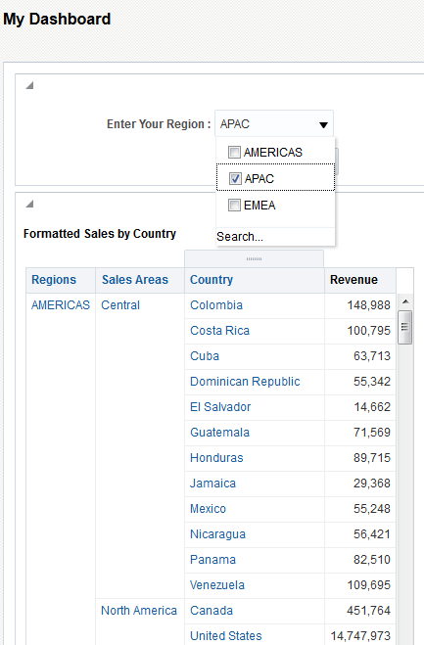

9. Test the Results
2
1
Notes:
1. Click Run.
From the Region drop-down list, select the desired value or values and click OK.
If there is an asterisk next to the prompt, it indicates required entry.
Oracle BI 12c: Create Analyses and Dashboards 12 - <number>

Slide 28
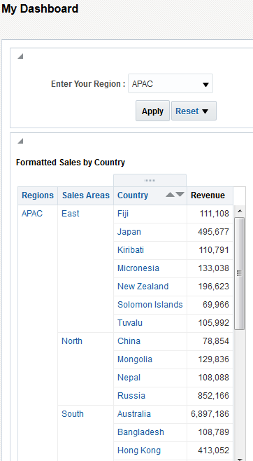
9. Test the Results
Analysis is filtered for the APAC region.
Notes:
Oracle BI 12c: Create Analyses and Dashboards 12 - <number>

Slide 29
Adding a Hidden Named Prompt to a Dashboard
  Edit Dashboard Properties.
  Navigate the Catalog to locate the named prompt.
  Test the results.
Notes:
Instructor Note
This is a structuring slide. Do not teach the steps or concepts here because the subsequent slides cover them in detail.
Oracle BI 12c: Create Analyses and Dashboards 12 - <number>

Slide 30
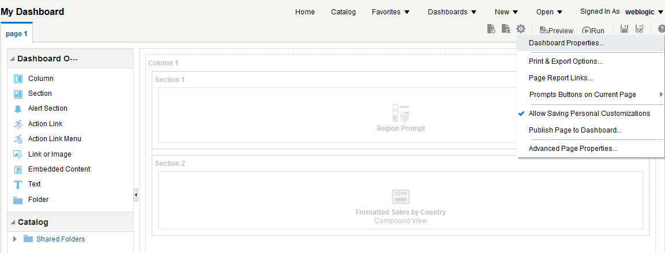

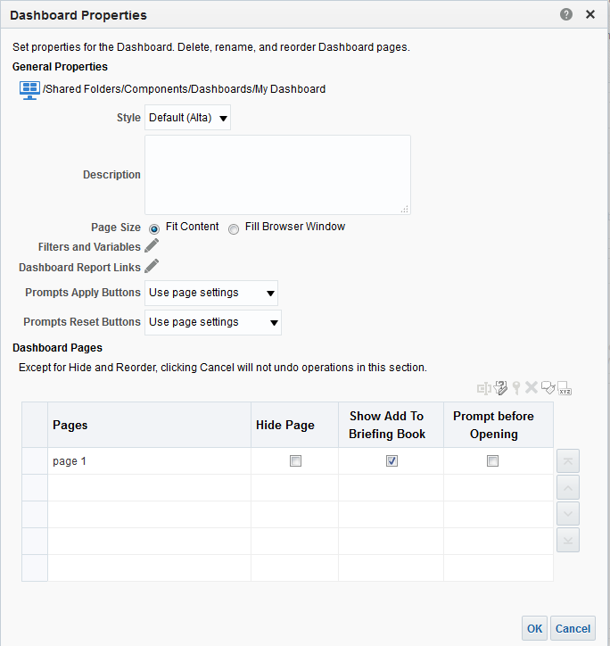

1. Edit Dashboard Properties
Create hidden prompts from the Dashboard Properties dialog box.
Edit dashboard properties.
1
2
Notes:
A hidden named prompt can be any prompt type that was previously created and stored in the catalog.
At run time, the hidden named prompts set the default values for all of the corresponding prompts on the dashboard or dashboard page and for the unprotected inline prompts that are located in the analyses on the dashboard or dashboard page. You can add one or more hidden named prompts to a dashboard or dashboard page.
The Filters and Variables link in the Dashboard Properties dialog box allows you to add hidden prompts.
1. From within the Dashboard Builder, click the Tools toolbar icon and select Dashboard Properties.
2. Click the “Filters and Variables” link in the Dashboard Properties dialog box. To add a hidden prompt for the entire dashboard, you click the “Filters and Variables” link. To add a hidden prompt for a specific dashboard page, select the page and click the “Select a prompt to capture default filters and variables” button.
Oracle BI 12c: Create Analyses and Dashboards 12 - <number>

Slide 31
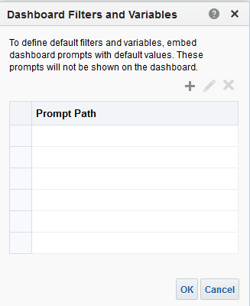


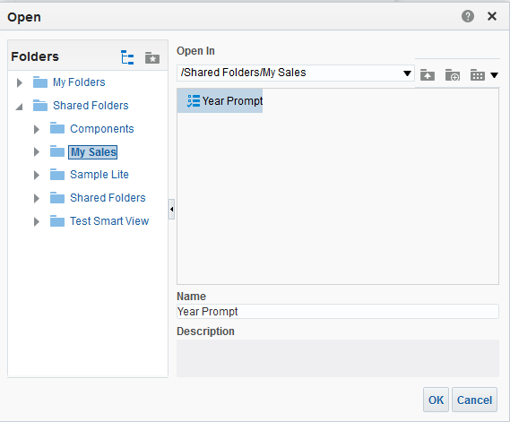
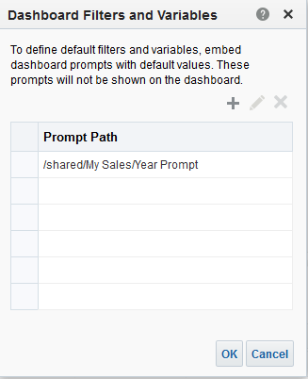
2. Navigate the Catalog to Locate the Named Prompt
Add a prompt.
Year Prompt stored in the Catalog
4
3
Notes:
1. Click the Add button.
2. Browse to locate the prompt. Select the prompt.
3. Click OK to return to the “Dashboard Filters and Variables” dialog box.
4. Click OK again to return to the Dashboard Properties dialog box and click OK a final time to return to the Dashboard Builder.
Oracle BI 12c: Create Analyses and Dashboards 12 - <number>

Slide 32
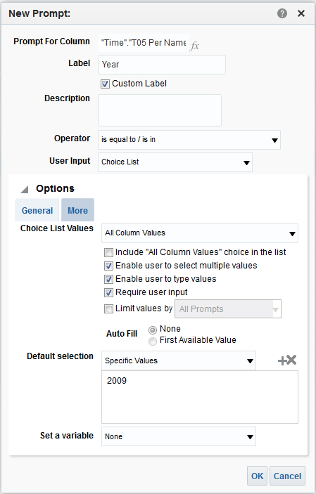
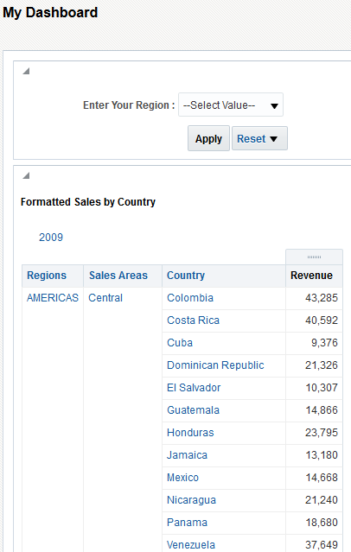


3. Test the Results
Year Prompt properties
Hidden prompt default initial value set to 2009
Notes:
Save the dashboard and click Run. The Dashboard appears with the default hidden prompt value in the analysis.
Note: The Year prompt used in this example was created with an initial value of 2009 as shown in the slide.
Oracle BI 12c: Create Analyses and Dashboards 12 - <number>

Slide 33
Creating a Second Prompt Page
  Add a new prompt to an existing prompt page.
  Insert a page break.
  Edit the dashboard and add the prompt.
  Test the results.
Notes:
Instructor Note
This is a structuring slide. Do not teach the steps or concepts here because the subsequent slides cover them in detail.
Oracle BI 12c: Create Analyses and Dashboards 12 - <number>

Slide 34
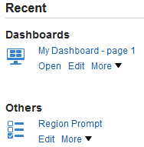

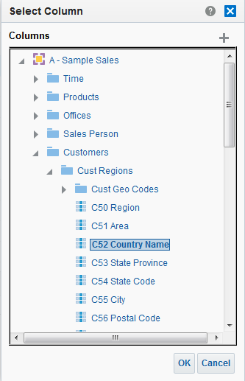
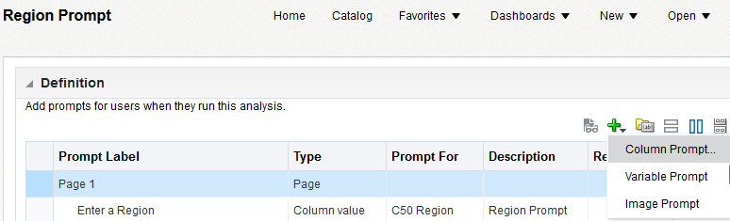


1. Add a New Prompt to an Existing Prompt Page
Separate prompts by creating an additional prompt page.
Edit the prompt.
1
Add a new prompt.
2
3
Choose a subject area and column.
Notes:
1. Edit the prompt to which you want to add a second prompt and page. From the Home page, click the hotlink for the appropriate prompt.
2. Click Add Prompt and select the prompt type.
3. Select the subject area and the column to build the prompt.
Oracle BI 12c: Create Analyses and Dashboards 12 - <number>

Slide 35
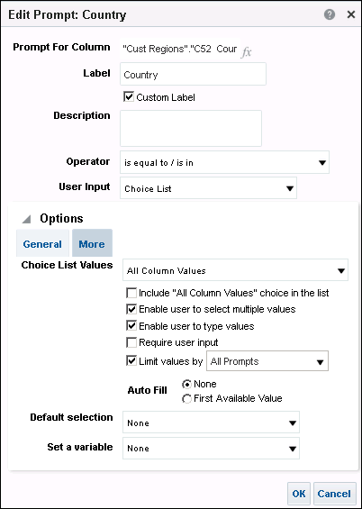
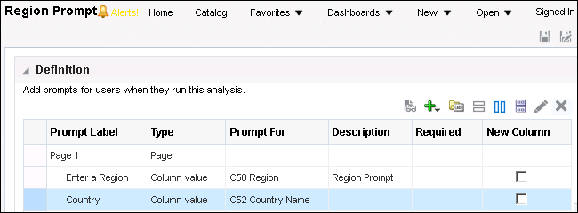



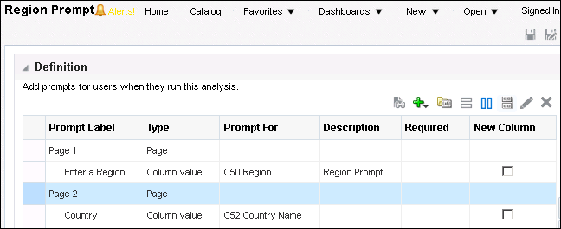

2. Insert a Page Break
Insert page break.
2
Select the prompt.
1
Complete the detail for the prompt.
3
Notes:
1. Complete the New Prompt dialog box, limit values by all prompts, and click OK.
2. Select the new prompt to set the insertion point for the page and click “Insert page break.”
3. The page break appears in the Definition pane table between the two prompts.
Save the prompt.
Note: The Region prompt is required and the Country prompt is optional. The analysis (built in Analysis Editor) on this dashboard page contains two filters that correspond with the two prompts that are being added.
Oracle BI 12c: Create Analyses and Dashboards 12 - <number>

Slide 36
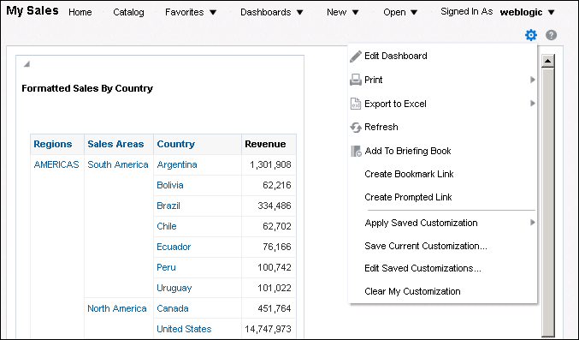

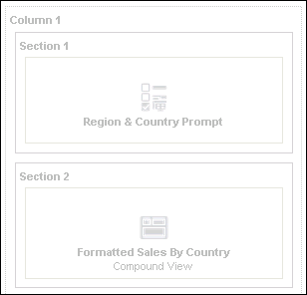


3. Edit the Dashboard and Add the Prompt
Edit the dashboard.
1
Add the prompt.
2
Notes:
1. Edit the dashboard to which you want to add the new prompt.
2. Add the prompt and save the changes.
Note: This prompt is being added to a dashboard analysis that contains the Region and Country columns.
Oracle BI 12c: Create Analyses and Dashboards 12 - <number>

Slide 37
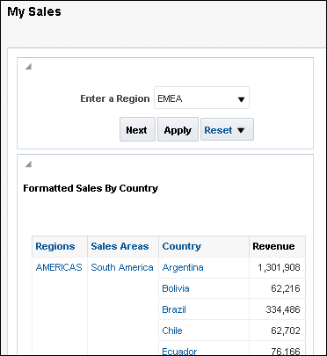

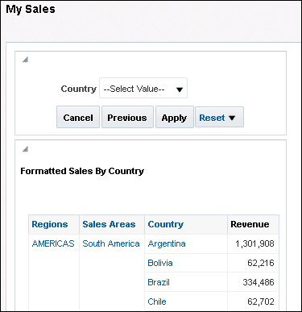

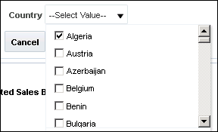
4. Test the Results
Choose a Region.
1
2
Choose a Country.
3
Notes:
1. Run the dashboard to view the new prompt and prompt page. Select the first prompt value, which is the required prompt. At this point, you can click Apply to run the analysis for the specified region.
2. Click Next.
3. Choose a country and click Apply.
Oracle BI 12c: Create Analyses and Dashboards 12 - <number>

Slide 38
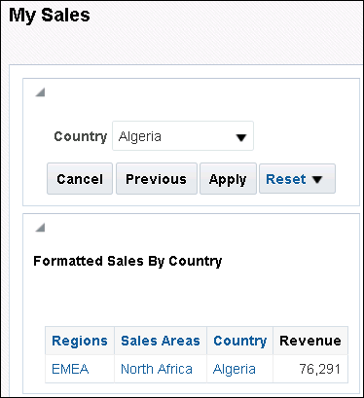
4. Test the Results
Dashboard reflects the two prompted values.
Country = Algeria
Region = EMEA
Notes:
Oracle BI 12c: Create Analyses and Dashboards 12 - <number>

Slide 39
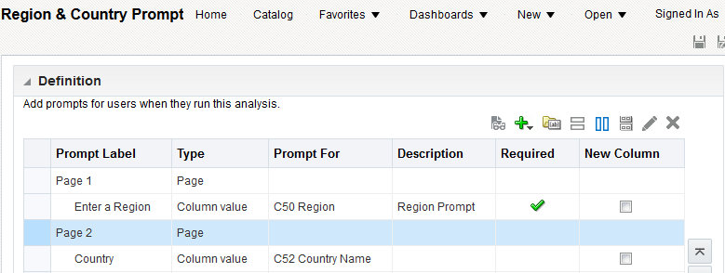

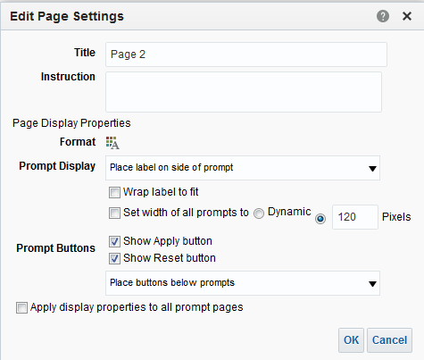



Setting Preferences for a Prompt Page
Set preferences for a prompt page.
Double-click the prompt page.
Instructions appear below the prompt.
Title will be displayed on the prompt page.
Format the title.
Notes:
Oracle BI 12c: Create Analyses and Dashboards 12 - <number>

Slide 40
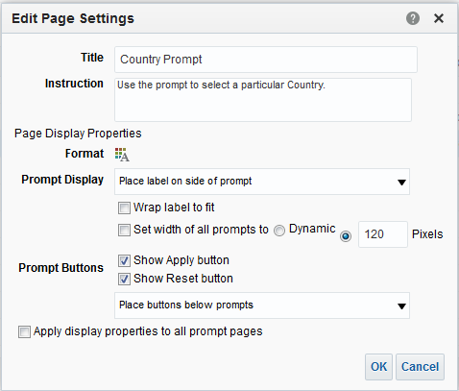
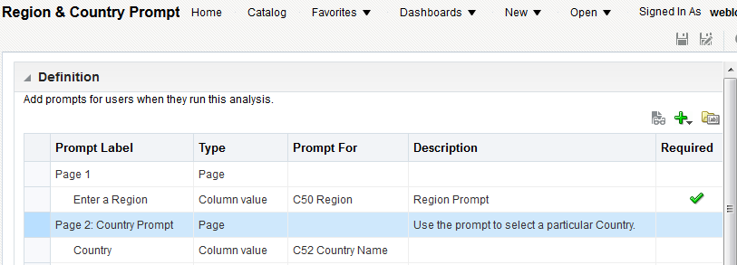

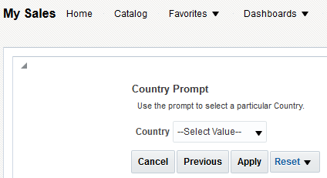

Setting Preferences for a Prompt Page
The table reflects the new page settings.
The dashboard reflects the new prompt preferences.
Notes:
Oracle BI 12c: Create Analyses and Dashboards 12 - <number>

Slide 41
Presentation Variables and Prompts
  These can be created as part of the process for creating a column prompt or a variable prompt.
    As part of a column prompt:
      Associated with a column
      Takes its value from the column
    As part of a variable prompt:
      It is not associated with any column.
      You define the values that the prompt can take.
  The name and value of the presentation variable are determined by the user when it is initially declared or when it is referenced in the analysis, dashboard, or agent.
Notes:
Oracle BI 12c: Create Analyses and Dashboards 12 - <number>

Slide 42
Request Variables and Prompts
  They let you override the value of a session variable, but only for the duration of a database request initiated from a column or variable prompt.
  They can be created as part of the process of creating a column or variable prompt.
    Works similarly to the creation of a Presentation variable or column prompt (see previous slide for details)
  The value of the request variable is populated by the column or variable prompt with which it was created.
Notes:
The value of a request variable is populated by the column or variable prompt with which it was created. That is, each time a user selects a value in the column or variable prompt, the value of the request variable is set to the value that the user selects. The value, however, is in effect only from the time the user clicks the OK button for the prompt, until the analysis results are returned to the dashboard.
Oracle BI 12c: Create Analyses and Dashboards 12 - <number>

Slide 43
Adding a Variable Prompt to a Dashboard
  Add a variable to an existing analysis.
  Create a new variable prompt.
  Select the prompt type.
  Define the prompt properties.
  Save the prompt.
  Select the dashboard.
  Add the prompt to the dashboard.
  Navigate the Catalog to locate the named prompt.
  Test the results.
Notes:
Instructor Note
This is a structuring slide. Do not teach the steps or concepts here because the subsequent slides cover them in detail.
Oracle BI 12c: Create Analyses and Dashboards 12 - <number>

Slide 44
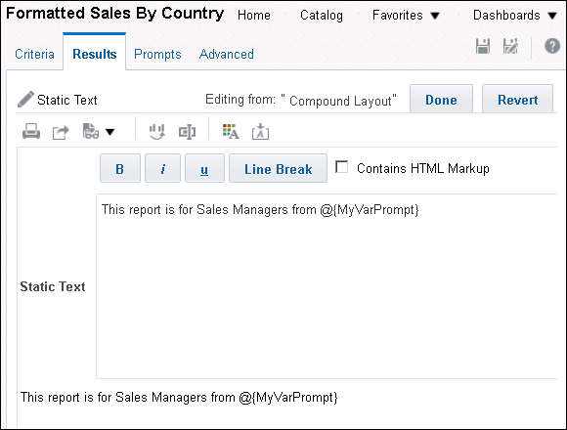
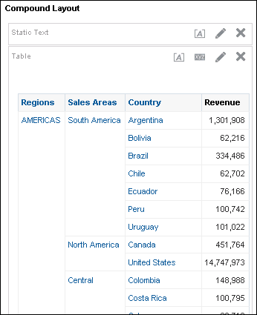


1. Add a Variable to an Existing Analysis
Edit the properties of the view to which you want to add the variable. This variable will accept the prompt at run time.
1
3
2
The analysis reflects the new variable.
Notes:
1. Open an existing analysis having static text view and click the Edit icon.
2. Enter a variable name for the prompt that you will create on the dashboard. In the example in the slide, the prompt name is MyVarPrompt. You can enter additional static text as well.
The syntax for a presentation or request variable is as follows:
@{variables.variablename}[format]{defaultvalue} or @{scope.variables['variablename']}
where:
variablename is the name of the presentation or request variable
(optional) format is a format mask dependent upon the data type of the variable, for example, #, ##0, MM/DD/YY hh:mm:ss. (Note that the format is not applied to the default value.)
(optional) defaultvalue is a constant or variable reference indicating a value to be used if the variable referenced by variablename is not populated
Oracle BI 12c: Create Analyses and Dashboards 12 - <number>

Slide 45
Notes:
scope identifies the qualifiers for the variable. You need to specify the scope when a variable is used at multiple levels (analyses, dashboard pages, and dashboards) and you want to access a specific value. (If you do not specify the scope, then the order of precedence is analyses, dashboard pages, and dashboards.)
Examples:
@{variables.MyFavoriteRegion}{EASTERN REGION}
or
@{dashboard.variables['MyFavoriteRegion']}
Note that your entry is reflected in the Static Text pane for your review.
3. Click Done and review the variable on the analysis. Save the analysis.
Oracle BI 12c: Create Analyses and Dashboards 12 - <number>

Slide 46
2. Create a New Variable Prompt
To add a new prompt to a dashboard, click New > Dashboard Prompt and select the subject area.
Notes:
Oracle BI 12c: Create Analyses and Dashboards 12 - <number>

Slide 47
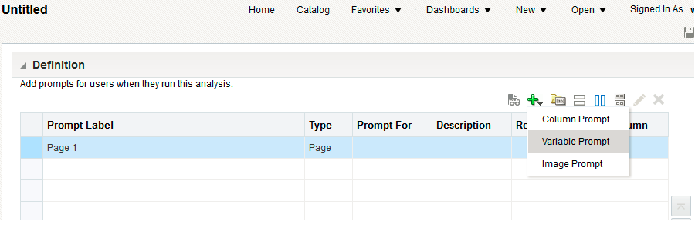

3. Select the Prompt Type
Next, click the Add icon and select Variable Prompt from the
drop-down list.
Add a new prompt.
Notes:
Oracle BI 12c: Create Analyses and Dashboards 12 - <number>

Slide 48
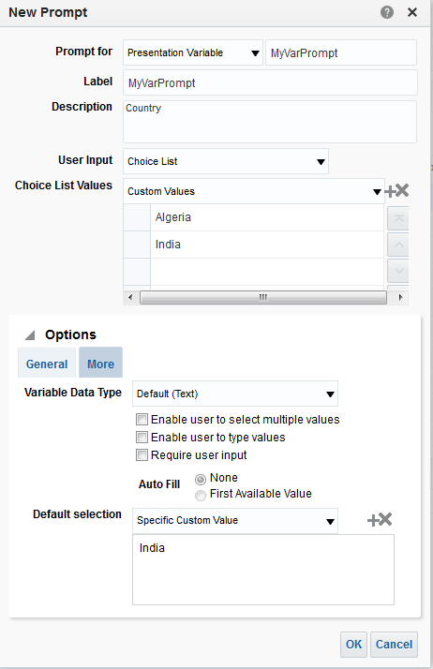


4. Define the Prompt Properties
Complete the New Prompt dialog box.
1
This is the same name that you used in the Static Text view on the analysis.
2
Complete the New Prompt dialog box.
3
Notes:
1. Enter the same name that you used in the analysis in the Prompt for text box.
2. Complete the remainder of the New Prompt dialog box fields as you deem appropriate. In the example in the slide, only two values are allowed and the default value is India.
3. Click OK.
Note: This prompt can now be added to a dashboard as a named prompt or a hidden named prompt.
Oracle BI 12c: Create Analyses and Dashboards 12 - <number>

Slide 49
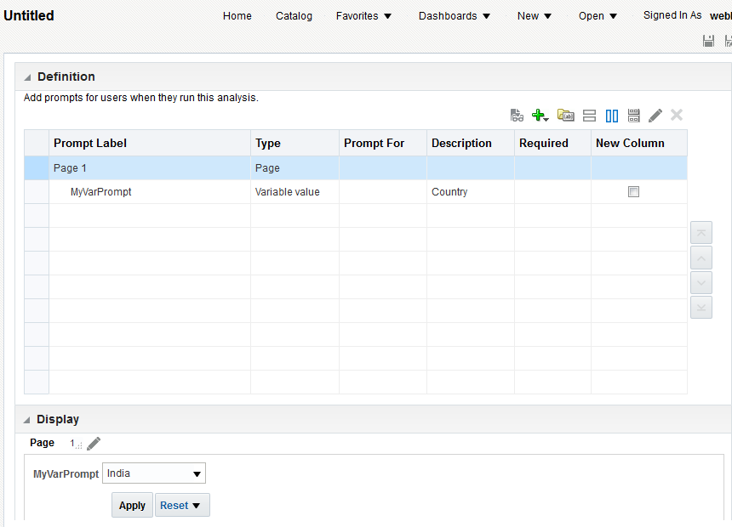


5. Save the Prompt
Save the prompt to add it to the Catalog.
Preview the prompt in the Display pane.
Notes:
Oracle BI 12c: Create Analyses and Dashboards 12 - <number>

Slide 50
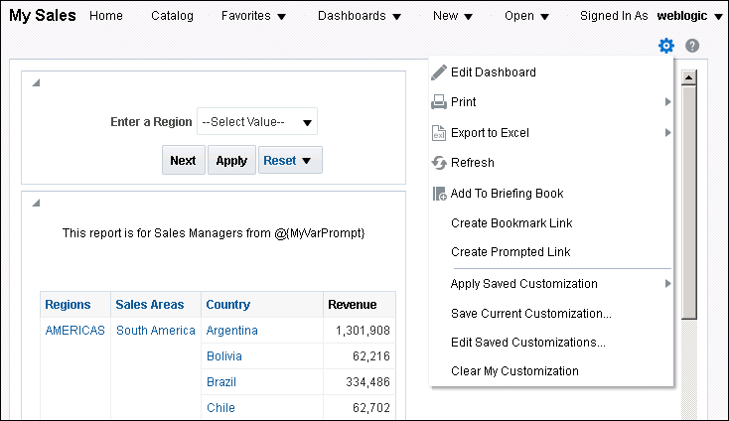


6. Select the Dashboard
Open the dashboard to which you want to add the variable prompt.
Edit the dashboard.
Modifications that you made to the analysis are reflected on the dashboard.
Notes:
Open the dashboard page to which you want to add the new prompt. This dashboard already contained the report that was modified in step 1. Therefore, you are able to see the static text and the variable name.
Edit the dashboard to add the prompt.
Oracle BI 12c: Create Analyses and Dashboards 12 - <number>

Slide 51
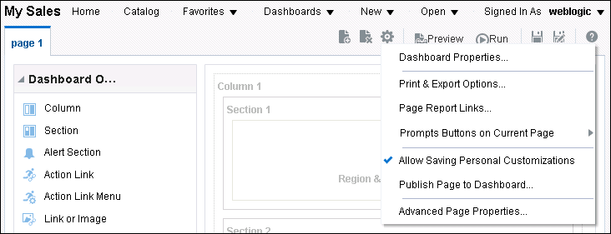

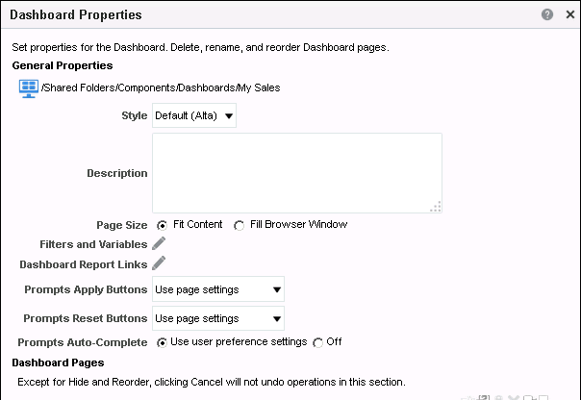
7. Add the Prompt to the Dashboard
Associate the variable prompt with the analysis.
1
Edit the dashboard properties.
2
Notes:
1. From within the Dashboard Builder, click the Tools toolbar icon and select Dashboard Properties.
2. Click the “Filters and Variables” link in the Dashboard Properties dialog box.
Oracle BI 12c: Create Analyses and Dashboards 12 - <number>

Slide 52
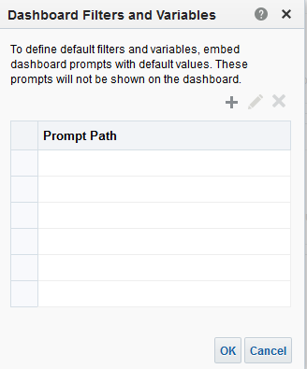


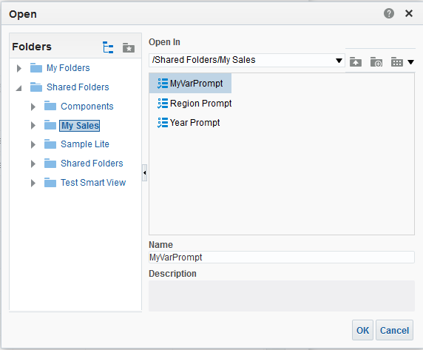
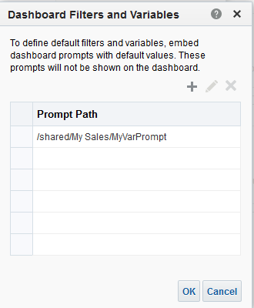
8. Navigate the Catalog to Locate the Named Prompt
Add a prompt.
The MyVarPrompt prompt stored in the Catalog
1
2
4
3
Notes:
1. Click the Add icon.
2. Locate the prompt.
3. Click OK to return to the “Dashboard Filters and Variables” dialog box.
4. Click OK again to return to the Dashboard Properties dialog box and click OK a final time to return to the Dashboard Builder.
Save the dashboard and run it.
Oracle BI 12c: Create Analyses and Dashboards 12 - <number>

Slide 53
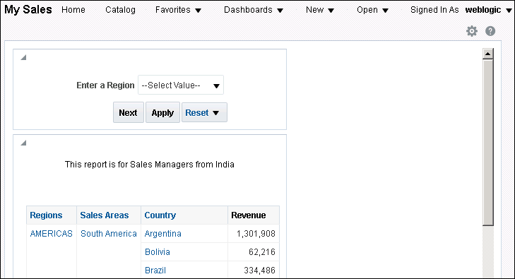

9. Test the Results
MyVarPrompt appears on the dashboard populated with the default value.
Notes:
Oracle BI 12c: Create Analyses and Dashboards 12 - <number>

Slide 54




Adding a Hierarchical Prompt
1
3
2
Notes:
In Oracle BI EE release 12.2.1, you can set prompts on hierarchical columns. Similar to the preceding example, where the MyVarPrompt presentation variable was added to the dashboard, you can specify a presentation variable in the column prompt for a hierarchical column.
To create a hierarchical column prompt that uses a presentation variable, perform the following steps:
1. Select a hierarchical column to be added to a column prompt.
2. In the “Set a variable” drop-down list, select Presentation Variable. Enter a variable name, and then click OK.
3. Test the prompt. You can select hierarchy members for the prompt and observe the results.
Oracle BI 12c: Create Analyses and Dashboards 12 - <number>

Slide 55
Applying Prompts with Default Values
Oracle BI run time applies prompts with default values as
follows:
  Hidden prompts whose scope is the dashboard page
  Hidden prompts whose scope is the whole dashboard
  Visible prompts whose scope is the dashboard page (Precedence order is unspecified.)
  Visible prompts whose scope is the whole dashboard
  Prompts, either inline or named, whose scope is analysis
Notes:
Because prompting allows you to build rich dashboards and analyses, it is important to understand how Oracle BI initiates a complex dashboard’s prompts.
Note: “Scope is analysis” (sometimes called report scope) refers to prompts that are created using Analysis Editor.
Oracle BI 12c: Create Analyses and Dashboards 12 - <number>

Slide 56
Wiring Dashboard Prompts
  Specify how dashboard prompts interact with analysis prompts
  Five methods:
    Auto wiring
    Constrained prompts
    Filter value set to * Prompt User
    Selection steps override with prompts option
    Unprotected versus protected filters
Notes:
Oracle BI includes functionality that enables you to wire column and image prompts together in various ways to create dashboards and reports that allow users to quickly and easily request precise, meaningful data. Wiring prompts allow you to specify how dashboard prompts interact with analysis prompts. You cannot wire hierarchical column prompts, currency prompts, and variable prompts.
Auto wiring: Oracle BI applies the auto wiring method when you create an analysis and add a column prompt or image prompt, and do not create either a filter or a column filter with a filter value other than the is prompted operator. Oracle BI will not perform auto wiring if an unprotected column filter exists for the analysis. The auto wiring functionality assumes that you intended to create a functioning prompt for the column and, therefore, activates and applies the prompt. Auto wiring applies only to inline prompts and does not apply to named prompts.
Note that setting the filter value to is prompted provides a more precise level of control between prompts and filters than the auto wiring method.
Oracle BI 12c: Create Analyses and Dashboards 12 - <number>

Slide 57
Notes:
Constrained Prompts: Use this method with several columns in a prompt to create a way to constrain the user’s prompt choice based on subsequent choices. For example, if one column filters on region, and the next column filters on districts, then the district column can be constrained to show only districts in the region that the user selects. With this wiring method, you can create a named prompt with default values that are programmatically customized for each user. This eliminates the choice of a mutually exclusive filter that could result in no data.
Filter value is set to * Prompt User: Use this method to build complex prompts that interact with filters. When you use this method, you have full control over how the named prompts, inline prompts, and filters are applied to the embedded analysis.
Selection Steps Override with Prompts Option: Use this method to use an analysis or dashboard column prompt to provide the data choices for a specific member selection step on a hierarchical column. Only one selection step per column selection step set can be overridden with a prompt. All selection steps before and after the overridden step will be processed as specified.
Unprotected versus protected filters: Use this method to determine whether the dashboard prompt can supply the analysis prompt's value when the corresponding prompt column's filter value is set to something other than is prompted. The unprotected and protected filter settings can be used when a dashboard prompt and analysis prompt reside on the same dashboard and both prompts are created for the same column. When the column's filter value is unprotected, the dashboard prompt value determines the analysis' results. If the filter value is set to something other than is prompted (for example, is equal to/is in) and the filter is set to protected filter, the dashboard prompt cannot determine the report results.
Example: You create analysis A that contains information about the amount of products sold by region. You also add to the Region column a filter value of is protected and a Region prompt. You then create analysis B that contains information about sales representatives by region and analysis C that contains information about city by region. You then create and save a dashboard prompt for Region. When you create a dashboard and add analyses A, B, and C, and the Region dashboard prompt, and then run the dashboard, the dashboard prompt input will only drive what displays in analyses B and C. In this scenario, analysis A would not use the Region value specified in the dashboard prompt because you set analysis A's Region column filter value to is prompted. Therefore, the only way that analysis A will accept a prompt value is if the user specifies a prompt value in Region A's prompt fields.
Oracle BI 12c: Create Analyses and Dashboards 12 - <number>

Slide 58



Auto-Complete for Prompts
The auto-complete functionality for prompts suggests and highlights matching prompt values as the user types in the prompt selection field.
User selects matching level and value.
Matching values are highlighted.
Notes:
Oracle BI EE provides the auto-complete functionality for prompts, which, when enabled, suggests and highlights matching prompt values as the user types in the prompt selection field. Auto-complete is available only for the Choice List prompt type when the prompt designer selected the “Enable User to Type Value” option in the New Prompt dialog box. Note that auto-complete is not available for hierarchical prompts.
The administrator configures the auto-complete functionality to be case-sensitive or not case-sensitive, and then specifies the matching level. The matching level determines how Oracle BI EE matches the column’s values to what the user types. There are three different ways that the administrator can set up auto-complete matching:
Starts With: As the user types, Oracle BI EE suggests the column values that begin with the letter or text that the user is typing.
Word Starts With: As the user types, Oracle BI EE suggests the column values that contain any words whose first letter matches with what the user is typing.
Match All: As the user types, Oracle BI EE suggests the column values that contain any letter that the user is typing.
Oracle BI 12c: Create Analyses and Dashboards 12 - <number>

Slide 59
Notes:
When the administrator properly configures the prompts setting in the Oracle BI EE instance configuration file, the auto-complete functionality highlights matching values when the user accesses the Select Values dialog box to search for a prompt value. However, the matching level is not determined by the preference set by the administrator. Instead, the user selects the matching level in the Select Values dialog box.
Oracle BI 12c: Create Analyses and Dashboards 12 - <number>

Slide 60



Optional Apply and Reset Buttons for Prompts
Show or hide a prompt’s apply and reset buttons.
1. Apply and Reset buttons defined for prompt
2. Hide All Apply Buttons
3. The specified prompt value is immediately applied to the dashboard or analysis.
Notes:
You can choose to show or hide a prompt’s Apply and Reset buttons at run time. If you choose to hide the Apply button, then the specified prompt value is immediately applied to the dashboard or analysis. You can specify these settings in the Dashboard Properties dialog box, a drop-down list in the Dashboard Editor, for individual dashboard pages, and individual prompts.
At the dashboard level, there are three options for both Apply and Reset buttons:
Use page setting: Select this option to use the Apply buttons as defined by the dashboard page settings.
Show All (Apply/Reset) buttons: Select this option to override the dashboard page setting’s button preferences and show the buttons for the prompts included on the dashboard and embedded analyses,
Hide All (Apply/Reset) buttons: Select this option to override the dashboard page setting’s button preferences and hide the buttons for the prompts included on the dashboard and embedded analyses.
Oracle BI 12c: Create Analyses and Dashboards 12 - <number>

Slide 61

Quiz: Overview
This quiz examines your knowledge of variables and dashboard prompts.
Notes:
In this quiz, you answer questions regarding the various types of dashboard content.
Oracle BI 12c: Create Analyses and Dashboards 12 - <number>

Slide 62
Quiz
An inline prompt can be saved to the Catalog and reused for dashboard pages.
  True
  False
Notes:
Answer: b
A named prompt can be saved to the Catalog and reused, whereas an inline prompt is created while building an analysis and cannot be shared with other analyses. Inline prompts are deleted when the analyses are deleted.
Oracle BI 12c: Create Analyses and Dashboards 12 - <number>

Slide 63
Quiz
Constraining columns using named prompts allows you to
customize and restrict information presented to end users.
  True
  False
Notes:
Answer: a
If one column filters on region, and the next column filters on districts, then the district column can be constrained to show only districts in the region that the user selects. With this wiring method, you can create a named prompt with default values that are programmatically customized for each user.
Oracle BI 12c: Create Analyses and Dashboards 12 - <number>

Slide 64

Summary
In this lesson, you should have learned how to:
  Explain the different variable types supported by Oracle BI
  Describe and build dashboard prompts
Notes:
Oracle BI 12c: Create Analyses and Dashboards 12 - <number>

Slide 65

Practice 12: Overview
This practice covers building dashboard prompts and declaring and populating variables.
Notes:
Oracle BI 12c: Create Analyses and Dashboards 12 - <number>

