Slide 1
Oracle Business Intelligence Mobile App Designer
Notes:
Schedule: Timing Topic
45 minutes Lecture
60 minutes Practice
05 minutes Quiz
110 minutes Total

Slide 2
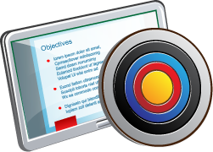
Objectives
After completing this lesson, you should be able to:
  Use Oracle BI Mobile App Designer to create basic mobile apps and tile pages
  Describe subpages
  Describe navigation pages
Notes:
Oracle BI 12c: Create Analyses and Dashboards 16 - <number>

Slide 3
BI Mobile App Designer
  Empowers business users to easily create interactive BI content for any mobile device
  Provides users with a drag-and-drop design interface, thus making them self-sufficient
  Works on all HTML5 devices—Android, Windows, and Blackberry 10
  Is versatile—build once, distribute anywhere, any device, any screen size
  Allows the sharing of apps easily via APPS LIBRARY
  Scales to unlimited users without compromising security
Notes:
Oracle BI 12c: Create Analyses and Dashboards 16 - <number>

Slide 4
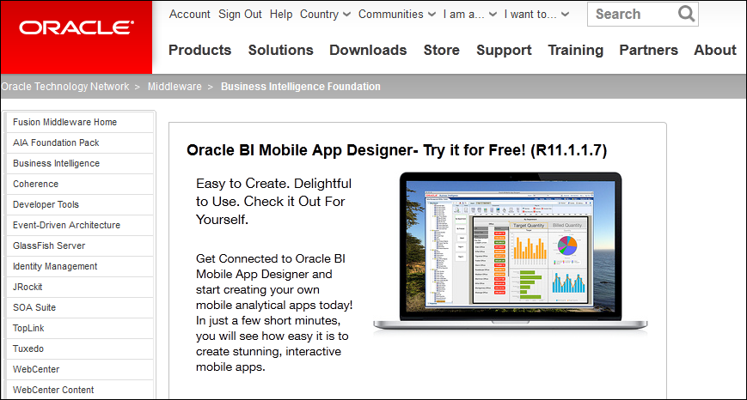
BI Mobile App Designer Trial Edition
Notes:
Oracle BI Mobile App Designer is available with Oracle BI EE Release 11.1.1.7.1. However, you can download and install a stand-alone trial version of Oracle BI Mobile App Designer for nonproduction evaluation purposes from the Oracle Technology Network (http://www.oracle.com/technetwork/middleware/bi-foundation/bi-mobile-app-designer-1983915.html). The trial edition omits enterprise management functionality, is unsupported, and may not be used for any production deployment.
The trial edition enables you to evaluate the Oracle BI Mobile App Designer using a small set of demo data and a demo application server. You cannot use the trial edition to connect to an existing Oracle BI server.
The examples and practices for this lesson are from the trial edition.
Oracle BI 12c: Create Analyses and Dashboards 16 - <number>

Slide 5
Creating Basic Mobile Apps
  Starting Oracle BI Mobile App Designer
  Exploring the Mobile App Designer Interface
  Modifying the Cover Page
  Adding Pages to the App
  Previewing the App
Notes:
Oracle BI 12c: Create Analyses and Dashboards 16 - <number>

Slide 6
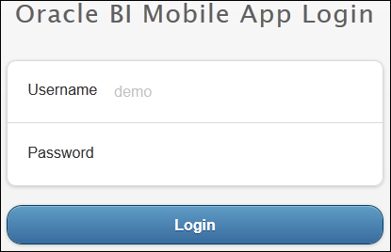
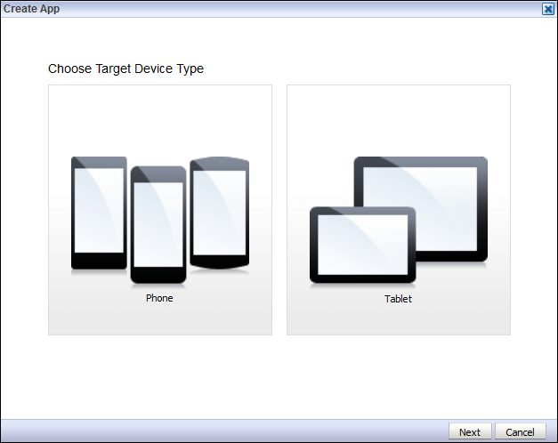

1. Starting Oracle BI Mobile App Designer
Trial edition login
2
1
Notes:
1. Do one of the following:
Log in to Oracle BI Mobile App Designer Trial Edition.
Note: You may have to start the Oracle BI Mobile App Designer Trial Edition application server first.
In Oracle BI EE release 11.1.1.7.1 or higher, in Presentation Services, under Create, click Mobile App.
2. The Create App dialog box is displayed. Under "Choose Target Device Type," select Tablet or Phone.
Oracle BI 12c: Create Analyses and Dashboards 16 - <number>

Slide 7
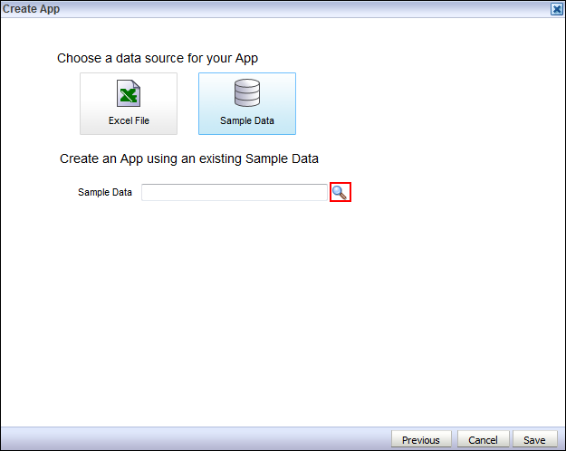

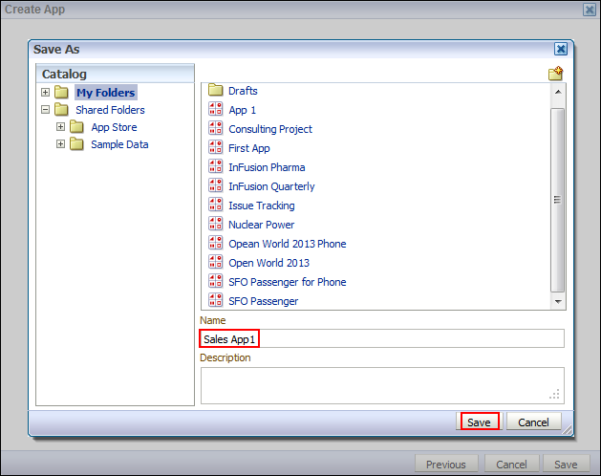
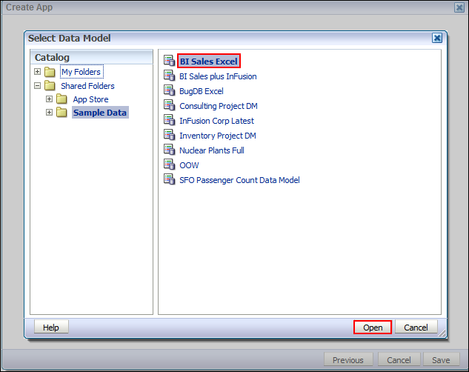
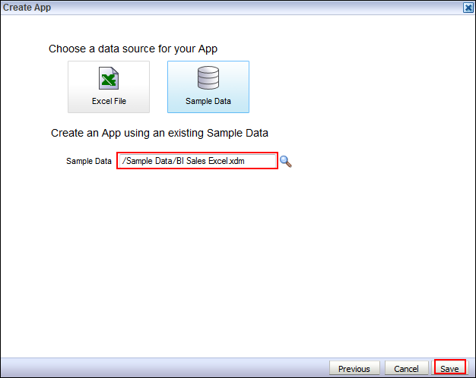

1. Starting Oracle BI Mobile App Designer
3
6
4
5
Notes:
3. Select a data source:
BI Subject Area
BI Publisher Data Model
Excel File
Sample Data (trial edition only)
Note: The trial edition of Oracle BI Mobile App Designer enables you to use only Excel files or the provided sample data.
4. Select a data model and click Open.
5. The new data model is displayed in the Create App dialog box. Click Save.
6. Enter a name for your app and click Save to display the Mobile App Designer interface.
Oracle BI 12c: Create Analyses and Dashboards 16 - <number>

Slide 8
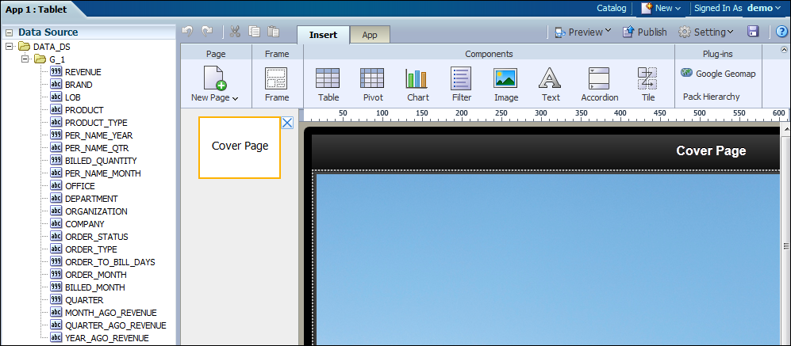
2. Exploring the Mobile App Designer Interface
You can drag and drop columns from data source to workspace.
The tools ribbon displays tabs related to the current selection.
Pages are displayed in the side bar.
Notes:
By default, a new app contains only a cover page. The Insert and App tabs are displayed in the tools ribbon.
You can click the default image in the center of the designer to display the Image tab. In the Pages sidebar, you can click the Cover Page tile to display the Page Layout tab.
Oracle BI 12c: Create Analyses and Dashboards 16 - <number>

Slide 9
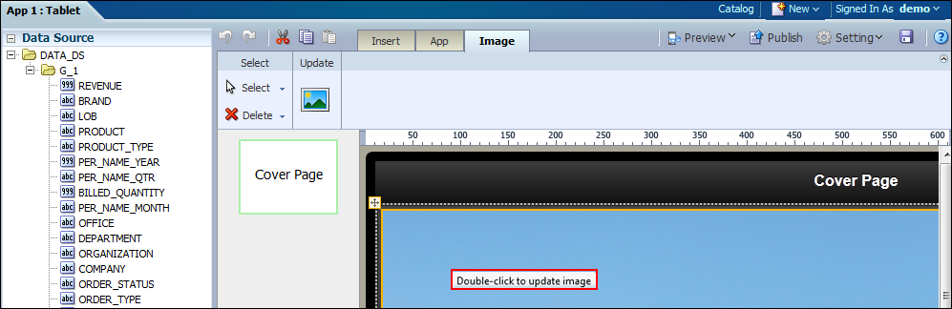
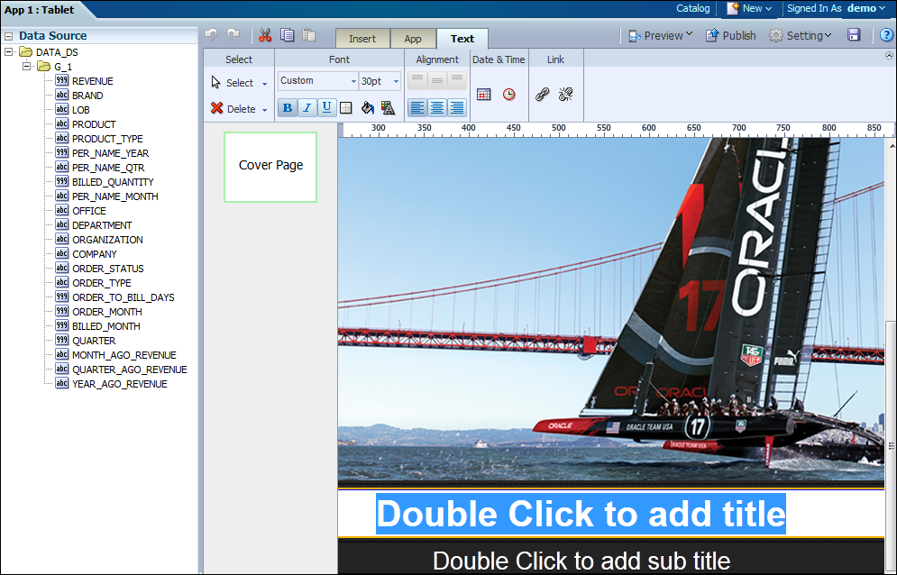

3. Optional: Modifying the Cover Page
1
2
Notes:
1. Double-click the image to replace the default photo on the cover page with a custom photo.
2. Scroll down to the bottom of the cover page. To modify or delete a title or sub title, double-click it.
Note: A cover page is not required for an app.
Oracle BI 12c: Create Analyses and Dashboards 16 - <number>

Slide 10
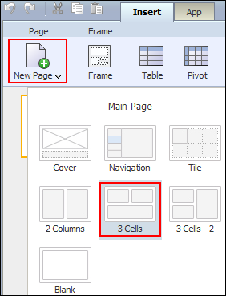
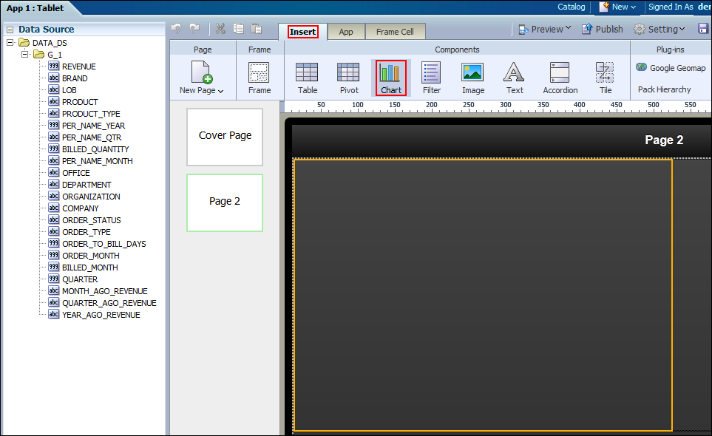
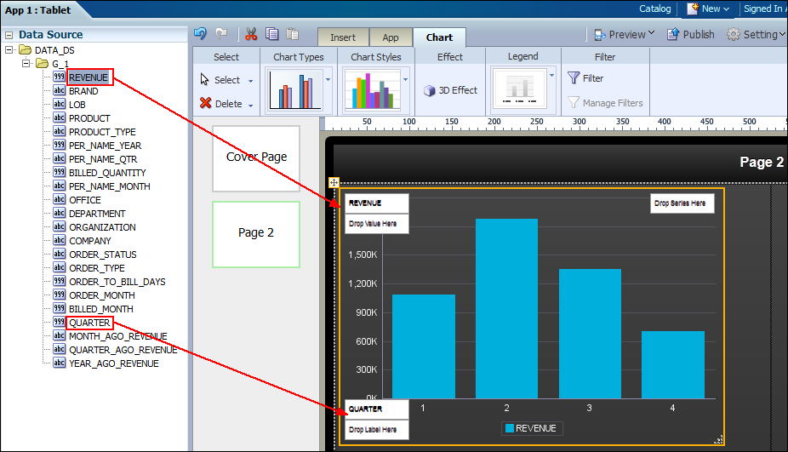
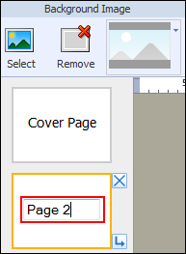
4. Adding Pages to the App
1
2
3
4
Notes:
1. On the Insert tab, select New Page, and then select a page type. Notice that a second page is added to the Pages side bar.
2. Use the tools ribbon to insert page content. The following content types are available:
Table
Pivot table
Chart
Filter
Image
Text
Accordion
Tile
3. If inserting a table, pivot table, chart, or tile, drag data columns from the Data Source section to the page.
4. Optional: Double-click the page name to rename the page.
Oracle BI 12c: Create Analyses and Dashboards 16 - <number>

Slide 11
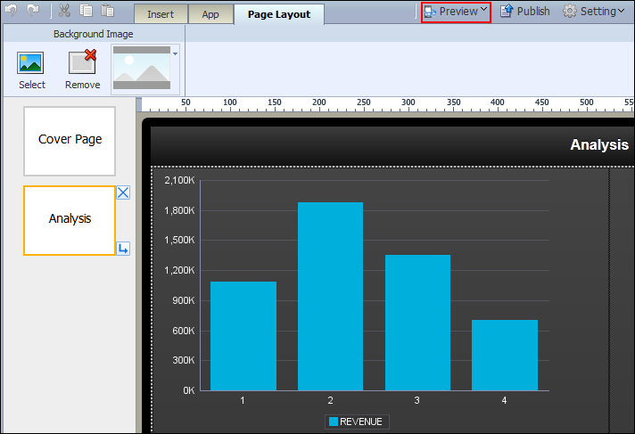
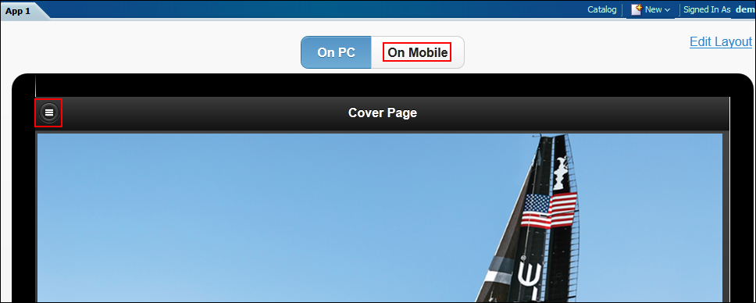
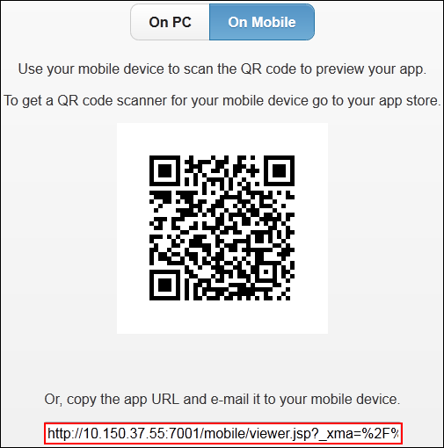
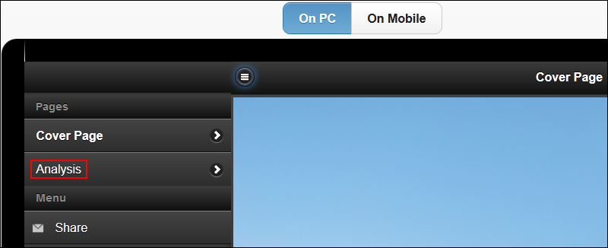
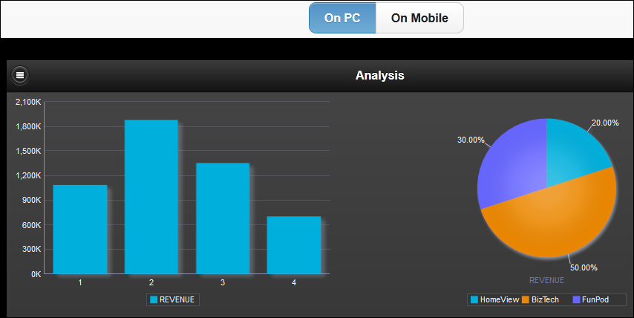
5. Previewing the App
1
2
4
3
5
Notes:
1. Click Preview to open a web preview of the app.
2. Optional: If you have a QR Code scanner app on a tablet device, you can preview the app on your tablet instead of on the web. Click On Mobile.
3. Optional: Use a QR Code scanner on your tablet device to scan the code. This opens the app preview on your tablet device.
Note: If you do not have a QR Code scanner app on your tablet, you can copy the app URL (displayed under the QR code) and email it to your mobile device.
4. From the cover page, click the page list icon to display the list of pages in the app.
5. Click a page name to preview the page.
Oracle BI 12c: Create Analyses and Dashboards 16 - <number>

Slide 12
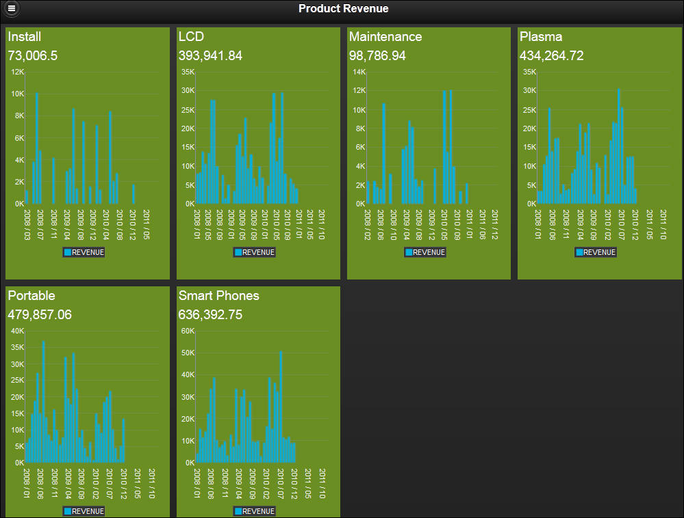
Tile Pages
Notes:
Tile pages provide a scrollable grid of cells, each containing identical components that are repeated for a specific field of data. The example in the slide displays revenue over time repeated for each product type. You can use tile pages to provide an instant view of a key measure across a specific dimension. This view not only provides a complete picture within each cell, but also enables an at-a-glance comparison across the data set. You can further enhance the visual impact of the values represented in each cell by creating stoplight formatting to highlight cells whose results fall outside the range of specific threshold values.
Oracle BI 12c: Create Analyses and Dashboards 16 - <number>

Slide 13
Designing Apps with Tile Pages
  Inserting tile pages
  Adding stoplight formatting
Notes:
Oracle BI 12c: Create Analyses and Dashboards 16 - <number>

Slide 14
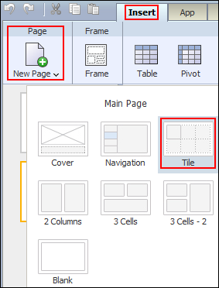
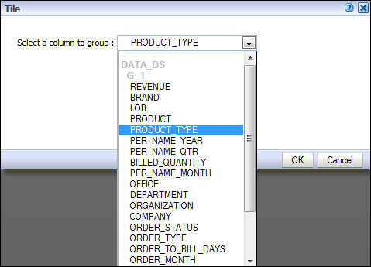
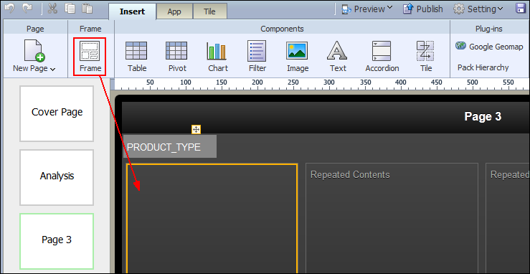
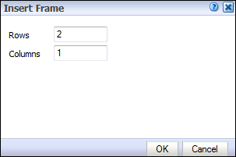
1. Inserting Tile Pages
1
2
3
4
Notes:
1. Click the Insert tab and then select New Page > Tile.
2. Select a column to group the entire tile page by.
3. Click the Insert tab, and drag the Frame icon to the layout cell on the tile page.
4. Specify the number of rows and columns for the tile display.
Oracle BI 12c: Create Analyses and Dashboards 16 - <number>

Slide 15
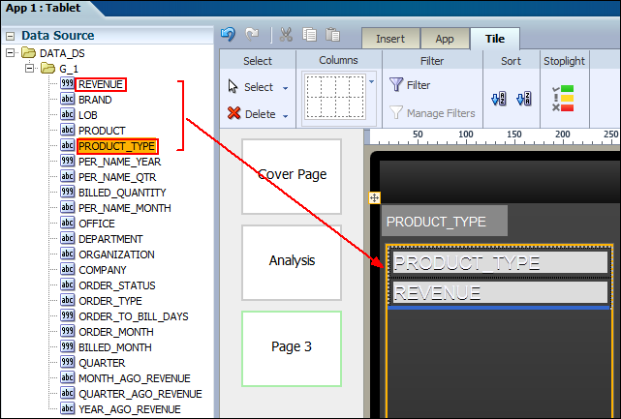
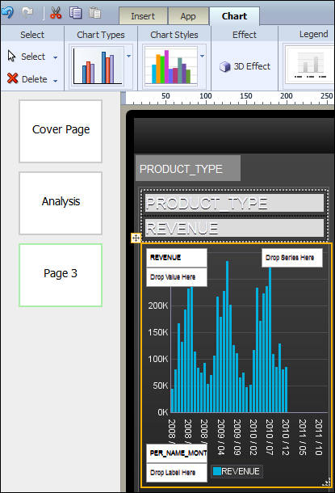
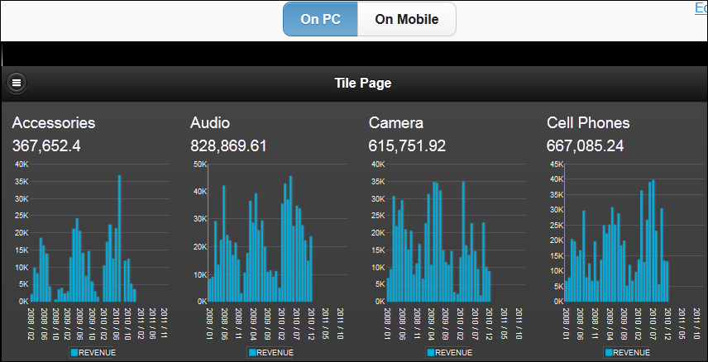
1. Inserting Tile Pages
5
6
7
Notes:
5. Add data columns to the Layout grid cell.
6. Insert a chart to in the Layout grid cell and drag the required columns in to it.
7. Preview the Tile Page.
Oracle BI 12c: Create Analyses and Dashboards 16 - <number>

Slide 16
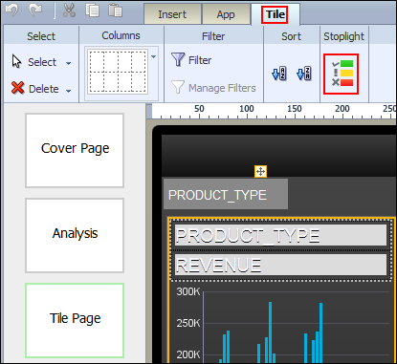
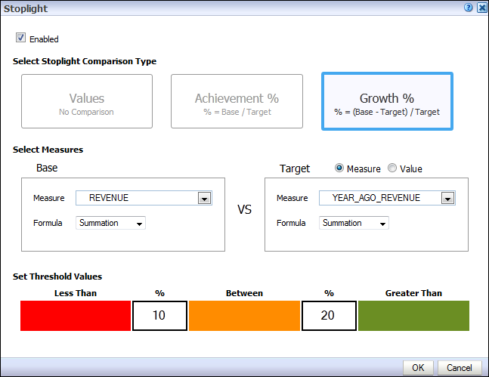
2. Adding Stoplight Formatting
1
2
Notes:
You can further enhance the visual impact of the values represented in each cell by creating stoplight formatting to highlight cells whose results fall outside the range of specific threshold values.
To add Stoplight formatting, perform the following steps:
1. On the Tile tab, click Stoplight.
2. Define the stoplight format:
Select a comparison type (Values, Achievement %, or Growth %).
Select base and target measures or values.
Set threshold values.
Note: Stoplight formatting is not displayed in the designer.
Oracle BI 12c: Create Analyses and Dashboards 16 - <number>

Slide 17
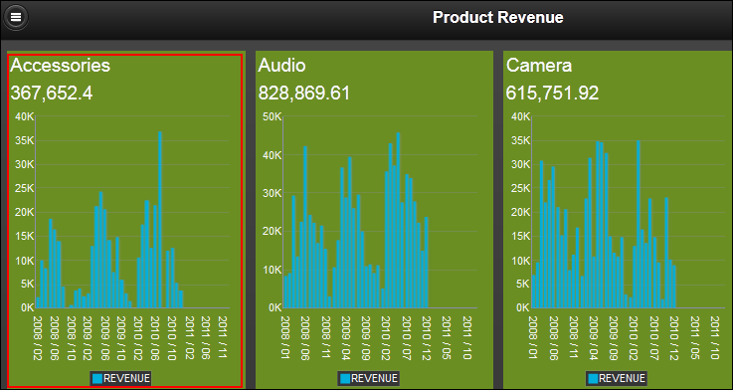
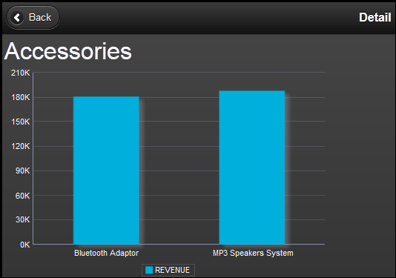
Subpage
  Provides detailed information of the main page to which it is associated
Click a particular graph.
Corresponding data in the subpage
Notes:
A subpage presents detail information of the main page to which it is associated. Typically you navigate to a subpage by clicking a data item on the related main page (such as a repeating grid cell, or a chart value). The data presented on the subpage is automatically filtered based on the item you clicked on the main page. The subpage is not displayed in the app’s table of contents. When navigating sequentially through the pages of the app, the subpage is displayed with no filters applied.
Oracle BI 12c: Create Analyses and Dashboards 16 - <number>

Slide 18
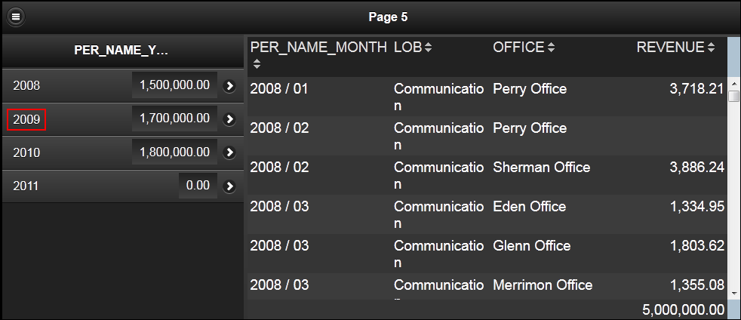
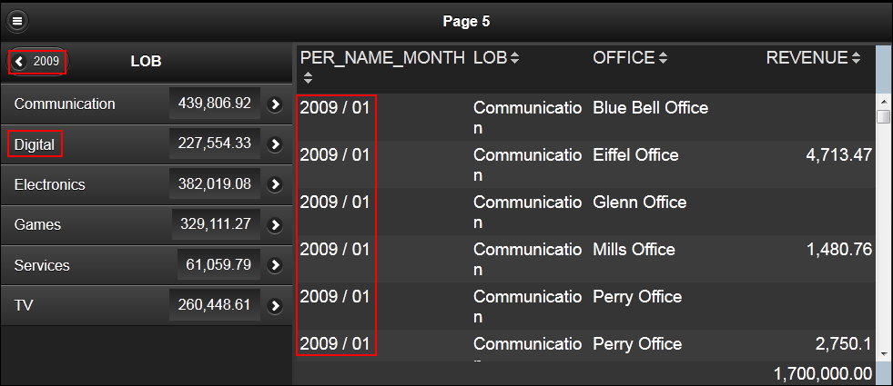
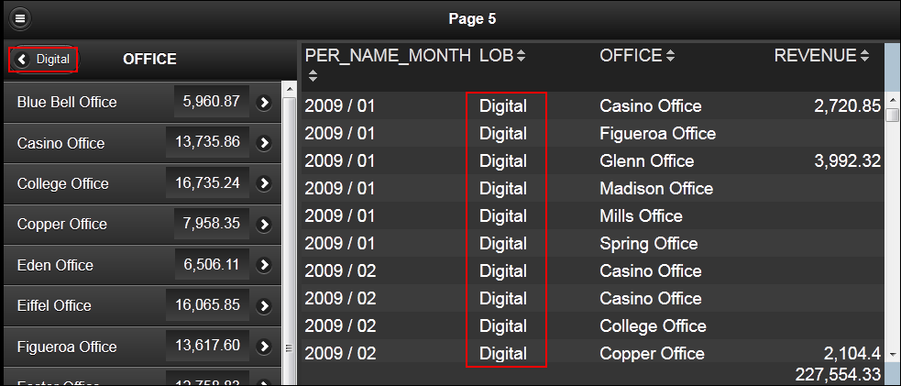
Navigation Pages
Enable you to define a navigable set of filters that a user can use to filter the data displayed on the page
Notes:
Navigation pages enable you to define a navigable set of filters that you can use to filter the data visualized on the page. The navigation area of the page contains a hierarchy of dimensions that you click through to drive the display on the detail side of the page; you can see successively more refined sets of data, or navigate up and down the hierarchical filters to see the subsets of data that interest you.
The navigation page shown in the slide enables you to navigate from a yearly revenue summary, to revenue for lines of business, and then to revenue for individual offices.
Oracle BI 12c: Create Analyses and Dashboards 16 - <number>

Slide 19
Creating Navigation Pages
  Inserting navigation pages
  Creating a navigation hierarchy
Notes:
Oracle BI 12c: Create Analyses and Dashboards 16 - <number>

Slide 20
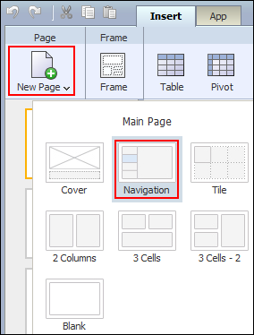
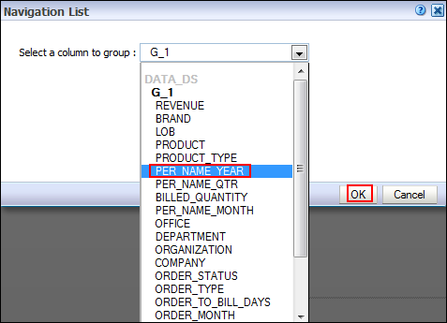
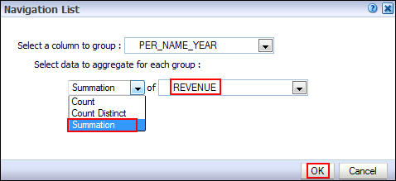
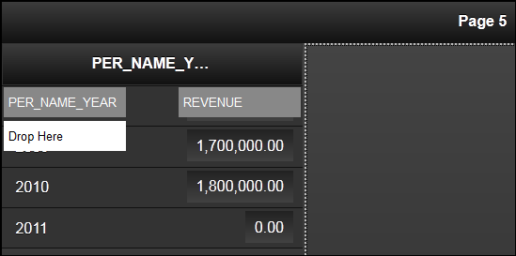
1. Inserting Navigation Pages
1
2
3
Notes:
1. Select New Page > Navigation.
2. Select a column to specify it as the top level in the navigation hierarchy.
3. Under “Select data to aggregate for each group,” define an aggregation rule based on any particular column to display next to the navigation groupings. In the example in the slide, summation of revenue for the column PER_NAME_YEAR is selected. Click OK.
In the example in the slide, a navigation page is displayed with the navigation area containing PER_NAME_YEAR and a sum of revenue by year.
Oracle BI 12c: Create Analyses and Dashboards 16 - <number>

Slide 21
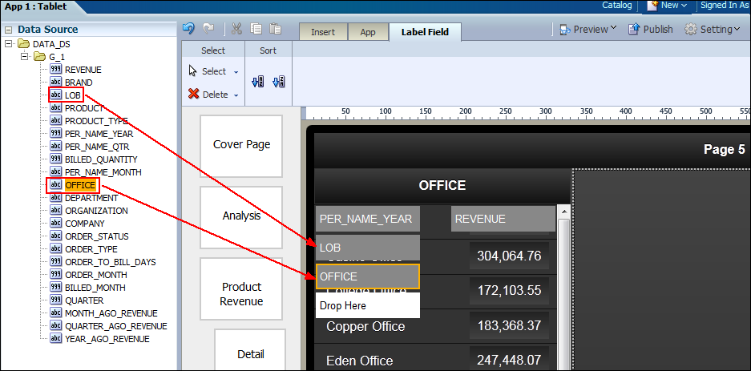
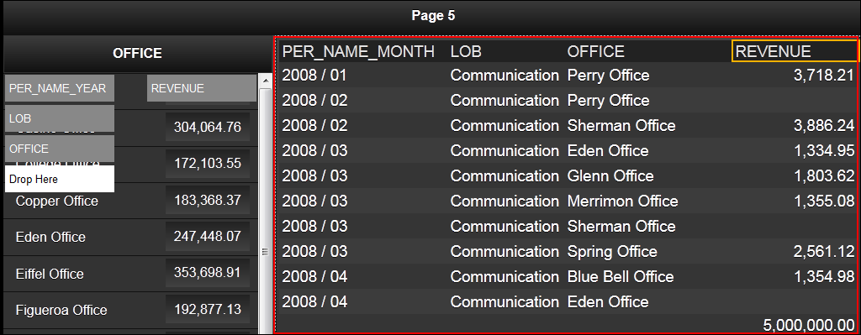
2. Creating a Navigation Hierarchy
1
2
Notes:
1. Drag columns from the data source to create a navigation hierarchy. In the example in the slide, the hierarchy is PER_ NAME_YEAR > LOB > OFFICE.
2. Create a view to visualize how the navigation page content is filtered as per the navigation hierarchy. In the example in the slide, a table view displays data related to the navigation hierarchy.
When you preview a navigation page, clicking a value in the navigation hierarchy filters data in the related view.
Oracle BI 12c: Create Analyses and Dashboards 16 - <number>

Slide 22

Quiz: Overview
This quiz examines your knowledge of Oracle BI Mobile App Designer.
Notes:
In this quiz, you answer questions regarding Oracle BI Mobile App Designer.
Oracle BI 12c: Create Analyses and Dashboards 16 - <number>

Slide 23
Quiz
You can preview mobile apps either on the web or on your mobile device.
  True
  False
Notes:
Answer: a
Oracle BI 12c: Create Analyses and Dashboards 16 - <number>

Slide 24
Quiz
A page that enables you to filter content based on a defined hierarchy of dimensions is called a:
  Tile page
  Filter page
  Hierarchy page
  Navigation page
Notes:
Answer: d
Oracle BI 12c: Create Analyses and Dashboards 16 - <number>

Slide 25
Quiz
You must install an application on your mobile device to view apps created in the Mobile App Designer.
  True
  False
Notes:
Answer: b
Apps generated by the Mobile App Designer are in HTML5 format. This means that you can open the apps with any modern browser on any type of mobile device without installing anything.
Oracle BI 12c: Create Analyses and Dashboards 16 - <number>

Slide 26
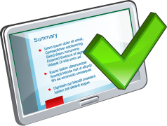
Summary
In this lesson, you should have learned how to:
  Use Oracle BI Mobile App Designer to create basic mobile apps and tile pages
  Describe subpages
  Describe navigation pages
Notes:
Oracle BI 12c: Create Analyses and Dashboards 16 - <number>

Slide 27

Practice 16: Overview
This practice covers the following topics:
  Creating a basic mobile app
  Creating tile pages
Notes:
Oracle BI 12c: Create Analyses and Dashboards 16 - <number>

