Slide 1
Direct Database Analysis
Notes:
Schedule: Timing Topic
20 minutes Lecture
25 minutes Practice
05 minutes Quiz
50 minutes Total

Slide 2

Objectives
After completing this lesson, you should be able to:
  Create direct database analyses
  Edit XML and SQL on the Advanced tab
Notes:
Oracle BI 12c: Create Analyses and Dashboards 19 - <number>

Slide 3
Direct Database Analysis Privileges
  Users with appropriate privileges can create and issue direct database analyses to physical back-end data sources.
    Display and manipulate results in Oracle Business Intelligence.
    Incorporate results into dashboards.
  Required privileges include:
    Edit Direct Database Analysis
    Execute Direct Database Analysis
Notes:
Users who are given these privileges should know advanced SQL and understand the content and structure of underlying data sources. Results can be displayed and manipulated in Oracle Business Intelligence and incorporated into dashboards.
Edit Direct Database Analysis
This privilege is used to create direct database analyses.
By default, this is set for only those users that are defined as Oracle BI Presentation Server Administrators.
Execute Direct Database Analysis
This privilege is used to issue physical analyses.
By default, this is set for only those users that are defined as Oracle BI Presentation Server Administrators.
Oracle BI 12c: Create Analyses and Dashboards 19 - <number>

Slide 4

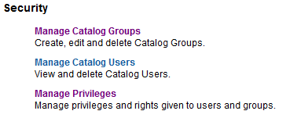


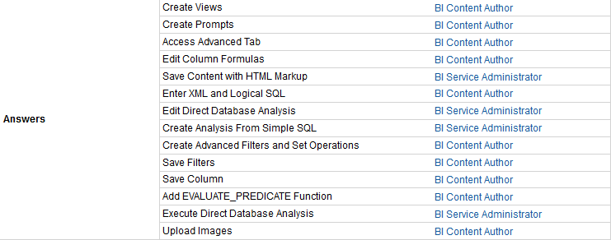
Changing Direct Database Analysis Privileges
Changes are made in the Oracle BI Administration window.
1
2
3
Notes:
In the Global Header, click the Administration link.
In the Administration window, click the Manage Privileges link in the Security section to open the Manage Privileges window.
In the Answers section, edit the direct database analysis privileges.
Oracle BI 12c: Create Analyses and Dashboards 19 - <number>

Slide 5
Creating and Executing a Direct Database Analysis
  Create a direct analysis.
  Construct a direct database analysis.
Notes:
Instructor Note
This is a structuring slide. Do not teach the steps or concepts here because the following slides cover them in detail. Instead, provide a high-level description of what is discussed.
Oracle BI 12c: Create Analyses and Dashboards 19 - <number>

Slide 6
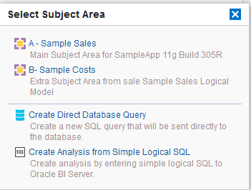
1. Create a Direct Analysis
Click Create Direct Database Request in the Select Subject Area window.
Notes:
On the Home page, create a new analysis. In the Select Subject Area window, click the Create Direct Database Request link to open the Direct Database analysis page on the Criteria tab of the Analysis Editor.
Oracle BI 12c: Create Analyses and Dashboards 19 - <number>

Slide 7
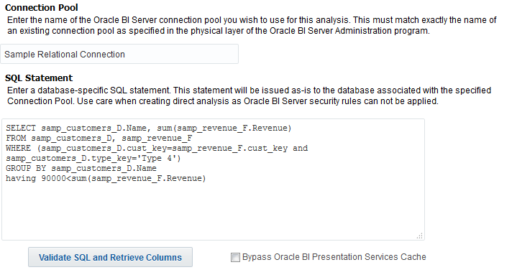

2. Construct a Direct Database Analysis
Follow the on-screen instructions to create the analysis.
1
2
4
3
Notes:
1. Specify a connection pool for the database defined in the physical layer of the repository. Use quotation marks if there are spaces in the connection pool name.
2. Enter a database-specific SQL statement. Use caution because Oracle BI Server security rules are bypassed and cannot be applied when direct database analyses are issued.
3. Optional: Select the bypass option to bypass the Oracle BI Presentation Services Cache.
4. Click “Validate SQL and Retrieve Columns” to check the SQL statement and retrieve the result columns, which are displayed in the Result Columns section of the Criteria tab.
Note: For more information about connection pools and the Oracle BI repository, see the Metadata Repository Builder’s Guide for Oracle Business Intelligence Enterprise Edition.
Oracle BI 12c: Create Analyses and Dashboards 19 - <number>

Slide 8
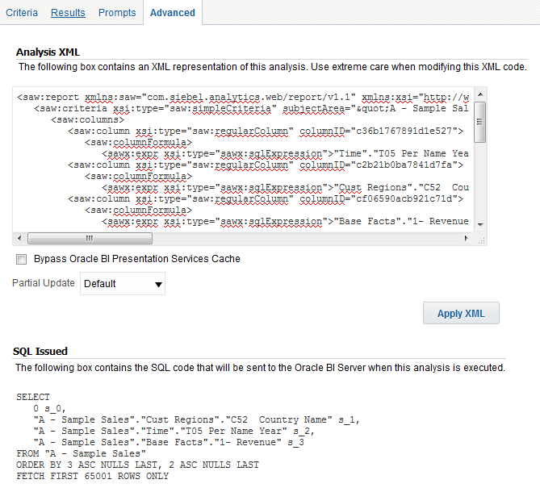
Editing XML and SQL
Use the Advanced tab to examine or edit the XML code and the logical SQL statement that are generated for an analysis.
For use by advanced users and developers who have the appropriate responsibilities
Notes:
You use the Advanced tab in the Analysis Editor to examine the XML code and the logical SQL statement that are generated for an analysis and optionally create a new analysis based on that SQL statement.
Generally, you need not use the features of this tab, because the majority of functionality for working with analyses is provided through the user interface.
The Advanced tab is only for advanced users and developers who have the appropriate responsibilities to access the Advanced tab. If you use the Advanced tab, it is assumed that you understand advanced SQL statements, have expertise working with the Oracle BI Server metadata, are familiar with Oracle BI logical SQL, and understand the content and structure of the underlying data sources.
Oracle BI 12c: Create Analyses and Dashboards 19 - <number>

Slide 9
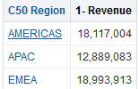


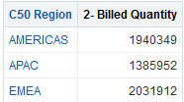
Using the Advanced Tab to Modify XML
Use the fields in the Analysis XML area to view and modify the XML code for an analysis.
1. Create an analysis.
2. View XML representation of the analysis on the Advanced tab.
3. Modify XML.
4. Apply XML.
5. Analysis is updated.
Notes:
Use the fields in the Analysis XML area to view and modify the XML code, and click Apply XML. Modifying the XML code for an analysis is not recommended. If you do choose to modify the XML code, then you affect the analysis because it is saved in the Oracle BI Presentation Catalog. The slide shows the steps for editing XML code on the Advanced tab:
1. Create an analysis.
2. View the XML representation of the analysis on the Advanced tab.
3. Modify the XML code as desired.
4. Click the Apply XML button to update the analysis.
5. Return to the Results tab and verify that the analysis is updated.
Oracle BI 12c: Create Analyses and Dashboards 19 - <number>

Slide 10

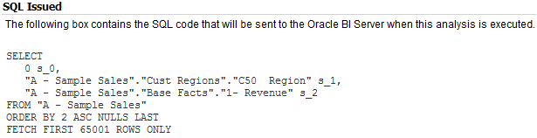


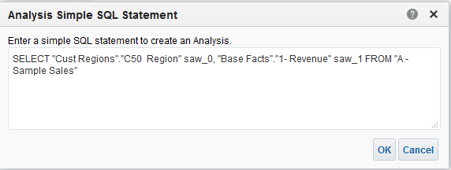


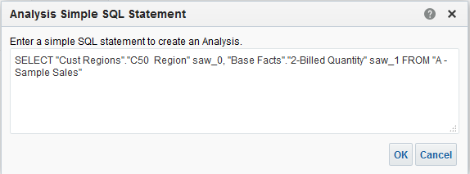
Using the Advanced Tab to Modify SQL
Use the SQL Issued area to view and modify the SQL code for an analysis.
1. Create analysis.
3. Click New Analysis.
2. View SQL.
4. Modify SQL.
6. Analysis is updated.
5
Notes:
Use the read-only box in the SQL Issued area to examine the SQL statement that is sent to the Oracle BI Server when the analysis is executed. If you want to create an analysis using the SQL statement from the current analysis as the starting point, then click the New Analysis button. Any hierarchical columns, selection steps, groups, or formatting that are specified in the current analysis are removed. The slide shows the steps for editing SQL code on the Advanced tab:
1. Create an analysis.
2. View the SQL issued for the analysis on the Advanced tab.
3. Click the New Analysis button to open the Analysis Simple SQL Statement dialog box.
4. Modify the SQL code as desired.
5. Click the OK button in the Analysis Simple SQL Statement dialog box to update the analysis.
6. Return to the Results tab and verify that the analysis is updated.
Oracle BI 12c: Create Analyses and Dashboards 19 - <number>

Slide 11
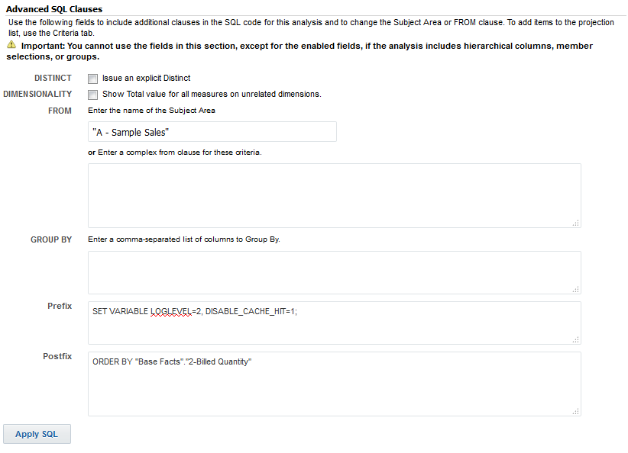






Using the Advanced Tab to Include
Advanced SQL Clauses
Use the Advanced SQL Clauses area to include additional clauses in the SQL code for an analysis.
Change the subject area.
Enter a complex FROM clause.
Enter a comma-delimited list of columns to use in a GROUP BY command.
Enter SQL statements to be run before the SQL statement for the analysis runs.
Enter SQL statements to be run after the SQL statement for the analysis runs.
Apply SQL.
Notes:
Depending on the content of an analysis, you can use the available fields in the Advanced SQL Clauses area to include additional clauses in the SQL code:
Use the FROM field to point the analysis to a new subject area. You can do this if you want to keep the same analysis criteria and layout, but want to change to a different subject area with the same columns. You also have the option of entering a complex FROM clause.
You can use the Prefix section to override any user variable or session variable that has been marked as available for updating. You can specify multiple variables to update with one line of code. In this example, you use variables to set the logging level and disable the cache for this analysis.
Use the Postfix field to enter any additional SQL clauses that you would like to include with the analysis, including a full SQL statement. If you include an ORDER BY command, then you override any ORDER BY commands from the SQL statement for the analysis.
Use Issue an Explicit Distinct to send a SELECT DISTINCT SQL statement to the Oracle BI Server.
Use the GROUP BY field to enter a comma-delimited list of columns from the analysis to use in a GROUP BY command.
Oracle BI 12c: Create Analyses and Dashboards 19 - <number>

Slide 12
Notes:
Take care when clicking the Apply SQL button. When you do, Oracle BI EE creates a new analysis based on the SQL statement that you have added or modified. Therefore, you lose all views, formatting, and so on that you had previously created for the analysis. The XML code is also modified for the new analysis.
Oracle BI 12c: Create Analyses and Dashboards 19 - <number>

Slide 13

Quiz: Overview
This quiz examines your knowledge of direct database analyses and modifying XML and SQL.
Notes:
In this quiz, you answer questions regarding direct database analyses and editing XML and SQL on the Advanced tab.
Oracle BI 12c: Create Analyses and Dashboards 19 - <number>

Slide 14
Quiz
By default, the Execute Direct Database Analysis privilege is set for only those users that are defined as Oracle BI Presentation Server Administrators.
  True
  False
Notes:
Answer: a
Oracle BI 12c: Create Analyses and Dashboards 19 - <number>

Slide 15
Quiz
The Results tab in the Analysis Editor is used to examine the XML code and the logical SQL statement that are generated for an analysis.
  True
  False
Notes:
Answer: b
Use the Advanced tab in the Analysis Editor to examine the XML code and the logical SQL statement that are generated for an analysis and optionally create a new analysis based on that SQL statement.
Oracle BI 12c: Create Analyses and Dashboards 19 - <number>

Slide 16
Quiz
The Create direct database request link is available in the Select Subject Area window.
  True
  False
Notes:
Answer: a
Oracle BI 12c: Create Analyses and Dashboards 19 - <number>

Slide 17
Quiz
Every Oracle BI EE user can create and issue direct database requests to physical back-end data sources.
  True
  False
Notes:
Answer: b
Only users who have been granted the appropriate privileges can create and issue direct database requests to physical back-end data sources. By default, only those users that are defined as Oracle BI Presentation Server Administrators have the appropriate privileges.
Oracle BI 12c: Create Analyses and Dashboards 19 - <number>

Slide 18
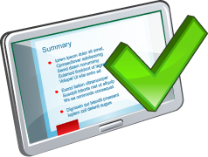
Summary
In this lesson, you should have learned how to:
  Create direct database analyses
  Edit XML and SQL on the Advanced tab
Notes:
Oracle BI 12c: Create Analyses and Dashboards 19 - <number>

Slide 19

Practice 19: Overview
This practice covers the following topics:
  Executing a Direct Database Analysis
  Modifying XML code and SQL statements
Notes:
Oracle BI 12c: Create Analyses and Dashboards 19 - <number>

