Slide 1
Working with BI Content in Smart View
Notes:
Schedule: Timing Topic
40 minutes Lecture
70 minutes Practice
05 minutes Quiz
115 minutes Total

Slide 2

Objectives
After completing this lesson, you should be able to:
  Set up Smart View
  Work with views in Smart View Clients
  Copy and paste Oracle BI content into Microsoft Office
  Create and publish BI Catalog content from Smart View
Notes:
Oracle BI 12c: Create Analyses and Dashboards 15 - <number>

Slide 3
Setting Up Smart View
  Installing Smart View
  Creating Connections in Smart View
  Viewing the BI Catalog in Smart View
Notes:
Oracle BI 12c: Create Analyses and Dashboards 15 - <number>

Slide 4
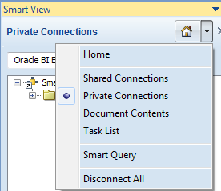
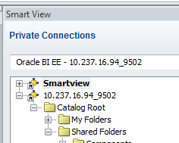
Setting Up a Smart View Connection
  Install Smart View for MS Office.
  Set up a connection in Excel:
    Go to Excel -> Smart View -> Panel -> Private Connection.
    Provide URL.
    Connect to Data Source with Username and Password.
    Save the private connection with a name.
Notes:
Oracle BI 12c: Create Analyses and Dashboards 15 - <number>

Slide 5
Working with Views in Smart View Clients
  Working with views in the Document Contents pane
  Working with prompts
  Setting refresh preferences and refreshing views
  Masking data in views
Notes:
Smart View supports both analysis-level prompts and page-level prompts. Additionally, you can mask data in Smart View, which requires users to refresh and provide authentication before viewing the information. The following subtopics describe how to work with prompts, mask data, and refresh views.
Oracle BI 12c: Create Analyses and Dashboards 15 - <number>

Slide 6
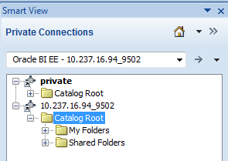
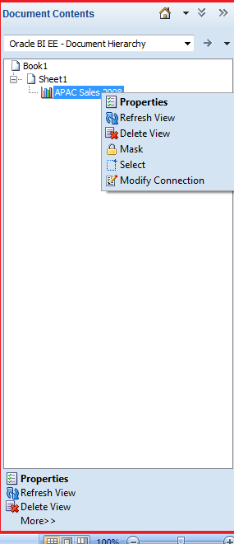
Document Contents Pane
  Display view properties
    General properties
    Refresh settings
    Analysis and page prompt values
  Refresh views
  Delete views
  Mask data in views
Notes:
The Document Contents pane is displayed if you have inserted one or more views in an Office document. The Document Contents pane is displayed in the bottom half of the Smart View panel. You can use the options in the Document Contents pane to display the view properties, refresh views, delete views, and mask data in views.
Note: Using the Document Contents pane to refresh views, control refresh preferences, and mask data in views is covered in the following topics.
Oracle BI 12c: Create Analyses and Dashboards 15 - <number>

Slide 7
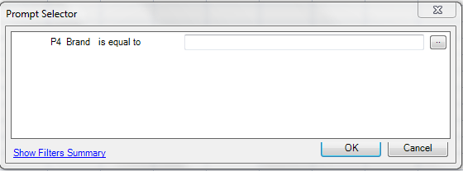



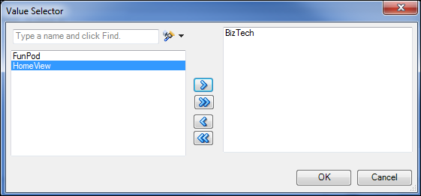


Working with Analysis Prompts
2
1
3
4
Notes:
When you insert a view from an analysis where analysis-level prompts are defined, the Prompt Selector dialog box is displayed before the view is inserted. You can click the ellipsis button to display the Value Selector dialog box for the prompt.
After inserting the view and setting the initial prompt values, you can edit the analysis prompt selections by using the Oracle BI EE ribbon.
To modify analysis prompts, perform the following steps:
1. After inserting a view from an analysis with a prompt, click the Oracle BI EE tab, and then click Edit Prompts to display the Prompt Selector dialog box.
2. For each prompt, click the ellipsis button to open the Value Selector dialog box.
3. Select prompt values and click the Add button to add values to the selected list.
4. Click OK to close the Value Selector dialog box, and then click OK to close the Prompt Selector dialog box.
Oracle BI 12c: Create Analyses and Dashboards 15 - <number>

Slide 8

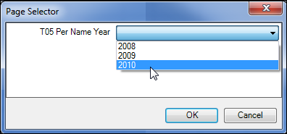

Working with Page Prompts
1
2
3
Notes:
Unlike analysis prompts, page prompts (view-level prompts) are not set when you initially insert a view. You can set page prompt values using the Oracle BI EE ribbon.
To set page prompt values, perform the following steps:
1. After inserting a view that includes page prompts, click the Oracle BI EE tab, and then click Edit Page Prompts.
2. In the Page Selector dialog box, select the value for the page you want to view.
3. Click OK.
Oracle BI 12c: Create Analyses and Dashboards 15 - <number>

Slide 9
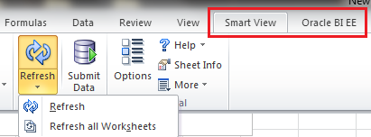

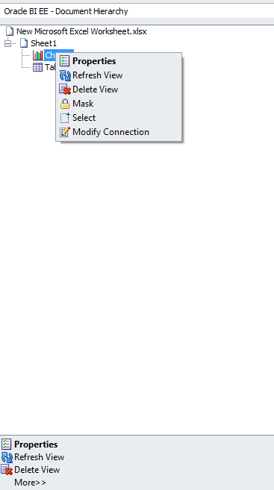



Refreshing Views
Refresh options vary by the Office document type:
  Excel
    Individual views
    Individual worksheets
    Entire workbook
  Word
    Individual views
    Entire document
  PowerPoint
    Individual views
    Individual slides
Smart View and Oracle BI EE ribbons
Right-click refresh
Document Contents pane
Refresh link
Notes:
You can refresh the data in your inserted views. You have the option of refreshing selected views or refreshing all views, depending on the Office document type, as listed in the slide.
You can refresh views from the Document Contents pane, the Oracle BI EE ribbon, or the Smart View ribbon. The refresh action is limited according to the refresh preference set for a selected view.
To refresh the selected view from the Document Contents pane, perform the following steps:
1. In the Document Contents pane, select the view object.
2. Perform one of the following actions:
Right-click the view and select Refresh View.
Click the Refresh View link at the bottom of the Document Contents pane.
To refresh all views on a selected Excel worksheet or PowerPoint slide from the Document Contents pane, perform the following steps:
1. In the Document Contents pane, select the sheet or slide name.
2. Perform one of the following actions:
Right-click the sheet or slide name and select Refresh.
Click the Refresh View link at the bottom of the Document Contents pane.
Oracle BI 12c: Create Analyses and Dashboards 15 - <number>

Slide 10
Notes:
To refresh all Oracle BI EE views on a worksheet or slide, or an entire Word document, using the ribbons, perform the following steps:
1. Perform an action:
Select the worksheet or slide to make it active.
Place your cursor in the Word document to select it.
2. Click the Refresh button in the Oracle BI EE ribbon or the Smart View ribbon.
To refresh all Oracle BI EE views in an Excel workbook, perform the following steps:
1. Place your cursor anywhere in the workbook to select it.
2. In the Smart View ribbon, click the down arrow on the Refresh button, and select Refresh all Worksheets.
Oracle BI 12c: Create Analyses and Dashboards 15 - <number>

Slide 11
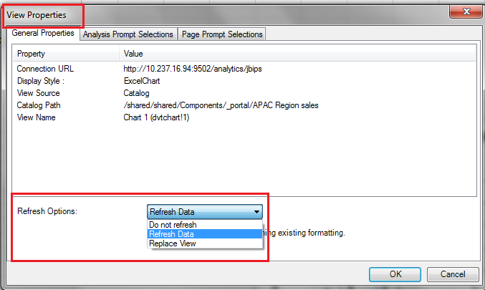
Setting Refresh Preferences
Refresh preferences:
  Refresh Data
  Replace View
  Do not refresh
Notes:
Refresh preferences are available on a per-view basis. The refresh preferences that you set for each view within a workbook, slide, or page are saved along with the Office document, and affect refresh behavior for the view. The following refresh preferences are available:
Refresh Data: Refreshes only the data points in the selected view or analysis.
Replace View: Replaces the entire view, including any formatting changes set in BI Analyses. If you select this option, your prompt and graph selections and the custom formatting you created in Smart View are lost upon refresh if the view definition has changed in Oracle BI EE.
Note: Oracle BI EE title views are not included in refresh actions, so all customizations to a title view in Smart View are retained when you refresh the document.
Do not refresh: Refreshing is not allowed.
By default, new views have a refresh preference of Refresh Data.
Oracle BI 12c: Create Analyses and Dashboards 15 - <number>

Slide 12

Notes:
To change the refresh preference for a view, perform the following steps:
1. In the Document Contents pane, right-click a view and select Properties to open the View Properties dialog box.
2. Click the General Properties tab.
3. In the Refresh Options drop-down list, select a refresh preference.
4. Click OK.
Oracle BI 12c: Create Analyses and Dashboards 15 - <number>

Slide 13
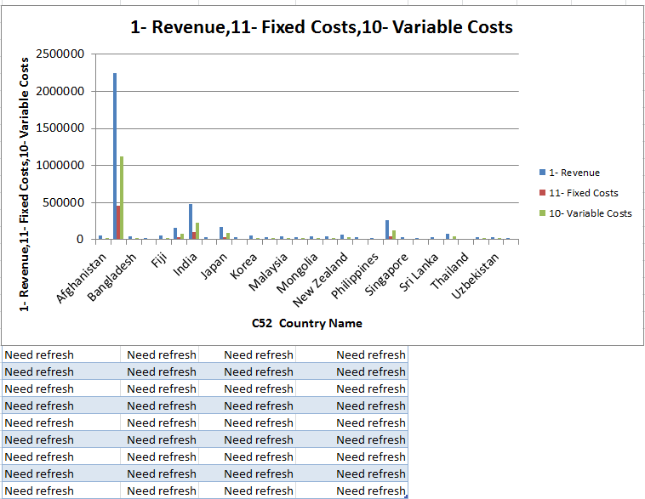
Masking Data in Views
Unmasked graph view
Masked pivot table view
Notes:
You can mask data in the Oracle BI EE views displayed in Smart View clients. Masking data ensures that users who view Office documents with Oracle BI EE views must be authenticated, and can only view data to which they have been granted access.
Tip: After you mask data, you must refresh the masked views before you can view the data again.
You have the option of masking data in:
Selected views
All views on a worksheet or a slide
All views in an Office document
To mask data for an individual view, perform the following steps:
1. In the Document Contents pane, select the view you want to mask.
2. Perform an action:
Right-click the view and select Mask.
Click the Mask link at the bottom of the Document Contents pane.
3. Save the current document. The masked state of the view remains intact after saving.
Oracle BI 12c: Create Analyses and Dashboards 15 - <number>

Slide 14
Notes:
To mask all data on an Excel worksheet or PowerPoint slide, perform the following steps:
1. Place the cursor directly in the worksheet or slide.
2. In the Oracle BI EE ribbon, click the Mask Data button.
Note: You cannot mask data on individual pages in a Word document.
3. Save the current workbook or presentation. The masked state of the workbook or presentation remains intact after saving.
To mask data in an entire Office document, perform the following steps:
1. In the opened Office document, click the Oracle BI EE ribbon tab and perform an action:
Excel: Click the down arrow on the Mask Data button and select Mask Workbook Data.
PowerPoint: Click the down arrow on the Mask Data button and select Mask Presentation Data.
Word: Click the Mask Data button.
2. Save the current Office document. The masked state of the workbook, presentation, or document remains intact after saving.
Oracle BI 12c: Create Analyses and Dashboards 15 - <number>

Slide 15
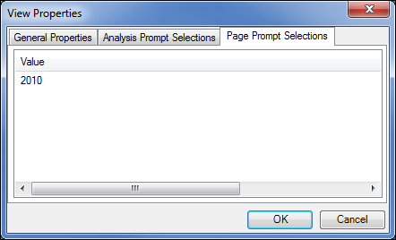
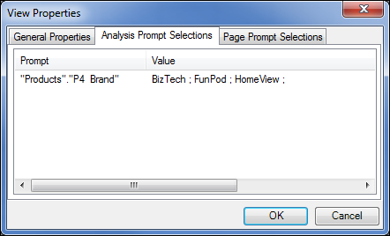
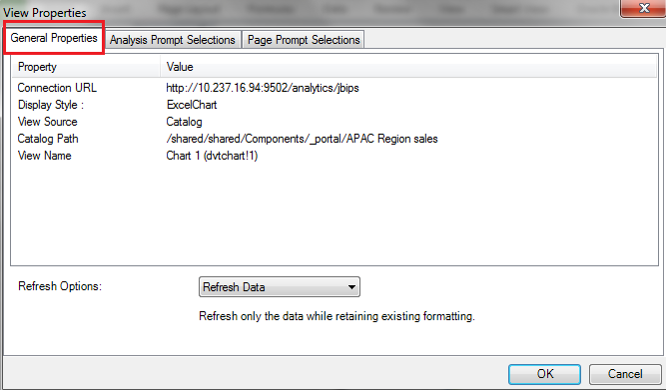
View Properties
Notes:
In addition to the view refresh options, the View Properties dialog box contains useful information such as:
Connection URL
View display style
View source
Catalog path and view name
Analysis prompt selections
Page prompt selections
To open the View Properties dialog box, perform the following steps:
1. In the Document Contents pane, select a view.
2. Perform an action:
Right-click the view and select Properties.
Click the Properties link at the bottom of the Document Contents pane.
Oracle BI 12c: Create Analyses and Dashboards 15 - <number>

Slide 16
Customizing Data in Office
  Editing Microsoft Office chart objects
  Changing chart layout and style
  Using PowerPoint themes
Notes:
Instructor Note
This is an organizational slide. The topics listed here are described in detail in the following slides.
Oracle BI 12c: Create Analyses and Dashboards 15 - <number>

Slide 17
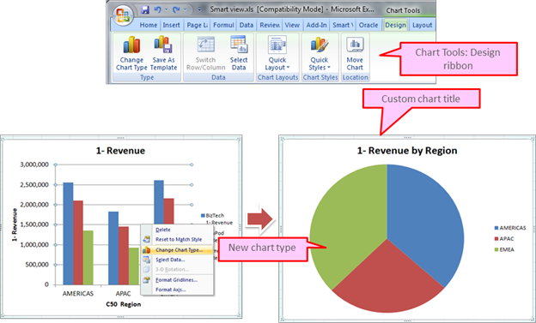
Editing Microsoft Office Charts
Notes:
If you insert a graph view as a Microsoft Office chart, you can edit the chart type, style, display, and title. The Chart Tools: Design ribbon provides a number of options for editing charts. You can also use right-click options or directly edit the chart object.
To change the chart type, perform the following steps:
1. Right-click the chart object and select Change Chart Type to display the Change Chart Type dialog box.
2. Select a chart template icon, and click OK.
To change the chart title, perform the following steps:
1. Select the chart title to enter edit mode.
2. Enter a new title.
Oracle BI 12c: Create Analyses and Dashboards 15 - <number>

Slide 18
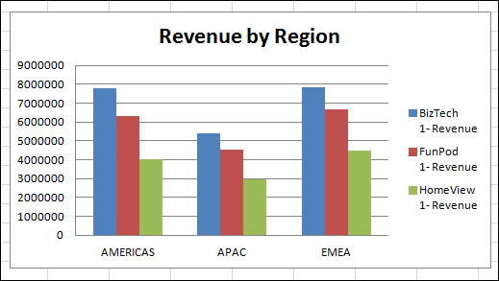
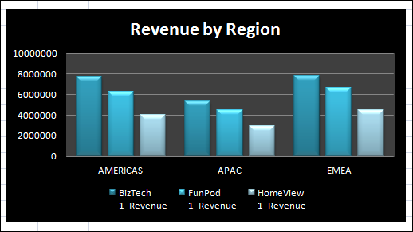
Changing Chart Layout and Style
Custom chart layout and style
Default chart from Oracle BI EE
Notes:
The Chart Tools: Design ribbon provides a number of predefined chart layouts and styles from which you can choose to customize the display of your graph view.
To change the chart layout or style using predefined layouts or styles, perform the following steps:
1. Select the chart object to display the Chart Tools ribbon tabs.
2. Perform an action:
In the Chart Layouts section, select a chart layout.
In the Chart Styles section, select a chart style.
Note: In addition to the predefined layouts and styles, the Chart Tools: Layout ribbon provides detailed customization options for your chart layout and the Chart Tools: Format ribbon provides detailed customization options for your chart style.
Oracle BI 12c: Create Analyses and Dashboards 15 - <number>

Slide 19
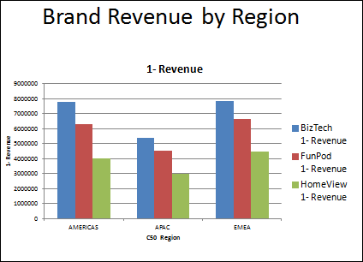
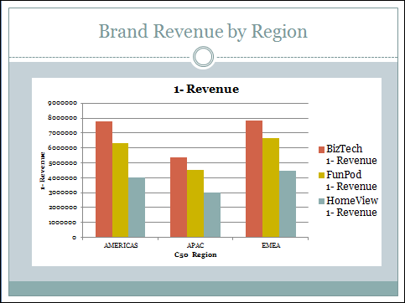
Changing PowerPoint Themes
Chart object after applying a predefined PowerPoint theme
Chart object in the default PowerPoint theme
Notes:
Microsoft Office PowerPoint themes often include custom table and chart templates; thus, when you change the PowerPoint theme, the look and feel of your table, pivot table, or graph views may change.
To change the PowerPoint theme, perform the following steps:
1. In the open presentation, click the Design tab on the ribbon.
2. In the Themes section, select a theme.
Note: PowerPoint themes are applied to the entire presentation, not just the current slide.
Oracle BI 12c: Create Analyses and Dashboards 15 - <number>

Slide 20
Copying and Pasting BI Objects
  Copy and paste views between Smart View clients.
  Copy and paste views from Oracle BI Presentation Services to Smart View.
Notes:
Smart View enables you to copy Oracle BI EE views within and between Smart View clients, with some limitations. Additionally, when you design analyses in Oracle BI Analyses, you can enable the option to copy directly from the Oracle BI Presentation Services web interface to Smart View clients.
Oracle BI 12c: Create Analyses and Dashboards 15 - <number>

Slide 21
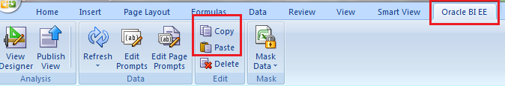
Copying and Pasting BI Objects Between
Smart View Clients
  You can copy graph views within and between any Office application.
  You can copy table views and pivot table views within and between Word and PowerPoint.
  You cannot copy table views and pivot table views within Excel, from Excel to another Office application, or from another Office application to Excel.
  You can copy sectioned table and pivot table views only one section at a time.
Notes:
Oracle BI 12c: Create Analyses and Dashboards 15 - <number>

Slide 22
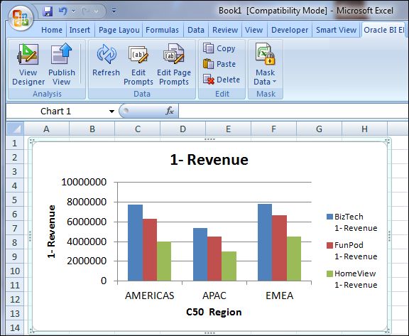
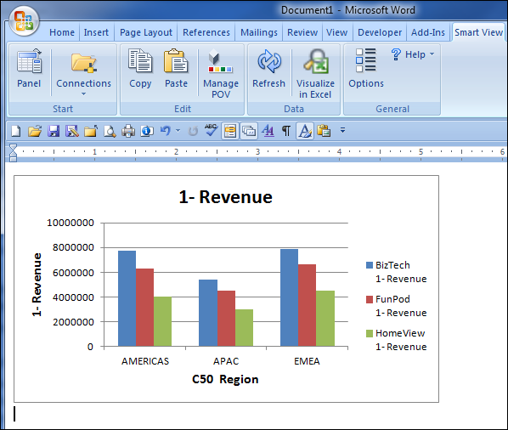
Copying and Pasting Graph Views
2
4
1
3
Notes:
To copy and paste a graph view, perform the following steps:
1. In Excel, Word, or PowerPoint, select the graph view to copy.
Note: You can use the Document Contents pane to locate the view, but you must select the graph directly in the sheet, slide, or page.
2. On the Oracle BI EE or Smart View ribbon, click Copy.
3. Access the destination Excel, Word, or PowerPoint document and position the cursor where you want to paste the graph view. For example, if you are pasting from Excel to Word, open a Word document and place the cursor at the point within the Word document where you want to paste the object.
4. On the Oracle BI EE or Smart View ribbon, click Paste.
Note: If you are not already using BI content in the destination document, the Oracle BI EE ribbon is not displayed.
Oracle BI 12c: Create Analyses and Dashboards 15 - <number>

Slide 23
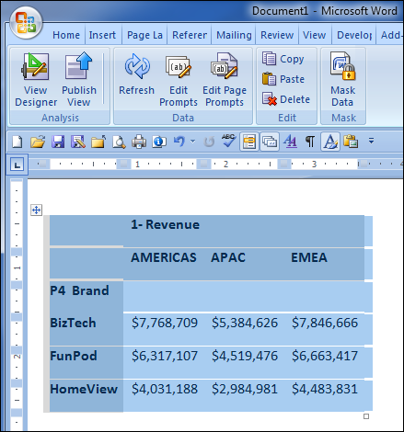


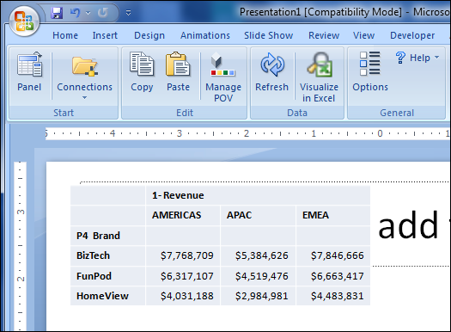
Copying and Pasting Table or Pivot Table Views
Oracle BI EE ribbon
2
Smart View ribbon
1
4
3
Notes:
To copy and paste table or pivot table views, perform the following steps:
1. In Word or PowerPoint, select the table or pivot table view to copy.
Note: You can use the Document Contents pane to locate the view, but you must select the table or pivot table view directly in the slide or page.
2. On the Oracle BI EE or Smart View ribbon, click Copy.
3. Access the destination Word or PowerPoint document and position the cursor where you want to paste the table or pivot table view. For example, if you are pasting from Word to PowerPoint, open a PowerPoint document and position the cursor in the slide where you want to paste the table or pivot table view.
4. On the Oracle BI EE or Smart View ribbon, click Paste.
Note: If you are not already using BI content in the destination document, the Oracle BI EE ribbon is not displayed.
Oracle BI 12c: Create Analyses and Dashboards 15 - <number>

Slide 24
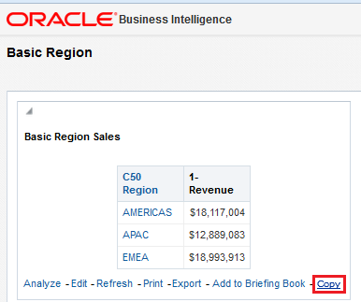
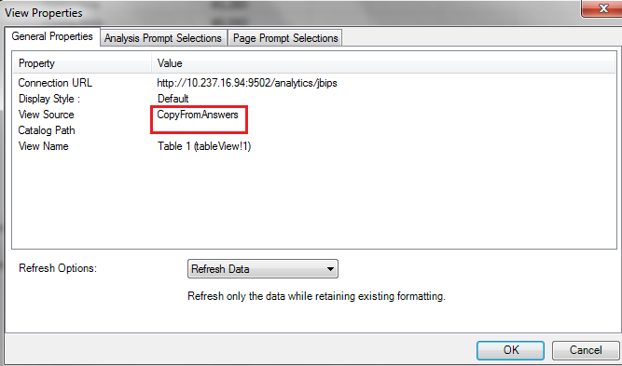
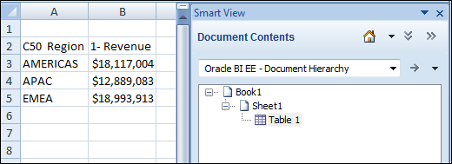
Copying and Pasting Views from Oracle BI to
Smart View
Notes:
You can copy and paste views from BI Answers to Smart View. Views that are enabled for copying display a Copy link when viewed in BI Analyses. The link copies the XML definition for the view to the Windows clipboard, which you can then paste into Smart View clients.
If you open the View Properties dialog box for the view in Smart View, you see the View Source listed as CopyFromAnswers and no catalog path defined. When you refresh views that were copied from BI Analyses, the data is refreshed, but the analysis definition is not, even if its definition has been modified in BI Analyses; there is no link to the original analysis in the catalog.
To copy and paste a view from Oracle BI to Excel, perform the following steps:
1. Log in to Oracle BI EE and from BI Analyses or Interactive Dashboards, launch the analysis that you want to copy.
2. Click the Copy link at the bottom of the analysis (displayed only if the analysis is enabled for copying).
3. Open a Smart View client, and connect to the appropriate Oracle BI EE data source.
4. On the Oracle BI EE or Smart View ribbon, click Paste.
Oracle BI 12c: Create Analyses and Dashboards 15 - <number>

Slide 25
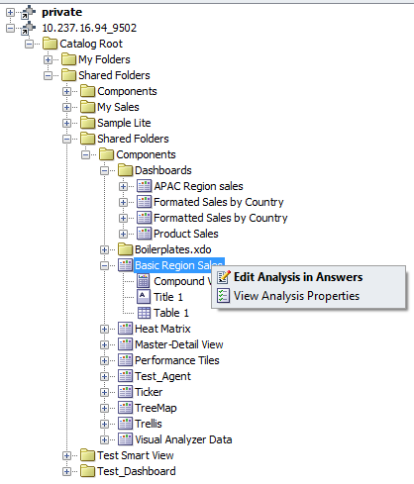
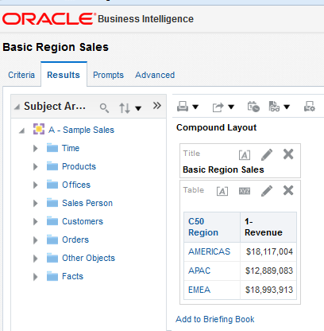
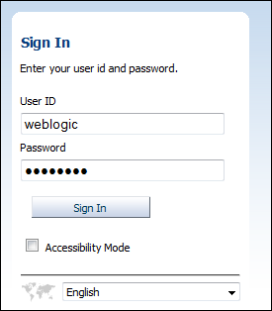
Editing Analyses in Oracle BI EE
1
3
2
Notes:
If the analyses displayed in the BI Catalog in the Smart View client do not display the data required, or the data is not displayed as desired, you can edit analyses in Oracle BI EE.
Note: To edit an analysis in Oracle BI EE, you must have the required Oracle BI EE permissions.
To edit an analysis in Oracle BI EE, perform the following steps:
1. In the Smart View panel, right-click an analysis and select Edit Analysis in Answers.
2. If you are not already logged in, the Oracle BI EE login screen is displayed. Enter your credentials and click Sign In.
3. The analysis is opened in edit mode. Make your desired changes to the analysis, and then save it.
Note: Changes to the views in the analysis are reflected in Smart View clients the next time you refresh the views, depending on the refresh preferences for the view.
Oracle BI 12c: Create Analyses and Dashboards 15 - <number>

Slide 26
Creating and Publishing Views Using the
View Designer
  Create a view layout and type.
  Define filter expressions for views.
  Publish views to the BI catalog.
Notes:
Using the View Designer in Smart View, you can create a new ad hoc view based on an Oracle BI EE subject area.
Note: The View Designer is available only in Microsoft Excel.
The following topics describe each of the steps for creating a view using the View Designer in detail.
Oracle BI 12c: Create Analyses and Dashboards 15 - <number>

Slide 27
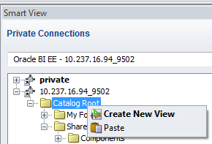
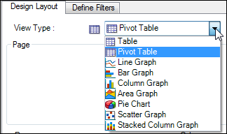
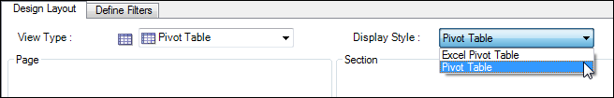
Creating a View Layout and Type
Steps 1–3
2
1
3
Notes:
To define a view layout and type, perform the following steps:
1. To open the View Designer, in the Smart View panel, right-click the Catalog Root node in the catalog tree, and then select Create New View.
2. In the View Type drop-down list, select the type of view that you are creating.
Table
Pivot Table (the default)
Line Graph
Bar Graph
Column Graph
Area Graph
Pie Chart
Scatter Graph
Stacked Column Graph
Note: The selection that you make affects the options available in the Display Style drop-down list and the available fields in the layout area.
3. In the Display Style drop-down list, select a display style for the view. The display style determines how the view is inserted into Excel. For example, for a table view, you can select the Excel Pivot Table or Pivot Table display styles.
Oracle BI 12c: Create Analyses and Dashboards 15 - <number>

Slide 28
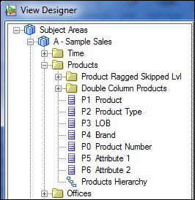
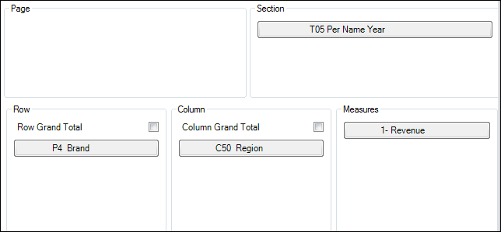
Creating a View Layout and Type
Steps 4–5
4
5
Notes:
4. In the left pane of the View Designer, expand a subject area and the folders and columns that you want to work with.
5. Drag columns from the expanded subject area tree and drop them in the layout area. The available edges in the layout area vary depending on your view type selection.
Oracle BI 12c: Create Analyses and Dashboards 15 - <number>

Slide 29
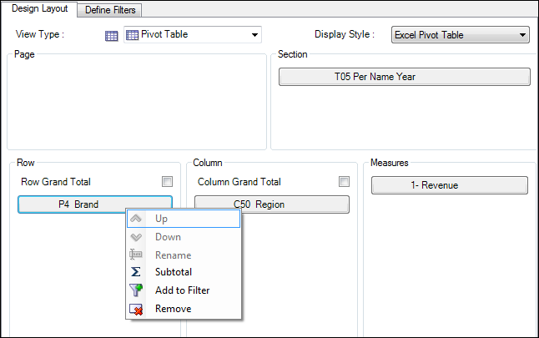
Creating a View Layout and Type
Step 6 (Optional)
6
Notes:
6. Optional: Perform any of these tasks, as applicable, on the columns you have dragged to edges in the View Designer:
To move a column between edges, drag the column tile from one edge and drop it on another. For example, drag a column from the Row edge and drop it on the Column edge.
To reposition the column within the edge, right-click a column tile and click the Up or Down arrow.
To add a subtotal to a column in an edge, right-click a column tile and select Subtotal.
To remove a column from an edge, right-click the column tile and select Remove.
Oracle BI 12c: Create Analyses and Dashboards 15 - <number>

Slide 30
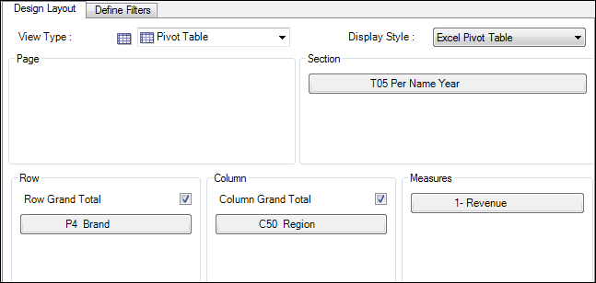
Creating a View Layout and Type
Step 7 (Optional)
7
Notes:
7. Optional: If you are creating a table or pivot table view, regardless of the display style, perform the following actions:
Pivot Table view: In the Row and Column edges, select or deselect the Row Grand Total and Column Grand Total check boxes as necessary.
Table view: In the Row edge, select or deselect the Row Grand Total check box.
Oracle BI 12c: Create Analyses and Dashboards 15 - <number>

Slide 31
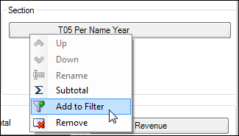
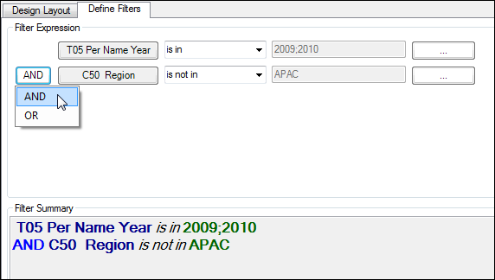
Defining Filter Expressions in the View Designer
1
2
3
4
Notes:
To define filter expressions in the View Designer, perform the following steps:
1. Add columns for filtering by performing one of the following actions:
On the Design Layout tab, right-click a column tile and select Add to Filter.
Drag a column from the subject area hierarchy to the Define Filters tab.
2. On the Define Filters tab, select a filter operator next to the corresponding column name.
Note: The operator list from which you can choose is based on the type of column.
3. Specify a filter value.
4. Optional: If required, click the logical operator button in the Filter Expression pane and change the logical operator. The default logical operator is AND.
5. When you have finished defining filters, click OK to insert the view into Excel.
Note: You cannot open the view in the View Designer again after you insert it into Excel.
Oracle BI 12c: Create Analyses and Dashboards 15 - <number>

Slide 32
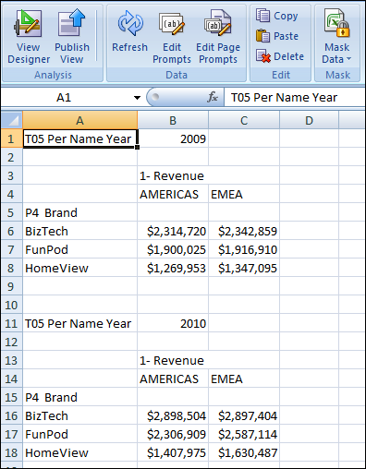
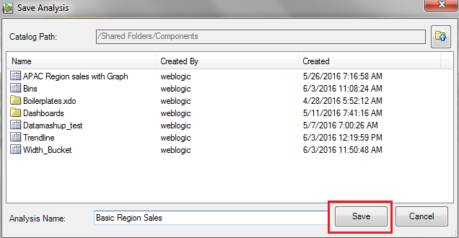
Publishing Views to the BI Catalog
2
1
3
4
5
Notes:
The ad hoc view definition that you create in View Designer can be published to the Presentation Catalog in BI Analyses after you have inserted it in Smart View. When you publish an ad hoc view, a new analysis in BI Analyses is created with the default views of compound view and title view, along with the applicable user-created view.
After publishing a view to the BI Catalog, you can edit the new analysis as you would edit any analysis created in BI Analyses.
To publish a view to the Oracle BI EE Presentation Catalog, perform the following steps:
1. Position the cursor within the view that you just created using the View Designer.
2. On the Oracle BI EE ribbon, click Publish View.
3. The Save Analysis dialog box is displayed. Browse to the location in the catalog where you will save the view.
4. In the Analysis Name text box, enter a name for the analysis.
5. Click Save.
Oracle BI 12c: Create Analyses and Dashboards 15 - <number>

Slide 33
Guidelines for Publishing Ad Hoc Views
  An error message is displayed if you attempt to overwrite an existing view in the Presentation Catalog.
  After an ad hoc view is published, you can make changes to the view in BI Answers. You cannot edit the view in Smart View.
  You can refresh only the data in views created in View Designer. Ad hoc views created in View Designer are snapshots and are not kept in sync with the analysis published to the catalog.
  Changes made to the published view in BI Answers are not reflected in the ad hoc view that you rendered in Excel. You must reinsert the view from the Presentation Catalog into a new sheet in Smart View in order to see changes that are made in BI Answers.
Notes:
Oracle BI 12c: Create Analyses and Dashboards 15 - <number>

Slide 34
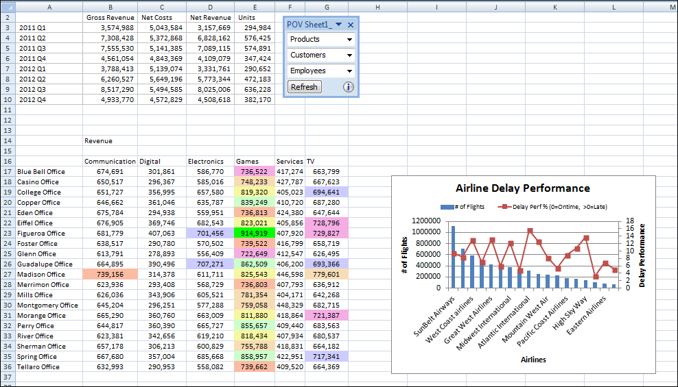



Federating Data
Ad hoc analysis from an Essbase data source
Graph view from an Oracle BI EE data source
Pivot table view from an Oracle BI EE data source
Notes:
One of the many benefits of using Smart View is the ability to easily federate data from multiple data sources in a single Office document. The example in the slide comes from the Oracle BI EE Sample Application VBox, where Essbase is installed along with Oracle BI EE. The top section of the worksheet contains data created by performing an ad hoc analysis against the Essbase server. The pivot table view has been inserted from the Oracle BI server, as has the graph view. The dimensionality and data in all three reports is different.
For a video demo on how to re-create this federated report, see “Smart View with OBI EE – Federating multiple data sources” on the ORACLE BI TECHDEMO YouTube channel (http://youtu.be/Yaonpq0xib8).
Oracle BI 12c: Create Analyses and Dashboards 15 - <number>

Slide 35

Quiz: Overview
This quiz examines your knowledge of Smart View.
Notes:
In this quiz, you answer questions regarding the interaction of Microsoft Office with Smart View.
Oracle BI 12c: Create Analyses and Dashboards 15 - <number>

Slide 36
Quiz
You can change a view’s properties so that it does not refresh when you click the Refresh button.
  True
  False
Notes:
Answer: a
Oracle BI 12c: Create Analyses and Dashboards 15 - <number>

Slide 37
Quiz
You cannot change analysis prompts after the initial insertion of the view.
  True
  False
Notes:
Answer: b
Oracle BI 12c: Create Analyses and Dashboards 15 - <number>

Slide 38
Quiz
You can copy a pivot table view from PowerPoint to Excel.
  True
  False
Notes:
Answer: b
Oracle BI 12c: Create Analyses and Dashboards 15 - <number>

Slide 39
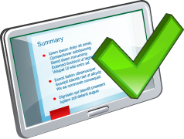
Summary
In this lesson, you should have learned how to:
  Set up Smart View
  Work with views in Smart View Clients
  Copy and paste Oracle BI content into Microsoft Office
  Create and publish BI Catalog content from Smart View
Notes:
Oracle BI 12c: Create Analyses and Dashboards 15 - <number>

Slide 40

Practice 15: Overview
This practice covers the following topics:
  Working with BI views in Smart View clients
  Creating and publishing views with the View Designer
Notes:
Oracle BI 12c: Create Analyses and Dashboards 15 - <number>

