Slide 1
Virtualization Techniques for Cloud Computing
Prof. Chih-Hung Wu
Dept. of Electrical Engineering
National University of Kaohsiung
Email: johnw@nuk.edu.tw
URL: http://www.johnw.idv.tw

Slide 2
Outline
The needs of virtualization
The concepts
Types of virtualization
Issues in virtualization
Implementation cases
Conclusion

Slide 3
In the computer-age…

Slide 4
A Lot of Servers/Machines...
Web server
Mail server
Database server
File server
Proxy server
Application server
…and many others

Slide 5
A Lot of Servers/Machines...
The data-centre is FULL
Full of under utilized servers
Complicate in management
Power consumption
Greater wattage per unit area than ever
Electricity overloaded
Cooling at capacity
Environmental problem
Green IT
Notes:
5

Slide 6
Virtualization
Virtualization -- the abstraction of computer resources.
Virtualization hides the physical characteristics of computing resources from their users, be they applications, or end users.
This includes making a single physical resource (such as a server, an operating system, an application, or storage device) appear to function as multiple virtual resources; it can also include making multiple physical resources (such as storage devices or servers) appear as a single virtual resource.

Slide 7
The Use of Computers
Applications
Operating
System
Hardware

Slide 8
Virtualization
Applications
Operating
System
Hypervisor
Hardware

Slide 9
Virtualization -- a Server for Multiple Applications/OS
Application
Application
Application
Applications
Application
Applications
Operating
System
Operating
System
Operating
System
Operating
System
Operating
System
Operating
System
Hardware
Hypervisor
Hardware
Hypervisor is a software program that manages multiple operating systems (or multiple instances of the same operating system) on a single computer system.
The hypervisor manages the system's processor, memory, and other resources to allocate what each operating system requires.
Hypervisors are designed for a particular processor architecture and may also be called virtualization managers.

Slide 10
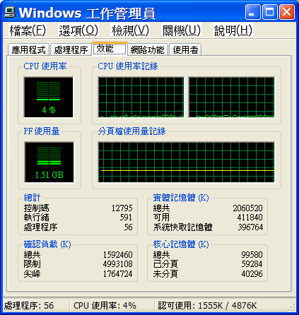
Capacity Utilization
Virtualized system (high)
High utilized*
Low utilized
Stand alone system (low)
* But not overloaded…

Slide 11
Why now?
1960—1999
IBM, CP-40, CP/CMS, S/360-370, VM370, Virtual PC, VMware
2000—2005
IBM z/VM, Xen
2006
Intel VT-x
AMD’s AMD-V
2008—

Slide 12
Hardware evolution
Faster CPU clock than ever
Though almost hit its top
More CPU cores in a single chip
4-core CPUs already in the market
6- or 8-core CPUs will be there soon
Multi-core architectures make parallel processing more realizable
Virtualization support on chip from CPU manufacturers (e.g., Intel, AMD)
Notes:
12

Slide 13
Software maturity
More than one credible player in the market
Available and stable open-sourced software
OS, DB, Web server, Java, PHP, gcc, etc.
Established and mature software standards
Web service, XML, SOAP, COM, etc.
Notes:
13

Slide 14
Types of Virtualization
Virtual memory
Desktop virtualization
Platform virtualization
Full virtualization
Paravirtualization
Hardware-assisted virtualization
Partial virtualization
OS-level virtualization
Hosted environment (e.g. User-mode Linux)
Storage virtualization
Network virtualization
Application virtualizationPortable application
Cross-platform virtualization
Emulation or simulation
Hosted Virtual Desktop
In this talk, we mainly focus on Platform virtualization which is mostly related to cloud-computing
Full virtualization
Binary transaltion
Hardware-assisted virtualization
Paravirtualization
OS-level virtualization
Hosted environment (e.g. User-mode Linux)
Hardware level
Operating system level
Application level
Category in Wiki

Slide 15
Full Virtualization
A certain kind of virtual machine environment: one that provides a complete simulation of the underlying hardware.
The result is a system in which all software (including all OS’s) capable of execution on the raw hardware can be run in the virtual machine.
Comprehensively simulate all computing elements as instruction set, main memory, interrupts, exceptions, and device access.
Full virtualization is only possible given the right combination of hardware and software elements.
Full virtualization has proven highly successful
Sharing a computer system among multiple users
Isolating users from each other (and from the control program) and
Emulating new hardware to achieve improved reliability, security and productivity.

Slide 16
Full Virtualization
It needs a single machine that could be multiplexed among many users. Each such virtual machine had the complete capabilities of the underlying machine, and (for its user) the virtual machine was indistinguishable from a private system.
Examples
First demonstrated with IBM's CP-40 research system in 1967
Re-implemented CP/CMS in IBM's VM family from 1972 to the present.
Each CP/CMS user was provided a simulated, stand-alone computer.

Slide 17
Full Virtualization
Virtualization requirements (by Popek and Goldberg) :
Equivalence: a program running under the VMM should exhibit a behavior essentially identical to that demonstrated when running on an equivalent machine directly;
Resource control (safety): the VMM must be in complete control of the virtualized resources;
Efficiency: a statistically dominant fraction of machine instructions must be executed without VMM intervention.
VMM: Virtual Machine Monitor

Slide 18
Full Virtualization -- challenge
Security issues -- Interception
Simulation of privileged operations -- I/O instructions
The effects of every operation performed within a given virtual machine must be kept within that virtual machine – virtual operations cannot be allowed to alter the state of any other virtual machine, the control program, or the hardware.
Some machine instructions can be executed directly by the hardware,
E.g., memory locations and arithmetic registers.
But other instructions that would "pierce the virtual machine" cannot be allowed to execute directly; they must instead be trapped and simulated. Such instructions either access or affect state information that is outside the virtual machine.
Some hardware is not easy to be used for full virtualization, e.g., x86

Slide 19
Restrict on Intel IA32 Protection Rings
Level-3
Lowest
privilege
Level-2
Level-1
OS kernel
Level -0
Highest
privilege
OS services
(device driver, etc.)
Applications

Slide 20
The challenges of x86 hardware virtualization
Ring 3
Application
Ring 2
Ring 1
Direct
Execution
of user and OS
Requests
Ring 0
OS
Hardware

Slide 21
The Problems and the Solutions
Originally designed for “personal use” (PC)
Security problems caused by Interception and privileged operations becomes critical
Solutions to Full virtualization of x86 CPU
Full description of operations of all x86 hardware (but they evolve)
Binary translation (almost established)
OS-assisted (or paravirtualization)
Hardware-assisted (future direction)

Slide 22
Binary translation
Kernel code of non-virtualizable instructions are translated to replace with new sequences of instructions that have the intended effect on the virtual hardware. Each virtual machine monitor provides each Virtual Machine with all the services of the physical system, including a virtual BIOS, virtual devices and virtualized memory management.
This combination of binary translation and direct execution provides Full Virtualization as the guest OS is fully abstracted (completely decoupled) from the underlying hardware by the virtualization layer. The guest OS is not aware it is being virtualized and requires no modification.
The hypervisor translates all operating system instructions on the fly and caches the results for future use, while user level instructions run unmodified at native speed.
Examples
VMware
Microsoft Virtual Server

Slide 23
Binary translation
Ring 3
Application
Direct
Execution
of user and OS
Requests
Ring 2
Ring 1
Guest OS
Ring 0
VMM
Binary translation
of OS Requests
Hardware
VMM: Virtual Machine Monitor

Slide 24
OS assisted (Paravirtualization)
Paravirtualization – via an modified OS kernel as guest OS
It is very difficult to build the more sophisticated binary translation support necessary for full virtualization.
Paravirtualization involves modifying the OS kernel to replace non-virtualizable instructions with hypercalls that communicate directly with the virtualization layer hypervisor.
The hypervisor also provides hypercall interfaces for other critical kernel operations such as memory management, interrupt handling and time keeping.
Paravirtualization is different from full virtualization, where the unmodified OS does not know it is virtualized and sensitive OS calls are trapped using binary translation.
Paravirtualization cannot support unmodified OS
Example:
Xen -- modified Linux kernel and a version of Windows XP

Slide 25
OS assisted (Paravirtualization)
Ring 3
Application
Direct
Execution
of user and OS
Requests
Ring 2
Ring 1
Ring 0
Paravirtualized
Guest OS
Virtualization layer
Hypercalls to the
Virtualization Layer
replace
non-virtualiable
OS instructions
Hardware
VMM: Virtual Machine Monitor

Slide 26
Hardware Assisted Virtualization
Also known as accelerated virtualization, hardware virtual machine (Xen), native virtualization (Virtual iron).
Hardware switch supported by CPU, e.g.
Intel Virtualization Technology (VT-x)
AMD’s AMD-V
target privileged instructions with a new CPU execution mode feature that al lows the VMM to run in a new root mode below ring 0.
Privileged and sensitive calls are set to automatically trap to the hypervisor, removing the need for either binary translation or paravirtualization.
The guest state is stored in Virtual Machine Control Structures (VT-x) or Virtual Machine Control Blocks (AMD-V).
High hypervisor to guest transition overhead and a rigid programming model

Slide 27
Hardware Assisted Virtualization
Ring 3
Application
Direct
Execution
of user and OS
Requests
Ring 2
Non-root
Mode
Privilege
Levels
Ring 1
Ring 0
Guest OS
VMM
OS requests traps
to VMM without
binary translation
or paravirtualization
Root Mode
Privilege
Levels
Hardware
VMM: Virtual Machine Monitor

Slide 28
OS-Level Virtualization
OS-level virtualization
kernel of an OS allows for multiple isolated user-space instances, instead of just one.
Each OS instance looks and feels like a real server
OS virtualization virtualizes servers on the operating system (kernel) layer. This creates isolated containers on a single physical server and OS instance to utilize hardware, software, data center and management efforts with maximum efficiency.
OS-level virtualization implementations that are capable of live migration can be used for dynamic load balancing of containers between nodes in a cluster.
OS-Level Virtualization
OS
Container 1
OS
Container 2
OS
Container 3
OS virtualization
layer
Standard
Host OS
Hardware

Slide 29
Confusion…
OS-Level Virtualization. A type of server virtualization technology which works at the OS layer. The physical server and single instance of the operating system is virtualized into multiple isolated partitions, where each partition replicates a real server. The OS kernel will run a single operating system and provide that operating system functionality to each of the partitions.
Operating system virtualization refers to the use of software to allow system hardware to run multiple instances of different operating systems concurrently, allowing you to run different applications requiring different operating systems on one computer system. The operating systems do not interfere with each other or the various applications.

Slide 30
Application virtualization
Application runs on
Different OS, platform, etc.
Same OS, different version/framework
Encapsulation of OS/platform
Improve portability, manageability and compatibility of applications
A fully virtualized application is not installed in the traditional sense, although it is still executed as if it is (runtime virtualization)
Full application virtualization requires a virtualization layer.

Slide 31
Memory Virtualization
Not only virtual memory
Hardware support
e.g., x86 MMU and TLB
To run multiple virtual machines on a single system, another level of memory virtualization is required.
The VMM is responsible for mapping guest physical memory to the actual machine memory, and it uses shadow page tables to accelerate the mappings.
VM1
VM2
Process 1
Process 2
Process 1
Process 2
Virtual memory
Physical memory
Machine memory

Slide 32
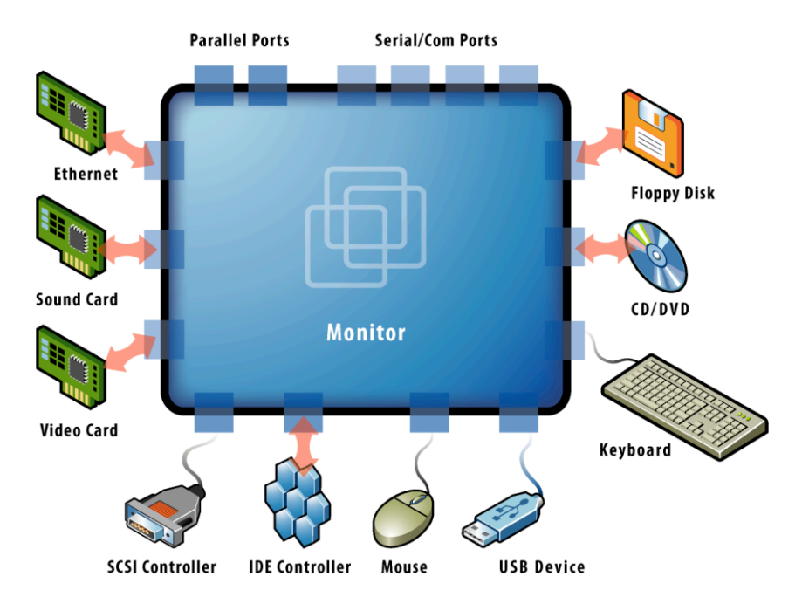
Device and I/O Virtualization
VMM supports all device/IO drivers
Physically/virtually existed
Source: VMware white paper, “Understanding Full Virtualization, Paravirtualization, and Hardware Assist”

Slide 33
Techniques for X86 virtualization
 | Full Virtualization with Binary Translation | Hardware Assisted Virtualization | OS Assisted Virtualization / Paravirtualization
Technique | Binary Translation and Direct Execution | Exit to Root Mode on Privileged Instructions | Hypercalls
Guest Modification / Compatibility | Unmodified Guest OS Excellent compatibility | Unmodified Guest OS Excellent compatibility | Guest OS codified to issue Hypercalls so it can't run on Native Hardware or other Hypervisors Poor compatibility; Not available on Windows OSes
Performance | Good | Fair Current performance lags Binary Translation virtualization on various workloads but will improve over time | Better in certain cases
Used By | VMware, Microsoft, Parallels | VMware, Microsoft, Parallels, Xen | VMware, Xen
Guest OS Hypervisor Independent? | yes | yes | XenLinux runs only on Xen Hypervisor VMI-Linux is Hypervisor agnostic
Source: VMware white paper, “Understanding Full Virtualization, Paravirtualization, and Hardware Assist”

Slide 34
Virtualization
Binary translation is the most established technology for full virtualization
Hardware assist is the future of virtualization, but it still has a long way to go
Paravirtualization delivers performance benefits with maintenance costs
Xen
VMWare

Slide 35


Issues in Virtualization for Cloud-Computing
Aspects and expectation from
End-user
Operator/Manager
Virtualization

Slide 36
Issues in Virtualization for Cloud-Computing
Virtualization implemented on
a single machine (with multi-core CPUs)
a cluster of machines (with multi-core CPUs)
The state-of-the-art
Running a Xen or a cluster of Xens
Applications
Application
Application
Application
Application
Applications
Application
Application
Application
Application
Application
Application
Application
Virtualization
?
Application
Operating
System
Operating
System
Operating
System
Operating
System
Operating
System
Operating
System
Operating
System
Operating
System
Operating
System
Operating
System
Operating
System
Operating
System
Operating
System
Operating
System
Hypervisor
or
or
Hypervisor
Hardware
Hardware
Hardware
Hardware

Slide 37
Issues in Virtualization for Cloud-Computing
Abiquo/abicloud may provide partial solutions
Management
System
Applications
Applications
Application
Application
Application
Application
Application
Application
Application
Application
Operating
System
Operating
System
Operating
System
Operating
System
Operating
System
Operating
System
Operating
System
Operating
System
Operating
System
Operating
System
Hypervisor
Hypervisor
Virtualization
Hardware
Hardware
Applications
Applications
Application
Application
Application
Application
Application
Application
Application
Application
Operating
System
Operating
System
Operating
System
Operating
System
Operating
System
Operating
System
Operating
System
Operating
System
Operating
System
Operating
System
Hypervisor
Hypervisor
Hardware
Hardware

Slide 38
Running multiple OS and applications
Virtualization: One physical
hardware can run multiple
OS and applications
through a hypervisor.
A hypervisor is the
virtualization manager
on a physical hardware.
Applications
Application
Application
Application
Application
Operating
System
Operating
System
Operating
System
Operating
System
Operating
System
Hypervisor
Hardware

Slide 39
Popular hypervisors
Xen
KVM
QEMU
virtualBox
VMWare
Xen is the selected hypervisor of the project.

Slide 40
Steps to use Xen
Connect to a Xen host (i.e., a physical hardware + Xen + Dom0 OS) via ssh.
Use xen-tools to create (xen-create-image), list (xen-list-images) and delete (xen-delete-image) images of virtual machines.
Use the xm tool to manage (create, list and shutdown) DomU guests.

Slide 41
Issues related to clouds with Xen
Xen-tools and xm are great for a single machine, but …
Today’s private or public clouds often include hundreds or thousands of machines.
How to manage the cloud effectively and efficiently becomes a central issue in cloud computing.

Slide 42
Objectives of managing clouds
Easy-to-use client interface
Effective and efficient management of cloud infrastructure
Scalable deployment
Robust performance
Other nice characteristics associated with information systems management

Slide 43
Some solutions for managing clouds
abiCloud is the topic of this class.
EUCALYPTUS, originating in the CS department of UC Santa Barbara, is an open source software infrastructure for implementing cloud computing on clusters.
OpenNebula is an open source virtual infrastructure engine that enables the dynamic deployment and replacement of virtualized service within and across sites.
Other solutions from Citrix, Microsoft, Sun, …

Slide 44
Why use abiCloud?
Open platform
Rich web interface for managing the cloud infrastructure
Deploy a new service by dragging and dropping a virtual machine with the web interface

Slide 45
Issues in Virtualization for Cloud-Computing
Software deployment
Open-source
Commercial products
Re-installation or not
Compatibility
Legacy software/database
Copyright patent problem
Full virtualization
Hardware ISA?
Paravirtualization
Modifiable OS?
Hardware assisted virtualization
Problem model
Re-write

Slide 46
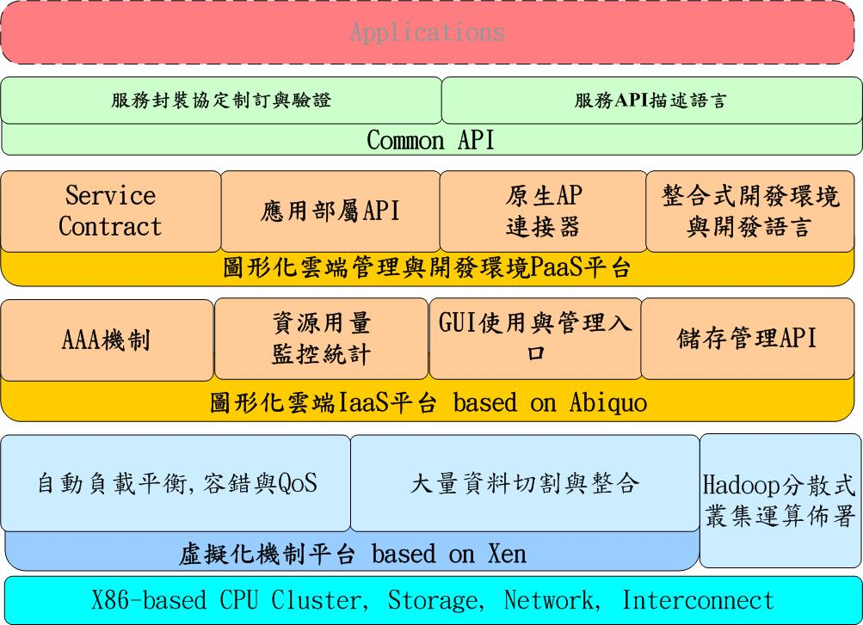
Issues in Cloud-API

Slide 47
Issues in Virtualization for Cloud-Computing
There are more problems…
The answer is hidden behind the “cloud”

Slide 48
Reference
VMWare ®
IBM ®
Miscrosoft®
Intel ®
AMD ®
http://www.xen.org/
http://en.wikipedia.org/
http://www.parallels.com/
http://www.webopedia.com/

