Slide 1

Vmware ESXi
Virtualization with Vmware ESXi
Notes:
Virtualizing your Datacenter with Windows Server 2012 R2 & System Center 2012 R2
Attend this IT Camp, Virtualizing your Datacenter with Windows Server 2012 R2 & System Center 2012 R2, to gain a deep understanding of the strides made in helping businesses consolidate workloads and improve server utilization while reducing costs through comprehensive management using System Center.
At this event, you will get hands-on experience on how System Center helps you realize the most value from Hyper-V infrastructure. You will learn how System Center Virtual Machine Manager provides powerful management capabilities for a VMware environment through virtual machine management, monitoring, and automation. Finally, the camp will walk you through some of the options for migrating virtual machines from VMware to Microsoft.

Slide 2
Course Introduction

Slide 3
Modules
Module | Title
1 | Introduction to Virtualization Technologies
2 | Introduction to VMware Virtualization
3 | VMware ESX and ESXi (ESX/ESXi 4.1)
4 | VMware vCenter Server
5 | Networking

Slide 4
Modules
Module | Title
6 | Storage
7 | Virtual Machines
8 | Access Control
9 | Resource Monitoring
10 | Data Protection

Slide 5

Carlos Carreño
Senior Infrastructure Architect
Red Hat Trainer, Private Cloud, System Center & Hyper-V
MCSE Private Cloud, Red Hat and VMware Certified Trainer
Recognized Industry Expert, Speaker
Datacenter management, cloud, virtualization, high-availability, disaster recovery, mobile technologies and social media
Vmware Tanzu, Red Hat Openshift, Suse Rancher Implementer
ccarrenovi@Gmail.com
Notes:
Let me just introduce myself briefly here. I am a Technical Evangelist working with Microsoft. I have been with Microsoft almost 6 years now, spending 4 years working on the product engineering group at Windows Server high availability , so building clusters and designing virtual machines to run on those clusters. In my current role I am a Technical Evangelist covering all of our private cloud technologies which includes virtualization, Systems Center Suite and several pieces of Windows Server and I am joined by Matt today, why don’t you introduce yourself?

Slide 6
Introduction to VMware Virtualization Module 2

Slide 7
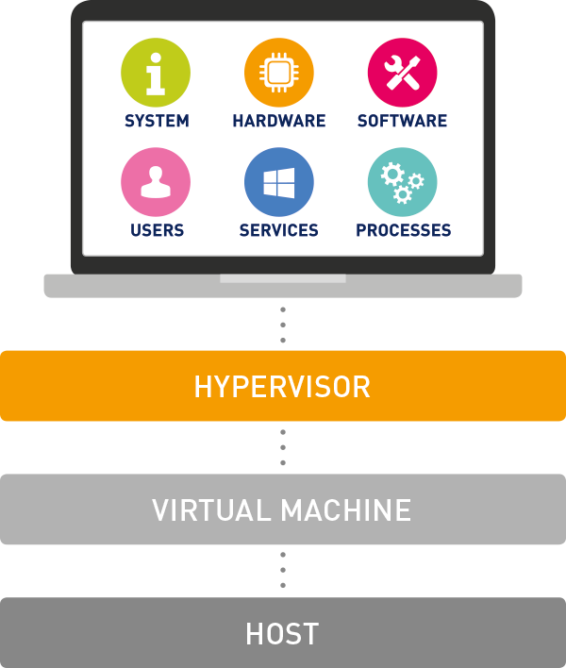
Introduce Virtualization
Virtualization is a technology that allows multiple operating systems and applications to run simultaneously on a single physical machine by abstracting the underlying hardware. This process creates virtual versions of computing resources—such as servers, storage devices, networks, and operating systems—enabling more efficient use of hardware and greater flexibility in IT environments.

Slide 8
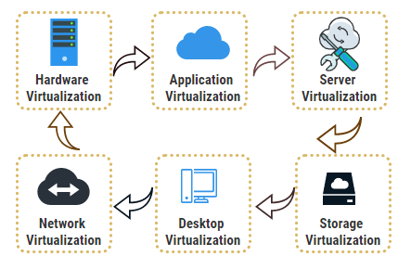
Virtualization: Key Concepts
Virtual Machine
Hypervisor
Type 1 Hypervisor (Bare Metal)
Type 2 Hypervisor (Hosted)
Host Machine
Guest Machine

Slide 9
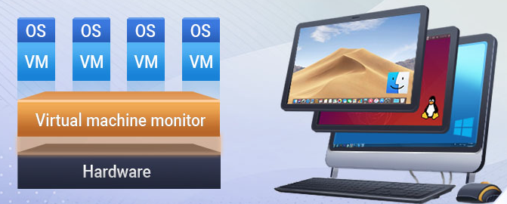
Introduce Virtual Machines
A Virtual Machine (VM) is a software-based emulation of a physical computer that runs an operating system (OS) and applications just like a physical machine would. VMs are created and managed by a hypervisor, which allocates a portion of the host system's resources—such as CPU, memory, storage, and network connectivity—to each virtual machine.
Components of a Virtual Machine
Virtual CPU
Virtual Memory
Virtual Disk
Virtual Network Interface Card
Virtual Bios/EFI
Guest Operating System

Slide 10


Key Technologies
Automation
System Center 2012 R2
vCloud Suite & vCenter
Orchestrator
vCenter Orchestrator
Service Mgmt.
Service Manager
vCloud Automation Center
Protection
Data Protection Manager
vSphere Data Protection
Monitoring
Operations Manager
vCenter Ops Mgmt. Suite
Self-Service
App Controller
vCloud Director
VM Management
Virtual Machine Manager
vCenter Server
Hypervisor
Hyper-V
vSphere Hypervisor
Notes:
What are our key technology focus areas?
<click>
Well, firstly, and predominantly, we’ll be looking at the hypervisor layer, with Hyper-V and VMware. We’re going to spend the majority of the first day building our knowledge of the key features of Hyper-V, as the engine of the Microsoft private cloud, and we’ll also look at how this compares and contrasts with the vSphere hypervisor – part of vSphere.
<click>
We’ll then look specifically at VM management, and how we perform the day to day tasks of managing the virtual machines running on your infrastructure, from deployment and migration, through to templating and cloud creation. This section, combined with the Hyper-V modules, will make up the majority of the course, as their equivalents, vSphere hypervisor and vCenter, are what the majority of vSphere admins will be used to using on a day to day basis.
<click>
Once we’re comfortable with the VM management, we’ll start to look at how we can better delegate access to our infrastructure through self service, and how this gives application owners, VM owners, service owners, the ability to access the resources they need, in a controlled yet intuitive manner.
<click>
We’ll then take a look at how we can use Operations Manager to start to gain visibility into our virtualized infrastructure, gaining levels of insight into both Microsoft, and heterogeneous infrastructures, from the metal, right up into the applications running inside the VMs, from both inside, and outside the infrastructure walls.
<click>
We’ll take a quick look at backup, and how Data Protection Manager plays a part in protecting Hyper-V virtual machines, but also, workloads and applications inside your infrastructure too.
<click>
Finally, we’ll wrap up with a look at Service Management, specifically how we can introduce the ability for users to request resources, infrastructure components, virtual machines, cloud capacity, and more, and how <click> we can automate all of the technologies we’ve seen and heard about, into a powerful private cloud, which can keep costs low, and free up administrator time to work on using the technology to drive the business forward.
<click>
From a licensing and acquisition perspective, both VMware and Microsoft have made significant strides in simplifying the acquisition of their portfolios, with Microsoft adopting a single licensing approach for System Center, which provides organizations with all the key components we’ve discussed. Hyper-V, as we’ll find out, is available as a separate download, or purchase, but can also be acquired with System Center as a combination, saving customers even more money.
VMware have taken a similar approach, combining the still-individually-licensable products, in an offer, known as the vCloud Suite, that customers can embrace to reduce the cost of purchasing the licensing separately, and also, because the vCloud Suite (just like the System Center licensing we discussed earlier) is licensed per CPU, it makes it slightly more affordable versus the per-VM licensing that customers would have to adhere to, if they were to purchase the vCenter Management components outside of the vCloud Suite.
<next slide>

Slide 11
Key Technologies - Licensing
Automation
Orchestrator
vCenter Orchestrator
System Center 2012 R2 Licensing
 | Standard | Datacenter
# of Physical CPUs per License | 2 | 2
# of Managed OSE’s per License | 2 + Host | Unlimited
Includes all SC Mgmt. Components | Yes | Yes
Includes SQL Server for Mgmt. Server Use | Yes | Yes
Open No Level (NL) & Software Assurance (L&SA) 2 year Pricing | $1,323 | $3,607
vCloud Suite Licensing
 | Std. | Adv. | Ent.
# of Physical CPUs per License | 1 | 1 | 1
# of Managed OSE’s per License | Unlimited VMs on Hosts
Includes vSphere 5.1 Enterprise Plus | Yes | Yes | Yes
Includes vCenter 5.5 | No | No | No
Includes all required database licenses | No | No | No
Retail Pricing per CPU (No S&S) | $4,995 | $7,495 | $11,495
Service Mgmt.
Service Manager
vCloud Automation Center
Protection
Data Protection Manager
vSphere Data Protection
Monitoring
Operations Manager
vCenter Ops Mgmt. Suite
Self-Service
App Controller
vCloud Director
VM Management
Virtual Machine Manager
vCenter Server
vSphere 5.5 Standalone Per CPU Pricing (Excl. S&S): Standard = $995 Enterprise = $2,875
Enterprise Plus = $3,495
Hypervisor
Windows Server 2012 R2 Inc. Hyper-V
Hyper-V Server 2012 R2 = Free Download
vSphere Hypervisor
Notes:
And from a licensing perspective…
As we can see from the Microsoft column, Hyper-V is included within Windows Server 2012 and Windows Server 2012 R2, or it’s available as a free download as Hyper-V Server, which you’ll learn more about shortly. From a management perspective, System Center, as a single license, provides all of the management agents, the management servers, and the usage rights for SQL Server, and can be purchased in 2 SKUs:
System Center 2012 R2 Standard
System Center 2012 R2 Datacenter
Just like Windows Server licensing, the only difference is the virtualization rights. Each license covers 2 CPUs, and whilst Standard edition provides 2 VM’s worth of System Center management, plus the host OS, Datacenter on the other hand, provides an unlimited number of OSE’s that can be managed by all the components of System Center, from VM management, through to monitoring, through to backup and more.
VMware on the other hand, as part of the vCloud Suite 5.5, license per individual CPU, and the features/components included within each of the SKUs (Standard, Advanced or Enterprise), differ depending on which one you choose. As you can see, the pricing for the Enterprise edition of the vCloud Suite, which does include several management tools along with vSphere, is over $11,000 a CPU, which is considerably more than what System Center costs, and delivers fewer integrated capabilities from a management perspective.
You can also see, for reference, the prices (excluding S&S) of the core vSphere suite, which wouldn’t provide management outside of core VM management.

Slide 12
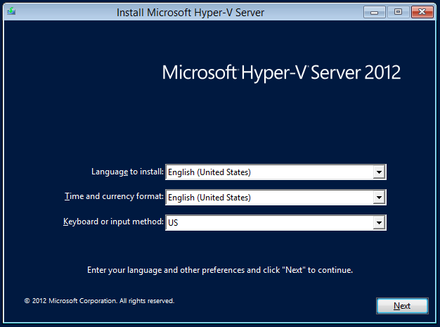
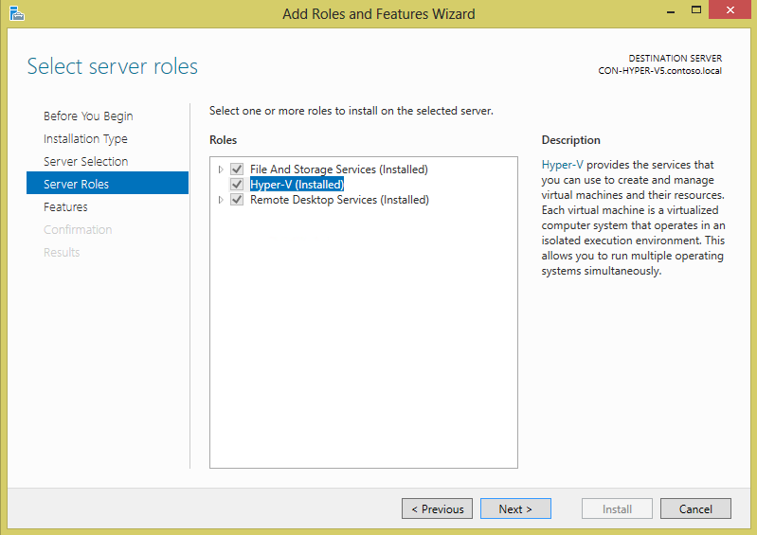
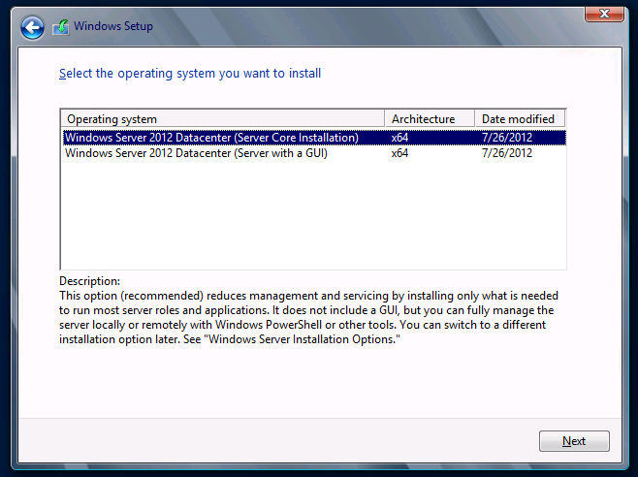
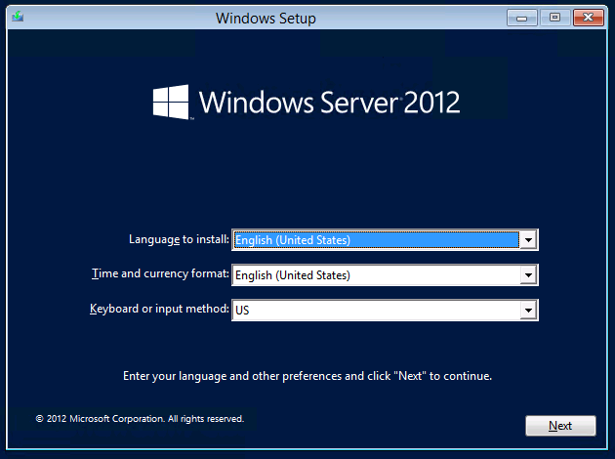
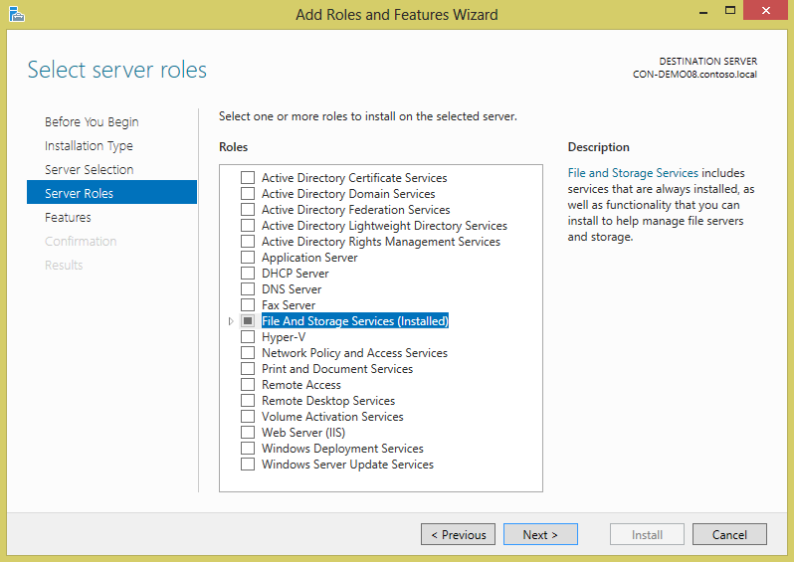
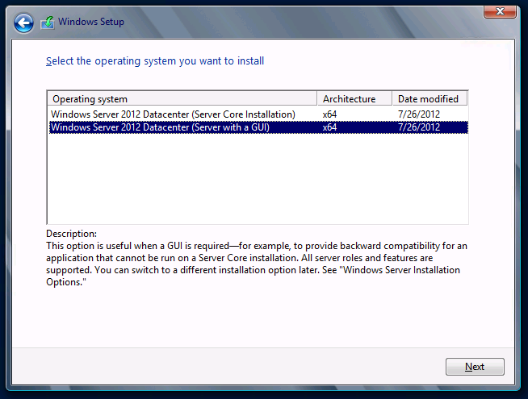
Hyper-V Deployment Options
Windows Server
Server with a GUI
Server Core Installation
Many roles available incl. Hyper-V
Hyper-V Server
Free Standalone Download
Contains hypervisor, driver model & key virtualization components
Server Core minus other roles
From a Hyper-V perspective, all 3 deployment options have identical capabilities
Notes:
For the actual deployment however, there are a few more, well, choices. Firstly, customers have to make a decision about what hypervisor they deploy. Well, from an interface and roles/features perspective at least.
<click>
The first way to deploy Hyper-V, is as part of Windows Server 2012 R2. Now Windows Server 2012 R2 itself, actually has a couple of deployment options. The first…
<click>
Is to deploy Windows Server how many customers have deployed Windows Server throughout the years, which is a full edition, with a GUI to interact locally. This makes installation and local configuration straightforward and familiar.
<click>
You could alternatively choose to deploy the Core installation, which provides a command shell locally for management, and a reduced disk footprint, and number of patches too. Installation is quick, but remote management would become very important, however fortunately, Windows Server 2012 R2 can be managed remotely from the inbox tools in Windows Server 2012 R2 or Windows 8.
<click>
As part of the Windows Server 2012 R2 installation, either GUI or Core, you can turn on a number of roles and features, including Hyper-V.
<click>
What about Hyper-V Server? Well, that’s a free download from Microsoft.com, and <click> it only contains the key Hyper-V components, the hypervisor, core driver model and other components Hyper-V needs to do it’s job. It has a reduced footprint, reduced number of services running, and reduced patching. It doesn’t…
<click>
…contain the rest of the roles, which as you can see. Hyper-V Server just has few roles and features. Anything that’s not specific to Hyper-V, or benefitting Hyper-V, isn’t in there.
<click>
The key thing to note is, whichever deployment option you choose, the features and functionality provided by Hyper-V are the same. They all have identical capabilities.
<next slide>

Slide 13
Before Windows Server 2012 R2
Windows Server 2008 R2 Hyper-V & Hyper-V Server 2008 R2 launched
SP1 for Windows Server 2008 R2 & Hyper-V Server 2008 R2 launched
Hyper-V introduced in Windows Server 2008
Windows Server 2012 Hyper-V & Hyper-V Server 2012 Launched
Hyper-V Server 2008 launched
Live Migration
Cluster Shared Volumes
Processor Compatibility
Hot-Add Storage
Performance & Scalability Improvements
Huge Scalability
Storage Spaces
Metering & QoS
Migration Enhancements
Extensibility
Hardware Offloading
Network Virtualization
Replication
Dynamic Memory
RemoteFX
June 2008
October 2008
October 2009
February 2011
September 2012
Notes:
Before Windows Server 2012 R2
Let’s first review the Hyper V improvements that the earlier versions of Windows Server provide. Beginning with Windows Server 2008, server virtualization via Hyper V technology has been an integral part of the operating system. A new version of Hyper V is included as a part of Windows Server 2008 R2, and this was further enhanced with Service Pack 1 (SP1).
There are two manifestations of the Hyper V technology:
Hyper V is the hypervisor-based virtualization feature of Windows Server 2008 R2.
Microsoft Hyper V Server is the hypervisor-based server virtualization product that allows customers to consolidate workloads onto a single physical server. This is available as a free download.
Windows Server 2008 R2 Hyper V enhancements
With the launch of Windows Server 2008 R2 Hyper-V, Microsoft introduced a number of compelling capabilities to help organizations reduce costs, whilst increasing agility and flexibility. Key features introduced included:
Live Migration – Enabling the movement of virtual machines (VMs) with no interruption or downtime
Cluster Shared Volumes – Highly scalable and flexible use of shared storage (SAN) for VMs
Processor Compatibility – Increase the Flexibility for Live Migration across hosts with differing CPU architectures
Hot Add Storage – Flexibly add or remove storage to and from VMs
Improved Virtual Networking Performance – Support for Jumbo Frames and Virtual Machine Queue (VMq)
With the addition of Service Pack 1 (SP1) for Hyper-V, Microsoft introduced 2 new, key capabilities to help organizations realize even greater value from the platform:
Dynamic Memory – More efficient use of memory while maintaining consistent workload performance and scalability.
RemoteFX – Provides the richest virtualized Windows 7 experience for Virtual Desktop Infrastructure (VDI) deployments.
Windows Server 2008 R2 Hyper V Benefits
Hyper V is an integral part of Windows Server and provides a foundational virtualization platform that lets customers transition to the cloud. With Windows Server 2008 R2, customers get a compelling solution for core virtualization scenarios; production server consolidation, dynamic data center, business continuity, Virtual Desktop Infrastructure (VDI), and test and development. Hyper V provides customers with better flexibility with features like live migration and cluster shared volumes for storage flexibility. In Windows Server 2008 R2, Hyper V also delivers greater scalability with support for up to 64 logical processors and improved performance with support for dynamic memory and enhanced networking support.

Slide 14

Physical & Virtual Scalability
Massive scalability for the most demanding workloads
Enterprise Class Scale for Key Workloads
Virtual CPU
64
Hosts
Support for up to 320 logical processors & 4TB physical memory per host
Support for up to 1,024 virtual machines per host
Clusters
Support for up to 64 physical nodes & 8,000 virtual machines per cluster
Virtual Machines
Support for up to 64 virtual processors and 1TB memory per VM
Supports in-guest NUMA
Virtual Memory
1TB
320
4TB
Logical Processors
Physical Memory
Cluster Nodes
64
Notes:
Hyper V in Windows Server 2008 R2 supported configuring virtual machines with a maximum of four virtual processors and up to 64 GB of memory. However, IT organizations increasingly want to use virtualization when they deploy mission critical, tier-1 business applications. Large, demanding workloads such as online transaction processing (OLTP) databases and online transaction analysis (OLTA) solutions typically run on systems with 16 or more processors and demand large amounts of memory. For this class of workloads, more virtual processors and larger amounts of virtual machine memory are a core requirement.
Scalability however, goes beyond just running workloads. Customers also need to ensure that the demands of workloads can be handled effectively by scalable storage and networking infrastructure, and to do so, must take advantage of the latest, and greatest hardware innovations.
With Windows Server 2012, and subsequently 2012 R2, there were a number of design goals to try to address these challenges. Not only do we want to enable customers to run their most demanding of applications, whilst providing the highest levels of performance and scale, but at the same time, we want to ensure that customers can provide optimal resource usage and availability across their infrastructure.
From an out and out scalability perspective, Hyper V in Windows Server 2012 R2 greatly expands support for host processors and memory over Windows Server 2008 R2 Hyper-V. New features include support for up to 64 virtual processors and 1TB of memory for Hyper V guests, a new VHDX virtual hard disk format with larger disk capacity of up to 64 TB, and additional resiliency and alignment optimization, which we’ll discuss later. These features help ensure that the virtualization infrastructure can support the configuration of large, high-performance virtual machines to support workloads that might need to scale up significantly
From a host perspective, you can see that Hyper-V supports up to 4TB of physical memory per host, and up to 2,048 vCPUs per host. This is a 4x increase over Windows Server 2008 R2 Hyper-V, and means that a customer could, in reality, run 1,024 2-vCPU virtual machines, each with around 4GB memory, and still be within a supported configuration. This scalability is immense, and ensures customers can realize the greatest value for their hardware investments.
When we think about Virtual Machines (VM) in particular, again, significant improvements have been made across the board, with Hyper-V now supporting VMs with up to 64 vCPUs, and 1TB memory. This is huge scale, and opens the door to running high-end, mission-critical in-memory transactional or analysis workloads that can benefit significantly from that kind of resource capacity.
Earlier, we briefly discussed how customers are demanding higher levels of availability and resiliency for their key virtualized workloads. With Windows Server and Hyper-V, the foundation of providing that higher level of availability is the Failover Cluster. With Windows Server 2012 R2, cluster sizes have increased from a maximum of 16 nodes in Windows Server 2008 R2, to 64 nodes in Windows Server 2012 and Windows Server 2012 R2. This in turn, supports a significantly higher number of active virtual machines per cluster, up from 1,000 to 8,000.
There is another innovation that can drive higher levels of performance for virtualized workloads, and is of particular importance when running virtualized workloads with significant numbers of virtual processors, and high levels of memory. That innovation is Virtual Machine NUMA.
Windows Server 2012 R2 Hyper-V now supports NUMA, or Non-Uniform Memory Access, inside a virtual machine. NUMA refers to a computer architecture in multiprocessor systems, in which the required time for a processor to access memory depends on the memory’s location relative to the processor.
With NUMA, a processor can access local memory (memory attached directly to the processor) faster than it can access remote memory (memory that is local to another processor in the system). Modern operating systems and high-performance applications such as SQL Server have developed optimizations to recognize the system’s NUMA topology and consider NUMA when they schedule threads or allocate memory to increase performance.
Projecting a virtual NUMA topology into a virtual machine provides optimal performance and workload scalability in large virtual machine configurations. It does this by letting the guest operating system and applications such as SQL Server, or the Windows Web Server, IIS, take advantage of their inherent NUMA performance optimizations. The default virtual NUMA topology that is projected into a Hyper-V virtual machine is optimized to match the host’s NUMA topology, as shown on the slide.
<next slide>

Slide 15
VMware Comparison
System | Resource | Windows Server 2012 R2 Hyper-V | vSphere Hypervisor | vSphere 5.5 Enterprise Plus
Host | Logical Processors | 320 | 320 | 320
 | Physical Memory | 4TB | 4TB | 4TB
 | Virtual CPUs per Host | 2,048 | 4,096 | 4,096
VM | Virtual CPUs per VM | 64 | 8 | 64¹
 | Memory per VM | 1TB | 1TB | 1TB
 | Active VMs per Host | 1,024 | 512 | 512
 | Guest NUMA | Yes | Yes | Yes
Cluster | Maximum Nodes | 64 | N/A² | 32
 | Maximum VMs | 8,000 | N/A² | 4,000
vSphere 5.5 Enterprise Plus is the only vSphere edition that supports 64 vCPUs. Enterprise edition supports 32 vCPU per VM with all other editions supporting 8 vCPUs per VM
For clustering/high availability, customers must purchase vSphere
vSphere Hypervisor / vSphere 5.x Ent+ Information: http://www.vmware.com/pdf/vsphere5/r55/vsphere-55-configuration-maximums.pdf and http://www.vmware.com/products/vsphere-hypervisor/faq.html, http://www.vmware.com/files/pdf/vsphere/VMware-vSphere-Platform-Whats-New.pdf
Notes:
How does VMware Compare?
The table shows a comparison between Windows Server 2012 R2 Hyper-V, and both the VMware vSphere Hypervisor; VMware’s free standalone hypervisor, and VMware vSphere 5.5 Enterprise Plus; VMware’s per-CPU licensed, most advanced edition.
The table above shows that Hyper-V has a number of advantages from a scalability perspective, especially when it comes to comparison with the vSphere Hypervisor. vSphere 5.5 brought a number of scalability increases for vSphere environments, doubling the number of host logical processors supported from 160 to 320, and doubling the host physical memory from 2TB to 4TB, but this still only brings vSphere up to the level that Hyper-V has been offering since September 2012, at the launch of Windows Server 2012 Hyper-V.
VMware positions the vSphere Hypervisor as simple, entry-level solution designed to allow users to experience the benefits of VMware’s virtualization platform at no cost, however on closer examination, certain restrictions are imposed which prevent customers utilizing the solution at scale, meaning customers have to purchase, at significant cost, one of the more advanced vSphere editions.
Since the launch of vSphere 5.0, in 2011, VMware has regularly discussed the inclusion of 32 virtual processors within a virtual machine, yet at the time, this was exclusive to the Enterprise Plus edition of vSphere, and not the vSphere Hypervisor, vSphere 5.0 Essentials, Essentials Plus, Standard, and Enterprise editions, which were all capped at 8 virtual processors per virtual machine. With vSphere 5.1, and subsequently, 5.5, however, the Enterprise edition can now support VMs with up to 32 vCPUs, and the Enterprise Plus edition, 64 vCPUs. Compare this with Hyper-V in Windows Server 2012 and 2012 R2, and customers not only receive up to 64 virtual processors per virtual machine, but this comes with no SKU-specific restrictions. Customers are free to run the most demanding of their workloads on Hyper-V, without additional costs or expensive edition upgrades. The table also shows that both Windows Server 2012 R2 Hyper-V and vSphere 5.5 deliver up to 1TB of memory to an individual virtual machine.
Previously, the vSphere Hypervisor was physically limited from consuming more than 32GB of memory, which severely restricted VM sizes, however this restriction has been lifted with the 5.5 release. From an individual host perspective, Hyper-V also supports double the number of active virtual machines per host, than both the vSphere Hypervisor and vSphere 5.5 Enterprise Plus, ensuring customers can realize even greater levels of density for their key workloads, whilst achieving a better return on investment.
Whilst virtualization itself is an incredibly important aspect within the datacenter, resiliency and high availability of workloads is of equal importance. The inclusion of Failover Clustering with Windows Server 2012 R2 enables customers to achieve massive scale with an unparalleled number of nodes within a cluster, and virtual machines per cluster. Unfortunately, the vSphere Hypervisor alone doesn’t provide any high availability, or resiliency features, and customers must purchase vSphere 5.5 to unlock these features, and even then, cluster sizes are restricted to only 32 nodes, and 4,000 virtual machines per cluster, which is considerably smaller than the 64 nodes, and 8,000 VMs supported by Windows Server 2012 R2.

Slide 16

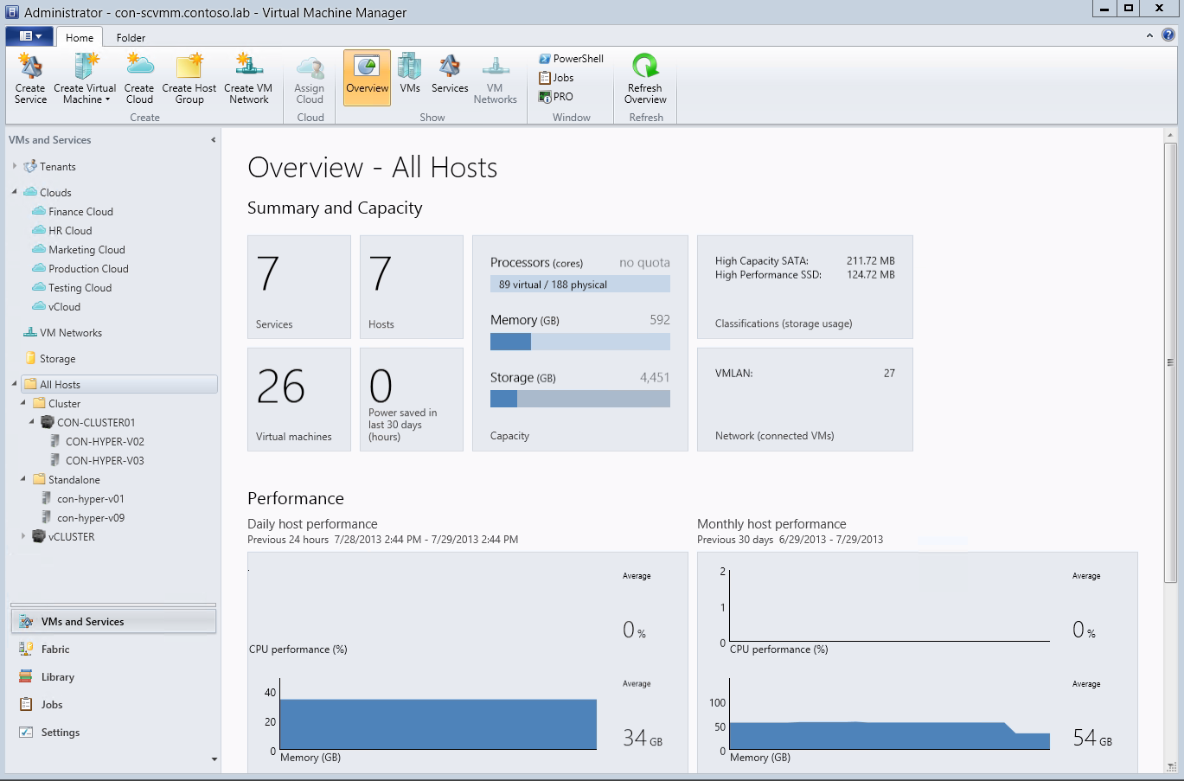
Virtualization Management
Compares with
vCenter Server
Centralized, Scalable Management of Hyper-V
{
Supports up to 1,000 Hyper-V hosts & 25,000 virtual machines per VMM Server
Supports Hyper-V hosts in trusted & untrusted domains, disjointed namespace & perimeter networks
Supports Hyper-V from 2008 R2 SP1 through to 2012 R2
Comprehensive fabric management capabilities across Compute, Network & Storage
End to end VM management across heterogeneous hosts & clouds
System Center Virtual Machine Manager 2012 R2 VM and Cloud management
Hyper-V Hosts
Notes:
So, how do we manage Hyper-V? Well, for starters, you can make use of the integrated MMC management interfaces that are built into Windows Server, such as Hyper-V Manager and Failover Cluster Manager, to manage a smaller number of hosts and virtual machines, however as you start to grow, or look to utilize more advanced features and capabilities, System Center, in particular, Virtual Machine Manager, starts to play a critical role.
VMM provides support for up to 1,000 Hyper-V hosts, and provides a centralized view of up to 25,000 VMs running across those hosts, which is significantly greater scalability than what is provided by the inbox interfaces alone. VMM also provides a richer interface for management of those VMs, as show in the graphic <click>
VMM provides support for a variety of current and older versions of Hyper-V, including both the Windows Server and Hyper-V Server versions, back from 2008 R2 SP1, through to 2012 R2. In addition, those hosts don’t have to be in trusted domains, with VMM providing support for hosts that may be located in untrusted domains, or networks with disjointed namespaces, or DMZs.
The name, Virtual Machine Manager, in some ways, is misleading, as VMM provides considerably more capability than just VM management, extending to Services, along with deep fabric integration through the network, storage and compute integration points that you’ll explore throughout this course.
VMM isn’t also restricted to managing just Hyper-V host, with it’s VM management capabilities extended to support management of virtual machines running on both VMware and Citrix hypervisors.
<next slide>

Slide 17

VMM Architecture
SQL
Management Console
App Controller
Management Server
Hosts (1000 Per Management Server)
Library
Notes:
Now on the slide, we have a number of components.
Firstly, in grey, we have our hosts, and these are connected to a management server, over the network. Each management server can manage 1000 hosts, and up to 25,000 virtual machines. This is significant scalability, and more than enough headroom for many organizations. System Center 2012 R2 VMM has been significantly enhanced in terms of it’s scalability.
This management server relies on a couple of key components. Firstly, it requires a SQL Server database, which it utilizes to store it’s key information about the virtualized infrastructure. Secondly, VMM requires a library. This can be a file share on the same server as VMM, or on a completely different file server. As long as VMM can access it, it will be able to use the library server to store it’s key pieces of information, such as offline VMs, templates, PowerShell scripts, ISO files and more. VMM can attach to multiple library servers and shares, and can manage duplication between them ensuring at deployment time, the most appropriate file shares to the target deployment hosts are used.
In addition, to use the VMM management server, IT admins will need to install a management console. This could be installed on the same server as the management server, or could be installed on an alternative server, or client OS.
<click>
In previous releases of VMM, there was a basic Self-Service Portal that administrators could use to delegate access to virtual machines to different users or groups, however this has now been replaced with a significantly more capable, rich and streamlined self-service portal in the form of System Center 2012 R2 App Controller, which we’ll look at in more depth later. This also utilizes a SQL database, and can harness the same SQL Server as VMM, or a separate one.
<next slide>

Slide 18
VMM Architecture - HA
Compares with
vCenter Heartbeat
SQL Cluster
Management Console
NLB App Controller
Management Server Cluster
Library on Clustered File Server
Hosts (1000 Per Management Server)
Notes:
But how do we ensure that VMM is resilient? Well, with VMM becoming more pivotal to the scaled management of Hyper-V hosts and VMs, it’s certainly important that we ensure VMM is resilient, and thankfully, it’s pretty straightforward. Obviously, you could run VMM, and all of it’s key components, inside a single, or a set of VMs on top of a Hyper-V Cluster, however VMM has resiliency mechanisms of it’s own, built in.
Firstly, the management server itself. Well, if you choose to install VMM on a Windows Server OS that is part of a cluster, VMM’s installer will recognize this, and prompt the administrator to install in a HA configuration, ensuring that upon failure of a management server node, another will take over. This would compare with the kind of functionality provided by vCenter Heartbeat – an additional product customers can purchase to ensure vCenter is more resilient. With VMM, it’s included in the box at no additional cost, and with the enhancements around Guest Clustering support offered by the underlying hypervisor, it’s a solution that is achievable for many customers.
Secondly, the library – this could be made highly available by utilizing a clustered file server, ensuring the shares VMM needs to store it’s key data, such as offline VMs, templates, ISOs etc, is as available as possible.
Thirdly, we need a resilient database, which could be achieved through SQL Clustering.
Finally, App Controller, used for Self-Service, can be placed behind an NLB, with App Controller instances running on multiple web servers, and if one fails, another will provide access for the end users.
<next slide>

Slide 19
System Center for the Datacenter
}
App Controller VM & application self-service
Operations Manager Infrastructure & application monitoring & alerting
{
Service Manager IT Service Management & IaaS Self-Service
Virtual Machine Manager VM & cloud management
Orchestrator Integration & automation of key technologies & processes
Data Protection Manager Continuous protection of key applications & workloads
Hyper-V Hosts
Notes:
Now before we start to look at both Hyper-V & Virtual Machine Manager in more detail, it’s important we understand some of the other key System Center components that play a part in managing the datacenter.
Firstly, we have VMM, which we’re going to look at extensively, as this is the key tool you’ll use to manage your hypervisor hosts, along with the VMs and services on top. It provides complete control of the virtualized infrastructure and centralizes all of the key management tasks so you rarely need to visit either Hyper-V Manager, or Failover Cluster Manager again.
<click>
For organizations exploring Private Clouds, self-service becomes an important consideration as a way to provide end users, and application owners with the ability to consume IT infrastructure, in a controlled and abstracted way. App Controller provides a common self-service experience that can help you easily configure, deploy, and manage virtual machines and services across private and public clouds. These could be private clouds on your premises, on a service provider premises, or Windows Azure public clouds.
<click>
We then think about monitoring. How does IT gain insight into the infrastructure, both at the fabric, and the application layers? Well, Operations Manager provides infrastructure monitoring that is flexible and cost-effective, helps ensure the predictable performance and availability of vital applications, and offers comprehensive monitoring for your datacenter and cloud, both private and public.
<click>
Service Manager provides an integrated platform for automating and adapting your organization’s IT service management best practices, such as those found in Microsoft Operations Framework (MOF) and Information Technology Infrastructure Library (ITIL). It provides built-in processes for incident and problem resolution, change control, and asset lifecycle management. It also provides a rich self-service portal for requesting access to resources that could then be consumed through App Controller.
<click>
Orchestrator is a workflow management solution for the data center. Orchestrator lets you automate the creation, monitoring, and deployment of resources in your environment. It helps IT to automate key tasks and processes, along with integrating both Microsoft and non-Microsoft systems, platforms and applications, to increase efficiencies within the environment.
<click>
Finally, we have Data Protection Manager. Data Protection Manager (DPM) enables disk-based and tape-based data protection and recovery for servers such as SQL Server, Exchange Server, SharePoint, virtual servers, file servers, and support for Windows desktops and laptops. DPM can also centrally manage system state and Bare Metal Recovery (BMR).
Together, these components form System Center, and as mentioned earlier, they are available as a single product, licensed via 2 SKUs, Standard or Datacenter, depending on your virtualization needs.
<next slide>

Slide 20
Deploying Hyper-V
Compares with
PXE & Auto Deploy
Deploy from DVD/ISO
Create bootable DVD from Windows Server/Hyper-V Server source ISO
Deploy from USB Disk
Create bootable USB from Windows Server/Hyper-V Server source media
Network Deployment
PXE boot physical hosts and deploy a Windows Server/Hyper-V Server image over the network
Notes:
So how can I deploy Hyper-V?
Well, pretty much in the same ways you can deploy vSphere, with some subtle differences.
Firstly, you can download the ISO file from the web, burn it to a DVD (or attach it to a Virtual CD in an iLO-type approach), and boot the machine, installing in the way many are familiar with. The installation, depending on your hardware, will take around 20 minutes, end to end, but may be much faster on more modern hardware.
<click>
Alternatively, you could extract those same files from the ISO, but place them on a bootable USB, and boot from there, installing Windows Server & Hyper-V onto the local disk.
<click>
Finally, you could deploy Hyper-V over the network, which would be similar to the approach taken by VMware, who allow booting over the network from a regular PXE infrastructure, or with more recent developments, through a mechanism called Auto Deploy, which used vCenter and an Auto Deploy server to push an ESXi image across the network onto hosts. From a Hyper-V perspective, this network deployment could be via the core, inbox Windows Deployment Services, or, enhanced with VMM.
<next slide>

Slide 21
Virtualization Deployment with VMM
Deep Discovery Prior to Hyper-V Deployment
Through integration with the BMC, VMM can wake a physical server & collect information to determine appropriate deployment
OOB Reboot
Boot from PXE
Authorize PXE boot
Download VMM customized WinPE
Execute a set of calls in WinPE to collect hardware inventory data (network adapters and disks)
Send hardware data back to VMM
Bare-metal server
WDS server
4
2
3
5
VMM server
6
1
Notes:
Now before we deploy a new Hyper-V-enabled image to a blank server, there’s a little bit of work we may want to do to streamline that process and ensure we’re sending the correct image, and configuration down to the host in question.
Before initiating the actual deployment of the image, VMM will initiate a collection of information about the target host, and allow the IT administrator to make a few selections and configuration choices, before VMM automates the remainder of the tasks.
<click>
The first key task that VMM executes, is an OOB reboot, or wake up. For this to work, VMM will need the IP address of the Baseboard Management Controller of the target host. Admins can provide the IP specifically, or scan a range, but once located VMM will initiate the wake up, or reboot depending on the current state of that target host.
<click>
VMM will then orchestrate the target host to PXE boot and attach to the WDS server that we talked about earlier. VMM and the WDS server work in harmony to firstly <click> authorize that host to PXE boot and attach to the WDS server, and then <click> for the WDS server to deliver a VMM-specific WinPE image down to the target host. It’s important to note that not just any physical server, or desktop, PXE booting off the WDS server, will receive this WinPE image – VMM has provided the WDS server with specific information on what to send over to the host located at the IP/MAC address specified earlier in the process.
<click>
Once WinPE is loaded, a number of pre-defined scripts will execute automatically, triggering a collection of information about network adaptors, and disks, and this information <click> is sent back to VMM and presented in the wizard, so the user can continue on, knowing specific information about the networking and storage configuration of that target host, and they can now configure the deployment in respect of that information.
<next slide>

Slide 22
Virtualization Deployment with VMM
Centralized, Automated Bare Metal Hyper-V Deployment
Post-deep discovery, VMM will deploy a Hyper-V image to the physical server
OOB Reboot
Boot from PXE
Authorize PXE boot
Download VMM customized WinPE
Run generic command execution scripts and configure partitions
Download VHD & Inject Drivers
The host is then domain joined, added to VMM Management & post-install scripts executed
WDS server
Bare-metal server
2
4
Virtual Hard Disk
3
VMM server
5
1
Physical Hardware Drivers
Library server
Physical Computer Profile
6
Notes:
Once the administrator has all the information from deep discovery, the admin continues the wizard, provides a computer name, configures networks, local storage options etc, and chooses a physical computer profile. The physical computer profile is a set of configuration options that are used by VMM to standardize deployment of new hosts into the infrastructure. These host profiles will have a number of configuration options, that relate to network, storage, drivers, naming, but most importantly, the physical computer profile has a Hyper-V image, contained within a VHD or VHDX file, assigned to it. These Physical Computer Profiles, drivers and VHDX files are stored in VMM’s library.
So, when the admin finally finishes the wizard, VMM starts the deployment process. The host will have been shut down after deep discovery, <click> so VMM will first wake up that host, using the BMC. <click> It will coordinate the host to boot from PXE and again, <click> work in conjunction with the WDS server to allow this particular host to PXE boot and connect to the WDS server itself. <click> Once connected, the host will download a WinPE image, and <click> begin executing the custom scripts and partition configuration.
Once this stage has completed, <click> VMM will push down the VHD/VHDX file to the host. Note, this is configuring the host for a boot from VHD configuration, rather than a traditional Windows Server install. VMM pushes the image down from the library, onto the host’s newly partitioned hard drive. <click> Once complete, VMM will inject drivers <click>, run the customization wizards and join the host to the domain, enable Hyper-V if required, and whilst doing so, brings the new host into VMM’s complete management control and finishes off the process with any post-install scripts that it needs itself, or that have been added by the administrator.
The admin is left with a new Hyper-V host, which can now accept virtual machines.
<next slide>

Slide 23
VMware Comparison
Capability | Microsoft | VMware
Deployment from DVD | Yes | Yes
Deployment from USB | Yes | Yes
PXE Deployment - Stateful | Yes – WDS, MDT, SCCM, SCVMM | Yes – PXE/Auto Deploy¹
PXE Deployment - Stateless | No | Yes – Auto Deploy
A Stateful option for Auto Deploy was introduced in vSphere 5.1 after previously only providing a stateless, in-memory version in 5.0.
Notes:
How does this compare, on paper, with VMware?
Well, as the table shows, both vendors provide options for customers to centrally deploy the hypervisor, however VMware do provide one option to deploy the hypervisor stateless, into memory of the physical server, and hold the state elsewhere, using the Auto Deploy technology we discussed earlier. What’s interesting to note is, that in vSphere 5.0, this stateless method was the only way to use Auto Deploy, however VMware have since provided more options that fit with the more traditional ways of deploying OS images to servers with local spinning media.
<next slide>

Slide 24
Introduction to vSphere Components
1. ESXi (vSphere Hypervisor)
2. vCenter Server
3. vSphere Client
4. VMFS (Virtual Machine File System)
5. vMotion
6. vSphere Distributed Resource Scheduler (DRS)
7. vSphere High Availability (HA)
8. vSphere Distributed Switch (vDS)
9. vSAN (Virtual SAN)

Slide 25
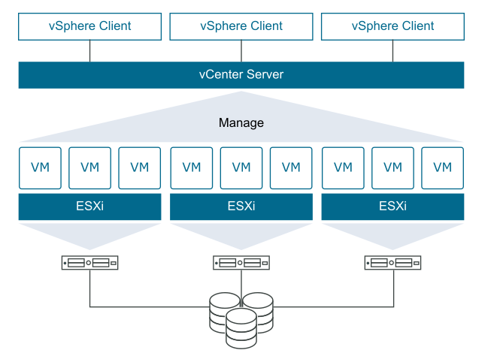
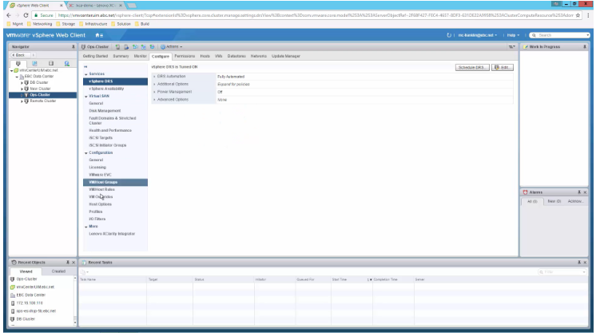
Introduce to vSphere Components
Notes:
Introduction to vSphere Components
VMware vSphere is a comprehensive suite of virtualization and cloud computing products developed by VMware. It is designed to provide a robust and scalable platform for managing virtualized IT environments. vSphere is widely used in data centers and enterprise environments to optimize the use of hardware resources, improve scalability, and enable advanced features such as high availability, disaster recovery, and centralized management.
vSphere is made up of several key components, each playing a critical role in the overall virtualization infrastructure. Below are the primary components of VMware vSphere:
1. ESXi (vSphere Hypervisor)
ESXi is the core hypervisor within the vSphere suite. It is a bare-metal hypervisor, meaning it installs directly on the physical hardware without requiring an underlying operating system.
Functionality: ESXi manages the hardware resources (CPU, memory, storage, and network) and allocates them to the virtual machines (VMs) running on the host. It provides a secure and efficient platform for running multiple VMs on a single physical server.
Key Features: ESXi is known for its small footprint, reliability, and security. It supports advanced features such as live migration (vMotion), high availability, and distributed resource scheduling.
2. vCenter Server
vCenter Server is the centralized management component of the vSphere suite. It provides a single interface for managing multiple ESXi hosts and the virtual machines running on them.
Functionality: vCenter Server allows administrators to monitor and manage the virtual infrastructure, including tasks such as VM creation, resource allocation, performance monitoring, and configuring advanced features like Distributed Resource Scheduler (DRS) and High Availability (HA).
Key Features: vCenter Server supports role-based access control, allowing different levels of access for various users. It also integrates with other VMware products and services, providing a comprehensive management platform for the entire virtual environment.
3. vSphere Client
vSphere Client is the user interface used to interact with vCenter Server and ESXi hosts. It can be accessed through a web browser (HTML5-based interface) or as a standalone application.
Functionality: vSphere Client allows administrators to perform tasks such as deploying VMs, configuring networking and storage, monitoring performance, and managing resource allocation.
Key Features: The web-based vSphere Client provides a consistent and responsive interface, making it easy to manage the vSphere environment from any location.
4. VMFS (Virtual Machine File System)
VMFS is a high-performance clustered file system that provides storage virtualization for VMware ESXi hosts. It is used to store VM disk files, snapshots, and other VM-related data.
Functionality: VMFS allows multiple ESXi hosts to read and write to the same storage simultaneously, enabling features like vMotion, which allows live migration of VMs between hosts without downtime.
Key Features: VMFS supports thin provisioning, allowing over-allocation of storage capacity, and provides built-in mechanisms for ensuring data integrity and recovery.
5. vMotion
vMotion is a key feature of vSphere that allows live migration of running VMs from one ESXi host to another without any downtime.
Functionality: vMotion enables load balancing across hosts, minimizes downtime during maintenance, and allows for dynamic resource allocation based on workload demands.
Key Features: vMotion requires shared storage accessible by both source and destination hosts, and it can be performed over a dedicated network to ensure minimal impact on production traffic.
6. vSphere Distributed Resource Scheduler (DRS)
DRS is a feature within vSphere that automatically balances computing resources across multiple ESXi hosts based on workload demand.
Functionality: DRS continuously monitors resource utilization and can automatically move VMs between hosts using vMotion to ensure optimal performance and resource distribution.
Key Features: DRS can be configured in manual, partially automated, or fully automated modes, allowing administrators to control the level of automation in resource management.
7. vSphere High Availability (HA)
HA is a feature that provides automatic recovery for VMs in case of host failure. It ensures that VMs are restarted on other available hosts in the cluster without manual intervention.
Functionality: HA monitors ESXi hosts within a cluster and, in the event of a failure, restarts the affected VMs on other hosts with minimal downtime.
Key Features: HA is essential for maintaining service continuity and minimizing the impact of hardware failures in a virtualized environment.
8. vSphere Distributed Switch (vDS)
vDS is a virtual network switch that provides centralized management and configuration of networking across multiple ESXi hosts.
Functionality: vDS allows for consistent network configuration, monitoring, and troubleshooting across the entire vSphere environment.
Key Features: vDS supports advanced networking features such as VLANs, traffic shaping, private VLANs, and port mirroring, making it a powerful tool for managing complex virtual network infrastructures.
9. vSAN (Virtual SAN)
vSAN is a software-defined storage solution integrated with vSphere that pools local storage from ESXi hosts to create a shared datastore.
Functionality: vSAN provides scalable, high-performance storage for VMs, without the need for external storage arrays. It supports features like deduplication, compression, and erasure coding for efficient storage utilization.
Key Features: vSAN is tightly integrated with vSphere, making it easy to manage and scale, and it supports policies-based storage management, allowing administrators to define storage policies for individual VMs.
Conclusion
VMware vSphere is a comprehensive and versatile platform that includes various components to manage and optimize virtualized environments effectively. From ESXi hypervisor and vCenter Server for centralized management to advanced features like vMotion, DRS, and HA for ensuring availability and performance, vSphere provides a robust foundation for modern data centers. Understanding these components is crucial for effectively deploying, managing, and scaling virtualization solutions in enterprise environments.
4o

Slide 26
Lab
Quiz 1

