Slide 1

Vmware ESXi
Virtualization with Vmware ESXi
Notes:
Virtualizing your Datacenter with Windows Server 2012 R2 & System Center 2012 R2
Attend this IT Camp, Virtualizing your Datacenter with Windows Server 2012 R2 & System Center 2012 R2, to gain a deep understanding of the strides made in helping businesses consolidate workloads and improve server utilization while reducing costs through comprehensive management using System Center.
At this event, you will get hands-on experience on how System Center helps you realize the most value from Hyper-V infrastructure. You will learn how System Center Virtual Machine Manager provides powerful management capabilities for a VMware environment through virtual machine management, monitoring, and automation. Finally, the camp will walk you through some of the options for migrating virtual machines from VMware to Microsoft.

Slide 2
Course Introduction

Slide 3
Modules
Module | Title
1 | Introduction to Virtualization Technologies
2 | Introduction to VMware Virtualization
3 | VMware ESX and ESXi (ESX/ESXi 4.1)
4 | VMware vCenter Server
5 | Networking

Slide 4
Modules
Module | Title
6 | Storage
7 | Virtual Machines
8 | Access Control
9 | Resource Monitoring
10 | Data Protection

Slide 5

Carlos Carreño
Senior Infrastructure Architect
Red Hat Trainer, Private Cloud, System Center & Hyper-V
MCSE Private Cloud, Red Hat and VMware Certified Trainer
Recognized Industry Expert, Speaker
Datacenter management, cloud, virtualization, high-availability, disaster recovery, mobile technologies and social media
Vmware Tanzu, Red Hat Openshift, Suse Rancher Implementer
ccarrenovi@Gmail.com
Notes:
Let me just introduce myself briefly here. I am a Technical Evangelist working with Microsoft. I have been with Microsoft almost 6 years now, spending 4 years working on the product engineering group at Windows Server high availability , so building clusters and designing virtual machines to run on those clusters. In my current role I am a Technical Evangelist covering all of our private cloud technologies which includes virtualization, Systems Center Suite and several pieces of Windows Server and I am joined by Matt today, why don’t you introduce yourself?

Slide 6
VMware vCenter Server Module 4

Slide 7
VMware vCenter Server
Install and configure vCenter Server components
Manage vCenter Server inventory objects

Slide 8
VMware vCenter Server
VMware vCenter Server is a centralized management platform for VMware vSphere environments. It allows administrators to manage multiple ESXi hosts and their associated virtual machines (VMs) from a single interface. vCenter Server is essential for managing larger VMware deployments, as it provides a wide range of features that enhance the functionality, scalability, and ease of use of a VMware environment.

Slide 9
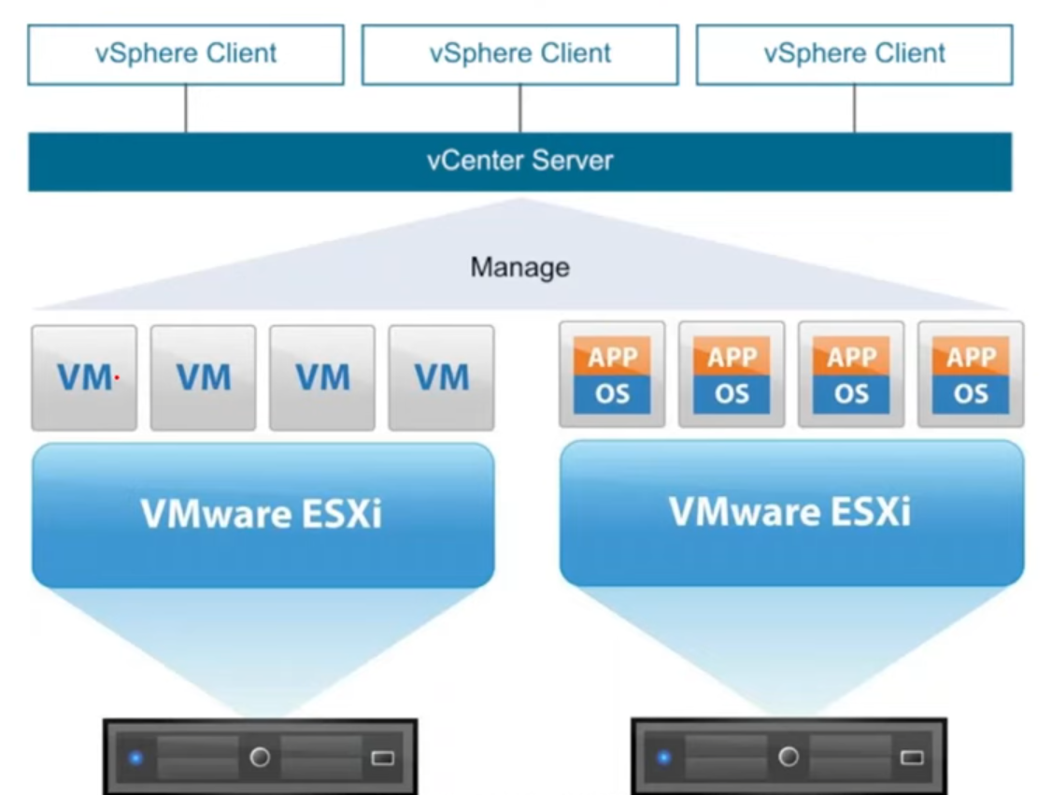
ESXi and vCenter

Slide 10
Install and configure vCenter Server components
1. vCenter Server Core Components:
a. vCenter Server Database:
Purpose: The vCenter Server database stores all configuration, inventory, and performance data for the VMware environment. This includes information about hosts, clusters, resource pools, virtual machines, datastores, and more.
Types: The database can be an external database (like Microsoft SQL Server or Oracle) or the embedded PostgreSQL database that comes with the vCenter Server Appliance (VCSA).
b. vCenter Single Sign-On (SSO):
Purpose: SSO is a security component that provides authentication services to vSphere components. It allows users to log in once and gain access to all vSphere components without needing to log in again.
Features: SSO supports various authentication methods, including username/password, smart cards, and integration with Active Directory (AD) or other LDAP services.
Components: SSO includes a Security Token Service (STS), administration server, and identity sources.
c. vSphere Web Client/HTML5 Client:
Purpose: The vSphere Web Client and the newer HTML5-based vSphere Client are web-based management interfaces used to interact with vCenter Server. Administrators use these clients to manage and monitor ESXi hosts, VMs, clusters, and other resources.
Evolution: The HTML5-based vSphere Client has largely replaced the older Flash-based Web Client, providing a more modern and responsive user experience.

Slide 11
continue
d. vCenter Server Inventory Service:
Purpose: The Inventory Service manages and caches the vSphere inventory objects like data centers, clusters, hosts, and VMs. It enhances performance by reducing the load on the vCenter Server database.
Functionality: It allows vSphere clients to browse the inventory faster, especially in large environments with many objects.
e. vCenter Server Management Web Interface (VAMI):
Purpose: VAMI (vCenter Appliance Management Interface) is a web-based interface specifically for managing the vCenter Server Appliance (VCSA). It is used for tasks like monitoring the health of the appliance, configuring network settings, updating the appliance, and managing services.
Access: VAMI is typically accessed via https://<vcenter-ip>:5480.
f. vCenter Server Licensing:
Purpose: The licensing component manages and enforces the licensing of vCenter Server and the vSphere environment. It controls which features are available based on the installed licenses.
Functionality: Administrators can assign and manage licenses for vCenter Server, ESXi hosts, and other VMware products.

Slide 12
continue
2. vSphere Distributed Services:
a. vSphere Distributed Resource Scheduler (DRS):
Purpose: DRS automatically balances the workload across ESXi hosts in a cluster by migrating VMs using vMotion. It optimizes resource utilization and ensures that VMs have the necessary resources to operate efficiently.
Functionality: DRS uses rules and policies defined by the administrator to manage resource allocation and balance across the cluster.
b. vSphere High Availability (HA):
Purpose: VMware HA provides automatic failover in case of a host failure. It restarts VMs on other hosts in the cluster to minimize downtime.
Components: HA includes an agent on each host that communicates with the vCenter Server to monitor the health of hosts and VMs.
c. vSphere vMotion:
Purpose: vMotion enables the live migration of running VMs from one ESXi host to another without downtime. It is critical for load balancing, maintenance, and reducing downtime during hardware upgrades.
Functionality: vMotion requires a shared storage environment and a consistent network configuration between the source and destination hosts.

Slide 13
continue
d. vSphere Storage vMotion:
Purpose: Storage vMotion allows the migration of a VM's disk files from one datastore to another while the VM is running. This is useful for balancing storage loads and performing maintenance on storage devices.
Functionality: Like vMotion, Storage vMotion operates without disrupting VM operations, providing flexibility in managing storage resources.
e. vSphere Update Manager (VUM):
Purpose: VUM automates the patching and upgrading of ESXi hosts, VMs, and virtual appliances. It helps ensure that the environment remains up-to-date and secure.
Components: VUM consists of a patch repository, remediation scheduler, and compliance checker, and integrates with the vSphere Client for management.

Slide 14
continue
3. vCenter Server Optional Components:
a. vCenter Orchestrator (vRO):
Purpose: vRO is an automation tool that allows administrators to create complex workflows for automating tasks in the vSphere environment. It integrates with vCenter Server and other VMware products.
Functionality: vRO includes a drag-and-drop workflow designer, pre-built workflows, and the ability to integrate with third-party tools via plugins.
b. vCenter Server Linked Mode:
Purpose: Linked Mode allows multiple vCenter Servers to be linked together, providing a single pane of glass for managing multiple vCenter instances. It allows for centralized management of roles, permissions, and licenses across the linked vCenter Servers.
Enhanced Linked Mode (ELM): ELM provides a more robust and integrated experience, especially when using the vCenter Server Appliance, allowing for consistent management across multiple sites.
c. vCenter Server Heartbeat (Deprecated):
Purpose: vCenter Server Heartbeat was used to provide high availability and disaster recovery for the vCenter Server service by replicating it to a secondary server. It has been deprecated, and its functionality is now incorporated into other VMware solutions.

Slide 15
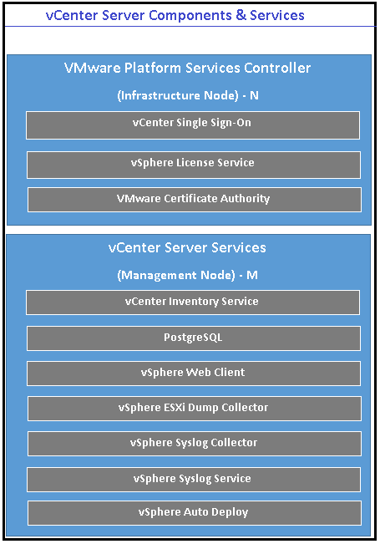
continue
4. vCenter Server API and SDK:
Purpose: vCenter Server exposes a rich set of APIs that allow developers and administrators to interact programmatically with the vSphere environment. This enables integration with third-party tools, custom automation, and advanced scripting.
SDKs: VMware provides SDKs for various programming languages (e.g., Java, Python, PowerShell) to facilitate the development of applications and scripts that interact with vCenter Server.

Slide 16
Manage vCenter Server inventory objects
Managing vCenter Server inventory objects involves organizing and handling the various components within a VMware vSphere environment. Inventory objects in vCenter Server include data centers, clusters, hosts, virtual machines (VMs), datastores, networks, and more.

Slide 17
Understanding vCenter Server Inventory Objects
Data Center: A logical container that groups clusters, hosts, networks, and datastores. It serves as the highest-level organizational unit.
Cluster: A group of ESXi hosts that work together as a single entity for features like HA (High Availability), DRS (Distributed Resource Scheduler), and FT (Fault Tolerance).
Host: An ESXi physical server that provides resources like CPU, memory, storage, and networking for VMs.
Virtual Machine (VM): A software-based emulation of a physical computer that runs an operating system and applications.

Slide 18
Understanding vCenter Server Inventory Objects
Resource Pool: A logical abstraction for dividing and allocating resources (CPU and memory) among VMs and other resource pools.
Datastore: A storage container that holds VM files, such as VM disk files (VMDKs), snapshots, and ISO images.
Network: Includes standard and distributed virtual switches (vSwitches), port groups, and VMkernel ports for managing network traffic.

Slide 19
Creating and Organizing Inventory Objects
Creating a Data Center:
Steps:
Log in to the vSphere Client.
Right-click the vCenter Server instance in the inventory pane.
Select New Datacenter.
Enter a name for the data center and click OK.
Purpose: A data center organizes clusters, hosts, and associated resources.

Slide 20
Creating and Organizing Inventory Objects
Creating a Cluster:
Steps:
Right-click the data center where you want to create a cluster.
Select New Cluster.
Enter a name and configure options such as DRS, HA, and EVC (Enhanced vMotion Compatibility).
Click OK to create the cluster.
Purpose: Clusters enable the pooling of host resources and support advanced features like HA and DRS.

Slide 21
Lab
Install Vmware vCenter

Slide 22
Come Back for More!

