Slide 1

Vmware ESXi
Virtualization with Vmware ESXi
Notes:
Virtualizing your Datacenter with Windows Server 2012 R2 & System Center 2012 R2
Attend this IT Camp, Virtualizing your Datacenter with Windows Server 2012 R2 & System Center 2012 R2, to gain a deep understanding of the strides made in helping businesses consolidate workloads and improve server utilization while reducing costs through comprehensive management using System Center.
At this event, you will get hands-on experience on how System Center helps you realize the most value from Hyper-V infrastructure. You will learn how System Center Virtual Machine Manager provides powerful management capabilities for a VMware environment through virtual machine management, monitoring, and automation. Finally, the camp will walk you through some of the options for migrating virtual machines from VMware to Microsoft.

Slide 2
Course Introduction

Slide 3
Modules
Module | Title
1 | Introduction to Virtualization Technologies
2 | Introduction to VMware Virtualization
3 | VMware ESX and ESXi (ESX/ESXi 4.1)
4 | VMware vCenter Server
5 | Networking

Slide 4
Modules
Module | Title
6 | Storage
7 | Virtual Machines
8 | Access Control
9 | Resource Monitoring
10 | Data Protection

Slide 5

Carlos Carreño
Senior Infrastructure Architect
Red Hat Trainer, Private Cloud, System Center & Hyper-V
MCSE Private Cloud, Red Hat and VMware Certified Trainer
Recognized Industry Expert, Speaker
Datacenter management, cloud, virtualization, high-availability, disaster recovery, mobile technologies and social media
Vmware Tanzu, Red Hat Openshift, Suse Rancher Implementer
ccarrenovi@Gmail.com
Notes:
Let me just introduce myself briefly here. I am a Technical Evangelist working with Microsoft. I have been with Microsoft almost 6 years now, spending 4 years working on the product engineering group at Windows Server high availability , so building clusters and designing virtual machines to run on those clusters. In my current role I am a Technical Evangelist covering all of our private cloud technologies which includes virtualization, Systems Center Suite and several pieces of Windows Server and I am joined by Matt today, why don’t you introduce yourself?

Slide 6
Networking Module 5

Slide 7
Networking
Create, configure and manage vNetwork standard switches
Create, configure and manage network connections
Create, configure and manage port groups

Slide 8
Vmware Networking Concepts
Virtual Switch (vSwitch): A virtual switch is a software-based switch that facilitates communication between VMs on the same host and between VMs and external networks. There are two types of virtual switches in VMware: Standard Switch (vSS) and Distributed Switch (vDS).
Port Group: A port group defines a set of network configurations that can be applied to VM network interfaces (vNICs). It acts as a template for network settings, such as VLAN IDs, security policies, and traffic shaping.
VMkernel Interface (vmk): A VMkernel interface is a special network interface on an ESXi host used for host management, vMotion, IP storage, and other host services. It is configured with an IP address to facilitate these services.

Slide 9
continue
VLAN (Virtual Local Area Network): VLANs are used to segment network traffic logically, even if devices are on the same physical network. VLANs help in isolating traffic for security, performance, and organizational purposes.
NIC Teaming: NIC teaming involves combining multiple physical network adapters (NICs) into a single logical network interface for redundancy and load balancing. This improves network performance and availability.
Network I/O Control (NIOC): NIOC is a feature of the distributed switch that allows for the prioritization and allocation of network bandwidth based on the type of traffic, such as management, vMotion, or VM traffic.

Slide 10
Networking Components and Services
a. VMkernel Adapters (vmk):
Purpose: VMkernel adapters are used for network services like management traffic, vMotion, fault tolerance (FT), and storage (iSCSI, NFS). Each service can be assigned a dedicated VMkernel adapter with its own IP address.
Configuration: Created and managed through the host’s networking settings in the vSphere Client. Each adapter can be bound to a specific port group on a vSwitch.
b. VLANs and VLAN Tagging:
VLAN ID Assignment: VLAN IDs are assigned to port groups to segment traffic. VMs connected to a port group with a VLAN ID will have their traffic tagged with that VLAN ID.
Trunk Ports: Physical NICs connected to a vSwitch must be configured as trunk ports on the physical switch to allow VLAN-tagged traffic.

Slide 11
continue
c. NIC Teaming and Load Balancing:
Purpose: NIC teaming is used to provide network redundancy and load balancing. Multiple physical NICs can be grouped to form a single logical network adapter, enhancing network performance and fault tolerance.
Load Balancing Algorithms: Includes options like "Route based on originating virtual port," "Route based on IP hash," and "Route based on source MAC hash."
d. Network I/O Control (NIOC):
Purpose: NIOC allows for the allocation of bandwidth to different types of network traffic, ensuring critical traffic like vMotion or management has enough bandwidth even under high load conditions.
Configuration: NIOC is configured on a vDS and allows administrators to set shares, limits, and reservations for different traffic types.

Slide 12
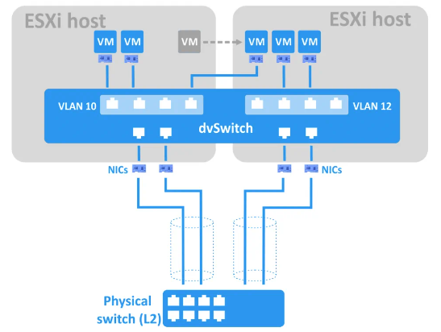
continue
e. Private VLANs (PVLANs):
Purpose: PVLANs provide additional security by isolating VMs at the second layer (L2) of the OSI model, even if they are on the same VLAN.
Configuration: PVLANs are configured on a vDS and include primary VLANs (promiscuous) and secondary VLANs (isolated and community).

Slide 13
Best Practices for VMware Networking
Use Distributed Switches (vDS) in Larger Environments: vDS provides centralized management and advanced features that simplify network administration and improve scalability.
Implement NIC Teaming: Ensure high availability and load balancing by configuring NIC teaming on both vSS and vDS.
Segment Traffic with VLANs: Use VLANs to separate different types of network traffic (e.g., management, storage, VM traffic) for security and performance reasons.
Regularly Monitor Network Performance: Utilize monitoring tools to keep an eye on network performance and address issues proactively.
Leverage NIOC for Critical Traffic: Ensure that essential services like vMotion and management traffic have sufficient bandwidth through NIOC configurations.
Secure Your Network: Apply security policies and consider integrating NSX for advanced security features like micro-segmentation.

Slide 14
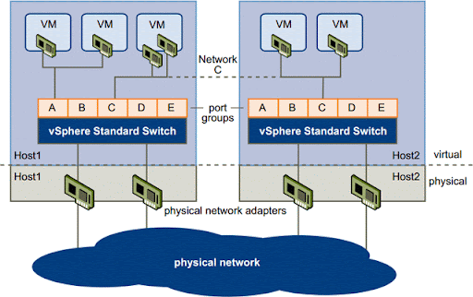
Create, configure and manage vNetwork standard switches

Slide 15
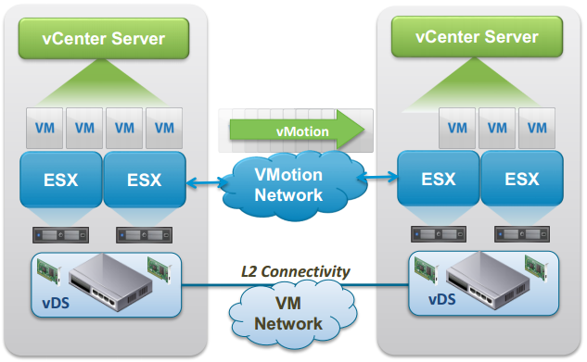
Create, configure and manage network connections

Slide 16
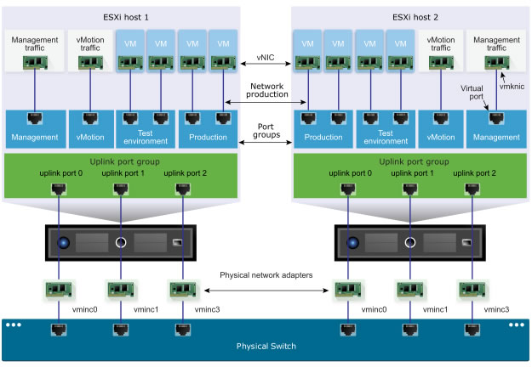
Create, configure and manage port groups

Slide 17
Lab
Setting Vmware Networking

Slide 18
Come Back for More!

