Slide 1

Vmware ESXi
Virtualization with Vmware ESXi
Notes:
Virtualizing your Datacenter with Windows Server 2012 R2 & System Center 2012 R2
Attend this IT Camp, Virtualizing your Datacenter with Windows Server 2012 R2 & System Center 2012 R2, to gain a deep understanding of the strides made in helping businesses consolidate workloads and improve server utilization while reducing costs through comprehensive management using System Center.
At this event, you will get hands-on experience on how System Center helps you realize the most value from Hyper-V infrastructure. You will learn how System Center Virtual Machine Manager provides powerful management capabilities for a VMware environment through virtual machine management, monitoring, and automation. Finally, the camp will walk you through some of the options for migrating virtual machines from VMware to Microsoft.

Slide 2
Course Introduction

Slide 3
Modules
Module | Title
1 | Introduction to Virtualization Technologies
2 | Introduction to VMware Virtualization
3 | VMware ESX and ESXi (ESX/ESXi 4.1)
4 | VMware vCenter Server
5 | Networking

Slide 4
Modules
Module | Title
6 | Storage
7 | Virtual Machines
8 | Access Control
9 | Resource Monitoring
10 | Data Protection

Slide 5

Carlos Carreño
Senior Infrastructure Architect
Red Hat Trainer, Private Cloud, System Center & Hyper-V
MCSE Private Cloud, Red Hat and VMware Certified Trainer
Recognized Industry Expert, Speaker
Datacenter management, cloud, virtualization, high-availability, disaster recovery, mobile technologies and social media
Vmware Tanzu, Red Hat Openshift, Suse Rancher Implementer
ccarrenovi@Gmail.com
Notes:
Let me just introduce myself briefly here. I am a Technical Evangelist working with Microsoft. I have been with Microsoft almost 6 years now, spending 4 years working on the product engineering group at Windows Server high availability , so building clusters and designing virtual machines to run on those clusters. In my current role I am a Technical Evangelist covering all of our private cloud technologies which includes virtualization, Systems Center Suite and several pieces of Windows Server and I am joined by Matt today, why don’t you introduce yourself?

Slide 6
Storage Module 6

Slide 7
Storage
Configure ESX/ESXi with iSCSI, NFS
Create and manage vSphere datastores

Slide 8
ESXi Storage
ESXi storage configuration involves setting up and managing the storage resources that ESXi hosts use to run virtual machines (VMs) and store data. ESXi supports different types of storage, including local storage, network storage, and shared storage

Slide 9
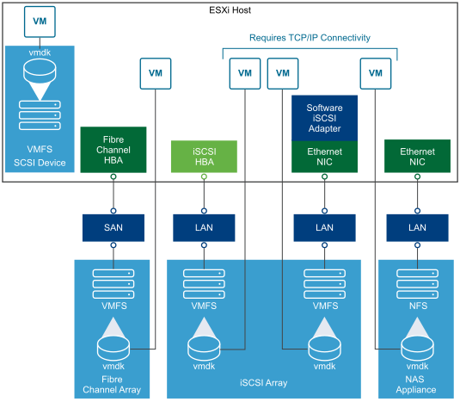
ESXi Storage

Slide 10
Configure ESX/ESXi with iSCSI, NFS
Local Storage
Network Storage
Shared Storage

Slide 11
Local Storage
Local Disks: Physical disks installed in the ESXi host.
Local Datastore: A VMFS datastore created on local disks.

Slide 12
Network Storage
iSCSI: Uses the iSCSI protocol to connect to storage devices over a TCP/IP network. It can be software-based (using the software iSCSI adapter) or hardware-based (using an iSCSI HBA).
NFS (Network File System): A file-level storage protocol that allows ESXi to mount an NFS share from a NAS device as a datastore.

Slide 13
Shared Storage
Fibre Channel (FC): A high-speed network technology that uses fiber-optic cables to connect ESXi hosts to storage devices.
Fibre Channel over Ethernet (FCoE): Combines Fibre Channel protocols with Ethernet networks.
vSAN (VMware vSphere Virtual SAN): A software-defined storage solution that pools local storage from multiple ESXi hosts into a single shared datastore.

Slide 14
Create and manage vSphere datastores
Expanding Datastores
Multipathing
Storage vMotion
Monitoring and Alerts

Slide 15
Expanding Datastores
You can expand a VMFS datastore by increasing the size of the LUN or adding a new extent to the datastore.
For NFS datastores, you can increase the size of the share on the NFS server, and the datastore will reflect the new size after a rescan.

Slide 16
Multipathing
Configure multipathing for redundancy and performance.
ESXi supports different multipathing policies, such as Fixed Path, Round Robin, and Most Recently Used (MRU).

Slide 17
Storage vMotion
Storage vMotion allows you to migrate VM files from one datastore to another without downtime.
Useful for balancing storage utilization or migrating to new storage hardware.

Slide 18
Monitoring and Alerts
Monitor datastore usage, I/O performance, and latency using the vSphere Client or vRealize Operations Manager.
Set up alarms to notify you of storage-related issues, such as datastore capacity thresholds.

Slide 19
Best Practices for ESXi Storage
Use Redundant Paths: Ensure that storage paths are redundant to avoid single points of failure.
Storage DRS: Use Storage DRS to balance the load across multiple datastores automatically.
Snapshots: Manage snapshots carefully, as they can grow quickly and consume significant datastore space.
Regular Backups: Regularly back up datastores to protect against data loss.
Performance Tuning: Optimize storage performance by aligning VMFS block sizes with the underlying storage and tuning network settings for iSCSI/NFS.

Slide 20
Lab
Create and Management Datastores
Activities:
Add a 20GB disk drive to the ESXi VM in VMWare Workstation
Start the ESXi VM in VMWare Workstation
Create the Datastore Datastore2 with the added drive

Slide 21
Come Back for More!

