Slide 1

Vmware ESXi
Virtualization with Vmware ESXi
Notes:
Virtualizing your Datacenter with Windows Server 2012 R2 & System Center 2012 R2
Attend this IT Camp, Virtualizing your Datacenter with Windows Server 2012 R2 & System Center 2012 R2, to gain a deep understanding of the strides made in helping businesses consolidate workloads and improve server utilization while reducing costs through comprehensive management using System Center.
At this event, you will get hands-on experience on how System Center helps you realize the most value from Hyper-V infrastructure. You will learn how System Center Virtual Machine Manager provides powerful management capabilities for a VMware environment through virtual machine management, monitoring, and automation. Finally, the camp will walk you through some of the options for migrating virtual machines from VMware to Microsoft.

Slide 2
Course Introduction

Slide 3
Modules
Module | Title
1 | Introduction to Virtualization Technologies
2 | Introduction to VMware Virtualization
3 | VMware ESX and ESXi (ESX/ESXi 4.1)
4 | VMware vCenter Server
5 | Networking

Slide 4
Modules
Module | Title
6 | Storage
7 | Virtual Machines
8 | Access Control
9 | Resource Monitoring
10 | Data Protection

Slide 5

Carlos Carreño
Senior Infrastructure Architect
Red Hat Trainer, Private Cloud, System Center & Hyper-V
MCSE Private Cloud, Red Hat and VMware Certified Trainer
Recognized Industry Expert, Speaker
Datacenter management, cloud, virtualization, high-availability, disaster recovery, mobile technologies and social media
Vmware Tanzu, Red Hat Openshift, Suse Rancher Implementer
ccarrenovi@Gmail.com
Notes:
Let me just introduce myself briefly here. I am a Technical Evangelist working with Microsoft. I have been with Microsoft almost 6 years now, spending 4 years working on the product engineering group at Windows Server high availability , so building clusters and designing virtual machines to run on those clusters. In my current role I am a Technical Evangelist covering all of our private cloud technologies which includes virtualization, Systems Center Suite and several pieces of Windows Server and I am joined by Matt today, why don’t you introduce yourself?

Slide 6
Virtual Machines Module 7

Slide 7
Virtual Machines
Deploy virtual machines using the Create New Virtual Machine wizard, templates, cloning and VMware vCenter Converter
Modify and manage virtual machines
Perform Storage vMotion migrations

Slide 8
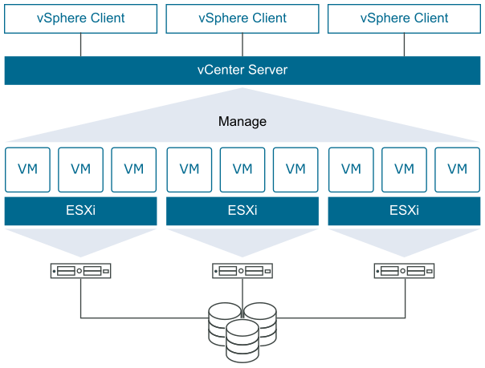
Deploy virtual machines using the Create New Virtual Machine wizard, templates, cloning and VMware vCenter Converter

Slide 9
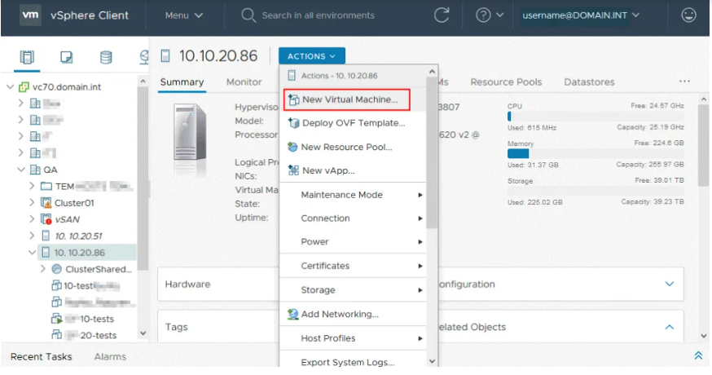
Modify and manage virtual machines

Slide 10
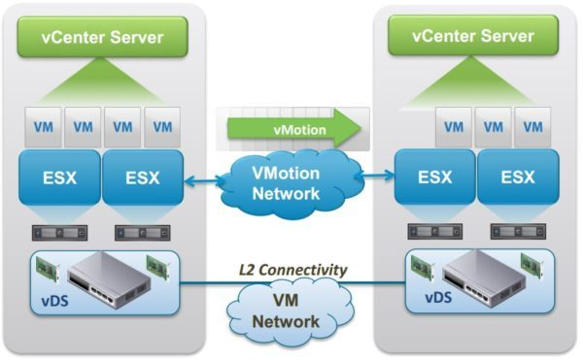
Perform Storage vMotion migrations

Slide 11
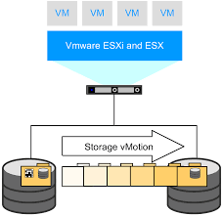
Storage vMotion

Slide 12
Lab
Create Virtual Machine for Elementary SO
Activities:
Download the ISO file of the Ubuntu or Elementary distribution.
Upload the ISO to a Datastore on the ESXi server
Create a VM in ESXi with the downloaded distribution, assign a 16 GB disk in the Datastore2 created in the previous LAB.

Slide 13
Come Back for More!

