Slide 1

Vmware ESXi
Virtualization with Vmware ESXi
Notes:
Virtualizing your Datacenter with Windows Server 2012 R2 & System Center 2012 R2
Attend this IT Camp, Virtualizing your Datacenter with Windows Server 2012 R2 & System Center 2012 R2, to gain a deep understanding of the strides made in helping businesses consolidate workloads and improve server utilization while reducing costs through comprehensive management using System Center.
At this event, you will get hands-on experience on how System Center helps you realize the most value from Hyper-V infrastructure. You will learn how System Center Virtual Machine Manager provides powerful management capabilities for a VMware environment through virtual machine management, monitoring, and automation. Finally, the camp will walk you through some of the options for migrating virtual machines from VMware to Microsoft.

Slide 2
Course Introduction

Slide 3
Modules
Module | Title
1 | Introduction to Virtualization Technologies
2 | Introduction to VMware Virtualization
3 | VMware ESX and ESXi (ESX/ESXi 4.1)
4 | VMware vCenter Server
5 | Networking

Slide 4
Modules
Module | Title
6 | Storage
7 | Virtual Machines
8 | Access Control
9 | Resource Monitoring
10 | Data Protection

Slide 5

Carlos Carreño
Senior Infrastructure Architect
Red Hat Trainer, Private Cloud, System Center & Hyper-V
MCSE Private Cloud, Red Hat and VMware Certified Trainer
Recognized Industry Expert, Speaker
Datacenter management, cloud, virtualization, high-availability, disaster recovery, mobile technologies and social media
Vmware Tanzu, Red Hat Openshift, Suse Rancher Implementer
ccarrenovi@Gmail.com
Notes:
Let me just introduce myself briefly here. I am a Technical Evangelist working with Microsoft. I have been with Microsoft almost 6 years now, spending 4 years working on the product engineering group at Windows Server high availability , so building clusters and designing virtual machines to run on those clusters. In my current role I am a Technical Evangelist covering all of our private cloud technologies which includes virtualization, Systems Center Suite and several pieces of Windows Server and I am joined by Matt today, why don’t you introduce yourself?

Slide 6
Access Control Module 8

Slide 7
Access Control
Control user Access through roles and permissions

Slide 8
Control user Access through roles and permissions
As a system administrator (or virtualization administrator, in this case), you will often be called upon to perform such or such modification on a server, a router, etc.
In the case of VMware ESXi, as with other technologies (including Active Directory), it's possible to create additional users with limited rights to be able to delegate some common tasks without giving them too many rights.
To delegate some tasks to people you trust (whether managers or employees), you will always need to use a combination of 3 elements : user accounts, roles and permissions.

Slide 9
VMware ESXi Roles
Administrator : allows you to give all rights to a user on an object (whether it's the entire hypervisor, or a specific virtual machine, or any other object).
Anonymous : corresponds to the rights possessed by an unconnected "user". Note that this right can't be granted and that it will therefore not be visible in the "Actions -> Permissions" menu of the desired objects.
No access : allows you to limit (remove) the rights that a user had on a child object thanks to the rights that you would have granted him on a parent object.
No cryptography administrator : has almost the same rights as the "Administrator" role except for encryption operations which will not be possible with this role.
Read-only : allows you to see various information (depending on the object concerned), but the user will not be able to make any changes to the objects concerned.
Show : similar to the previous role (Read-only), but with the difference that this role can't be granted. It will therefore not be visible from the window for managing permissions on the desired object.

Slide 10
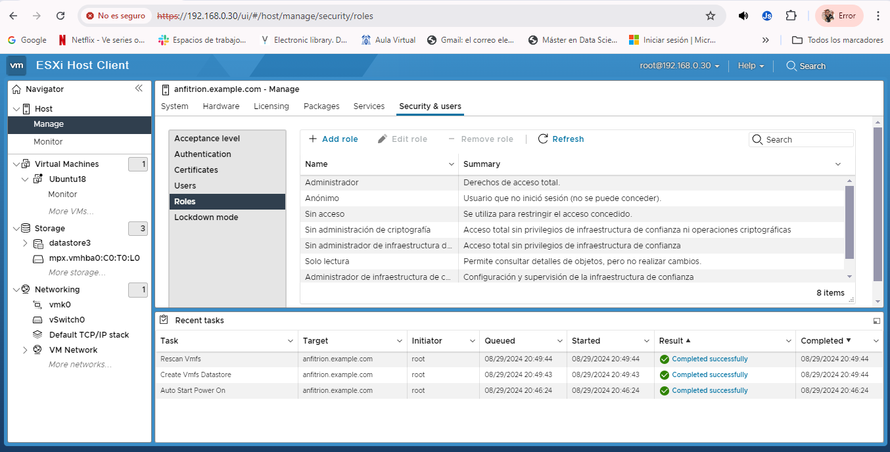
Show ESXi Roles

Slide 11
VMware ESXi 7 new roles
No Trusted Infrastructure administrator: allows you to grant all rights on the vCenter Server (except the rights necessary for calls to the vSphere Trust Authority APIs).
Trusted Infrastructure administrator: allows you to configure and manage a vSphere Trust Authority deployment.

Slide 12
ESXi Custom Roles
Although there are default roles with predefined permissions for them, you can also create your own roles to be able to manage the granting of permissions in more detail.
To add a role, you will need to :
Role name (required) : enter a name for it
Privileges : choose the privileges you want to grant to your future users thanks to this role

Slide 13
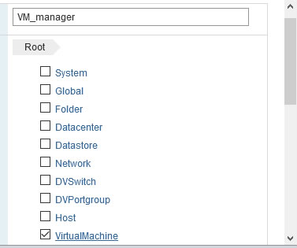
ESXi Custom Roles
you will be able to grant or not grant privileges for
Datastore : management of datastores. To allow or not users to manage files, move them, delete them, allocate space (necessary to create a virtual hard disk, for example), ...
Network : network management. Configure networks, delete them, assign them, ...
Host : host (VMware ESXi hypervisor) management
Virtual Machine : virtual machine management.
Authorization : management of roles and permissions.
Certificate : digital certificate management.
and more.

Slide 14
ESXi Manage Users
Once you have grouped the different privileges to be granted to your future users thanks to the roles, you will have to create user accounts for them.
In business, creating users allows you to grant different rights depending on the user, but also to control what they do.
This way, if something goes wrong, you can easily tell which person did the wrong thing or something they shouldn't have done.
To manage the users of your VMware ESXi hypervisor, go to : Host -> Manage -> Security & Users -> Users.
As you can see, by default only the "root" account is present in this user list.

Slide 15
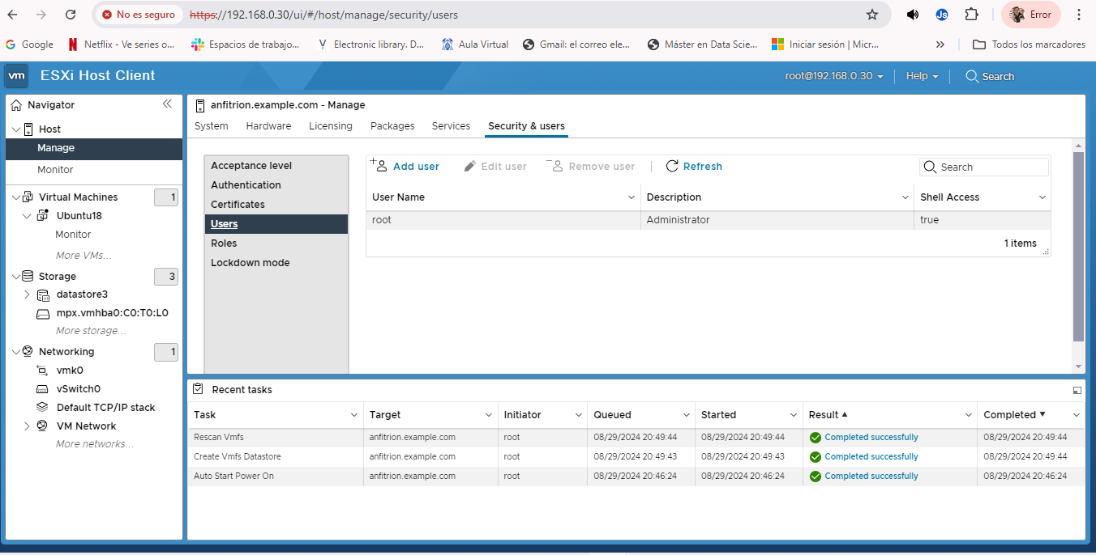
ESXi Show Users

Slide 16
Lab
Create ESXi User
Activities:
Create Custome Role Operator
Create user for Administration

Slide 17
Come Back for More!

