Slide 1

.NET Deep Dive - IL
Carlos dos Santos
CDS Software
Microsoft MVP
Microsoft Regional Director
carlos@cds-software.com.br
www.cds-software.com.br
@cdssoftware

Slide 2






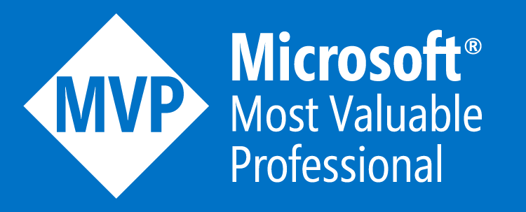


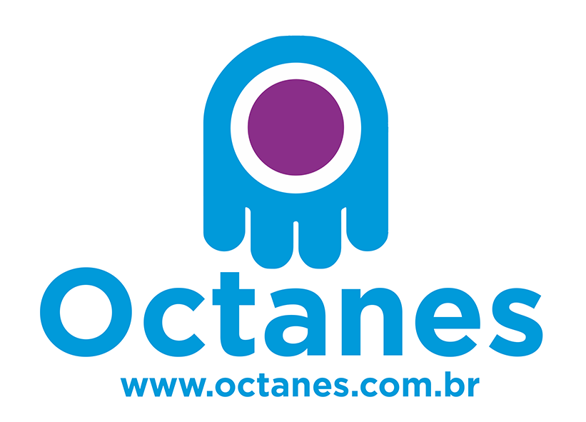


Carlos dos Santos CTO CDS Software Microsoft MVP & RD
carlos@cds-software.com.br
www.cds-software.com.br
@cdssoftware
@CDSSOFTWARE
Responsável por Pesquisa e Desenvolvimento na CDS Informática
Microsoft MVP desde 2008
Microsoft Regional Director
Palestrante do Microsoft Ignite/USA
Um dos criadores do projeto open source CodeCracker: www.github.com/code-cracker
Mantenedor do projeto open source BoletoNet: www.github.com/boletonet
Blog: www.carloscds.net
GitHub: www.github.com/carloscds

Slide 3
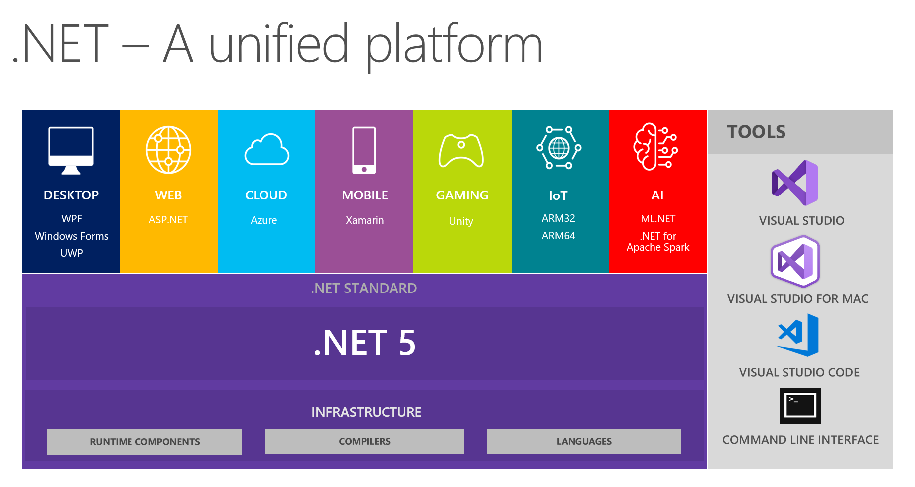
Estrutura do .Net
Notes:
Slide Objectives:
Explain the three established industry terms for serviços de nuvem
Speaker Notes:
There is a lot of talk in the industry about different terms like Platform as a Service, Infrastructure as a Service, and Software as a Service.
Since PDC08 when we first announced the Windows Azure our focus has been on delivering a platform as a service offering where you can build applications. Where the platform abstracts you from the complexities of building and running applications.
We fundamentally believe that the future path forward for development is by providing a platform. In fact, as you’ll see in a few minutes, we believe that there are a number of new capabilities that should be delivered as services to the platform.
Notes:
There is a lot of confusion in the industry when it comes to the cloud.
It’s important that you understand both what is happening in the industry and how we think about the cloud.
This is the most commonly used taxonomy for differentiating between types of serviços de nuvem.
The industry has defined three categories of services:
IaaS – a set of infrastructure level capabilities such as an operating system, network connectivity, etc. that are delivered as pay for use services and can be used to host applications.
PaaS – higher level sets of functionality that are delivered as consumable services for developers who are building applications. PaaS is about abstracting developers from the underlying infrastructure to enable applications to quickly be composed.
SaaS – applications that are delivered using a service delivery model where organizations can simply consume and use the application. Typically an organization would pay for the use of the application or the application could be monetized through ad revenue.
It is important to note that these 3 types of services may exist independently of one another or combined with one another.

Slide 4
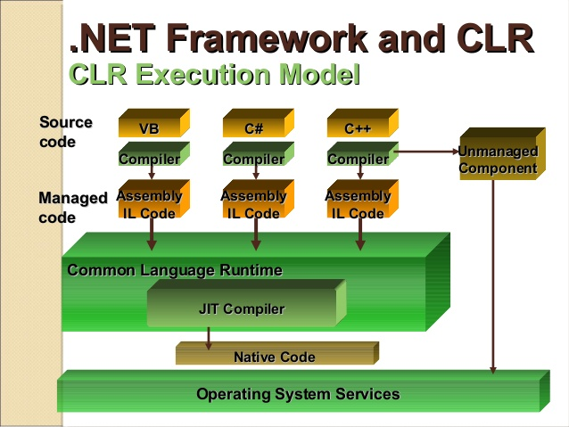
Estrutura do .Net
Notes:
Slide Objectives:
Explain the three established industry terms for serviços de nuvem
Speaker Notes:
There is a lot of talk in the industry about different terms like Platform as a Service, Infrastructure as a Service, and Software as a Service.
Since PDC08 when we first announced the Windows Azure our focus has been on delivering a platform as a service offering where you can build applications. Where the platform abstracts you from the complexities of building and running applications.
We fundamentally believe that the future path forward for development is by providing a platform. In fact, as you’ll see in a few minutes, we believe that there are a number of new capabilities that should be delivered as services to the platform.
Notes:
There is a lot of confusion in the industry when it comes to the cloud.
It’s important that you understand both what is happening in the industry and how we think about the cloud.
This is the most commonly used taxonomy for differentiating between types of serviços de nuvem.
The industry has defined three categories of services:
IaaS – a set of infrastructure level capabilities such as an operating system, network connectivity, etc. that are delivered as pay for use services and can be used to host applications.
PaaS – higher level sets of functionality that are delivered as consumable services for developers who are building applications. PaaS is about abstracting developers from the underlying infrastructure to enable applications to quickly be composed.
SaaS – applications that are delivered using a service delivery model where organizations can simply consume and use the application. Typically an organization would pay for the use of the application or the application could be monetized through ad revenue.
It is important to note that these 3 types of services may exist independently of one another or combined with one another.

Slide 5








Como funciona ?
Compilação
SourceCode
Language Compiler
Code (IL)
Assembly (exe/dll)
Metadata
No momento da instalação ou na primeira vez que o método é chamado
Native
Code
JIT Compiler
Execução

Slide 6
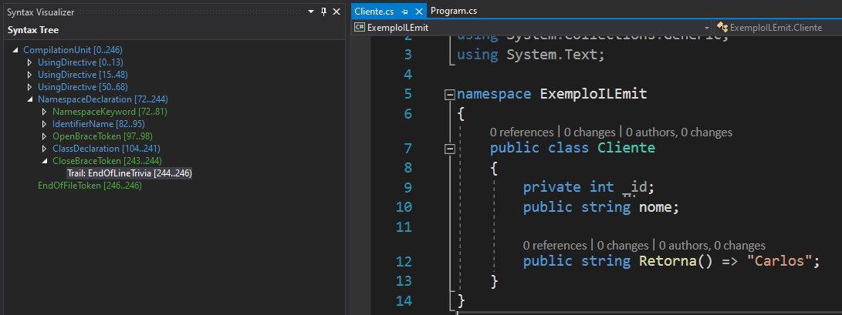
O que o compilador “vê”?

Slide 7
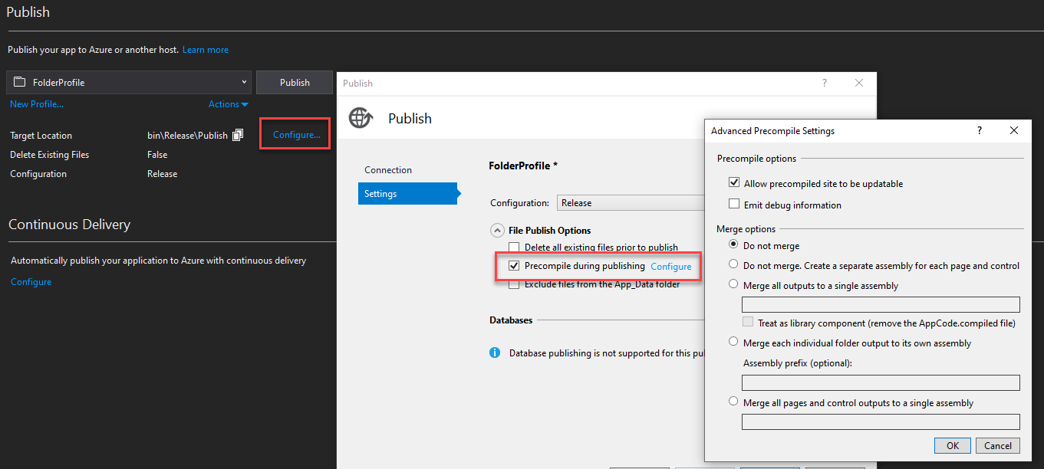
Otimização da execução
Pré compilação
Força o JIT pós compilação!
aspnet_compiler (linha de comando .Net Full)
Visual Studio Publish:

Slide 8
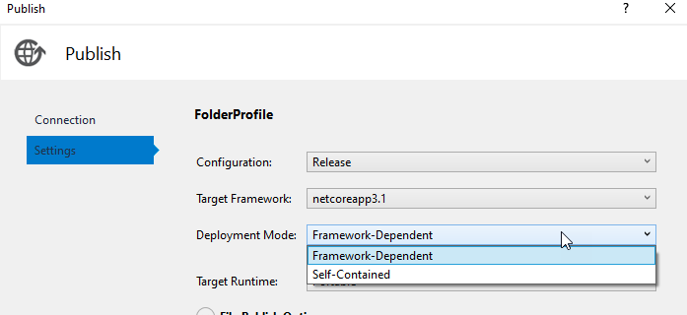
Otimização da execução
Em .NET Core muda um pouco:
Podemos ter Self-contained, sem dependência do runtime (ele não precisa estar instalado)
http://carloscds.net/2019/07/voce-ja-ouviu-falar-em-self-contained-application/

Slide 9
E onde entra a IL nisto ?
Em praticamente tudo:
É o resultado da compilação, o binário
Mas ainda não é um executável nativo, pois precisa do JIT
O JIT é quem vai ler e transformar este código em algo executável pela máquina de destino
E a maquina de destino pode ser “qualquer” máquina que possua um JIT
Então um IL bem gerado impacta na performance da sua aplicação
O compilador consegue otimizar muito o código IL

Slide 10
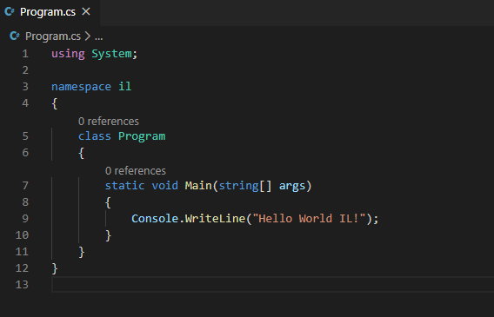
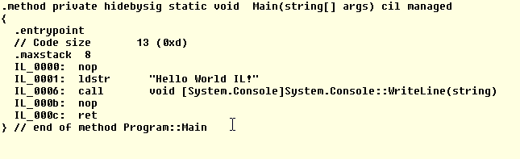
Vamos a um exemplo simples
nop – do nothing
ldstr – carrega um ojeto string
call – executa um método
ret - return
https://en.wikipedia.org/wiki/List_of_CIL_instructions

Slide 11
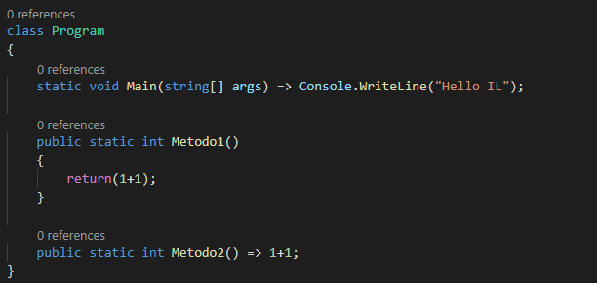
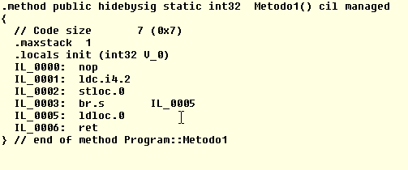
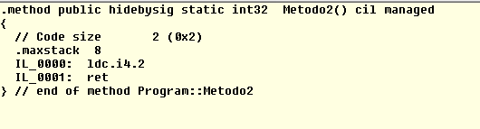
Veja a diferença em um código simples

Slide 12
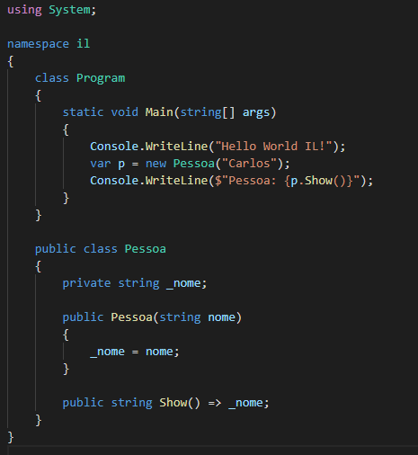
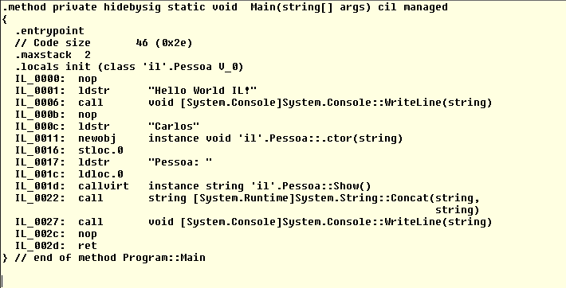
Exemplo com Classe

Slide 13
Algumas ferramentas:
IL DASM
Mostra o manifestó e o código IL
ILSpy
Abre praticamente tudo que tem no assembly
É um descompilador

Slide 14
Demo Ferramentas

Slide 15
Por que eu preciso saber isto?
M I C R O O T I M I Z A Ç Ã O
Significa otimizar muito, mas muito mesmo, o seu código, controlando como a IL é gerada!

Slide 16
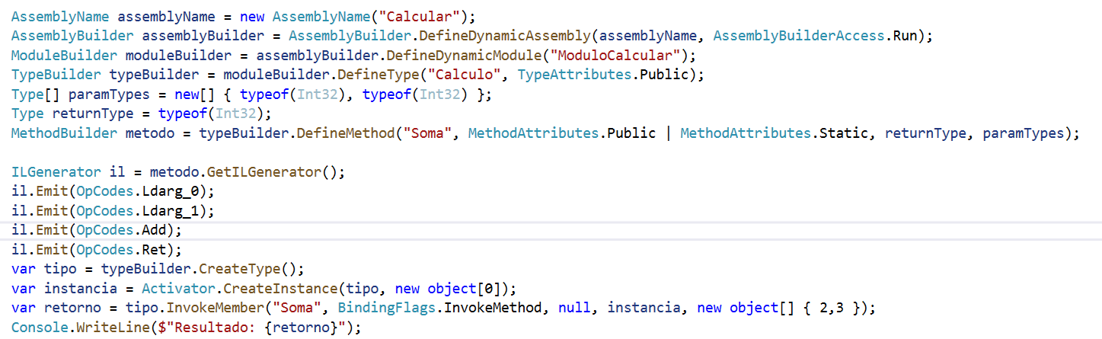
Um exemplo de Código Escrito em IL

Slide 17
Exemplos Reais de Uso
Linq:
https://github.com/dotnet/runtime/blob/master/src/libraries/System.Linq.Expressions/src/System/Linq/Expressions/Compiler/CompilerScope.cs
RunTime do .NET para Testes:
https://github.com/dotnet/runtime/tree/master/src/coreclr/tests/src/JIT/Stress/ABI

Slide 18



Perguntas?
Carlos dos Santos
CDS Informática Ltda.
carlos@cdsinformatica.com.br
www.carloscds.net
@cdssoftware

