Slide 1
Vert.x (cont.d)
The event bus.

Slide 2
What is the event bus?
Communication between verticles.
Use of destination and messages.

Slide 3
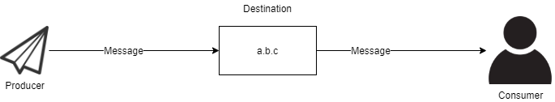

Slide 4
What is the event bus?(cont’d)
Communication supporting patterns.
Point-to-point messaging
Request-reply messaging
Publish/subscribe messaging

Slide 5
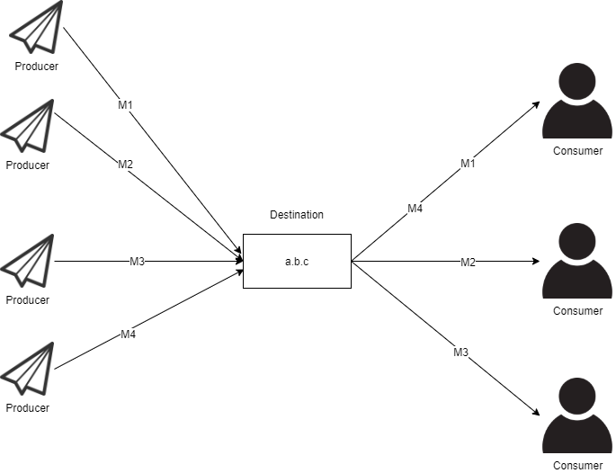
Point-to-point messaging

Slide 6
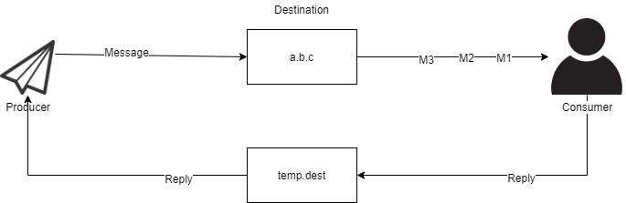
Request-reply messaging

Slide 7
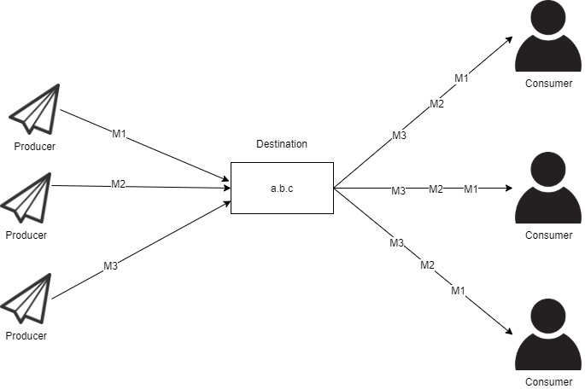
Publish/subscribe messaging

Slide 8
Clustering the event bus
Vert.x is able to run in clustering mode
A set of Vert.x application nodes can work together over the network.
Use of a cluster manager (Infinispan, Hazelcast, Apache Ignite and Apache Zookeeper).

Slide 9
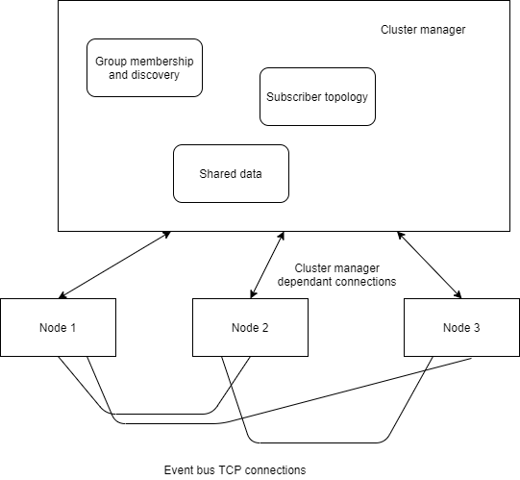
Cluster manager structure

Slide 10
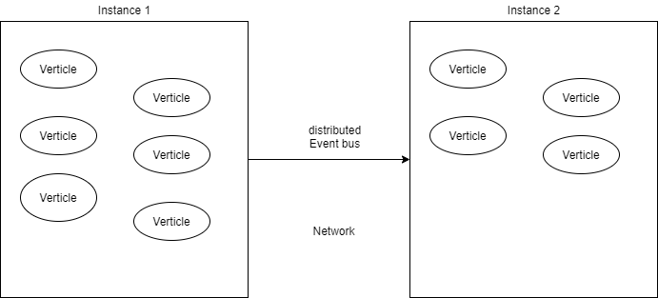
Vert.x application in cluster mode

Slide 11
Thanks!

