Slide 1
Lunch and learn session
Getting started with Eclipse Vert.x.

Slide 2
Before going into Vert.x
Asynchronous and non-blocking programming
- Blocking API’s waste resources and increase infrastructure costs.
- Do another tasks until the blocking operation is ready.
The event loop
- Thread use model for async events.
- The events are thrown to the event loop instead of a pool.
- Javascript runs on an event loop when called by the browser.

Slide 3
Before going into Vert.x (Cont’d)
The reactive manifesto
1. Elastic: Ability of an application to work with more or less instances depending the need.
2. Resilient: Redirects the traffic requests to other instances or a new one.
3. Responsive: Is the union of elasticity and resiliency. The goal is to provide consistent response times
4. Message driven: Dispatches messages to the instances and controls flow between producers and consumers.

Slide 4
Introduction to Asynchronous programming with Vert.x
Is a library to create reactive applications in the JVM.
Created by Tim Fox in 2012.
Was created to be a “node.js like tool to run in the JVM”.
Vert.x is a library not a framework.
Use event-loop model and non-blocking operations
Vert.x is polygloth

Slide 5
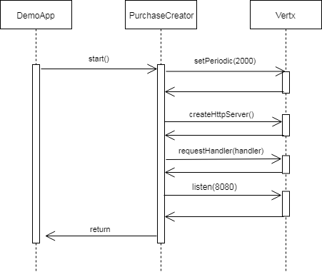
The purchase process example

Slide 6
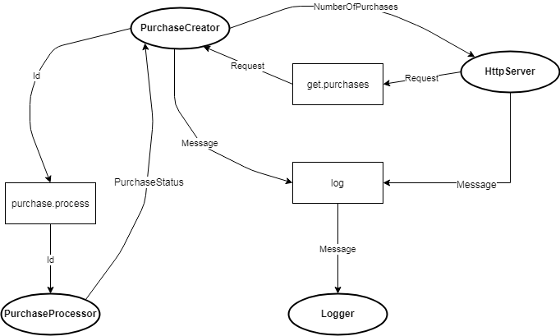
The purchase process example (ultra violento)

Slide 7
Github example projects:
https://github.com/carloscl1987/LunchAndLearning
https://github.com/carloscl1987/LunchAndLearningUltraViolento

Slide 8
QA
[Session name]

Slide 9
Thanks!

