Slide 1
Active Directory
Setting of a failover Domain Control for a domain.
Carlos Gerez

Slide 2
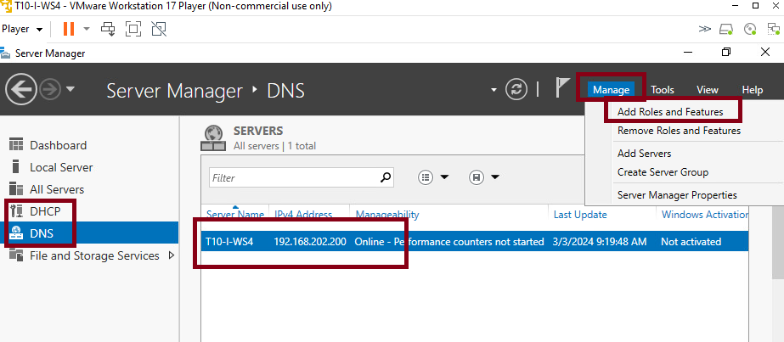
Active Directory Installation.
On the server I will install this domain control, are already installed DNS and DHCP. First go to Manage and chose Add Roles and Features.

Slide 3
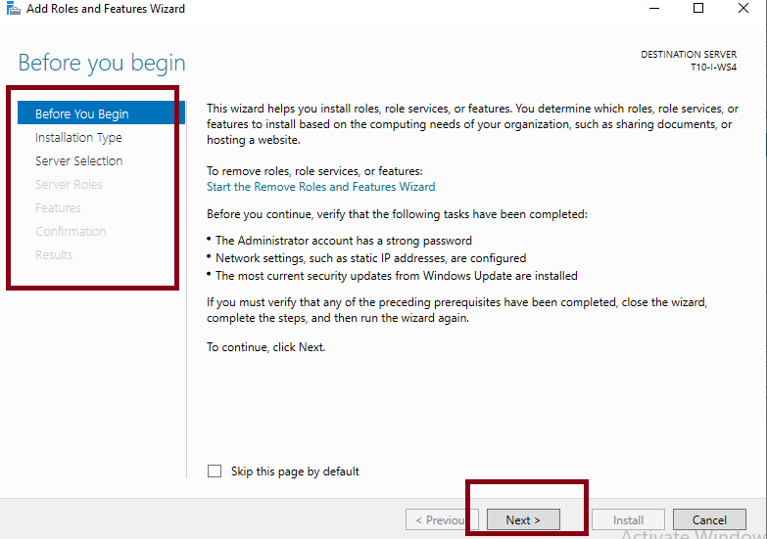
Active Directory Installation.
Follow the directions of the wizard. This is the first creen, click next.

Slide 4
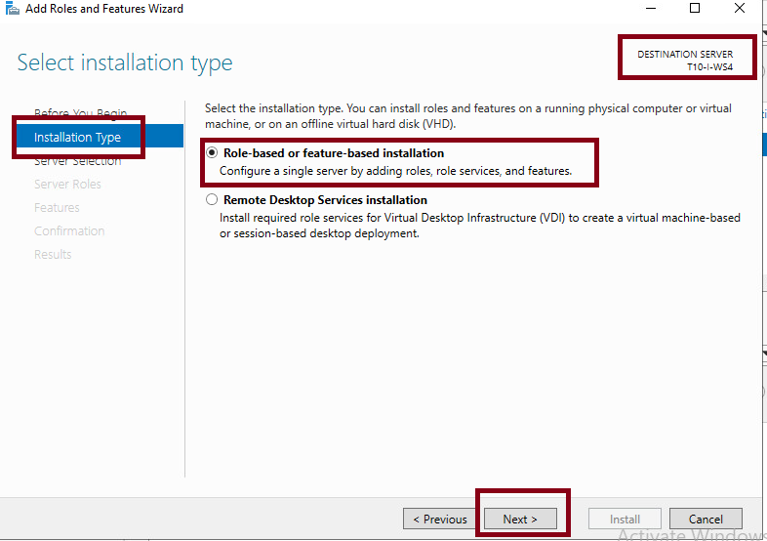
Active Directory Installation.
Select role based or feature based installation and click next.

Slide 5
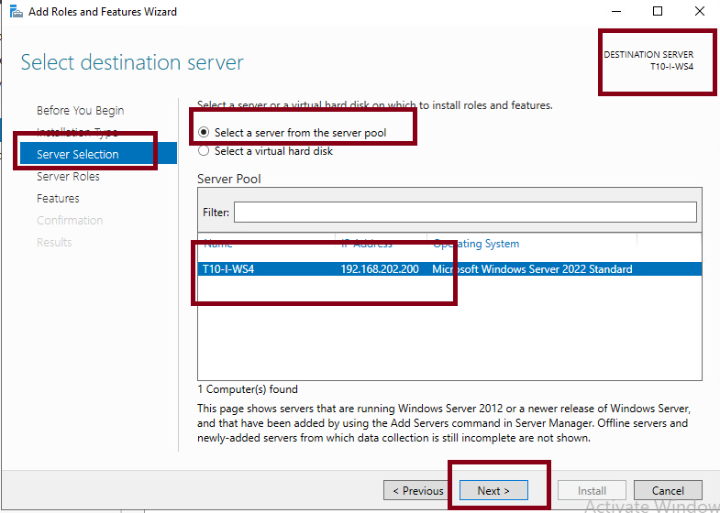
Active Directory Installation.
On Server Selection select the server , we have just one then select next.

Slide 6
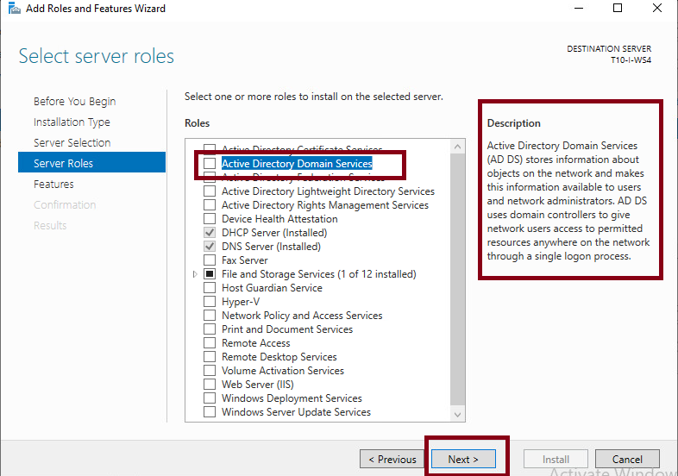
Active Directory Installation.
Select in server roles, Active Directory. You can read the description to get more information about the role.

Slide 7
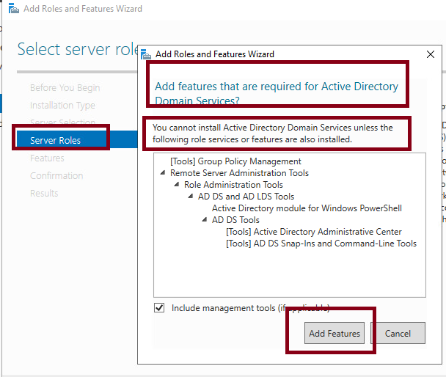
Active Directory Installation.
On server roles add the features asked as necessary for this installation.

Slide 8
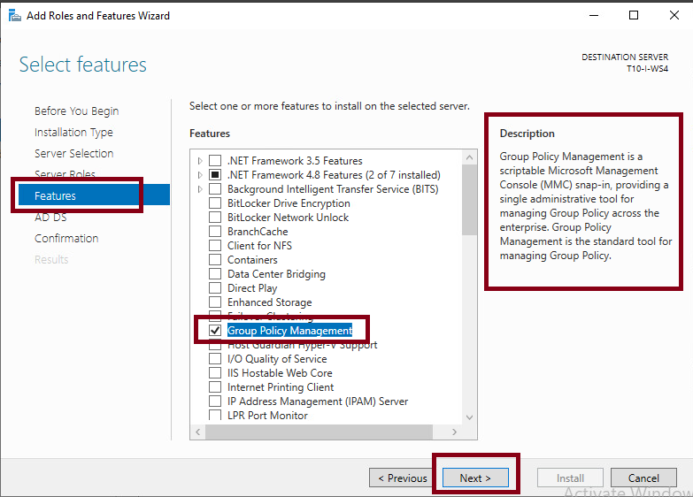
Active Directory Installation.
On features be sure at the group policy management is selected.

Slide 9
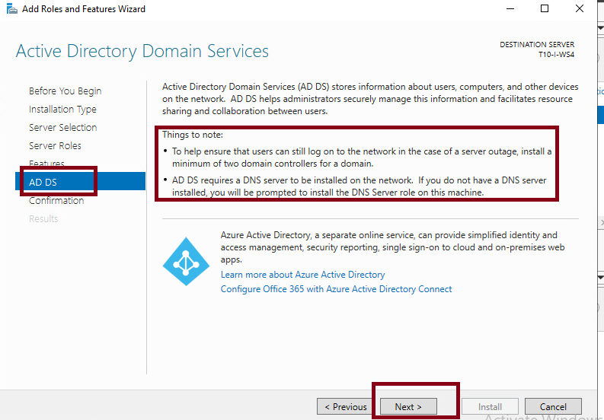
Active Directory Installation.
This is just informative, but notice that is recommended to have a minimum of 2 domain controllers on the domain.

Slide 10
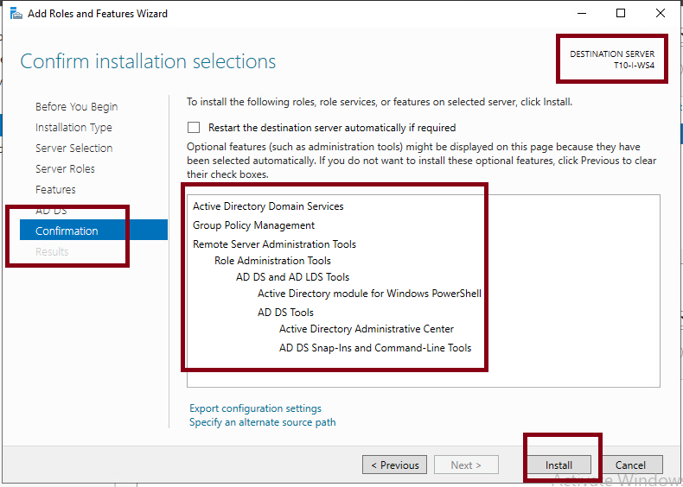
Active Directory Installation.
The last screen shows a resume of the selected items to install.

Slide 11
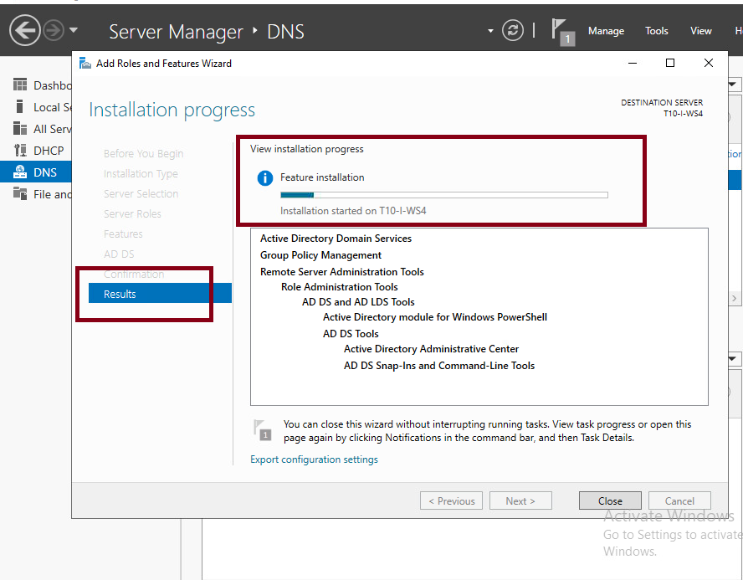
Active Directory Installation.
After click install the installation process will take several minutes.

Slide 12
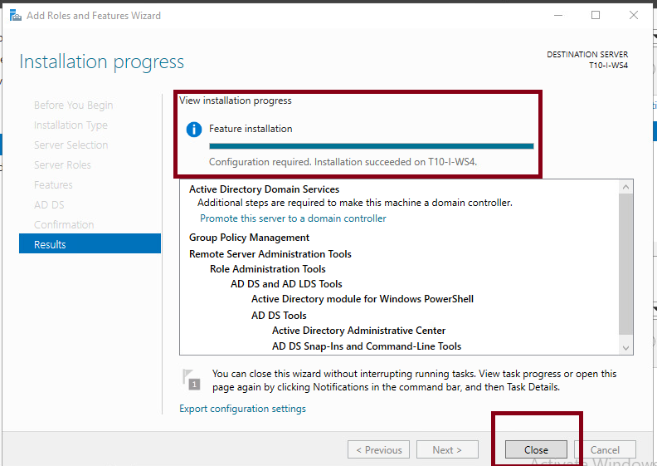
Active Directory Installation.
Once finished, close the wizard.

Slide 13
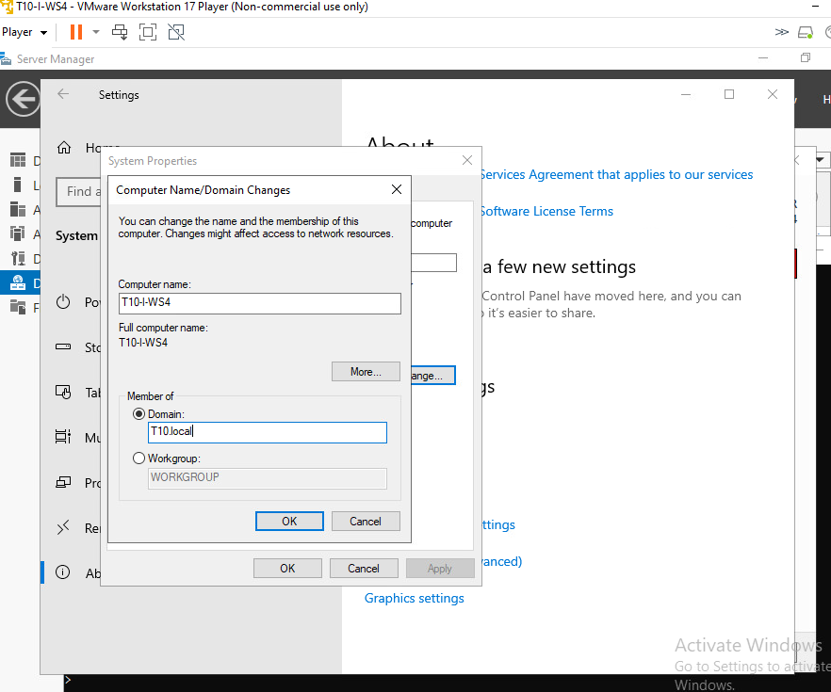
Active Directory Configuration as a secondary Domain Controller for T10.local domain.
Is better to enroll this machine to the domain to get access to the primary Domain controller to configure the second domain in this machine.

Slide 14
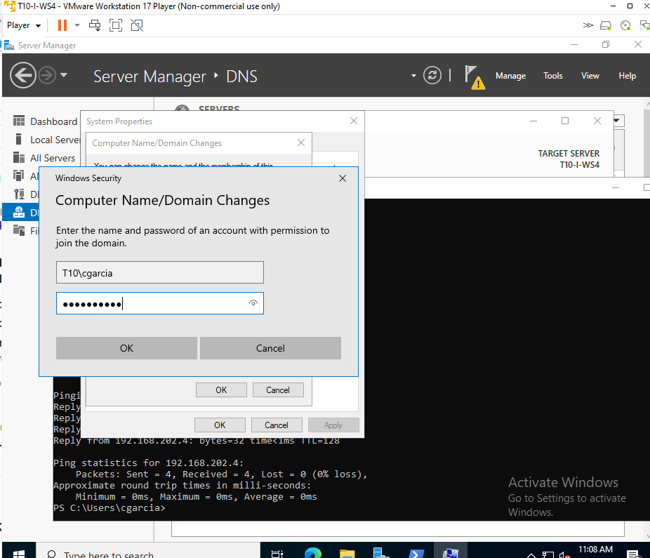
Active Directory Configuration as a secondary Domain Controller for T10.local domain.
Confirm with credentials to allow this machine into the domain T10.local

Slide 15
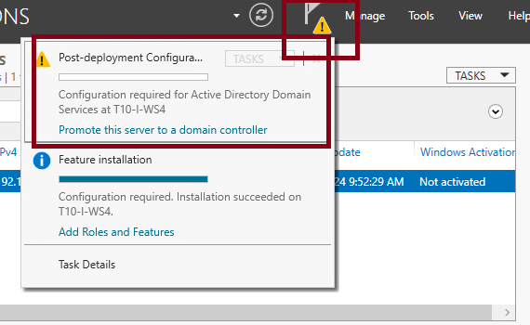
Active Directory Configuration as a secondary Domain Controller for T10.local domain.
Go to the warning sign in the dashboard to start the post deployment configuration. Select promote this server to a domain controller.

Slide 16
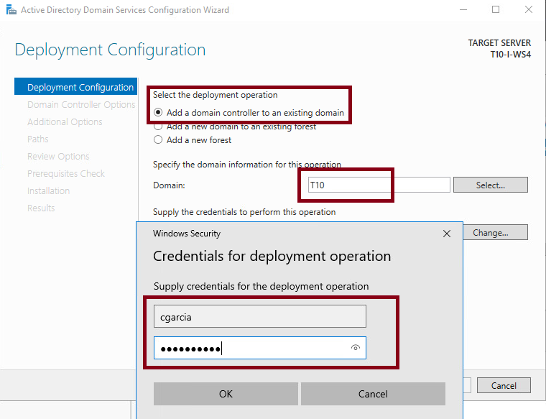
Active Directory Configuration as a secondary Domain Controller for T10.local domain.
In the new wizard that will open start by selecting Add a domain controller to an existing domain and set the domain name. After pressing select you will be asked for credentials to confirm. Use your credentials in the domain T10.local.

Slide 17
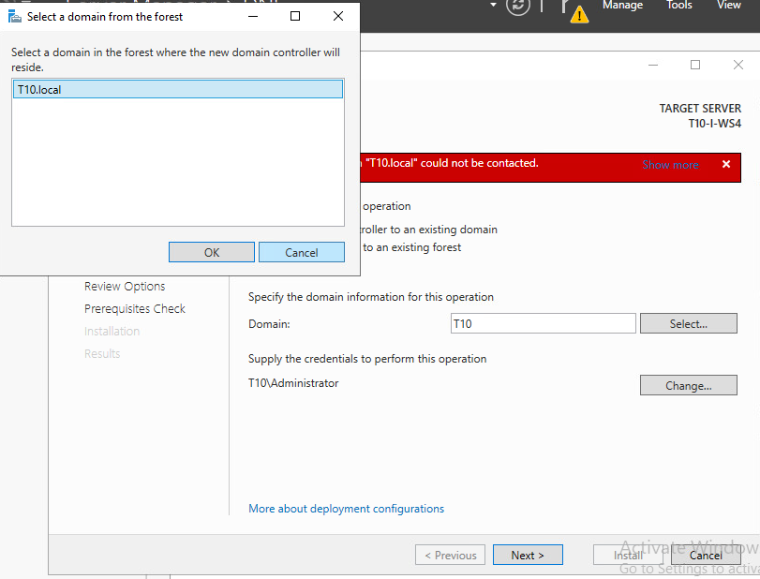
Active Directory Configuration as a secondary Domain Controller for T10.local domain.
You will be ask to select a domain from the forest in case that your domain have more than one forest.

Slide 18
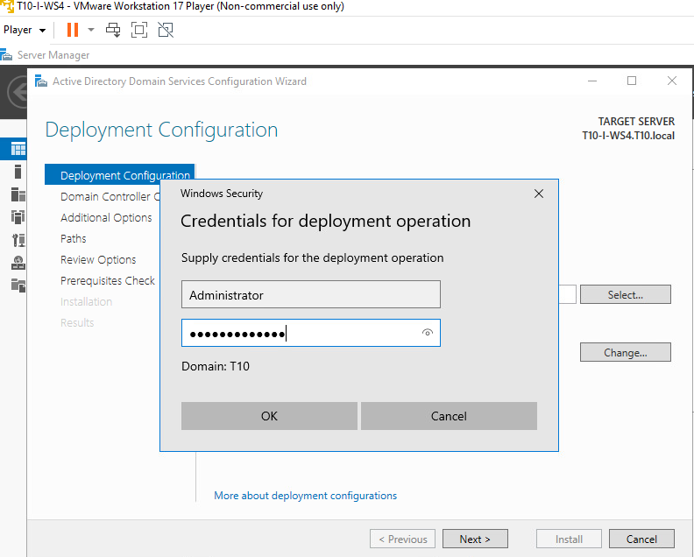
Active Directory Configuration as a secondary Domain Controller for T10.local domain.
When asked use Administrator privileges for credentials to perform the task.

Slide 19
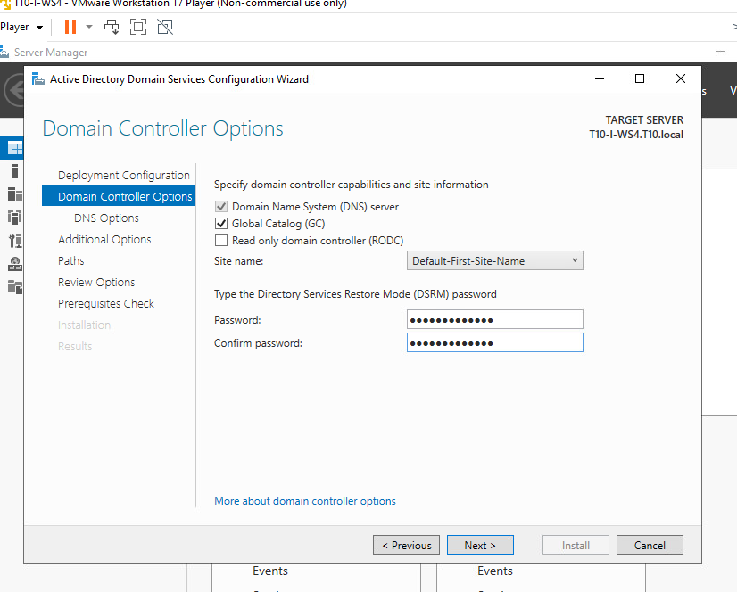
Active Directory Configuration as a secondary Domain Controller for T10.local domain.
On Domain control options select read only domain controller(RODC) leave the rest as default and set credentials for DSRM, that are in case you need to restore your domain controller.

Slide 20
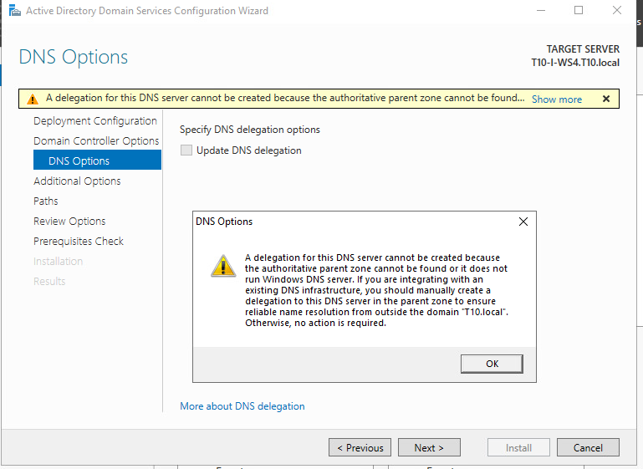
Active Directory Configuration as a secondary Domain Controller for T10.local domain.
This is a warning about DNS. We need to create a secondary Zone in this DNS server to allocate the information that will receive from the primary controller. We can do this before to finish this wizard by open the DNS management and create a secondary zone.

Slide 21
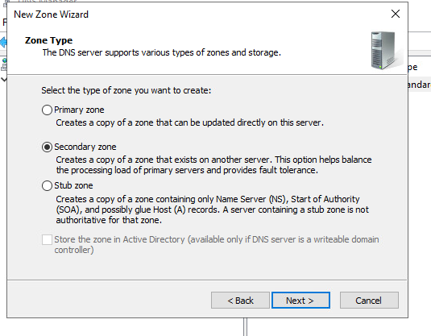
Active Directory Configuration as a secondary Domain Controller for T10.local domain.
On DNS management click to create a secondary zone and follow this wizard. The zone will be secondary, a copy from the primary server.

Slide 22
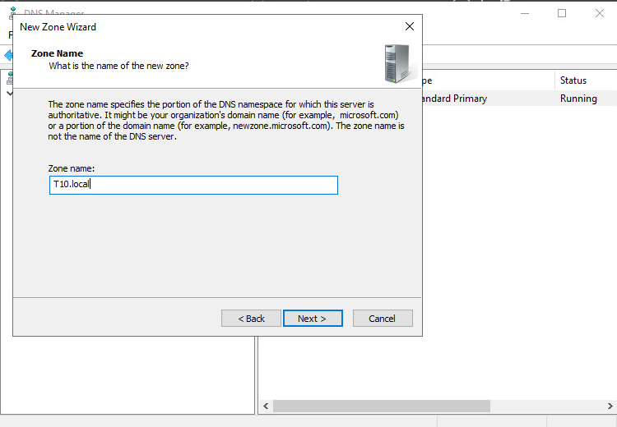
Active Directory Configuration as a secondary Domain Controller for T10.local domain.
Give the local domain name to the zone.

Slide 23
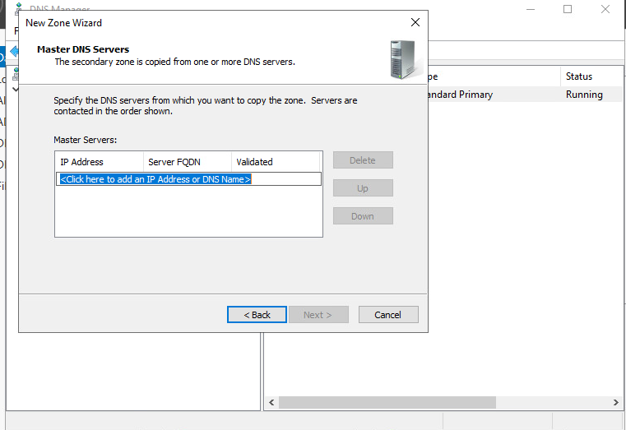
Active Directory Configuration as a secondary Domain Controller for T10.local domain.
Her you will set from which server this DNS will receive copies.

Slide 24
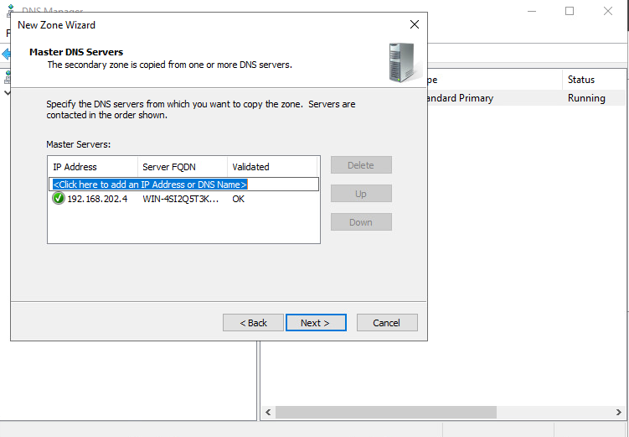
Active Directory Configuration as a secondary Domain Controller for T10.local domain.
Set the ip address or name of the primary server.

Slide 25
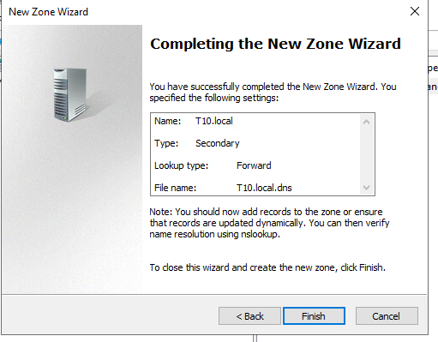
Active Directory Configuration as a secondary Domain Controller for T10.local domain.
Finish the wizard, now you have a secondary zone to receive copies from the master DNS.

Slide 26
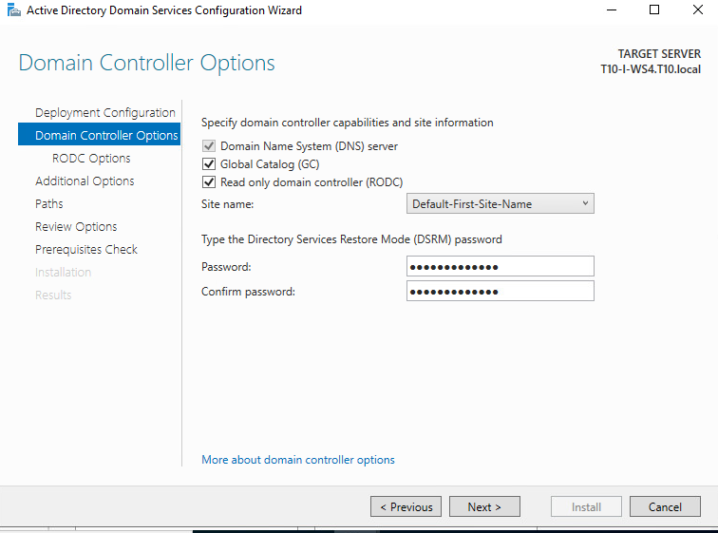
Active Directory Configuration as a secondary Domain Controller for T10.local domain.
Get to the previous step and reintroduce all the information. Continue with the settings as before.

Slide 27
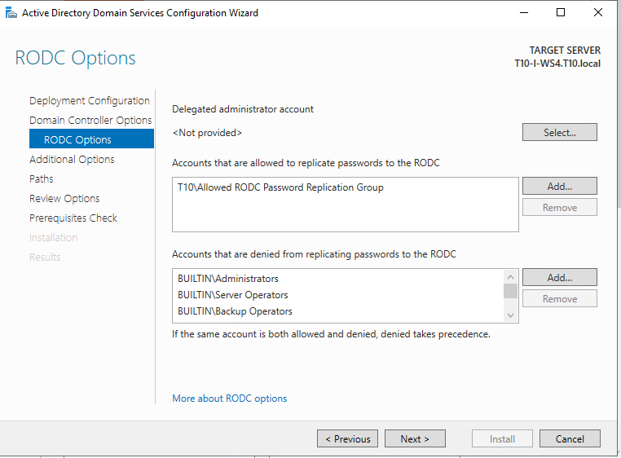
Active Directory Configuration as a secondary Domain Controller for T10.local domain.
On RODC options leave the defaults.

Slide 28
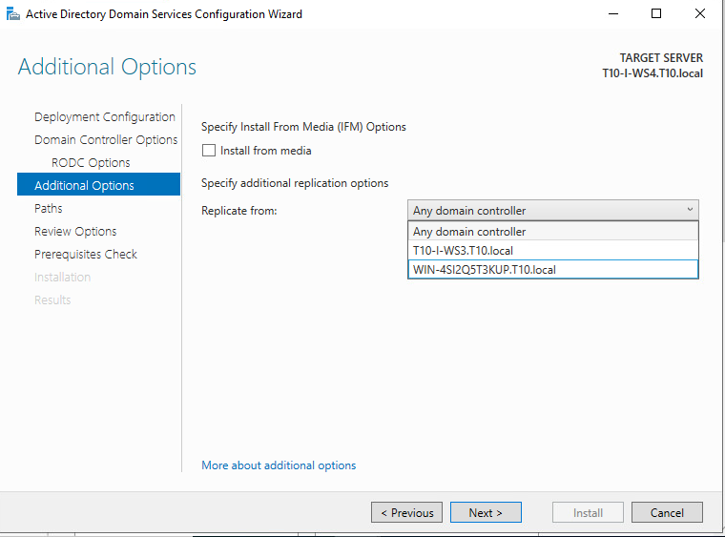
Active Directory Configuration as a secondary Domain Controller for T10.local domain.
Here you can select from where replicate information. We have a domain controller with the main DHCP and a second with a failover DHCP. You can choose any of them, but is recommended to replicate from the second DHCP since if the primary server fails, still all the network will receive ip addresses from the failover and you will need replications from that one.

Slide 29
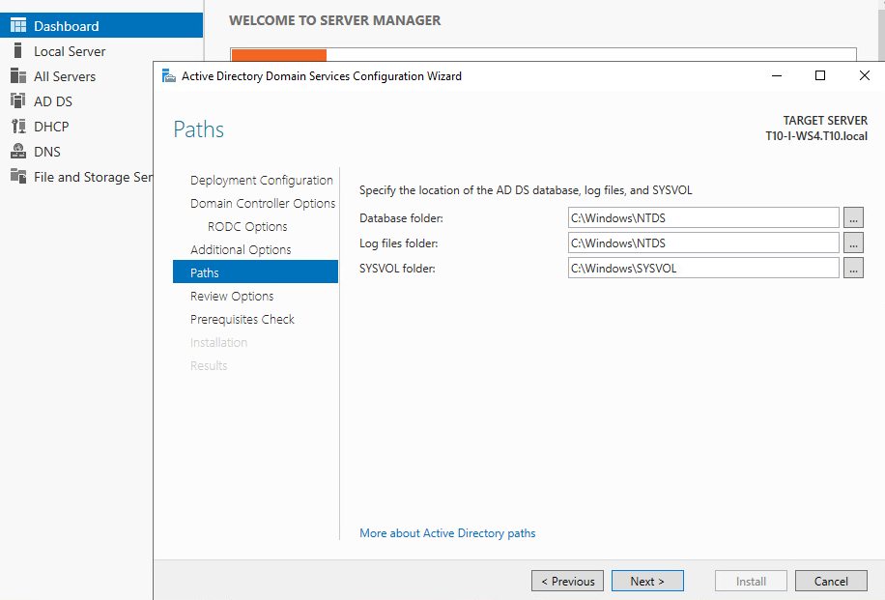
Active Directory Configuration as a secondary Domain Controller for T10.local domain.
Leave paths as default and continue with next.

Slide 30
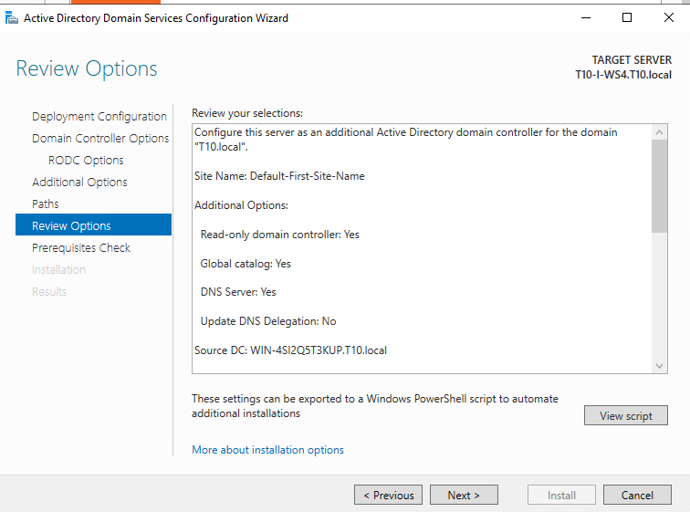
Active Directory Configuration as a secondary Domain Controller for T10.local domain.
The last screen allow to check the configuration before installation.

Slide 31
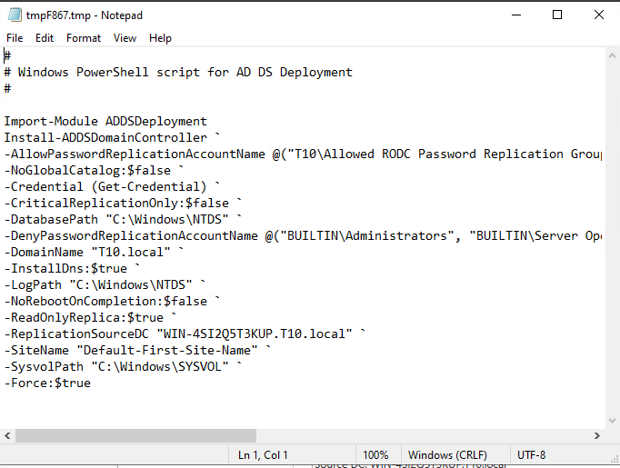
Active Directory Configuration as a secondary Domain Controller for T10.local domain.
The view script allow to see the commands that will be executed on installation.

Slide 32
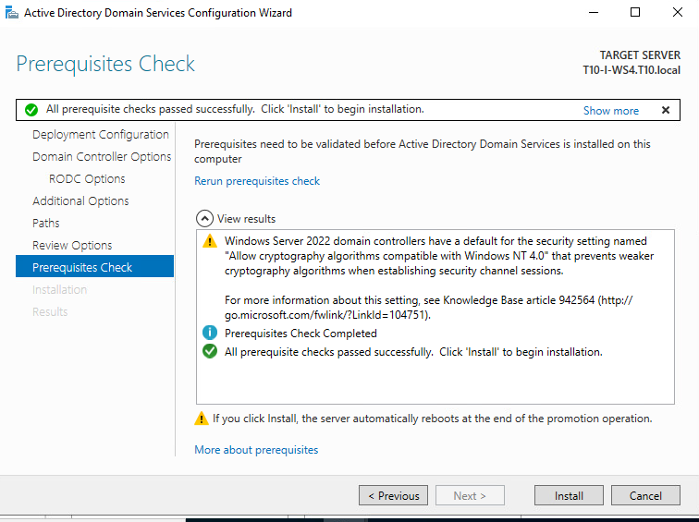
Active Directory Configuration as a secondary Domain Controller for T10.local domain.
After finished it will show that all it was ok and that this is a replica of the primary controller and will work as a failover in case the other fails, click install.

Slide 33
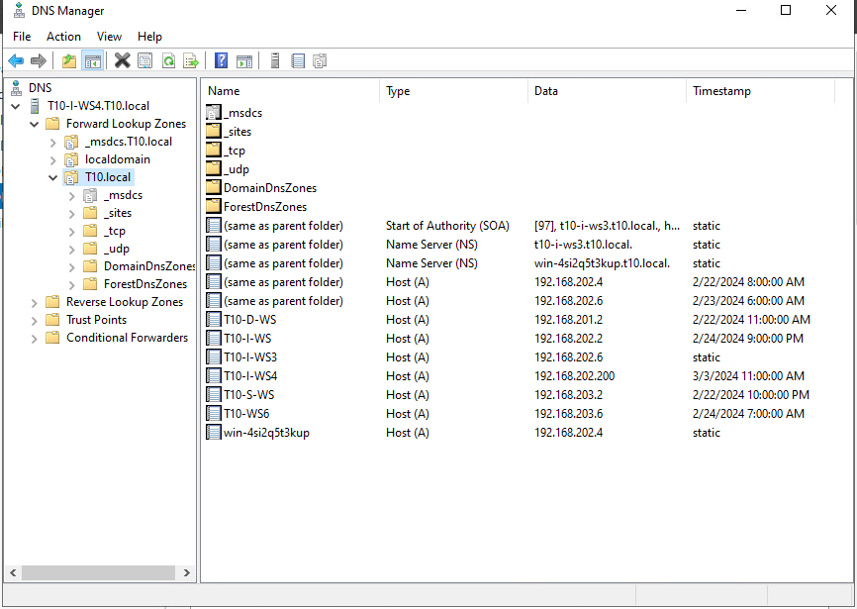
DNS Replication in the failover AD.
Once installation finished we can check that all the informations is replicated on this new Active Directory from the original.

Slide 34
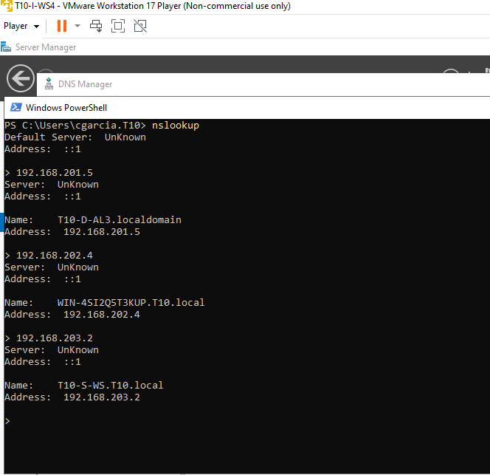
DNS resolution from the new DNS.
On the same machine we can check that DNS can resolve now any address on the domain T10.local.

