Slide 1
Task: Above-and-Beyond 0

Slide 2
Task: Above-and-Beyond 0

Slide 3
Active Directory Installation

Slide 4
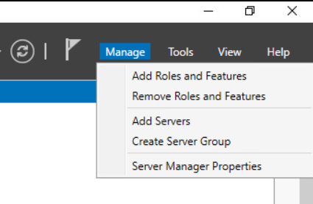
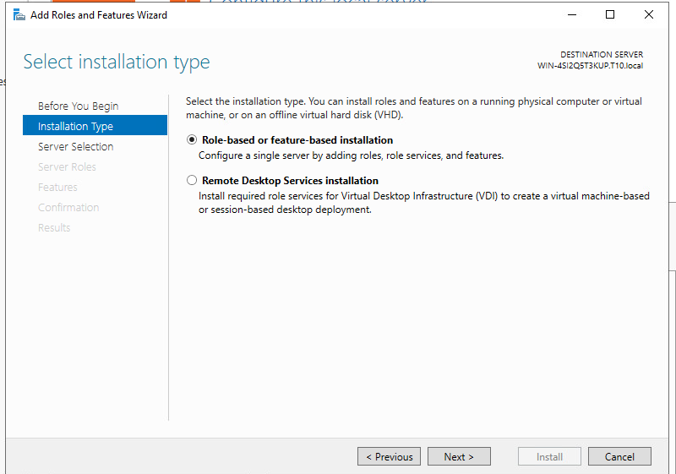
Active Directory Installation
Open server manager
Select the “Manage” Tab
Select “Roles and Features”
Select the default and click “Next”

Slide 5
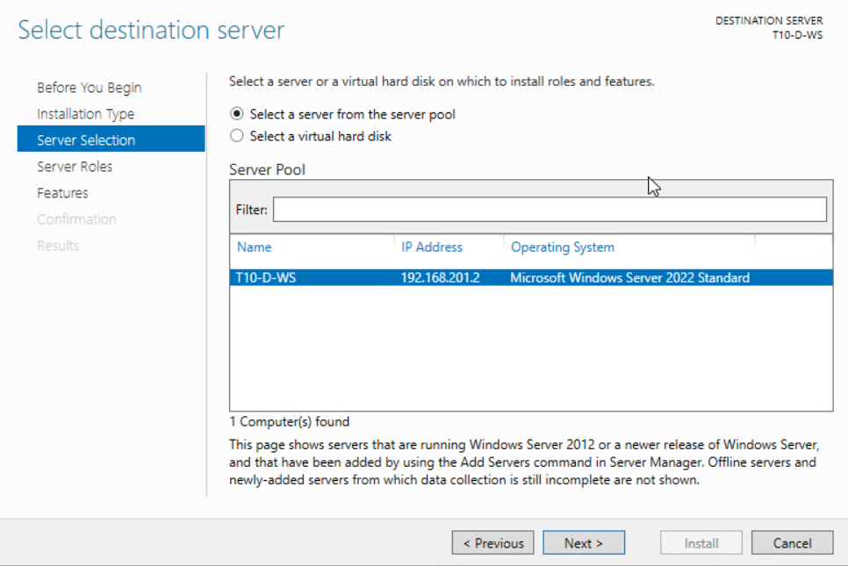

Slide 6
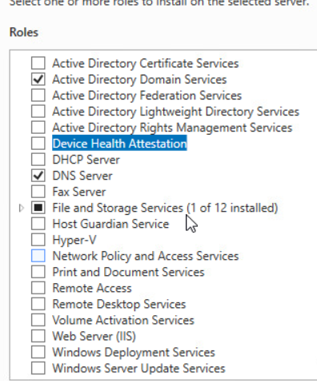
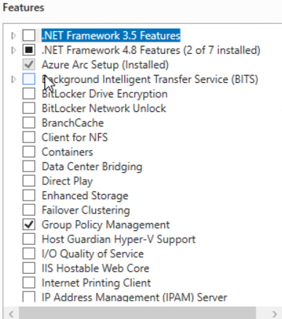
Active Directory Installation
Under “Roles”
Select the “Active Directory Domain Services” and the “DNS Server” options.
Under “Features” make sure that “Group Policy Manager” is selected.
Click Next and then click Next on the following two pages.

Slide 7
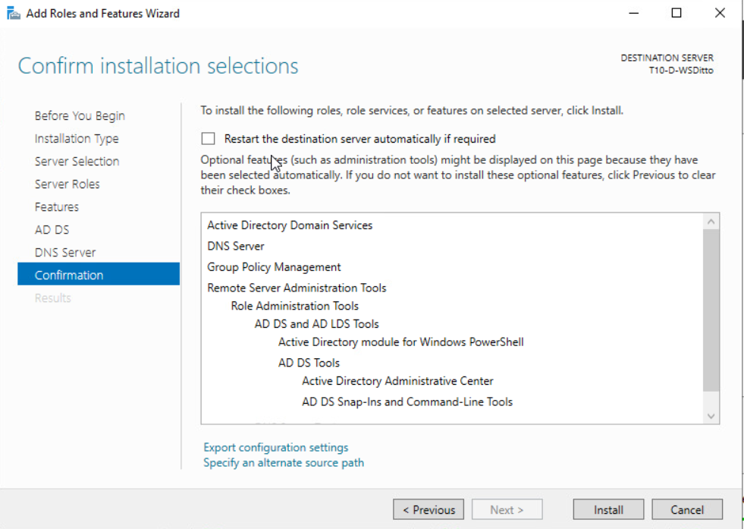
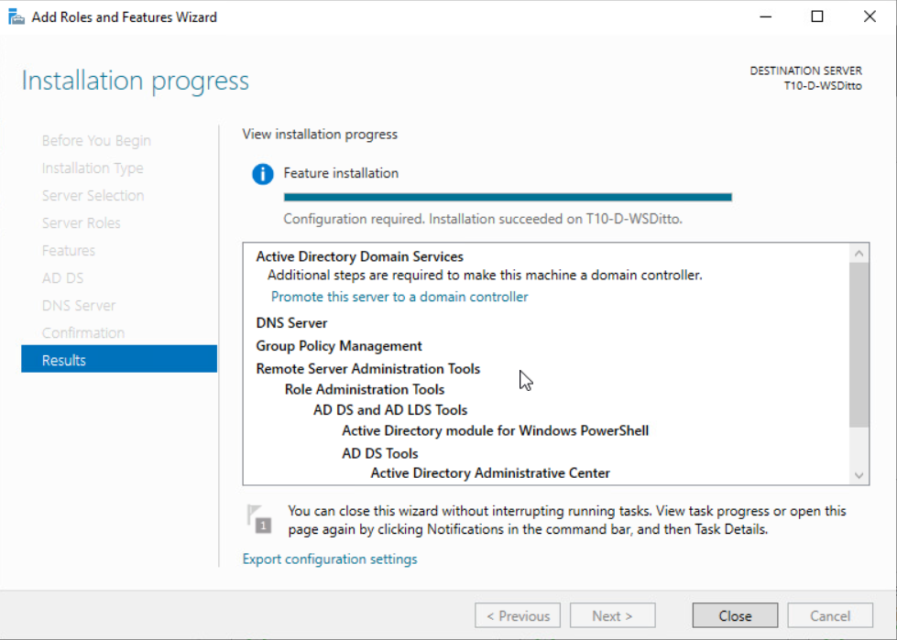

Active Directory Installation
Click “Install”
Once the Installation has finished
Click “Close”

Slide 8
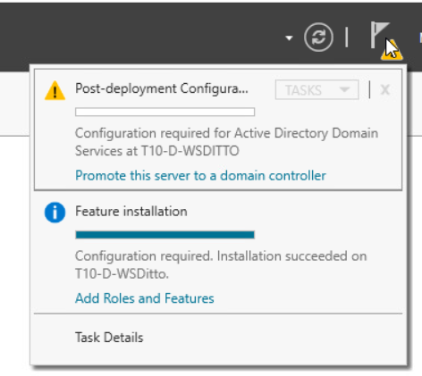
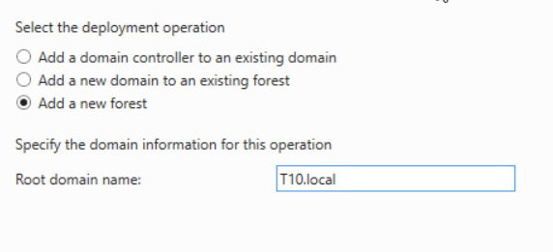
Active Directory Installation
Click on the exclamation flag and then select “Promote this server to domain controller”.
When the Active Directory Domain Services Configuration Wizard opens, Select “Add a new forest”.
Enter your Domain name and click ”Next”.

Slide 9
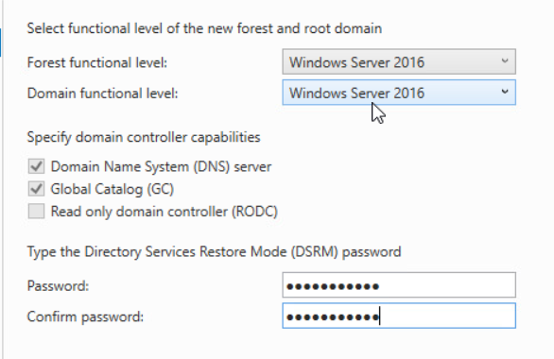
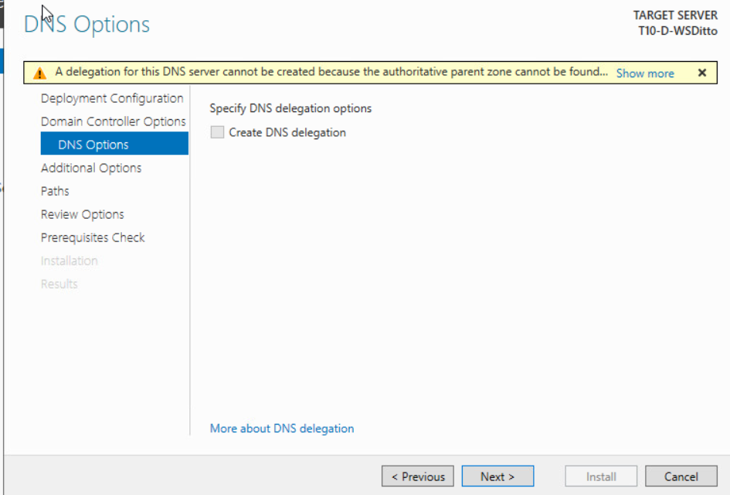
Active Directory Installation
Enter a DSRM Password
Click ”Next”
On the DNS Options page click “Next”

Slide 10
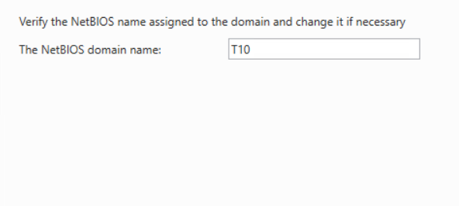
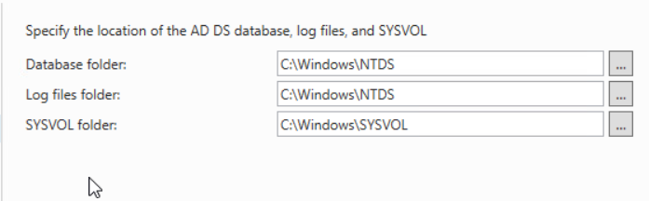
Active Directory Installation
On the other Options Page and the Paths page leave the default settings and click “Next”.

Slide 11
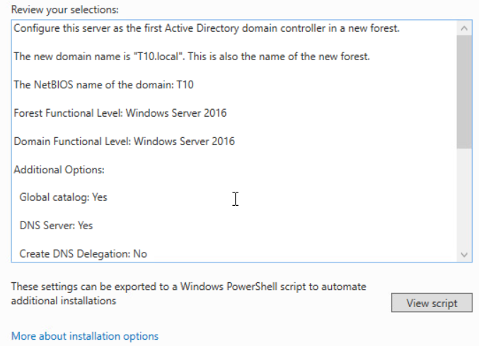
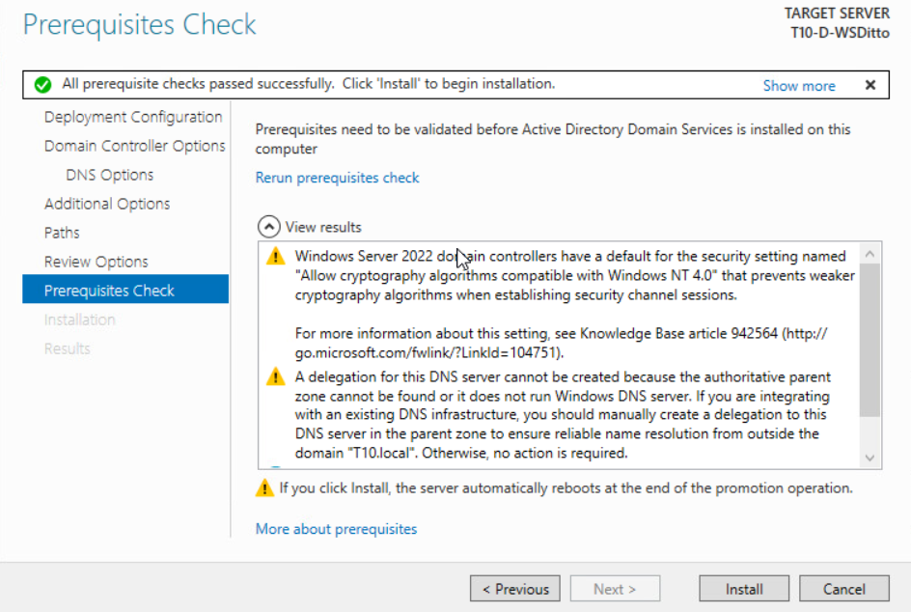
Active Directory Installation
Review options then click “Next”.
Once Prerequisite Check is completed click “Install”.
The Server will automatically restart.

Slide 12
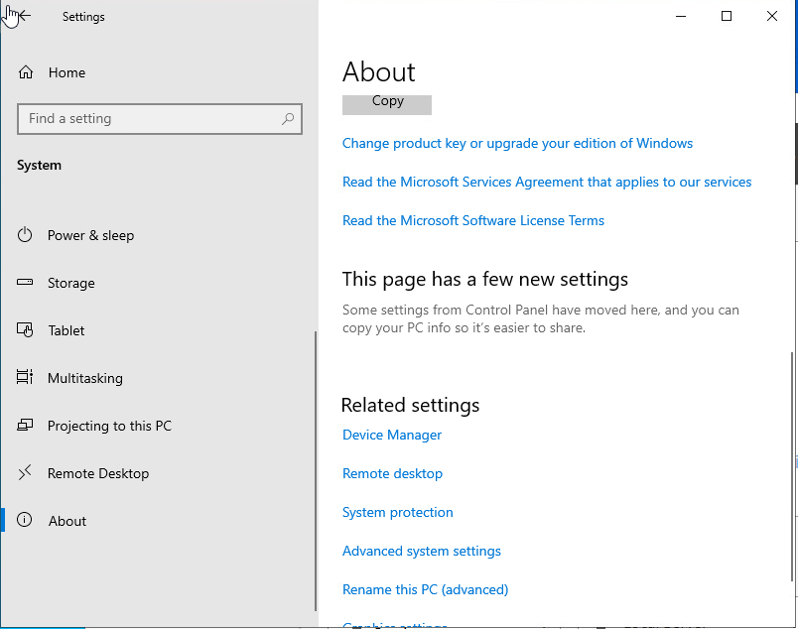
Join Windows Computer to a Domain
On the Windows computer you want to join to the domain, go to Settings > About > Advanced System Settings

Slide 13
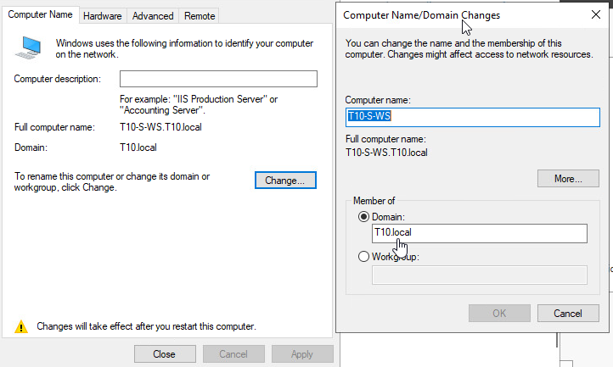
Join Windows Computer to a Domain
Select the “Computer Name” tab
Click ”Change” to rename the computer or change its domain or workgroup
Select “Domain” then enter the domain name
Select OK

Slide 14
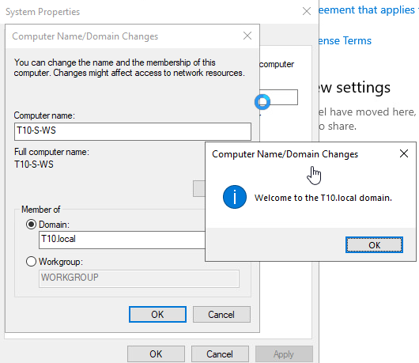
Join Windows Computer to a Domain
Once welcome confirmation is received, click OK, then OK

Slide 15
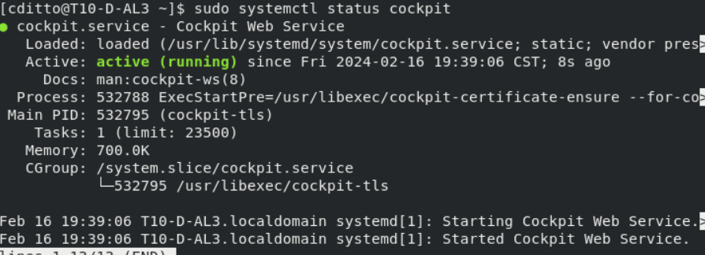
Install Cockpit

Slide 16
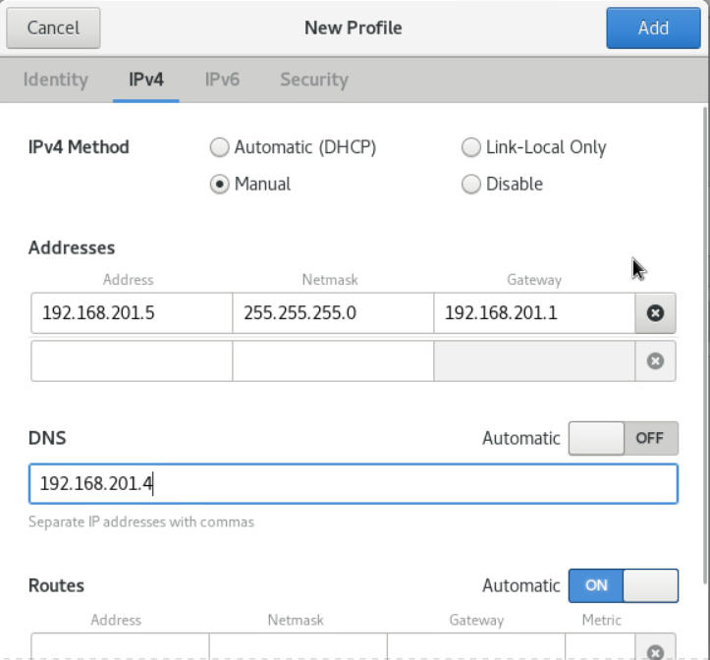
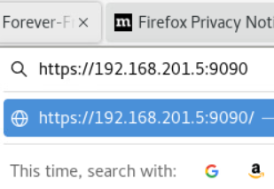
Join a Linux Machine to a Domain Using Cockpit
Check IP configuration to make sure DNS is pointing to the DNS server the Domain is using
(Once DNS and DCHP is set up in active Directory this step should already be done for you)
Get The IP address of the machine cockpit is installed on
Open a web-browser and enter the <IP Address>:9090

Slide 17
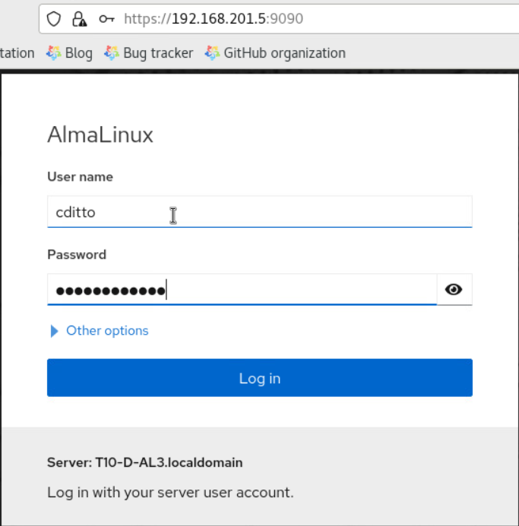
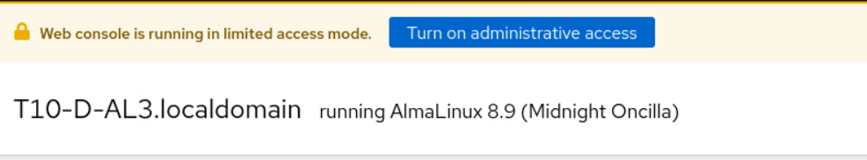
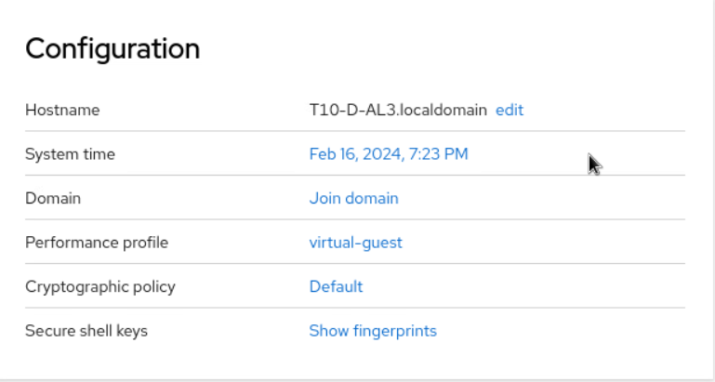
Join a Linux Machine to a Domain Using Cockpit
Sign in using credentials for the machine
Change limited access settings and turn on administrator access
Scroll down and select “join Domain”

Slide 18
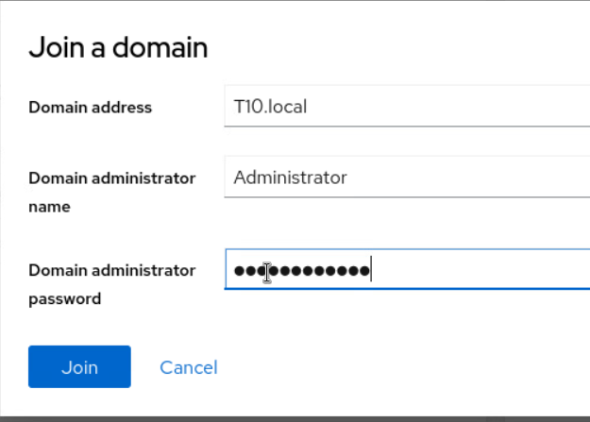
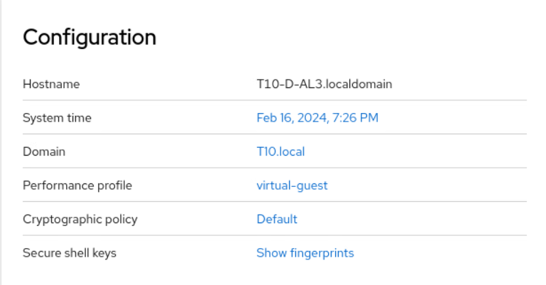
Join a Linux Machine to a Domain Using Cockpit
Enter Domain credentials then click “Join”

Slide 19
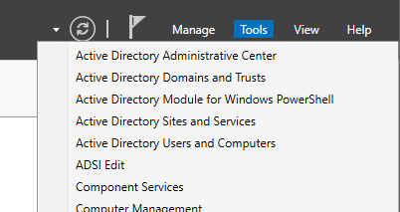
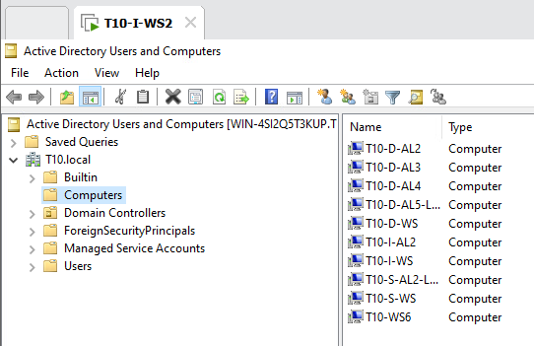
Check Active Directory for Joined Computers
On the Domain Controller go to server manager
In the right hand corner select the “Tools” tab
Select “Active Directory User and Computers”
Select desired Domain and then the “Computer” folder
All domain computers should be listed.

