Slide 1
IDS Sensor

Slide 2
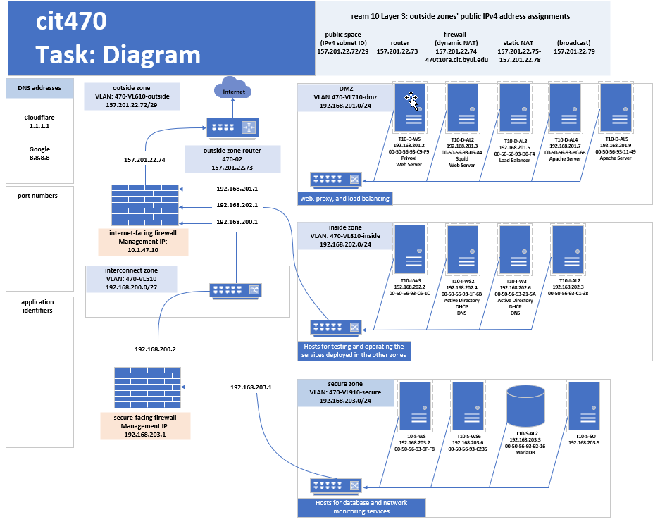

Slide 3
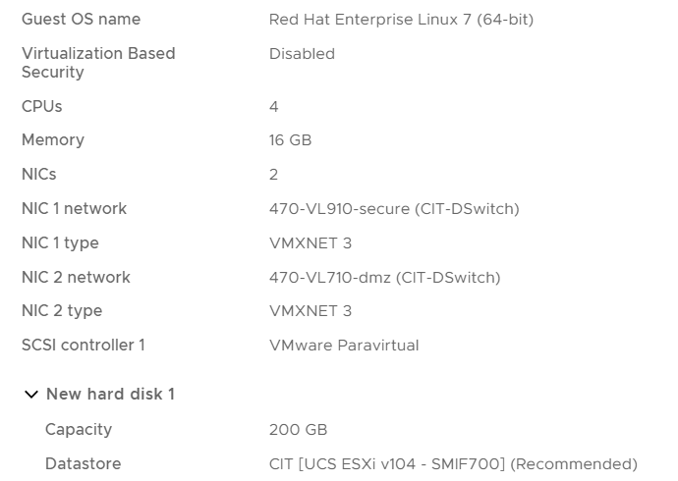
Deploy VM
Deploy security Onion VM with at least 4 CPUs and 16 GB of memory, and a 200 GB hard drive.
Add 2 NICs, one connected to the DMZ and on connected to the Secure zone.
For this example we will use securityonion-2.3.210-20230202.iso

Slide 4
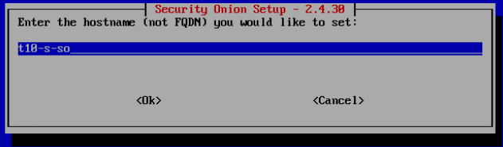
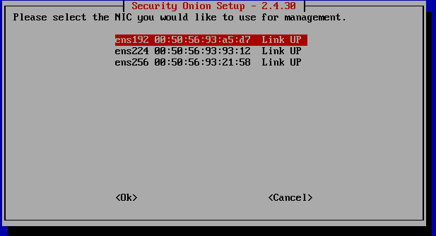
Security Onion Configuration
Launch the new VM and configure Security Onion
Enter the hostname you would like to use (in this example we will use t10-s-so
Pick the NIC you would like to use for management. Use the first choice, which is the NIC connected to the secure zone.

Slide 5
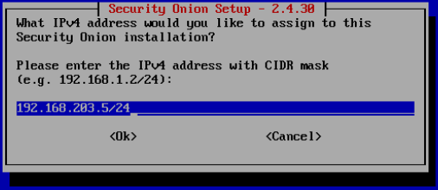
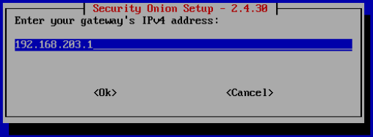
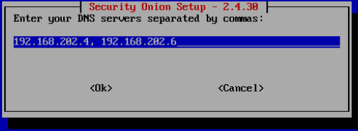
Security Onion Configuration
Enter the IP Address of the Security Onion installation
Enter the gateway to the Secure zone where we installed the Security Onion installation
Enter the DNS server address. (in this case we entered the addresses to the DHCP servers we installed in an earlier project

Slide 6
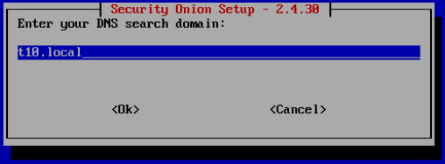
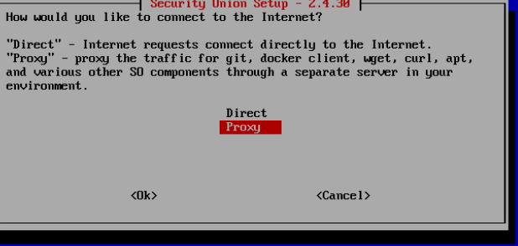
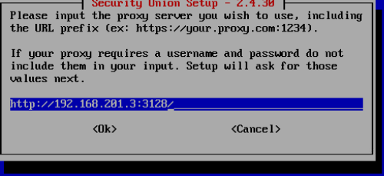
Security Onion Configuration
Enter the DNS search domain
In this example our Secure zone is connected by proxy through the DMZ to the internet, when prompted as to how we would like to connect to the internet we will select proxy
Input the proxy server we will use

Slide 7
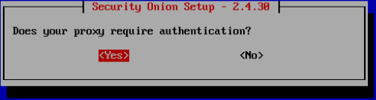
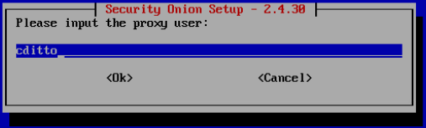
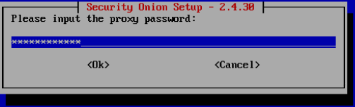
Security Onion Configuration
Set proxy authentication
Unlike the example shown, the proxy does not need authentication
Click “No”

Slide 8
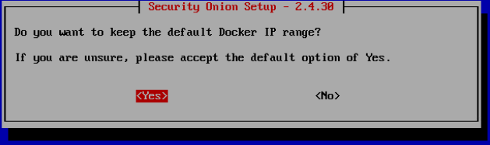
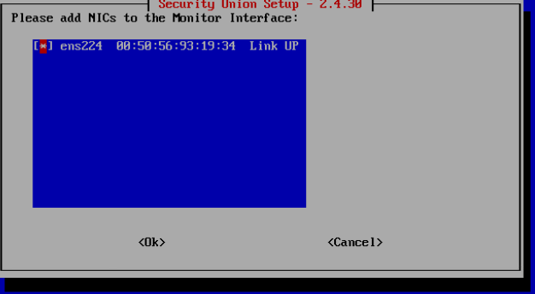
Security Onion Configuration
When asked if you want to keep the default Docker IP range, select the default “Yes”
Select the Monitor interface NIC by pressing the space bar then select “OK”

Slide 9
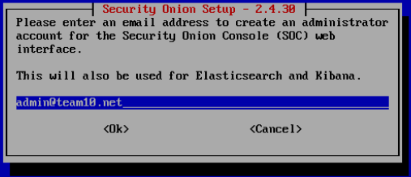
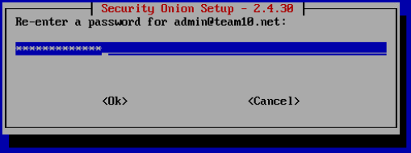
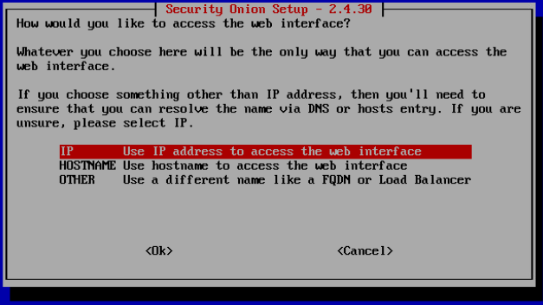
Security Onion Configuration
For this example we will use a ficticious email address to create the administrator account for use in the Security Onion Console web interface
Enter and re-enter a password for the administrator account
When asked how you would like to access the web interface we will choose IP

Slide 10
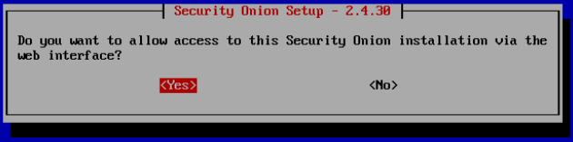
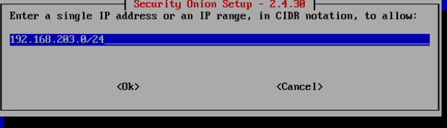
Security Onion Configuration
When asked if you want to allow access to this Security Onion installation via the web interface, select “Yes”
For this example, when asked to enter a single address of IP range, in CIDR notation, we will enter the IP range of the Secure zone since there is little risk of a breach in that zone.

Slide 11
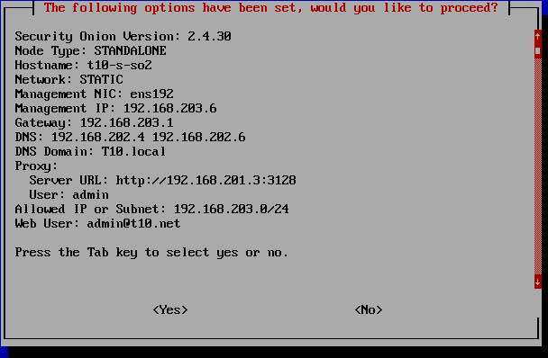
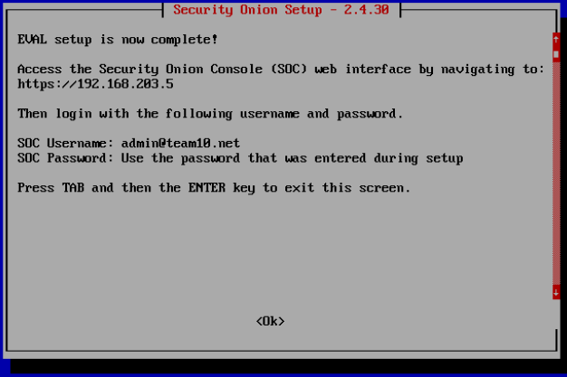
Security Onion Configuration
Review the Security Onion configuration and select “Yes” then select “Ok”

Slide 12
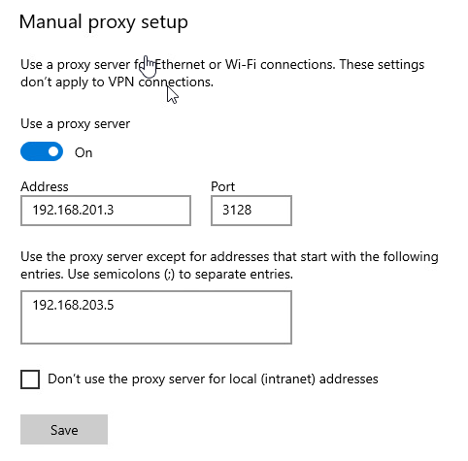
Security Onion Configuration
On the machine that we will be using to manage the Security Onion web interface, enter the IP address of the SO machine into the proxy server settings as shown in the following example

Slide 13
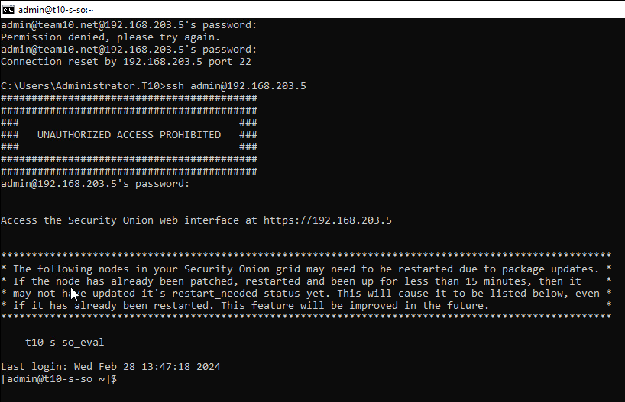
Security Onion SSH Login
We will now access the Security Onion console through SSH
Before we move on to this next step it is important that we reach out to our instructor as the nodes we need to connect to and from the Secure zone and the DMZ must be the same and the instructor has permissions to change them
Open CMD through the machine in which we are managing Secure Onion
Enter the command:
ssh –l admin 192.168.203.5
When prompted enter the administrators password
We should now have access to the SOC through SSH

Slide 14
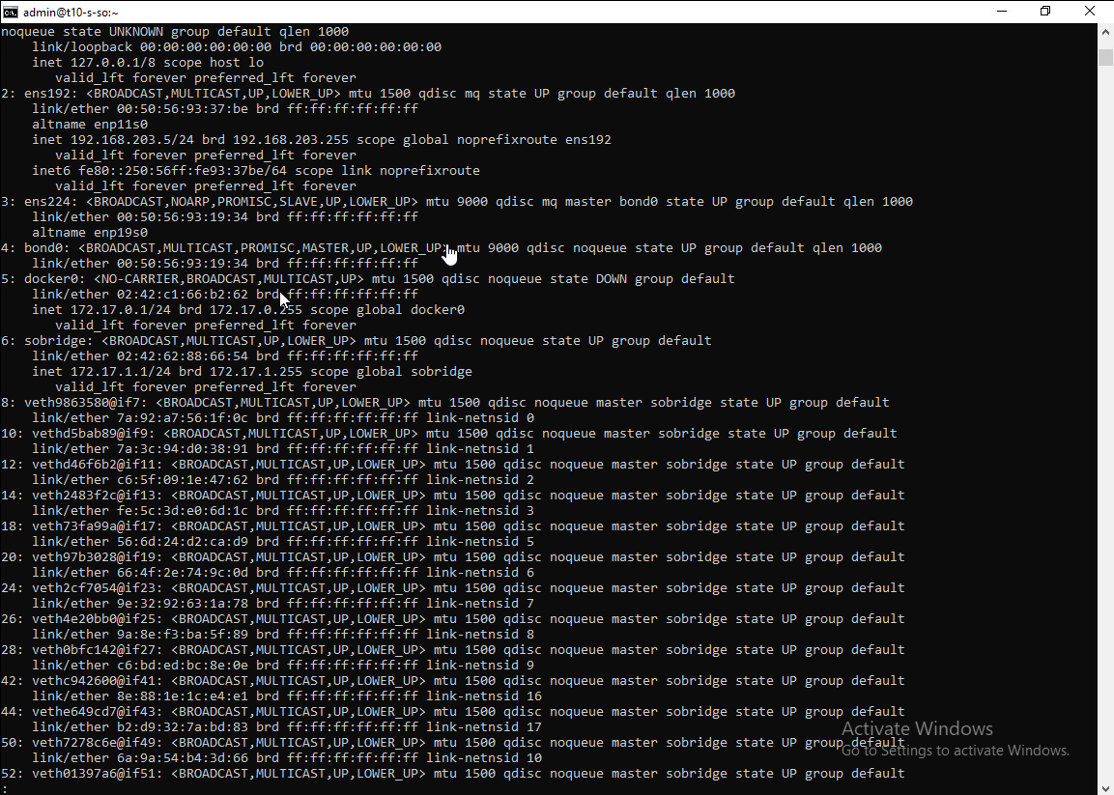
Security Onion SSH
Enter the command:
Ip address |less
You should see our NICs ens192 which is our Secure zone and ens224 which is our DMZ
Make sure that our DMZ connection ens224 is set to promiscuous mode

Slide 15
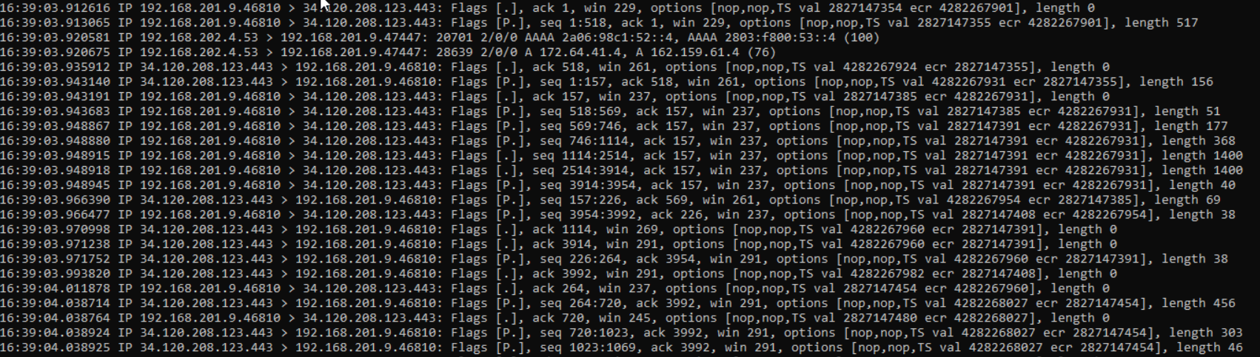
Security Onion SSH DMZ Traffic Test
Now enter the command:
Sudo tcpdump –nn –I ens224 the –nn turns off name lookups for IP addresses and port numbers and the –i option specifies the name of the interface we want to capture
The output of this command should look something like the example shown

Slide 16
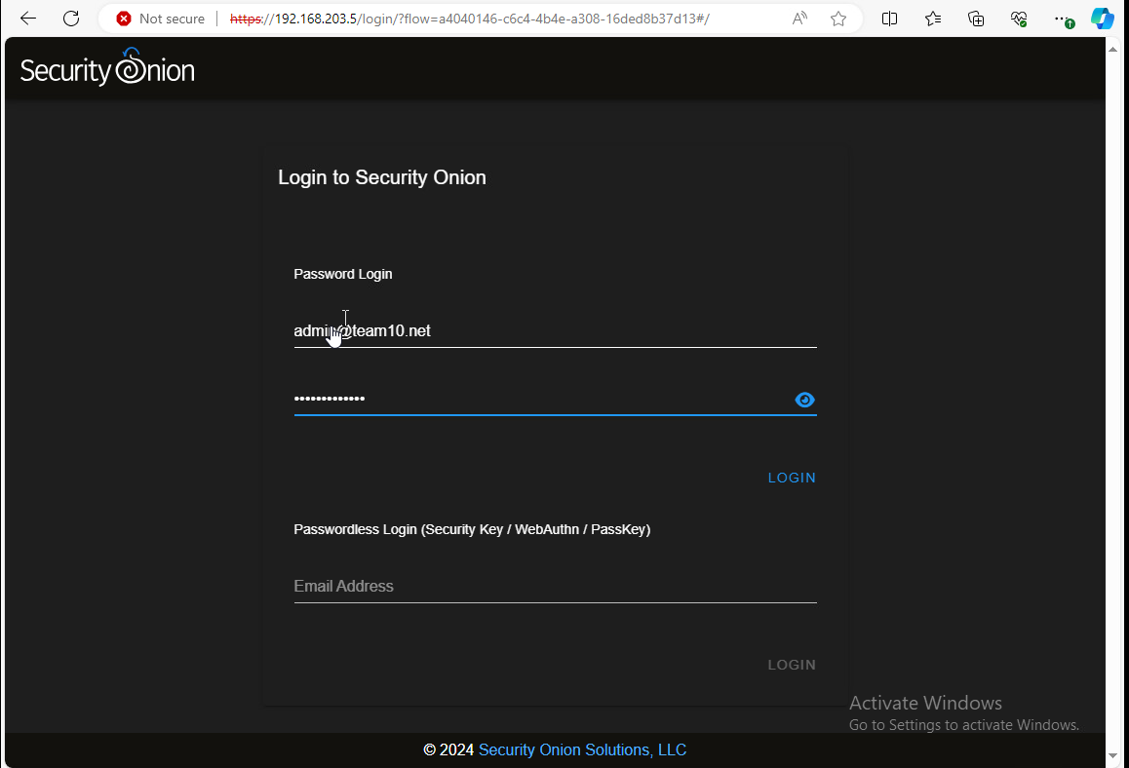
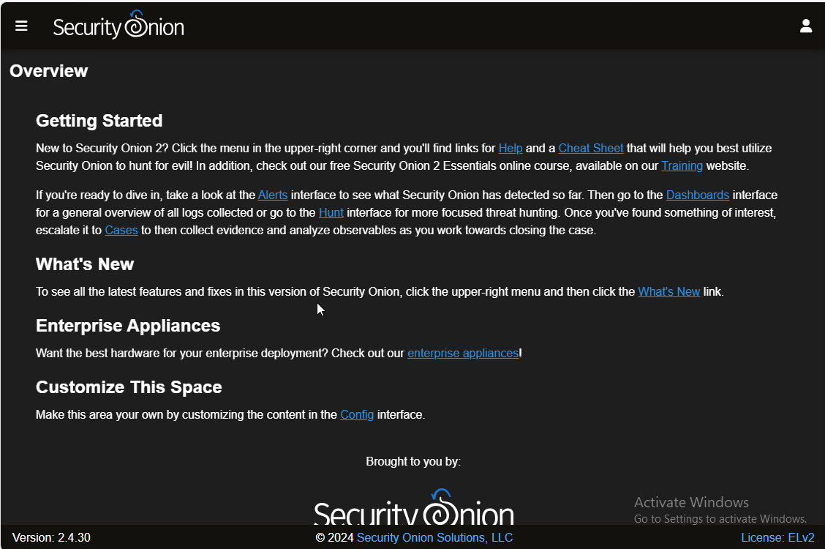
Security Onion Login
Open the Security Onion web interface by entering the IP address of the Security Onion machine into the web browser of the machine we will use to manage the Security Onion installation
Enter the administrator credentials to the web interface

Slide 17
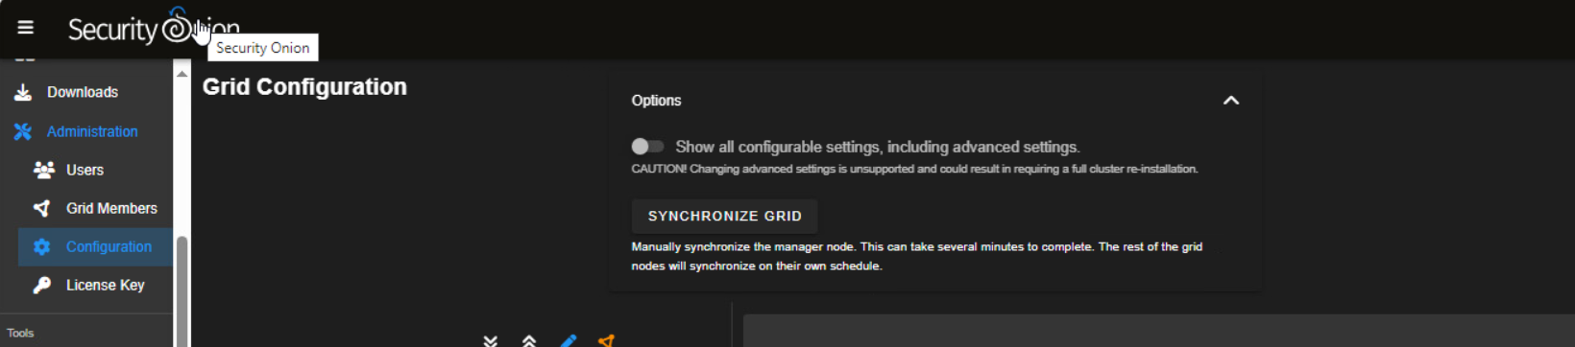
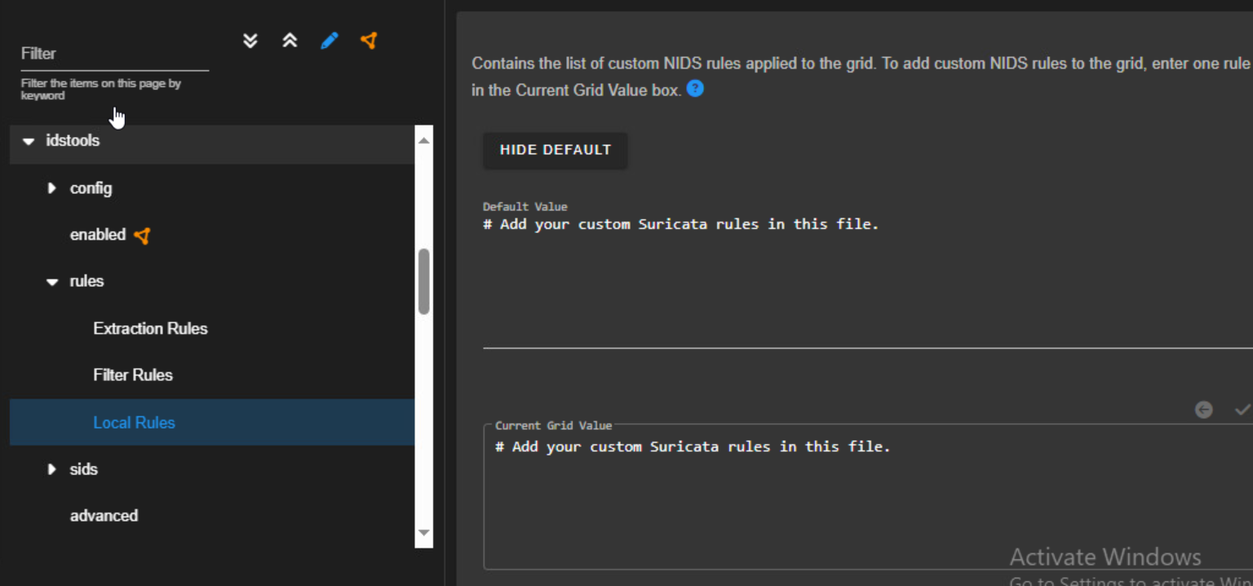
Security Onion Ruleset Change
We will now make a rule and test whether our alert system is working for DMZ traffic
Select “administration” and then “configuration”
Select the “Options” dropdown at the top of the page and move the slider where it says “Show all configurable settings, including advanced settings”
Select “idstools” and then from the dropdown menu select “rules” then “Local Rules
We will now enter our rule into the “Current Grid Value” box at the bottom right of the page

Slide 18
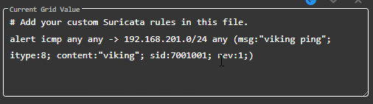
Security Onion Ruleset Change
Add the rule shown in the example
This rule will alert Security Onion whenever it detect the word Viking over the DMZ network
The rule can also be set through the command line using vim or nano to create the rule in the local.rules file. The path to the local rules file is shown in the example

Slide 19
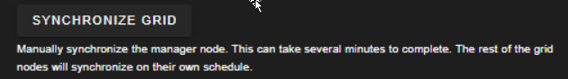
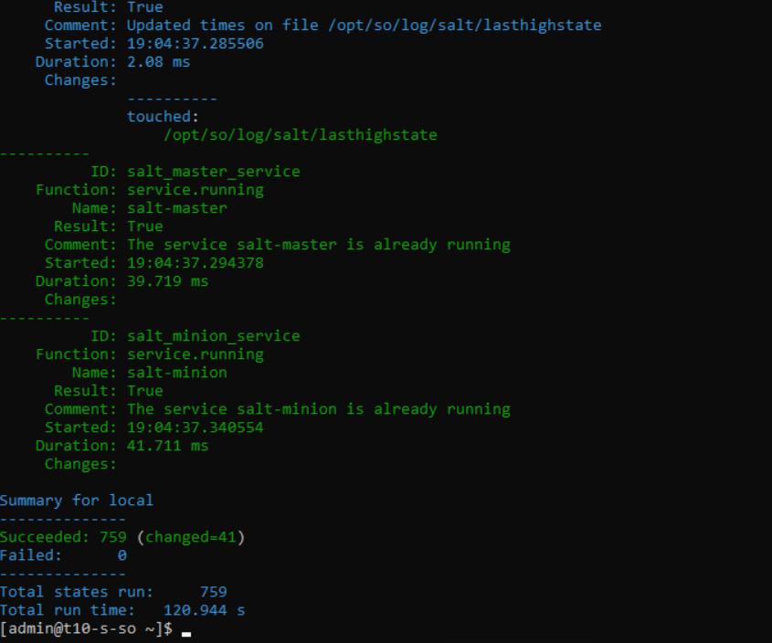
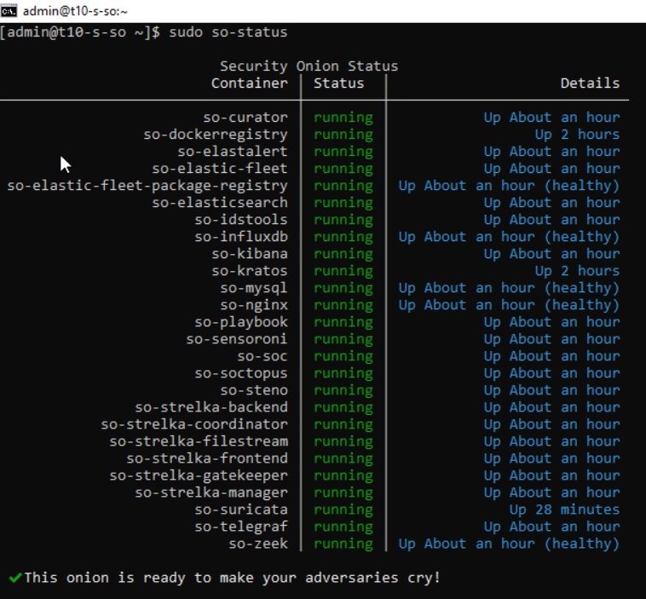
Security Onion Ruleset Change
The new rule will take around 15 minutes to commit but the process can be expedited using either the “SYNCHRONIZE GRID” selection located under the “Options” menu dropdown, or by entering the command:
sudo so-rule-update
Next enter the command:
sudo salt-call state.highstate
These commands took around 4 minutes to commit
To check the rule use the command:
sudo so-status

Slide 20
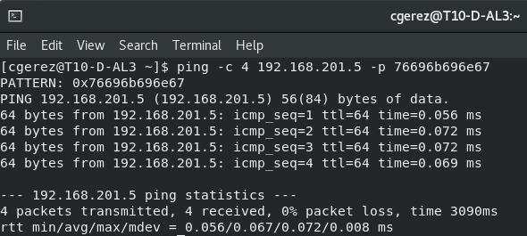
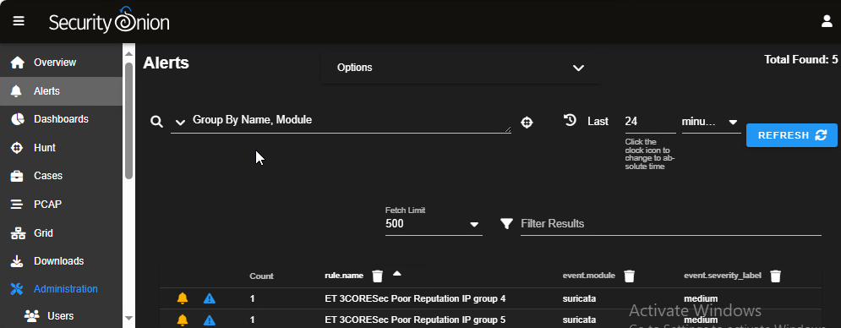
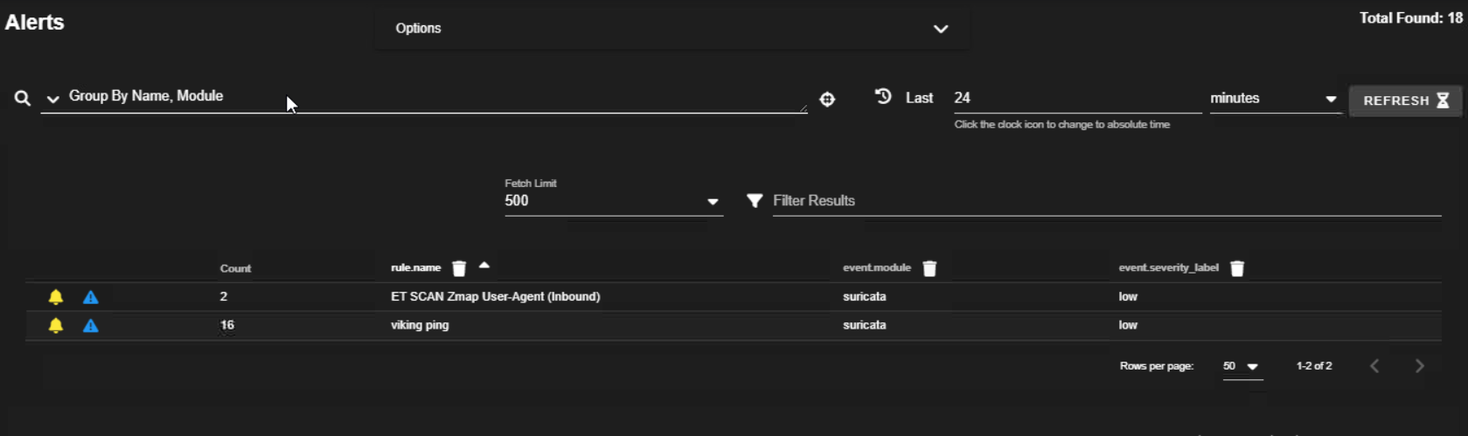
Security Onion Ruleset Change
We will now ping the DMX machine using the command:
Ping –c 4 192.168.201.9 –p 76696b696e67 the last set of digits being the word viking in hexadecimal notation
Now we can go back to our web interface > Alerts and see our rule viking ping has caused Security Onion to alert.

