Slide 1
Proxy Services
By Carlos Gerez Garcia, Christopher Ditto , and Mark Riley Slik

Slide 2
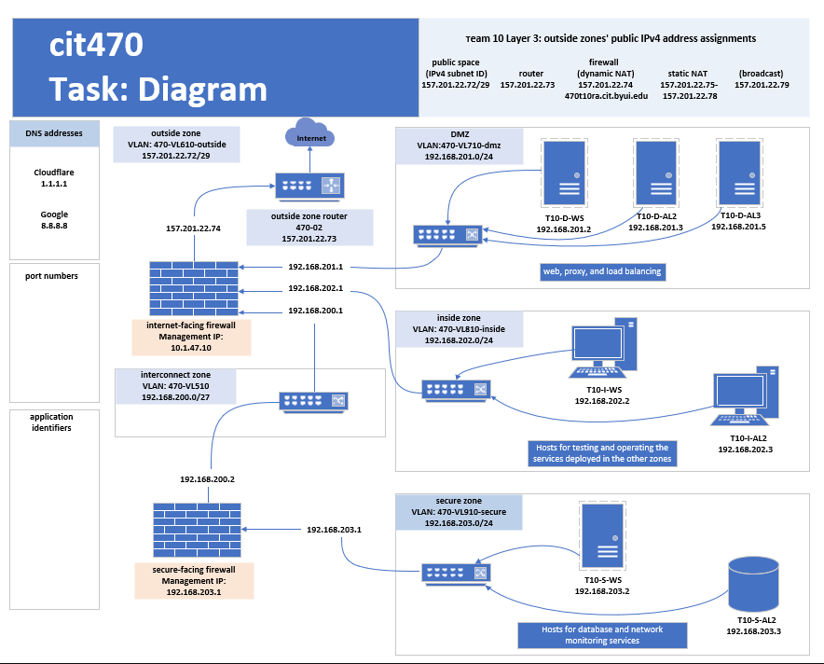
Team 10 network Diagram

Slide 3
DNS resolution with unbound DNS Proxy

Slide 4
Check ,Update ,and Install unbound
Run these commands to check for updates and install unbound

Slide 5
Copy unbound.conf and edit
Cd into unbound and make a copy of the unbound.conf after making a copy open it in vi editor

Slide 6
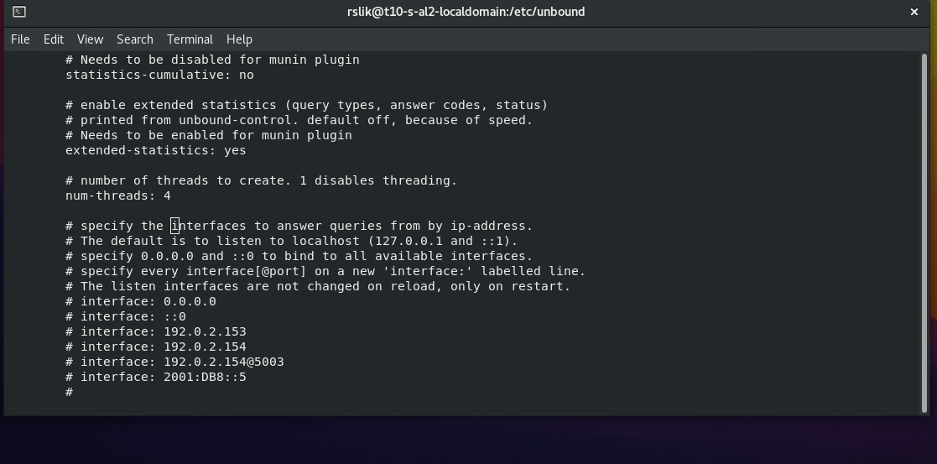
Search for interface
Use / interface to search the document for interface

Slide 7
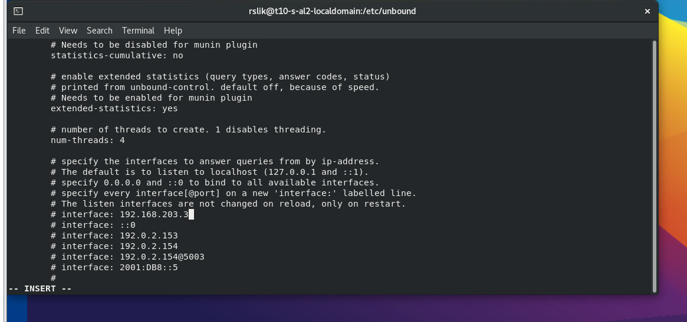
Change interface too servers ip address
Use the vi editor to change the interface address to the servers address

Slide 8
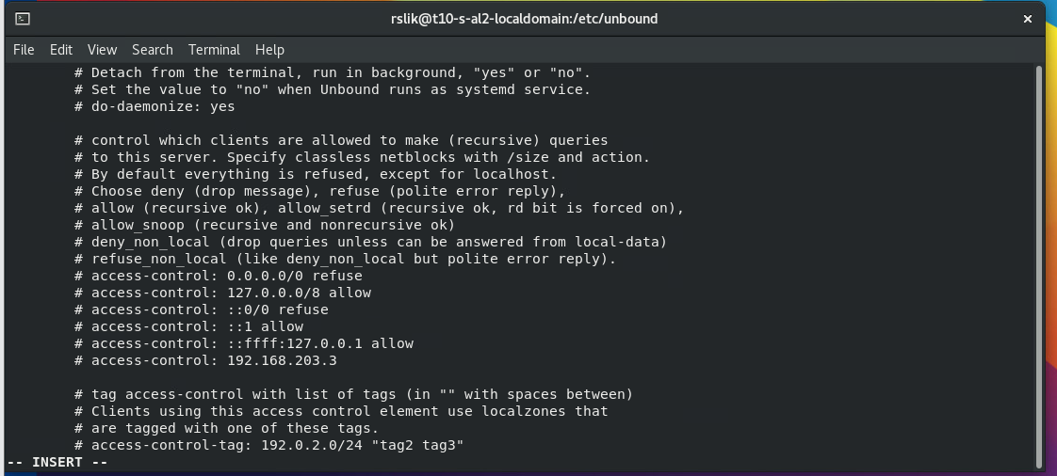
Access control
Use /access-control to search the document. Add an access-control for the the DMZ sone

Slide 9

Set forward address for dns
In the documents use /forward-zone
And the address for the dns.
Exit the document

Slide 10
Add DNS to the firewall
Use the commands as shown to check the firewall allow services and then add DNS if it is not there. Check to make sure it got added properly

Slide 11
Enable and Start
Use these commands to enable Unbound and Start unbound

Slide 12
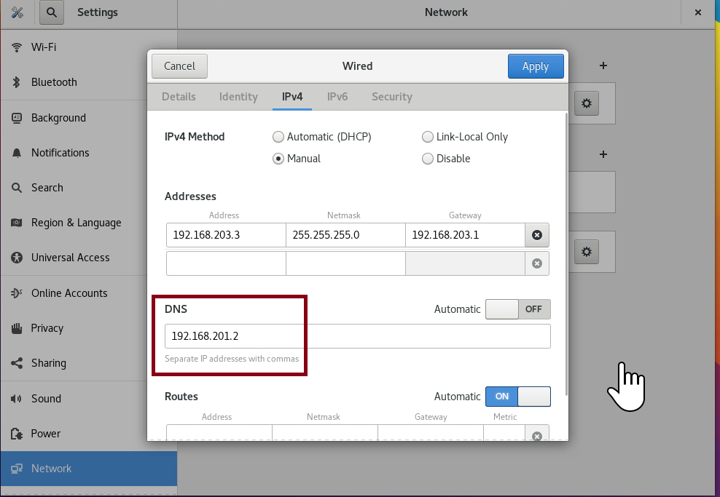
Set unbound for DNS for linux DMZ
Check and make sure that the DNS setup for your DMZ linux machine

Slide 13
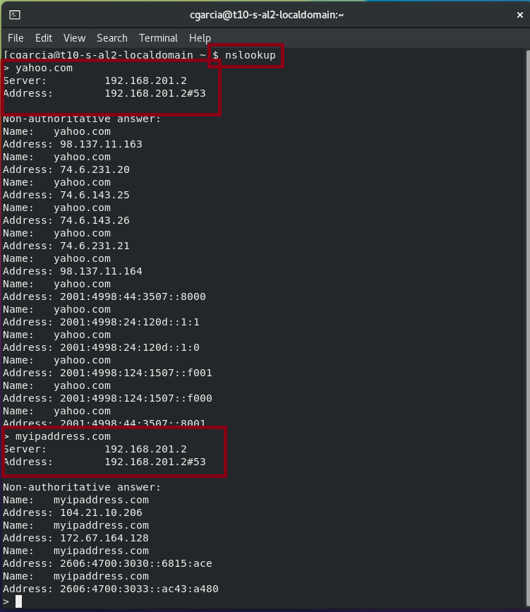
You can also check in the terminal if it is working

Slide 14
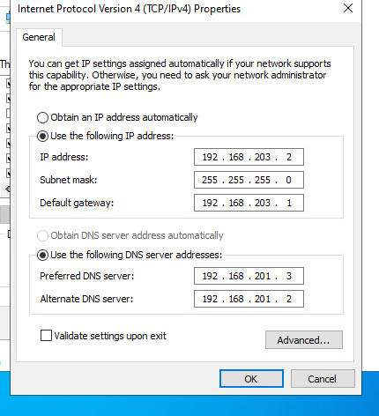
Check DNS on Windows
Check your Ipv4 address and make sure that the DNS address is set

Slide 15
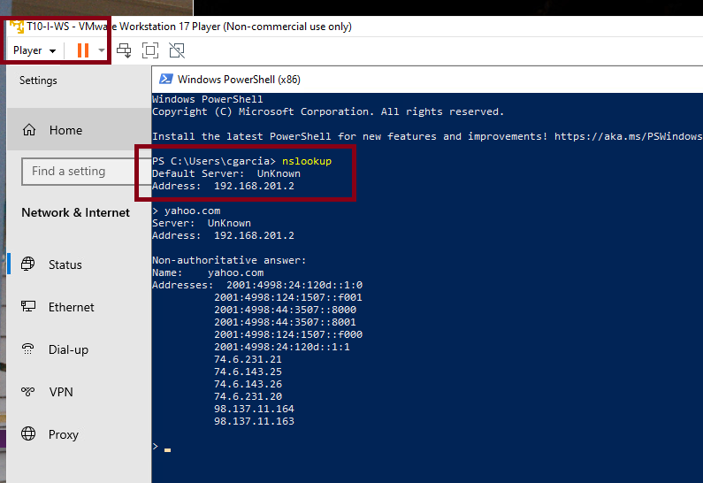
Check DNS on Windows
You can also check in the terminal if it is working using
nslookup

Slide 16
Squid Proxy

Slide 17
How to Download and install squid in Alma Linux
In a Linux terminal use this commands.
The first 2 commands check for updates. The third installs squid.
The final 2 commands check that those 2 files are identical. They are the configuration file and a backup. They are identical as you will noticed when running diff.

Slide 18
Firewall rules edition.
The first line confirm that squid is not included as allowed. The second command looks if is supported that you see is true. Then the third and fourth command change the configuration of this endpoint to allow request from squid.

Slide 19
Check status and start service.
Again the first command check if squid is enabled and active. Since is not enabled and is inactive as all new services in Linux, enable and start it with the final 2 commands.

Slide 20
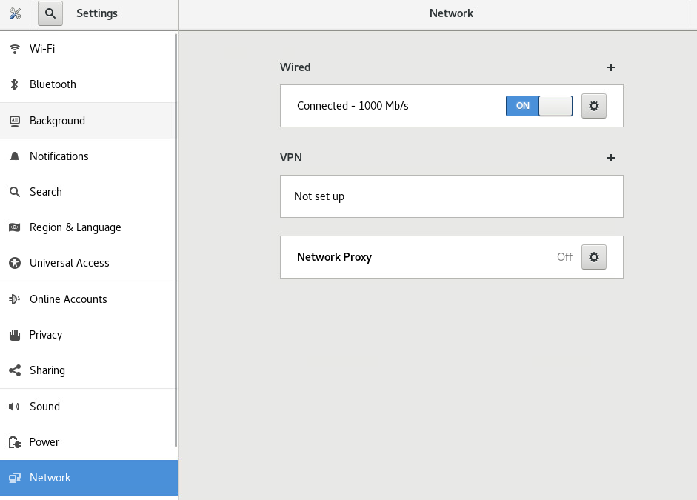
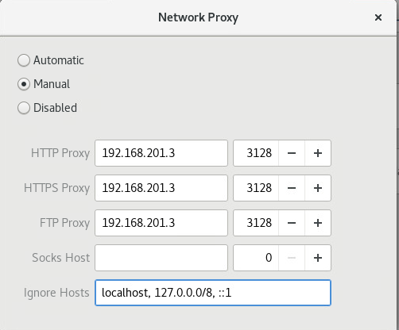
Configure machines in the secure zone to use squid.
On the gui, in network select network proxy and then set the ip address of the Alma Linux in the DMZ zone configured with squid. Use the port 3128. Remember to turn off and on the interface to be sure the new configuration is applied.

Slide 21
Now you can update your Alma Linux server in the secure zone.
Remember to change the /etc/dnf/dnf.conf file and add in the last line: proxy=http://192.168.201.3:3128

Slide 22
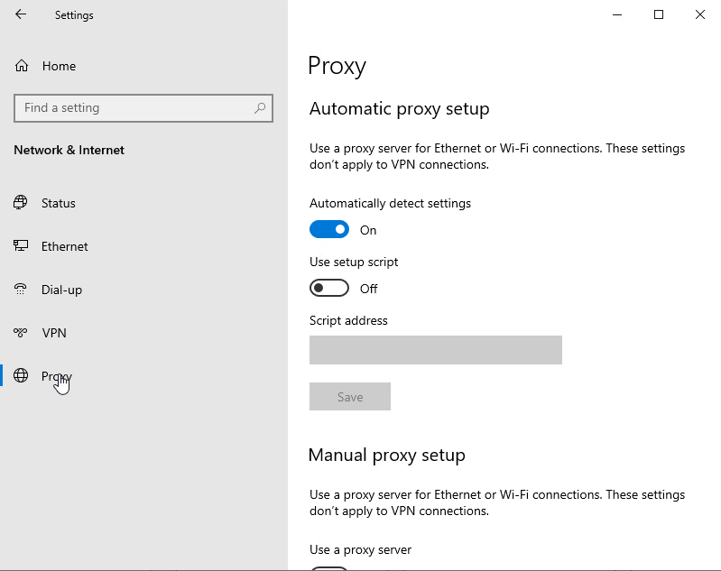
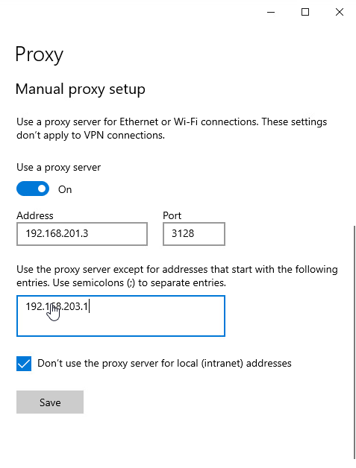
Configuration of web services in a Windows system.
Turned off the automatic proxy detection and on Use a proxy server. Fill in the required information. Add the secure gateway as a proxy exception.

Slide 23
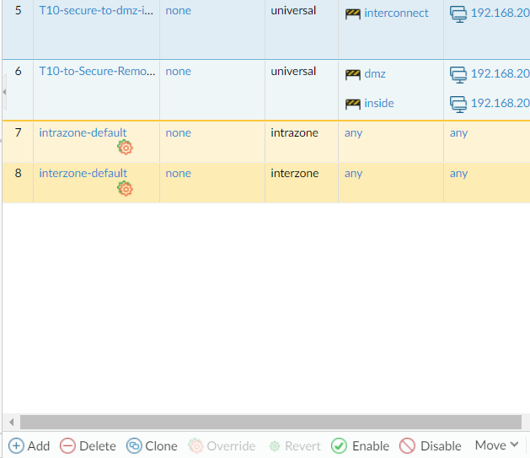
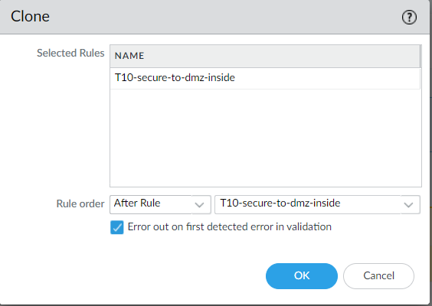
Add a policy in the Palo Alto firewall to allow traffic for the squid services in the DMZ zone.
This rule is similar to the one we have from before, but this time we will select the squid service as the application to be allowed.
Notes:
Move thin image to different slide

Slide 24
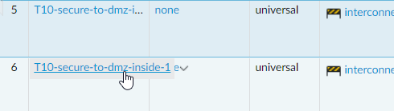
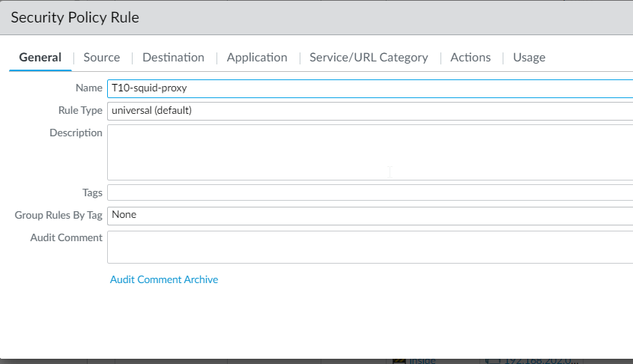
Rename clone
Under the General tab enter the rule name using your team name followed by -squid-proxy

Slide 25
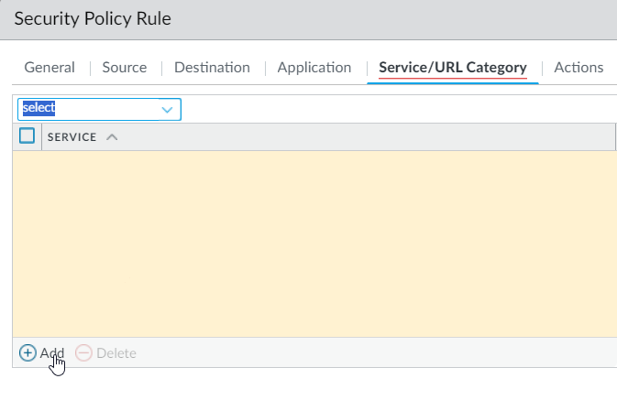
Start the rule by selecting policy and add a new service security policy.
Under the service/URL Category tab, change from application default to select

Slide 26
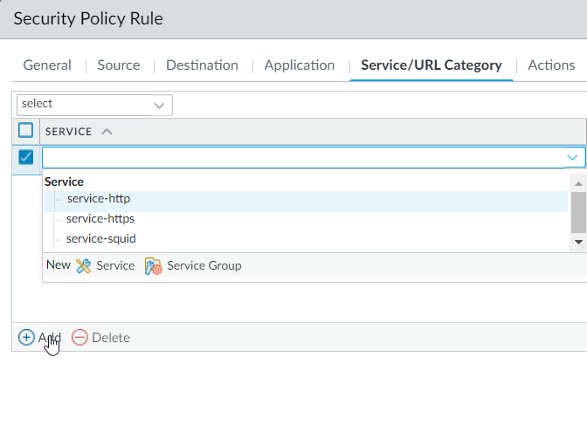
Create a new service
In select click on new services to create a new service object.

Slide 27
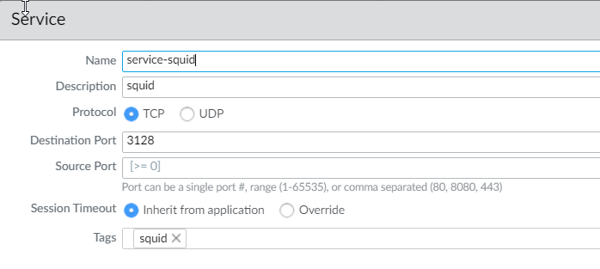
Set the name of the policy, the protocol and port.
Name the object service- squid.
Under Description insert squid.
Under the Destination port select 3128.
Under Tags enter Squid.
The reason we are doing this is because the firewall does not expect a web object to come through port 3128 and will deny that object type whereas, squid will run unhindered.

Slide 28
In service/Url Category select service-squid.
Select the new object “service-squid”

Slide 29
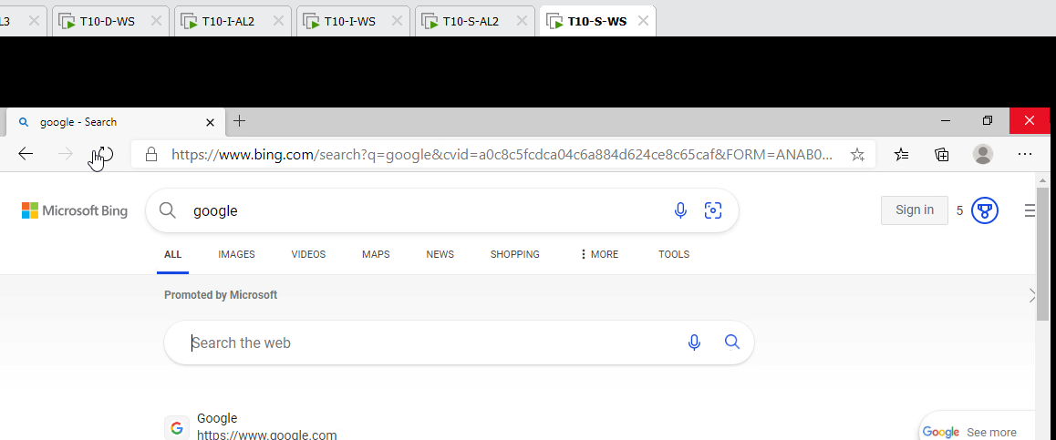
Confirm connectivity in the secure zone Windows system.
With the firewalls configured we have internet connectivity to our Windows machine

Slide 30
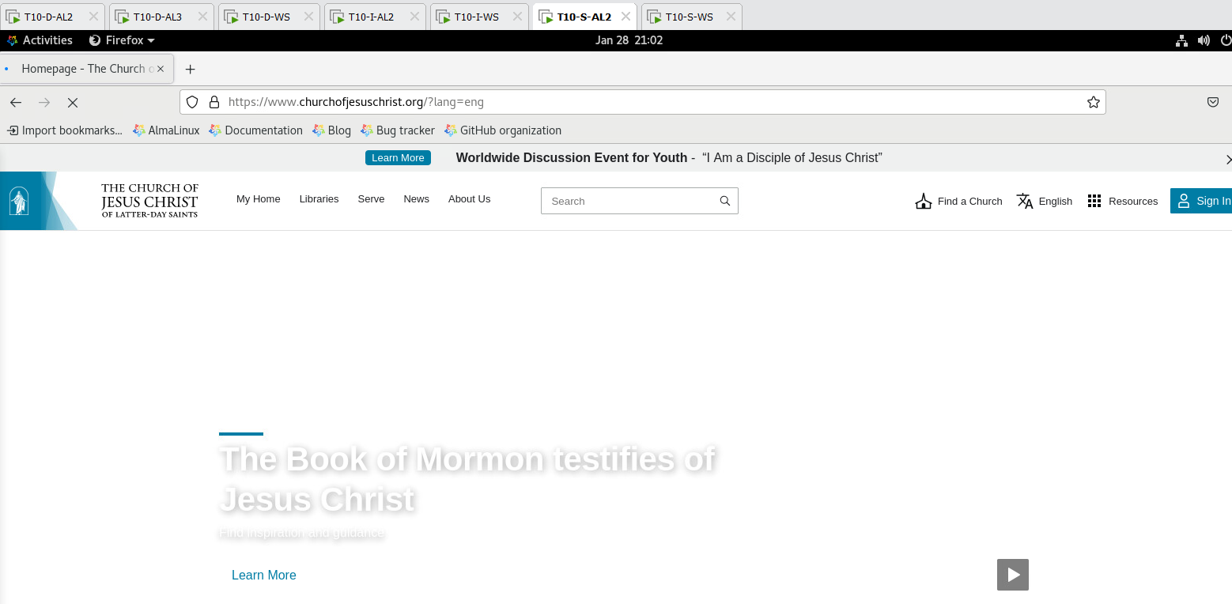
Confirmation of internet connection in the Alma Linux system in the secure zone.
As well as to our Linux machine.

Slide 31
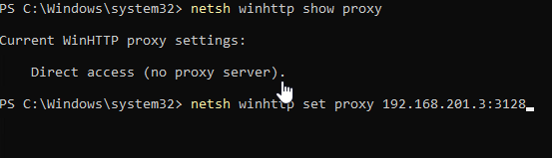
Configure updates from the proxy server on Windows.
In windows is a different proxy setting for administrative task as updates. This is the command for configure the settings on Windows.

Slide 32
Challenges we faced

Slide 33
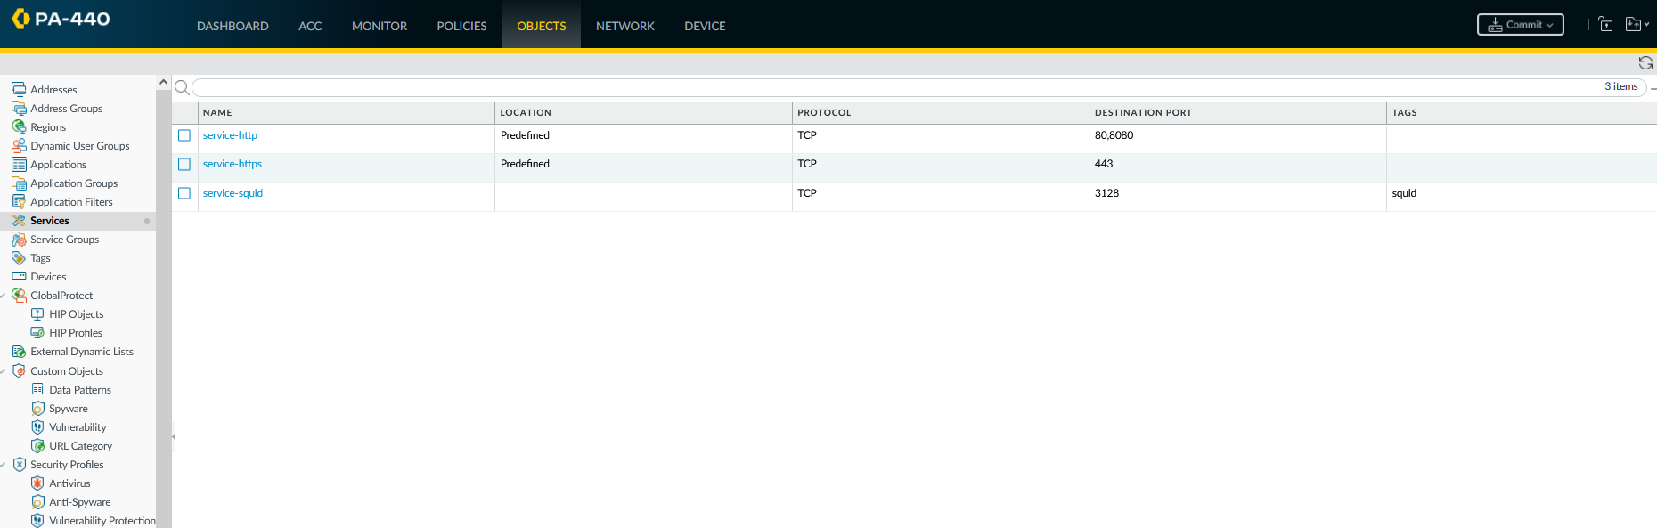
It was necessary to create an object tailored for the squid services to grant access through the Palo Alto firewall.
The only issue that I ran into was learning how to create an object and then due to having to make some changes, how to delete and object. Neither was difficult it just took a minute to puzzle it out.

